Slide 1


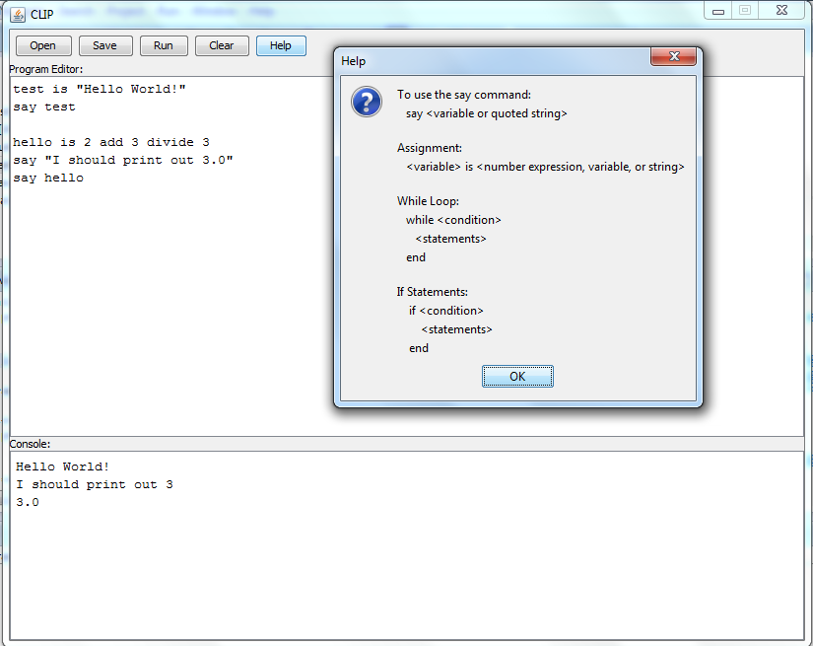
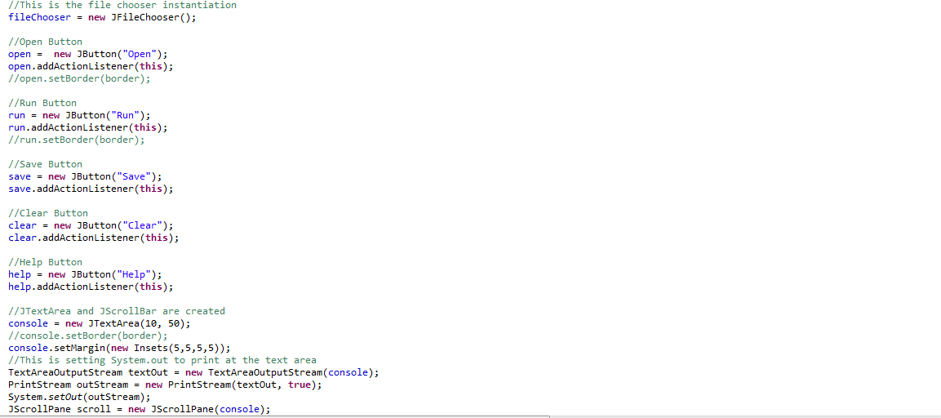
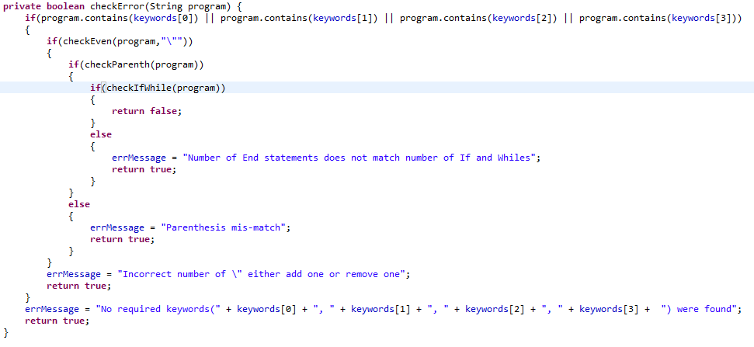
CLIP: An Introduction to Programming
Abstract
EBNF Grammar
Commands
The purpose of this project is to bridge the learning gap in learning programming tools by providing an easy to learn, English-like language that allows a sense of accomplishment one would find in making a program in a more conventional language, such as Java or C++. In order to achieve this goal, three classes were written in order to create the language with it's syntax. The language was then taught to a group of students who were then given a survey about the language and about computer science in general.
statement: iteration_statement | if_statement | output_statement | assignment ;
statement_block: statement statement_block | statement ;
assignment: math_expression | string_expression ;
math_expression: number operator number | number operator math_expression | math_expression operator number | math_expression operator math_expression | number;
number: {digit} ;
digit: “0”| … |“9” ;
string: “”” {character} “”” ;
character: “A”|…|”z” ;
operator: “add” | “subtract” | “divide” | “multiply” ;
iteration_statement: “while” condition statement_block “end” ;
if_statement: “if” condition statement_block “end” ;
condition: math_expression conditional_operator math_expression | condition and_or condition | condition conditional_operator condition ;
conditional_operator: “less” | “greater” | ”le” | “ge” ;
and_or: “and” | “or” ;
output_statement: “say” math_expression | “say” number | “say” string ;
The following is the current list of commands. CLIP is very extensible and new commands can be added in the future.
Say: Prints out what the user wants to the console
Add: Basic addition
Subtract: Basic subtraction
Multiply: Basic multiplication
Divide: Basic division
Exp: Basic exponentiation
While: Conditional that allows looping
If: Conditional that allows branching
End: Closes off the While and If loops
Source: www.clipartguide.com
Source: www.123rf.com
Purpose
CLIP Interface
Code Snippets
The purpose of this project is to teach younger children about programming concepts while providing a simple, yet fulfilling language. The language is intended to be easy to learn, but still allow the programmer to create useful programs that could be created in a language such as Java or Python. It will be English-like in its syntax. Each command, one line in the program, will be formatted similarly to a sentence. The language is a prototype with many more commands that could be added in the future.
This Snippet shows how some of the interface is created.
Materials
Oracle’s Java Development Kit
Eclipse
TextAreaOutputStream class
Screenshot of CLIP and it’s interface
This Snippet shows the pre-runtime error checking.

Slide 2
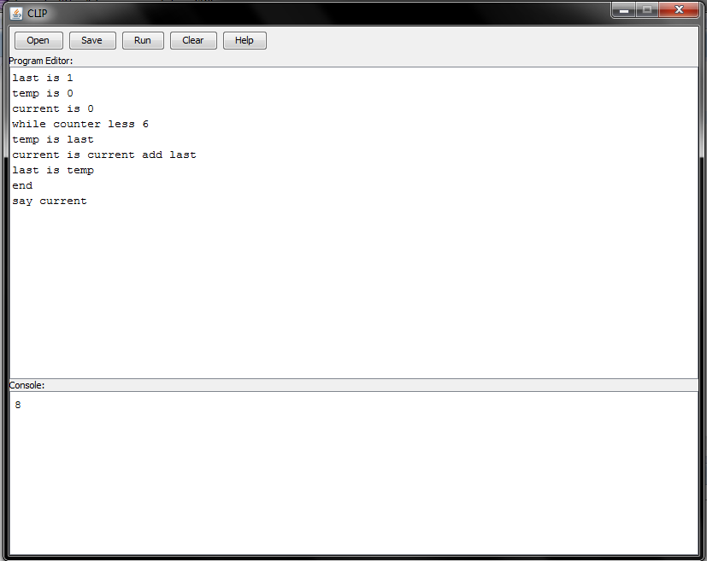
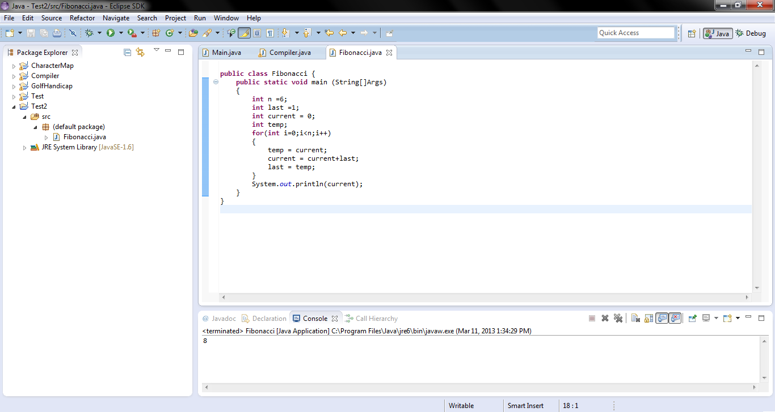
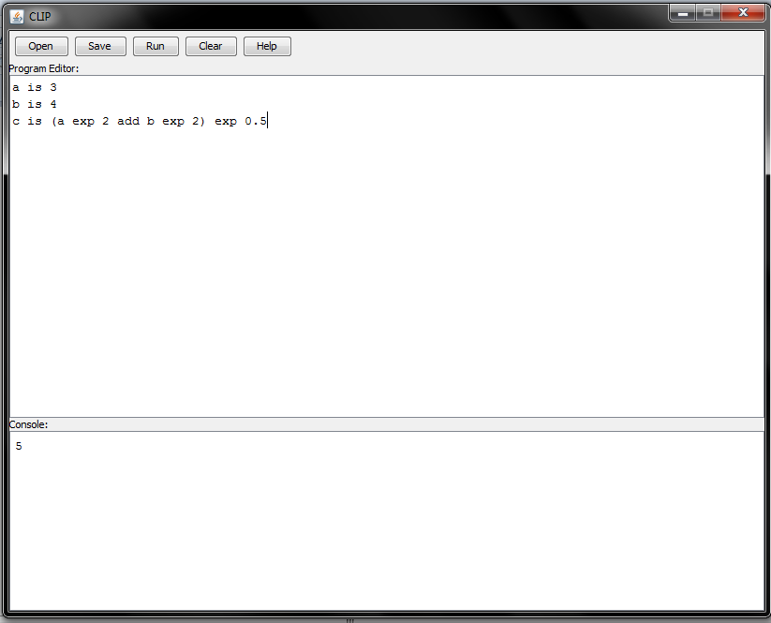
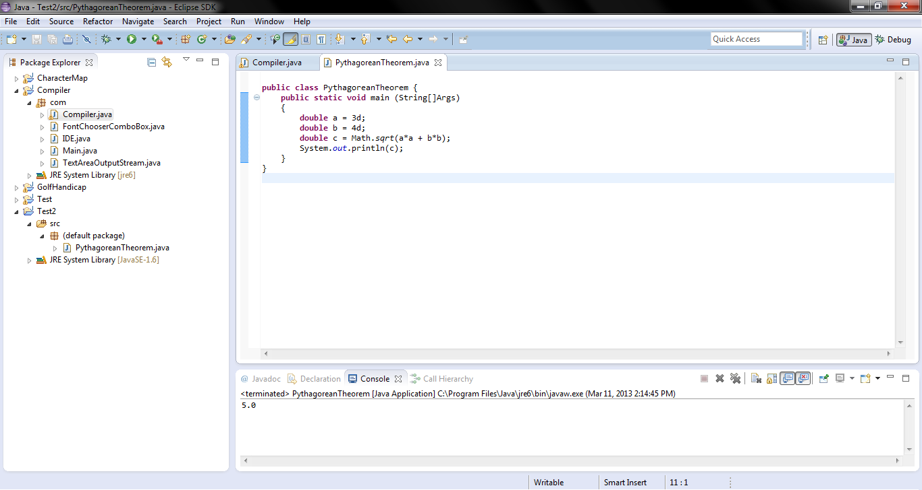
Development
CLIP vs Java
Developed in Java
Java was chosen because it is cross-platform
Using Oracle’s JDK
Eclipse was the Integrated Developer’s Environment chosen
Other languages such as C, Java, and C++ were looked at to decide what to add to the language and what to remove
CLIP was made in such a way to fill the gap between learning tools and complex languages
It was intended to be lightweight so that it can be run on all computers
CLIP was created in a way that it is easily extensible meaning it can be added on in the future
CLIP
Java
This is Fibonacci in CLIP and Java
Why it’s important
Computer Science is one of the fastest growing fields
By 2018, current government projections show that more than 800,000 high-end computing jobs will be created in the economy
Computer science and computer engineering bachelor degrees are in high demand and command two of the top three average salary offers from employers among all majors
Though the demand for degrees in computer science has increased schools teaching it have decreased
The percent of high schools with rigorous computer science courses fell from 40% to 27% from 2005-2009.
The percent of high schools with introductory computer science courses fell from 78% to 65% from 2005-2009
This is the Pythagorean Theorem in CLIP and Java
Data Analysis
Clip is easier to read for someone who doesn’t know it
There is no complicated IDE to go along with it
Symbols are non-existent in CLIP
It accomplishes the same thing but looks nicer
Not easy to read for a beginner
There is a complicated IDE to figure out
Even for a simple program there is seemingly useless
Much more complicated and can’t easily be read by a new user
A group of willing 8th grade students at my school were taught CLIP for one class period, approximately 50 minutes, they were then given an anonymous survey and the data was analyzed
Variable | Mean
Interest in Computer Science | 3.047619
Experience in Computer Science | 2.047619
CLIP is easy to learn | 3.142857
CLIP is structured like a sentence | 3.952381
Future Work
Sources
In the future, I plan to add on to CLIP. One of the first things I plan to add to CLIP is the ability for the programmer to prompt the user for input. This would open up more possibilities for the types of programs that could be created. I would also like to try to implement simple file input-output. Adding an import system similar to that of Java, or the header files for C, would allow even more extensibility of the language. While implementing such a system would require a slight rework of the parser, the system itself would not require a large refactoring. A simple if statement could be added to check if some of the used commands are in the imported packages. While at its current stage CLIP is fairly simplistic, it has the capacity to grow into a very large, easy to use, and useful language.
http://docs.oracle.com/javase/tutorial/uiswing/layout/visual.html
http://dl.acm.org/citation.cfm?id=1089734
http://docs.oracle.com/
http://www.ccs.neu.edu/home/vkp/Papers/Gmunden93.doc
http://www.csedweek.org/key-facts

