Slide 1
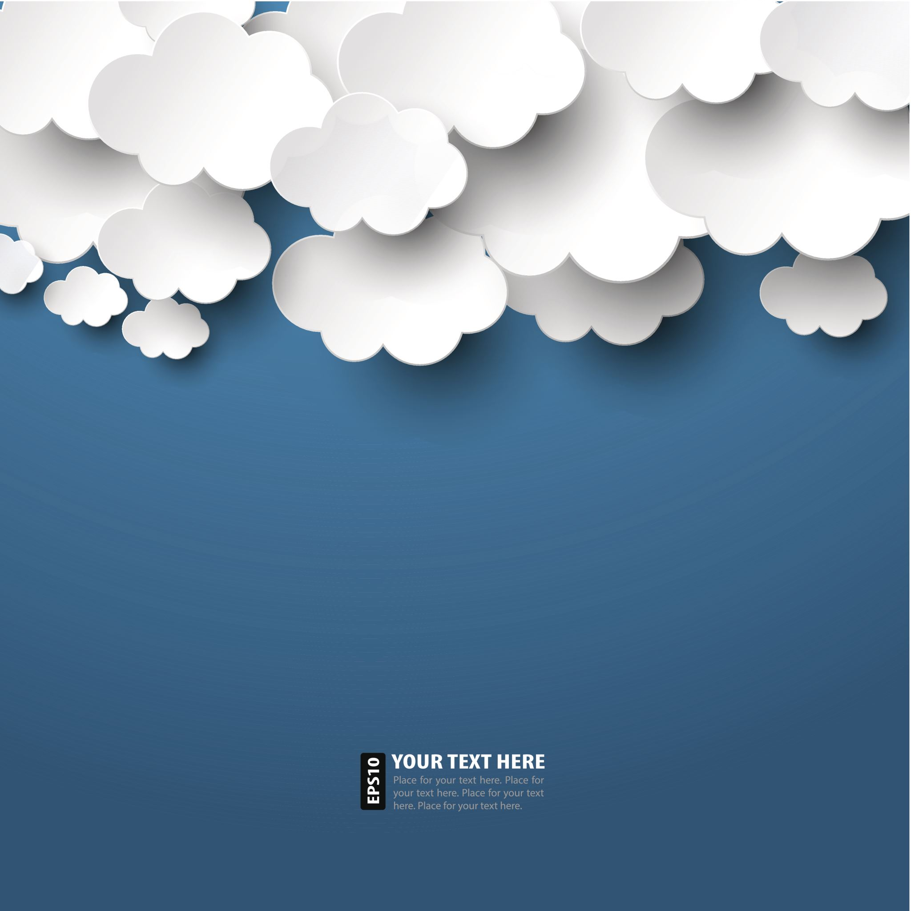
Web Scraping Project
Casey Hoffman

Slide 2
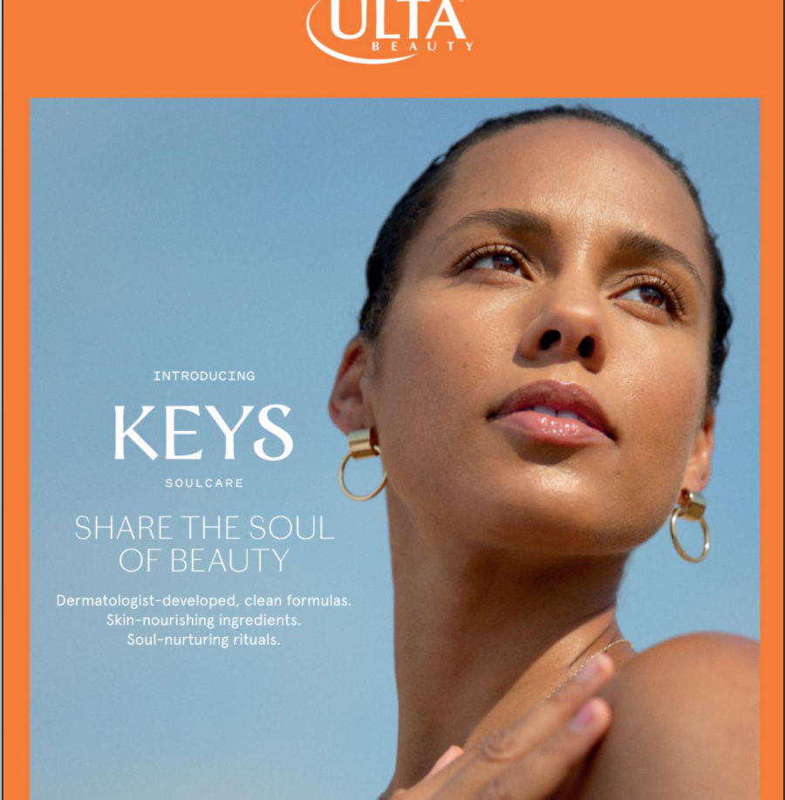
Background
Ulta Beauty is an online and in-store beauty retailer, offering skincare, hair and makeup products, and more.
Carries a huge range of products, varying in quality and price range.
For this project, I decided to focus on their moisturizers (~700 products). I used Scrapy to obtain the data.

Slide 3
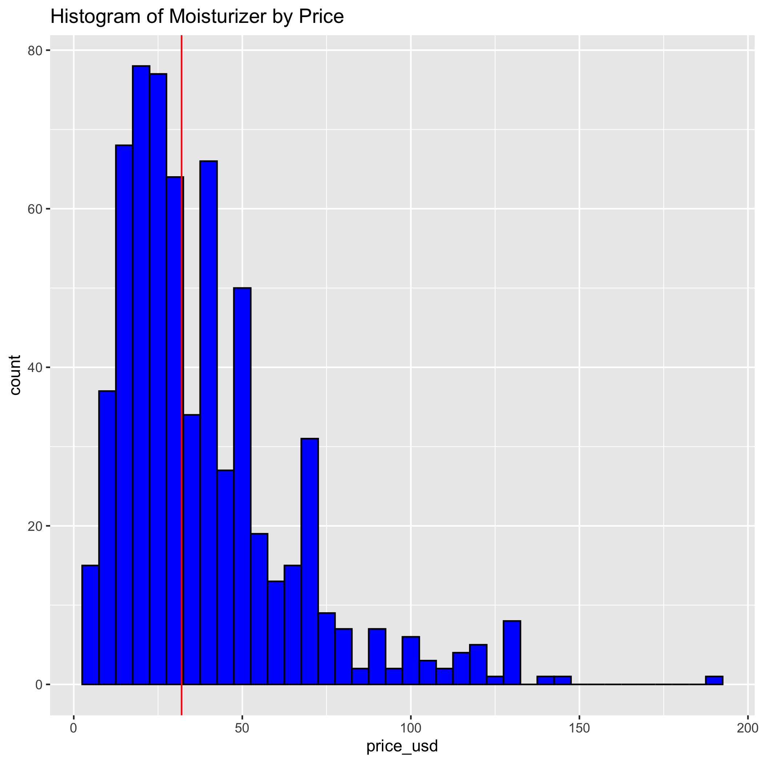
Histogram of Moisturizer Prices
The majority of moisturizers are less than $50.
The red line denotes the median price ($31.99).
However, this alone does not provide enough information on which products are highly purchased.

Slide 4
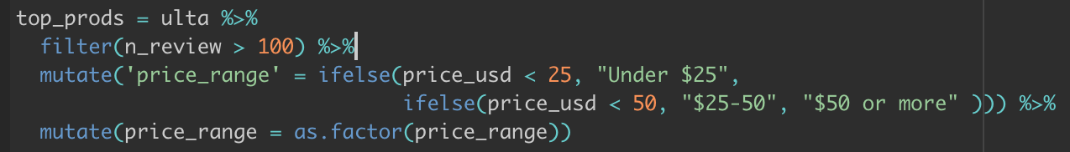
Analyzing the bestsellers…

Slide 5
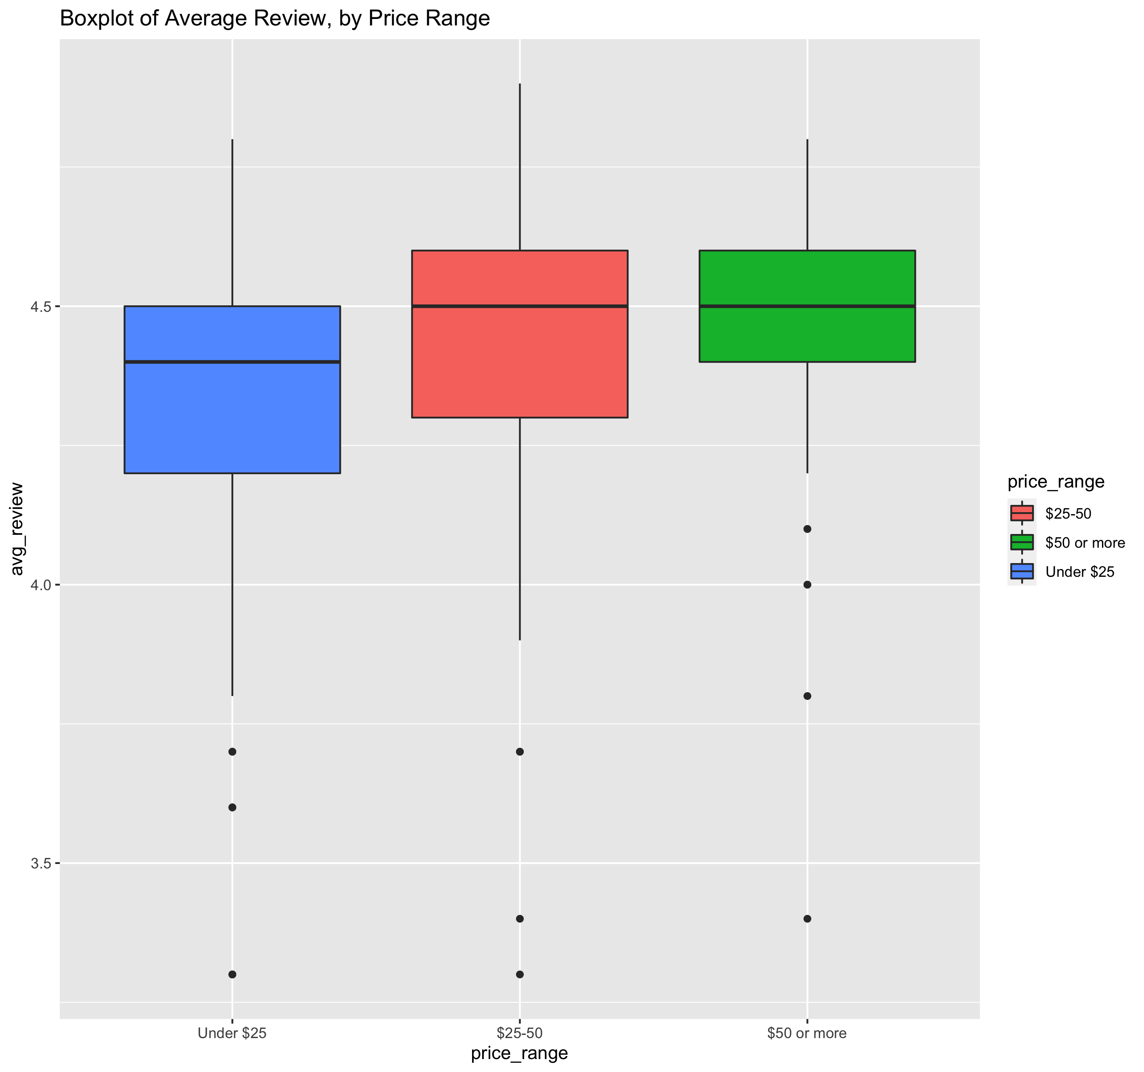
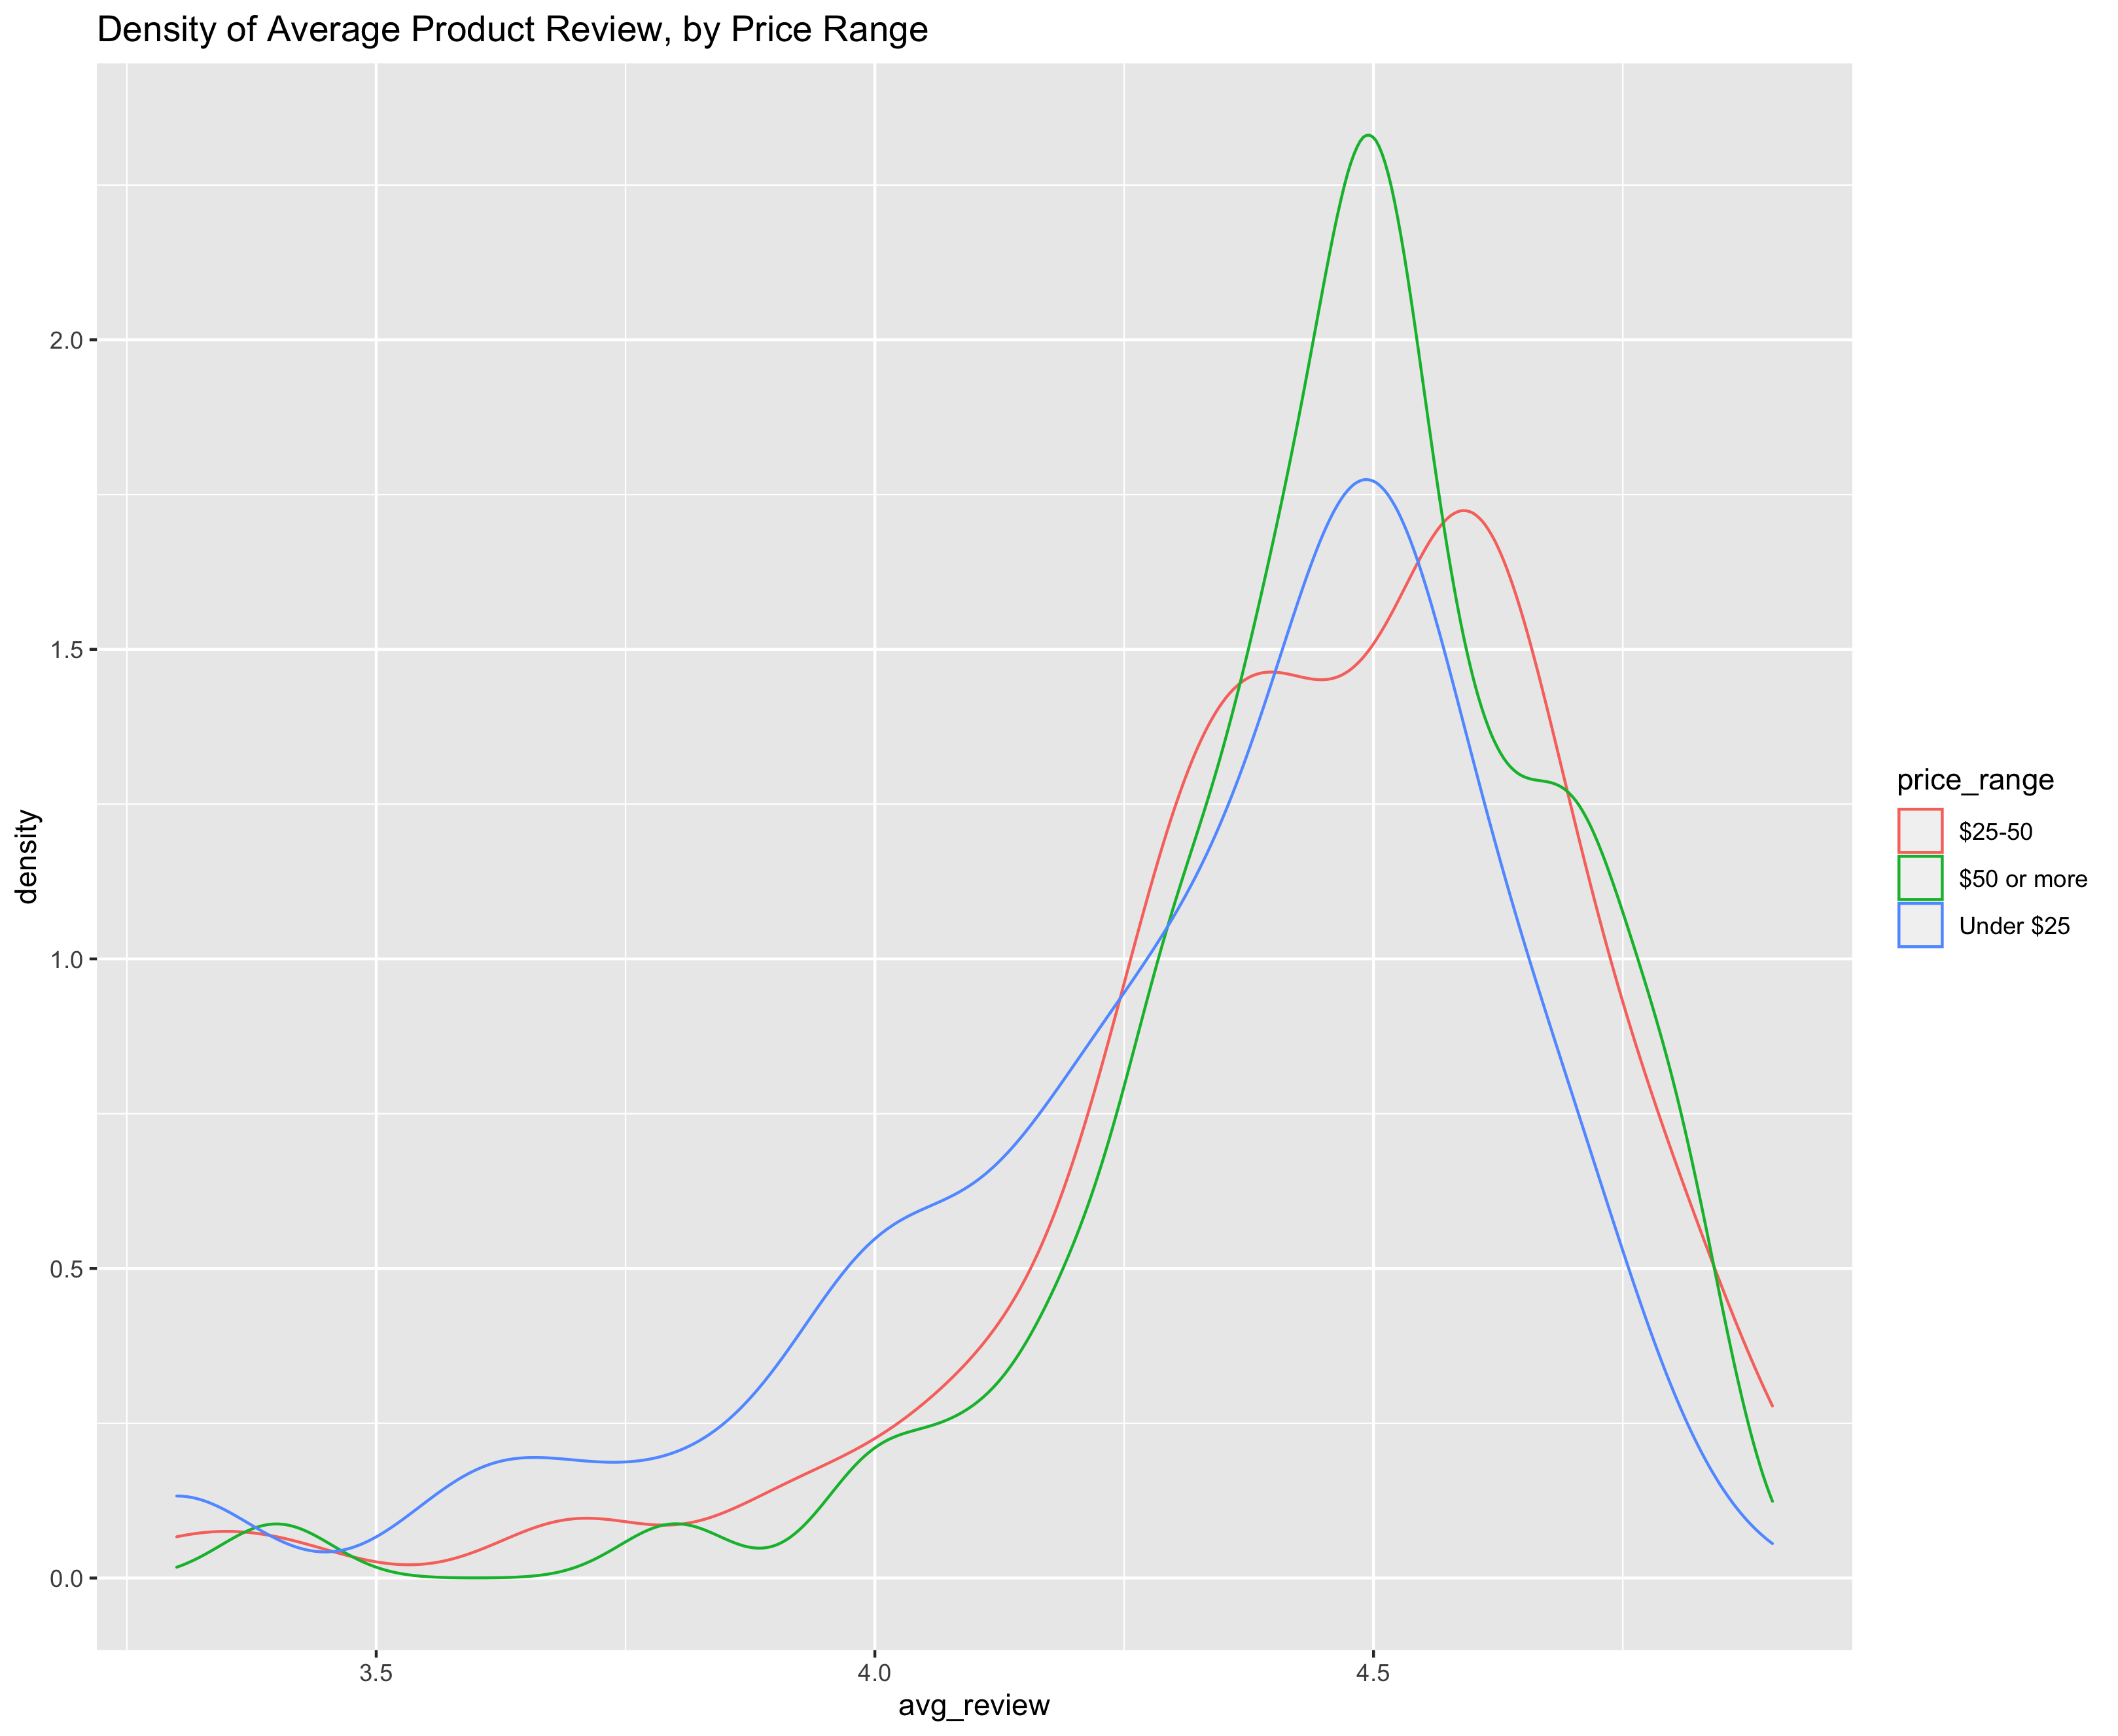
Distributions of Reviews: Boxplot + Density Plot

Slide 6
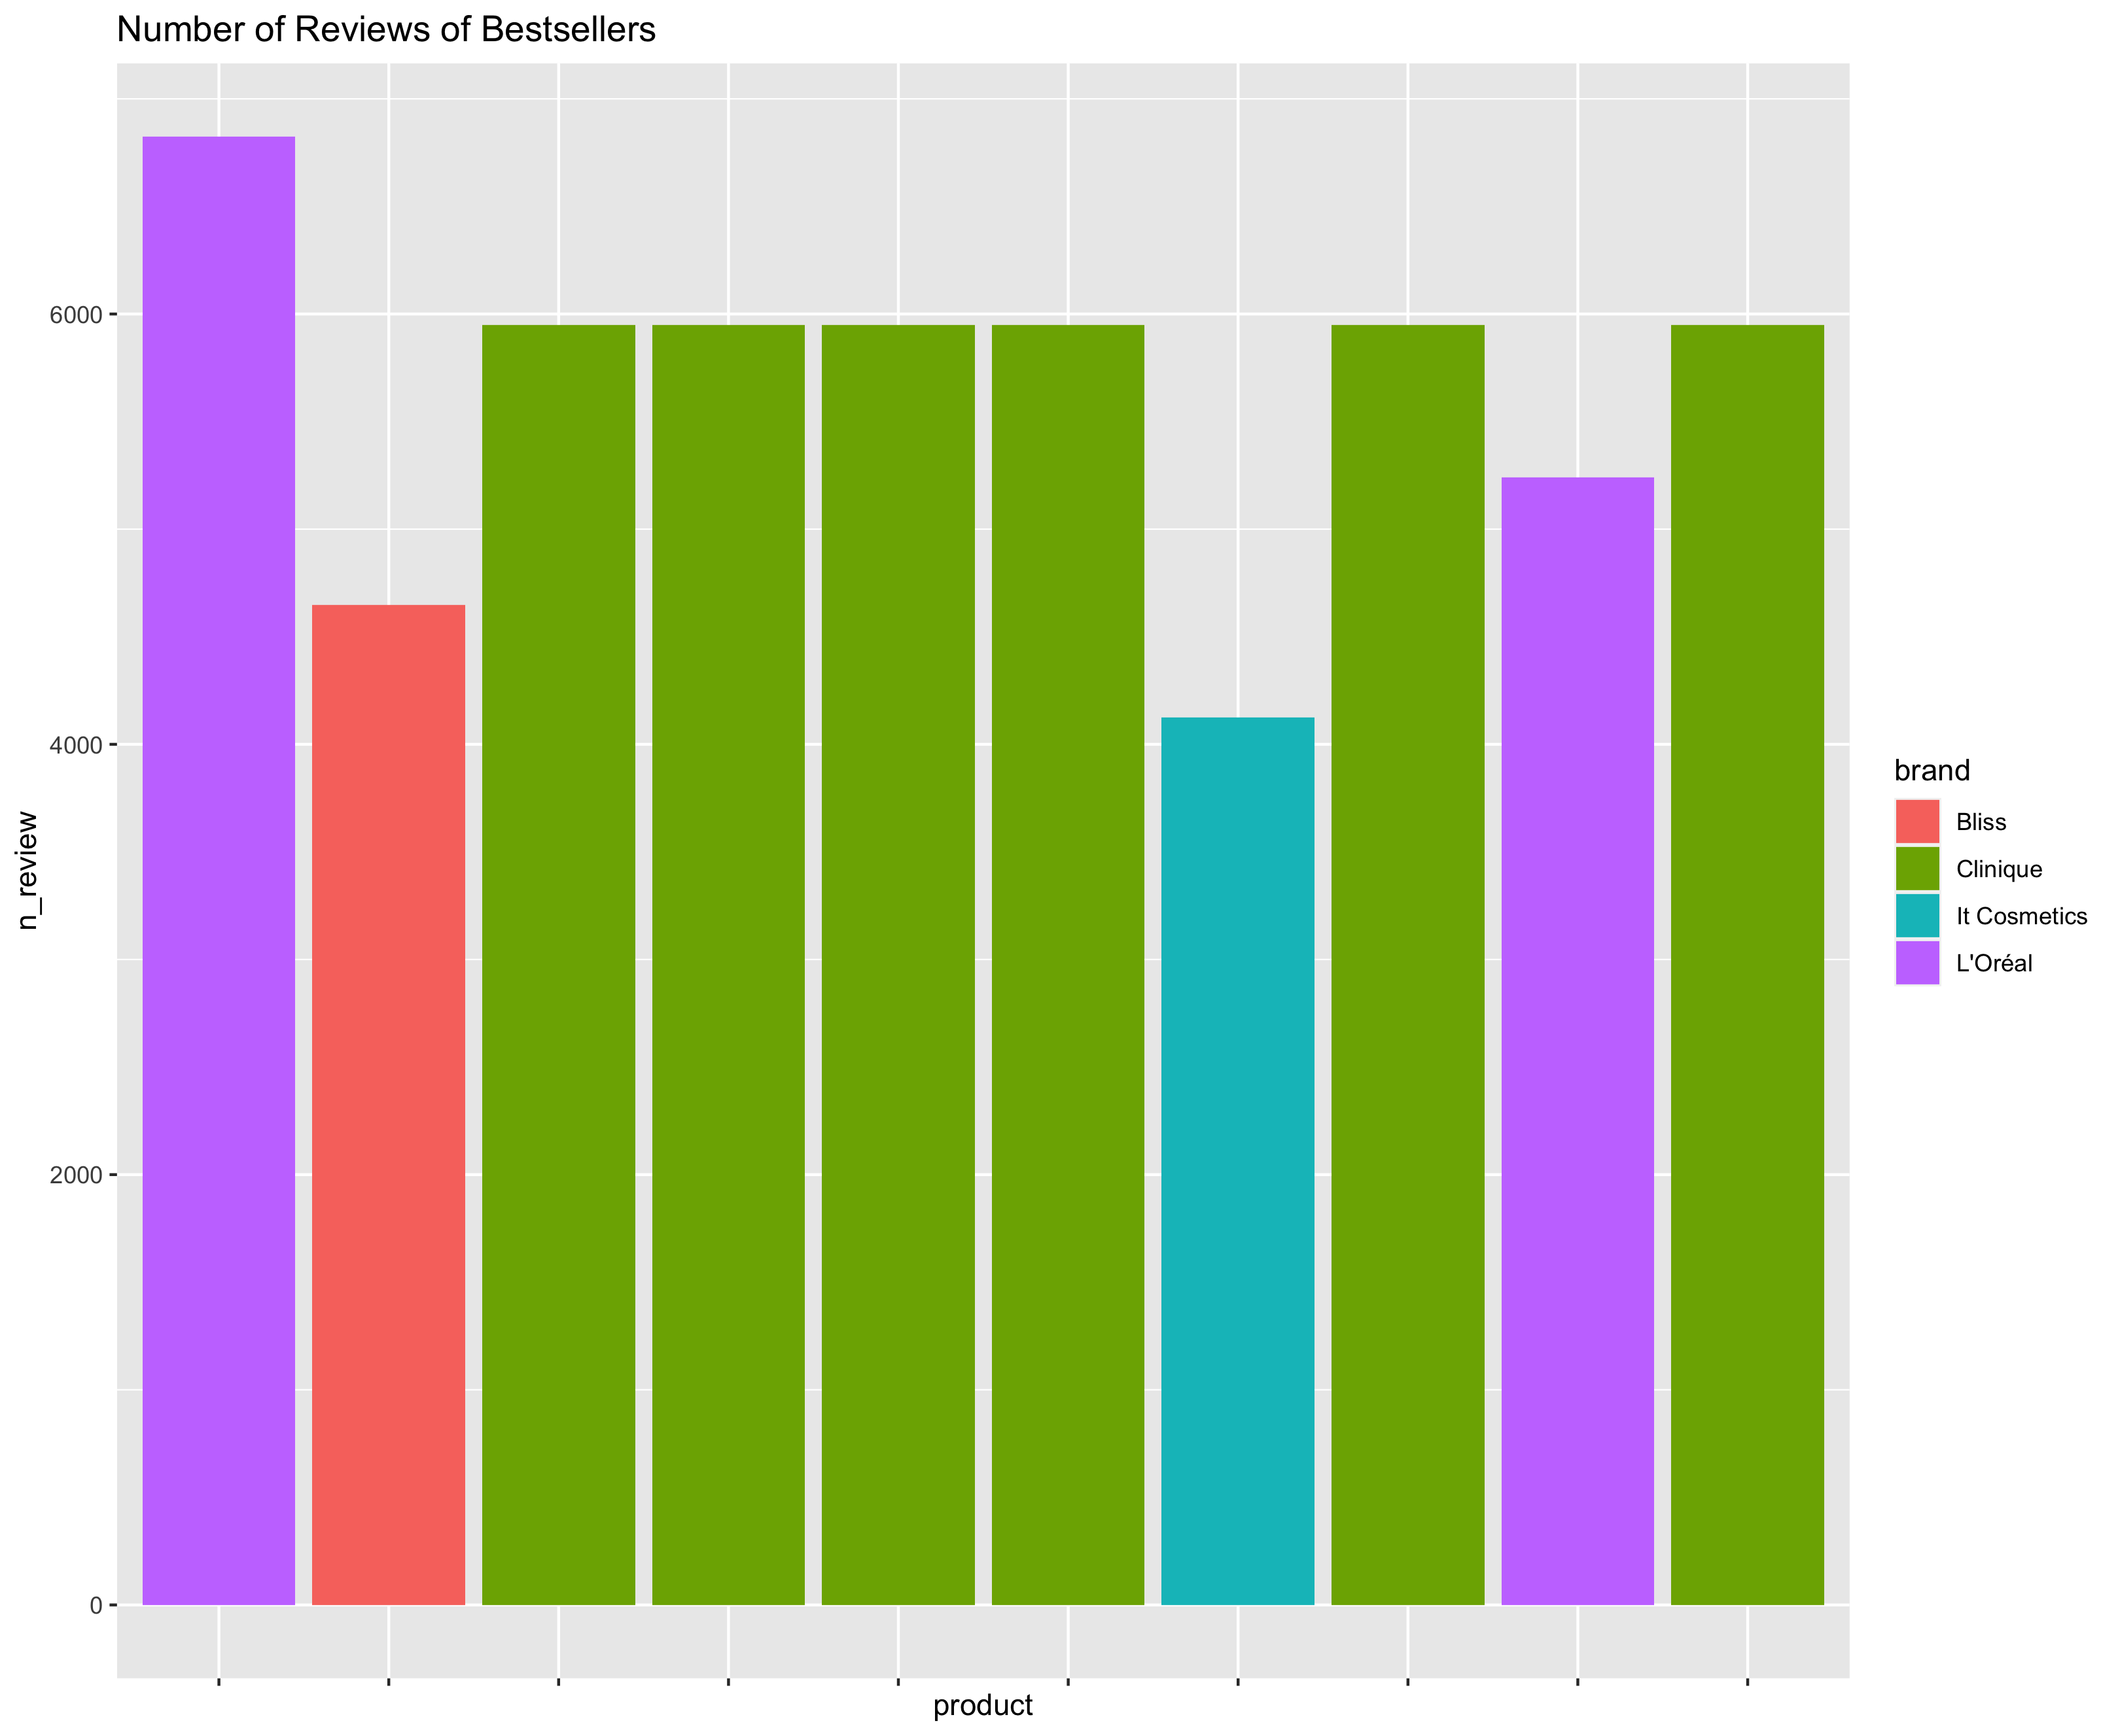
The Top 10 Products
I determined the Top 10 bestselling products by computing a score based on the overall average rating and number of ratings per product. 6/10 of the best-selling products are from the Clinique brand.
The highest-rated product included is the “Confidence In A Cream Anti-Aging Moisturizer” from It Cosmetics (4.5/5 stars, n = 4124).

Slide 7
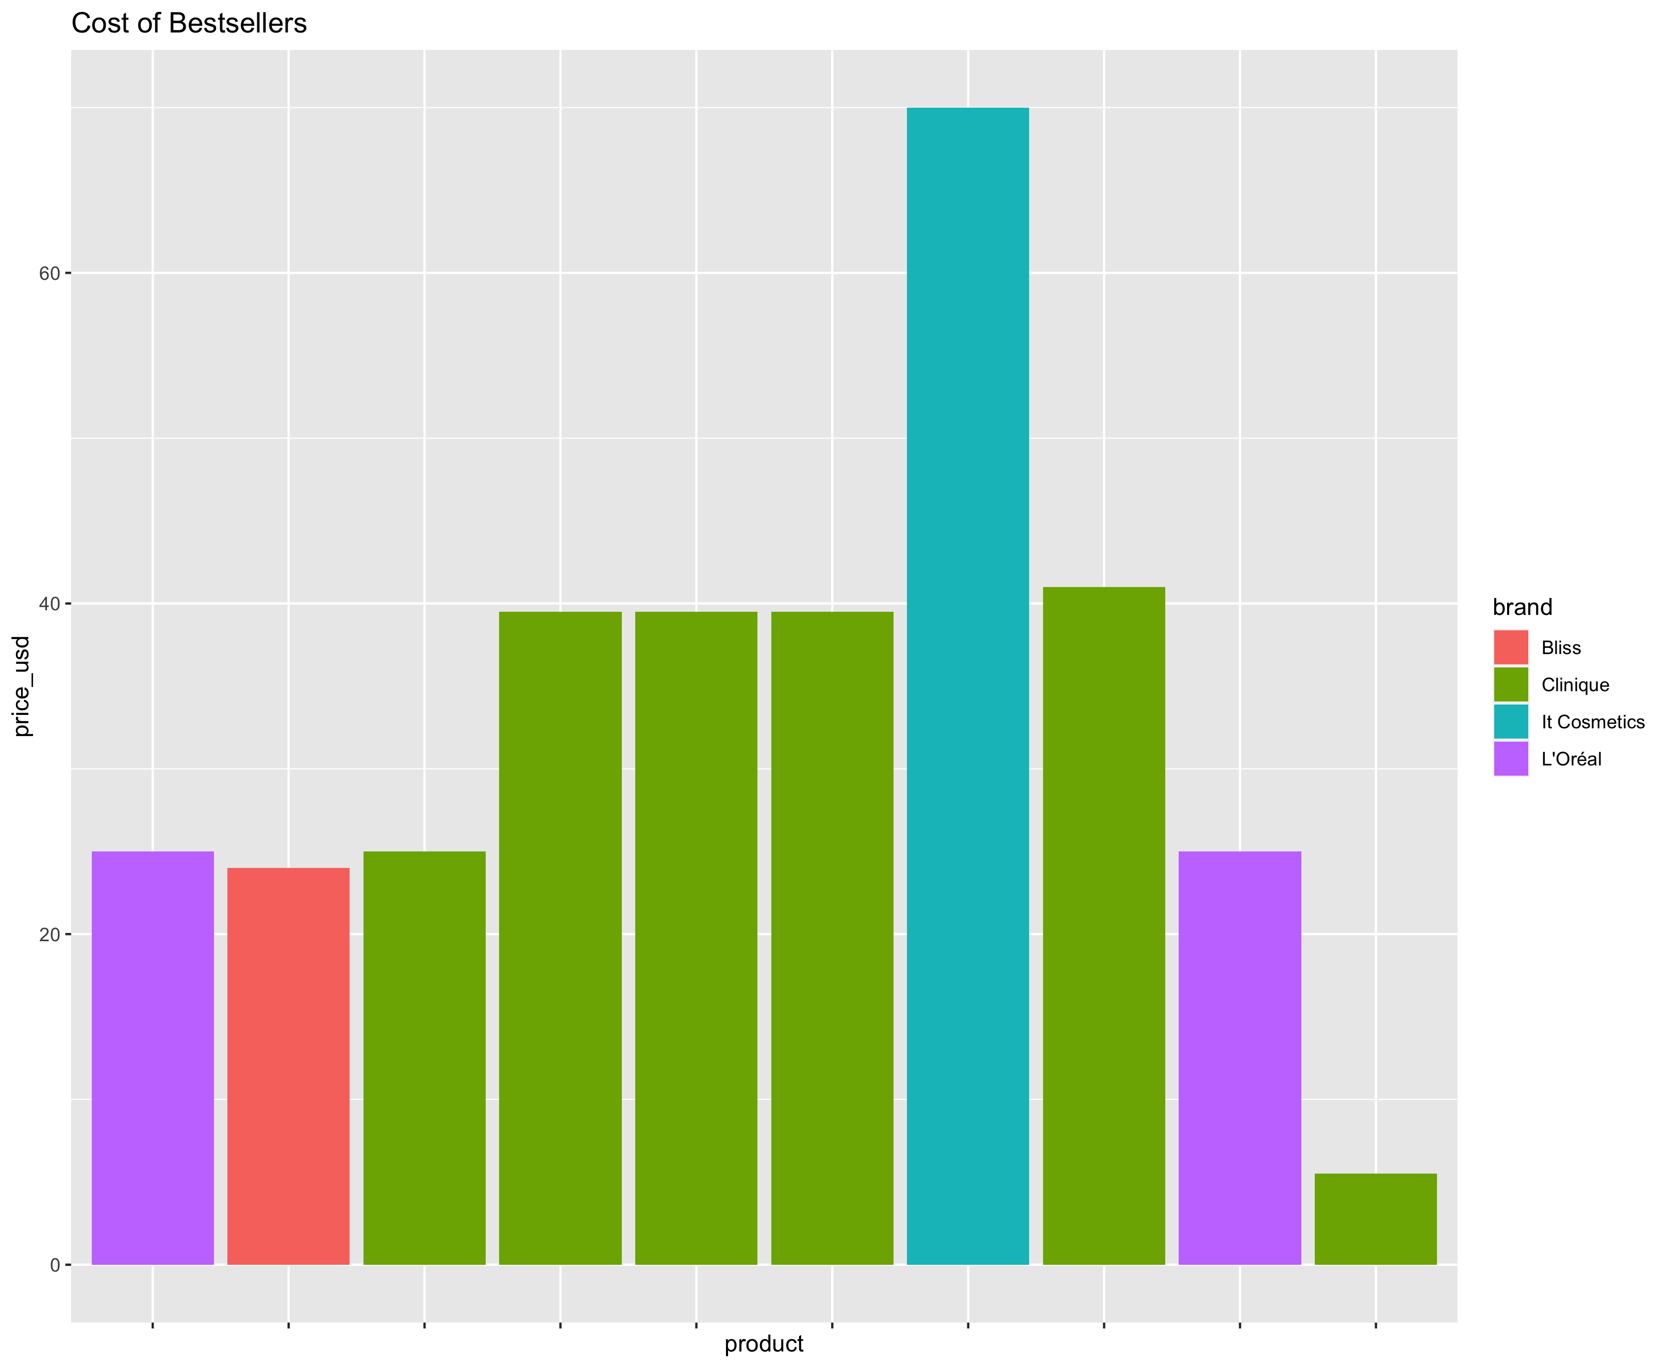
The Top 10 Products - Cost
A
The majority of the products in the Top 10 are between $25 and $40. However, two outliers do not fit this pattern, labeled A and B.
These are the “Confidence In A Cream Anti-Aging Moisturizer” from It Cosmetics and “Travel Size Dramatically Different Hydrating Jelly” from Clinique.
B

Slide 8
Interesting Findings
Due to time constraints, I was unable to conduct NLP on the review text for these products.
However, I took some time to look at the product names from the Top 10 and see what commonalities arise.
All the products in the top 10 are anti-aging skincare products.
I interpret this to mean that anti-aging skincare products are the most popular type of moisturizers on Ulta’s website.
Validated by an outside source: the It Cosmetics moisturizer was the #1 selling moisturizer product in 2019

Slide 9
Future Directions / What I would do…
I would like to scrape all text data from all reviews, and analyze to see what words are present in high-rated, best-selling products.
It would also have been cool to extract the type of moisturizer from the product text (i.e., anti-aging, for sensitive skin, anti-acne).
I also would have liked to compare the bestselling products across different websites, to see if these are really the most best-selling products (or just the best-selling on Ulta).

