Slide 1
Department of Sociology | University of Texas at Austin
Casey Breen

Slide 2
Welcome to “Intro to R”
Course website:
  www.github.com/caseybreen/intro_r
  Slides, exercises, and solutions
Course goals
Overview: why R is a powerful tool for social science research
. . .
Install R and RStudio
. . .
Introduction to R syntax, data types, and data structures
. . .
Basic understanding of data manipulation and visualization
Course agenda
Session 1
  Module 1: Introduction to R, RStudio, and code formats
  Module 2: R programming fundamentals (syntax, operators, data types, data structures, sequencing)
  Module 3: Working with data (indexing vectors / matrices, importing data)
Session 2
  Module 4: Importing and exporting data
  Module 5: Data manipulation (dplyr) and data visualization (ggplot2)
  Module 6: Best practices and resources for self-study

Slide 3
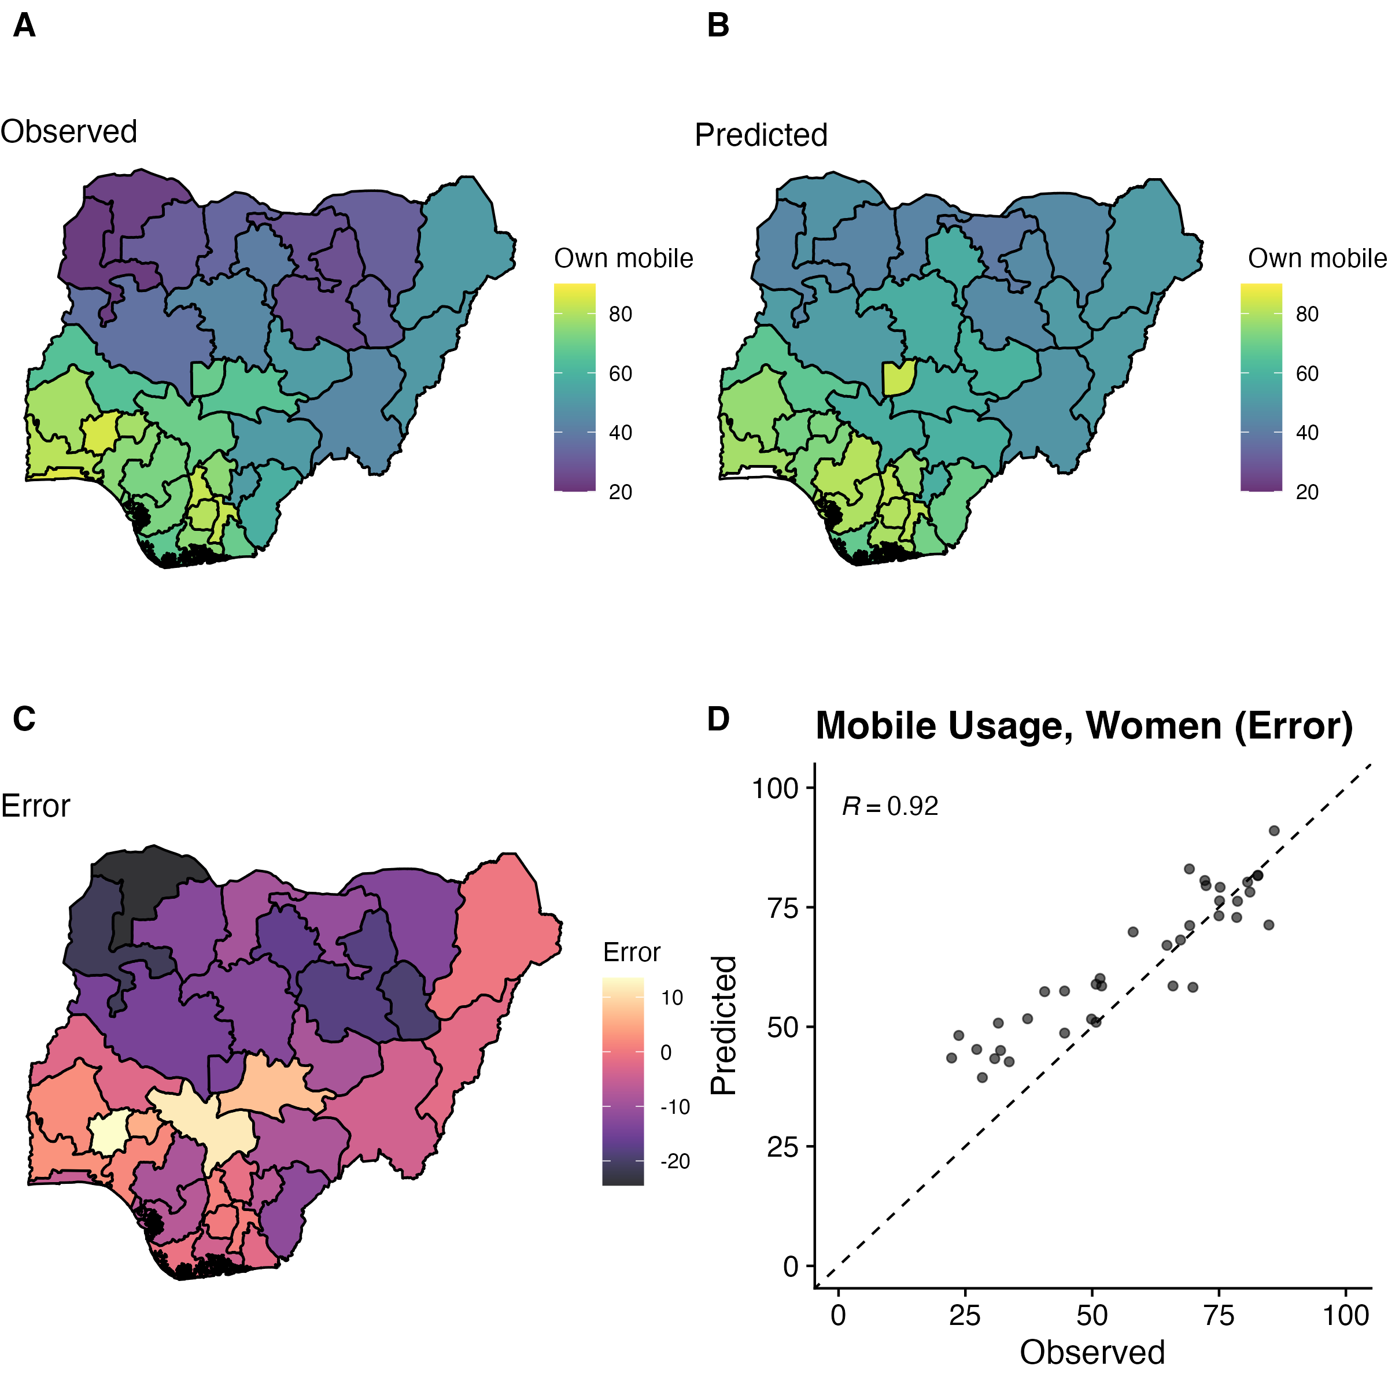
Module 1
Introduction to R, RStudio, and code formats
Learning objectives:
Installing R and RStudio
Why R?
Understanding R Scripts, R notebooks, Quarto documents
R and RStudio
R is a statistical programming language
  Download: https://cloud.r-project.org
RStudio is an integrated development environment (IDE) for R programming
  Download: http://www.rstudio.com/download
Why R?
Free, open source — great for reproducibility and open science
Powerful language for data manipulation, statistical analysis, and publication-ready data visualizations
Excellent community, lots of free resources
Data visualization

Slide 4
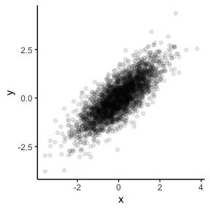
Easy to simulate + plot data
# Generate random data for x
x <- rnorm(n = 3000)
y <- 0.8 * x + rnorm(3000, 0, sqrt(1 - 0.8^2))
# Create data.frame
data_df <- data.frame(x = x, y = y)
# Generate visualization
data_df %>%
ggplot(aes(x = x, y = y)) +
geom_point(alpha = 0.1) +
theme_classic()

Slide 5
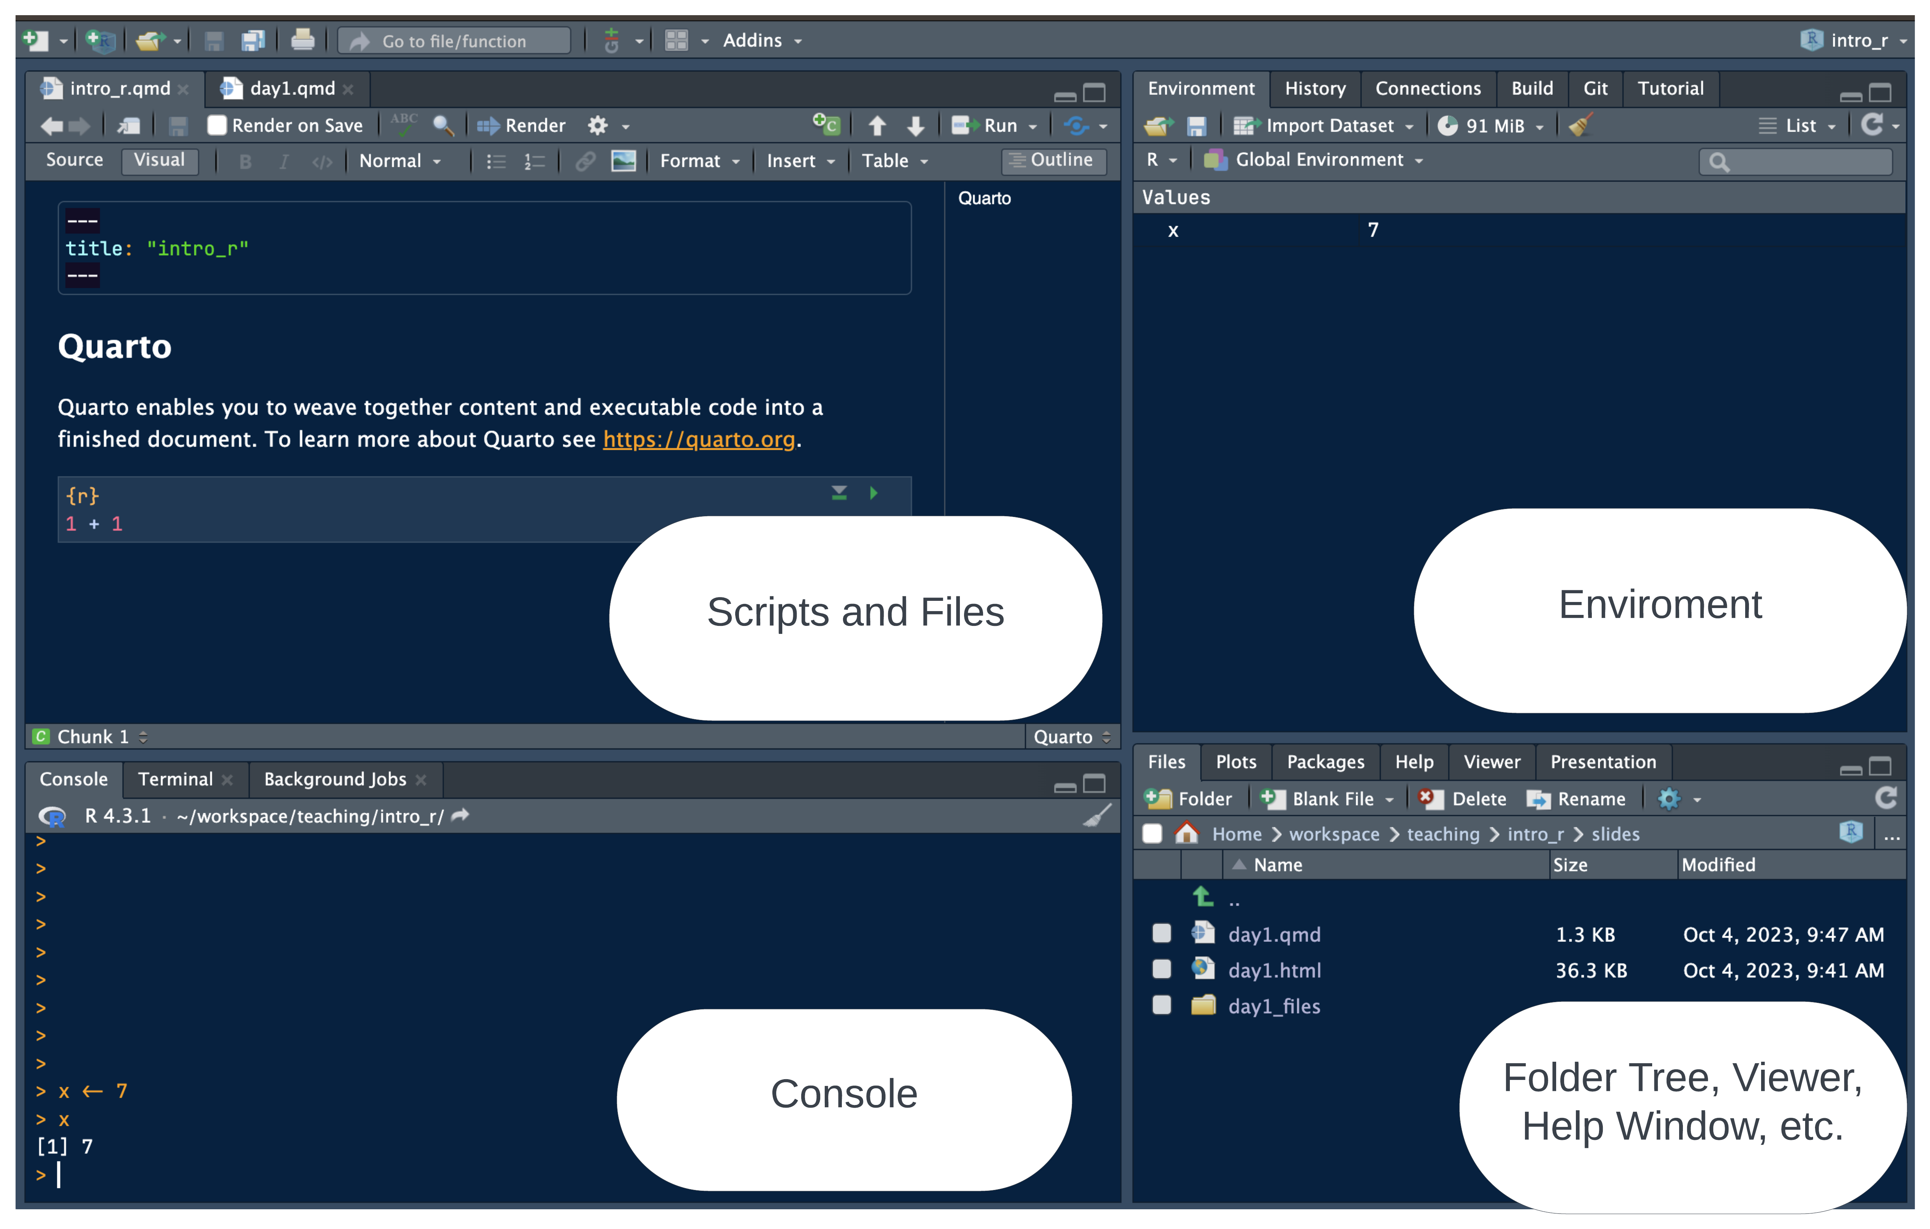
RStudio panes

Slide 6
Why RStudio?
All-in-one development environment: streamlines coding, data visualization, and workflow
Extensible: supports R — but also Python, SQL, and Git
Rich community: eases learning and problem-solving
Code formats: R Scripts vs. R Notebooks
R Scripts
  Simple: just code
  Best for simple tasks (and multi-script pipelines)
R Notebooks (Quarto, R Notebook)
  Integrated: Mix of code, text, and outputs for easy documentation
  Interactive: real-time code execution and output display
Quarto documents

Slide 7
“Notebook” Style: supports interactive code and text
  Code cells: segments for code execution
  Text chunks: annotations or explanations in Markdown format.
Inline output: figures and code output display directly below the corresponding code cell

Slide 8
Installing packages

Slide 9
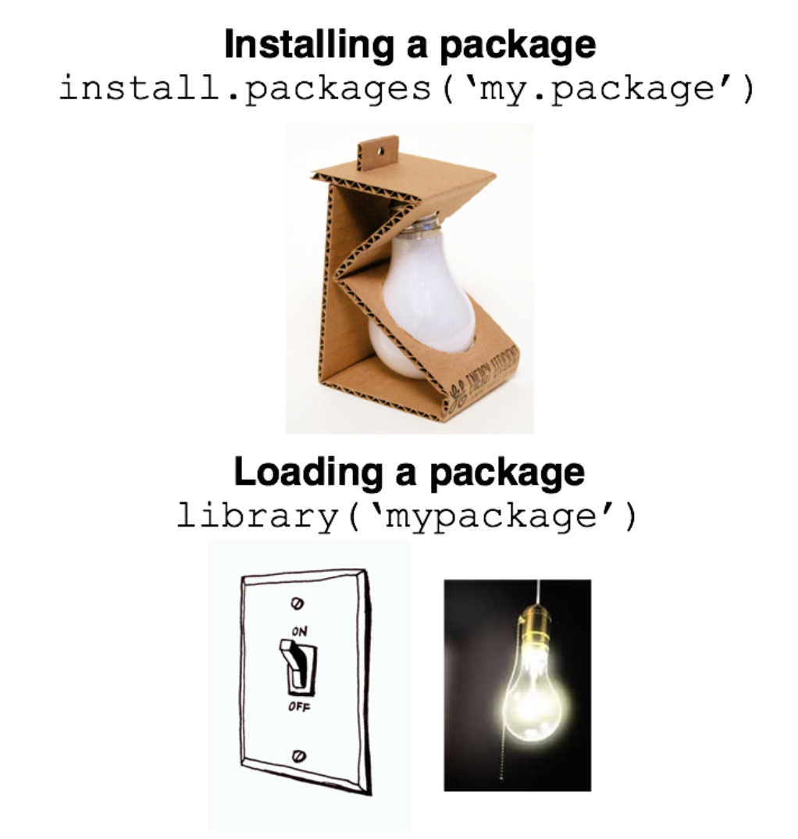
Packages: pre-built code and functions.
Packages are generally installed from the Comprehensive R Archive Network (CRAN)
Install: new packages
install.packages("tidyverse")
Library: load installed packages
library(tidyverse)
YaRrr! The Pirates Guide to R. Nathaniel D. Phillips, 2018.

Slide 10
Running code
Run all code in a quarto document (or R script, or R notebook)
  Exception: install packages, quick checks in console
To run a single line of code in a code cell
  Cursor over line, Ctrl + Enter (Windows/Linux) or Cmd + Enter (Mac).
To run a full code cell (or script)
  Ctrl + Shift + Enter (Windows/Linux) or Cmd + Shift + Enter (Mac).
Live coding demo
Demo of creating a new Quarto document and running code in a code cell
Your turn next…
In-class exercise 0
Create a new quarto document
  File -> New File -> Quarto Document -> Create
Create a new code cell
  Insert -> Executable cell -> R
Practice running code below
3+3
[1] 6
print("Thank you for attending the intro to R session!")
[1] "Thank you for attending the intro to R session!"

Slide 11
Module 2
R programming fundamentals
Learning objectives:
Comprehend R objects and functions
Master basic syntax, including comments, assignment, and operators
Understand data structures and types in R
Objects

Slide 12
Everything in R is an object
  Vectors: Ordered collection of same type
  Data Frames: Table of columns and rows
  Function: Reusable code block
  List: Ordered collection of objects
## Objects in R
## Numeric like `1`, `2.5`
x <- 2.5
## Character: Text strings like `"hello"`
y <- "hello"
## Boolean: `TRUE`, `FALSE`
z <- TRUE
## Vectors
vec1 <- c(1, 2, 3)
vec2 <- c("a", "b", "c")
## data.frames
df <- data.frame(vec1, vec2)

Slide 13
Functions
Built-in “base” functions
## Functions in R
result_sqrt <- sqrt(25)
result_sqrt
[1] 5
Custom, user-defined functions
# User-Defined Functions: Custom functions
my_function <- function(a, b) {
return(a^2 + b)
}
my_function(2, 3)
[1] 7
Functions from packages
# User-Defined Functions: Custom functions
library(here) ## library package here
here() ## run custom "here" function to print out working directory
[1] "/Users/cb48679/workspace/intro_r"
Comments
Use # to start a single-line comment
Comments are an important way to document code
## Add comments
x <- 7 # assigns 1 to x
## the line below won't assign 12 to x because it's commented out
# x <- 12
x
[1] 7
Assignment operators
Use <- or = for assignment
  <- is preferred and advised for readability
Formally, assignment means “assign the result of the operation on the right to object on the left”
## Add comments
x <- 7 # assigns 7 to x
## Question: what does this do?
y <- x
Arithmetic operators
Addition / Subtraction
## R as a calculator (# adds a comment)
## Addition
10 + 3
[1] 13
## Subtraction
4 - 2
[1] 2
Multiplication / division
## Multiplication
4 * 3
[1] 12
## Division
12 / 6
[1] 2
Exponents
## exponents
10^2 ## or 10 ** 2
[1] 100
Comparison and logical operators

Slide 14
Operators
Examples
## Logical operators
10 == 10
[1] TRUE
9 == 10
[1] FALSE
9 < 10
[1] TRUE
"apple" %in% c("bananas", "oranges")
[1] FALSE
"apple" %in% "bananas" | "apple" %in% "apple"
[1] TRUE
"apple" %in% "bananas" & "apple" %in% "apple"
[1] FALSE
Operator | Symbol
AND | &
OR | |
NOT | !
Equal | ==
Not Equal | !=
Greater/Less Than | > or <
Greater/Less Than or Equal | >= or <=
Element-wise In | %in%

Slide 15
Data structures
There are lots of data structures; we’ll focus on vectors and data frames.
  Vectors: One-dimensional arrays that hold elements of a single data type (e.g., all numeric or all character).
  Data frames: Two-dimensional tables where each column can have a different data type; essentially a list of vectors of equal length.
Vectors and data frames
Vector example
## Vector Example
vec_example <- c(1, 2, 3, 4, 5)
vec_example ## prints out vec_example
[1] 1 2 3 4 5
Data frame example
# Data.frame example
example_df <- data.frame(
ID = c(1, 2, 3, 4),
Name = c("Alice", "Bob", "Charlie", "David"),
Age = c(25, 30, 35, 40),
Score = c(90, 85, 88, 76)
)
example_df ## prints out df_example
ID Name Age Score
1 1 Alice 25 90
2 2 Bob 30 85
3 3 Charlie 35 88
4 4 David 40 76
Data types
Each vector or data frame column can only contain one data type:
  Numeric: Used for numerical values like integers or decimals.
  Character: Holds text and alphanumeric characters.
  Logical: Represents binary values - TRUE or FALSE.
  Factor: Categorical data, either ordered or unordered, stored as levels.
## generate vectors
vec1 <- c(1, 2, 3)
vec2 <- c("a", "b", "c")
## check type
class(vec1)
[1] "numeric"
class(vec2)
[1] "character"
NA (missing) values in R
NA represents missing or undefined data.
  Can vary by data type (e.g., NA_character_ and NA_integer_)
NA values can affect summary statistics and data visualization.
What happens when you run the code below?
vec <- c(1, 2, 3, NA)
mean(vec)
Generating sequences in R
Method 1: Manually write out sequence using c()
## Basic
c(1, 2, 3, 4, 5, 6, 7, 8, 9, 10)
[1] 1 2 3 4 5 6 7 8 9 10
Method 2: Colon operator (:), creates sequences with increments of 1
c(1:10)
[1] 1 2 3 4 5 6 7 8 9 10
Method 3: seq() Function: More flexible and allows you to specify the start, end, and by parameters.
## seq 1-10, by = 2
seq(1, 10, by = 2)
[1] 1 3 5 7 9
Functions
Function: Input arguments, performs operations on them, and returns a result
For each of the below functions, what are the:
  Input arguments?
  Operations performed?
  Results?
## hint: rnorm simulates random draws from a standard normal distribution
random_draws <- rnorm(n = 5,
mean = 0,
sd = 1)
## find the mean
mean(random_draws)
[1] 0.08688706
## find the median
median(random_draws)
[1] -0.1895134
## find the standard deviation
sd(random_draws)
[1] 0.8448568
Keyboard shortcuts
Insert new code cell
macOS: Cmd + Option + I
Windows/Linux: Ctrl + Alt + I
Run full code cell or script
macOS: Cmd + Shift + Enter
Windows/Linux: Ctrl + Shift + enter
Assignment operator (creates <-)
macOS: option + -
Windows/Linux: option + -
Live coding demo
Assignment (e.g., x <- 4)
Logical expressions (e.g., x > 10)
Creating a basic sequence
Your turn next…
In-class exercise 1
Assign x and y to take values 3 and 4.
Assign z as the product of x and y.
Write code to calculate the square of 3. Assign this to a variable three_squared.
Write a logical expression to check if three_squared is greater than 10.
Write a logical expression testing whether x is not greater than 10. Use the negate symbol (!).
Exercise 1 solutions
Assign x and y to take values 3 and 4.
x <- 3
y <- 4
Assign z as the product of x and y.
z <- x * y
Calculate the square of 3 and assign it to a variable called three_squared.
three_squared <- 3^2
Write a logical expression to check if three_squared is greater than 10.
three_squared > 10
[1] FALSE
Write a logical expression to test whether three_squared is not greater than 10. Use the negate symbol (!).
!three_squared > 10
[1] TRUE
In-class exercise 2
Generate vectors containing the numbers 100, 101, 102, 103, 104, and 105 using 3 different methods (e.g., c(), seq(), :). In what scenarios might each method be most convenient?
Generate a sequences of all even numbers between 0 and 100. Use the seq() function.
Create a descending sequence of numbers from 100 to 1, and assign it to a variable. Use the seq() function.
Exercise 2 solutions
Generate vectors containing the numbers 100 to 105 using three different methods (c(), seq(), :). Discuss the convenience of each method.
# Generate a vector using c() method
vector_c <- c(100, 101, 102, 103, 104, 105)
# Generate a vector using seq() method
vector_seq <- seq(100, 105, by = 1)
# Generate a vector using : operator
vector_colon <- c(100:105)
Generate a sequence of all even numbers between 0 and 100. Use the seq() function.
# Generate a sequence of all even numbers between 0 and 100
even_seq <- seq(0, 100, by = 2)
Create a descending sequence of numbers from 100 to 1, and assign it to a variable. Use the seq() function.
# Create a descending sequence of numbers from 100 to 1
desc_seq <- seq(100, 1, by = -1)

Slide 16
Module 3
id | name | age | gender | score
1 | Alice | 25 | F | 90
2 | Bob | 30 | M | 85
3 | Carol | 22 | F | 88
4 | Dave | 28 | M | 92
5 | Emily | 24 | F | 89
Working with vectors and data frames
Learning objectives
Select elements from vectors and columns from data frames
Subset data frames
Investigate characteristics of data frames
Indexing vectors
Basic indexing
vec <- c(1, 2, 3, 4, 5)
first_element <- vec[1]
first_element
[1] 1
third_element <- vec[3]
third_element
[1] 3
Conditional indexing
vec <- seq(5, 33, by = 2)
vec[vec > 25]
[1] 27 29 31 33
Working with data frames
Data frames are the most common and versatile data structure in R
Structured as rows (observations) and columns (variables)
test_scores <- data.frame(
id = c(1, 2, 3, 4, 5),
name = c("Alice", "Bob", "Carol", "Dave", "Emily"),
age = c(25, 30, 22, 28, 24),
gender = c("F", "M", "F", "M", "F"),
score = c(90, 85, 88, 92, 89)
)
knitr::kable(test_scores)

Slide 17
Working with data frames
head()- looks at top rows of the data frame
$ operator - access a column as a vector
## print first two rows first row
head(test_scores, 2)
id name age gender score
1 1 Alice 25 F 90
2 2 Bob 30 M 85
## access name column
test_scores$name
[1] "Alice" "Bob" "Carol" "Dave" "Emily"
Subsetting data frames
Methods:
  $: Single column by name.
  df[i, j]: Row i and column j.
  df[i:j, k:l]: Rows i to j and columns k to l.
Conditional Subsetting: df[df$age > 25, ].
## all rows, columns 1-3
test_scores[,1:3]
id name age
1 1 Alice 25
2 2 Bob 30
3 3 Carol 22
4 4 Dave 28
5 5 Emily 24
## all columns, rows 4-5
test_scores[4:5,]
id name age gender score
4 4 Dave 28 M 92
5 5 Emily 24 F 89
Quiz
Which rows and will this return?
test_scores[1:3,]
Which rows and which columns will this return?
test_scores[test_scores$score >= 90, ]
Answers
test_scores[1:3,]
id name age gender score
1 1 Alice 25 F 90
2 2 Bob 30 M 85
3 3 Carol 22 F 88
test_scores[test_scores$score >= 90, ]
id name age gender score
1 1 Alice 25 F 90
4 4 Dave 28 M 92
Explore data frame characteristics
Check number of rows
## check number of rows (observations)
nrow(test_scores)
[1] 5
Check number of columns
## check number of columns (variables)
ncol(test_scores)
[1] 5
Check column names
names(test_scores)
[1] "id" "name" "age" "gender" "score"
Live coding demo
Generate random draws from a normal distribution using the rnorm function
Subset the vector of random draws to only include certain observations
Look at basic summary statistics
In-class exercise 3
Generate a vector of 100 observations drawn from a normal distribution with a mean of 10 and a standard deviation of 2. Use the rnorm function.
What are the 1st, 10th, and 100th elements of this vector?
Calculate the mean of this vector. How does this sample mean relate to the population mean (hint: population mean = 10) of the distribution?
Calculate the difference between the sample mean and the population mean. Discuss the reason for the discrepancy.
Repeat steps 1-4 with a new sample size of 10,000. Did the difference between the sample mean and the population mean decrease? Why?
Exercise 3 solutions
# Generate a sample of 1,000 draws from a normal distribution with mean = 10 and sd = 2
sample_data_100 <- rnorm(100,
mean = 10,
sd = 2)
## look at 1st, 10th, and 100th element
sample_data_100[c(1, 10, 100)]
[1] 9.357484 9.322093 7.125744
# Calculate the mean of this sample
sample_mean_100 <- mean(sample_data_100)
# Calculate the difference between the mean of the sample and the expected value of the mean
difference_100 <- abs(sample_mean_100 - 10)
difference_100
[1] 0.1054441
# Calculate the Z-score for the sample mean
sample_data_10000 <- rnorm(10000,
mean = 10,
sd = 2)
# Calculate the mean of this sample
sample_data_10000 <- mean(sample_data_10000)
# Calculate the difference between the mean of the sample and the expected value of the mean
sample_data_10000 <- abs(sample_data_10000 - 10)
sample_data_10000
[1] 0.008479538
Questions?
Thanks for your attendance and participation
Please independently complete all exercises in problem set 1 (and review solutions)
Questions: casey.breen@demography.ox.ac.uk
Session 2
Module 4: Importing and exporting in data
Module 5: Data manipulation (dplyr) and data visualization (ggplot2)
Module 6: Best practices for R coding and resources for self-study

Slide 18
Module 4
Importing and exporting data
Learning objectives
Common data formats
Functions for importing / exporting data
Types of file paths in R
Importing data
Common formats for data
  .csv, .xlsx, .txt, .dat (stata), etc.
Key functions
  read_csv() function from tidyverse: Read CSV files
    Also built-in (“base”) function: read.csv()
  read.table(): Read text files
  readxl::read_excel(): Read Excel files
## read in CSV file
df <- read_csv("/path/to/your/data.csv") ## faster
## read in stata file
library(haven)
data <- read_dta("path/to/file.dta")
File paths
Absolute Path: Specifies the full path locate a file or directory, starting with the root directory.
  Windows: "C:\Users\username\folder\file.csv"
  macOS/Linux: "/home/username/folder/file.csv"
Relative Path: Specifies how to find the file or directory based on the current working directory.
  folder/file.csv
Working directories
The working directory is the folder where your R session or script looks for files to read, or where it saves files you write
Commands like read_csv("file.csv") or write_csv(data, "file.csv") will read from or write to this directory by default
Key syntax:
  getwd() — returns working directory
  setwd("/path/to/folder") — sets working directory
getwd()
[1] "/Users/cb48679/workspace/intro_r/slides_1day"
Reading in .CSV files
Recap: to read in .csv files use read_csv() function from tidyverse
  This will read in the .csv file into memory as a data frame
library(tidyverse)
df <- read_csv("dataset.csv")
Write out a data frame to a .csv file using write_csv():
write_csv(df, "dataset_v2.csv")
Downloading data for exercises
We will be using the CenSoc Numident Demo dataset
Please download the .csv file from the course website (intro_r/data)
  https://github.com/caseybreen/intro_r
Short url: https://tinyurl.com/intro-r-data
Live coding demo
Downloading demo file from Github
Reading in a .csv file in R using read_csv()
  Absolute and relative paths
Using tab to auto-complete file paths
Exploring a data frame: number of columns, rows, column names, etc.
In-class exercise 1
Load and install the tidyverse packages using the commands install.packages() and library()
Use the read_csv() function to read in the downloaded dataset and assign it to the object censoc
Use the head command to look at the first 5 rows
How many columns are in the dataset?
How many rows are in the dataset?
List the column names. What are a few research questions that could be addressed using this dataset?
Exercise 1 solutions
Load and install the tidyverse packages using the commands install.packages() and library()
install.packages(tidyverse) ## only have to do this once
library(tidyverse)
Use the read_csv() function to read in the dataset and assign it to the object censoc
censoc <- read_csv("censoc_numident_demo_v2.1.csv")
Use the head() command to look at the first 5 rows
head(censoc)
How many columns are in the dataset?
ncol(censoc)
[1] 39
Exercise 1 solutions (cont.)
How many rows are in the dataset?
nrow(censoc)
[1] 85865
List the column names.
colnames <- names(censoc)
head(colnames)
[1] "histid" "byear" "bmonth" "dyear" "dmonth" "death_age"

Slide 19
Module 5
Data manipulation and visualization
Learning objectives
Overview of tidyverse suite of packages
Fundamentals of data manipulation with dplyr
Data visualization with ggplot
Tidyverse

Slide 20
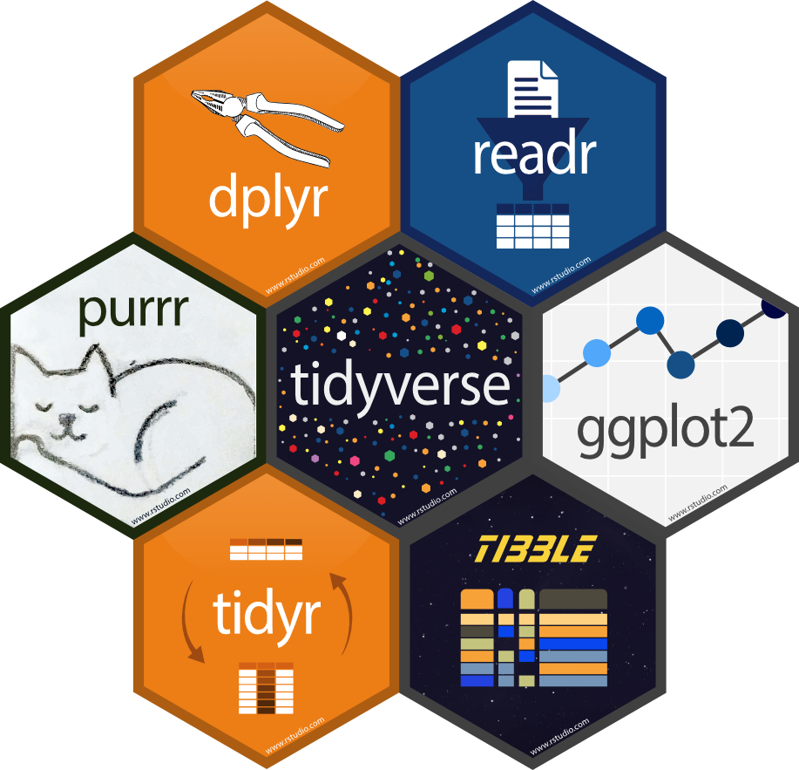
Packages: Collection of R packages designed for data science.
Data manipulation: Simplifies data cleaning and transformation with dplyr.
Data Visualization: Enables advanced plotting with ggplot2.

Slide 21
Data Manipulation using dplyr
filter: Select rows based on conditions.
filtered_df <- filter(df, age > 21)
select: Choose specific columns
filtered_df <- select(df)
mutate: Add or modify columns
df <- mutate(df, age_next_year = age + 1)
summarize or summarise: Aggregate or summarize data based on some criteria
filtered_df <- summarize(df, mean(age))
group_by: Group data by variables. Often used with summarise().
filtered_df <- df %>%
group_by(gender) %>%
summarize(mean(age))
The Pipe Operator %>% (or |> ) in R
Takes the output of one function and passes it as the first argument to another function
  “And then do…”
What’s the below code doing?
filtered_df <- df %>%
group_by(gender) %>%
summarize(mean(age))

Slide 22
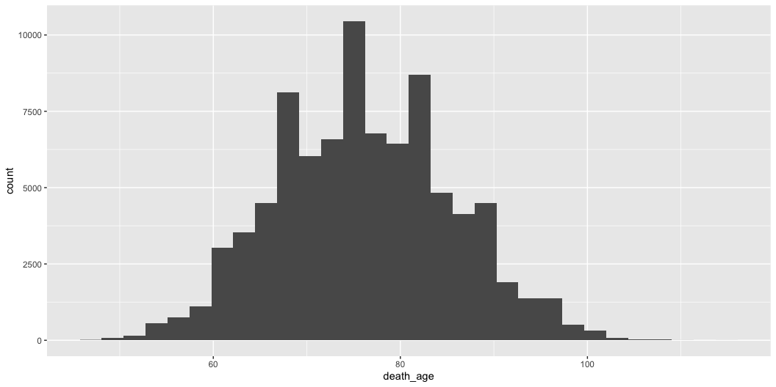
Recoding values in R
Sometime you want to recode a variable to take different values (e.g., recoding exact income to binary high/low income variable)
The case_when() function in R is part of the dplyr package and is used for creating new variables based on multiple conditions:
df_new <- df %>%
mutate(new_var = case_when(
condition1 ~ value1,
condition2 ~ value2,
TRUE ~ value_otherwise
))
Live coding demo
Filter data
Selecting data
Calculating summary statistics by group
Creating and recoding variables
In-class exercise 2
Filter the censoc data.frame to include only women (sex == 2). Use the filter command.
Filter the censoc data.frame to include only people born between 1905 and 1920 using the byear variable.
Select the columns histid, death_age, sex, and ownershp
Calculate the average age of death for women (hint: refer to question 1)
Exercise 2 solutions
Filter the censoc data.frame to include only women (sex == 2). Use the filter command.
## filter to only include women
censoc %>%
filter(sex == 2)
Filter the censoc data.frame to include only people born between 1905 and 1920 using the byear variable.
## method 1
censoc %>%
filter(byear %in% 1905:1920)
## method 2
censoc %>%
filter(byear >= 1905 & byear <= 1920)
Exercise 2 solutions (cont.)
Select the columns histid, death_age, sex, and ownershp
censoc_select <- censoc %>%
select(histid, death_age, sex, ownershp)
head(censoc_select)
# A tibble: 6 × 4
histid death_age sex ownershp
<chr> <dbl> <dbl> <dbl>
1 235C4FA2-B407-4E61-A31D-DBF299C1C120 85 1 1
2 0DE161A7-34A7-47EA-B053-EA8549172CCC 77 1 1
3 EFF79CEC-DA83-482A-AB9A-FFCAC3C9A6A5 77 1 1
4 B51D01FA-54A4-4E5E-8BCF-B6D9521A2983 73 2 2
5 D545AEB1-C5C3-4E32-BB22-4BF58CF50311 73 1 2
6 A71A537B-C440-4E85-A276-334B05B723A7 82 2 1
Calculate the average age of death for women (hint: refer to question 1)
censoc %>%
filter(sex == 2) %>%
summarize(mean_death_age_women = mean(death_age))
# A tibble: 1 × 1
mean_death_age_women
<dbl>
1 78.2
Data visualization using ggplot
ggplot2 provides a powerful and flexible system for creating a variety of data visualizations
data: specifies the dataset to be used for the plot
aes: Defines what data to show
geoms: Chooses the type of plot (e.g., histogram)
ggplot(data = <DATA>) +
<GEOM_FUNCTION>(mapping = aes(<MAPPINGS>))
Types of plots
geom_point(): Scatter plot
geom_bar(): Bar chart
geom_histogram(): Histogram
Basic histogram example
Histogram of age of death in censoc dataset
ggplot(data = censoc) +
geom_histogram(aes(x = death_age))

Slide 23
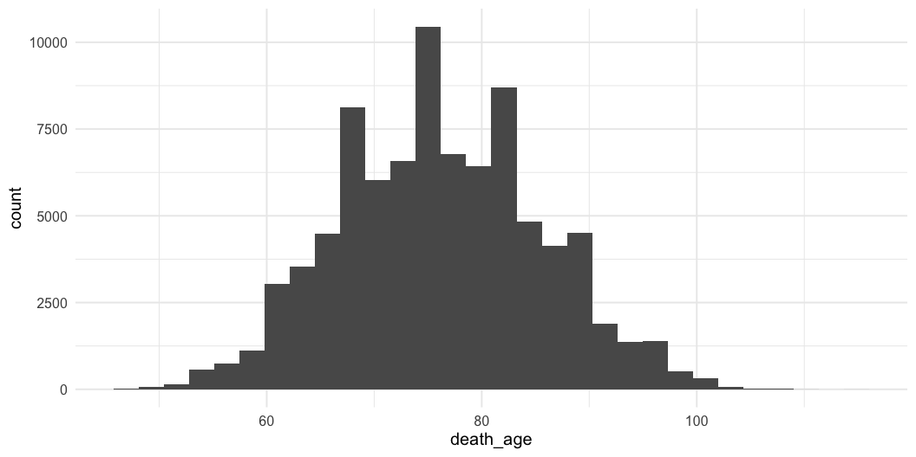
Customisable – specify theme
+ theme(<theme_choice>) will add on a theme
ggplot(data = censoc) +
geom_histogram(aes(x = death_age)) +
theme_minimal(base_size = 15)

Slide 24
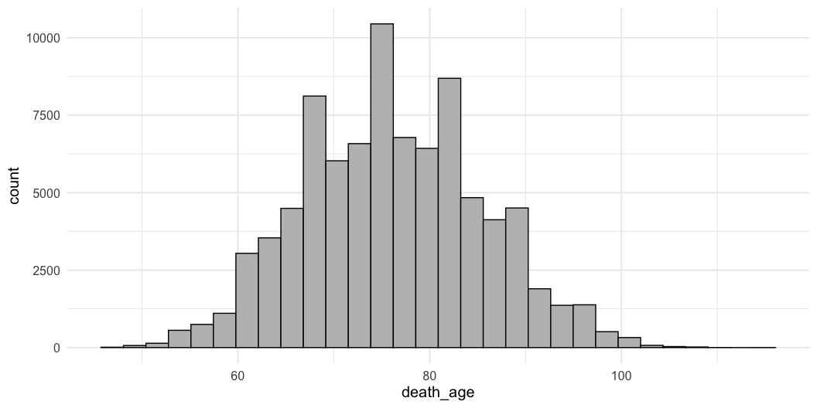
Customisable – specify colors
color and fill will can change color / fill of plot
ggplot(data = censoc) +
geom_histogram(aes(x = death_age), color = "black", fill = "grey") +
theme_minimal(base_size = 15)

Slide 25
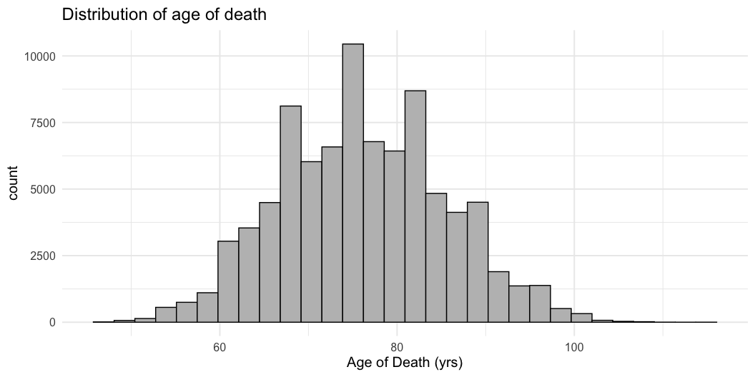
Customisable – add on labels/title
+ labs() add on title/axis labels
ggplot(data = censoc) +
geom_histogram(aes(x = death_age), color = "black", fill = "grey") +
theme_minimal(base_size = 15) +
labs(title = "Distribution of age of death", x = "Age of Death (yrs)")

Slide 26
Live coding demo
Create histogram using ggplot
Demonstrate flexibility of ggplot
  Themes
  Axis labels, titles
  Colors
In-class exercise 3
Make a histogram of the variable death_age. When are most people dying?
Make a histogram of the variable byear. When are most people born?
Recode the variable sex from numeric values (1, 2) to take character values (“men” and “women”). Note that 1 = men, 2 = women.
Calculate the mean of of death for both men and women using group_by() and summarize(). Use the death_age variable. Do men or women live longer in this sample?
Make a histogram of the variable death_age for both men and women. Use the filter() command.
Now try adding the following line to the histogram you made in question 1: + facet_wrap(~sex)
Exercise 3 solutions
Make a histogram of the variable death_age. When are most people dying?
ggplot(data = censoc) +
geom_histogram(aes(x = death_age))

Slide 27
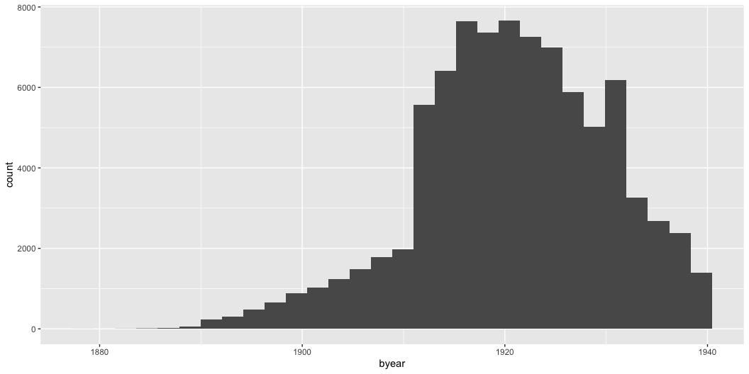
Exercise 3 solutions (cont.)
Make a histogram of the variable byear. When are most people born?
ggplot(data = censoc) +
geom_histogram(aes(x = byear))

Slide 28
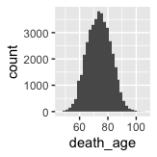
Exercise 3 solutions (cont.)
Recode the variable sex from numeric values (1, 2) to take character values (“men” and “women”). Note that 1 = men, 2 = women.
## recode sex
censoc <- censoc %>%
mutate(sex_recode = case_when(
sex == 1 ~ "men",
sex == 2 ~ "women"
))
## look at first few rows to check our recode worked
censoc %>%
select(sex, sex_recode) %>%
head()
# A tibble: 6 × 2
sex sex_recode
<dbl> <chr>
1 1 men
2 1 men
3 1 men
4 2 women
5 1 men
6 2 women
Exercise 3 solutions (cont.)
Calculate the mean of of death for both men and women using group_by() and summarize(). Do men or women live longer?
censoc %>%
group_by(sex_recode) %>%
summarize(mean(death_age))
# A tibble: 2 × 2
sex_recode `mean(death_age)`
<chr> <dbl>
1 men 73.9
2 women 78.2
Exercise 3 solutions (cont.)
Make a histogram of the variable death_age for both men and women.
censoc_men <- censoc %>% filter(sex_recode == "men")
censoc_women <- censoc %>% filter(sex_recode == "women")
ggplot(data = censoc_men) + ## histogram for men
geom_histogram(aes(x = death_age))

Slide 29
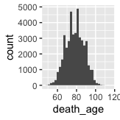
ggplot(data = censoc_women) + ## histogram for women
geom_histogram(aes(x = death_age))

Slide 30
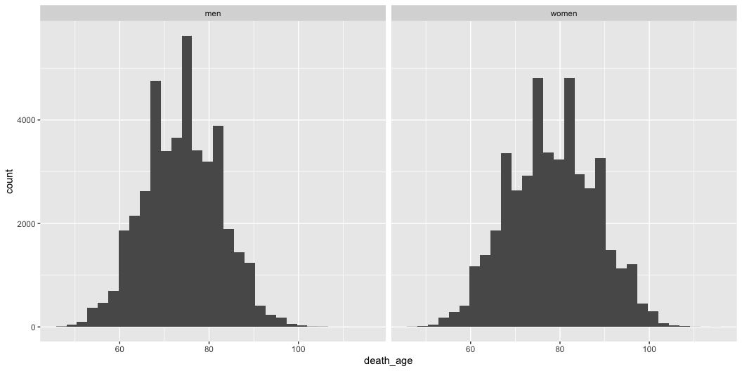
Exercise 3 solutions (cont.)
Now try adding the following line to the histogram you made in question 1: + facet_wrap(~sex)
ggplot(data = censoc) +
geom_histogram(aes(x = death_age)) +
facet_wrap(~sex_recode)

Slide 31
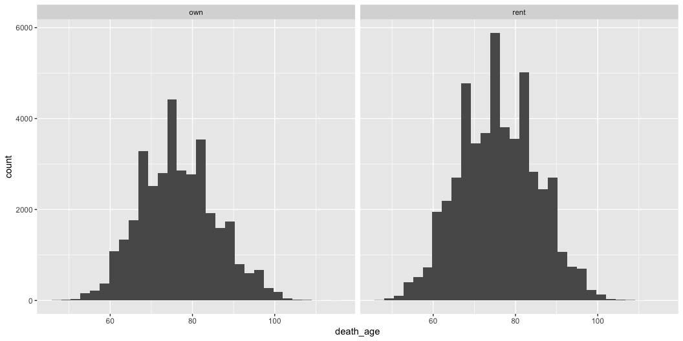
Module 6
Best practices and resources for self-study
Learning objectives
Best practices for writing and documenting code
Where to go when you’re stuck
Resources for learning more
Best practices (opinionated)
Style: use descriptive names and “snake_case”
Documentation: Start commenting your code early, it’s a good habit for the future
Learn tidyverse: offers a more coherent syntax and is widely used in data science
Advanced topics: R Projects, github integration, etc
When you’re stuck
Google
  Lots of packages have documentation available online
  Stack overflow – excellent resource
Use help syntax (e.g., ?dplyr)
GPT (decent, but be careful!)
Resources for learning more
R for data science (https://r4ds.hadley.nz/)
Data visualization: a practical introduction (https://socviz.co/)
In-class exercise 4
Do homeowners in the United States live longer than renters in the United States?
Using the censoc data.frame, create a new data.frame censoc_homeownership that filters out any “missing” value for the ownershp variable (missing = 0). Use the filter() command.
In the censoc_homeownership data.frame, create a new variable homeowner using the mutate() command and the case_when() command. Assign this new variable homeowner a value of “own” if ownershp == 1 and a value of “rent” if ownershp == 2.
Make a histogram on the age of death for “homeowner” and “renter” groups using ggplot using the censoc_homeownership data.frame. Use the + facet_wrap(~homeowner) command.
Calculate the average age of death for “homeowner” and “renter” groups. Which group lives longer, on average? Use the group_by() and summarize() functions. What are some possible explanations for homeowners living longer than renters in the US?
Exercise 4 solution
Do homeowners in the United States live longer than renters in the United States?
Using the censoc data.frame, create a new data.frame censoc_homeownership that filters out any “missing” value for the ownershp variable (missing = 0). Use the filter() command.
censoc_homeownership <- censoc %>%
filter(ownershp != 0)
In the censoc_homeownership data.frame, create a new variable homeowner using the mutate() command and the case_when() command. Assign this new variable homeowner a value of “own” if ownershp == 1 and a value of “rent” if ownershp == 2.
## create new homeowner variable
censoc_homeownership <- censoc_homeownership %>%
mutate(homeowner = case_when(
ownershp == 1 ~ "own",
ownershp == 2 ~ "rent"
))
Exercise 4 solution (cont.)
Make a histogram on the age of death for “homeowner” and “renter” groups using ggplot using the censoc_homeownership data.frame. Use the + facet_wrap(~homeowner) command.
ggplot(data = censoc_homeownership) +
geom_histogram(aes(x = death_age)) +
facet_wrap(~homeowner)

Slide 32
Exercise 4 solution (cont.)
Calculate the average age of death for “homeowner” and “renter” groups. Which group lives longer, on average? Use the group_by() and summarize() functions What are some possible explanations for homeowners living longer than renters in the US?
censoc_homeownership %>%
group_by(homeowner) %>%
summarize(mean(death_age))
# A tibble: 2 × 2
homeowner `mean(death_age)`
<chr> <dbl>
1 own 76.5
2 rent 75.8
Thank you
Course materials available from:
  www.github.com/caseybreen/intro_r
Please independently complete all exercises in problem set 2 (and review solutions)
Questions?

