Slide 1
import arcpy
An intro to Python and
the ArcMap Python Library
Casey Thomas – cpthomas@gmail.com

Slide 2
python
programming language
open source
high-level
inspired by Monty Python

Slide 3

Guido van Roosum
http://en.wikipedia.org/wiki/File:Guido_van_Rossum.jpg

Slide 4
programming
tell the computer what to do
text that gets interpreted as instructions
simple data processing scripts
software, such as ArcMap

Slide 5
open source
free, generally
anyone can view, edit and use
github.com – code repositories
ArcGIS is the opposite of this

Slide 6
high-level
many layers between language and cpu
simple syntax

Slide 7
.py
#sample script
import sys
x = 4
y = 5
z = x + y
print z
>>> 9

Slide 8
.py
# a more complicated sample script
import base64
from PIL import Image
from io import BytesIO
data = "DJHKDFEmn343n\\DHFDFH8348382323"
print “decoding image”
im = Image.open(BytesIO(base64.b64decode(data)))
print “saving image”
im.save('test.jpg','JPEG')

Slide 9
running .py
IDE:
IDLE, PythonWin
Interpreter:
>>> print “hello, world”
>>> “hello, world”

Slide 10
why python?
easy to learn
easy to read
free
powerful

Slide 11
why python?
lots of tools and libraries:
spreadsheets, csv (csvkit)
databases (pyodbc)
images (pil)
web (request, django)
science, engineering (scipy)
math (matplotlib)

Slide 12
ArcMap + python =
arcpy
import arcpy

Slide 13
what can arcpy do?
geoprocessing
map editing
field calculations
automation
you don't even need to open ArcMap!

Slide 14
geoprocessing
toolbox tools are exposed through arcpy
model builder will generate code
for example, intersect roads and streams
import arcpy
from arcpy import env
env.workspace = "c:/data/data.gdb"
in = ["roads", "streams"]
out = "stream_crossings"
arcpy.Intersect_analysis(in,out)

Slide 15
map editing
update labels and symbology
fix and add layers
export pdfs and images
import arcpy
mxd = arcpy.mapping.MapDocument("C:\Project.mxd")
  arcpy.mapping.ExportToJPEG(mxd, "C:\Project.jpg")
del mxd

Slide 16
field calculations
!FieldName!.replace(“One”,”1”)
Pre-logic Script Code
def density(pop,area):
return pop/area
PopDensity =
density(!Sum_pop!,!Area!)

Slide 17
automation
need to make lots of similar maps?
need to update maps on a regular basis?
need to geoprocess hundreds of layers?
write a script. seriously.

Slide 18
you don't even need to open ArcMap!
double-click yourscript.py

Slide 19
However, if you must
write your own toolbox tool
or run code from the command line
(Geoprocessing > Python)

Slide 20
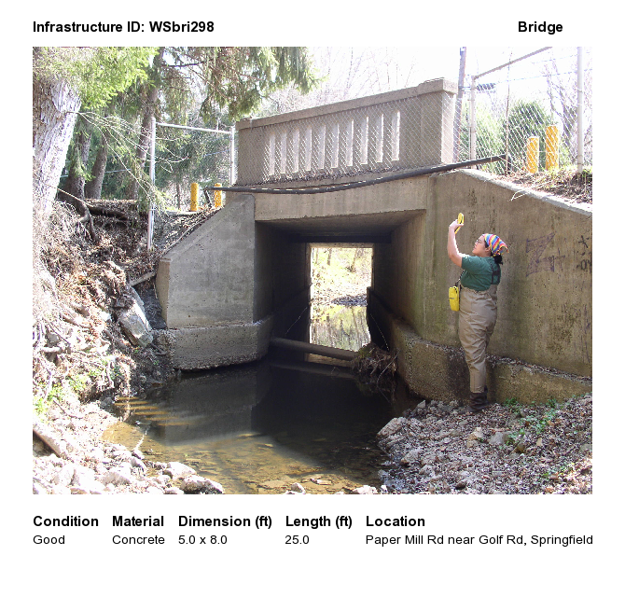
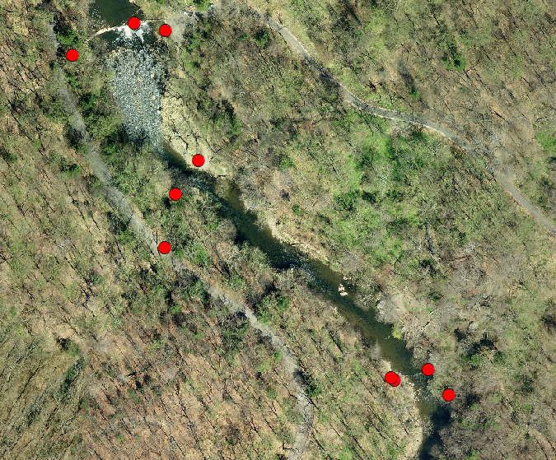
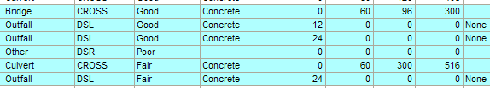
examples

Slide 21
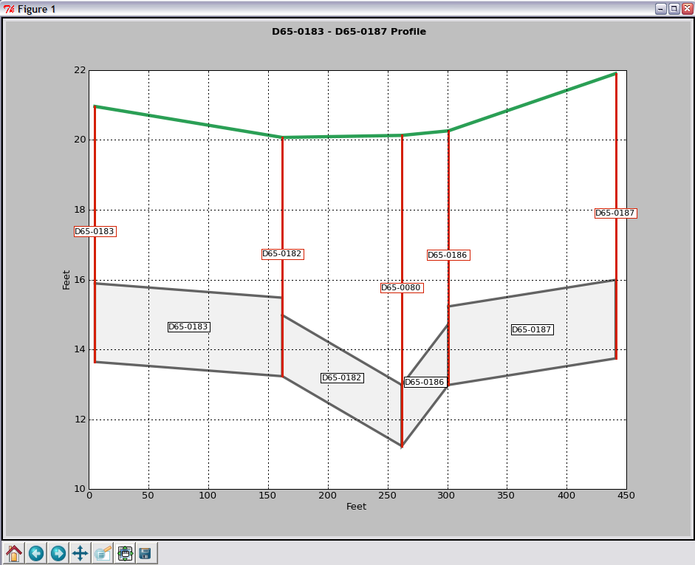
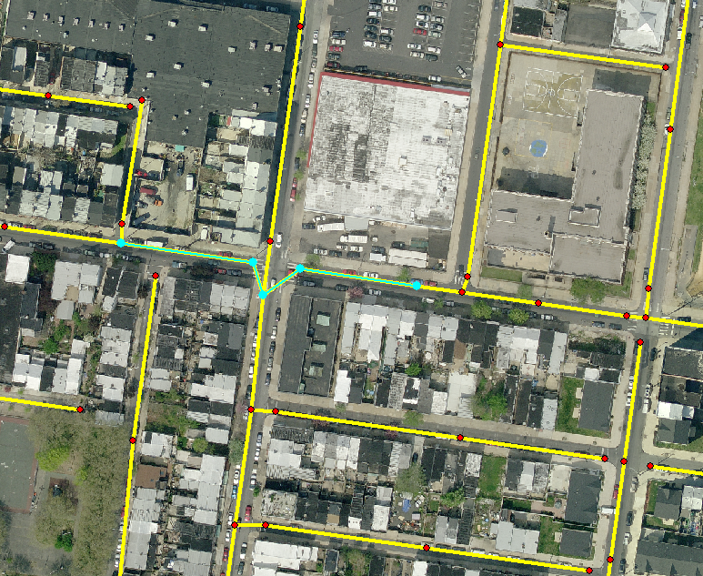
examples

Slide 22
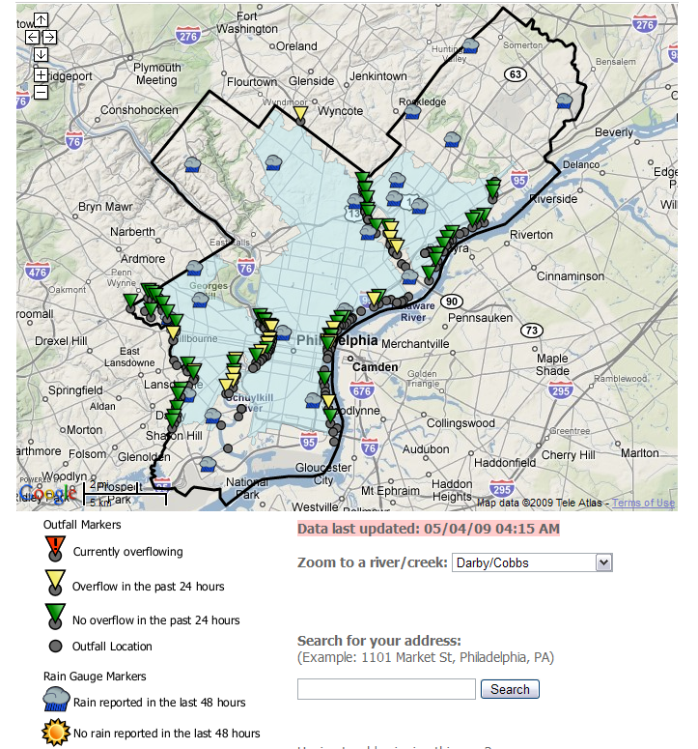
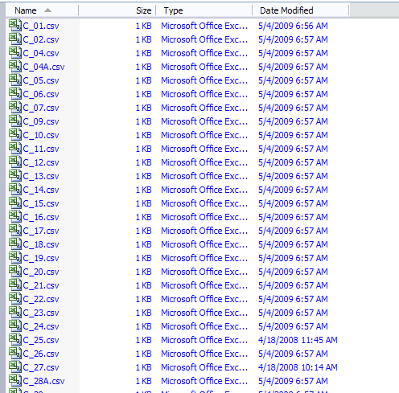

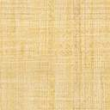
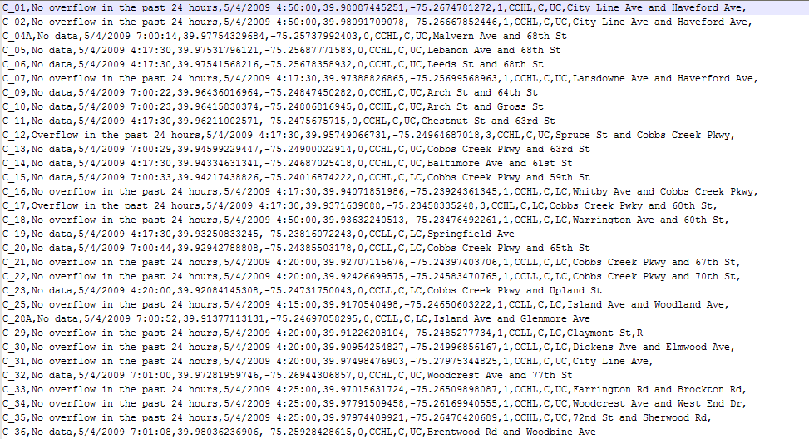
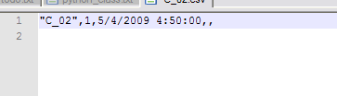
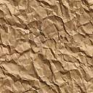
examples
Wet Weather
Downspout
Storm
drain
Sewage and stormwater
Dam
Outfall pipe to creek
Sewer to Water Treatment Plant

Slide 23
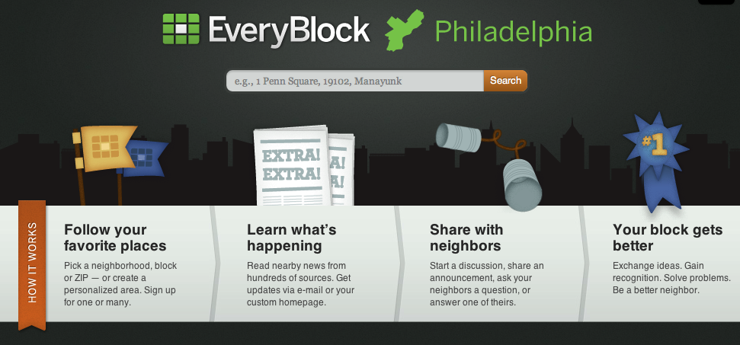
examples

Slide 24

ok, let's code!
http://training.esri.com
Using Python in ArcGIS Desktop
http://training.esri.com/gateway/index.cfm?fa=catalog.webCourseDetail&courseid=1868

Slide 25
open source mapping/GIS
QGIS - http://www.qgis.org/
GRASS - http://grass.fbk.eu/
OpenStreetMap - http://www.openstreetmap.org/
OSGeo - http://www.osgeo.org/

Slide 26
python resources
Homepage – http://www.python.org
Dive Into Python -http://www.diveintopython.net/
Python Cookbook - http://code.activestate.com/recipes/langs/python

