Slide 1
Latent Class Mixed Models in CF Infant Airway Microbiomes
Casey Sakamoto
Notes:
Quick greeting, intro to paper

Slide 2
Cystic Fibrosis (CF)
Hereditary disease which involves production of mucus which is much more viscous than usual
Early airway vulnerability to chronic bacterial infections
Most common life-threatening autosomal recessive disease in US
Affects 1 in 4000 newborns
No known cure
Notes:
Slide Purpose: Background info on CF- what is it, who does it affect
Mucus is difficult to expel from lungs
(3)All newborns (US) screened for CF
(4) Higher rates in some European countries

Slide 3
Cystic Fibrosis (CF) cont.
Subjects have varied disease progression
Unclear whether variability present in early CF airways, or if it develops over time
Identifying endotypes based on airway microbiome community composition may clarify this
Microbiome data complex
Notes:
Slide Purpose: Background info on CF- motivate analysis of the microbiome
Better understanding of early airway infections -> better understand variability of disease progression

Slide 4
Microbiome Data
Requires consideration of location & quantity of samples
Number of samples collected could often be limited
Sequencing of a specimen provides estimate of the relative abundance of different species within a sample
Potential lack of measurement precision provides some difficulty in conclusions drawn
Relative Abundances sum to 1; many standard statistical methods inappropriate here
Notes:
Slide Purpose: Insight into complexity of microbiome data
mention how microorganisms on/in the human body outnumber human cells tenfold, Can be used to identify diff between members of a family, community, or across different popns
Left:
Are our samples representative of our population (true mb comp); could it change based on location of sample (upper vs lower airways)
Limited based on difficulty of collecting the samples (is the procedure invasive? Is Location precision important?)
Right: pearson’s correlation coefficient, ANOVA, linear regression, t-tests

Slide 5
Latent Class Analysis: A “Classy” Take on Microbiome Data
The latent class mixed model is a sub-genre of structural equation modeling
Very similar to cluster analysis
Incorporates a linear mixed model framework into the modeling of unmeasured groups (endotypes) to fit longitudinal data
Notes:
SP: introduce the method & a general connection to the main thesis question
(3) Mention the unmeasured groups are the latent variables, will explain in a bit

Slide 6
Latent Class Analysis: A “Classy” Take on Microbiome Data
Application of Latent Class Analysis methods to microbiome still relatively novel
Especially longitudinal airway microbiome data
Few assumptions on the data; appealing for microbiome data
Normality assumption can be met via compositional transformations
Notes:
Slide purpose: to present LCA as a method of analyzing mb data
Several papers have emphasized the utility of building these models (in tangential areas of interest of the microbiome: true bacterial community composition, identifying phenotypes, Bayesian versions of SEM)
Hasn’t really been any applications applying lcmm to longi mb data (very novel application)
Really, the only main assumption is the outcomes are norm dist

Slide 7
Building a Latent Class Mixed Model: What is a Latent Variable?
Latent Variable: A variable for which there is no sample realization for at least some (sometimes all) observations in a sample
We can’t measure self-esteem (latent), but can use the compiled answers on a questionnaire (Observed r.v.) to glean info about it
If we treat groups/clusters of subjects as a latent variable, we can use the measured composition of their microbiome communities (trajectories) to build these endotypes
Notes:
SP: define latent variables, introduce idea of using lv to build endotypes
Undefined endotypes are the groups clusters

Slide 8
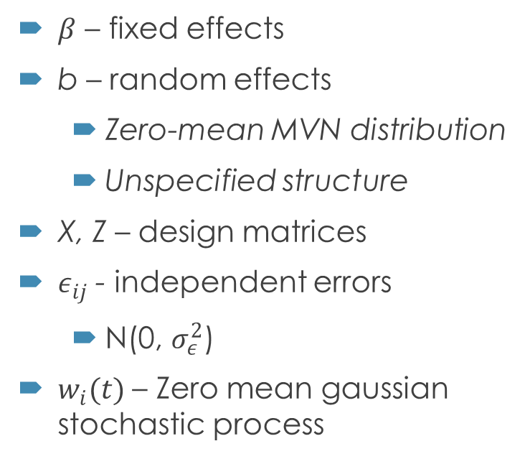
Building a Latent Class Mixed Model: Linear Mixed Model recap
$β$ – fixed effects
b – random effects
Zero-mean MVN distribution
Unspecified structure
X, Z – design matrices
$ε_{ij}$ - independent errors
N(0, $σ_{ε}^{2}$)
$w_{i}(t)$ – Zero mean gaussian stochastic process
Assume normally distributed measurement errors, random effects, correlated errors
Assume constant covariate effects across time
Notes:
SP: recap LMM
For subject i, repeated measure j
Design matrix trajectory shapes can be of any type (polynomial, specifically designed to the fit, spline methods)
w(t) ZM gaussian stoch process or stationary process w parameter $σ_{w}^{2}$; included in semiparametric lmm, used to model serial correlation

Slide 9
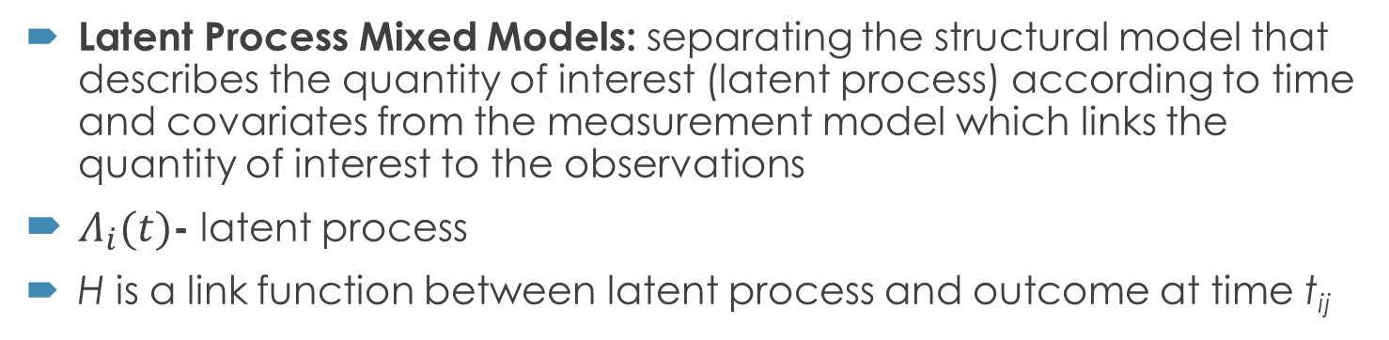
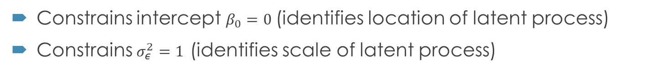
Building a Latent Class Mixed Model: Latent Process Mixed Model
Latent Process Mixed Models: separating the structural model that describes the quantity of interest (latent process) according to time and covariates from the measurement model which links the quantity of interest to the observations
$Λ_{i}(t)$- latent process
H is a link function between latent process and outcome at time t_{ij}
Constrains intercept $β_{0}=0$(identifies location of latent process)
Constrains $σ_{ε}^{2}=1$ (identifies scale of latent process)
Notes:
SP: introduce a latent model
Latent process- standard lmm w/o error
Several options for H in package lcmm, but we are going to opt for a compositional transform on the outcome instead

Slide 10

Building a Latent Class Mixed Model: Latent Process Mixed Model
Extended to Multivariate case with K longitudinal markers (such as bacterial taxa)
Similar constraints as in univariate case
Also requires a random intercept
Notes:
SP: multivariate case
Requires random intercept, because the dimension of the latent process constrained by intercept (B0=0) and variance of random intercept rather than se of a marker specific standard error

Slide 11
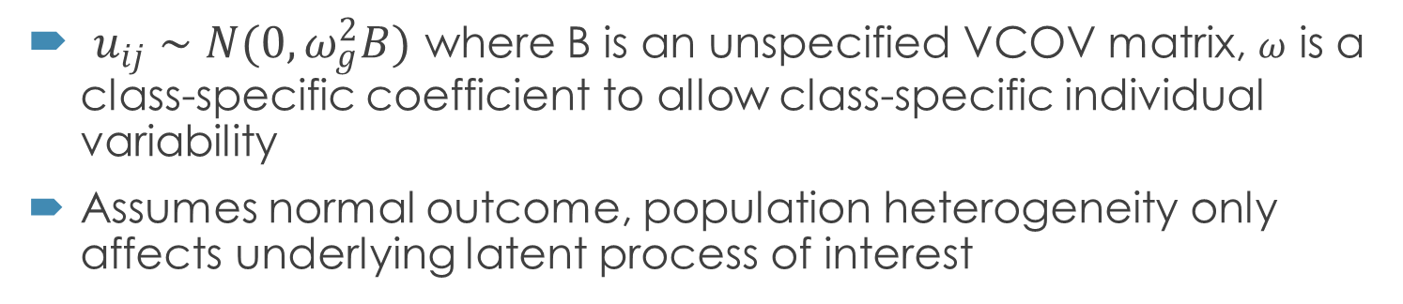
Building a Latent Class Mixed Model: Latent Class Mixed Model
Assume a heterogenous population with G latent classes of subjects (each subject belongs to one class)
C_{i} is a discrete random variable; P(C_{i} = g) is class-specific probability
$u_{ij}∼N(0,ω_{g}^{2}B)$ where B is an unspecified VCOV matrix, $ω$ is a class-specific coefficient to allow class-specific individual variability
Assumes normal outcome, population heterogeneity only affects underlying latent process of interest
Notes:
SP introduce the method to be used in the thesis
Linear mixed model for a normal outcome Yij in class g
This is extended to a latent process model

Slide 12


Building a Latent Class Mixed Model: Parameter Estimation
Individual contribution to the likelihood of LCMM:
Fixed effects, Random effects, Variance of random process, variance of errors, P(c = g), $ω$ all need to be estimated
Package lcmm maximizes log-likelihood using extended Marquadt algorithm with conservative convergence criteria
Notes:
SP: define parameters estimated, how they are estimated, likelihood form
Marquadt algorithm in family of newton Raphson
Convergence of log lik based on 3 criteria: stability of log lik, stability of parameters, size of derivatives (important we have three because some likelihood shapes can be quite flat in certain areas of param space)

Slide 13
Motivating Example: BONUS Study
Goetz et al. (2019)
231 CF infants within 28 US centers in Baby Observational and Nutritional Study (BONUS)
1053 throat swabs from 205 infants, most had around 4-6 samples
Relatively low number of taxa within samples
Age (months) measured both cts and “rounded”
194 infants (84%) developed a CF specific pathogen
Notes:
Sp: introduce dataset we’ll be working w/

Slide 14
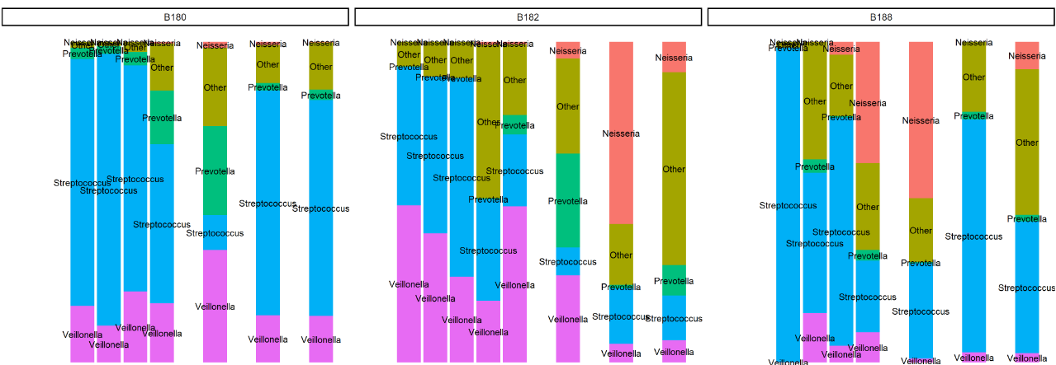
3 subjects from BONUS study
“consistent Veillonella pattern in subject B180 vs “decreasing” pattern in B182
Different trajectories within subjects of genus groups could indicate presence of latent classes
Notes:
Sp: show some trajectories are different; maybe they could be classified into endotypes from to these trajectories
Mention here they were grouped into 5 groups: Veillonella, streptococcus, Prevotella, Neisseria, and other at “genus” level → non specified genus were in other

Slide 15
Thesis Questions
Identify Airway microbiome endotypes in infants with CF
How many latent classes are there; can we build these classes using Latent Class Analysis
When we build these classes what covariates are associated with our clusters?
[Optional] How does the Latent Class model compare with 2-stage models
Notes:
SP: present proposed thesis
1- in brandies work there were 4 clusters from random forest analysis
2- building these classes we will start with just age in our model
3- if clinical findings are not interesting for 1, 2

Slide 16
Methods
Build a multivariate latent class mixed model to identify endotypes
Groups of subjects (classes/ endotypes) are latent variables
use the measured microbiome compositions (trajectories) to build these endotypes
Notes:
Sp: present methods for analysis
With latent class mixed model analysis we will be able to incorporate longitudinal mb data to build the endotypes (thesis q1) and also adjust for covariates (q2)
Lcmm package can do all of the heavy lifting in R

Slide 17

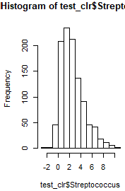
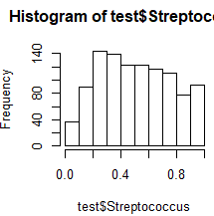
Proposed Analysis: Data Manipulation
Split the sample data into groups
Normalize outcomes:
Centered Logratio Transformation:
Isometric Logratio Transformation:
The transformation method may depend on the groups we select;
1: 5 groups CLR 2: 4 groups CLR
Notes:
SP: talk about data manipulation for the analysis plan
1 Streptococcus, Veillonella, Neisseria, Prevotella had the highest total sequence counts out of all the samples combined. “other” group also could be considered
2: CLR (subtract log of x from log geom mean) more simple to compute & interpret; resulting parts sum to 0 (could lead to singularity issues (might not be a problem if we don’t use all parts of composition)
3: ILR (mult CLR with an orthonormal basis of the clr plane) doesn’t run into singularity issues of CLR, but maps D parts into d-1 parts where there is no 1-1 relnship between original parts; less interpretable (might not be a problem if we can back track to original sample compositions)

Slide 18
Proposed Analysis: Model Selection
Primary models with only age:
Simple form for age (linear/ small order polynomial) used
Random intercept for subjects
Models with different numbers of latent classes (1-10) will be fit
Model with optimal number of latent classes (# endotypes characterized) selected with Bayes Information Criterion
Once this model is selected, secondary models will be fit to assess covariate associations
Notes:
SP: describe primary model fit & selection
Havent talked about which covariates to look at yet for 2nd models

Slide 19
Potential Output/ Results
Table 1: describe data
Table describing models fit, BIC, # parameters estimated
Posterior probability
Plot of trajectories of latent classes for each outcome
Stacked barcharts
Table of associations between covariate and outcome for second thesis question
Plotted Residuals to assess normality assumption
Notes:
SP potential output
Table2: illustrate how we chose model and compared to others
Included in lcmm is the postprob function which classifiesthe subjects into the latent classes for which they have the highest posterior class-membership probability- high prob in one class = good fit, low ambiguity

Slide 20
Timeline Goals
Analysis Done: June 23-June 25
Paper Written: July 7-9 (~2 weeks)
Defense done: Mid-Late July?

Slide 21
Works Cited
Aitchison, J. (1982). The Statistical Analysis of Compositional Data. Journal of the Royal Statistical Society. Series B (Methodological), 44(2), 139–177. JSTOR.
Bacharier, L. B., Beigelman, A., Calatroni, A., Jackson, D. J., Gergen, P. J., O’Connor, G. T., Kattan, M., Wood, R. A., Sandel, M. T., Lynch, S. V., Fujimura, K. E., Fadrosh, D. W., Santee, C. A., Boushey, H., Visness, C. M., Gern, J. E., & NIAID sponsored Inner-City Asthma Consortium. (2019). Longitudinal Phenotypes of Respiratory Health in a High-Risk Urban Birth Cohort. American Journal of Respiratory and Critical Care Medicine, 199(1), 71–82. https://doi.org/10.1164/rccm.201801-0190OC
Cystic Fibrosis Trust. (n.d.). Symptoms of cystic fibrosis. Lungs and Cystic Fibrosis. https://www.cysticfibrosis.org.uk/what-is-cystic-fibrosis/how-does-cystic-fibrosis-affect-the-body/symptoms-of-cystic-fibrosis/lungs
Farrell, P. M., White, T. B., Ren, C. L., Hempstead, S. E., Accurso, F., Derichs, N., Howenstine, M., McColley, S. A., Rock, M., Rosenfeld, M., Sermet-Gaudelus, I., Southern, K. W., Marshall, B. C., & Sosnay, P. R. (2017). Diagnosis of Cystic Fibrosis: Consensus Guidelines from the Cystic Fibrosis Foundation. The Journal of Pediatrics, 181, S4-S15.e1. https://doi.org/10.1016/j.jpeds.2016.09.064
Goetz, D., Kopp, B. T., Salvator, A., Moore‐Clingenpeel, M., McCoy, K., Leung, D. H., Kloster, M., Ramsey, B. R., Heltshe, S. H., & Borowitz, D. (2019). Pulmonary findings in infants with cystic fibrosis during the first year of life: Results from the Baby Observational and Nutrition Study (BONUS) cohort study. Pediatric Pulmonology, 54(5), 581–586. https://doi.org/10.1002/ppul.24261
Hoppe, J. E., Wagner, B. D., Accurso, F. J., Zemanick, E. T., & Sagel, S. D. (2018). Characteristics and outcomes of oral antibiotic treated pulmonary exacerbations in children with cystic fibrosis. Journal of Cystic Fibrosis, 17(6), 760–768. https://doi.org/10.1016/j.jcf.2018.05.015
Lee, E., Lee, S. H., Kwon, J.-W., Kim, Y.-H., Yoon, J., Cho, H.-J., Yang, S.-I., Jung, Y.-H., Kim, H. Y., Seo, J.-H., Kim, H. B., Lee, S. Y., Kwon, H.-J., & Hong, S.-J. (2017). Persistent asthma phenotype related with late-onset, high atopy, and low socioeconomic status in school-aged Korean children. BMC Pulmonary Medicine, 17(1), 45. https://doi.org/10.1186/s12890-017-0387-5
Mandal, S., Van Treuren, W., White, R. A., Eggesbø, M., Knight, R., & Peddada, S. D. (2015). Analysis of composition of microbiomes: A novel method for studying microbial composition. Microbial Ecology in Health & Disease, 26(0). https://doi.org/10.3402/mehd.v26.27663
Proust-Lima, C., Philipps, V., & Liquet, B. (2017). Estimation of Extended Mixed Models Using Latent Classes and Latent Processes: The R Package lcmm. Journal of Statistical Software, 78(2). https://doi.org/10.18637/jss.v078.i02
Son, J. S., Zheng, L. J., Rowehl, L. M., Tian, X., Zhang, Y., Zhu, W., Litcher-Kelly, L., Gadow, K. D., Gathungu, G., Robertson, C. E., Ir, D., Frank, D. N., & Li, E. (2015). Comparison of Fecal Microbiota in Children with Autism Spectrum Disorders and Neurotypical Siblings in the Simons Simplex Collection. PLOS ONE, 10(10), e0137725. https://doi.org/10.1371/journal.pone.0137725
Taddé, B. O., Jacqmin‐Gadda, H., Dartigues, J., Commenges, D., & Proust‐Lima, C. (2019). Dynamic modeling of multivariate dimensions and their temporal relationships using latent processes: Application to Alzheimer’s disease. Biometrics, biom.13168. https://doi.org/10.1111/biom.13168
Turnbaugh, P. J., Ley, R. E., Hamady, M., Fraser-Liggett, C. M., Knight, R., & Gordon, J. I. (2007). The Human Microbiome Project. Nature, 449(7164), 804–810. https://doi.org/10.1038/nature06244
Xu, L., Paterson, A. D., & Xu, W. (2017). Bayesian latent variable models for hierarchical clustered count outcomes with repeated measures in microbiome studies: Xu et al. Genetic Epidemiology, 41(3), 221–232. https://doi.org/10.1002/gepi.22031

