Slide 1
11-12: The First-Order Logic
CSCI 561 Foundation for Artificial Intelligence
Professor Wei-Min Shen
University of Southern California

Slide 2
Review: Logic and Reasoning
Knowledge Base (KB): contains a set of sentences expressed using a knowledge representation language
TELL: operator to add a sentence to the KB
ASK: to query the KB
Logics are KRLs where conclusions can be drawn
Syntax
Semantics
Entailment: KB |= α iff α is true in all worlds where KB is true
Inference: KB |–_{i} α = sentence α can be derived from KB using procedure i
Sound: whenever KB |–_{i} α, then KB |= α is true
Complete: whenever KB |= α, then KB |–_{i} α
Notes:
Confused by entailment and inference, the symbol |=

Slide 3
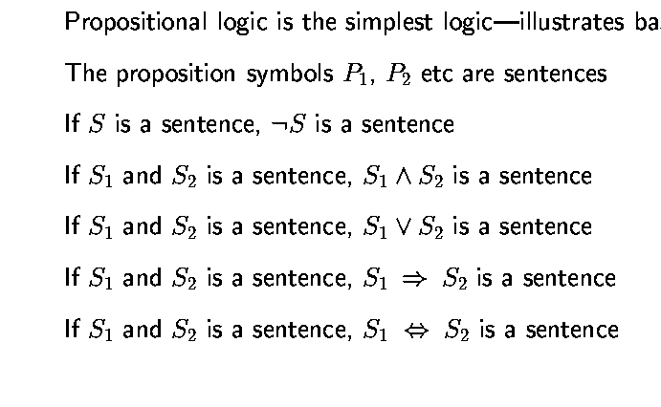
Last Time: Syntax of propositional logic

Slide 4
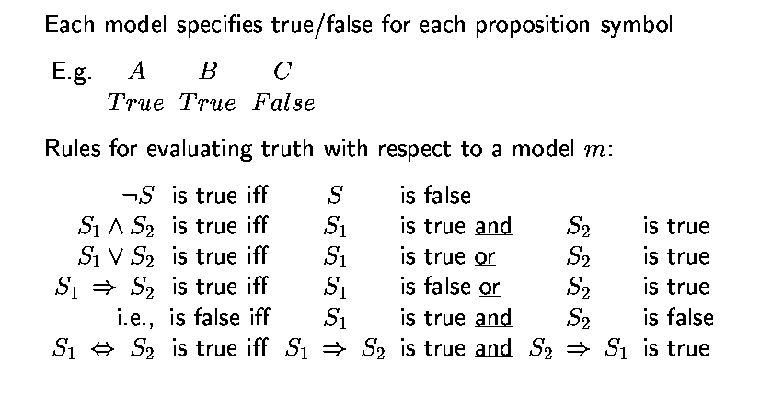
Last Time: Semantics of Propositional logic

Slide 5
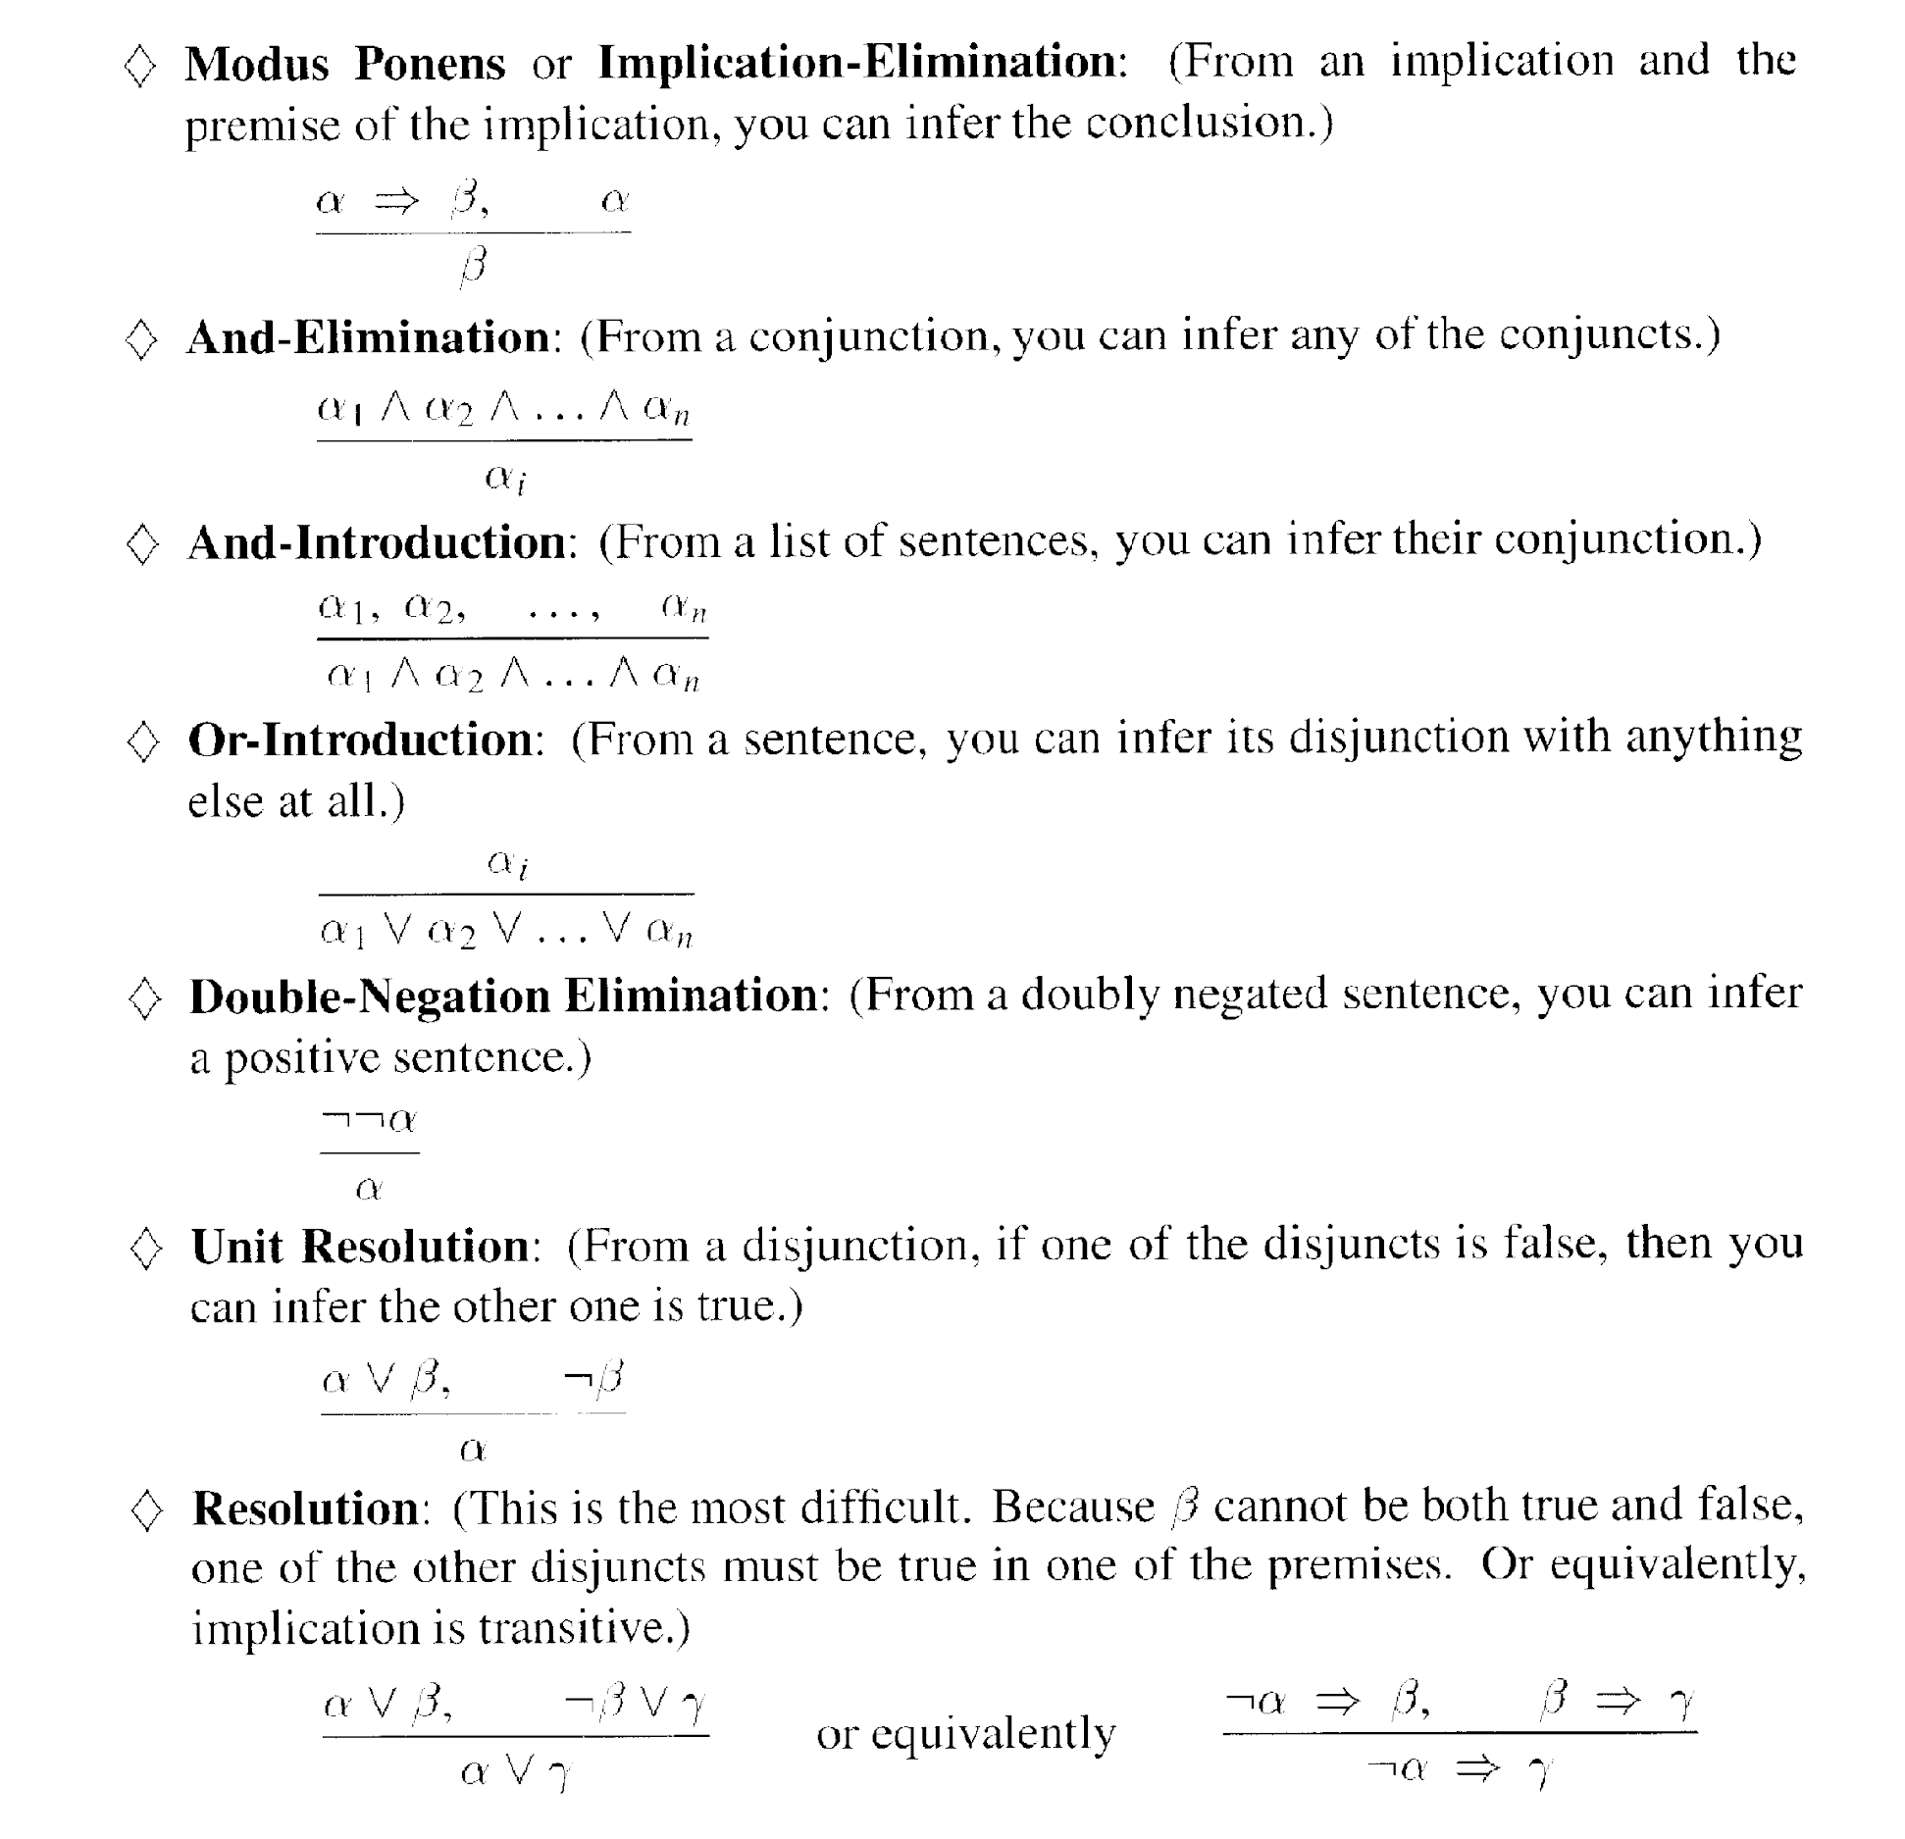
Last Time: Inference rules for propositional logic
Notes:
“Should be easy to memorize” – know these

Slide 6
This time
First-order logic
Syntax
Semantics
Wumpus world example
Ontology (ont = ‘to be’; logica = ‘word’): kinds of things one can talk about in the language

Slide 7
Why first-order logic?
We saw that propositional logic is limited because it only makes the ontological commitment that the world consists of facts.
Difficult to represent even simple worlds like the Wumpus world:
e.g.,
“don’t go forward if the Wumpus is in front of you” takes 64 rules

Slide 8
First-order logic (FOL)
Ontological commitments:
Objects: wheel, door, body, engine, seat, car, passenger, driver
Relations: Inside(car, passenger), Beside(driver, passenger)
Functions: ColorOf(car)
Properties: Color(car), IsOpen(door), IsOn(engine)
Differences between Functions and Relations
Relations return True/False
Functions return an object
Notes:
Predicate always return true or false (relations)
Function is a mapping of object to object
How do we know if a statement is using a function or relation?

Slide 9
Semantics
There is a correspondence between
functions, which return values (objects)
predicates, which are true or false
Function: fatherOf( Mary ) = Bill
Predicate: fatherOf( Mary, Bill ) [true or false]
Notes:
more formally, this is how build interpretation of whole from interpretation of parts.
predicate and relation used interchangeably; here predicate is the formal symbol and relation the real world relation
give example of tuples for functions and relations (e.g. son-of, son)

Slide 10
Examples:
“One plus two equals three”
Objects: One, two three
Relations: Equals
Properties:
Functions: Plus
“Squares neighboring the Wumpus are smelly”
Objects: Squares & Wumpus(?)
Relations: Neighboring
Properties: Smelly
Functions: Could be neighboring

Slide 11
Examples:
“One plus two equals three”
Objects: one, two, three, one plus two
Relations: equals
Properties: --
Functions: plus (“one plus two” is the name of the object obtained by applying function plus to one and two;
three is another name for this object)
“Squares neighboring the Wumpus are smelly”
Objects: Wumpus, square
Relations: neighboring
Properties: smelly
Functions: --

Slide 12
FOL: Syntax of basic elements
Constant symbols: 1, 5, A, B, USC, JPL, Alex, Manos, …
Predicate symbols: >, Friend, Student, Colleague, …
Function symbols: +, sqrt, SchoolOf, TeacherOf, ClassOf, …
Variables: x, y, z, next, first, last, …
Connectives: ∧, ∨, ⇒ (implies), ⇔ (equals)
Quantifiers: ∀ (for all), ∃ (exists)
Equality: =

Slide 13
FOL: Atomic sentences
AtomicSentence → Predicate(Term, …) | Term = Term
Term → Function(Term, …) | Constant | Variable
Examples:
SchoolOf(Manos)
Colleague(TeacherOf(Alex), TeacherOf(Manos))
>((+ x y), x)

Slide 14
FOL: Complex sentences
Sentence → AtomicSentence | Sentence Connective Sentence | Quantifier Variable, … Sentence | ¬ Sentence | (Sentence)
Examples:
S1 ∧ S2, S1 ∨ S2, (S1 ∧ S2) ∨ S3, S1 ⇒ S2, S1⇔ S3
Colleague(Paolo, Maja) ⇒ Colleague(Maja, Paolo) Student(Alex, Paolo) ⇒ Teacher(Paolo, Alex)

Slide 15
Semantics of atomic sentences
Sentences in FOL are interpreted with respect to a model
Model contains objects and relations among them
Terms: refer to objects (e.g., Door, Alex, StudentOf(Paolo))
Constant symbols: refer to objects
Predicate symbols: refer to relations
Function symbols: refer to functions
An atomic sentence predicate(term₁, …, term_{n}) is true iff the relation referred to by predicate holds between the objects referred to by term₁, …, term_{n}

Slide 16
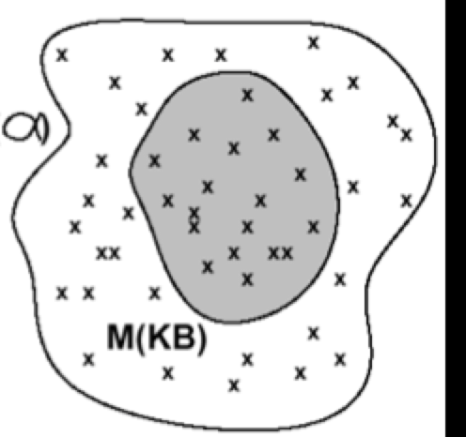
Logic (mind) and Models (real worlds)
Real Worlds
Models
Mind
ΚΒ
α
Μ(α)
“The semantic wall”

Slide 17
Logic Representation of the Real World
Symbol Systems The Real World
Objects:
+BLOCKA+
+BLOCKB+
+BLOCKC+
……
Relations:
ON ( +BLOCKA+ +BLOCKB+)
IS_RED (+BLOCKA+)
……
“Knowledge Base”
“Robot Brain”
“The semantic wall”
Notes:
Syntax: says what is allowed on the LHS
Semantics: says how what is on the LHS relates to what is on the RHS
Inference: says how you can manipulate (formally, i.e., with no reference to the RHS) the symbols. [remember PSSH]
Want to be able to trust the results: want whatever the inference procedure does to “respect” what’s true or what follows in the world. So this is where we’re headed; good to keep in mind as we go through all the definitions now to follow. There is a method in this madness...
algebra example (put on board): but don’t use “entails” instead convey the idea
> n m: is this true or false? don’t know
if n=3, m=5, and > has its usual meaning, then (>n m) is false
(> n m) and (> m p) entail (n p)

Slide 18
Example model
Objects: John, James, Marry, Alex, Dan, Joe, Anne, Rich
Relation: sets of tuples of objects {<John, James>, <Marry, Alex>, <Marry, James>, …} {<Dan, Joe>, <Anne, Marry>, <Marry, Joe>, …}
E.g.: Parent relation -- {<John, James>, <Marry, Alex>, <Marry, James>} then the predicate Parent(John, James) is true the predicate Parent(John, Marry) is false
Mind

Slide 19
Quantifiers
Expressing sentences about collections of objects without enumeration (naming individuals)
E.g., All Trojans are clever Someone in the class is sleeping
Universal quantification (for all): ∀
Existential quantification (there exists): ∃

Slide 20
Universal quantification (for all): ∀
∀ <variables> <sentence>
“Everyone in the CS561 class is smart”: ∀ x In(x, CS561) ⇒ Smart(x)
∀ P corresponds to the conjunction of instantiations of P (In(Manos, CS561) ⇒ Smart(Manos)) ∧ (In(Dan, CS561) ⇒ Smart(Dan)) ∧ … (In(Bush, CS561) ⇒ Smart(Bush))

Slide 21
Universal quantification (for all): ∀
⇒ is a natural connective to use with ∀
Common mistake: to use ∧ in conjunction with ∀ e.g.: ∀ x In(x, CS561) ∧ Smart(x) means “everyone is in CS561 and everyone is smart”

Slide 22
Existential quantification (there exists): ∃
∃ <variables> <sentence>
“Someone in the CS561 class is smart”: ∃ x In(x, CS561) ∧ Smart(x)
∃ P corresponds to the disjunction of instantiations of P (In(Manos, CS561) ∧ Smart(Manos)) ∨ (In(Dan, CS561) ∧ Smart(Dan)) ∨ … (In(Bush, CS561) ∧ Smart(Bush))

Slide 23
Existential quantification (there exists): ∃
∧ is a natural connective to use with ∃
Common mistake: to use ⇒ in conjunction with ∃ e.g: ∃ x In(x, CS561) ⇒ Smart(x) is true if there is anyone that is not in CS561! // ~In(x,CS561) ∨ Smart(x)
remember:
false ⇒ true is valid
P=>Q is the same as ~P ∨ Q

Slide 24
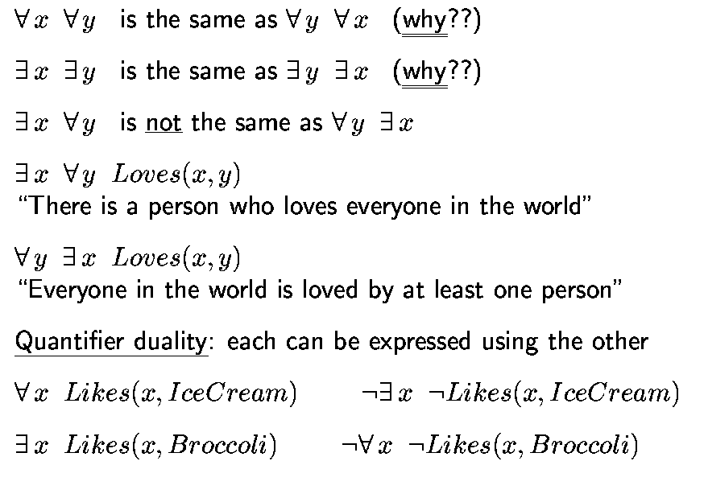
Properties of quantifiers
Not “all loved by one person” but “each is loved by at least one”
Proof?

Slide 25
Proof
Variable: x
Constants: X₁, X₂, … X_{n}
In general, we want to prove:
∀ x P(x) ⬄ ¬∃ x ¬P(x)
∀ x P(x) = ¬(¬(∀ x P(x))) = ¬(¬(P(X₁) ^ P(X₂) ^ … ^ P(X_{n})) ) = ¬(¬P(X₁) v ¬P(X₂) v … v ¬P(X_{n})) )
∃ x ¬P(x) = ¬P(X₁) v ¬P(X₂) v … v ¬P(X_{n})
¬∃ x ¬P(x) = ¬(¬P(X₁) v ¬P(X₂) v … v ¬P(X_{n}))

Slide 26
Example sentences
Brothers are siblings .
Sibling is transitive .
One’s mother is one’s sibling’s mother .
A first cousin is a child of a parent’s sibling .
Notes:
Practice these vy writing out the sentences in FOL

Slide 27
Example sentences
Brothers are siblings ∀ x, y Brother(x, y) ⇒ Sibling(x, y)
Sibling is transitive ∀ x, y, z Sibling(x, y) ∧ Sibling(y, z) ⇒ Sibling(x, z)
One’s mother is one’s sibling’s mother ∀ m, c, d Mother(m, c) ∧ Sibling(c, d) ⇒ Mother(m, d)
A first cousin is a child of a parent’s sibling ∀ c, d FirstCousin(c, d) ⇔ ∃ p, ps Parent(p, d) ∧ Sibling(p, ps) ∧ Child(c, ps)

Slide 28
Example sentences
One’s mother is one’s sibling’s mother ∀ m, c, d Mother(m, c) ∧ Sibling(c, d) ⇒ Mother(m, d)
∀ c, d ∃m Mother(m, c) ∧ Sibling(c, d) ⇒ Mother(m, d)
m
c
Mother of
d
sibling

Slide 29
Translating English to FOL
Every gardener likes the sun.
∀ x gardener(x) => likes(x,Sun)
You can fool some of the people all of the time.
∃ x ∀ t (person(x) ^ time(t)) => can-fool(x,t)
Notes:
Sun is a constant, x is a variable

Slide 30
Translating English to FOL
You can fool all of the people some of the time.
∀x (person(x) => ∃t (time(t) ^ can-fool(x,t)))
All purple mushrooms are poisonous.
∀x (mushroom(x) ^ purple(x) => poisonous(x))

Slide 31
Caution with nested quantifiers
∀x ∃y P(x,y) is the same as ∀x (∃y P(x,y)) which means “for every x, it is true that there exists y such that P(x,y)”
∃y ∀x P(x,y) is the same as ∃y (∀x P(x,y)) which means “there exists a y, such that it is true that for every x P(x,y)”

Slide 32
Translating English to FOL…
No purple mushroom is poisonous.
¬ ∃x ( purple(x) ^ mushroom(x) ^ poisonous(x))
or, equivalently,
∀x ((mushroom(x) ^ purple(x)) => ¬poisonous(x))

Slide 33
Translating English to FOL…
There are exactly two purple mushrooms.
∃x ∃y mushroom(x) ^ purple(x) ^ mushroom(y) ^ purple(y) ^ ¬(x=y) ^ ∀z((mushroom(z)^purple(z))=>((x=z) v (y=z)))
Deb is not tall.
¬tall(Deb)

Slide 34
Translating English to FOL…
X is above Y iff X is directly on top of Y or else there is a pile of one or more other objects directly on top of one another starting with X and ending with Y.
(∀ x)(∀ y) above(x,y) <=> (on(x,y) v (∃ z) (on(x,z) ^ above(z,y)))

Slide 35
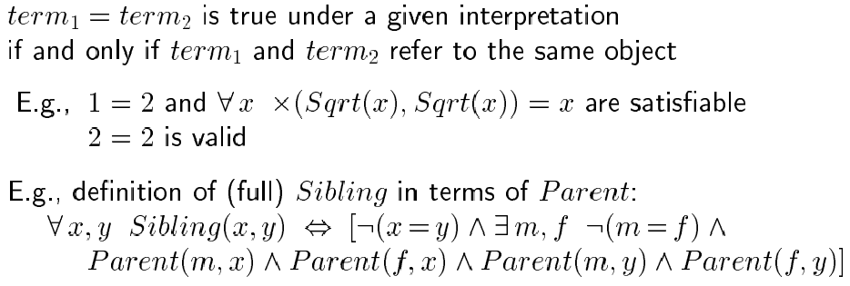
Equality

Slide 36
Higher-Order Logic?
First-order logic allows us to quantify over objects (= the first-order entities that exist in the world)
Higher-order logic also allows quantification over relations and functions.
e.g., “two objects are equal iff all properties applied to them are equivalent”:
∀ x,y (x=y) ⇔ (∀ p, p(x) ⇔ p(y))
Higher-order logics are more expressive than first-order; however, so far we have little understanding on how to effectively reason with sentences in higher-order logic

Slide 37
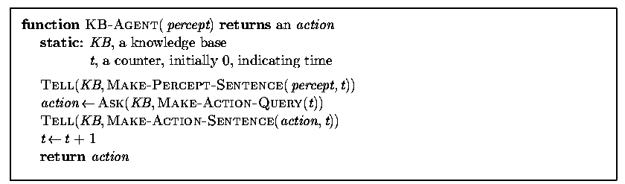
Logical Agents for the Wumpus World
Remember: generic knowledge-based agent:
TELL KB what was perceived Uses a KRL to insert new sentences, representations of facts, into KB
ASK KB what to do Uses logical reasoning to examine actions and select the best

Slide 38
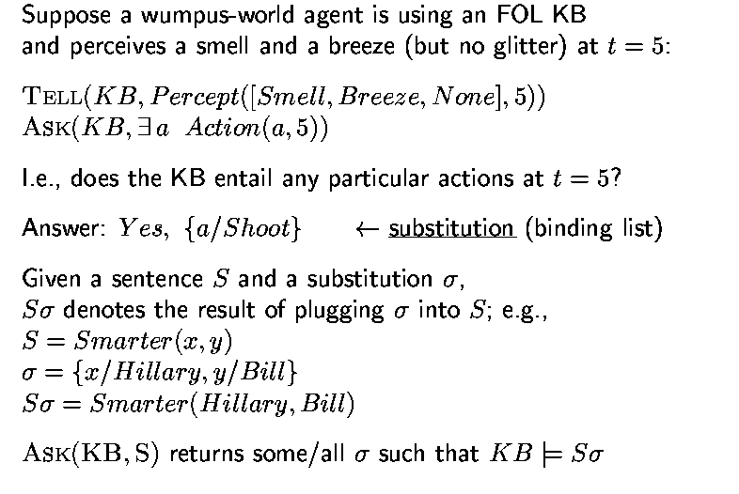
Using the FOL Knowledge Base
// set of solutions
Notes:
Review the second half Ssigma

Slide 39
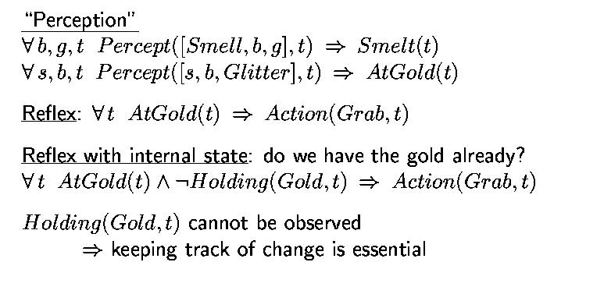
Wumpus World, FOL Knowledge Base

Slide 40
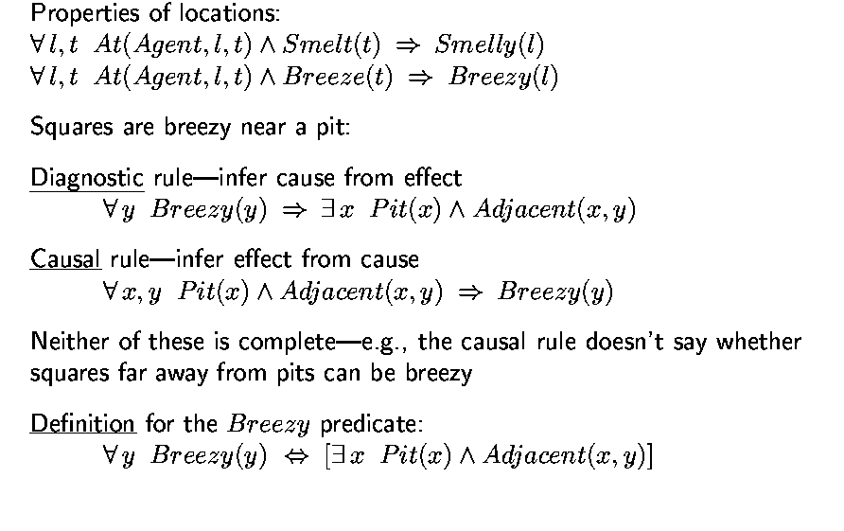
Deducing Hidden Properties

Slide 41
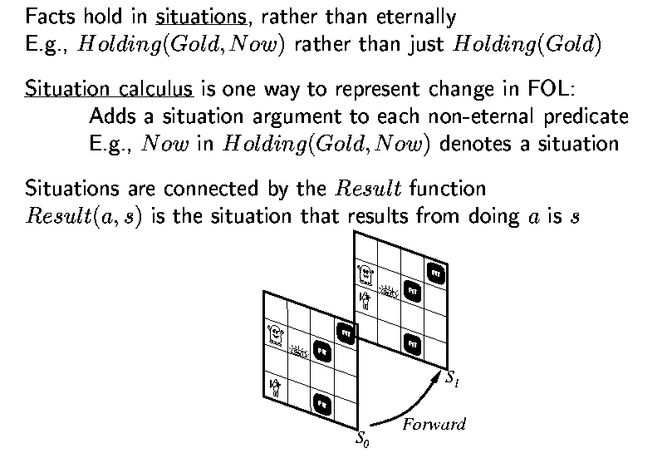
Situation Calculus
in

Slide 42
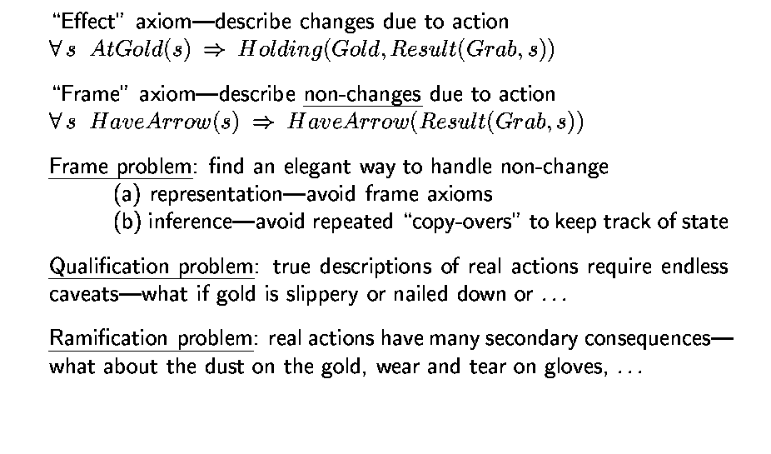
Describing Actions (in Situation Calculus)
// May result in too many frame axioms
Challenges

Slide 43
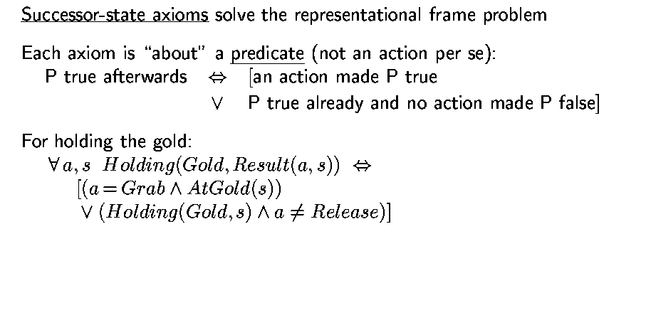
Describing Actions (cont’d)
Notes:
What is axiom?

Slide 44
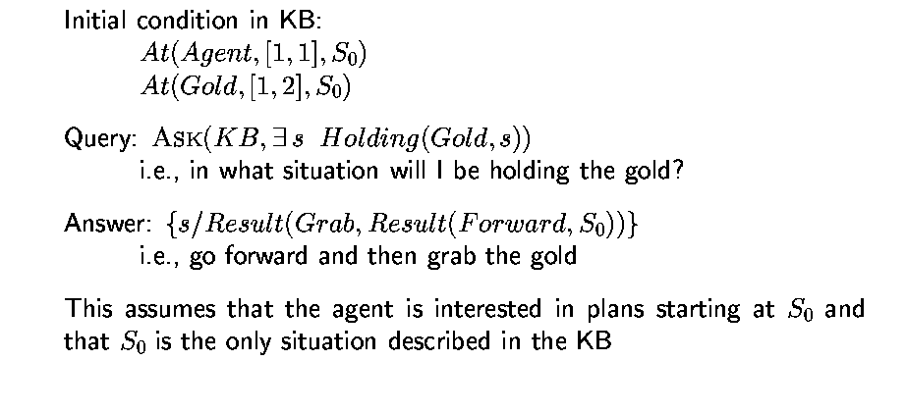
Planning (by Situation Calculus)

Slide 45
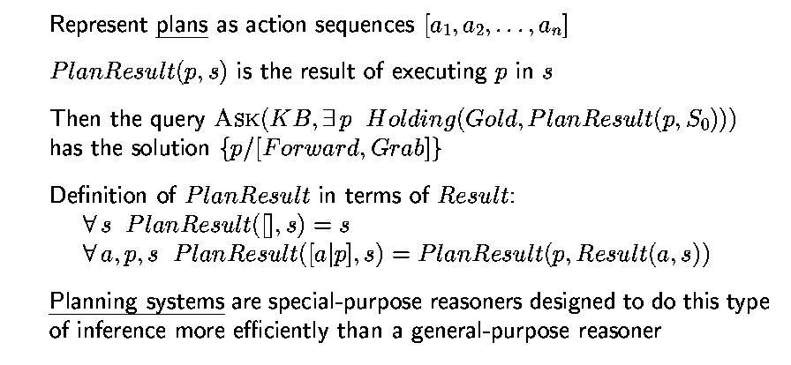
Generating Action Sequences
[ ] = empty plan
Recursively continue until it gets to empty plan [ ]
Notes:
Review this

Slide 46
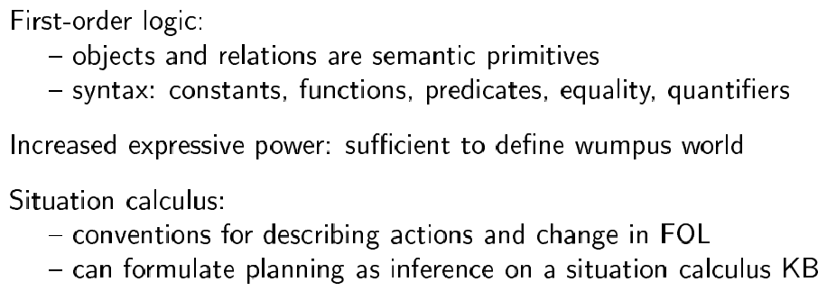
Summary

