Slide 1
Discussion Section (Week 5) Midterm-1 Review
CSCI 561 - Foundation for Artificial Intelligence
PROF WEI-MIN SHEN WMSHEN@USC.EDU

Slide 2
Material covered by midterm1
Covers everything studied in class up to and including CSP and RL (not include “logic”)
Lectures vs book: what to know?
- If something is covered both in the book and the slides of lecture/discussion: use the slides.
- If something is covered in the book only and was not covered at all in the lecture/discussions: you do not need to know it.
- If something is covered in the book and in the slides of lecture/discussion but with additional details provided in the book: you need to know both, and use the slides for the overlapping parts.

Slide 3
Midterm 1 Instructions:
Sep 28, 2022, 5-6:50PM, join your Zoom meeting
Maximum credits/points for this midterm: 100 points
Credits/points for each question is indicated on the question
Closed book
No books or any other material are allowed
Please practice in your sample exam sessions
Please make sure you know how to enter your answers
No questions during the exam
Be brief: a few words are often enough if they are precise and use the correct vocabulary studied in class
Make sure your environment for the exam is quite/exclusive

Slide 4
Sample exam Questions
General AI
Search Concepts
Comparing Strategies
Game Playing
CSP
RL (use examples in the lecture)
Note: The actual exam questions will be different or harder/easier
then those distributed in the sample papers or here.

Slide 5
____ The Turing test defines the conditions under which a machine can be said to be “intelligent”.
____ A* is an admissible algorithm.
____ DFS is faster than BFS.
____ DFS has lower asymptotic space complexity than BFS.
____ When using the correct temperature decrease schedule, simulated annealing is guaranteed to find the global optimum in finite time.
F
F
F
T
F

Slide 6
____ Alpha-beta pruning accelerates game playing at the cost of being an approximation to full minimax.
____ Hill-climbing is an entirely deterministic algorithm.
____ The exact evaluation function values do not affect minimax decision as long as the ordering of these values is maintained.
____ A perfectly rational backgammon-playing agent never loses
____ Hill climbing search is best used for problem domains with densely packed goals
F
F
T
F
T

Slide 7
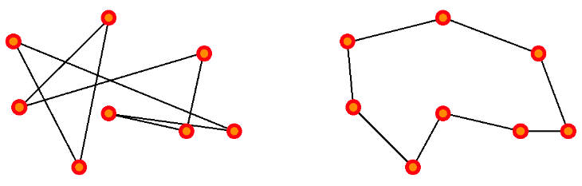
A suitable representation for states:
The initial state of the problem:
A good goal test to use in this problem:
Good operators to use for search:
Which search algorithm would be the most appropriate to use here if we want to minimize the distance of the tour found?
permutation of all cities in the tour
<A, B, C, D, E>
random permutation of all cities
minimize the distance travelled
permute 2 cities
Local Search - GA/SA/hill climbing, etc…
Suboptimal solution (long path) Optimal solution

Slide 8
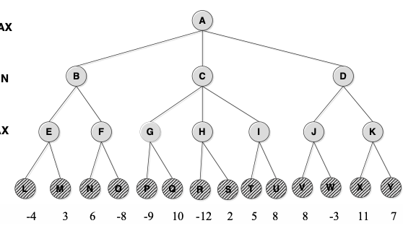
Minimax
MAX
MIN
MAX
Notes:
b) O , I, T , U , Y
c) Yes, the best order will be D , B , C .
Pruned nodes will be : Y , F , N , O , I , T , U

Slide 9
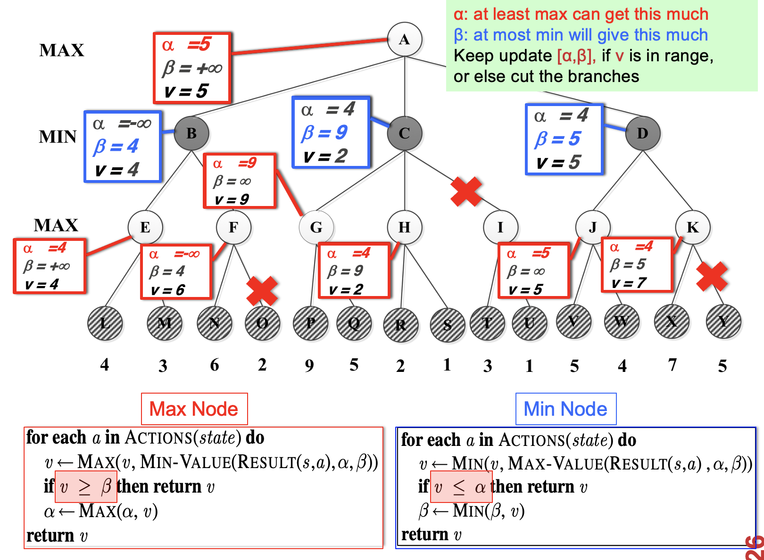

Slide 10
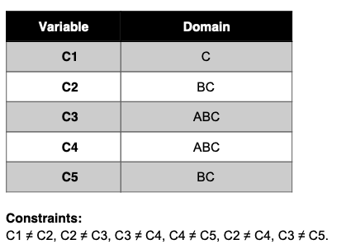
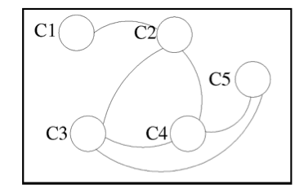
The schedules of the customers are:
Company 1: Webflix: 8:00-9:00am
Company 2: Anazon: 8:30-9:30am
Company 3: Pied Piper: 9:00-10:00am
Company 4: Hooli: 9:00-10:00am
Company 5: Gulu: 9:30-10:30am
Using Company as variable, formulate this problem as a CSP problem with variables, domains, and constraints. Constraints should be specified formally and precisely, but may be implicit rather than explicit.
Draw the constraint graph associated with your CSP.
The profiles of your engineers are:
Albacore can maintain Pied Piper and Hooli.
Bosam can maintain all companies, but Webflix.
Coleslaw can maintain all companies.

Slide 11
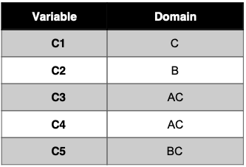

Show the domains of the variables after running arc-consistency on this initial graph (after having already enforced any unary constraints).
Give one solution to this CSP.

Slide 12
CSP Example: Map Coloring
NT
NT
Q
Q
WA
WA
SA
SA
NSW
NSW
V
V
T
T
7 variables {WA,NT,SA,Q,NSW,V,T}
Each variable has the same domain {red, green, blue}
No two adjacent variables have the same value:
WA≠NT, WA≠SA, NT≠SA, NT≠Q, SA≠Q, SA≠NSW, SA≠V,Q≠NSW, NSW≠V

Slide 13
Backtracking Search: Map Coloring
{}
WA=red
WA=green
WA=blue
WA=red
NT=green
WA=red
NT=blue
NT
Q
WA
WA=red
NT=green
Q=red
WA=red
NT=green
Q=blue
SA
NSW
V
T

Slide 14
Map Coloring: Forward Checking
NT
NT
Q
Q
WA
WA
SA
NSW
NSW
T
SA
V
V
T
WA | NT | Q | NSW | V | SA | T
RGB | RGB | RGB | RGB | RGB | RGB | RGB
1: R | RGB | RGB | RGB | RGB | RGB | RGB

Slide 15
Map Coloring: Forward Checking
NT
Q
WA
NSW
T
SA
V
WA | NT | Q | NSW | V | SA | T
RGB | RGB | RGB | RGB | RGB | RGB | RGB
1: R | RGB | RGB | RGB | RGB | RGB | RGB

Slide 16
Map Coloring: FC
NT
Q
WA
NSW
T
SA
V
WA | NT | Q | NSW | V | SA | T
RGB | RGB | RGB | RGB | RGB | RGB | RGB
R | RGB | RGB | RGB | RGB | RGB | RGB
R | RGB | 2: G | RGB | RGB | RGB | RGB

Slide 17
Map Coloring: FC
NT
Q
WA
NSW
T
SA
V
WA | NT | Q | NSW | V | SA | T
RGB | RGB | RGB | RGB | RGB | RGB | RGB
R | RGB | RGB | RGB | RGB | RGB | RGB
R | RGB | 2: G | RGB | RGB | RGB | RGB

Slide 18
Map Coloring: FC
NT
Q
WA
NSW
T
SA
V
WA | NT | Q | NSW | V | SA | T
RGB | RGB | RGB | RGB | RGB | RGB | RGB
R | RGB | RGB | RGB | RGB | RGB | RGB
R | RGB | G | RGB | RGB | RGB | RGB
R | RGB | G | RGB | 3:B | RGB | RGB

Slide 19
Map Coloring: FC
NT
Q
WA
NSW
T
SA
V
WA | NT | Q | NSW | V | SA | T
RGB | RGB | RGB | RGB | RGB | RGB | RGB
R | RGB | RGB | RGB | RGB | RGB | RGB
R | RGB | G | RGB | RGB | RGB | RGB
R | RGB | G | RGB | 3:B | RGB | RGB

Slide 20
Other inconsistencies
NT
Q
WA
NSW
T
SA
V
Impossible assignments that forward
checking does not detect
WA | NT | Q | NSW | V | SA | T
RGB | RGB | RGB | RGB | RGB | RGB | RGB
R | RGB | RGB | RGB | RGB | RGB | RGB
R | RGB | G | RGB | RGB | RGB | RGB
R | RGB | G | RGB | 3:B | RGB | RGB

Slide 21
Map Coloring: Constraint Propagation
NT
Q
WA
NSW
T
SA
V
WA | NT | Q | NSW | V | SA | T
RGB | RGB | RGB | RGB | RGB | RGB | RGB
R | RGB | RGB | RGB | RGB | RGB | RGB
R | RGB | 2: G | RGB | RGB | RGB | RGB
Go back to assigning “GREEN” to Queensland

Slide 22
Map Coloring: CP
NT
Q
WA
NSW
T
SA
V
WA | NT | Q | NSW | V | SA | T
RGB | RGB | RGB | RGB | RGB | RGB | RGB
R | RGB | RGB | RGB | RGB | RGB | RGB
R | RGB | 2: G | RGB | RGB | RGB | RGB
Immediate propagation removes GREEN for NSW, SA & NT

Slide 23
Map Coloring: CP
NT
Q
WA
NSW
T
SA
V
WA | NT | Q | NSW | V | SA | T
RGB | RGB | RGB | RGB | RGB | RGB | RGB
R | RGB | RGB | RGB | RGB | RGB | RGB
R | RGB | G | RGB | RGB | RGB | RGB
Since possible values for NT changed, continue to check arc consistency from NT

Slide 24
Map Coloring: CP
NT
Q
WA
NSW
T
SA
V
WA | NT | Q | NSW | V | SA | T
RGB | RGB | RGB | RGB | RGB | RGB | RGB
R | RGB | RGB | RGB | RGB | RGB | RGB
R | RGB | G | RGB | RGB | RGB | RGB
Constraint
NT≠SA
Constraint violation with SA immediately detected

Slide 25
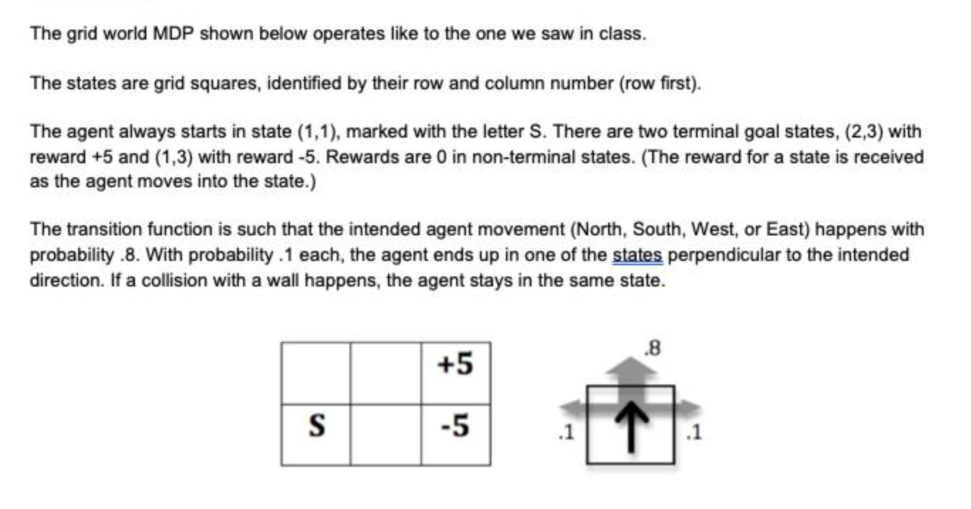
MDP and Q-Learning
2
1
1 2 3

Slide 26
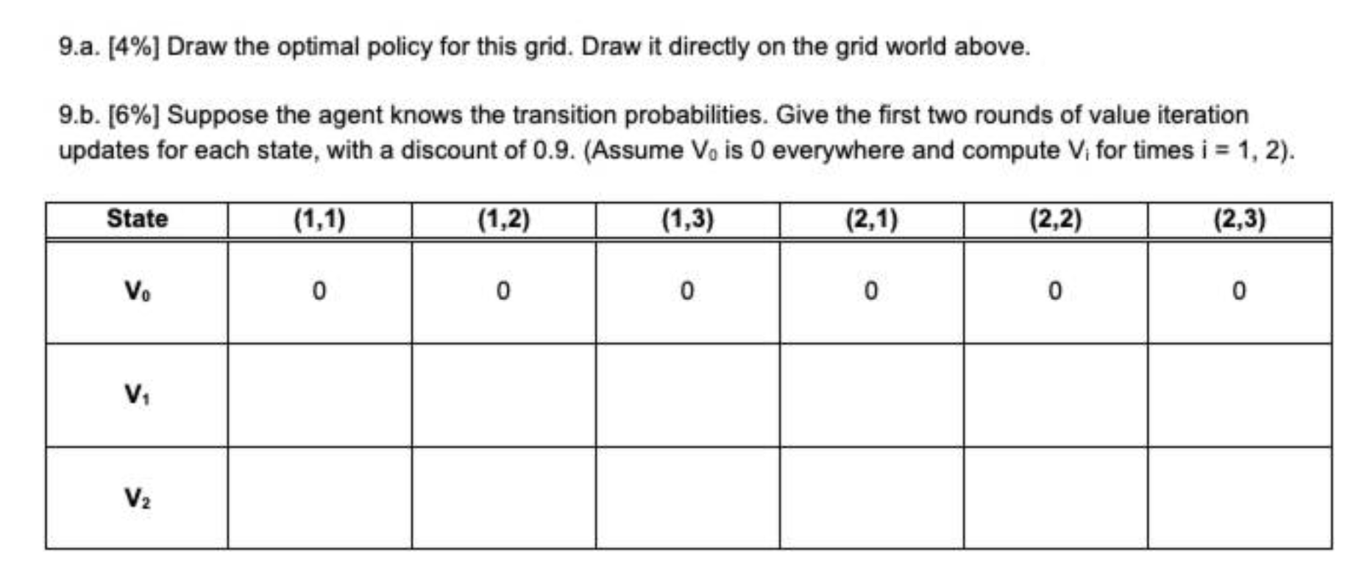
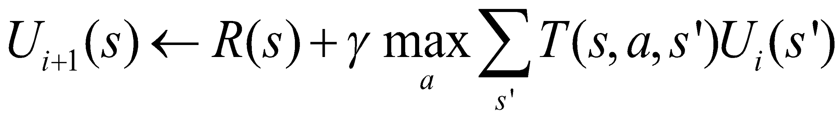
MDP and Q-Learning

Slide 27
MDP and Q-Learning
0
0
-5
0
0
+5

Slide 28
MDP and Q-Learning
0
0
-5
0
0
+5
0
0
-5
0
+5
0 + 0.9 * max{
left 0.8*0+0.1*0+0.1*0,
up 0.1*0+0.8*0+0.1*5,
down 0.1*0+0.8*0+0.1*5,
right 0.1*0+0.1*0+0.8*5}
= 0 + 0.9 * {4.0} = 3.6

