Slide 1
Week 7 Discussion Propositional Logic
CSCI 561 - Foundation for Artificial Intelligence
Prof Wei-min shen wmhen@usc.edu

Slide 2
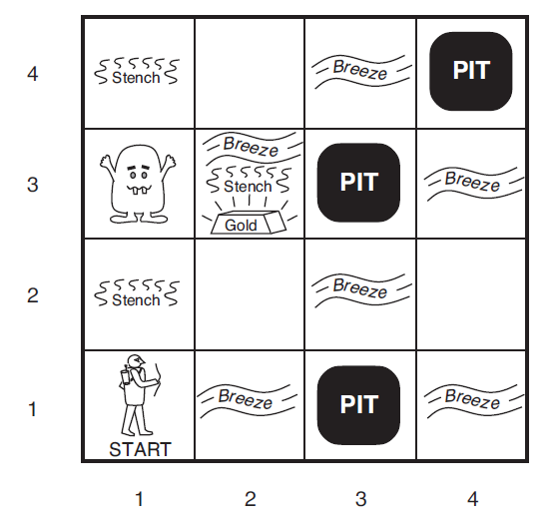
Logic Concepts
Entailment ⊨
Inference ⊢
Your head
A possible “real” world

Slide 3
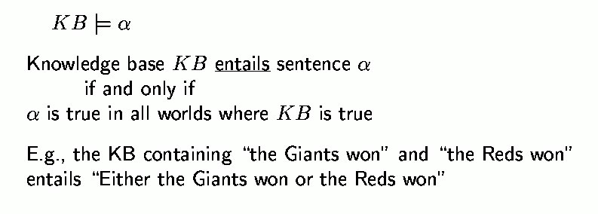

Entailment (between your head and the universe)
(in your head)
(in the universe)
Entailment means it is impossible for this case to occur:
premises are true and the consequence is false.
You must check in the whole
univese for this !!!
Notes:
Bottom checks for all knowledge to be a proper sibset of all actions

Slide 4

Entailment in Wumpus World
α₁ = ¬P_{1,2}
α₂ = ¬P_{2,2}
?
?
1
2
Notes:
Left entailed, right not entailed

Slide 5
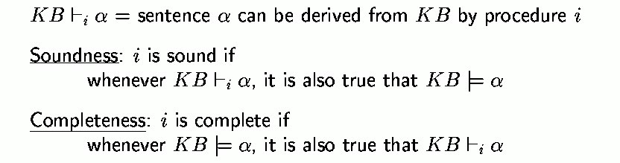
Inference (all in your head)

Slide 6
Entailment vs. Inference
Not quite sure with this example yet
X>Y |= X>=Y
you have to check with all numbers
(X>Y) → (X>=Y) ?

Slide 7
Exercise 7.4
False |= True
True |= False
(A∧B) |= (A ⇔ B)
A ⇔ B |= A ∨ B
A ⇔ B |= ¬A∨B
(A∧B) ⇒ C |= (A ⇒ C)∨(B ⇒ C). (C∨(¬A∧¬B))≡((A ⇒ C)∧(B ⇒ C))
(A∨B)∧(¬C∨¬D∨E) |= (A∨B)
(A∨B)∧(¬C∨¬D∨E) |= (A∨B)∧(¬D∨E)
(A∨B)∧¬(A ⇒ B) is satisfiable
(A ⇔ B)∧(¬A∨B) Is satisfiable
(A ⇔ B) ⇔ C has the same number of models as (A ⇔ B) for any
fixed set of proposition symbols that includes A, B, C.
Notes:
In all cases, the question can be resolved easily by referring to the definition of entail- ment.
False |= True is true because False has no models and hence entails every sentence AND because True is true in all models and hence is entailed by every sentence.
True |= False is false.
(A ∧ B) |= (A ⇔ B) is true because the left-hand side has exactly one model that is one of the two models of the right-hand side.
A ⇔ B|=A∨BisfalsebecauseoneofthemodelsofA ⇔ BhasbothAandB false, which does not satisfy A ∨ B.
A ⇔ B|=¬A∨BistruebecausetheRHSisA ⇒ B,oneoftheconjunctsinthe definition of A ⇔ B.
(A∧B) ⇒ C |= (A ⇒ C)∨(B ⇒ C) is true because the RHS is false only when both disjuncts are false, i.e., when A and B are true and C is false, in which case the LHS is also false. This may seem counterintuitive, and would not hold if ⇒ is interpreted as “causes.”
(C ∨(¬A∧¬B)) ≡ ((A ⇒ C)∧(B ⇒ C)) is true; proof by truth table enumeration, or by application of distributivity (Fig 7.11).
(A∨B)∧(¬C∨¬D∨E)|=(A∨B)istrue;removingaconjunctonlyallowsmore models.
(A∨B)∧(¬C∨¬D∨E)|=(A∨B)∧(¬D∨E)isfalse;removingadisjunctallows fewer models.
(A∨B)∧¬(A ⇒ B)issatisfiable;modelhasAand¬B. (A ⇔ B) ∧ (¬A ∨ B) is satisfiable; RHS is entailed by LHS so models are those of A ⇔ B.
l.(A ⇔ B) ⇔ Cdoeshavethesamenumberofmodelsas(A ⇔ B);halfthe models of (A ⇔ B) satisfy (A ⇔ B) ⇔ C, as do half the non-models, and there are the same numbers of models and non-models.

Slide 8
Exercise 7.4
False ⊨ True.
Notes:
In all cases, the question can be resolved easily by referring to the definition of entail- ment.
False |= True is true because False has no models and hence entails every sentence AND because True is true in all models and hence is entailed by every sentence.
True |= False is false.
(A ∧ B) |= (A ⇔ B) is true because the left-hand side has exactly one model that is one of the two models of the right-hand side.
A ⇔ B|=A∨BisfalsebecauseoneofthemodelsofA ⇔ BhasbothAandB false, which does not satisfy A ∨ B.
A ⇔ B|=¬A∨BistruebecausetheRHSisA ⇒ B,oneoftheconjunctsinthe definition of A ⇔ B.
(A∧B) ⇒ C |= (A ⇒ C)∨(B ⇒ C) is true because the RHS is false only when both disjuncts are false, i.e., when A and B are true and C is false, in which case the LHS is also false. This may seem counterintuitive, and would not hold if ⇒ is interpreted as “causes.”
(C ∨(¬A∧¬B)) ≡ ((A ⇒ C)∧(B ⇒ C)) is true; proof by truth table enumeration, or by application of distributivity (Fig 7.11).
(A∨B)∧(¬C∨¬D∨E)|=(A∨B)istrue;removingaconjunctonlyallowsmore models.
(A∨B)∧(¬C∨¬D∨E)|=(A∨B)∧(¬D∨E)isfalse;removingadisjunctallows fewer models.
(A∨B)∧¬(A ⇒ B)issatisfiable;modelhasAand¬B. (A ⇔ B) ∧ (¬A ∨ B) is satisfiable; RHS is entailed by LHS so models are those of A ⇔ B.
l.(A ⇔ B) ⇔ Cdoeshavethesamenumberofmodelsas(A ⇔ B);halfthe models of (A ⇔ B) satisfy (A ⇔ B) ⇔ C, as do half the non-models, and there are the same numbers of models and non-models.

Slide 9
Exercise 7.4
False ⊨ True. TRUE
False has no models and hence entails every sentence
True is true in all models and hence is entailed by every sentence.
Notes:
In all cases, the question can be resolved easily by referring to the definition of entail- ment.
False |= True is true because False has no models and hence entails every sentence AND because True is true in all models and hence is entailed by every sentence.
True |= False is false.
(A ∧ B) |= (A ⇔ B) is true because the left-hand side has exactly one model that is one of the two models of the right-hand side.
A ⇔ B|=A∨BisfalsebecauseoneofthemodelsofA ⇔ BhasbothAandB false, which does not satisfy A ∨ B.
A ⇔ B|=¬A∨BistruebecausetheRHSisA ⇒ B,oneoftheconjunctsinthe definition of A ⇔ B.
(A∧B) ⇒ C |= (A ⇒ C)∨(B ⇒ C) is true because the RHS is false only when both disjuncts are false, i.e., when A and B are true and C is false, in which case the LHS is also false. This may seem counterintuitive, and would not hold if ⇒ is interpreted as “causes.”
(C ∨(¬A∧¬B)) ≡ ((A ⇒ C)∧(B ⇒ C)) is true; proof by truth table enumeration, or by application of distributivity (Fig 7.11).
(A∨B)∧(¬C∨¬D∨E)|=(A∨B)istrue;removingaconjunctonlyallowsmore models.
(A∨B)∧(¬C∨¬D∨E)|=(A∨B)∧(¬D∨E)isfalse;removingadisjunctallows fewer models.
(A∨B)∧¬(A ⇒ B)issatisfiable;modelhasAand¬B. (A ⇔ B) ∧ (¬A ∨ B) is satisfiable; RHS is entailed by LHS so models are those of A ⇔ B.
l.(A ⇔ B) ⇔ Cdoeshavethesamenumberofmodelsas(A ⇔ B);halfthe models of (A ⇔ B) satisfy (A ⇔ B) ⇔ C, as do half the non-models, and there are the same numbers of models and non-models.

Slide 10
Exercise 7.4
True ⊨ False.
Notes:
In all cases, the question can be resolved easily by referring to the definition of entail- ment.
False |= True is true because False has no models and hence entails every sentence AND because True is true in all models and hence is entailed by every sentence.
True |= False is false.
(A ∧ B) |= (A ⇔ B) is true because the left-hand side has exactly one model that is one of the two models of the right-hand side.
A ⇔ B|=A∨BisfalsebecauseoneofthemodelsofA ⇔ BhasbothAandB false, which does not satisfy A ∨ B.
A ⇔ B|=¬A∨BistruebecausetheRHSisA ⇒ B,oneoftheconjunctsinthe definition of A ⇔ B.
(A∧B) ⇒ C |= (A ⇒ C)∨(B ⇒ C) is true because the RHS is false only when both disjuncts are false, i.e., when A and B are true and C is false, in which case the LHS is also false. This may seem counterintuitive, and would not hold if ⇒ is interpreted as “causes.”
(C ∨(¬A∧¬B)) ≡ ((A ⇒ C)∧(B ⇒ C)) is true; proof by truth table enumeration, or by application of distributivity (Fig 7.11).
(A∨B)∧(¬C∨¬D∨E)|=(A∨B)istrue;removingaconjunctonlyallowsmore models.
(A∨B)∧(¬C∨¬D∨E)|=(A∨B)∧(¬D∨E)isfalse;removingadisjunctallows fewer models.
(A∨B)∧¬(A ⇒ B)issatisfiable;modelhasAand¬B. (A ⇔ B) ∧ (¬A ∨ B) is satisfiable; RHS is entailed by LHS so models are those of A ⇔ B.
l.(A ⇔ B) ⇔ Cdoeshavethesamenumberofmodelsas(A ⇔ B);halfthe models of (A ⇔ B) satisfy (A ⇔ B) ⇔ C, as do half the non-models, and there are the same numbers of models and non-models.

Slide 11
Exercise 7.4
True ⊨ False. FALSE
False is not true in any models
Notes:
In all cases, the question can be resolved easily by referring to the definition of entail- ment.
False |= True is true because False has no models and hence entails every sentence AND because True is true in all models and hence is entailed by every sentence.
True |= False is false.
(A ∧ B) |= (A ⇔ B) is true because the left-hand side has exactly one model that is one of the two models of the right-hand side.
A ⇔ B|=A∨BisfalsebecauseoneofthemodelsofA ⇔ BhasbothAandB false, which does not satisfy A ∨ B.
A ⇔ B|=¬A∨BistruebecausetheRHSisA ⇒ B,oneoftheconjunctsinthe definition of A ⇔ B.
(A∧B) ⇒ C |= (A ⇒ C)∨(B ⇒ C) is true because the RHS is false only when both disjuncts are false, i.e., when A and B are true and C is false, in which case the LHS is also false. This may seem counterintuitive, and would not hold if ⇒ is interpreted as “causes.”
(C ∨(¬A∧¬B)) ≡ ((A ⇒ C)∧(B ⇒ C)) is true; proof by truth table enumeration, or by application of distributivity (Fig 7.11).
(A∨B)∧(¬C∨¬D∨E)|=(A∨B)istrue;removingaconjunctonlyallowsmore models.
(A∨B)∧(¬C∨¬D∨E)|=(A∨B)∧(¬D∨E)isfalse;removingadisjunctallows fewer models.
(A∨B)∧¬(A ⇒ B)issatisfiable;modelhasAand¬B. (A ⇔ B) ∧ (¬A ∨ B) is satisfiable; RHS is entailed by LHS so models are those of A ⇔ B.
l.(A ⇔ B) ⇔ Cdoeshavethesamenumberofmodelsas(A ⇔ B);halfthe models of (A ⇔ B) satisfy (A ⇔ B) ⇔ C, as do half the non-models, and there are the same numbers of models and non-models.

Slide 12
Exercise 7.4
(A∧B) ⊨ (A ⇔ B).
Notes:
In all cases, the question can be resolved easily by referring to the definition of entail- ment.
False |= True is true because False has no models and hence entails every sentence AND because True is true in all models and hence is entailed by every sentence.
True |= False is false.
(A ∧ B) |= (A ⇔ B) is true because the left-hand side has exactly one model that is one of the two models of the right-hand side.
A ⇔ B|=A∨BisfalsebecauseoneofthemodelsofA ⇔ BhasbothAandB false, which does not satisfy A ∨ B.
A ⇔ B|=¬A∨BistruebecausetheRHSisA ⇒ B,oneoftheconjunctsinthe definition of A ⇔ B.
(A∧B) ⇒ C |= (A ⇒ C)∨(B ⇒ C) is true because the RHS is false only when both disjuncts are false, i.e., when A and B are true and C is false, in which case the LHS is also false. This may seem counterintuitive, and would not hold if ⇒ is interpreted as “causes.”
(C ∨(¬A∧¬B)) ≡ ((A ⇒ C)∧(B ⇒ C)) is true; proof by truth table enumeration, or by application of distributivity (Fig 7.11).
(A∨B)∧(¬C∨¬D∨E)|=(A∨B)istrue;removingaconjunctonlyallowsmore models.
(A∨B)∧(¬C∨¬D∨E)|=(A∨B)∧(¬D∨E)isfalse;removingadisjunctallows fewer models.
(A∨B)∧¬(A ⇒ B)issatisfiable;modelhasAand¬B. (A ⇔ B) ∧ (¬A ∨ B) is satisfiable; RHS is entailed by LHS so models are those of A ⇔ B.
l.(A ⇔ B) ⇔ Cdoeshavethesamenumberofmodelsas(A ⇔ B);halfthe models of (A ⇔ B) satisfy (A ⇔ B) ⇔ C, as do half the non-models, and there are the same numbers of models and non-models.

Slide 13
Exercise 7.4
(A∧B) ⊨ (A ⇔ B). TRUE
The left-hand side (A∧B) has exactly one model: A=True and B=True then (A∧B)=True
That model is one of the two models of the right-hand side (A ⇔ B). Two models:
A=True and B=True then (A ⇔ B) =True
A=False and B=False then (A ⇔ B) =True
Notes:
In all cases, the question can be resolved easily by referring to the definition of entail- ment.
False |= True is true because False has no models and hence entails every sentence AND because True is true in all models and hence is entailed by every sentence.
True |= False is false.
(A ∧ B) |= (A ⇔ B) is true because the left-hand side has exactly one model that is one of the two models of the right-hand side.
A ⇔ B|=A∨BisfalsebecauseoneofthemodelsofA ⇔ BhasbothAandB false, which does not satisfy A ∨ B.
A ⇔ B|=¬A∨BistruebecausetheRHSisA ⇒ B,oneoftheconjunctsinthe definition of A ⇔ B.
(A∧B) ⇒ C |= (A ⇒ C)∨(B ⇒ C) is true because the RHS is false only when both disjuncts are false, i.e., when A and B are true and C is false, in which case the LHS is also false. This may seem counterintuitive, and would not hold if ⇒ is interpreted as “causes.”
(C ∨(¬A∧¬B)) ≡ ((A ⇒ C)∧(B ⇒ C)) is true; proof by truth table enumeration, or by application of distributivity (Fig 7.11).
(A∨B)∧(¬C∨¬D∨E)|=(A∨B)istrue;removingaconjunctonlyallowsmore models.
(A∨B)∧(¬C∨¬D∨E)|=(A∨B)∧(¬D∨E)isfalse;removingadisjunctallows fewer models.
(A∨B)∧¬(A ⇒ B)issatisfiable;modelhasAand¬B. (A ⇔ B) ∧ (¬A ∨ B) is satisfiable; RHS is entailed by LHS so models are those of A ⇔ B.
l.(A ⇔ B) ⇔ Cdoeshavethesamenumberofmodelsas(A ⇔ B);halfthe models of (A ⇔ B) satisfy (A ⇔ B) ⇔ C, as do half the non-models, and there are the same numbers of models and non-models.

Slide 14
Exercise 7.4
A ⇔ B ⊨ A ∨ B.
Notes:
In all cases, the question can be resolved easily by referring to the definition of entail- ment.
False |= True is true because False has no models and hence entails every sentence AND because True is true in all models and hence is entailed by every sentence.
True |= False is false.
(A ∧ B) |= (A ⇔ B) is true because the left-hand side has exactly one model that is one of the two models of the right-hand side.
A ⇔ B|=A∨BisfalsebecauseoneofthemodelsofA ⇔ BhasbothAandB false, which does not satisfy A ∨ B.
A ⇔ B|=¬A∨BistruebecausetheRHSisA ⇒ B,oneoftheconjunctsinthe definition of A ⇔ B.
(A∧B) ⇒ C |= (A ⇒ C)∨(B ⇒ C) is true because the RHS is false only when both disjuncts are false, i.e., when A and B are true and C is false, in which case the LHS is also false. This may seem counterintuitive, and would not hold if ⇒ is interpreted as “causes.”
(C ∨(¬A∧¬B)) ≡ ((A ⇒ C)∧(B ⇒ C)) is true; proof by truth table enumeration, or by application of distributivity (Fig 7.11).
(A∨B)∧(¬C∨¬D∨E)|=(A∨B)istrue;removingaconjunctonlyallowsmore models.
(A∨B)∧(¬C∨¬D∨E)|=(A∨B)∧(¬D∨E)isfalse;removingadisjunctallows fewer models.
(A∨B)∧¬(A ⇒ B)issatisfiable;modelhasAand¬B. (A ⇔ B) ∧ (¬A ∨ B) is satisfiable; RHS is entailed by LHS so models are those of A ⇔ B.
l.(A ⇔ B) ⇔ Cdoeshavethesamenumberofmodelsas(A ⇔ B);halfthe models of (A ⇔ B) satisfy (A ⇔ B) ⇔ C, as do half the non-models, and there are the same numbers of models and non-models.

Slide 15
Exercise 7.4
A ⇔ B ⊨ A ∨ B. FALSE
(A ⇔ B) has two models:
A=True and B=True then (A ⇔ B) =True
A=False and B=False then (A ⇔ B) =True
(A V B) is not True in this model
A=False and B=False then (A V B) = False
Notes:
In all cases, the question can be resolved easily by referring to the definition of entail- ment.
False |= True is true because False has no models and hence entails every sentence AND because True is true in all models and hence is entailed by every sentence.
True |= False is false.
(A ∧ B) |= (A ⇔ B) is true because the left-hand side has exactly one model that is one of the two models of the right-hand side.
A ⇔ B|=A∨BisfalsebecauseoneofthemodelsofA ⇔ BhasbothAandB false, which does not satisfy A ∨ B.
A ⇔ B|=¬A∨BistruebecausetheRHSisA ⇒ B,oneoftheconjunctsinthe definition of A ⇔ B.
(A∧B) ⇒ C |= (A ⇒ C)∨(B ⇒ C) is true because the RHS is false only when both disjuncts are false, i.e., when A and B are true and C is false, in which case the LHS is also false. This may seem counterintuitive, and would not hold if ⇒ is interpreted as “causes.”
(C ∨(¬A∧¬B)) ≡ ((A ⇒ C)∧(B ⇒ C)) is true; proof by truth table enumeration, or by application of distributivity (Fig 7.11).
(A∨B)∧(¬C∨¬D∨E)|=(A∨B)istrue;removingaconjunctonlyallowsmore models.
(A∨B)∧(¬C∨¬D∨E)|=(A∨B)∧(¬D∨E)isfalse;removingadisjunctallows fewer models.
(A∨B)∧¬(A ⇒ B)issatisfiable;modelhasAand¬B. (A ⇔ B) ∧ (¬A ∨ B) is satisfiable; RHS is entailed by LHS so models are those of A ⇔ B.
l.(A ⇔ B) ⇔ Cdoeshavethesamenumberofmodelsas(A ⇔ B);halfthe models of (A ⇔ B) satisfy (A ⇔ B) ⇔ C, as do half the non-models, and there are the same numbers of models and non-models.

Slide 16
Exercise 7.4
(A ⇔ B)∧(¬A∨B) is satisfiable.
Notes:
In all cases, the question can be resolved easily by referring to the definition of entail- ment.
False |= True is true because False has no models and hence entails every sentence AND because True is true in all models and hence is entailed by every sentence.
True |= False is false.
(A ∧ B) |= (A ⇔ B) is true because the left-hand side has exactly one model that is one of the two models of the right-hand side.
A ⇔ B|=A∨BisfalsebecauseoneofthemodelsofA ⇔ BhasbothAandB false, which does not satisfy A ∨ B.
A ⇔ B|=¬A∨BistruebecausetheRHSisA ⇒ B,oneoftheconjunctsinthe definition of A ⇔ B.
(A∧B) ⇒ C |= (A ⇒ C)∨(B ⇒ C) is true because the RHS is false only when both disjuncts are false, i.e., when A and B are true and C is false, in which case the LHS is also false. This may seem counterintuitive, and would not hold if ⇒ is interpreted as “causes.”
(C ∨(¬A∧¬B)) ≡ ((A ⇒ C)∧(B ⇒ C)) is true; proof by truth table enumeration, or by application of distributivity (Fig 7.11).
(A∨B)∧(¬C∨¬D∨E)|=(A∨B)istrue;removingaconjunctonlyallowsmore models.
(A∨B)∧(¬C∨¬D∨E)|=(A∨B)∧(¬D∨E)isfalse;removingadisjunctallows fewer models.
(A∨B)∧¬(A ⇒ B)issatisfiable;modelhasAand¬B. (A ⇔ B) ∧ (¬A ∨ B) is satisfiable; RHS is entailed by LHS so models are those of A ⇔ B.
l.(A ⇔ B) ⇔ Cdoeshavethesamenumberofmodelsas(A ⇔ B);halfthe models of (A ⇔ B) satisfy (A ⇔ B) ⇔ C, as do half the non-models, and there are the same numbers of models and non-models.

Slide 17
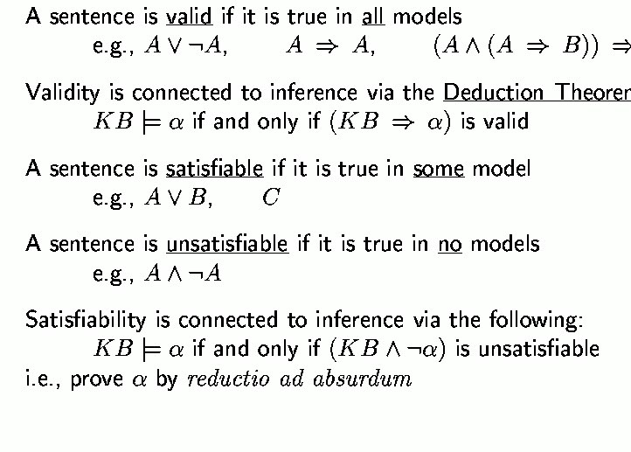
Validity and satisfiability
B
m
Notes:
Valid is true for all worlds in universe

Slide 18
Exercise 7.4
(A ⇔ B)∧(¬A∨B) is satisfiable. TRUE
This sentence (A ⇔ B)∧(¬A∨B) is True, when A=True and B=True
Notes:
In all cases, the question can be resolved easily by referring to the definition of entail- ment.
False |= True is true because False has no models and hence entails every sentence AND because True is true in all models and hence is entailed by every sentence.
True |= False is false.
(A ∧ B) |= (A ⇔ B) is true because the left-hand side has exactly one model that is one of the two models of the right-hand side.
A ⇔ B|=A∨BisfalsebecauseoneofthemodelsofA ⇔ BhasbothAandB false, which does not satisfy A ∨ B.
A ⇔ B|=¬A∨BistruebecausetheRHSisA ⇒ B,oneoftheconjunctsinthe definition of A ⇔ B.
(A∧B) ⇒ C |= (A ⇒ C)∨(B ⇒ C) is true because the RHS is false only when both disjuncts are false, i.e., when A and B are true and C is false, in which case the LHS is also false. This may seem counterintuitive, and would not hold if ⇒ is interpreted as “causes.”
(C ∨(¬A∧¬B)) ≡ ((A ⇒ C)∧(B ⇒ C)) is true; proof by truth table enumeration, or by application of distributivity (Fig 7.11).
(A∨B)∧(¬C∨¬D∨E)|=(A∨B)istrue;removingaconjunctonlyallowsmore models.
(A∨B)∧(¬C∨¬D∨E)|=(A∨B)∧(¬D∨E)isfalse;removingadisjunctallows fewer models.
(A∨B)∧¬(A ⇒ B)issatisfiable;modelhasAand¬B. (A ⇔ B) ∧ (¬A ∨ B) is satisfiable; RHS is entailed by LHS so models are those of A ⇔ B.
l.(A ⇔ B) ⇔ Cdoeshavethesamenumberofmodelsas(A ⇔ B);halfthe models of (A ⇔ B) satisfy (A ⇔ B) ⇔ C, as do half the non-models, and there are the same numbers of models and non-models.

Slide 19
Exercise 7.4
False |= True.
True |= False.
(A∧B)|=(A ⇔ B).
A ⇔ B |= A ∨ B .
A ⇔ B|=¬A∨B.
(A∧B) ⇒ C|=(A ⇒ C)∨(B ⇒ C). (C∨(¬A∧¬B))≡((A ⇒ C)∧(B ⇒ C)).
(A∨B)∧(¬C∨¬D∨E)|=(A∨B).
(A∨B)∧(¬C∨¬D∨E)|=(A∨B)∧(¬D∨E).
(A∨B)∧¬(A ⇒ B) is satisfiable.
(A ⇔ B)∧(¬A∨B) Is satisfiable.
(A ⇔ B) ⇔ C has the same number of models as (A ⇔ B) for any fixed set of proposition symbols that includes A, B, C.
Notes:
In all cases, the question can be resolved easily by referring to the definition of entail- ment.
False |= True is true because False has no models and hence entails every sentence AND because True is true in all models and hence is entailed by every sentence.
True |= False is false.
(A ∧ B) |= (A ⇔ B) is true because the left-hand side has exactly one model that is one of the two models of the right-hand side.
A ⇔ B|=A∨BisfalsebecauseoneofthemodelsofA ⇔ BhasbothAandB false, which does not satisfy A ∨ B.
A ⇔ B|=¬A∨BistruebecausetheRHSisA ⇒ B,oneoftheconjunctsinthe definition of A ⇔ B.
(A∧B) ⇒ C |= (A ⇒ C)∨(B ⇒ C) is true because the RHS is false only when both disjuncts are false, i.e., when A and B are true and C is false, in which case the LHS is also false. This may seem counterintuitive, and would not hold if ⇒ is interpreted as “causes.”
(C ∨(¬A∧¬B)) ≡ ((A ⇒ C)∧(B ⇒ C)) is true; proof by truth table enumeration, or by application of distributivity (Fig 7.11).
(A∨B)∧(¬C∨¬D∨E)|=(A∨B)istrue;removingaconjunctonlyallowsmore models.
(A∨B)∧(¬C∨¬D∨E)|=(A∨B)∧(¬D∨E)isfalse;removingadisjunctallows fewer models.
(A∨B)∧¬(A ⇒ B)issatisfiable;modelhasAand¬B. (A ⇔ B) ∧ (¬A ∨ B) is satisfiable; RHS is entailed by LHS so models are those of A ⇔ B.
l.(A ⇔ B) ⇔ Cdoeshavethesamenumberofmodelsas(A ⇔ B);halfthe models of (A ⇔ B) satisfy (A ⇔ B) ⇔ C, as do half the non-models, and there are the same numbers of models and non-models.

Slide 20
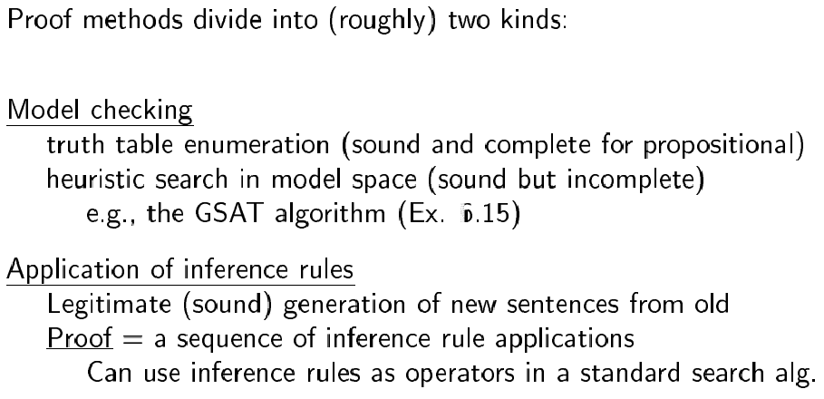
Proof methods

Slide 21
Basic manipulation rules
¬(¬A) = A Double negation
¬(A ^ B) = (¬A) V (¬B) Negated “and”
¬(A V B) = (¬A) ^ (¬B) Negated “or”
A ^ (B V C) = (A ^ B) V (A ^ C) Distributivity of ^ on V
A V (B ^ C) = (A V B) ^ (A V C) Distributivity of V on ^
A => B = (¬A) V B by definition
¬(A => B) = A ^ (¬B) using negated or
A ⬄ B = (A => B) ^ (B => A) by definition
¬(A ⬄ B) = (A ^ (¬B))V(B ^ (¬A)) using negated and & or
…

Slide 22
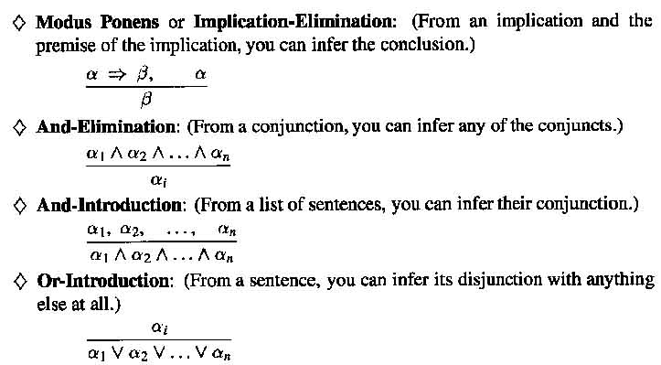
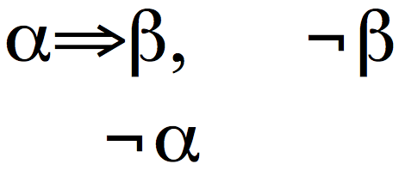
Inference Rules
Modus Tollens:z

Slide 23
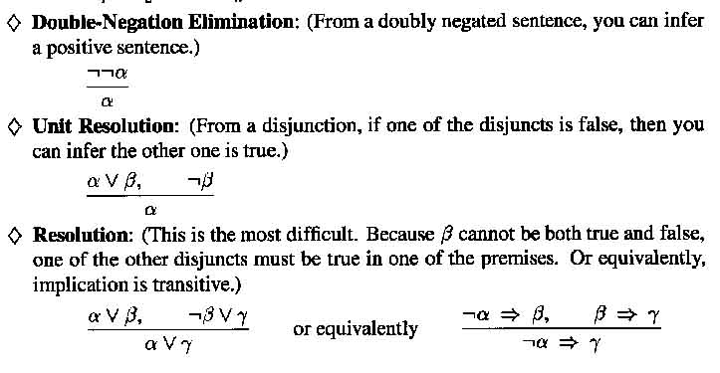
Inference Rules

Slide 24
What you should know
What is entailment and inference? How do they differ?
What are examples of sound or complete inference techniques?
What does satisfiable or valid mean?
What is propositional logic? Basic manipulation rules? Inference rules? What are some of its limitations?

Slide 25
Want More?
Check out some of these exercises in the book:
7.1, 7.4-8, 10
Chap 8: 8.1-3, 8.6, 8.9-10, 8.14,17, 8.28

