Slide 1
Project 3: Web APIs & NLP
by Casey Liu

Slide 2
Problem Statement
The goal of this project is to classify posts from two different subreddits.
Data Collection
Data Cleaning & EDA
Preprocessing and Modeling
Evaluation
Conclusion and Recommendations

Slide 3

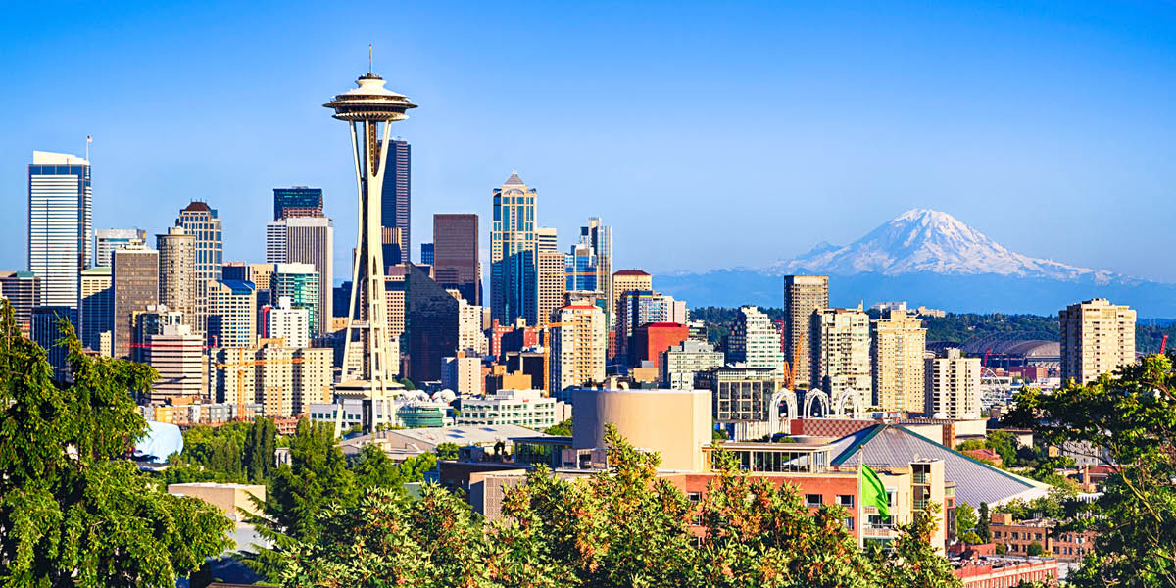
Data Collection
Total of 1785 posts: 944 from Boston and 841 from Seattle
r/boston
421k members
A reddit focused on the city of Boston, MA and the Greater Boston Area.
r/seattle
382k members
News, current events in & around Seattle, Washington, USA.

Slide 4
Data Cleaning
Fill NaN
Check duplicate rows
Combine title and selftext in one column
Convert subreddit to 0 and 1

Slide 5
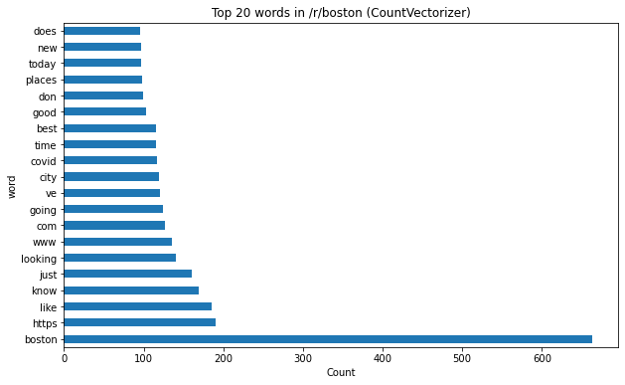
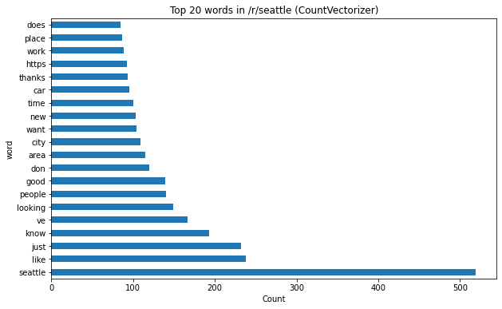
Frequent words with CountVectorizer
Boston:
covid, line, thread, mass, mbta, winter, event, walk, regularly, public, south, police, sunset
Seattle:
work, car, washington, homeless, experience, love, service, food, moved, county, ballard, lake, king

Slide 6
Models
Logistic Regression with CountVectorizer:
GridSearch best params: max_df: 0.5, min_df: 2, ngram_range: (1,2)
Train/test scores: 0.9933/0.8389
Random forest with CountVectorizer:
GridSearch best params: max_df: 0.5, min_df: 2, ngram_range: (1,2)
Train/test scores: 0.9985/0.8277

Slide 7
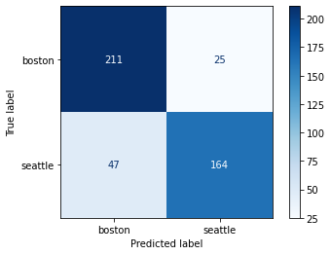
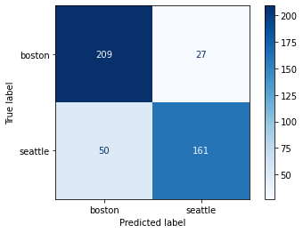
Evaluation
When we compare two models, it seems that logistic regression model performs better than random forest model.
In the logistic regression model:
The model correctly predicts 83.39% of observations.
From all posts that the model predicted to be in r/seattle, we have 86.67% of them correctly classified.
From all posts that are in r/seattle, we have 77.73% of them correctly classified.
From all posts that are in r/boston, we have 89.41% of them correctly classified.

