Slide 1
Tagalong
Milestone 1

Slide 2
Talking Points today
Architecture project
Database progress
User interface progress

Slide 3
Architecture progress and problems
Difficulty installing php.
Advice: Make sure you create your AWS account sooner than later.

Slide 4
Database Progress and problems
Problems: unclear how to do or what is really expected.
Very difficult without someone who has taken 336

Slide 5
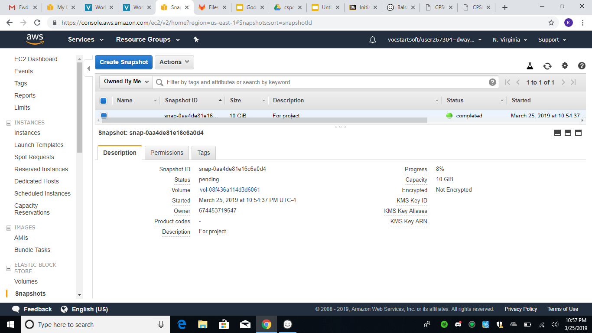

Slide 6
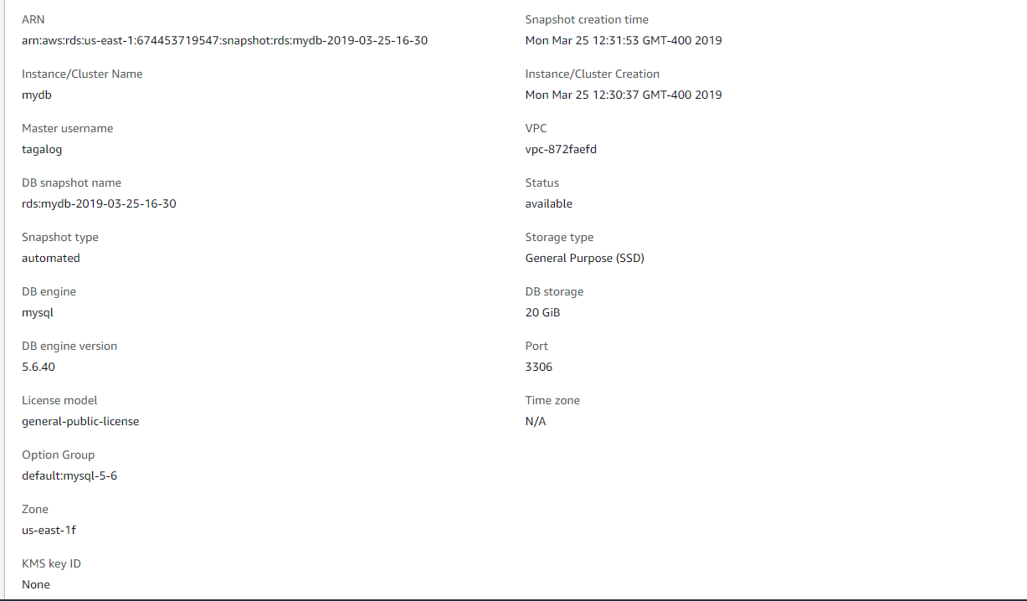

Slide 7
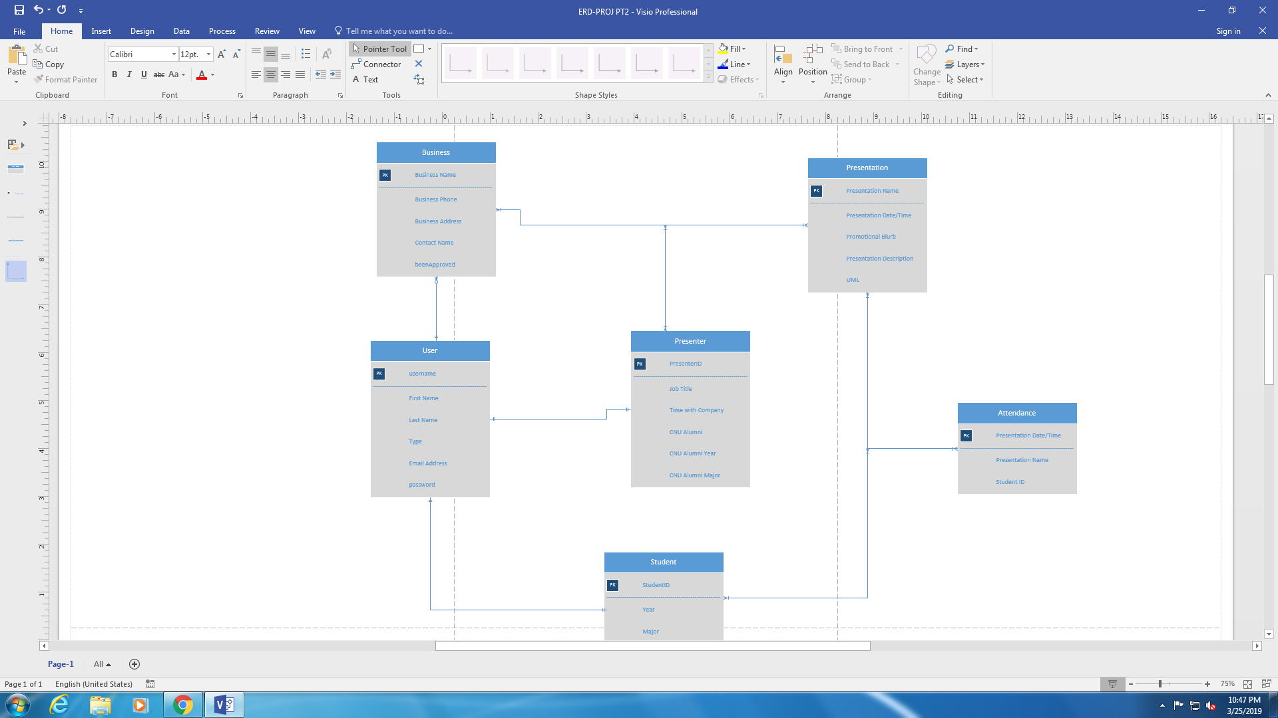

Slide 8
UI progress and problems
Created pages to map out how the web application will look.
Problem: unsure whether we were supposed to make rough look with Balsamiq or make more specific look by coding a website.

Slide 9
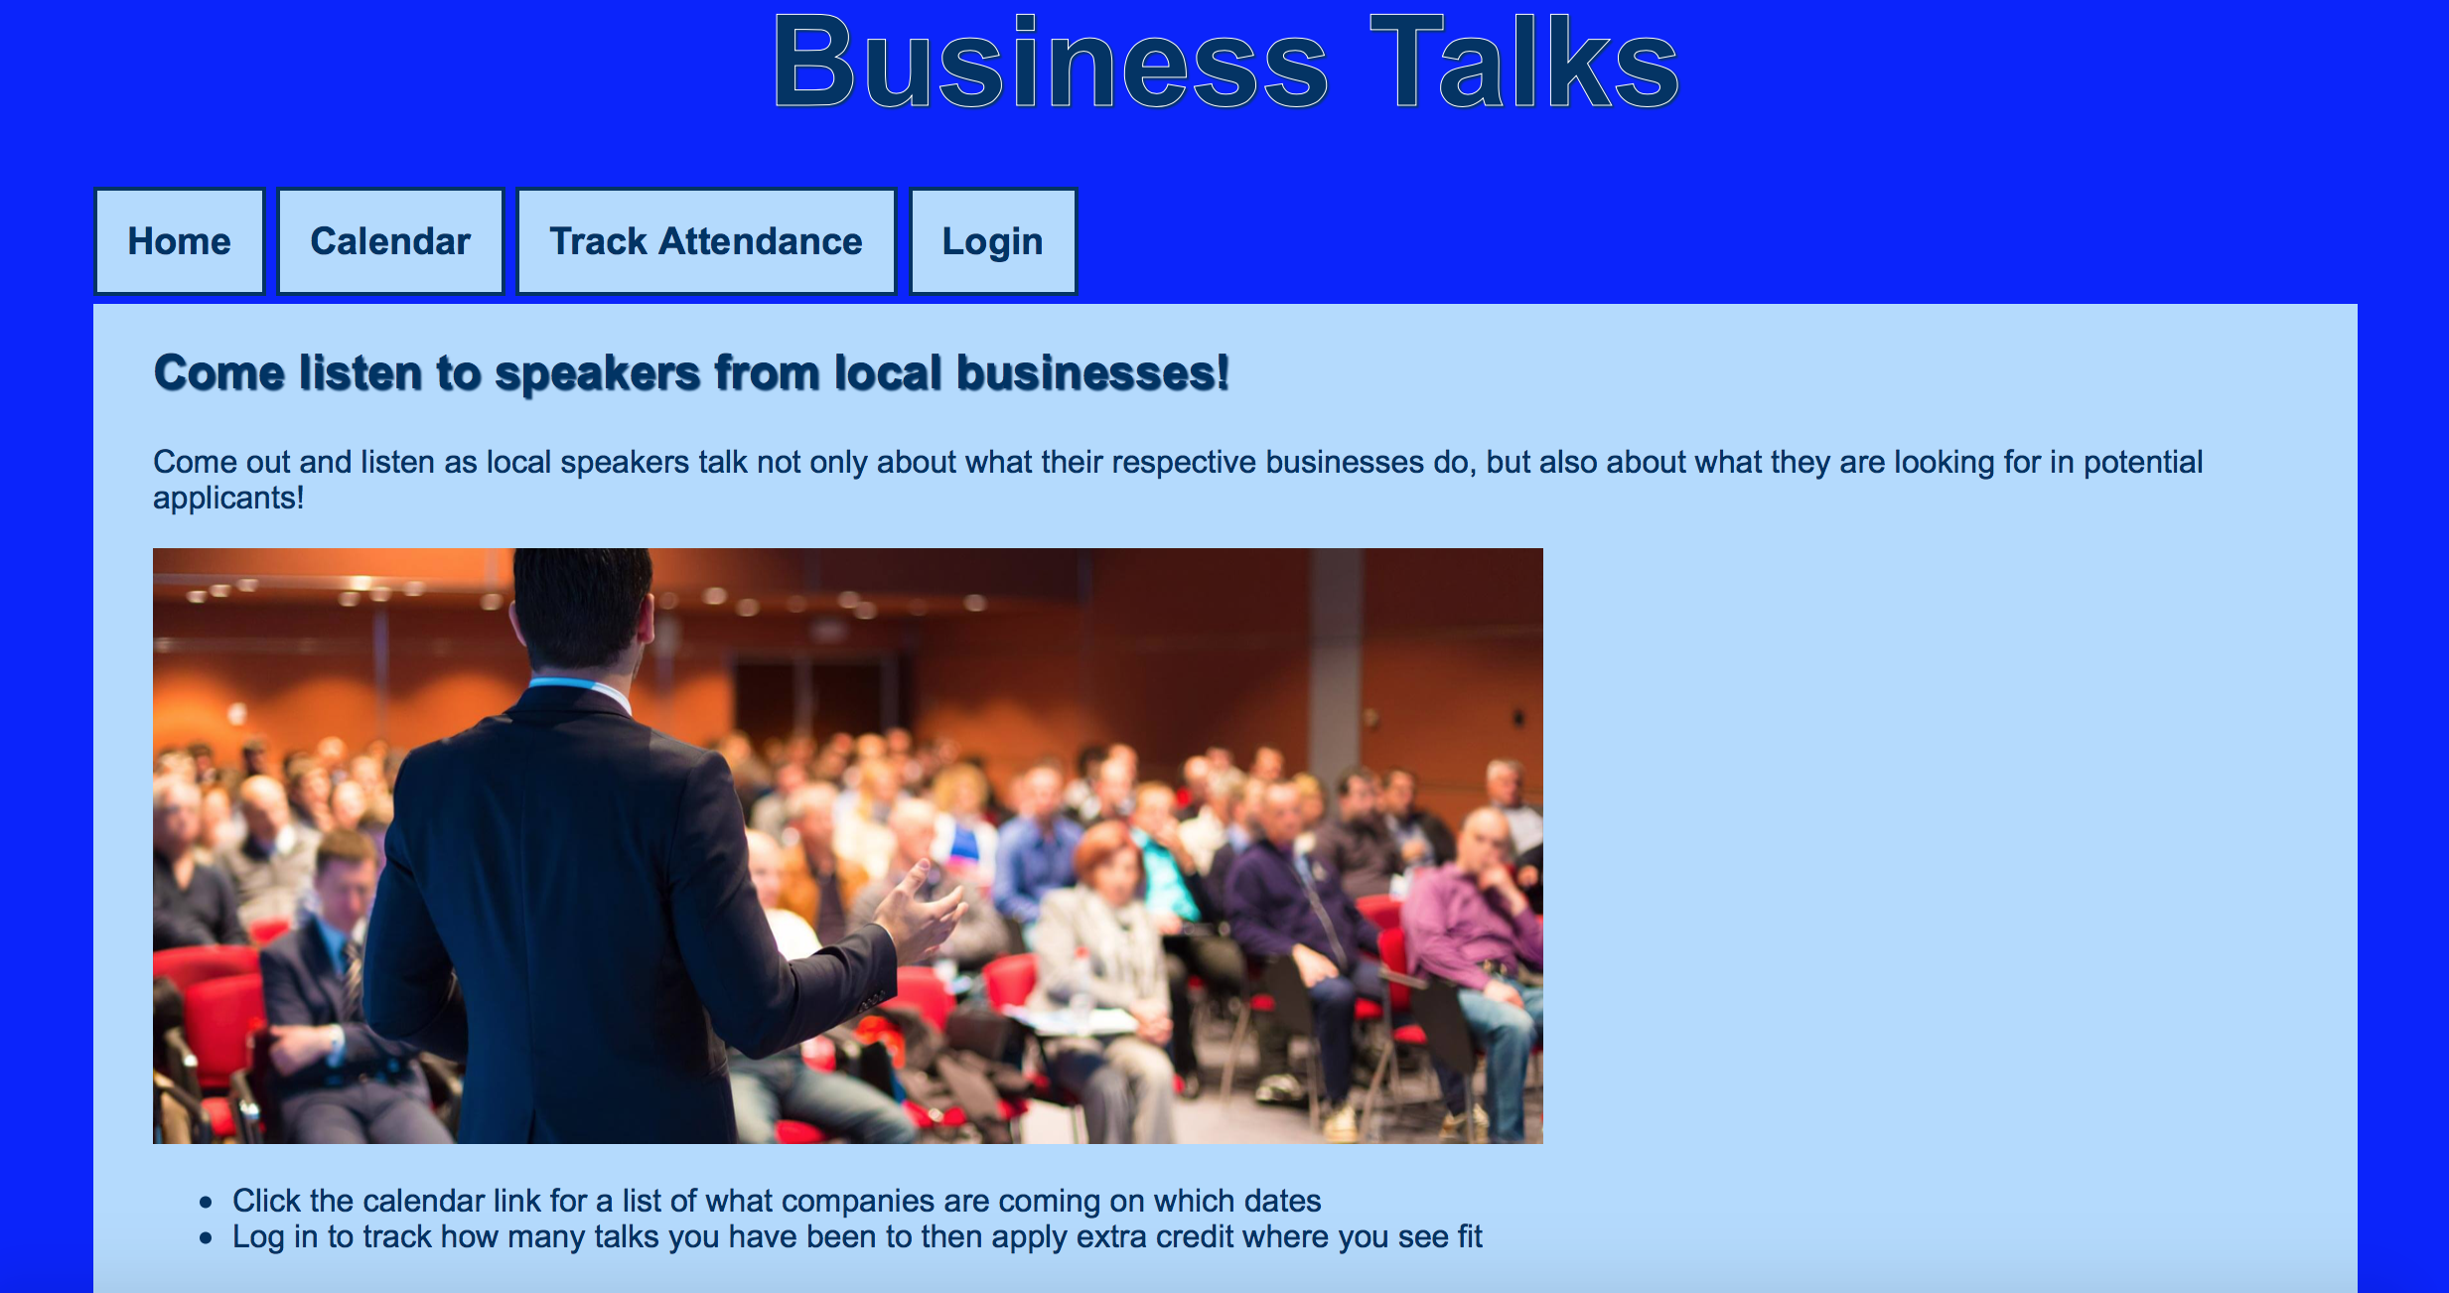

Slide 10
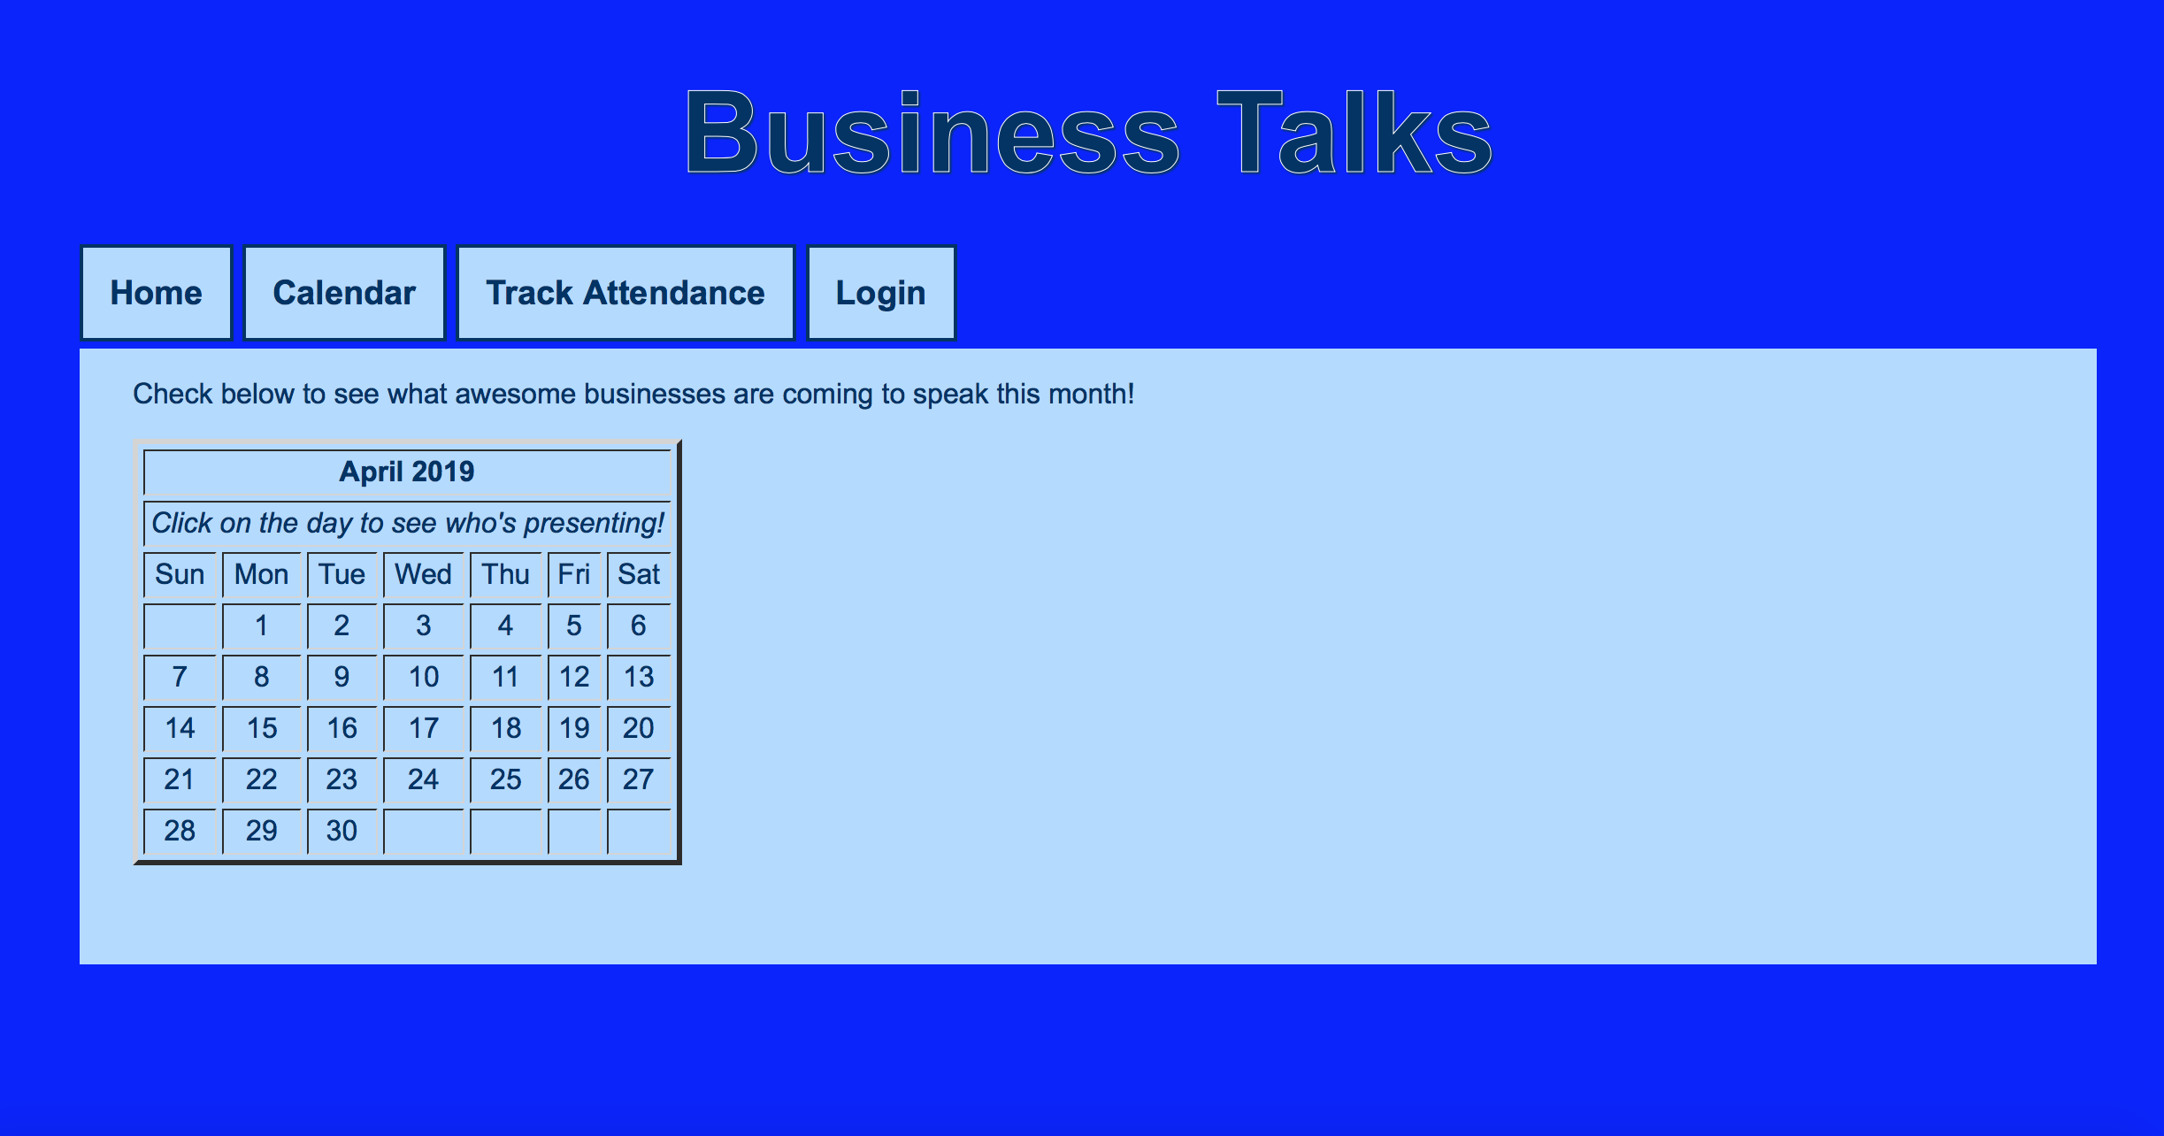

Slide 11
