Slide 1
The Command Pattern
Casey Scarborough
CSCI 4320

Slide 2
What is the Command Pattern?
Definition from Wikipedia:
  The command pattern is a behavioral design pattern in which an object is used to represent and encapsulate all the information needed to call a method at a later time. This information includes the method name, the object that owns the method and values for the method parameters.

Slide 3
What is the Command Pattern?
In simpler terms, the Command Design pattern gives you a way to execute commands, keep track of them, redo or undo them, along with some other useful features.

Slide 4
When is this Pattern Used?
The Command Pattern is a very popular Design Pattern. It is used in many different applications, such as:
  Macro Recording
  Multiple Undos
  GUI Buttons and Menu Items
  Thread Pools

Slide 5
Parts of the Pattern
The Command Design pattern is made up of five main components:
  Command
  Concrete Command
  Receiver
  Invoker
  Client

Slide 6
Command Interface
The Command Interface (also sometimes an abstract class) declares the methods that will be used for executing an operation.
Every command will implement this interface, and must implement all methods in this class.

Slide 7
ConcreteCommand
This class is the implementation of the Command interface, and must implement all methods inside of it.
It also defines a binding between the command and the Receiver to perform the action on.

Slide 8
Receiver
The Receiver class knows how to perform the actions associated with each request.
Each Concrete Command must map to an action in its corresponding Receiver.

Slide 9
Invoker
The Invoker asks the command to actually carry out the request, or invokes the action.
The Invoker knows nothing about the Command or the Receiver that the command will be executed on, it only handles asking the command to execute.

Slide 10
Client
The last part of the Command Pattern is the Client, which handles the creation of the Command and sets its Receiver.
This will usually become the main method in your application.

Slide 11
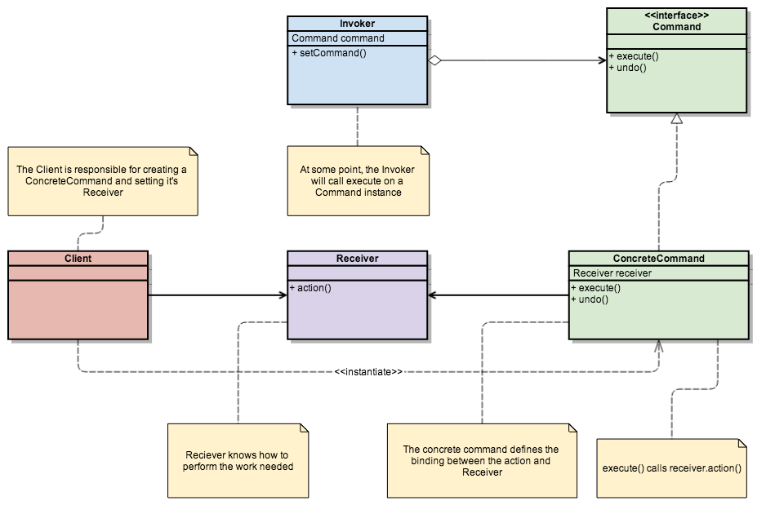
UML Diagram

Slide 12
Pattern Flow
The interaction between the participants in this design pattern are shown below:
Our Client instantiates a new Receiver.
The Client instantiates a new Command, and passes the Receiver object to the Command.
The Client will then instantiate a new Invoker and pass the command to it.

Slide 13
Pattern Flow
The Invoker will then have the ability to ask the Command to be executed, and the Command will execute it’s respective command on its Receiver.
The Invoker can then be passed different Commands to be executed.

Slide 14
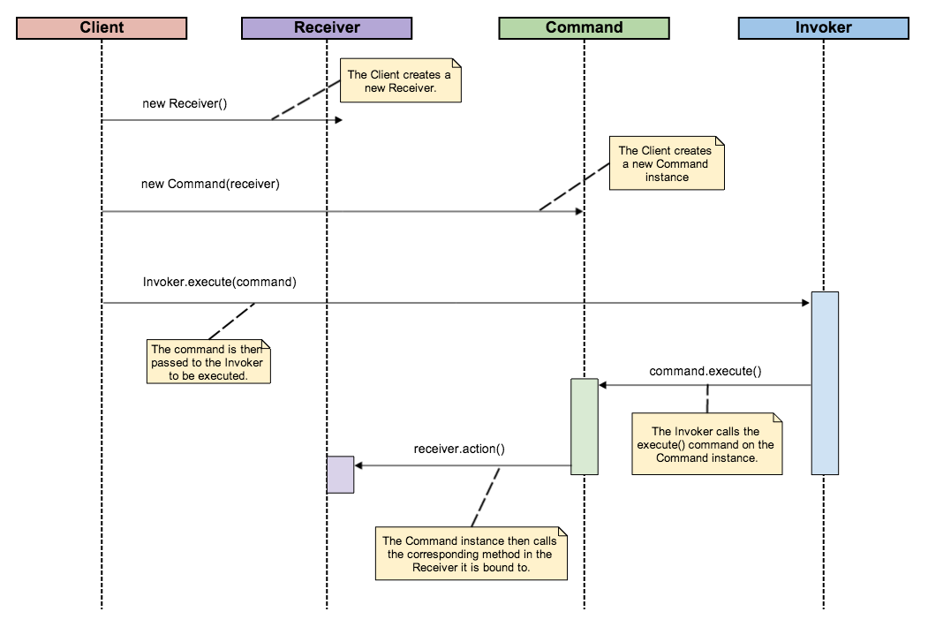
Sequence Diagram

Slide 15
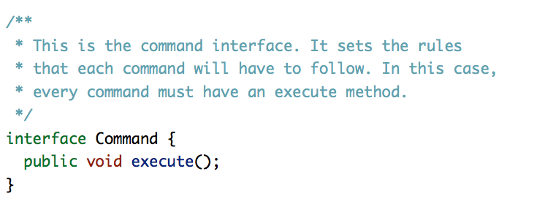
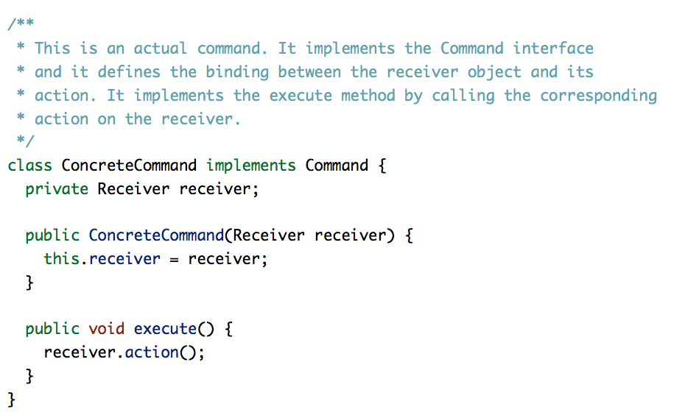

Slide 16
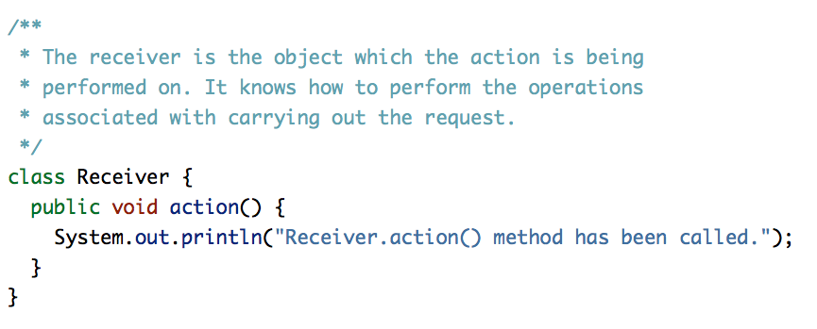
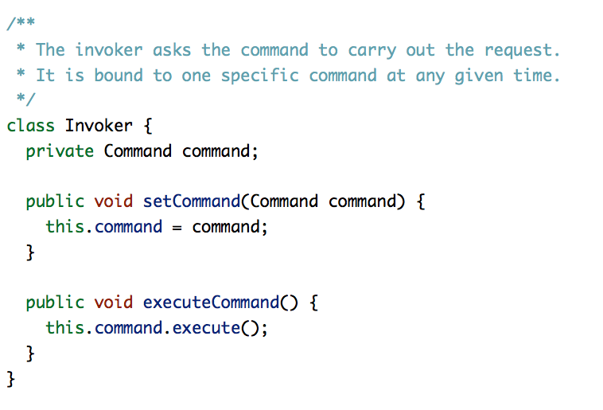

Slide 17
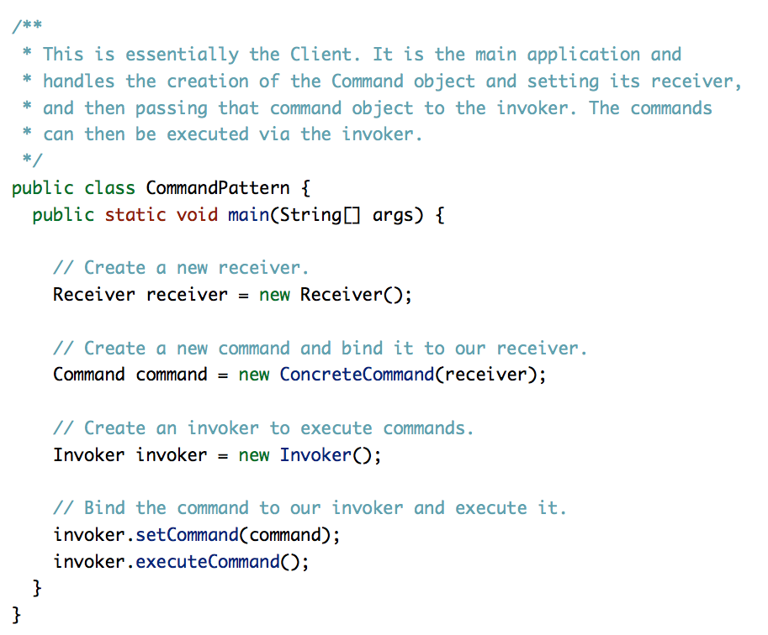

Slide 18
Pros and Cons
The Command Design pattern is useful for encapsulating requests as objects, allowing you to parameterize requests, log them, or queue them, as well as support undoable operations. The disadvantage (which may be slightly opinionated) to using this pattern is that you must create multiple small classes to store lists of commands.

Slide 19
Resources
http://www.dofactory.com/Patterns/PatternCommand.aspx
http://en.wikipedia.org/wiki/Command_pattern
http://www.oodesign.com/command-pattern.html
http://java.dzone.com/articles/design-patterns-command

