Slide 1
ACKNOWLEDGEMENT OF COUNTRY

Slide 2



Structure of the Session
What is AI?
Traditional AI
Traditional AI activities
Generative AI
Generative AI activities
Resource sharing
Notes:
Thanks for joining us this afternoon to discuss AI and how to bring it into your classroom.
Talk about the structure of the session.
Encourage them to ask questions.

Slide 3

What is Artificial Intelligence?
“Artificial Intelligence (AI) is nothing but digital brains inside large computers.”
IIya Sutskever
Notes:
Thanks for joining us this afternoon to discuss AI and how to bring it into your classroom.
Talk about the structure of the session.
Encourage them to ask questions.

Slide 4
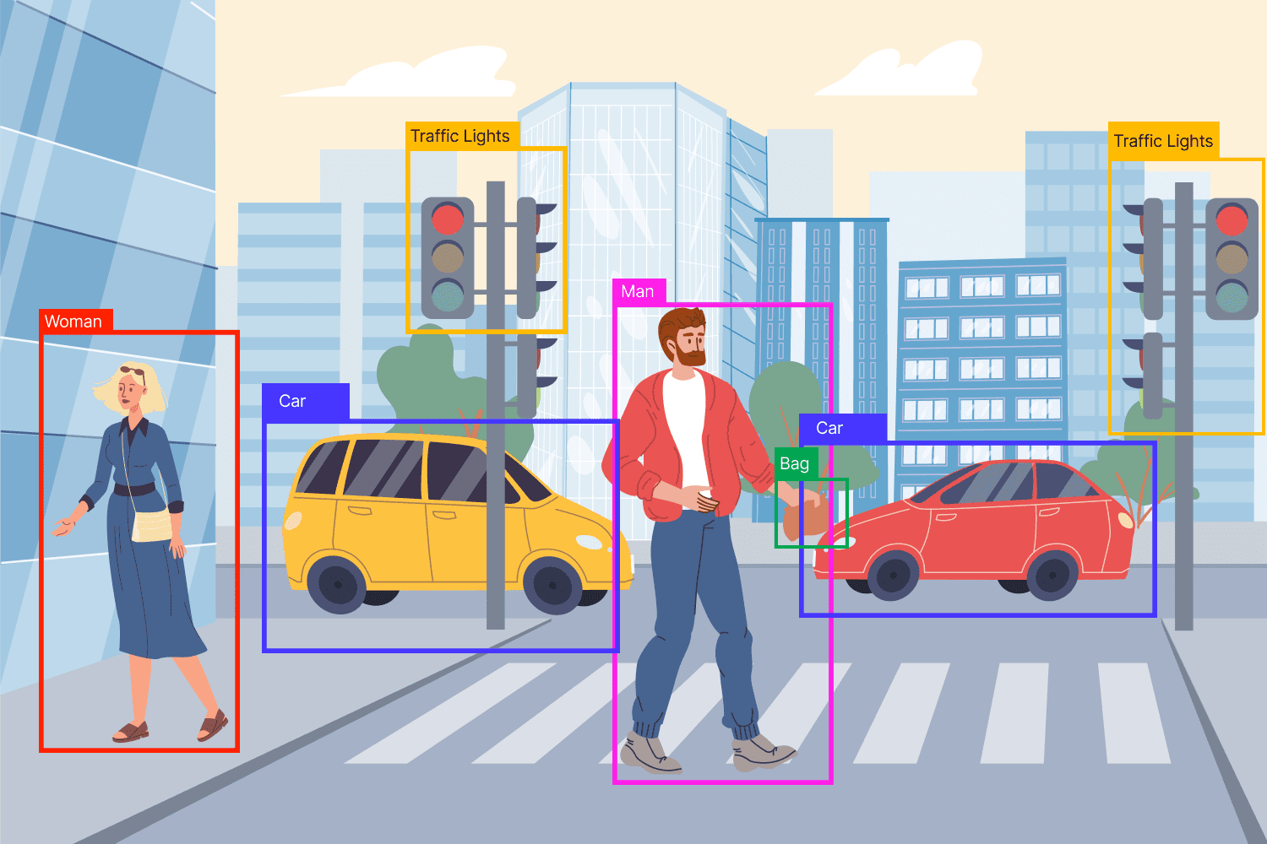

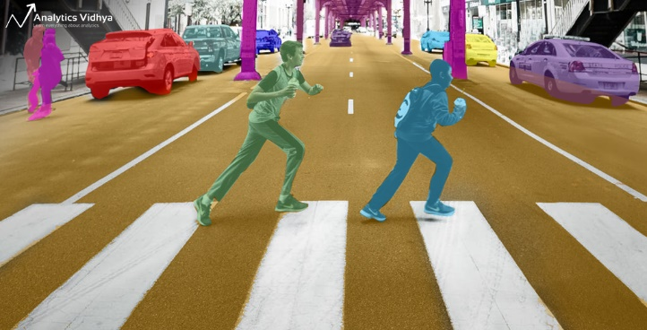
Traditional AI
Traditional AI does not involve understanding natural languages.
Examples:
Object detection
Image segmentation
Stock price prediction
Notes:
Thanks for joining us this afternoon to discuss AI and how to bring it into your classroom.
Talk about the structure of the session.
Encourage them to ask questions.

Slide 5
How does it work?
See a neural network in action
Black Box
Input
Output
Notes:
Thanks for joining us this afternoon to discuss AI and how to bring it into your classroom.
Talk about the structure of the session.
Encourage them to ask questions.

Slide 6

Traditional AI Activities
Teachable Machine
Happy and Sad faces
Use the model in Scratch
Landing AI
Notes:
Thanks for joining us this afternoon to discuss AI and how to bring it into your classroom.
Talk about the structure of the session.
Encourage them to ask questions.

Slide 7
Generative AI: Large Language Model
Communication in natural languages
Notes:
Thanks for joining us this afternoon to discuss AI and how to bring it into your classroom.
Talk about the structure of the session.
Encourage them to ask questions.

Slide 8
How does a LLM work?
What ‘GPT’ in ChatGPT stands for?
Generative pre-trained transformer
Notes:
Thanks for joining us this afternoon to discuss AI and how to bring it into your classroom.
Talk about the structure of the session.
Encourage them to ask questions.

Slide 9
Generative AI Activities
Generative AI children’s book creation
User profiles -> brainstorm -> Generative AI tools -> sharing
Notes:
Thanks for joining us this afternoon to discuss AI and how to bring it into your classroom.
Talk about the structure of the session.
Encourage them to ask questions.

Slide 10
AI Arts using PlaygroundAI
Demo
Notes:
Thanks for joining us this afternoon to discuss AI and how to bring it into your classroom.
Talk about the structure of the session.
Encourage them to ask questions.

Slide 11

Thank you for coming to Casey Tech School

