Slide 1
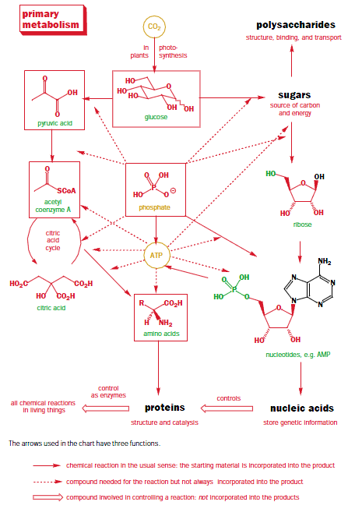
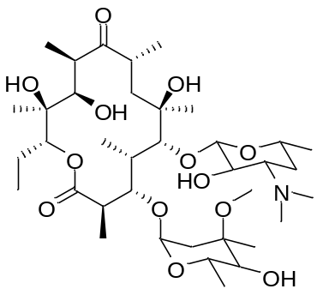
Primary Metabolism: Key Building Blocks for Life
Pathways for generally modifying and synthesizing carbohydrates, proteins, fats, and nucleic acids are essentially the same in all organisms → primary metabolism
primary metabolites
are also building blocks for
secondary metabolites

Slide 2
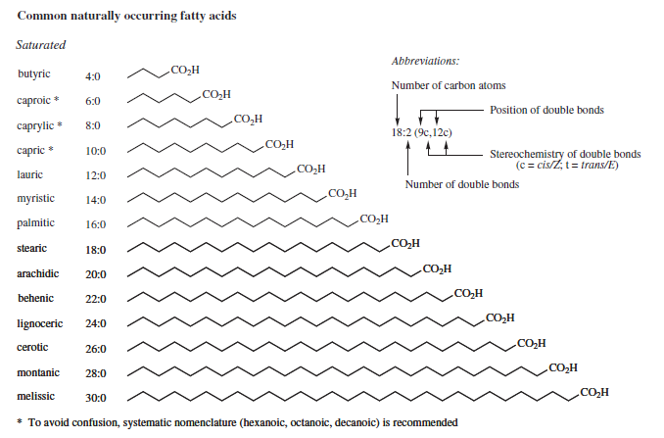
Saturated Fatty Acids

Slide 3
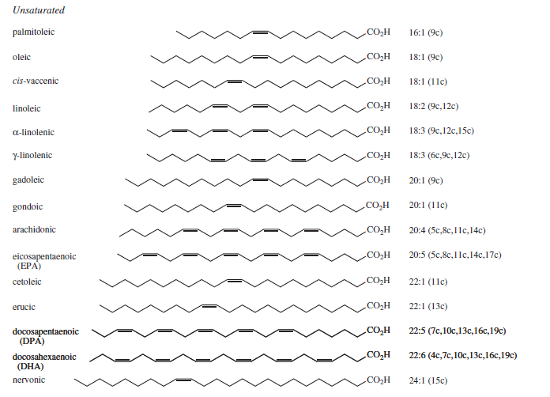
Unsaturated Fatty Acids

Slide 4
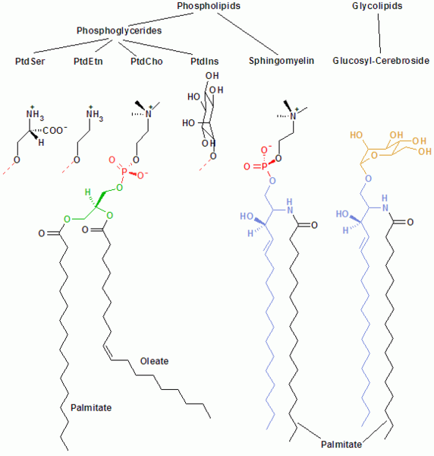
Families of Membrane Lipids

Slide 5
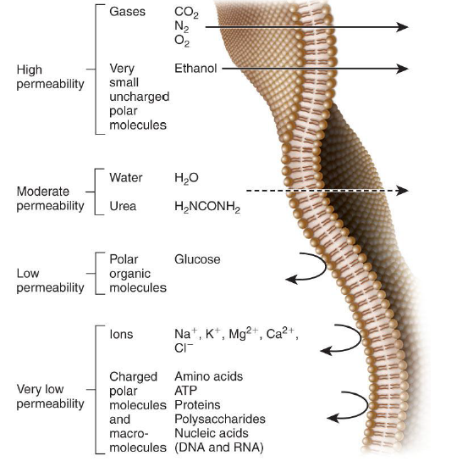
Compartmentalization and Permeation Across Membranes

Slide 6
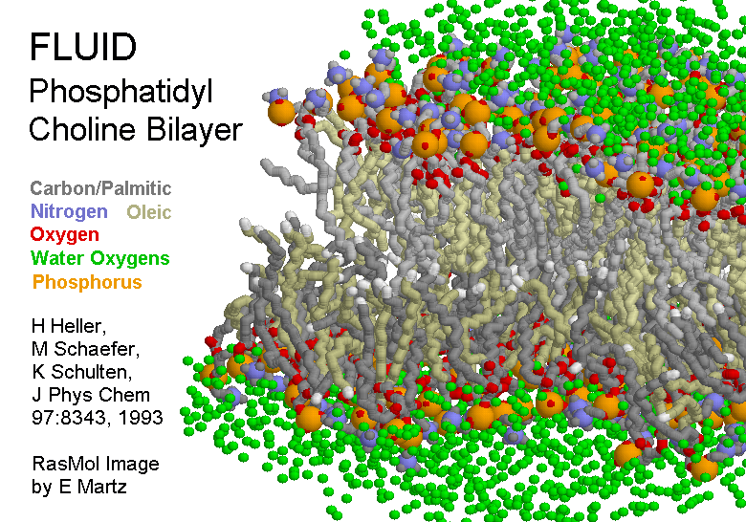

Slide 7

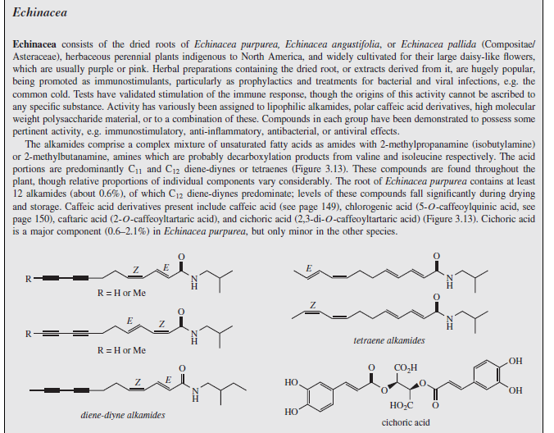

‘Medicinal’ Lipids

Slide 8
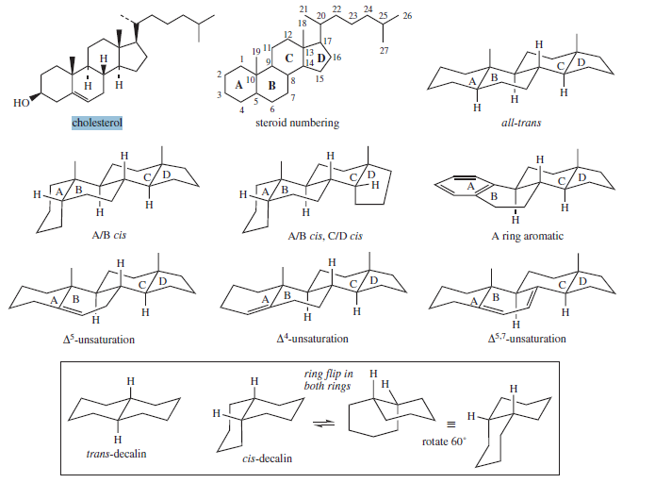
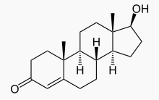
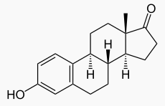
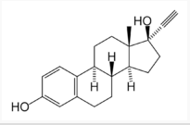
Steroid Lipids: Structural and Signaling Molecules

Slide 9
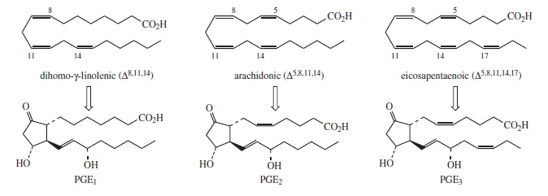
Prostaglandins: Signaling Molecules

Slide 10
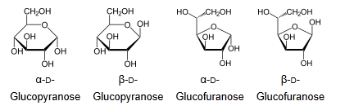

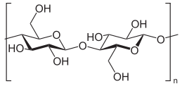
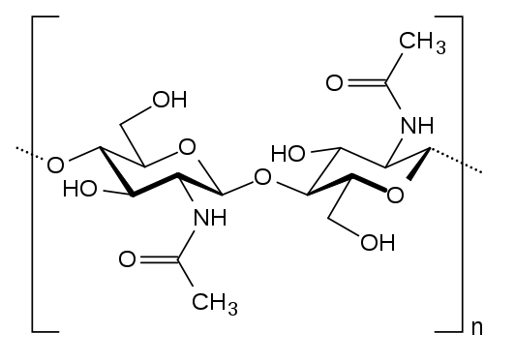
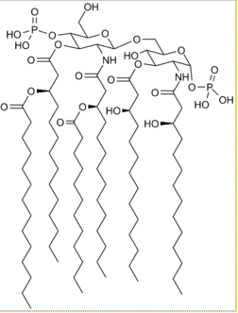
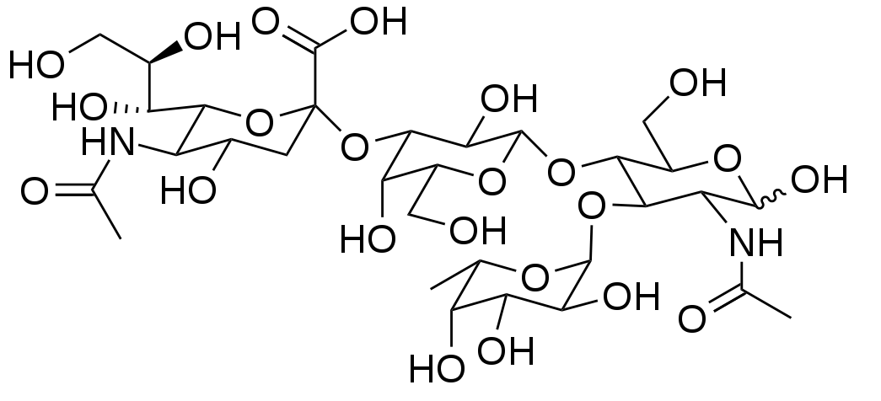
Carbohydrates: Structural and Functional Complexity

