Slide 1
The goal is to find a sort or formula(s) that can easily identify these numbers.
The common thread is these numbers all end in 1,3,7,9.
This is where we will create “wild card” numbers. So, any numbers that end in 3 (13, 23, 33, 43, … 113, 123, … 111003) can all be grouped together.
In real life we group and sub group collections of things all sorts of things. All the blue marbles. All the diesel engines. All the red trucks with manual transmissions. All the big birds. All the white buffalos. Sorting in and sorting out things.
Numbers are the same thing, there is nothing special about a group of numbers. All numbers that end with 3, could be categorized as *3 (wildcard three). This creates a sorting of the numbers with a least significant digit of 3.
'*' Wild Card Sort Least Significant Digit for Prime Numbers

Slide 2
0
1
2
3
4
5
6
7
8
9
All numbers no matter how big will end with one of the above digits. We can represent the number 113 as *3 or 1127 as *7.
'*' Wild Card Sort Least Significant Digit for Prime Numbers

Slide 3
0
2
4
6
8
1
3
5
7
9
All the even digits can be sorted off and discarded first.
'*' Wild Card Sort Least Significant Digit for Prime Numbers

Slide 4
0
2
4
6
8
5
1
3
7
9
Next we will move all the digits that end in 5 next to the even digits. Any multiple of 5 will end in zero (0) or five (5).
'*' Wild Card Sort Least Significant Digit for Prime Numbers

Slide 5
0
2
4
6
8
5
1
3
7
9
All multiples of 5 can then be discarded. This leaves the focus of primes to only numbers ending in 1,3,7,9
'*' Wild Card Sort Least Significant Digit for Prime Numbers

Slide 6
5 +/- 2
0 +/- 1
0
2
4
6
8
5
3
7
9
1
These number are unique in that they lay around 5 and 0 numbers. They can be represented as 5-2 or 5+2 or 0-1 or 0+1. All primes will lay near numbers ending in 5 or 0.
'*' Wild Card Sort Least Significant Digit for Prime Numbers

Slide 7
5 +/- 2
0 +/- 1
0
2
4
6
8
5
3
7
9
1
3
7
9
1
We can further eliminate multiples of 3; 3, 6, 9, 12, 15 . . .
Which are one third of all the wildcard numbers
'*' Wild Card Sort Least Significant Digit for Prime Numbers

Slide 8
5 - 2
0 - 1
0
2
4
6
8
5
3
7
9
1
3
7
9
1
This leaves 2/3’s of each wild card number.
5 + 2
0 + 1
'*' Wild Card Sort Least Significant Digit for Prime Numbers

Slide 9
5 - 2
0 - 1
3
7
9
1
3
7
9
1
0 + 1
5 + 2
'*' Wild Card Sort Least Significant Digit for Prime Numbers

Slide 10
3
7
9
1
3
7
9
1
5 - 2
0 - 1
0 + 1
5 + 2
'*' Wild Card Sort Least Significant Digit for Prime Numbers

Slide 11
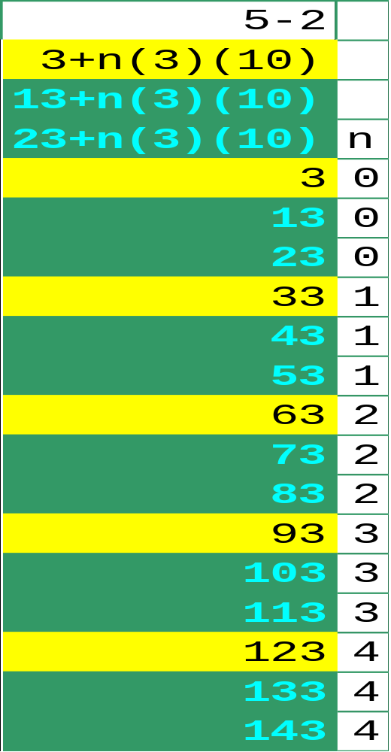
3
This leaves the following numbers and formulas.
The multiples of 3 are in yellow, the odd *3 numbers are in green. The *3 are odd candidates for prime.
3
5 - 2
'*' Wild Card Sort Least Significant Digit for Prime Numbers

Slide 12
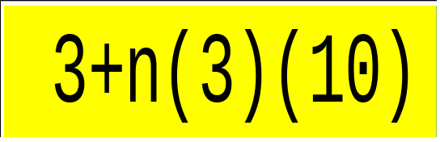
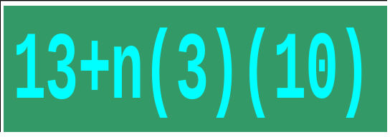
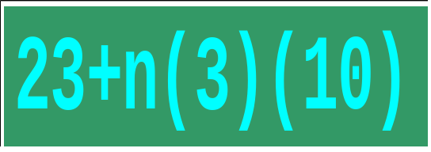
3
3
3
For n = 0,1,2,3, … ∞
'*' Wild Card Sort Least Significant Digit for Prime Numbers

Slide 13
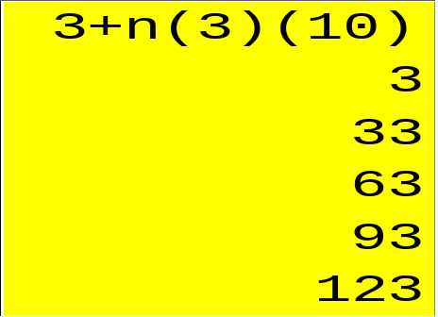
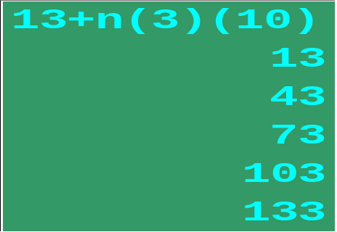
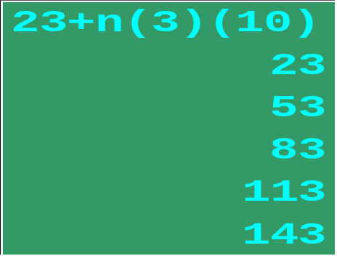
3
3
3
5 - 2
'*' Wild Card Sort Least Significant Digit for Prime Numbers

Slide 14
'*' Wild Card Sort Least Significant Digit for Prime Numbers

Slide 15
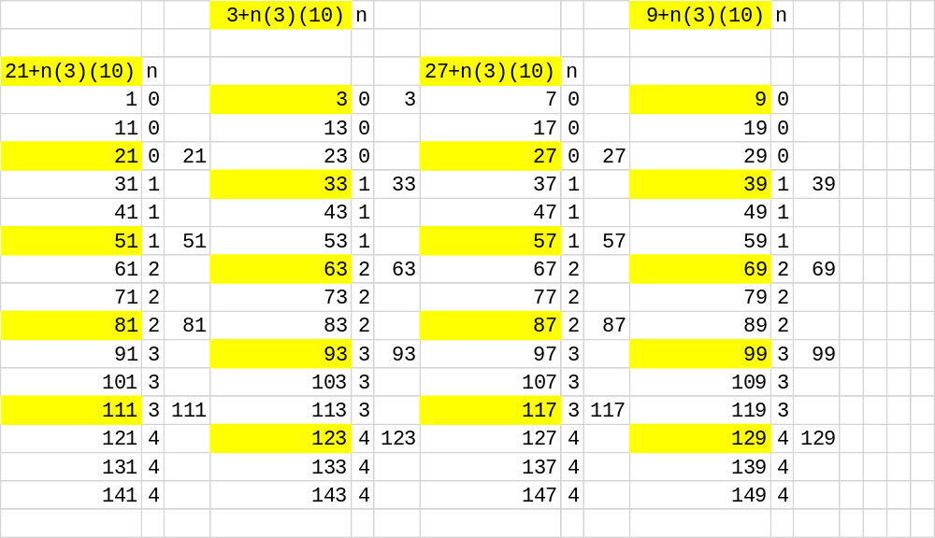
Here are all of the formulas, and the yellow marked numbers are multiples that can be divided by 3.
'*' Wild Card Sort Least Significant Digit for Prime Numbers

Slide 16
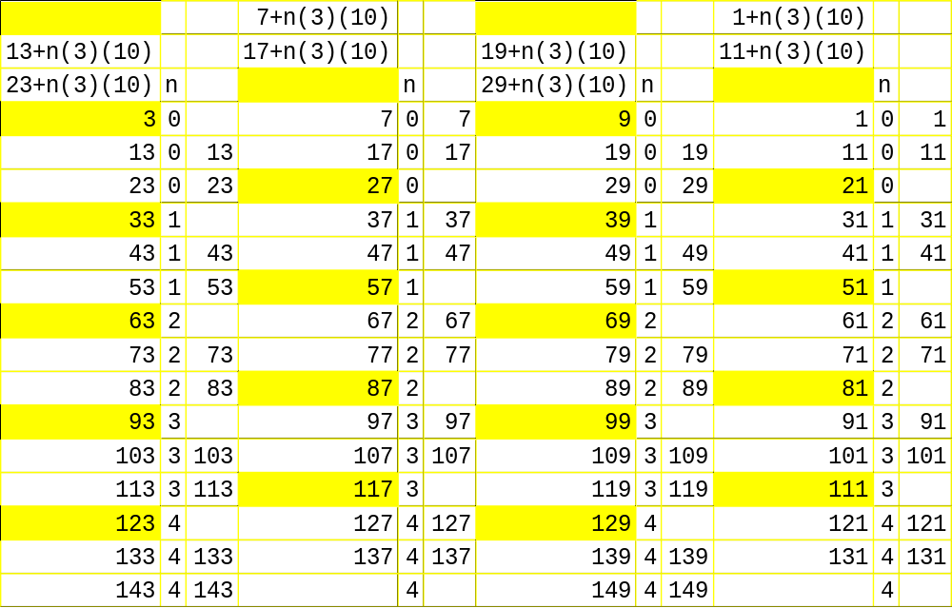
Next sort off all the yellow numbers, we are left with the matrix of odd numbers that could be prime numbers.
'*' Wild Card Sort Least Significant Digit for Prime Numbers

Slide 17
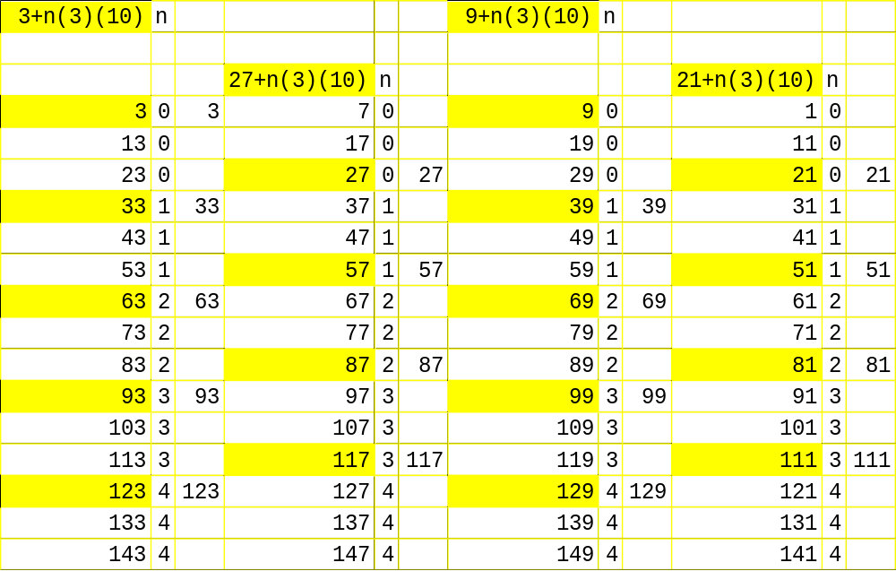
Finally, here are the sorted off numbers, these can be discarded.
'*' Wild Card Sort Least Significant Digit for Prime Numbers

Slide 18
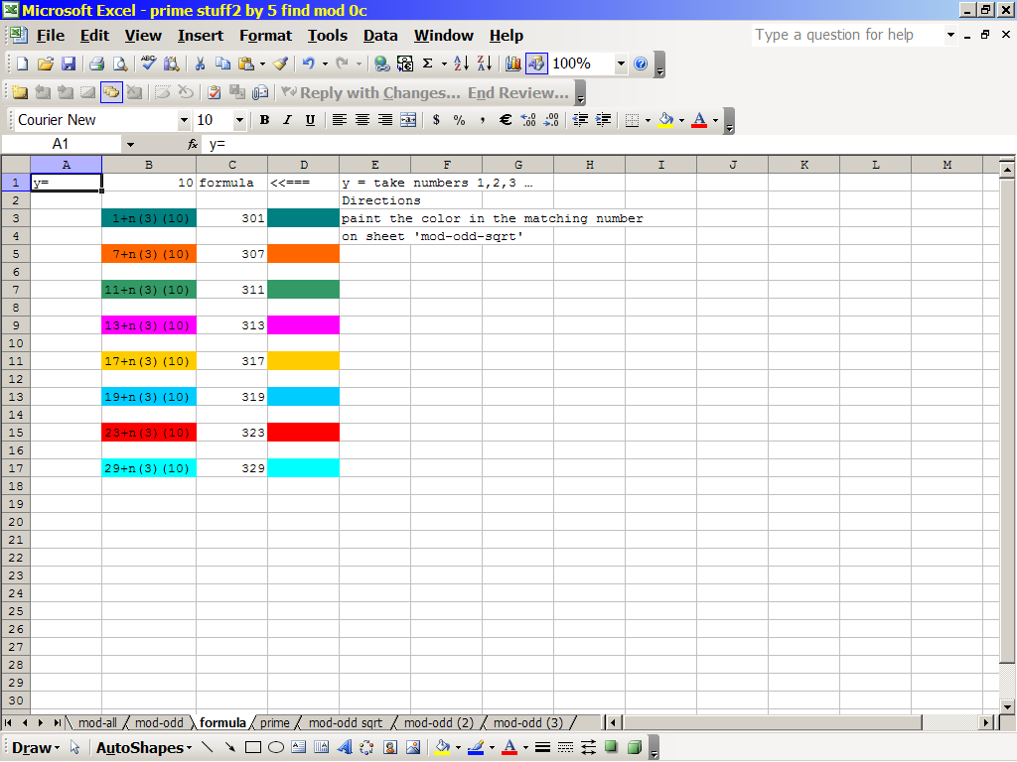
'*' Wild Card Sort Least Significant Digit for Prime Numbers

Slide 19
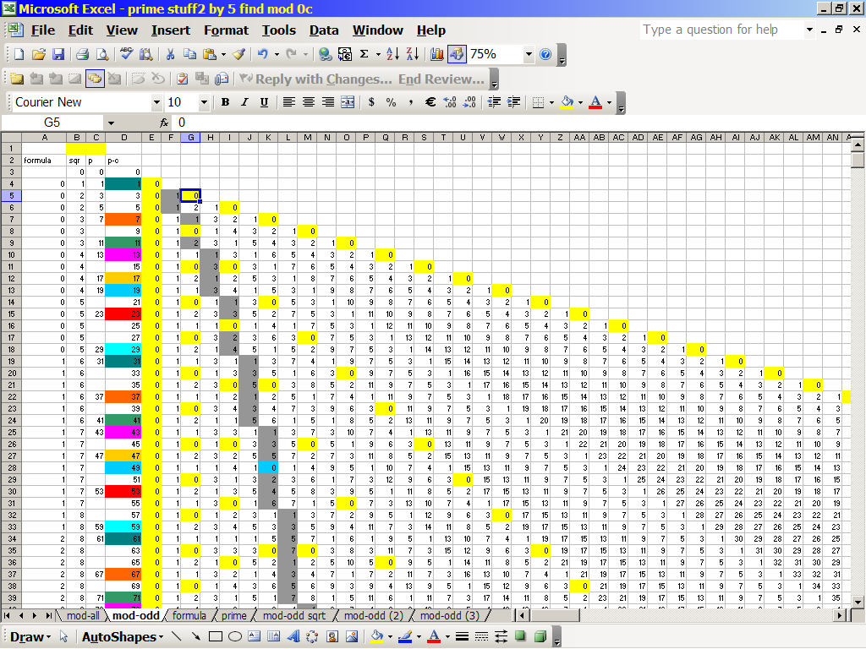
'*' Wild Card Sort Least Significant Digit for Prime Numbers

Slide 20
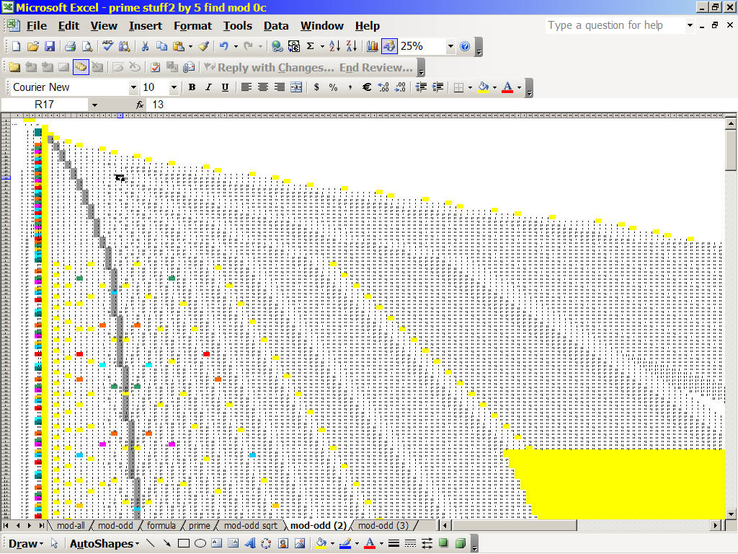
'*' Wild Card Sort Least Significant Digit for Prime Numbers

Slide 21
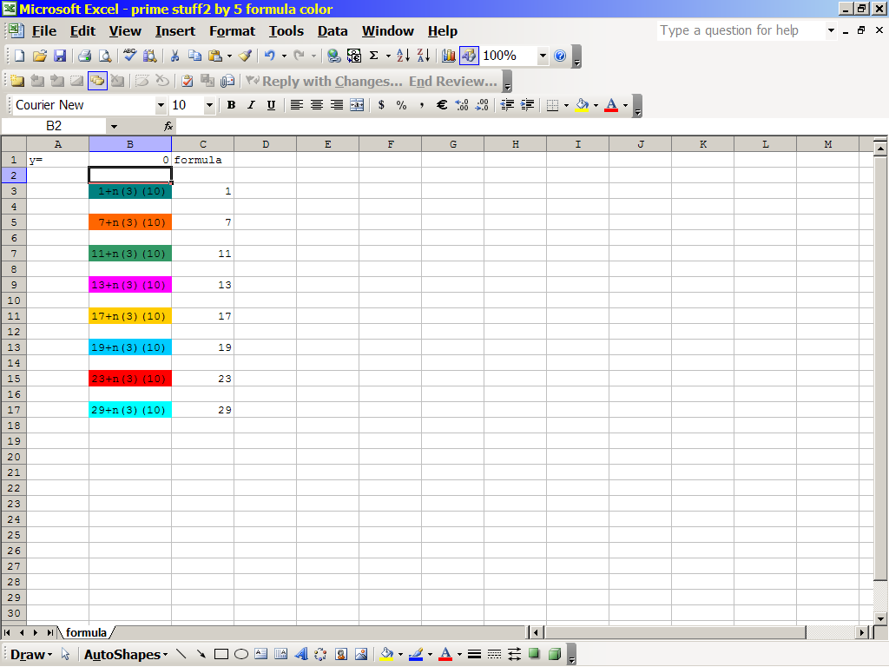
'*' Wild Card Sort Least Significant Digit for Prime Numbers

Slide 22
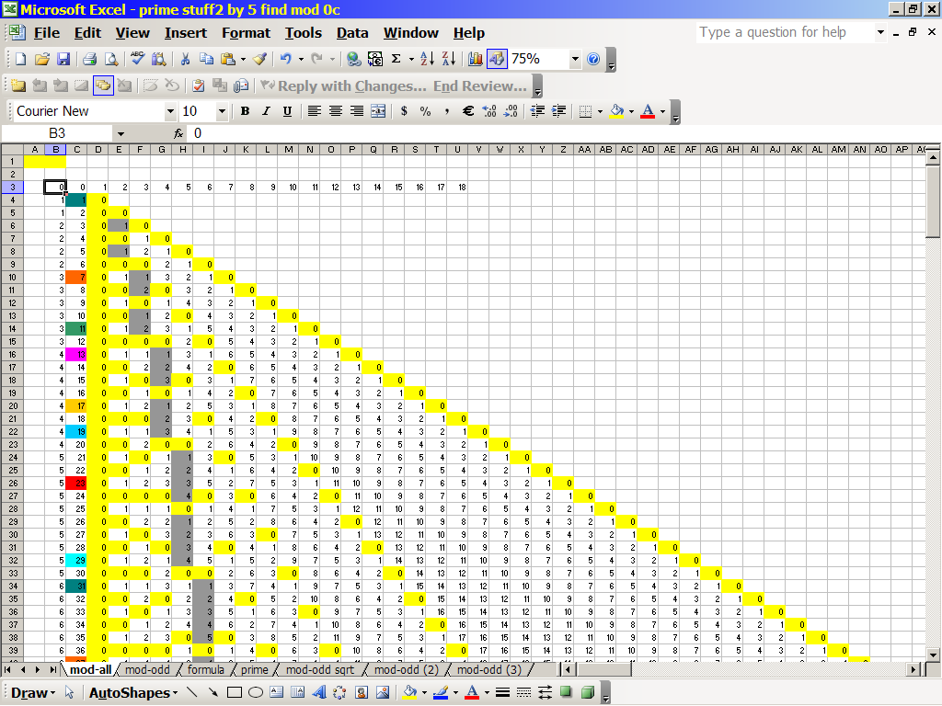
'*' Wild Card Sort Least Significant Digit for Prime Numbers

Slide 23
1
3
7
9
11
13
17
19
21
23
27
29
'*' Wild Card Sort Least Significant Digit for Prime Numbers

Slide 24
1
2
3
4
5
6
7
8
9
10
11
12
13
14
15
16
17
18
19
20
21
22
23
24
25
26
27
28
29
30
'*' Wild Card Sort Least Significant Digit for Prime Numbers

