Slide 1
Python Programming Foundations
Day 1 - Coding/Course Setup
“Creating the working environment”

Slide 2

Setup Is Part Of The Course
Before writing Python comfortably, your computer needs a stable setup.
The goal is not to memorize setup steps. The goal is to create a reliable place to run your code.
Notes:
**Instructor Notes:**
Frame setup as infrastructure, not as the first "programming test."
Students can become discouraged if installation issues feel like proof that they cannot code.
**Transition Cue:**
The setup has several pieces, but each has a clear job.

Slide 3

Setup Path
Course setup path:
Python ->
project folder ->
`.venv` ->
VS Code ->
GitHub
Each piece supports a different part of the workflow.

Slide 4
What Success Look Like
check your Python version
open a project in VS Code
select a `.venv` interpreter
run a small `.py` file
see your code in GitHub or prepare it for submission

Slide 5

What We Will Use Today
Python from `python.org`
PowerShell or terminal verification commands
project folders
`.venv` virtual environments
Visual Studio Code
Microsoft Python extension
VS Code interpreter selection
VS Code source control / GitHub integration

Slide 6
What We Will “Skip” For Now
advanced dependency management
publishing packages
complex Git branching
pull request reviews
deployment
Python pre-release versions

Slide 7
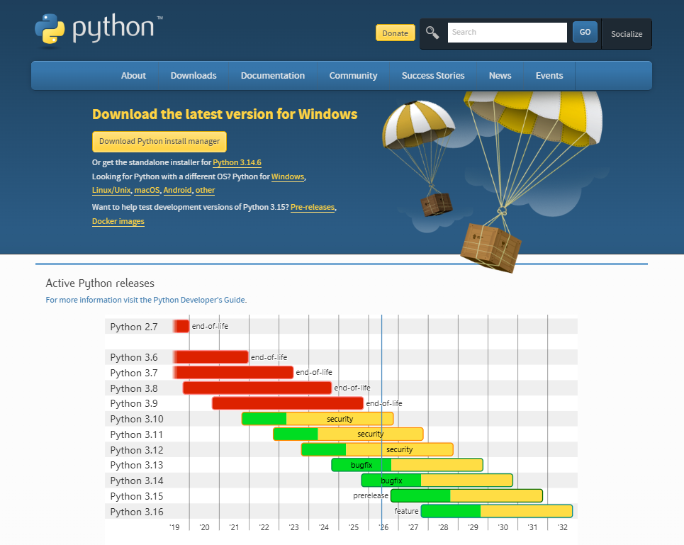
Download Python
url: python.org/downloads
Notes:
**Instructor Notes:**
As of June 9, 2026, Python.org lists Python 3.14.5 as the latest release.
Students should use the official Python website rather than random download mirrors.
For Windows, Python.org may offer the Python install manager or a standalone installer.
Either path is acceptable if the installation can be verified in the terminal.
**Transition Cue:**
After downloading, install in a way that lets the terminal find Python.

Slide 8
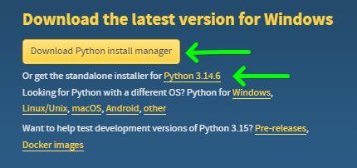
Windows – Two options
Either option will work
(The top one is the easiest)
Notes:
**Instructor Notes:**
For Windows, Python.org may offer the Python install manager or a standalone installer.
Either path is acceptable if the installation can be verified in the terminal.

Slide 9
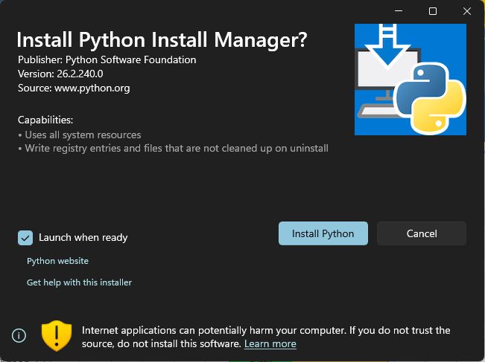
New: Python Install Manager
(Your textbook does not mention this)

Slide 10

Install Python
The Install manager will make sure that a usable `py` or `python` command is created.
If the installer offers PATH-related options, you should enable the option that lets Python run from the terminal.
Once the process is finished:
Open a terminal (powershell)
On the command line type `py`
Optionally, next type the command `help’
Notes:
**Instructor Notes:**
Avoid over-teaching every installer screen.
The practical success check is whether students can open PowerShell and run a version command.
If the installer offers PATH-related options, students should enable the option that lets Python run from the terminal.
**Transition Cue:**
The install is not complete until we verify it.

Slide 11

Verify Python
Once the process is finished:
Open a Terminal or Powershell and run one of the following commands:
`python --version`
`py --version`
`python –m pip --version`
Optionally, launch the interactive python shell and try the help command
`py`
Then type: `help`
Within help: `keywords`, `modules`, `symbols` or `topics`
Notes:
**Instructor Notes:**
On Windows, `py --version` may work even when `python --version` does not.
That is acceptable for course use as long as students know which command they are using.
The `pip` check confirms that package management is available through the selected Python.
**Transition Cue:**
Next, create a project folder so course work is organized from the beginning.

Slide 12
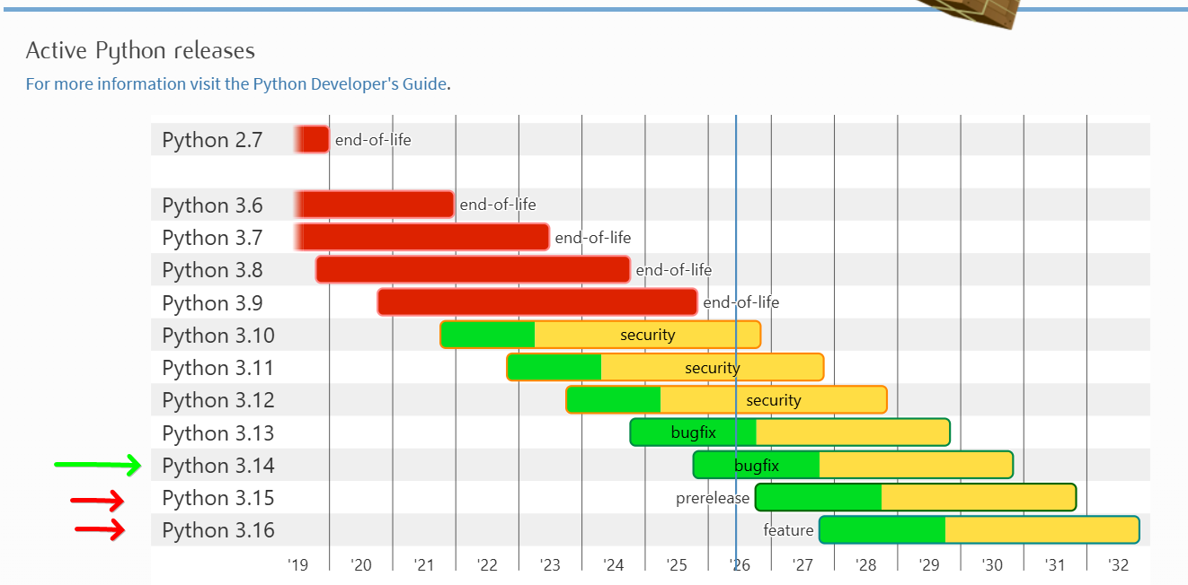
Version Boundary
Use a stable Python release.
Do not use pre-release versions for this course unless the instructor tells you to.
“You don’t want to get ‘bit’!” 😆
Notes:
**Instructor Notes:**
Students may see beta, alpha, or release candidate builds. Those are not appropriate for this course.
If a student already has Python installed, verify the version before deciding whether they need to change anything.
**Transition Cue:**
Now we need a place for the course files.

Slide 13
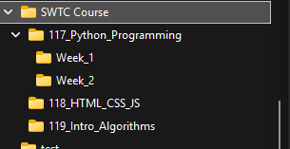
Create A Course Folder
Create a folder, or folder structure for your course work.
Keep your projects and assignments organized from the start.
Notes:
**Instructor Notes:**
Recommend a simple path without spaces or unusual characters if possible.
Students can use their normal Documents folder, but should know where the work is stored.
**Transition Cue:**
Inside project folders, Python can use a local virtual environment.

Slide 14
What A Virtual Environment Does
A virtual environment is a local Python workspace for one project.
It helps keep project packages separate from the rest of your computer.
It also allows for different “versions” of python to “co-exist” on one machine. This will be important when working on legacy software applications.
Notes:
**Instructor Notes:**
Keep this conceptual. Students do not need dependency theory yet.
They need the idea that `.venv` belongs to the project and helps prevent package confusion.
**Transition Cue:**
The standard beginner-friendly folder name is `.venv`.

Slide 15

Create `.venv`
From the project folder, using the terminal or powershell, create a virtual environment:
`py -m venv .venv`
If `py` is not available, use:
`python -m venv .venv`
Notes:
**Instructor Notes:**
Explain the command in plain language:
- `py` or `python` starts Python
- `-m venv` runs the virtual environment tool
- `.venv` is the folder being created
**Transition Cue:**
After creating `.venv`, activate it or select it in VS Code.

Slide 16
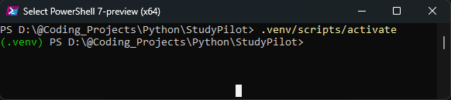
Activate `.venv` In PowerShell
Windows PowerShell activation:
Command:
`.\.venv\Scripts\Activate.ps1`
When active, the terminal prompt usually shows:
(.venv)
Notes:
**Instructor Notes:**
If execution policy blocks activation, do not derail the whole lesson.
VS Code can still select the interpreter, and the issue can be handled individually.
The visible `(.venv)` prefix is useful evidence, but the stronger check is which Python interpreter VS Code is using.
**Transition Cue:**
You can also let VS Code use the `.venv` directly.

Slide 17
Why `.venv` Matters Later
Later: when projects use packages, `.venv` helps keep installs project-specific.
For Week 1: the goal is simply to know what `.venv` is and how to create/select it.
Notes:
**Instructor Notes:**
This prevents a common misconception: students may think venv is unnecessary because early scripts do not install packages.
The value becomes more visible later.
**Transition Cue:**
Now we need an editor that can use Python and the virtual environment.

Slide 18
Install Visual Studio Code
Notes:
**Instructor Notes:**
NOTE: This may already be installed on their school issued laptops. In which case, skip or skim this section
Emphasize Visual Studio Code, not Visual Studio. These are different products.

Slide 19
Difference between VS Code and Visual Studio
Visual Studio is a true IDE - Integrated Developer Environment.
Heavy footprint (takes a lot of memory)
Great for C# and .NET framework development
Doesn’t play well on an iOS machines
VS Code is a code editor, not a true IDE … but can function as a full-IDE by installing the extensions
Widely used!!
Smaller footprint (faster load and execution)
Updated very frequently
Supports multiple development languages and frameworks

Slide 20
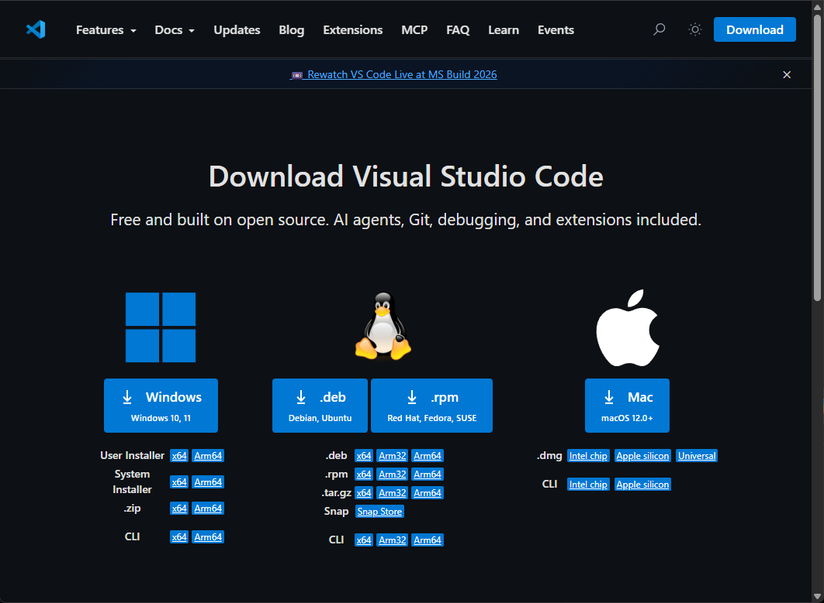
Download VS Code
url: code.visualstudio.com/download

Slide 21

VS Code Extensions

Slide 22
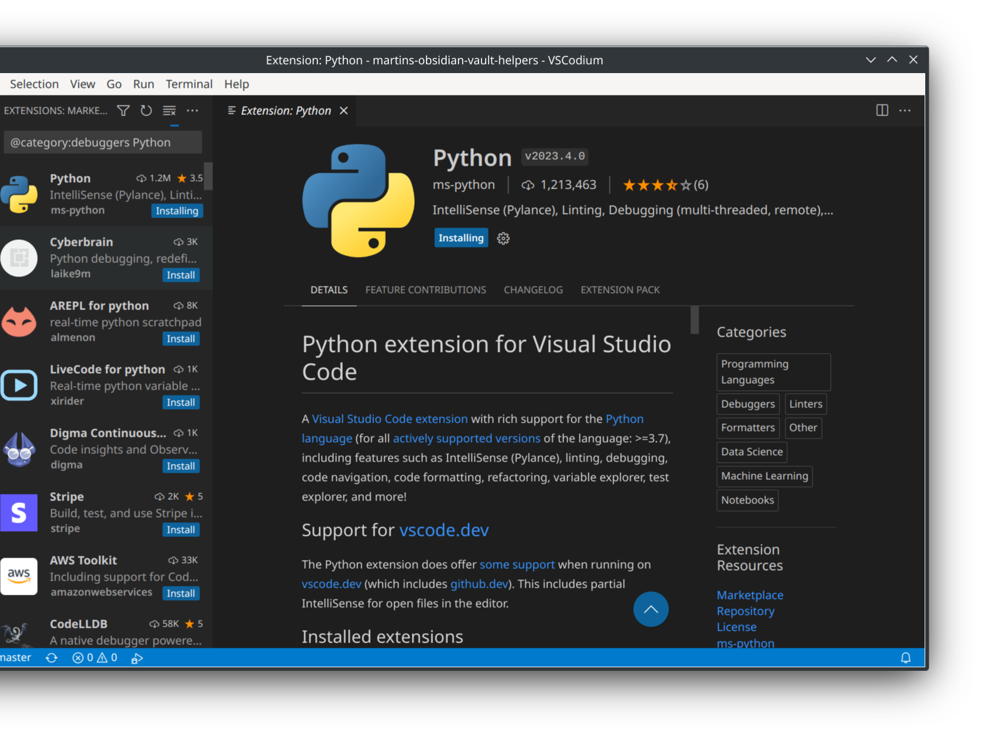
Install Python Extensions
Recommended VS Code extensions:
Python
Pylance
Python Environments
Python Extension Pack, optional (Don Jayamanne)
Python Development Extensions Pack, optional
Jupyter, optional
Use trusted publishers such as Microsoft.
This Photo by Unknown Author is licensed under CC BY-SA
Notes:
**Instructor Notes:**
The Microsoft Python extension provides core Python support.
Pylance provides language intelligence.
Python Environments helps manage and select environments.
The Extension packs auto install many supporting extensions and are optional
Jupyter is optional and only needed if notebooks are used.
Mention extension trust: students should avoid random extensions that claim to help with Python unless the instructor approves them.
**Transition Cue:**
After extensions are installed, VS Code must know which Python to use.

Slide 23
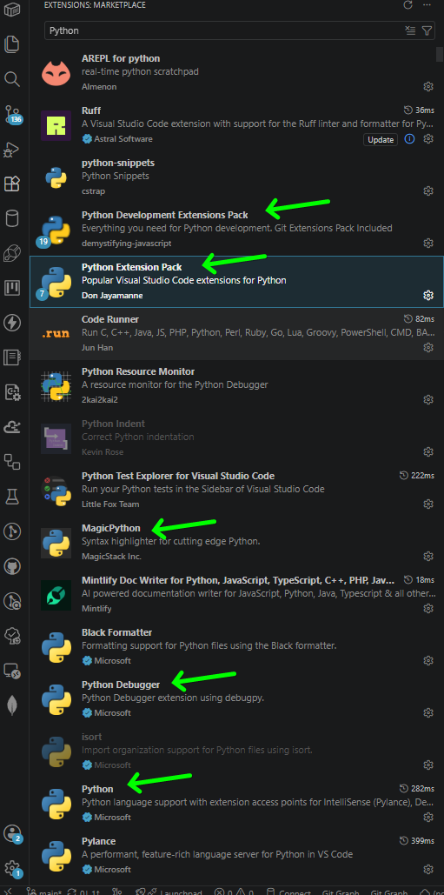
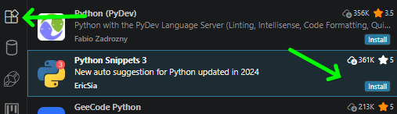
Install Python Extensions
Select the Extensions button on the left side bar.
Search for the desired extensions
Click on the “Install”
Notes:
**Instructor Notes**
Step by step instructions for those who may be a bit overwhelmed
**Transition Cue:**
There are some additional extensions that can provide helpful tools.
After extensions are installed, VS Code must know which Python to use.

Slide 24
Install Optional Additional Extensions
Some cool extensions
Better Comments
Better Todo Tree
Bracket Pair Color DLW
Colorful Dark+
Colorful Comments
#region folding for VS Code
Powershell Extension Pack
Print
Git Extensions Pack
Git Graph

Slide 25
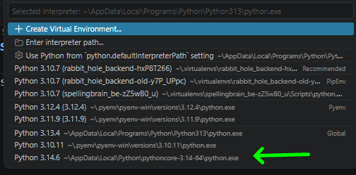
Select The Python Interpreter
In VS Code:
Open the project folder.
Open the Command Palette (Ctrl+Shift+P).
Choose `Python: Select Interpreter`.
Select the interpreter inside `.venv`.
Notes:
**Instructor Notes:**
This is the most important VS Code setup step.
Students often install Python correctly but run code with the wrong interpreter.
The selected interpreter may appear in the VS Code status bar or Python environment selector.
**Transition Cue:**
The terminal should also line up with the selected environment.

Slide 26
VS Code And `.venv`
VS Code can detect and use virtual environments.
When the `.venv` interpreter is selected, new VS Code terminals can activate that environment automatically.
If it is not selected, you will need to manually activate the virtual environment using the activate command
Notes:
**Instructor Notes:**
VS Code's Python tooling can switch between interpreters, including virtual environments.
If the terminal does not activate automatically, students can still activate manually or reselect the interpreter.
**Transition Cue:**
Now verify that VS Code can run a small Python file.

Slide 27
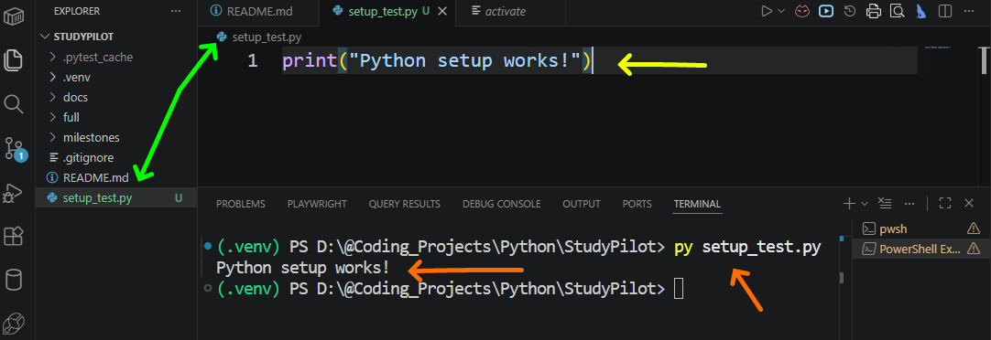
Run A Test File
Create a file: `setup_test.py`
Add the line: `print(“Python setup works!”)
Execute the file from integrated terminal: `py setup_test.py`
Notes:
**Instructor Notes:**
This is the practical setup success check. It is intentionally tiny.
**Transition Cue:**
After code runs locally, students need a way to submit and preserve work.

Slide 28

GitHub Submission Paths
There are two common GitHub paths:
Git CLI commands (you should learn these regardless)
VS Code Source Control and GitHub extensions
Both paths should preserve code changes clearly.
Notes:
**Instructor Notes:**
Frame VS Code GitHub integration as an alternate workflow, not as a separate standard.
The underlying concepts remain the same: files change, changes are committed, and work is pushed or submitted.
There will be times when the only available option is to use the CLI commands!
**Transition Cue:**
VS Code includes source control tools directly in the editor.

Slide 29
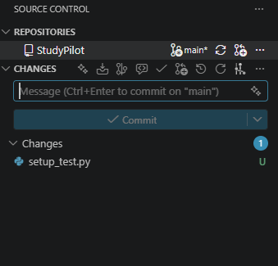
Source Control In VS Code
VS Code has a Source Control view for Git work.
You can see changed files, write a commit message, commit, and sync without typing every Git command manually.
Notes:
**Instructor Notes:**
Important boundary: VS Code still relies on Git being available on the computer for normal local Git workflows.
If Git is missing, install Git for Windows or use the GitHub tools supported by the instructor's workflow.
**Transition Cue:**
GitHub extensions can make GitHub-specific actions easier.

Slide 30
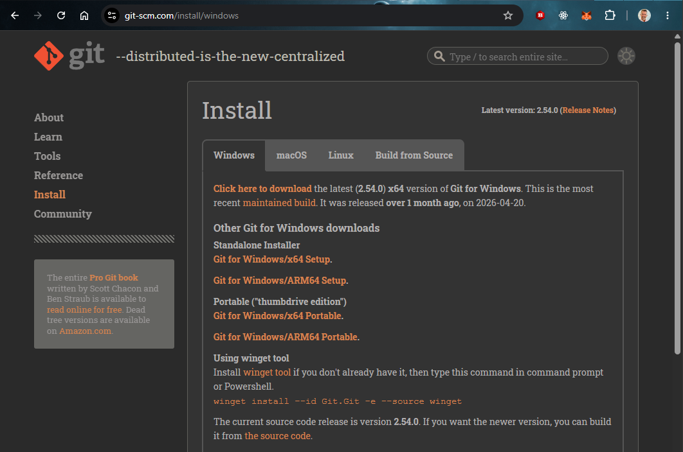
Git Install for Windows
url: git-scm.com/install/windows
Notes:
**Instructor Notes**
If Git is missing, install Git for Windows.

Slide 31
Initialize git for your project(s)
Using either VS Code or the CLI – initialize git (locally) for your project.
`git init`
Note:
This does not setup a GitHub repository in the cloud. It only sets it up local.
Later we will connect the local with the GitHub repo

Slide 32

GitHub Extensions
Useful GitHub-related VS Code extensions:
GitHub Pull Requests
GitHub Repositories
These can help with GitHub sign-in, repositories, commits, and pull-request workflows.
Notes:
**Instructor Notes:**
For this course, the most important student workflow is basic submission, not
advanced pull request review.
GitHub Repositories can browse and work with remote GitHub repositories from VS
Code. GitHub Pull Requests supports PR and issue workflows.
**Transition Cue:**
Students should still understand the basic vocabulary.

Slide 33
GitHub Vocabulary
Core GitHub Words
Keyword | Definition/Use
Repository | Project storage
Clone | Copy repository to your computer
Commit | Save a meaningful change
Push | Send commits to GitHub
Sync | Pull and push changes through VS Code
Notes:
**Instructor Notes:**
Keep this vocabulary practical. Do not teach complex branching here.
**Transition Cue:**
Now compare CLI and VS Code workflows.

Slide 34
CLI Or VS Code
Git CLI and VS Code can both support the same workflow:
change files -> review changes -> commit -> push or sync
Use either path (or the one your instructor approves) for the assignment.
Notes:
**Instructor Notes:**
This prevents students from treating VS Code as a separate concept from Git.
The interface changes; the core workflow remains.
**Transition Cue:**
Before the first assignment, check the setup end to end.

Slide 35

Setup Verification Checklist
Setup checklist:
Python version command works
project folder exists
`.venv` exists
VS Code opens the folder
VS Code selects the `.venv` interpreter
`setup_test.py` runs
GitHub workflow is understood or ready to practice
Notes:
**Instructor Notes:**
This slide can become the student-facing checklist in Schoology.
**Transition Cue:**
If something fails, diagnose the exact layer.

Slide 36

Troubleshooting Layers
When setup fails, locate the layer:
Python install
terminal command
project folder
`.venv`
VS Code interpreter
Git or GitHub sign-in
Fix one layer at a time.
Notes:
**Instructor Notes:**
This prevents broad panic.
Students often say "Python does not work" when the actual issue is PATH, interpreter selection, or terminal activation.
**Transition Cue:**
Once setup is verified, students are ready for the first real coding session.

Slide 37
Ready For First Programs
You are ready for Week 1 coding when:
Python runs
VS Code opens your project
`.venv` is available
a tiny `.py` file prints output
your submission path is clear
Notes:
**Instructor Notes:**
End with readiness, not tool worship.
The setup exists to support learning Python, not to become the course itself.
**Transition Cue:**
Next, we write the first tiny Python program.

Slide 38

Demo/ Walkthrough

Slide 39
Demo / Walkthrough Notes (Review)
1. Open `python.org/downloads/`.
2. Show the latest stable Python release.
3. Install or verify Python.
4. Run version checks in PowerShell.
5. Create a project folder.
6. Create `.venv`.
7. Open VS Code.
8. Install Python-related extensions.
9. Select the `.venv` interpreter.
10. Run `setup_test.py`.
11. Source Control and GitHub extension locations in VS Code.

Slide 40

Your Turn
Install Python
Run version checks
Install VS Code if needed
Setup Project Folders
Create .venv
Open VS Code
Install Extensions
Select the interpreter
Run `setup_test.py`
Initialize git locally
Commit your change(s)

Slide 41

Setup Evidence
Recommended evidence:
screenshot or copied terminal text showing Python version
screenshot or note showing `.venv` exists
screenshot or copied output from `setup_test.py`
confirmation that VS Code selected the `.venv` interpreter
confirmation of local git, GitHub sign-in, or instructor-approved submission path
Keep this as setup evidence only or for troubleshooting. This is NOT graded.
Notes:
**Instructor Notes:**
Do not rush the trace.
Ask students what low, high, and mid mean before running the binary search explanation.
The point is not that binary search "fails every time" on unsorted data.
The point is that it is not trustworthy because its reasoning no longer holds.
**Transition Cue:**
Watch the decisions, not just the final result.

Slide 42
Great! Now let’s start the class!

