Slide 1
Python Programming Foundations
Week 1 - First Programs and Basic Values
Day 2: “Move from Input to Output”

Slide 2

From Output To Value Flow
Yesterday:
we made output visible.
Today
We make values move through a program and produce a result.

Slide 3
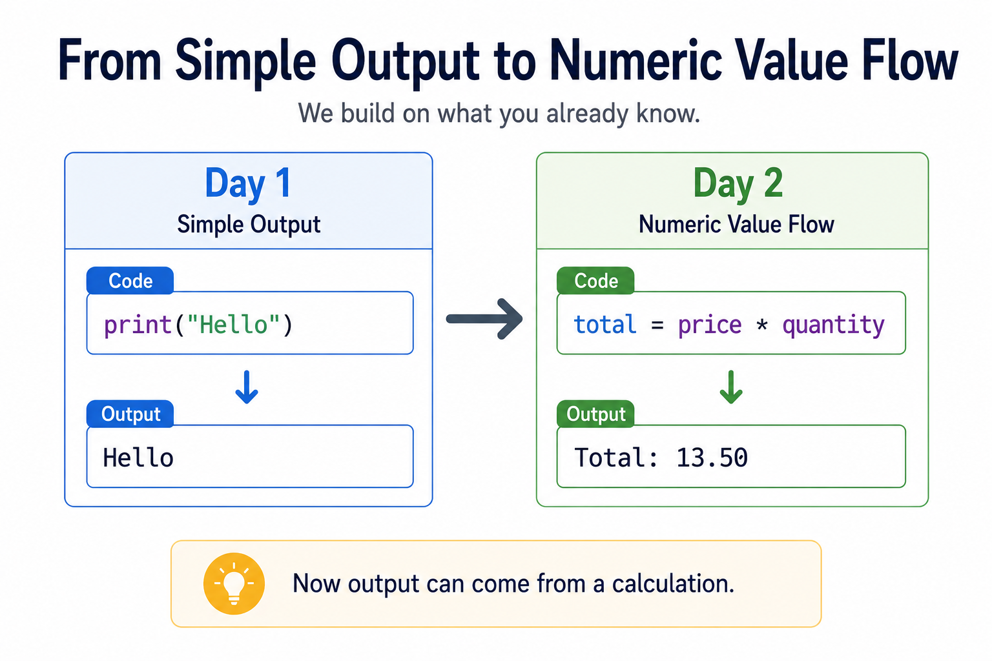
Output to Value Flow

Slide 4

Quick Review
A variable name refers to a stored value.
`print()` lets us see that value on the screen.
Notes:
**Instructor Notes:**
Ask students to identify the name and value in:
```python
course_name = "Python Programming"
```
Then ask what `print(course_name)` displays.
Keep this quick. The purpose is activation, not reteaching.
**Transition Cue:**
If a string can be stored in a variable, a number can be stored too.

Slide 5

What We Will Use Today
Numbers
simple expressions
result variables
`print()`
`input()` is optional and only useful if it does not distract you from value flow.
Notes:
**Instructor Notes:**
This slide protects cognitive load. Name what students should focus on and what they can safely ignore.
Explicitly say that assigned numeric variables are still a valid path for A1 if `input()` is not introduced or if it becomes distracting.
**Transition Cue:**
The first new idea is simple: numbers are values too.

Slide 6
What We Will “Skip” For Now
loops
functions
lists or dictionaries
file saving
AI-generated code
advanced numeric types

Slide 7
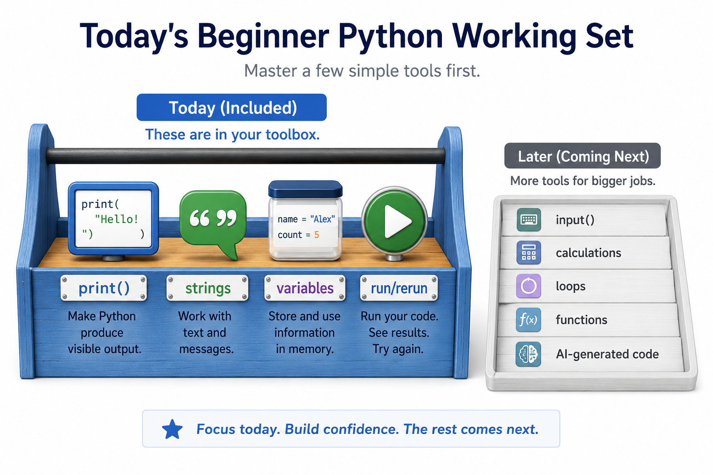
Working Set

Slide 8
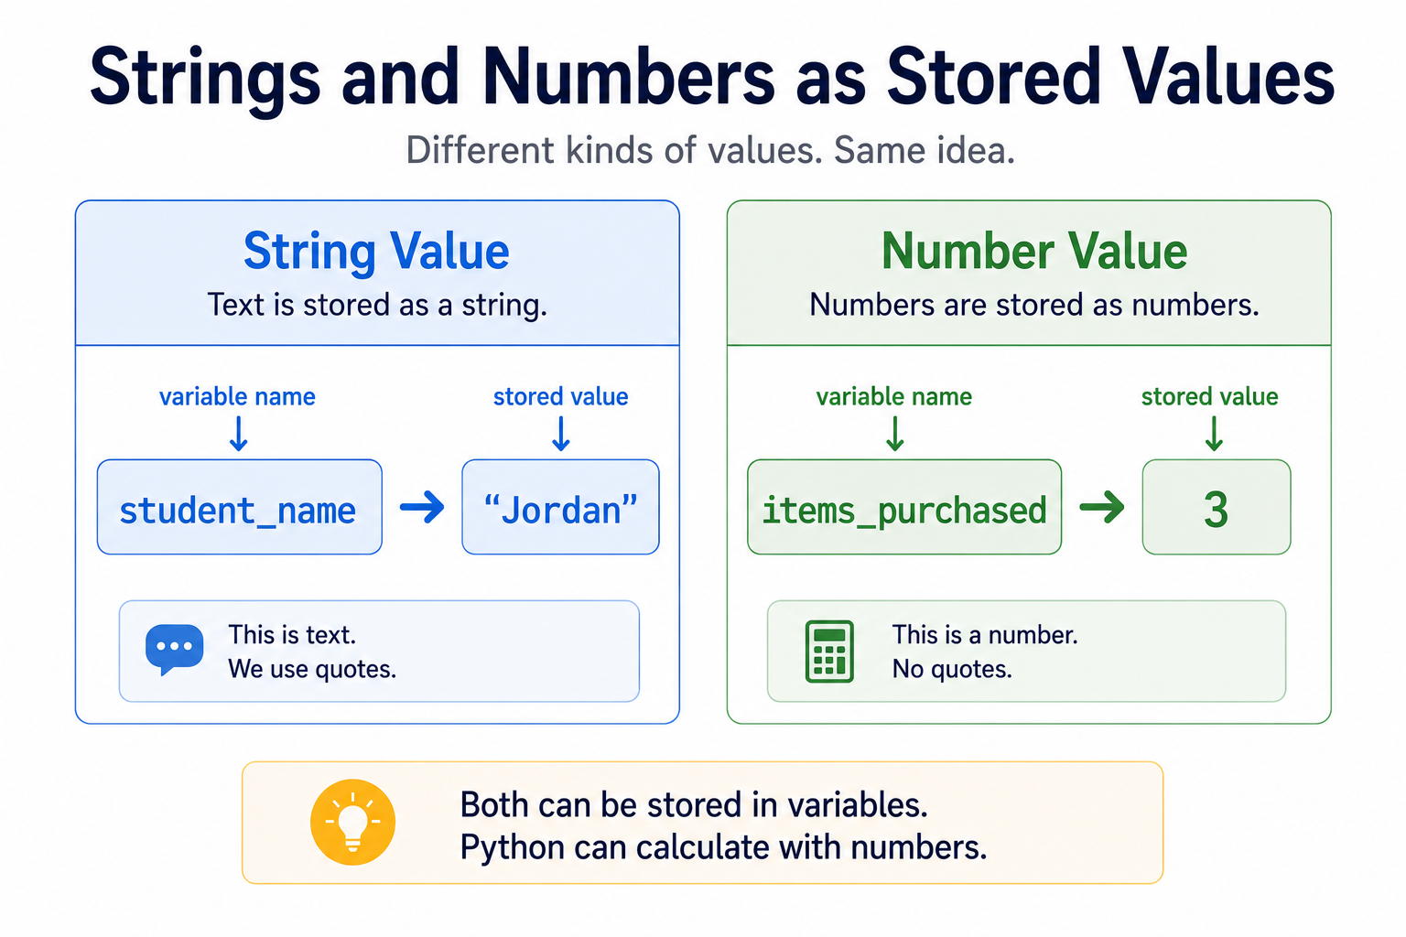
Numbers Are Values Too
Python can store numbers just like it stores text.
Numbers can also be used in calculations.
Notes:
**Instructor Notes:**
Use a direct comparison:
```python
student_name = "Jordan"
items_purchased = 3
```
Both are variables storing values.
The difference is what Python can do with those values.
**Transition Cue:**
Once numbers are stored, expressions can use them.

Slide 9
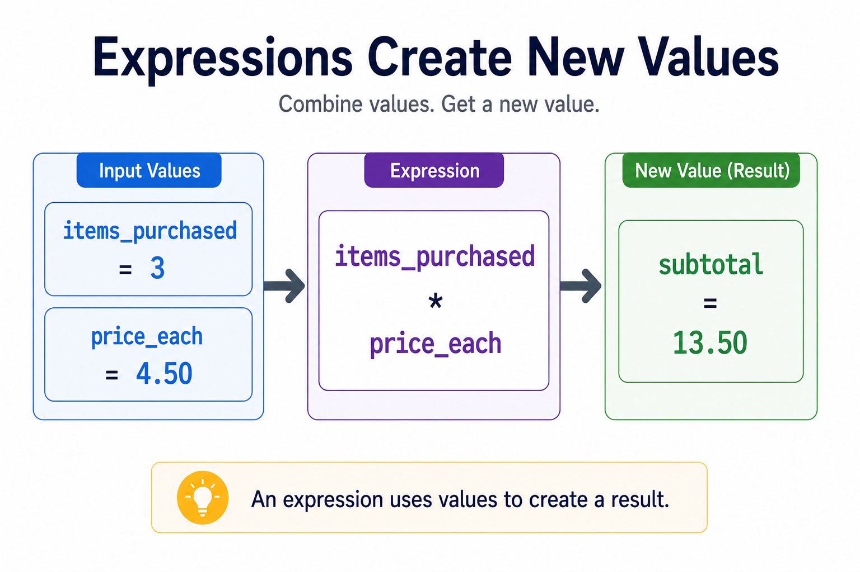
Expressions Create New Values
An expression combines values and produces a new value.
Example:
`items_purchased * price_each` creates a subtotal.
Notes:
**Instructor Notes:**
Keep operators practical:
- `+` adds
- `-` subtracts
- `*` multiplies
- `/` divides
Avoid turning this into a full math review.
The teaching point is that an expression produces a result the program can store or print.
**Transition Cue:**
The result of an expression usually deserves a clear name.

Slide 10
Result Variables
A result variable stores the answer from an expression.
Clear names help you explain what the answer means.
Notes:
**Instructor Notes:**
Use:
```python
subtotal = items_purchased * price_each
```
Ask what `subtotal` stores and why that name is easier to explain than `x`.
This reinforces professional habits gently without overloading naming theory.
**Transition Cue:**
Now the program has a value worth showing.

Slide 11

Output Should Mean Something
Printing a number is better when the output tells us what the number means.
`print("Subtotal:", subtotal)` is clearer than printing `subtotal` alone.
Notes:
**Instructor Notes:**
This slide prepares students for readable output in Assignment 1.
It also reinforces that output is communication, not just a proof that code ran.
Avoid formatting depth. Keep the pattern simple: label plus value.
**Transition Cue:**
The reasoning habit is to trace how the value reached the output.

Slide 12
Trace The Value
To understand a program, follow one value from start to finish.
Where did it start, what changed it, and where did it print?
Notes:
**Instructor Notes:**
This is the thinking-tool slide for the day.
Use the questions repeatedly:
- Where did this value start?
- Which expression changed it?
- Where was the result stored?
- What line printed it?
**Transition Cue:**
Let's turn that into a concrete path.

Slide 13
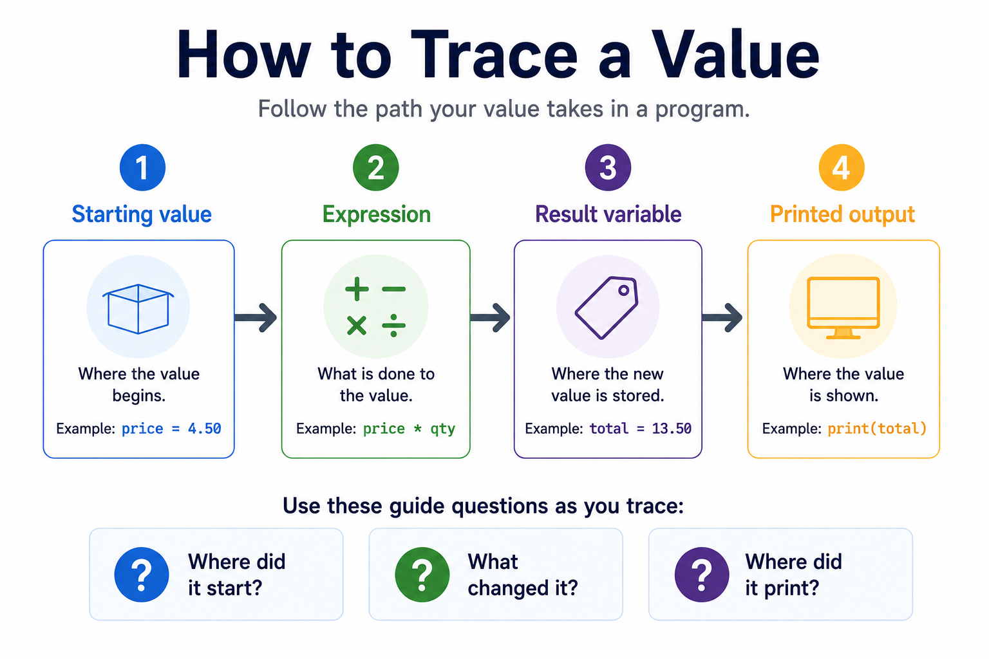
“Tracing a value path”

Slide 14

The Day 2 Value Path
Starting values become expression results.
Expression results become printed output.
This is also a foundation of knowing how to “debug” a programming issue.
Notes:
**Instructor Notes:**
Use the exact path:
```text
items_purchased -> subtotal -> tax_amount -> total -> printed output
```
Students do not need tax mastery. They need the habit of following the value.
**Transition Cue:**
Now we will watch that path in the numeric demo.

Slide 15

Demo #1
“Numeric Caclulation”

Slide 16
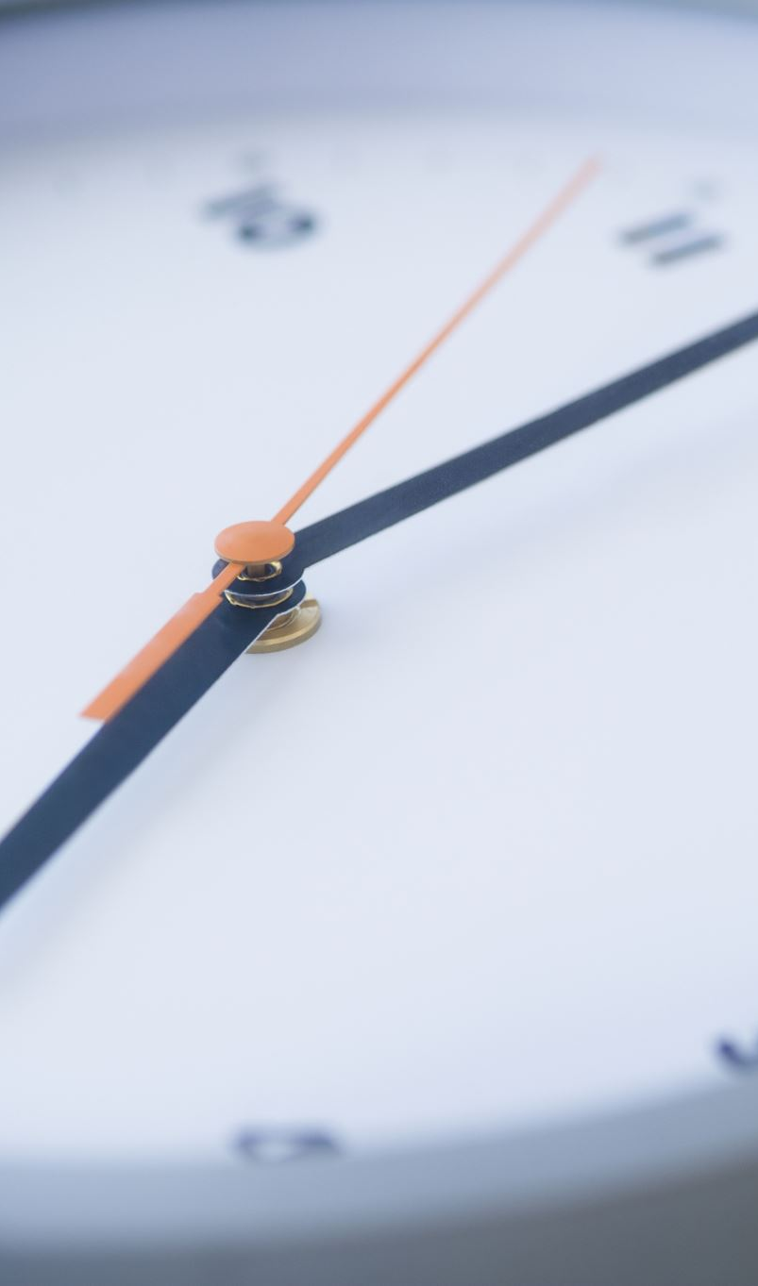
What to watch for
As the demo runs, watch for two things:
which values are stored
which lines make output appear
Notes:
**Instructor Notes**
`Demos/Week_01_First_Programs_and_Basic_Values/01_print_strings_variables.py`
Recommended live move:
1. Start with only `print("Welcome to class!")`.
2. Run it.
3. Add `course_name = "Python Programming"`.
4. Print `course_name`.
5. Add `student_name = "Jordan"`.
6. Print `student_name`.
After each run, ask:
What appeared?
Which line caused it?
Which value is being stored?
**Transition Cue:**
The next useful idea is that a variable can point to a different current value after we update it.

Slide 17
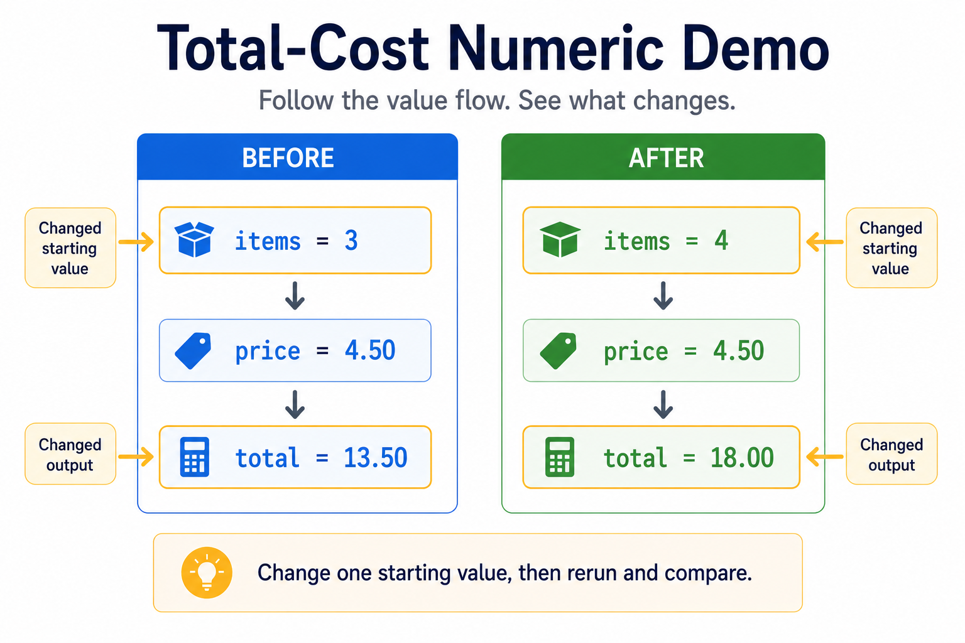
Numeric Demo Example

Slide 18
Optional Demo #2
“Simple Input”
Notes:
**Instructor Notes:**
Use only if students are stable with the first two demos and there is time.
Reference:
`Demos/Week_01_First_Programs_and_Basic_Values/03_numbers_expressions.py`
Frame this as a preview for Day 2, not as a Day 1 expectation. Students should
not leave thinking A1 must already include calculations if numbers have not
been taught carefully yet.
**Transition Cue:**
Before students begin, name the mistakes that are most likely to happen.

Slide 19

Optional Demo: Simple `input()`
`input()` can collect a user response.
That response still becomes a value the program must trace.
Notes:
**Instructor Notes:**
Use only if the class is ready:
`Demos/Week_01_First_Programs_and_Basic_Values/04_input_optional.py`
Keep it shallow:
- ask for a name
- store the response
- print a message using the stored value
Say explicitly that Assignment 1 may still use assigned variables if input has not been fully introduced.
**Transition Cue:**
If input is used for numbers, there is one extra issue to respect.

Slide 20
Optional Demo #3
“Numeric Conversion”
Notes:
**Instructor Notes:**
Use only if students are stable with the first two demos and there is time.
Reference:
`Demos/Week_01_First_Programs_and_Basic_Values/03_numbers_expressions.py`
Frame this as a preview for Day 2, not as a Day 1 expectation. Students should
not leave thinking A1 must already include calculations if numbers have not
been taught carefully yet.
**Transition Cue:**
Before students begin, name the mistakes that are most likely to happen.

Slide 21
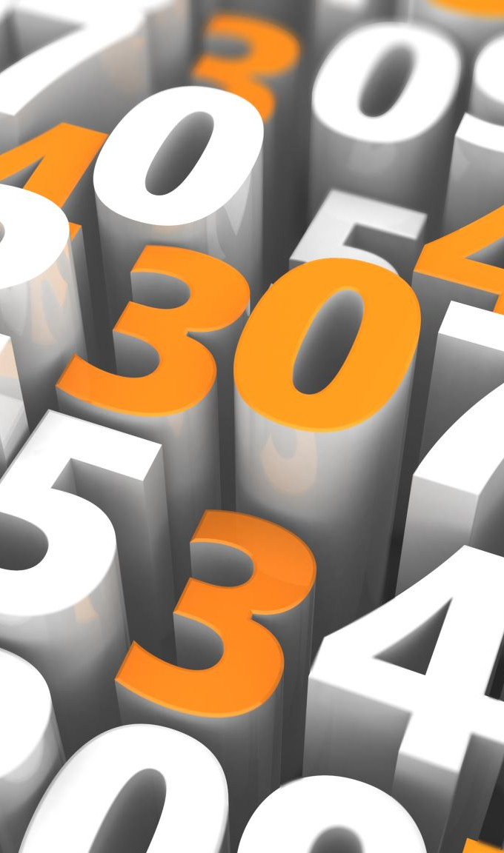
Optional Demo: Numeric Input Needs Conversion
`input()` gives Python text.
For math, numeric input must be converted first.
Notes:
**Instructor Notes:**
Use only if appropriate:
`Demos/Week_01_First_Programs_and_Basic_Values/05_input_number_conversion.py`
This is a common stumbling block.
If the group is shaky, do not demonstrate the error yet.
Show the correct pattern briefly or save it for a later session.
Keep the focus on concept:
------------------------------------------------------------------
typed response -> text -> converted number -> expression
------------------------------------------------------------------
**Transition Cue:**
Whether values are assigned or entered, the risk is losing track of where they came from.

Slide 22
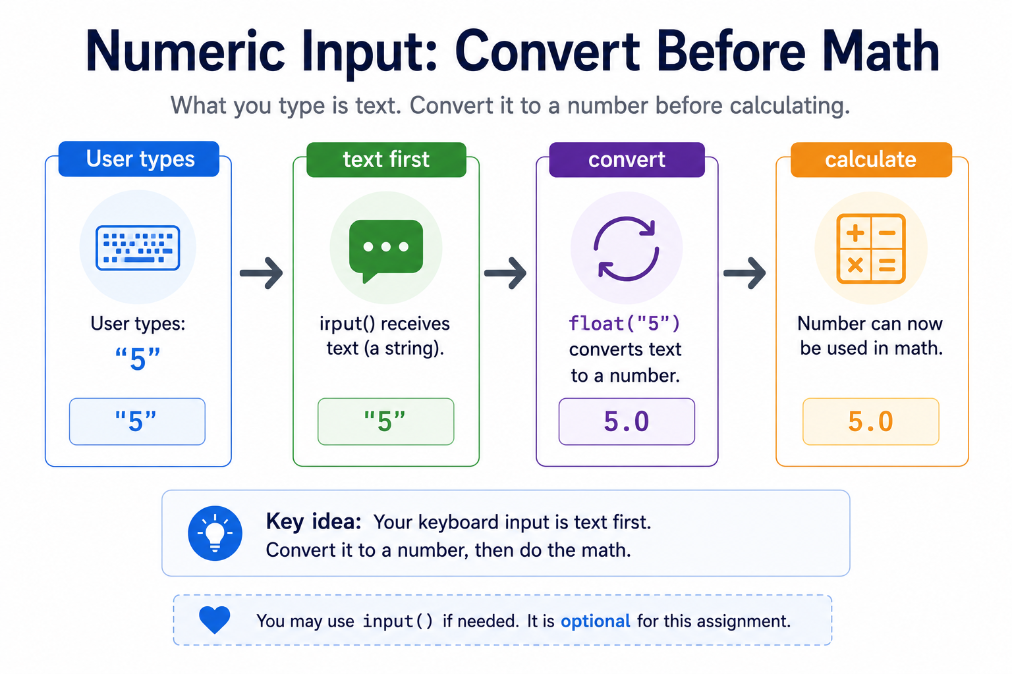
Numeric Conversion Example

Slide 23
Common Failure: Losing The Value
When several variables appear … it is easy to lose the path.
Slow down and ask:
“Where did this value come from?”
Notes:
**Instructor Notes:**
Students may see several variables and stop tracing.
Reinforce that tracing is not extra work.
It is how they understand the program.
Use the demo as the example:
- `items_purchased`
- `price_each`
- `subtotal`
- `tax_amount`
- `total`
**Transition Cue:**
The second risk is letting `input()` steal attention from the value path.

Slide 24
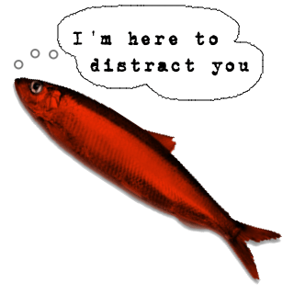
Common Failure: `input()` Can Distract
`input()` is useful, but it is not the main goal today.
The main goal is understanding how a value becomes output.
Notes:
**Instructor Notes:**
This slide keeps the course aligned with Assignment 1.
If students are excited by input, that is fine, but comprehension matters more.
Say:
------------------------------------------------------------------------------
If input helps your program, use it.
If input makes the program confusing, use assigned variables for now.
------------------------------------------------------------------------------
**Transition Cue:**
Now students can choose a small practical script and keep it traceable.

Slide 25

From Demo to Lab
In Lab/Assignment:
Build one small script that starts with numbers and prints a result.
Good choices:
Calculator
Converter
Total-cost estimator
This is a continuation of the first assignment.
Notes:
**Instructor Notes:**
Give students three controlled options:
- simple calculator
- unit converter
- total-cost estimator
Minimum version:
- assigned numeric variables
- one expression
- one result variable
- readable printed output
Optional extension:
- simple `input()` if introduced and stable
**Transition Cue:**
Before moving on, make sure the work has visible evidence.

Slide 26
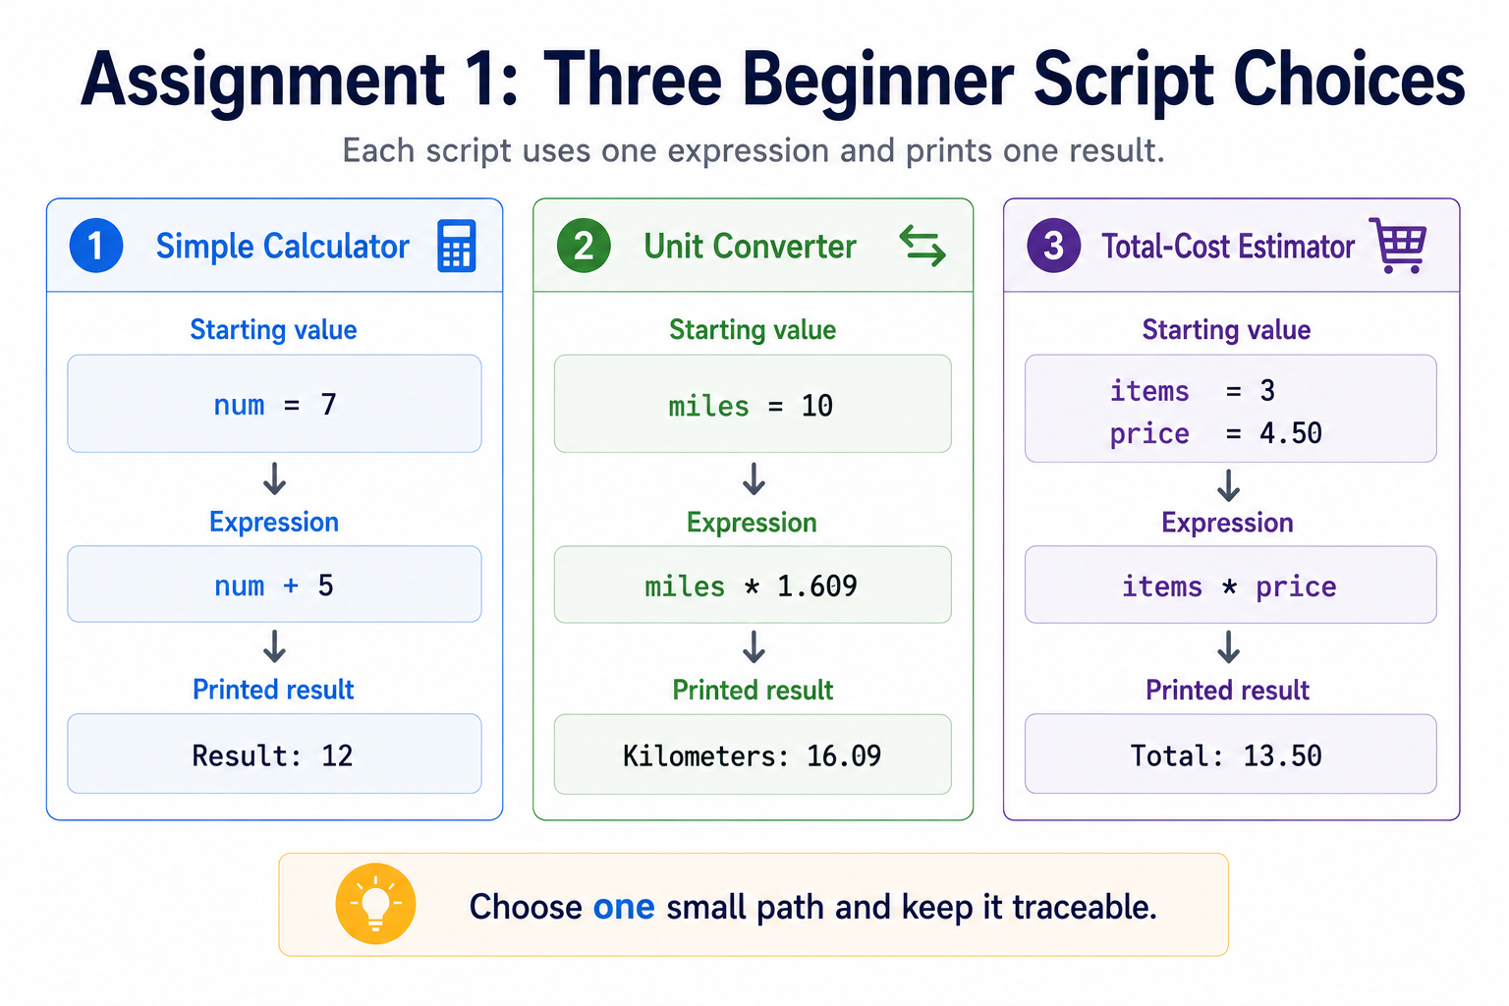
Hands-On Choices

Slide 27

Assignment Evidence
Preserve the `.py` file and one example of output.
Be ready to explain the value path from starting number to printed result.
Notes:
**Instructor Notes:**
Keep evidence light but real.
Students should be able to explain:
- starting value
- expression
- result variable
- printed output
If GitHub is already being introduced, this can become the first very small example of preserving code and output together.
Do not let that become the main lesson.
**Transition Cue:**
The final check is whether students can trace the result.

Slide 28
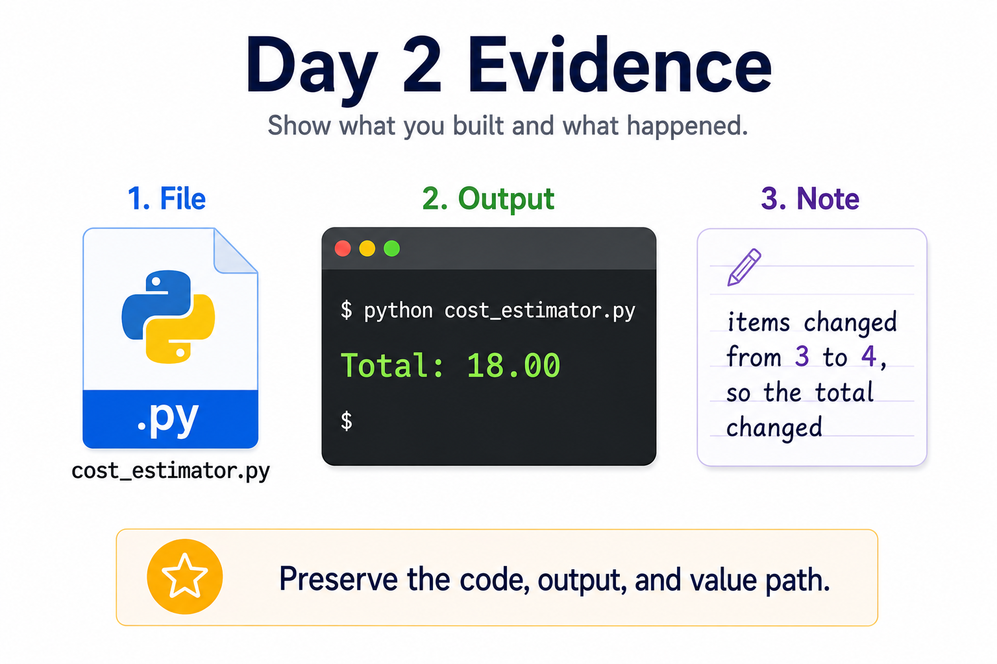
Assignment Evidence

Slide 29

Closing Success Check
By the end of today you should be able to:
store numbers,
calculate a result
print it clearly.
You should also be able to trace where the printed result came from.
Notes:
**Instructor Notes:**
Ask:
- What value started in this variable?
- What expression changed it?
- What was stored as the result?
- What printed at the end?
- If input was used, what did the user response become inside the program?
Name the next step: Day 3 will combine strings, numbers, and type awareness into clearer first programs.
**Transition Cue:**
Next class, we combine these values more carefully and prepare to close Assignment 1.

Slide 30
Thank you! Have Fun!

