Slide 1
Python Programming Foundations
Week 1 – First Programs and Basic Values
Day 3: “Basic Values Together”

Slide 2
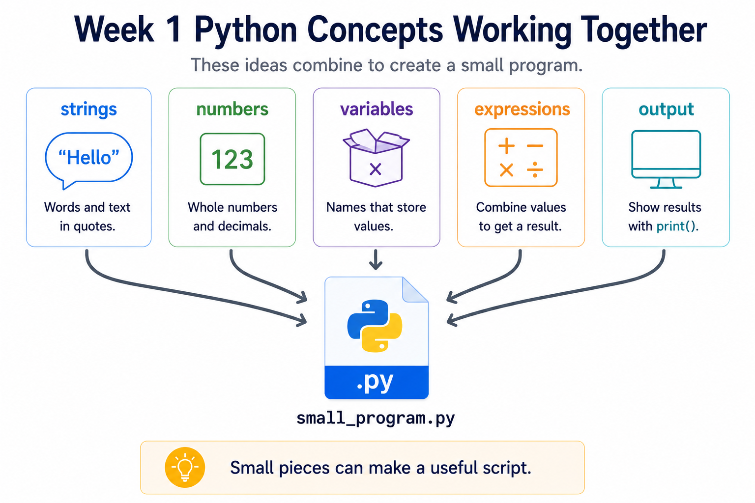
Put The Pieces Together
This week, you learned the smallest useful Python pieces.
Today, you combine them into tiny programs that run and make sense.
Notes:
**Instructor Notes:**
Frame the day as integration, not expansion.
Students may expect "more Python“ before they can build anything.
Push back gently: they already have enough to make several useful beginner scripts.
**Transition Cue:**
Start by naming what they already know.

Slide 3

Quick Review
Monday made output visible.
Tuesday made numeric value flow visible.
Notes:
**Instructor Notes:**
Ask students to recall one idea from each day:
- Monday: What does `print()` do?
- Tuesday: What does an expression create?
Keep this short. The point is to bridge into integration.
**Transition Cue:**
Now we focus on completing small programs, not collecting more topics.

Slide 4
What Counts as Success Today
NOT a large program
Small Program that:
Runs
Produces output
Can be Explained
Notes:
**Instructor Notes:**
This slide protects confidence.
Students may compare their first script to apps they use in daily life and feel the gap.
Reframe success around the course’s actual beginner target.
**Transition Cue:**
To stay focused, we need to name today's working set.

Slide 5

What We Will Use Today
strings
numbers
variables
simple expressions
`print()`
optional `input()` if stable
basic type awareness
Notes:
**Instructor Notes:**
This should feel like a toolbox students already recognize.
The point is integration, not a new list to memorize.
If `input()` is unstable or not introduced, state that assigned values remain a valid path for Assignment 1.
**Transition Cue:**
Just as important: there are topics we are not responsible for yet.

Slide 6
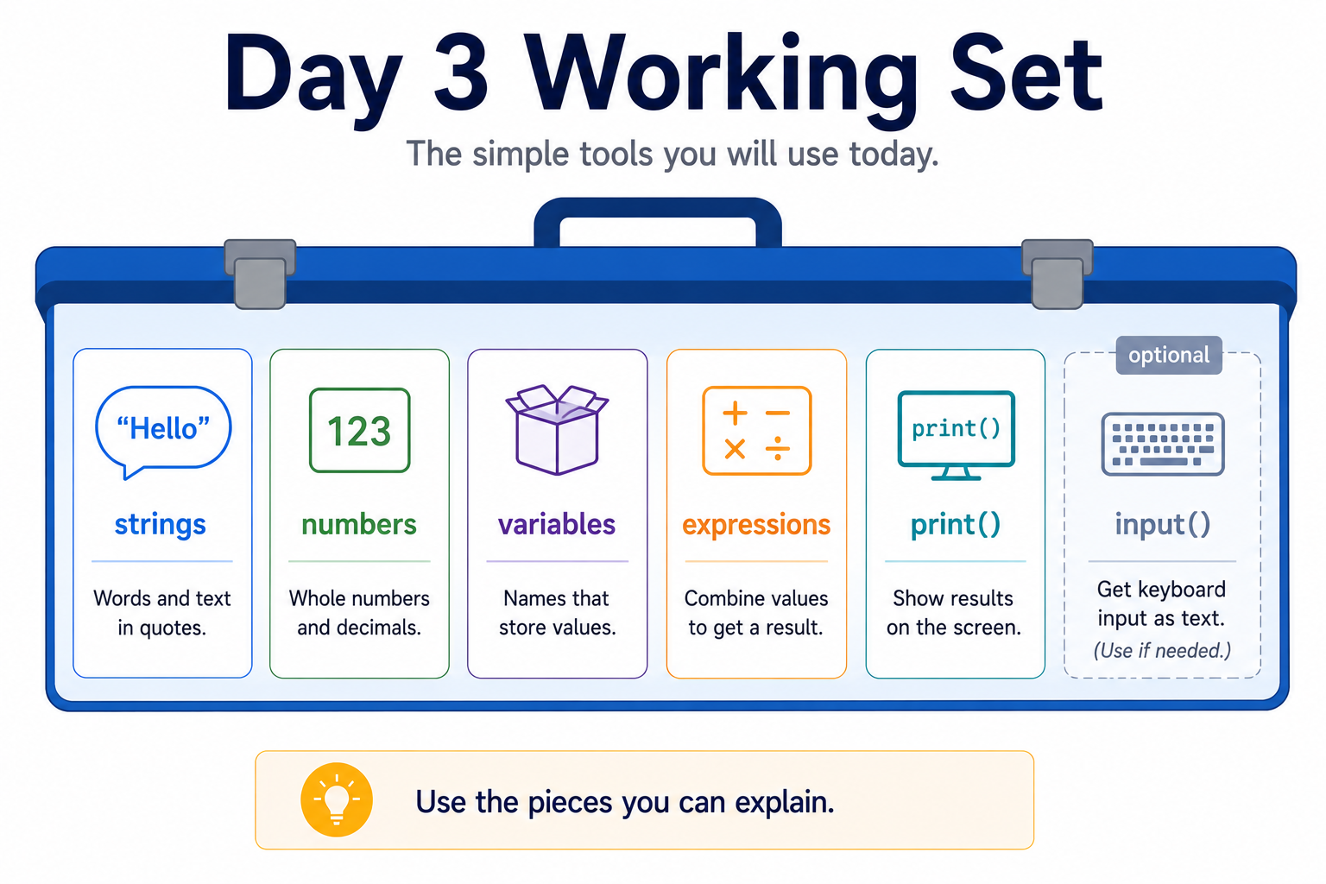
Working Set

Slide 7
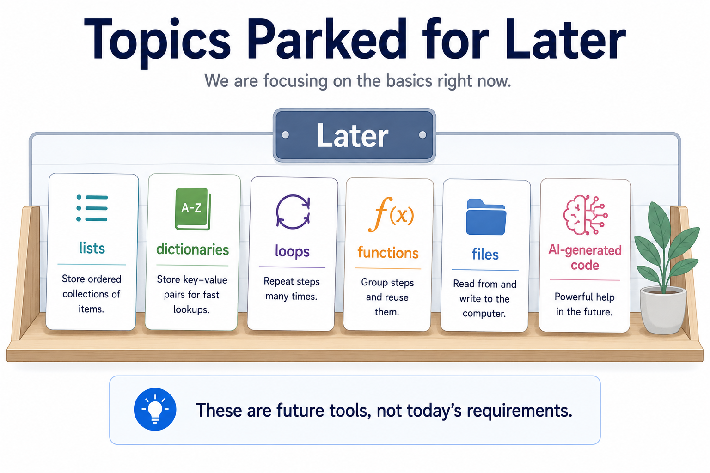
What to “Skip” for Now
Notes:
**Instructor Notes:**
Keep this reassuring.
These topics are not forbidden or unimportant.
They are future learning targets.
Separating them from today's working set prevents the textbook's breadth from turning into day-three anxiety.
**Transition Cue:**
With the working set clear, we can build small useful scripts.

Slide 8
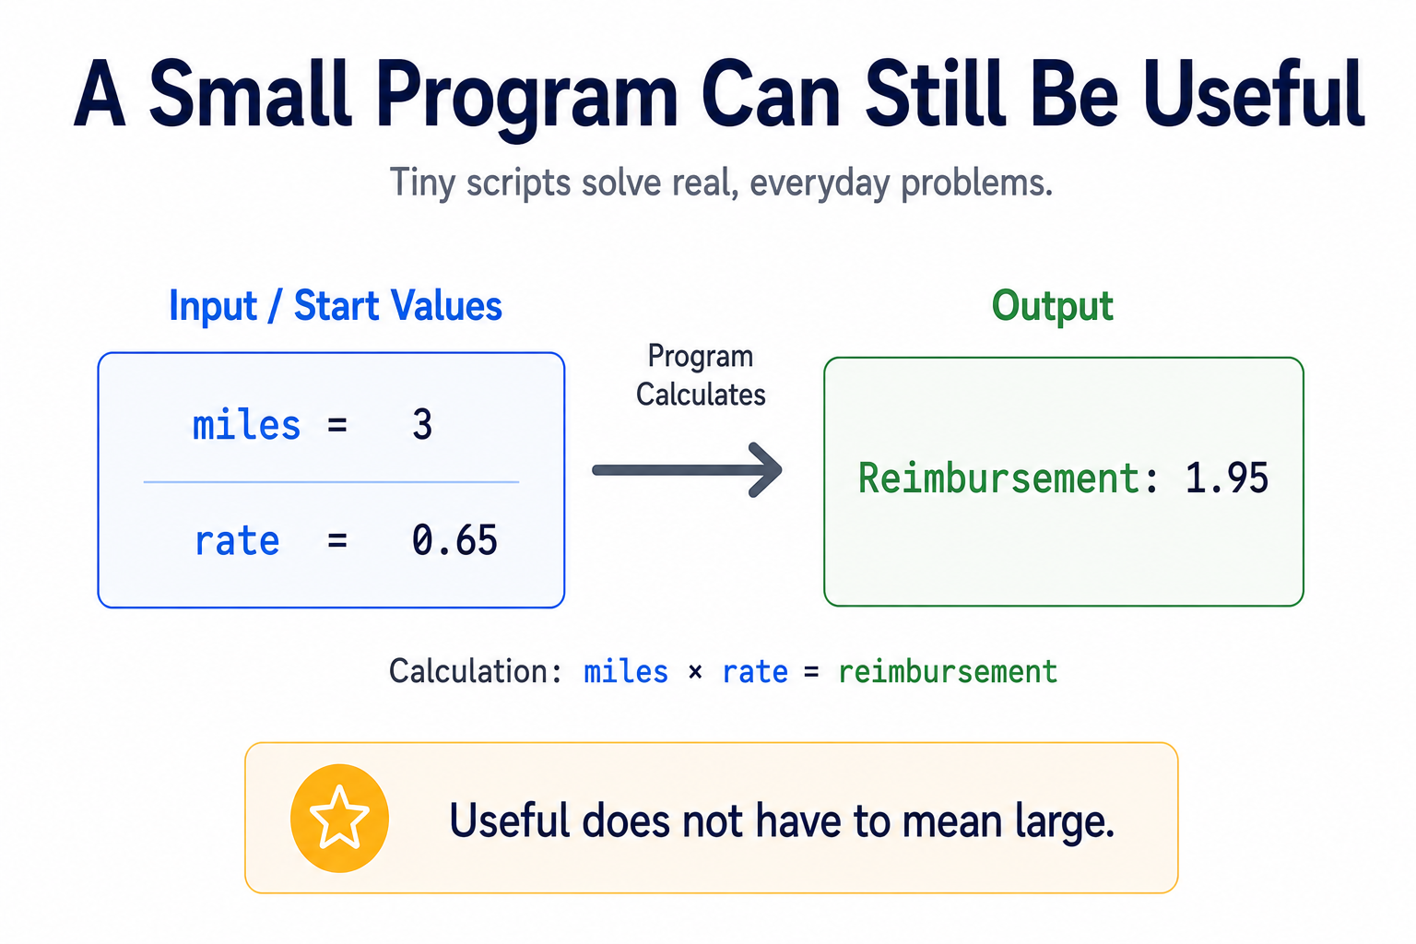
A useful first program does not have to be large.
It only needs a clear purpose, visible output, and values you can explain.
Notes:
**Instructor Notes:**
Reframe usefulness away from size. A unit converter, total-cost estimator, or personalized message builder is enough for Week 1.
**Transition Cue:**
The simplest useful programs combine values carefully.

Slide 9

Combine Values Carefully
Your program may use text and numbers together.
The important question is whether you can explain each value's role.
Notes:
**Instructor Notes:**
Introduce type awareness through use.
Do not launch into all built-in types.
Students need to know that text, whole numbers, decimal numbers, and boolean values behave differently enough that they should pay attention.
**Transition Cue:**
This is where basic type awareness helps.

Slide 10

Type Awareness Through Use
For Week 1, recognize:
Text
Whole numbers
Decimal numbers
True/false values (boolean)
Notes:
**Instructor Notes:**
Use practical names:
- string: text
- integer: whole number
- float: decimal number
- boolean: true/false
Avoid exhaustive coverage. The textbook covers more, but Assignment 1 needs practical recognition.
**Transition Cue:**
Type awareness matters because output and explanation should remain clear.

Slide 11
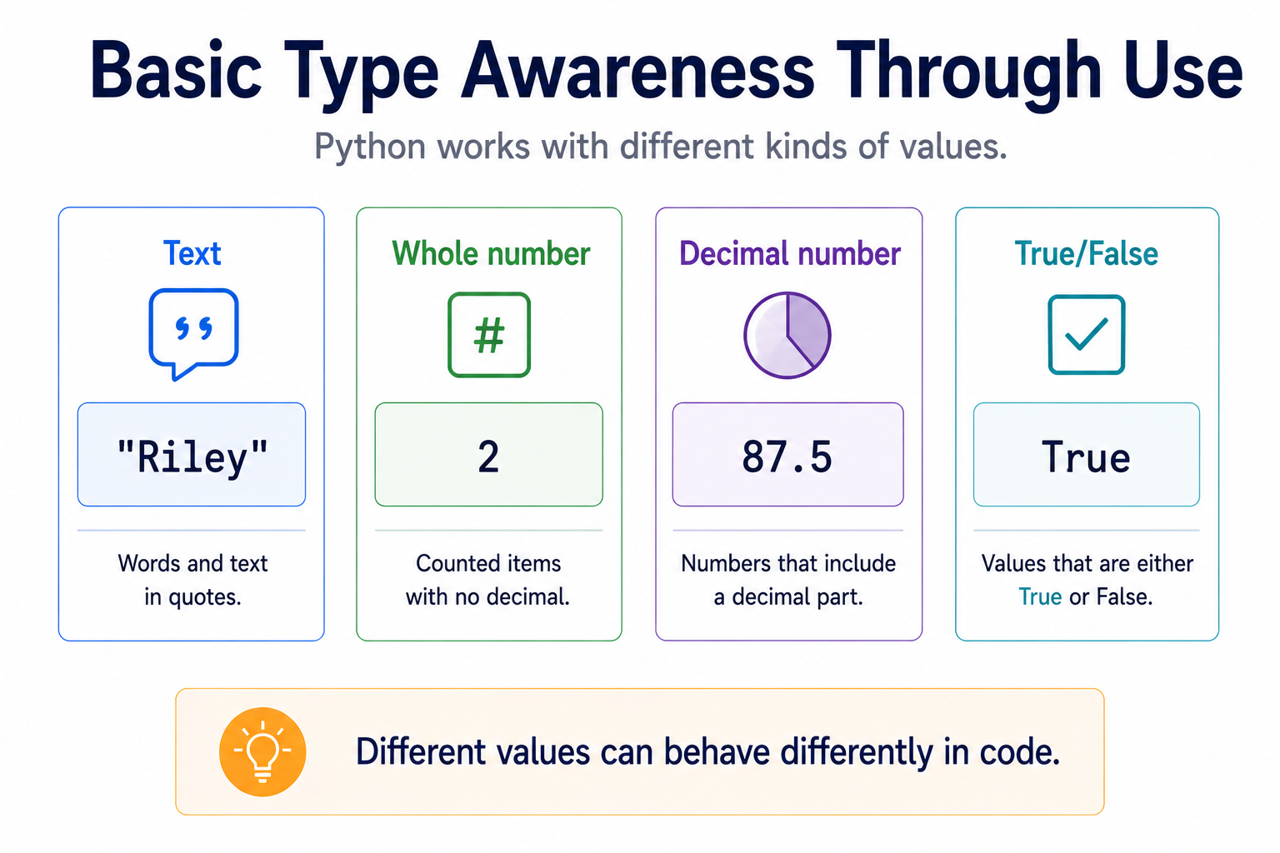
Type Awareness

Slide 12

Explain Every Main Line
Before submitting Assignment 1, ask: can I explain every main line?
If a line works but you cannot explain it, slow down and inspect it.
Notes:
**Instructor Notes:**
This is the Day 3 thinking tool.
It connects manual-first learning, debugging, and later AI accountability without introducing AI as a coding shortcut.
**Transition Cue:**
Let's watch a small example that uses several value types without becoming large.

Slide 13

Demo #1
“Basic Type Awareness”

Slide 14

What to watch for
As the demo runs, watch for two things:
How the program stores several different kinds of values.
Recognition. This is the goal - not a full type inventory.
Notes:
**Instructor Notes:**
Use:
`Demos/Week_01_First_Programs_and_Basic_Values/06_type_awareness.py`
Focus on:
- `student_name` as text
- `assignments_completed` as a whole number
- `average_score` as a decimal number
- `is_passing` as true/false
If using `type()`, explain it as an inspection tool.
Do not turn the demo into a type-system lecture.
**Transition Cue:**
If input is included, we need one more caution about numbers.

Slide 15
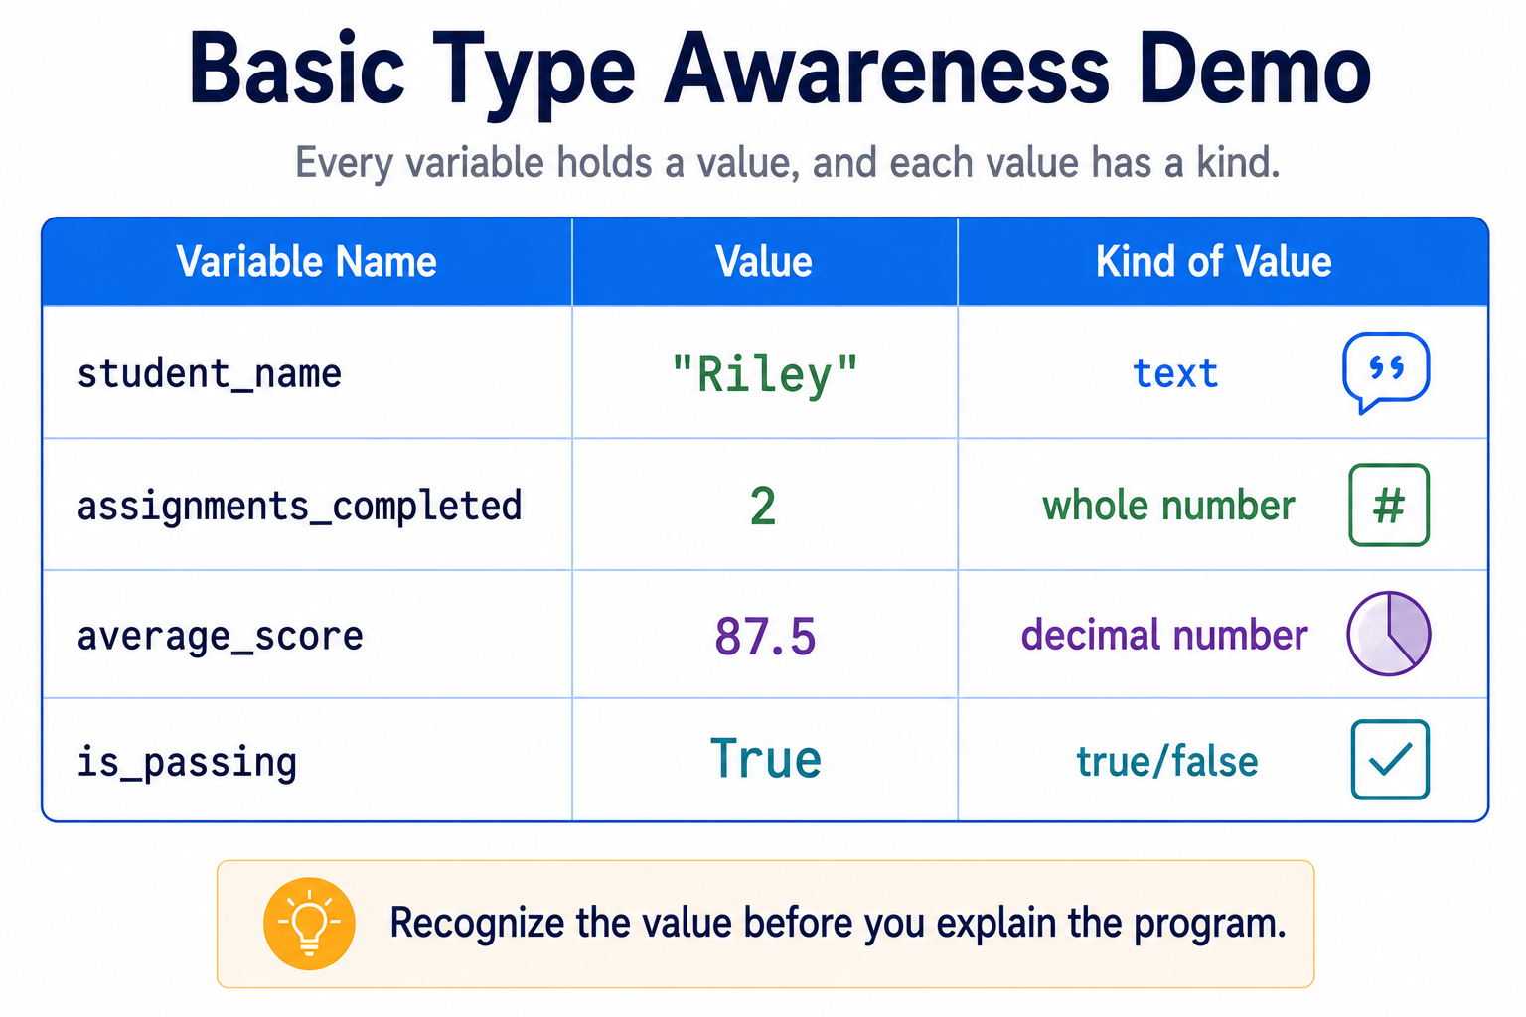
Type Demo

Slide 16
Optional Demo #2
“Input And Number Conversion”
Notes:
**Instructor Notes:**
Use only if students are stable with the first two demos and there is time.
Reference:
`Demos/Week_01_First_Programs_and_Basic_Values/03_numbers_expressions.py`
Frame this as a preview for Day 2, not as a Day 1 expectation. Students should
not leave thinking A1 must already include calculations if numbers have not
been taught carefully yet.
**Transition Cue:**
Before students begin, name the mistakes that are most likely to happen.

Slide 17

Optional Demo: Input And Number Conversion
When users type into `input()`, Python receives text first.
For math, the text must be converted into a number.
Notes:
**Instructor Notes:**
Use only if helpful:
`Demos/Week_01_First_Programs_and_Basic_Values/05_input_number_conversion.py`
This demo can support students who want an input-based calculator.
If the class is not ready, skip it and keep Assignment 1 on assigned values.
**Transition Cue:**
The next issue is not technical. It is how students should work with examples.

Slide 18
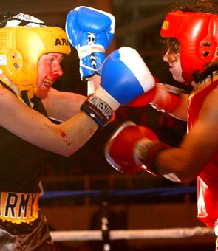
Typing vs. Copy-Paste
This Photo by Unknown Author is licensed under CC BY-SA

Slide 19
Learning Move: Type It When It Is New
Typing code can be part of learning.
Copying is not automatically wrong, but it should not replace understanding.
Notes:
**Instructor Notes:**
Use:
`Demos/Instructor_Notes-Typing_vs_CopyPaste.md`
Keep this brief but explicit. In Week 1, typing examples helps students process order, syntax, value names, and line relationships.
Connect this to Assignment 1: students should understand what they submit.
**Transition Cue:**
That leads to two common Week 1 traps.

Slide 20

Typing it Out
Typing code manually slows the process down in a useful way.
When you type an example, you are not just moving characters onto the screen. You are giving your mind time to process:
the order of the instructions
the names of variables
the structure of the logic
the punctuation and syntax
the relationship between one line and the next
what the program is actually doing
Notes:
# Instructor Narrative
You might say something like:
"Even after decades of programming, software development, and working with AI systems, I still type code examples out by hand in many situations.
I do this because typing slows me down enough to think. As I type, my mind processes the logic, the structure, and the implications of what is happening."
Then connect it directly to students:
"When you are new to Python, typing the example is not busywork. It is part of how your brain learns the pattern."

Slide 21

Copying and Pasting
Copying and pasting can also be appropriate. It may make sense when:
the code is long
the concept has already been learned
the focus is on a different part of the task
you understands the logic already
the code is being used as a scaffold for something else
Copy/paste becomes a problem when it replaces understanding. - Before copying, You should ask:
Do I understand what this code does?
Do I need to understand this more deeply right now?
Am I copying because it saves time, or because I am avoiding thinking?
Notes:
# Instructor Narrative
You might say something like:
"Sometimes I copy something because I think I understand it well enough.
If that turns out to be wrong, I go back and type it out.
That is not failure. That is calibration."

Slide 22

Connection to AI Prompting
Typing a prompt is not just the act of entering text into a tool. It is often part of the thinking process.
As a person writes a prompt, they may:
clarify the goal
revise wording
discover missing constraints
notice ambiguity
reshape the request
improve the structure of their own thinking
This is closely connected to AI-assisted development and Refraction-Based Architecture.
The human is not merely asking AI for output - The human is shaping intent!
This Photo by Unknown Author is licensed under CC BY-NC
Notes:
# Instructor Narrative for AI
You might say:
"When I write prompts for AI, I often learn while I am writing the prompt.
I revise my wording, change the structure, and clarify what I really mean as I type.
The typing itself becomes part of the thinking process."
Then connect it to Refraction-Based Architecture (RBA):
"In AI-assisted development, the quality of the output depends heavily on the clarity of the human intent.
Typing out the prompt can help you clarify that intent before AI ever responds."

Slide 23
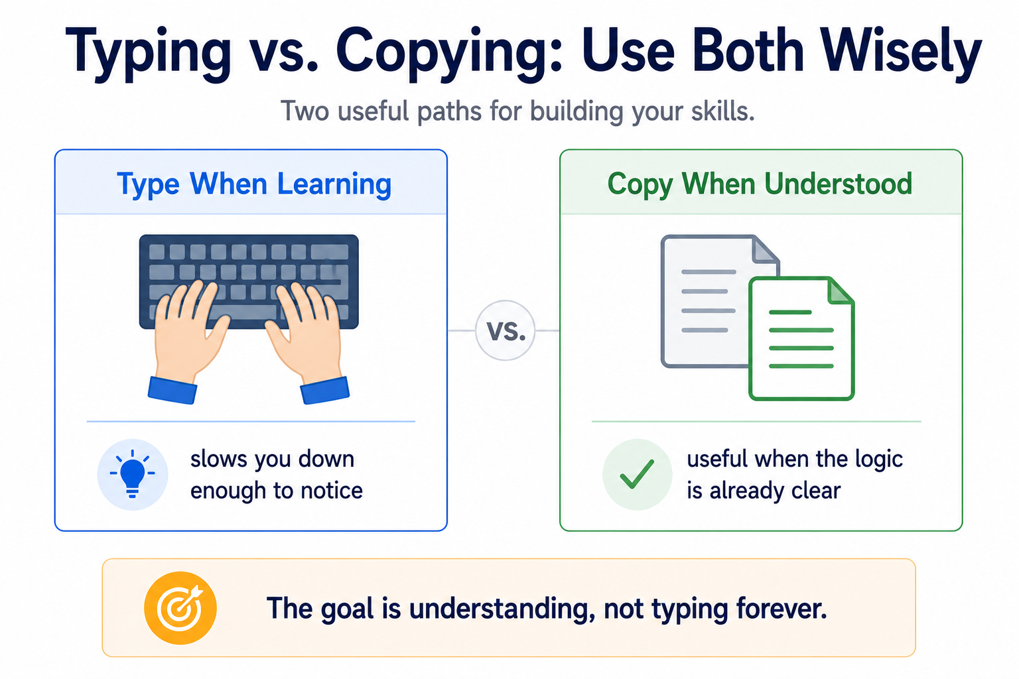
Typing vs Copy-Pasting

Slide 24
Common Failure: Too Much Is Too Much
Trying to impress can make the first assignment harder than it needs to be.
Small, clean, and explainable is better than large and confusing.
Notes:
**Instructor Notes:**
Name the trap kindly.
Some students will overbuild because they think larger means better.
In Week 1, larger often means less explainable.
For those students who absolutely, positively, must “scratch this itch” … Have them create 2 versions: Basic and enhanced
**Transition Cue:**
The other trap is using code that works but cannot be explained.

Slide 25

Common Failure: Working But Unexplained
Code that runs is not the whole goal.
You also need to explain what values the program uses and what output it creates.
This Photo by Unknown Author is licensed under CC BY-NC
Notes:
**Instructor Notes:**
This reinforces conceptual understanding over logic regurgitation.
A simple program with a clear explanation is stronger than a copied or overbuilt script the student cannot discuss.
**Transition Cue:**
Now students can finish Assignment 1 with a clear target.

Slide 26

From Demo to Assignment
For Assignment 1:
Finish two or three tiny programs.
Each program should run, show output, and make sense when you explain it.
Notes:
**Instructor Notes:**
Recommended options:
- greeting or introduction program
- simple calculator
- unit converter
- total-cost estimator
- personalized message builder
Keep students out of feature sprawl.
If a student is stuck, reduce scope until the value flow is visible again.
**Transition Cue:**
The submission should preserve the work and one explanation.
**Lab Connection:**
This closes Assignment 1 - First Programs.

Slide 27
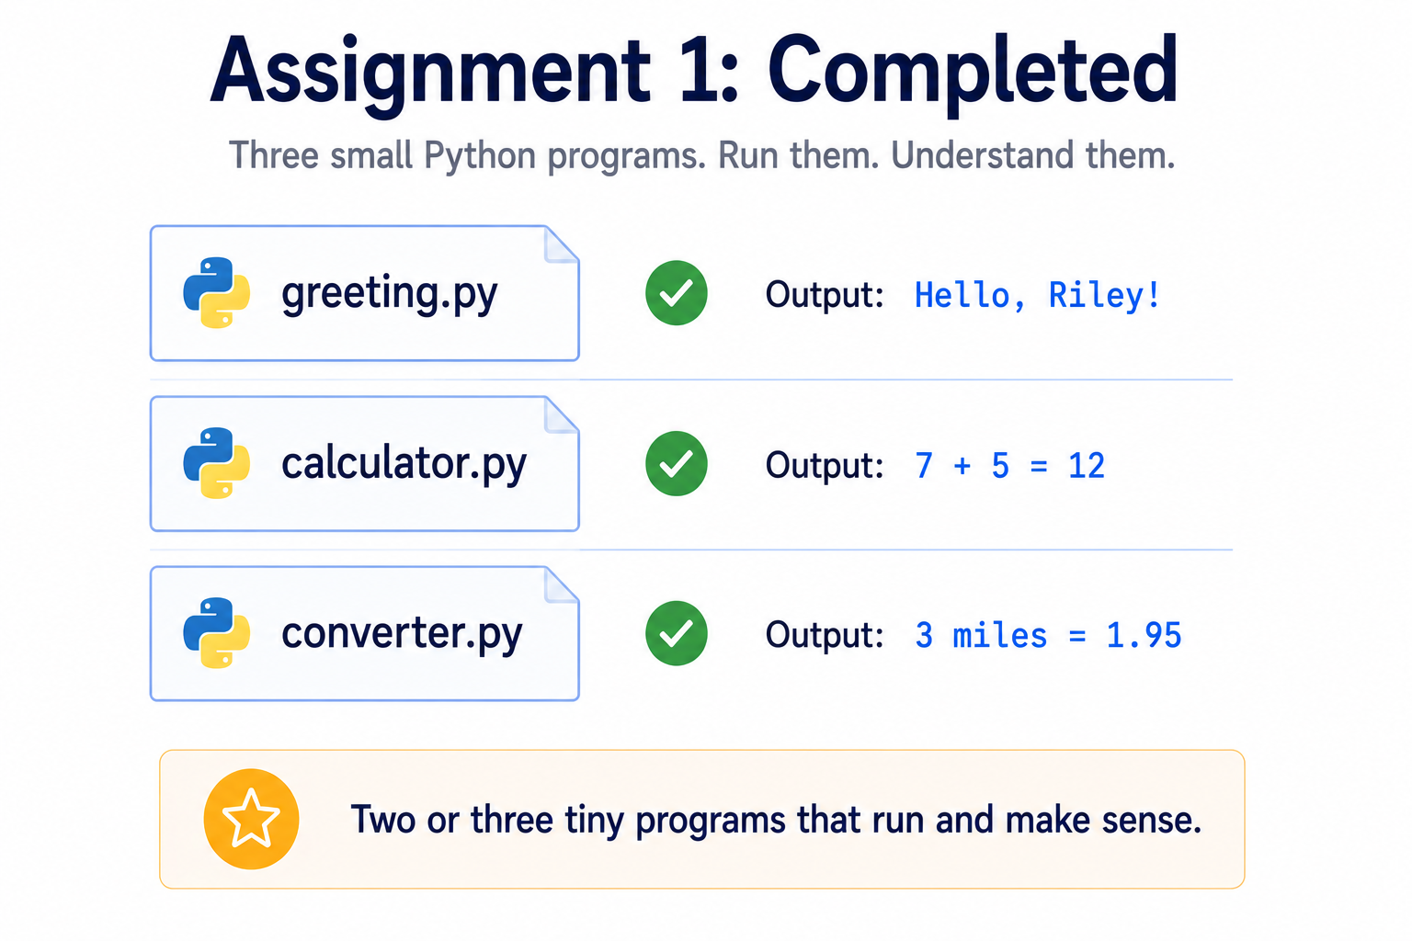
Assignment Completion

Slide 28
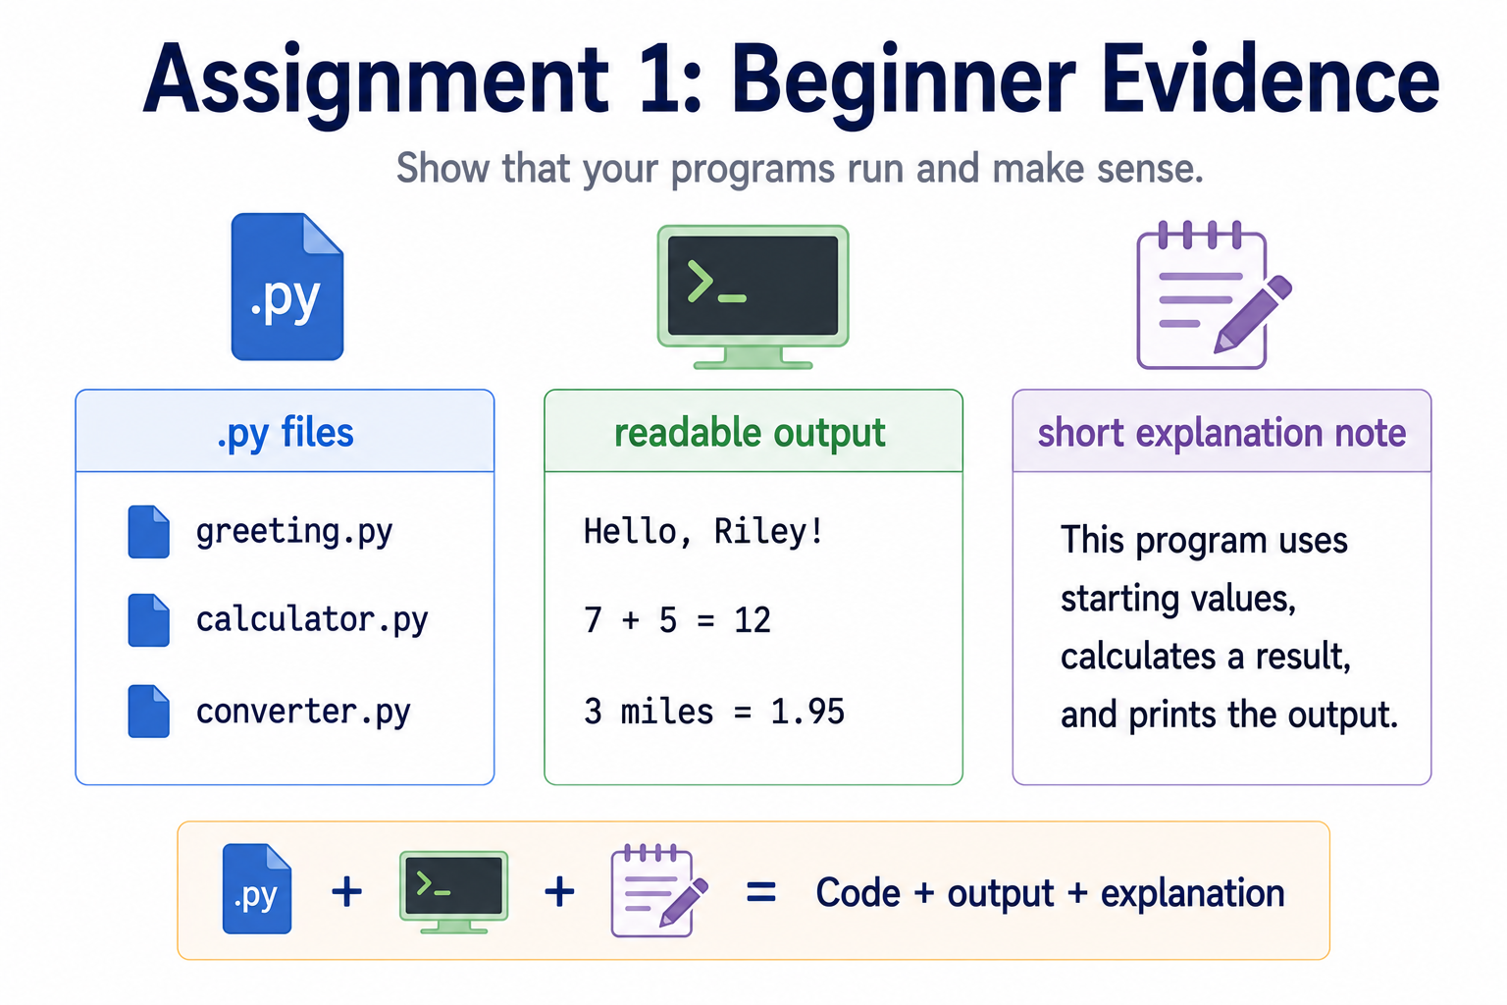
Assignment Evidence
Notes:
**Instructor Notes:**
Keep evidence requirements aligned with Assignment 1:
- `.py` file or files
- clear filenames
- code that runs
- readable output
- brief explanation of one program's value flow
For GitHub, reinforce that code and explanation should live together eventually.
However, do not let GitHub mechanics overtake the Assignment 1 target.
**Transition Cue:**
The final Week 1 check is whether the programs run and make sense.

Slide 29

Lab 0n Success Check
Week 1 worked if your small programs run and you can explain them.
Understanding what the code is doing:
What values does (each) program use?
What output does it produce?
Where does a value change?
Could you explain this script line by line to someone else?
Notes:
**Instructor Notes:**
Ask:
- What values does one program use?
- What output does it produce?
- Where does a value change?
- Could you explain this script line by line to someone else?
Name the next step: Week 2 adds decisions and repetition.
**Transition Cue:**
Next week, programs begin making choices and repeating work.

Slide 30
Thank you! Have Fun!

