Slide 1
Python Programming Foundations
Week 2 – Decision Logic and Repetition
Day 1: “How Programs Make Decisions”

Slide 2
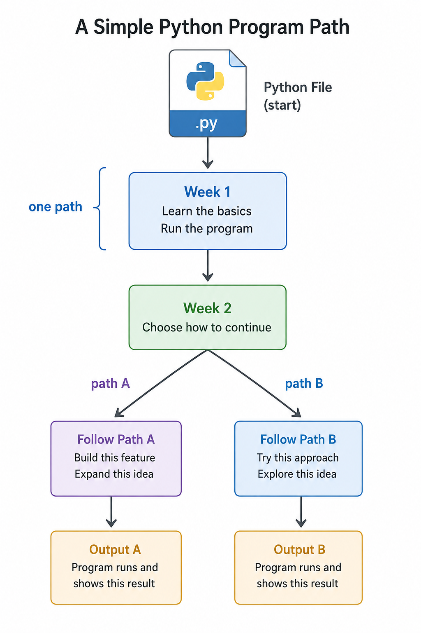
Programs Can Choose
Last week, most programs followed one path from top to bottom.
This week, programs begin choosing between possible paths.
Decision logic lets a program react to the data it has.
Today, watch for:
the value being checked
the condition being tested
the output that happens because of the result
Notes:
**Instructor Notes:**
Use this as the conceptual jump from Week 1 to Week 2.
The point is not that students are starting over.
They are reusing values, expressions, and output, but now the program can decide which output should appear.
**Transition Cue:**
Before the program can choose, it needs a value to check.

Slide 3

Week 1 Becomes Week 2
Week 1 gave us values and visible output.
Week 2 adds questions that choose which output should happen.
A decision program still uses the same basic pieces:
variables hold values
comparisons ask questions about those values
`print()` shows the result of the chosen path
Notes:
**Instructor Notes:**
Ask students to name one Week 1 value example: score, price, age, temperature, or quantity.
Then ask what question a program might ask about that value.
Examples:
- Is the score passing?
- Is the purchase large enough for a discount?
- Is the age old enough?
**Transition Cue:**
Those questions become conditions.

Slide 4
What Counts as Success Today
Condition checked -> branch selected -> output shown.
If you can predict that path, you understand the decision logic.
For every decision program, practice asking:
- What condition is checked?
- Is the condition `True` or `False`?
- Which branch runs?
- What output should appear?
Notes:
**Instructor Notes:**
Install this pattern early and return to it all day.
It gives students a simple mental model for reading decision code.
**Transition Cue:**
Let's name the specific tools we will use today.

Slide 5
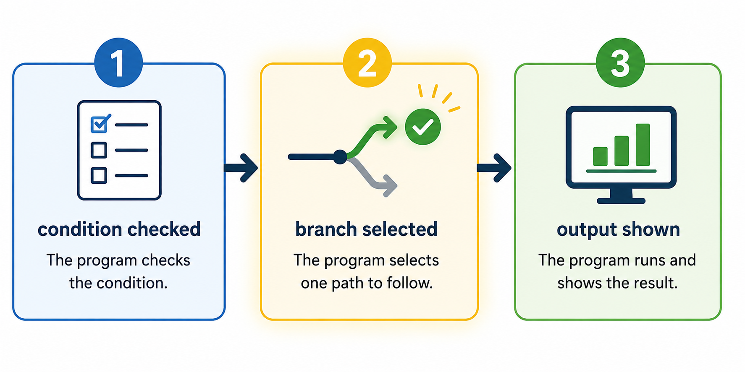
Success “Flow”

Slide 6

What We Will Use Today
Today we will use:
`True` and `False`
comparisons such as `>=`, `==`, and `!=`
`if`, `elif`, and `else`
branch prediction before running the code
These tools are enough to build a small decision program.
Notes:
**Instructor Notes:**
Keep this as the working set.
Students will see that conditionals are built from a small group of pieces, not a giant new language.
**Transition Cue:**
Just as important, several topics can wait.

Slide 7
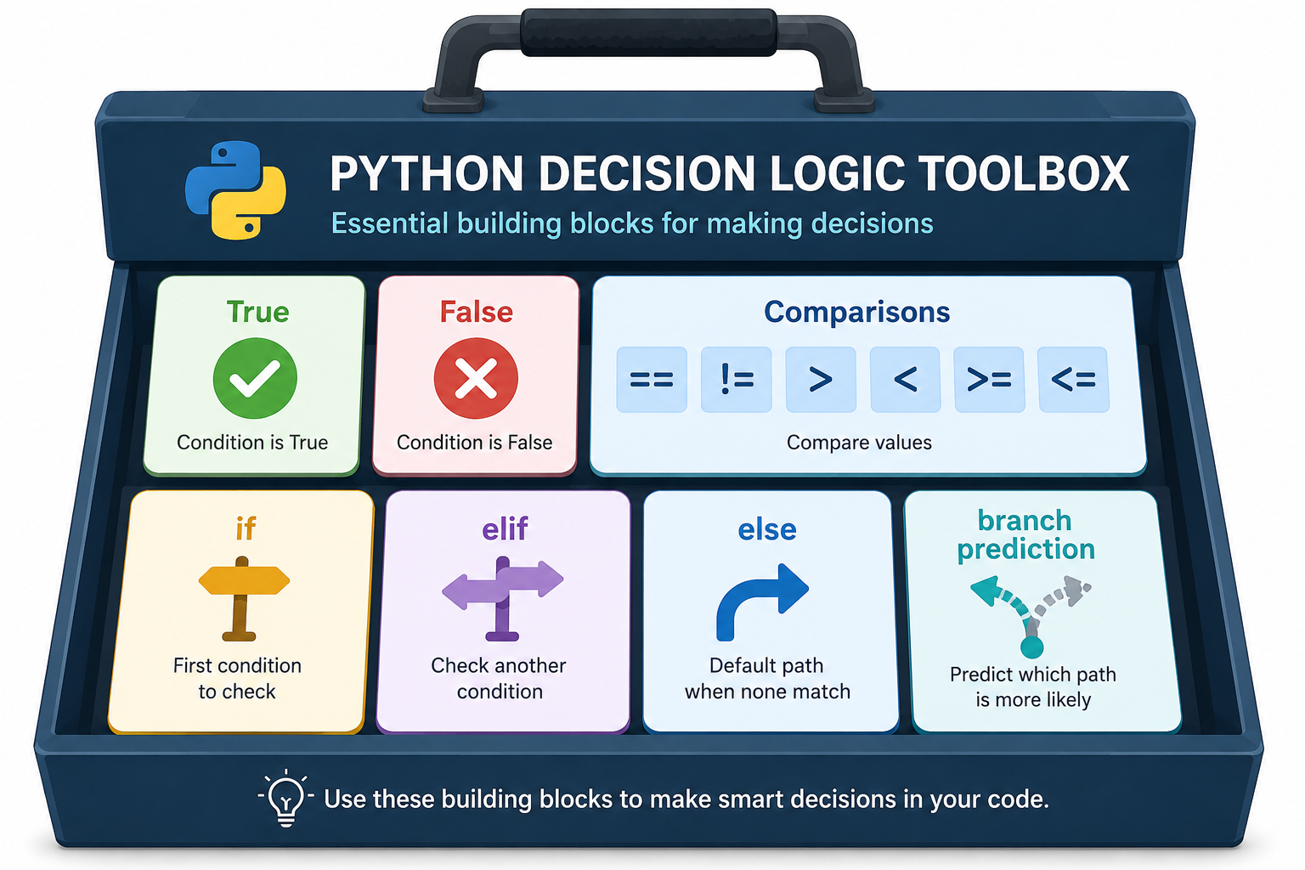
Today’s Toolbox

Slide 8
What We Will “Skip” For Now
We will skip loops, repeated input, pattern matching, and compact one-line
conditionals for now.
Today's job is to understand one decision path clearly.
That means the program should be small enough that you can trace:
the starting value
the condition
the branch
the final output
Notes:
**Instructor Notes:**
The reading may include more material than today's lecture needs.
This slide protects cognitive load. Loops arrive tomorrow, but they should not compete with first-contact branching.
**Transition Cue:**
The first decision tool is the boolean value.

Slide 9
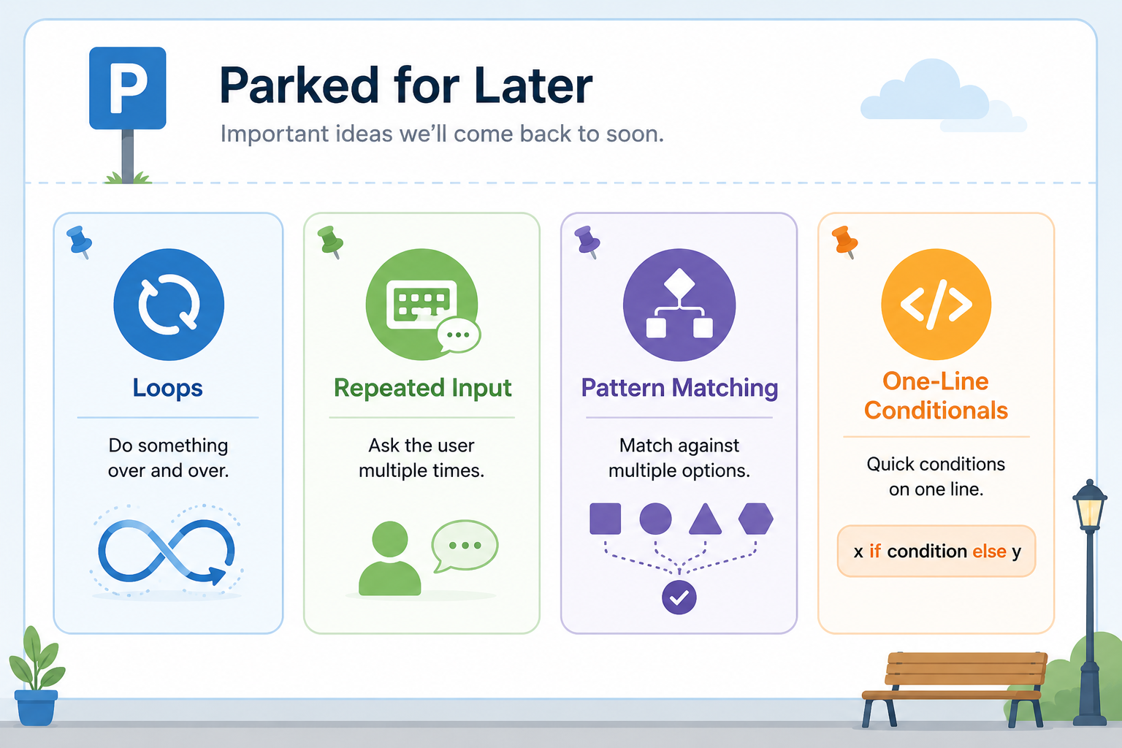
Parked Concepts

Slide 10
Review Coding Lab
Notes:
** Instructor Notes **
Step through the coding solution(s) for the Lab. Be sure to state that this is only *one* solution of many. NOT the best or only solution.

Slide 11
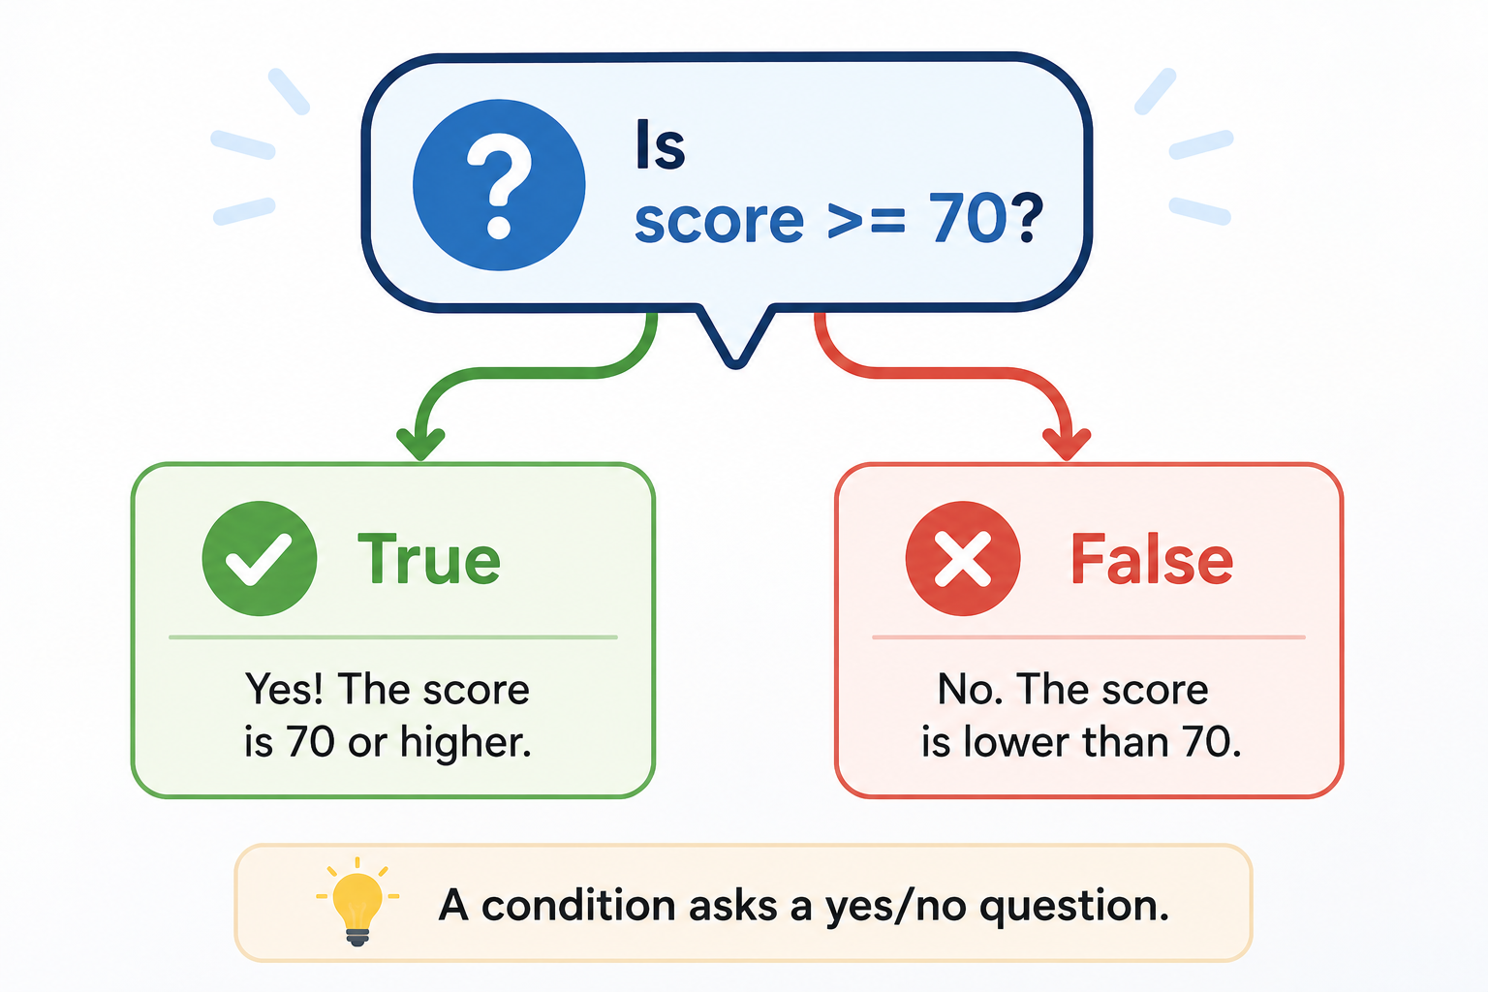
Conditions Ask Questions
A condition is a question the program can answer as `True` or `False`.
Example: `score >= 70`
Read the condition in plain language:
Is the score greater than or equal to 70?
If yes, the result is `True`.
If no, the result is `False`.
Notes:
**Instructor Notes:**
Translate comparisons into spoken questions:
- Is the score greater than or equal to 70?
- Is the age at least 16?
- Is the password attempt equal to the sample value?
The spoken question helps students see code as meaning, not symbols only.
**Transition Cue:**
Now we need the comparison symbols that create those answers.

Slide 12
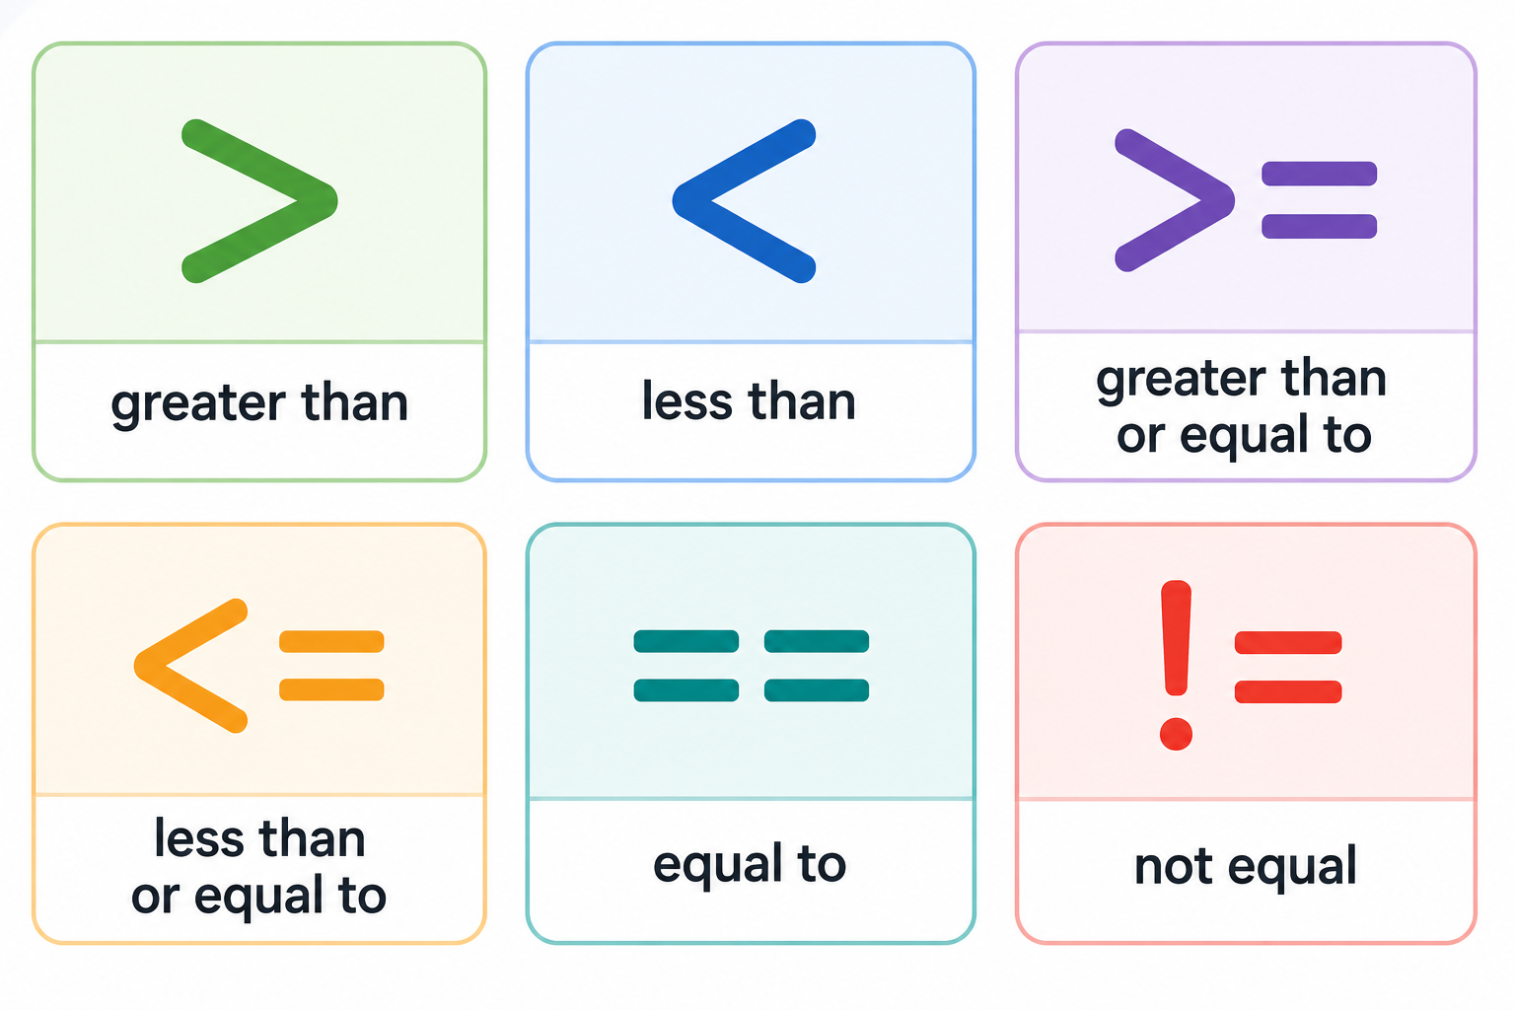
Comparison Operators
Comparisons create boolean results.
`>`, `<`, `>=`, `<=`, `==`, and `!=`
These do not print by themselves unless you ask Python to show the result.
Notes:
**Instructor Notes:**
Do not rush past `==` and `!=`.
Students will recognize some symbols from math, but `==` is a programming-specific adjustment for many beginners.
Use two or three concrete examples:
```python
age >= 16
score == 100
status != "closed"
```
**Transition Cue:**
Let's see comparisons produce visible `True` and `False` values.

Slide 13

Demo #1
“Boolean Comparisons”

Slide 14
Boolean Comparisons
Before running each comparison, predict the result.
Will Python answer `True` or `False`?
For each line, identify:
the value being checked
the comparison operator
the expected boolean result
Then run the program to confirm your prediction.
Notes:
**Instructor Notes:**
Use:
`Demos/Week_02_Decision_Logic_and_Repetition/01_booleans_comparisons.py`
Run once as written. Then change one value at a time:
- `age`
- `minimum_age`
- `score`
- `passing_score`
Ask students to predict the boolean result before running the file again.
**Transition Cue:**
A boolean result becomes more useful when it controls a branch.
**Demo Connection:**
Primary demo file: `01_booleans_comparisons.py`

Slide 15
The `if` Statement
`if` means: run this block only when the condition is `True`.
The condition decides whether the indented code runs.
Basic shape:
The indented line belongs to the branch.
if condition:
do_this()
Notes:
**Instructor Notes:**
Point directly at indentation.
Beginners often understand the condition but miss that indentation controls the branch body.
Use a tiny structure:
```python
if score >= 70:
print("Passing")
```
**Transition Cue:**
When there are multiple possible outcomes, we can add more branches.

Slide 16
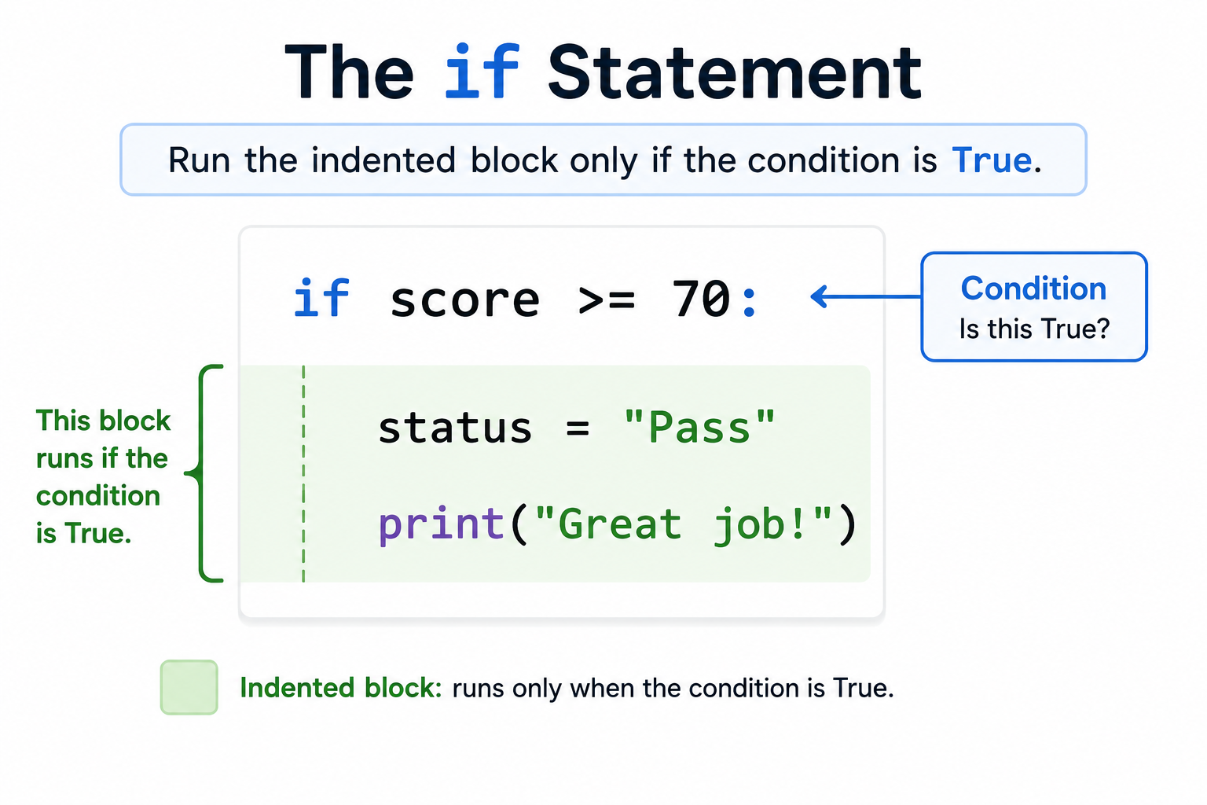
Indention Block of the “If”

Slide 17
`elif` and `else`
`elif` checks another condition.
`else` handles what is left when earlier conditions did not run.
Use this structure when there are multiple possible outcomes:
`if` starts the decision
`elif` adds another possible condition
`else` catches the remaining case
Notes:
**Instructor Notes:**
Explain `elif` as "else if" in plain language. Keep `else` simple: it is the fallback branch.
Stress that Python checks from top to bottom and stops once a matching branch is selected in the chain.
**Transition Cue:**
The next demo shows why prediction matters before running the code.

Slide 18
Demo #2
“Grade Checker”

Slide 19

What to watch for
Change the score.
Predict the grade branch before running the program.
For each score, explain:
which condition is checked first
which condition becomes true
which grade is printed
why later branches do or do not run
Notes:
**Instructor Notes:**
Use:
`Demos/Week_02_Decision_Logic_and_Repetition/02_if_elif_else_grade_check.py`
Suggested test values:
- `95`
- `84`
- `72`
- `59`
- boundary values such as `90`, `80`, `70`, and `60`
Pause before each run and ask: which branch should run, and why?
**Transition Cue:**
The order of the branches matters because Python reads the chain from top to bottom.
**Demo Connection:**
Primary demo file: `02_if_elif_else_grade_check.py`

Slide 20
Branch Order Matters
Python checks a branch chain from top to bottom.
The first matching branch wins.
Order matters when more than one condition could be true.
Place the most specific or highest-priority checks where they belong in the chain.
Notes:
**Instructor Notes:**
This prevents a major beginner mistake.
If a broad condition appears before a more specific one, the specific branch may never run.
Use a verbal example before code:
```text
If a score is at least 60, it is also at least 70? No.
If a score is at least 95, it is also at least 90? Yes.
So the order must match the intended logic.
```
**Transition Cue:**
Two common syntax problems can hide this logic from students.

Slide 21
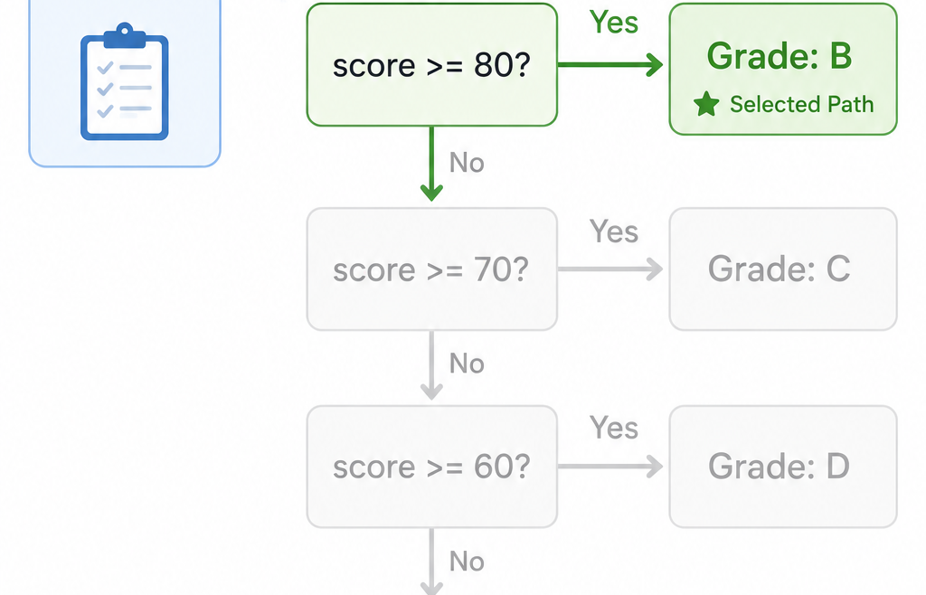
Demo 2: Grade Check Branches

Slide 22
Common Failure: `=` Is Not `==`
`=` stores a value.
`==` compares two values.
Example:
score = 84 # store the value
score == 84 # ask if the value matches
Mixing these up changes the meaning of the program.
Notes:
**Instructor Notes:**
Keep this blunt and memorable. Connect it back to Week 1:
- `score = 84` stores a value.
- `score == 84` asks whether the value matches.
This is one of the highest-value beginner warnings for Week 2.
**Transition Cue:**
The second common failure is indentation.

Slide 23
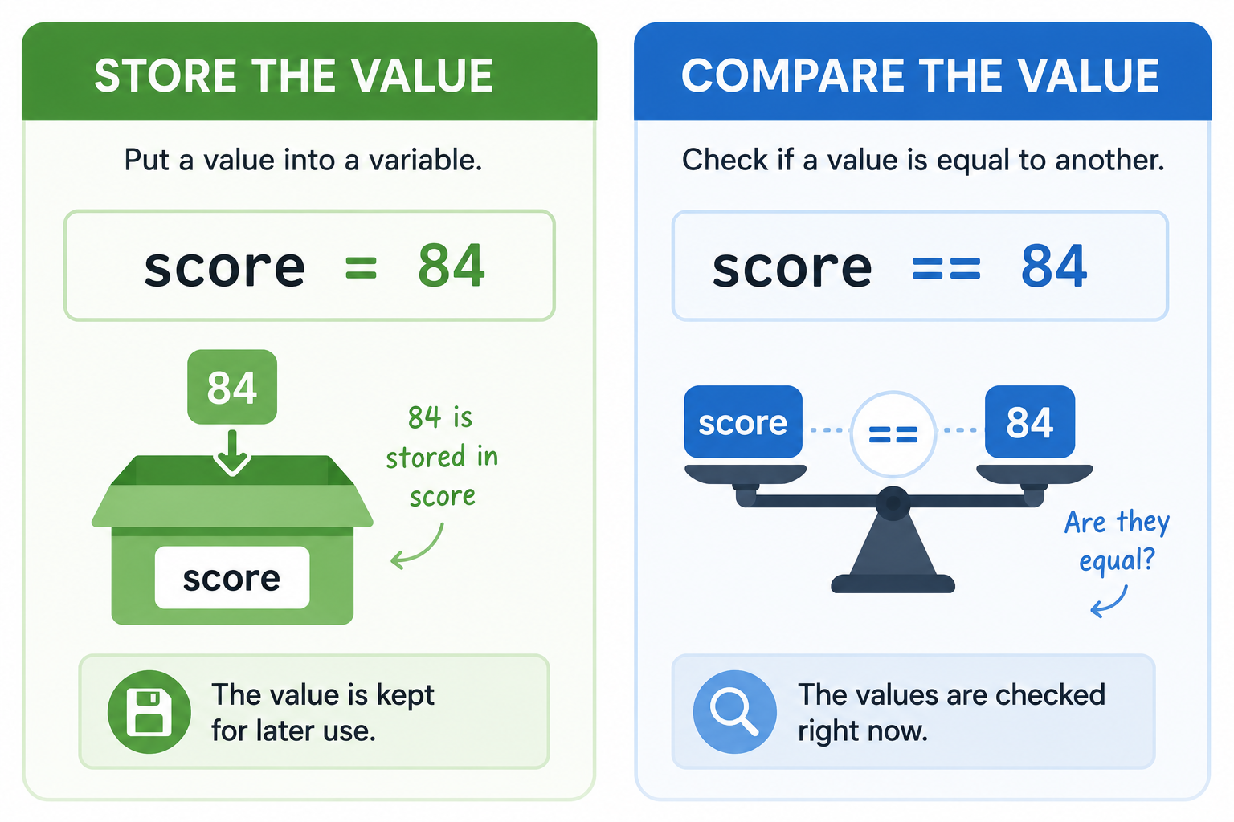
Common Failure: Equal sign

Slide 24
Common Failure: Indentation Changes Meaning
Indented lines belong to the branch.
Unindented lines run after the branch is finished.
In Python, indentation is structure. (aka: “scope”)
When reading a branch, ask:
Which lines are inside the branch?
Which lines run no matter what?
Notes:
**Instructor Notes:**
Show a tiny before/after example if helpful.
Students may think indentation is only formatting. In Python, it defines structure.
Recommended phrasing:
```text
Indentation is not decoration. It tells Python what belongs together.
```
**Transition Cue:**
Now we can connect the idea to Assignment 2.

Slide 25
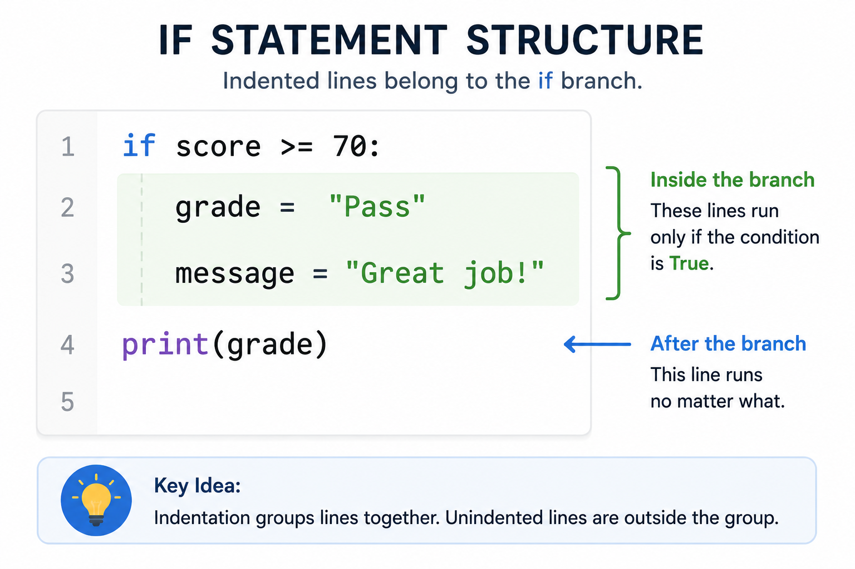
Indentation is about “scope” (in Python)

Slide 26

From Demo to Lab
In Lab For Assignment 2:
Build one small program that makes a clear decision.
Start with two or three test values before adding more features.
A good first version should include:
one main value to check
at least one comparison
at least two possible outputs
readable variable names
Notes:
**Instructor Notes:**
Point students toward manageable options:
- grade checker
- eligibility checker
- temperature message
- simple recommendation
- sample login-style rule checker
If using the discount checker demo, clarify that students should not simply submit the demo.
They should use the pattern in a different small decision problem or an approved variation.
**Transition Cue:**
A decision program is only clear if it can be tested with more than one value.
**Lab Connection:**
Supports Assignment 2 - Decisions in Code.

Slide 27
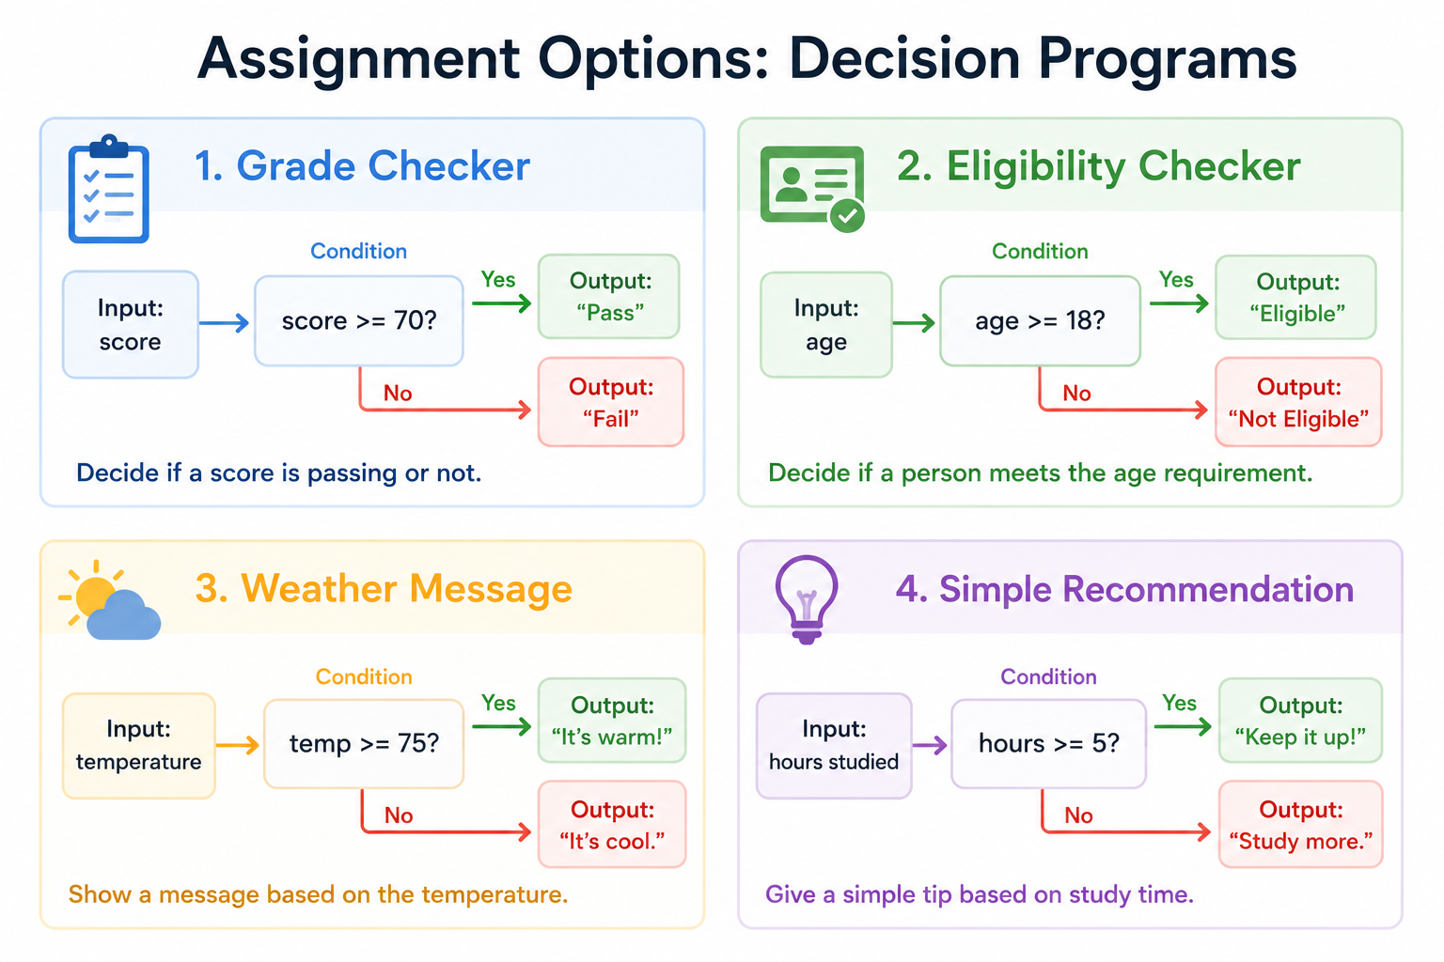
Assignment 2

Slide 28
Lab/Assignment Evidence
Your submission should show at least two possible outcomes.
Be ready to explain what condition is checked and why each branch runs.
Useful evidence includes:
a working `.py` file
sample values or scenarios
visible output
a short explanation of the decision
Notes:
**Instructor Notes:**
Recommended evidence:
- one working `.py` file
- readable variable names
- visible output
- two or more test values or scenarios
- brief explanation of the checked condition and possible outcomes
Keep README expectations light if this is still early in GitHub practice.
**Transition Cue:**
Before students begin, show one optional practical bridge if the class is ready.

Slide 29
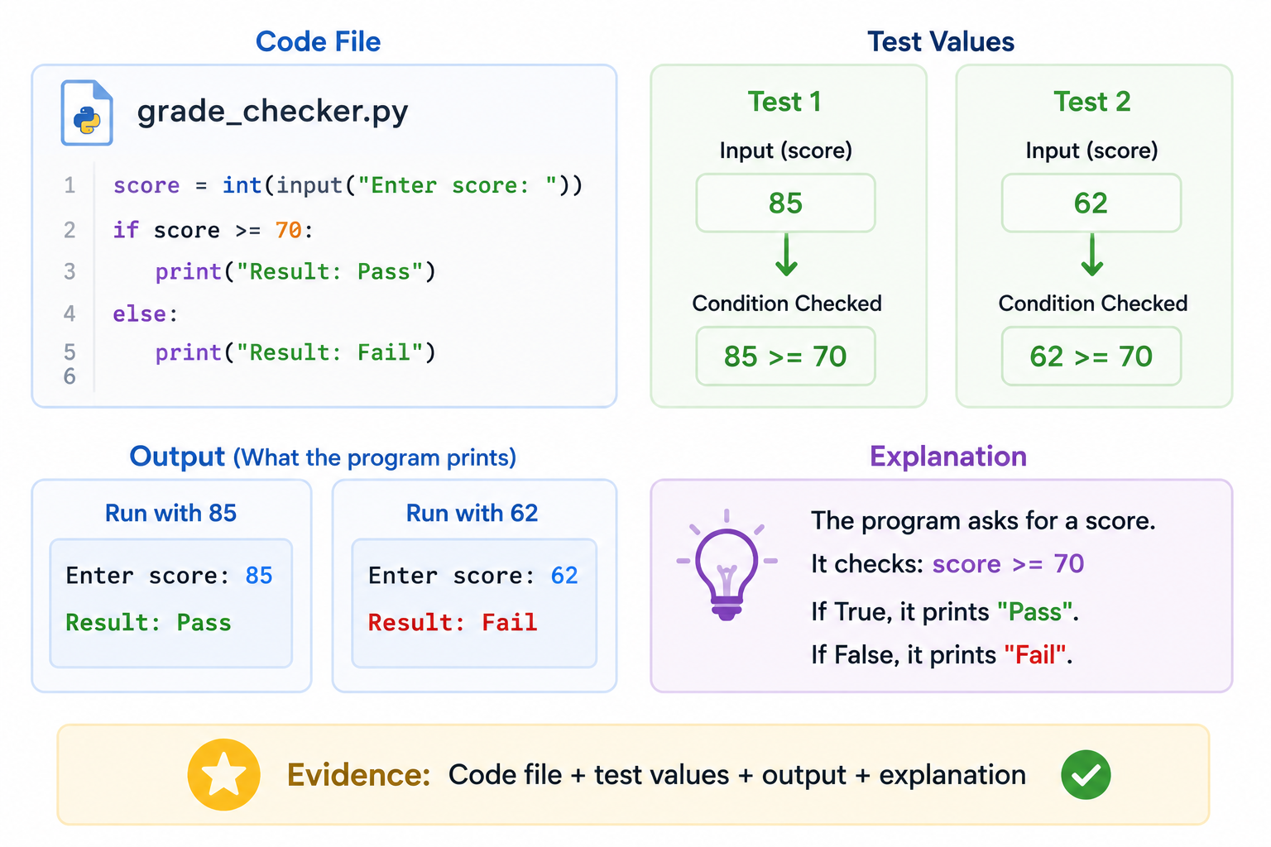
Evidence Example

Slide 30
Optional Demo #3
“Discount Checker”

Slide 31
What to watch for
A practical decision program still follows the same pattern:
check a condition -> choose a branch -> show the result.
In the demo, watch how the program:
checks the purchase total
decides whether a discount applies
calculates the final total only when needed
prints a result that matches the decision
Notes:
**Instructor Notes:**
Use only if students are ready:
`Demos/Week_02_Decision_Logic_and_Repetition/03_discount_checker.py`
This demo bridges toward A2, but it should not become the only model students can imagine.
Ask them to name other decision contexts after the demo.
**Transition Cue:**
The closing check is whether they can predict the branch before running code.
**Demo Connection:**
Optional demo file: `03_discount_checker.py`

Slide 32

Closing Success Check
If you can predict the branch and explain the output, you understand the logic.
Run the code to confirm your reasoning, not to replace it.
Before submitting Assignment 2, test your program with:
one value that should trigger the first branch
one value that should trigger another branch
one boundary value if your decision has a cutoff
Notes:
**Instructor Notes:**
Ask:
- What value started in this variable?
- What expression changed it?
- What was stored as the result?
- What printed at the end?
- If input was used, what did the user response become inside the program?
Name the next step: Day 3 will combine strings, numbers, and type awareness into clearer first programs.
**Transition Cue:**
Next class, we combine these values more carefully and prepare to close Assignment 1.

Slide 33
Thank you! Have Fun!

