Slide 1
Web Development Foundations
Week n – “Title”
Day 2: “Subtitle”

Slide 2

Reconnect
Monday:
a
Today:
a

Slide 4
What Counts as Success Today
the same CSS file styles more than one page
navigation looks consistent
text is readable
spacing is less crowded
one class-based style is used on purpose

Slide 5

What We Will Use Today

Slide 6
Topic

Slide 7

Demo
“Basic Type Awareness”

Slide 8

What to Watch For
a

Slide 10
Common Mistakes
A
A
A
a

Slide 11
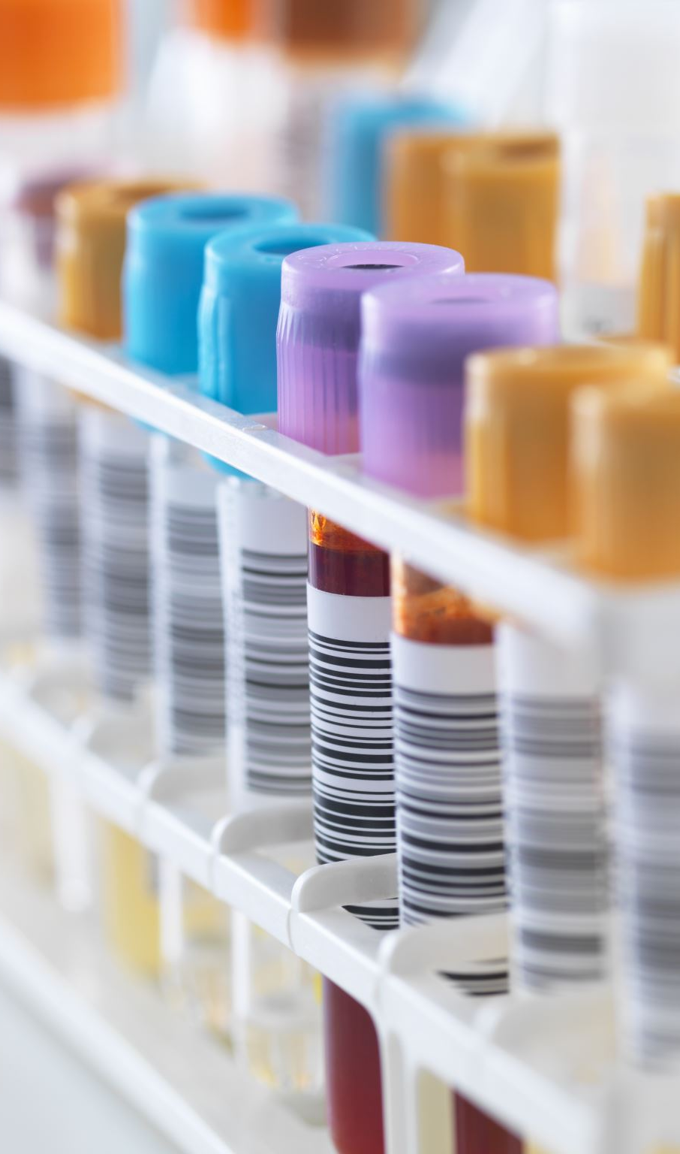
Lab Refinement
In Lab 0n

Slide 12
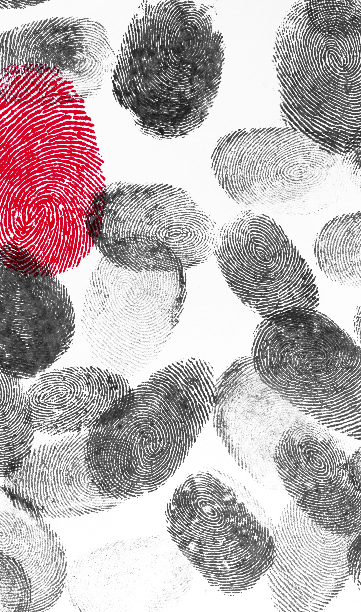
Evidence & Reflection

Slide 13

AI Use In Labs
a

Slide 14
How To Read Next Week's Material
Required: CSS rules and color.
Skim: text readability.
Reference: return during lab.
Focus on:
a.

Slide 15

Closing Success Check
a

Slide 16
Thank you! Have Fun!

Slide 17

Useful AI Prompt Pattern
“Prompt goes here …”

Slide 18
Image Slide

