Slide 1
Python Programming Foundations
Week 8 – Capstone Build, Justification, & Presentation
Day 1: “Build Expectations & Validation Evidence”

Slide 2
Finishing Code Is Not Enough
A capstone is not finished just because the code runs once.
It should run inside approved scope, produce meaningful behavior, and include evidence that important behavior was checked.
Notes:
**Instructor Notes:**
Open on quality and explainability.
This should not sound like extra paperwork; it is part of finishing well.
**Transition Cue:**
Connect this immediately to the Week 7 approval process: approved scope is only useful if the final build can be defended.

Slide 3
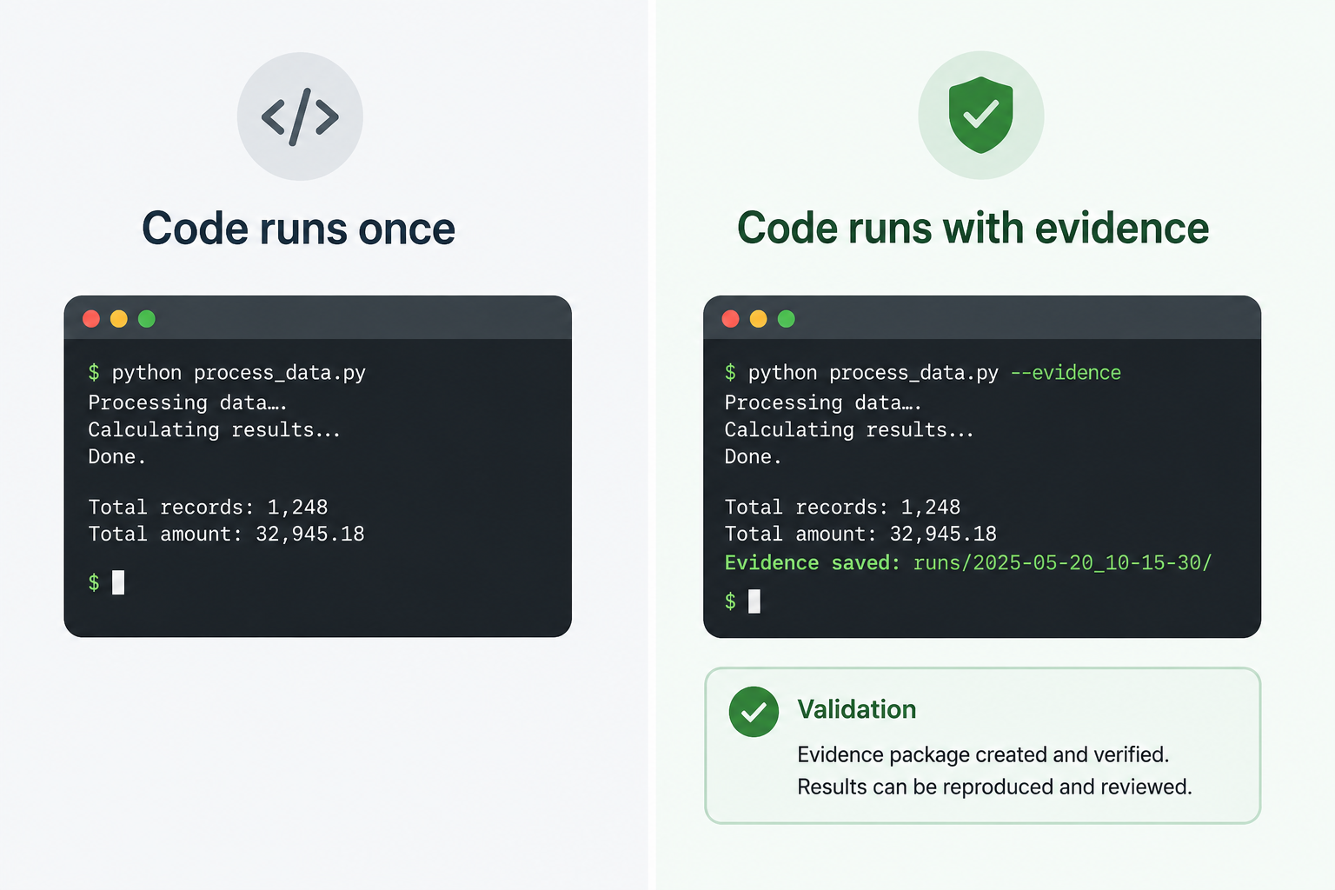
Finishing Code Is Not Enough

Slide 4
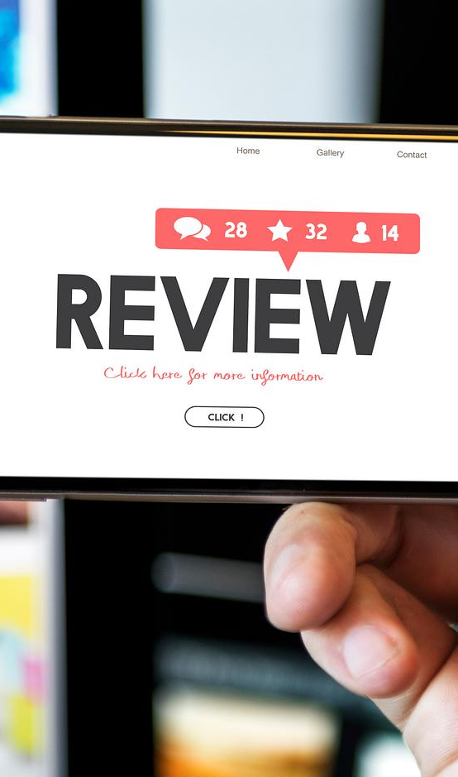
From Approved Scope To Build Evidence
Week 7 approved the project direction.
Week 8 asks: what did you build, how do you know it works, and how can someone else understand how to run it?
Notes:
**Instructor Notes:**
Tie A14 directly into A15.
**Transition Cue:**
Now name the success pattern for today's build work so students know what to prioritize during lab time.

Slide 5
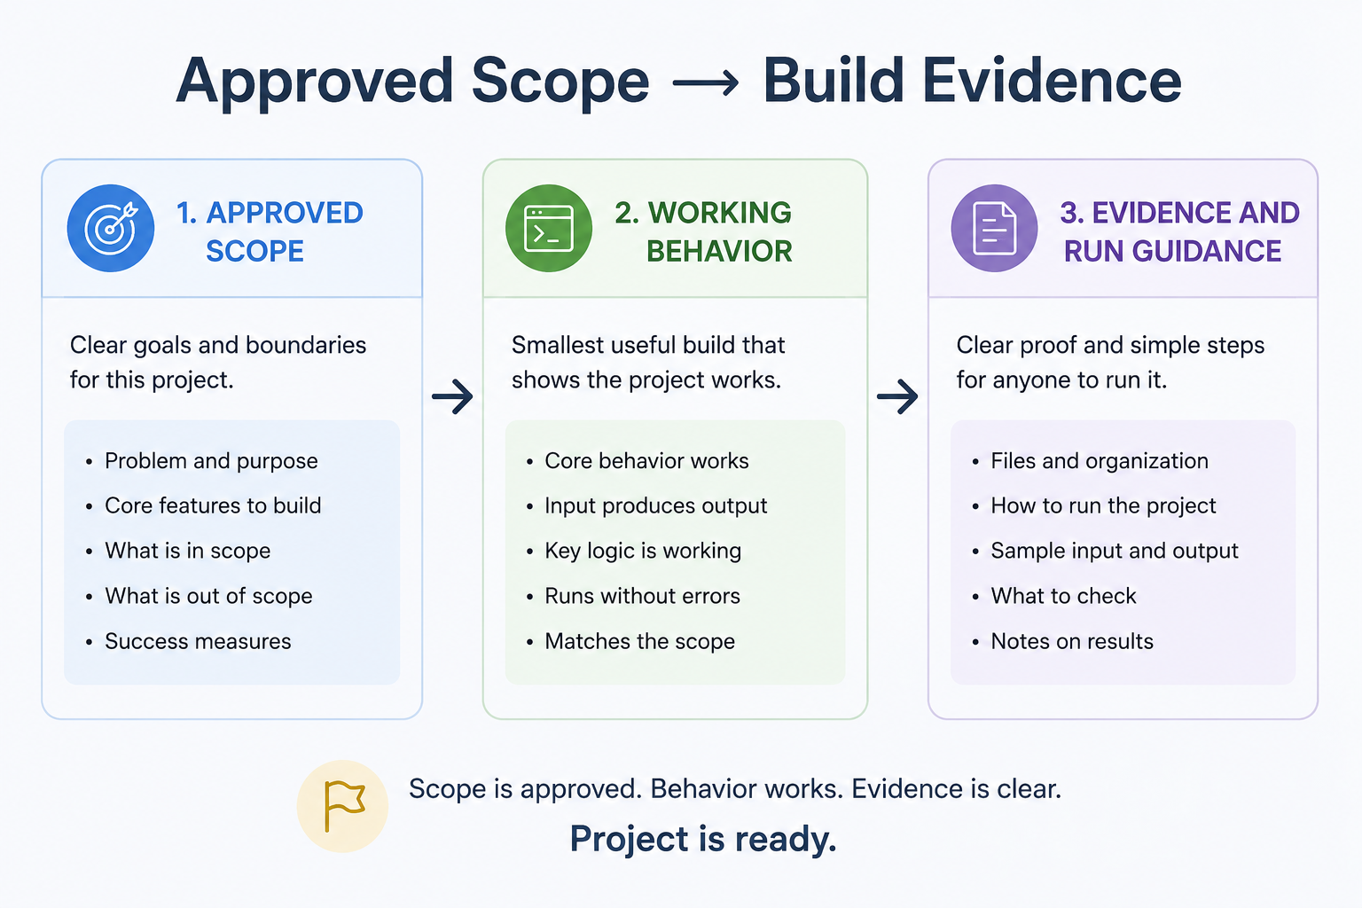
From Approved Scope To Build Evidence

Slide 6
What Counts as Success Today
Stay inside approved scope
Identify the most important behavior
Validate that behavior with real evidence
Preserve run instructions
Record meaningful AI help if used
Prepare to explain the work in Assignment 16
Notes:
**Instructor Notes:**
Ask students to write down the most important behavior for their own capstone.
That behavior becomes the anchor for validation, run instructions, and presentation explanation.
**Transition Cue:**
Once the important behavior is named, show that evidence can be small and still valid.

Slide 7
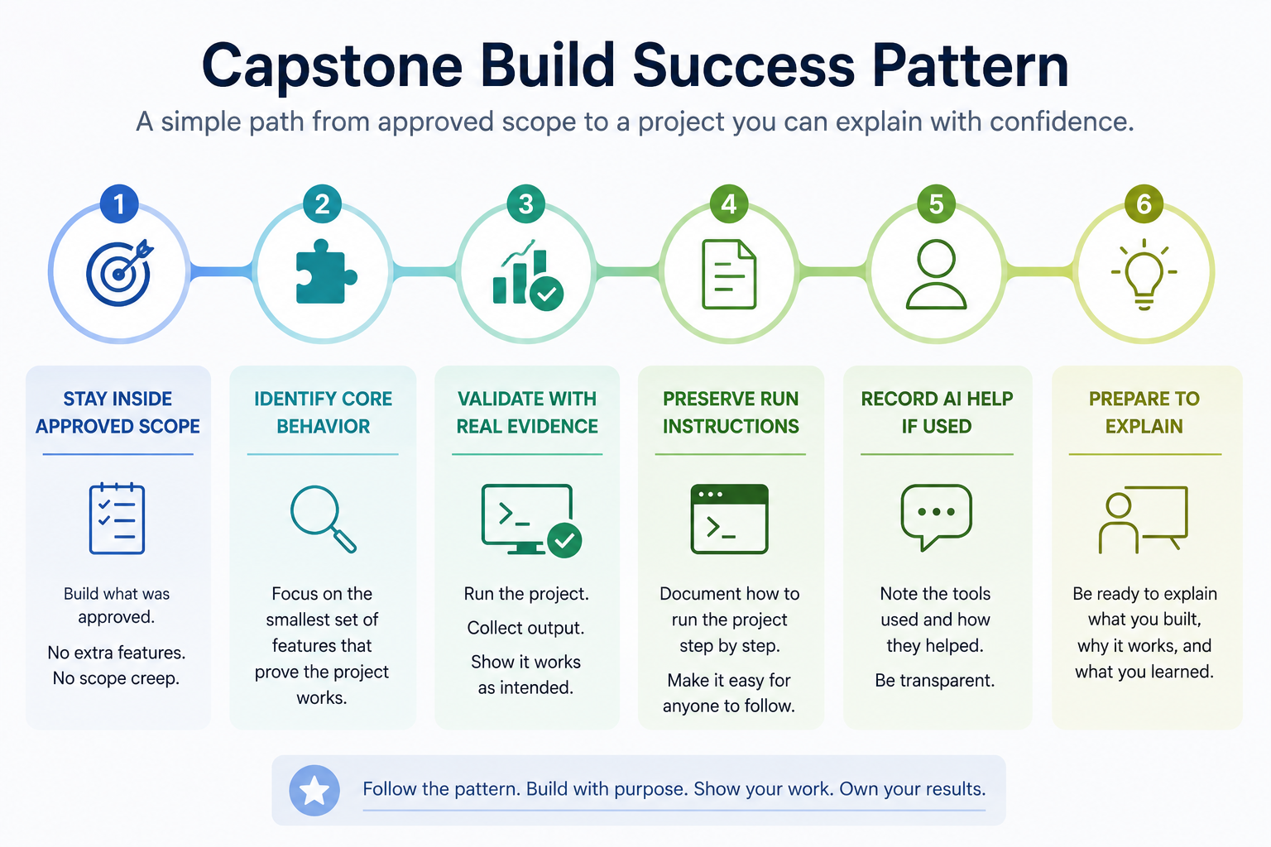
Today's Success

Slide 8

Capstone Test

Slide 9

Evidence Can Be Small And Real
Validation evidence can be simple:
expected versus actual output
one successful run
one boundary or error case
short validation note
screenshot or copied console output if required
Small evidence is acceptable when it is real.
Notes:
**Instructor Notes:**
This demystifies validation. Do not turn it into a full testing lecture.
**Transition Cue:**
Evidence is useful to the instructor, but run instructions are what make the project understandable to another person.

Slide 10
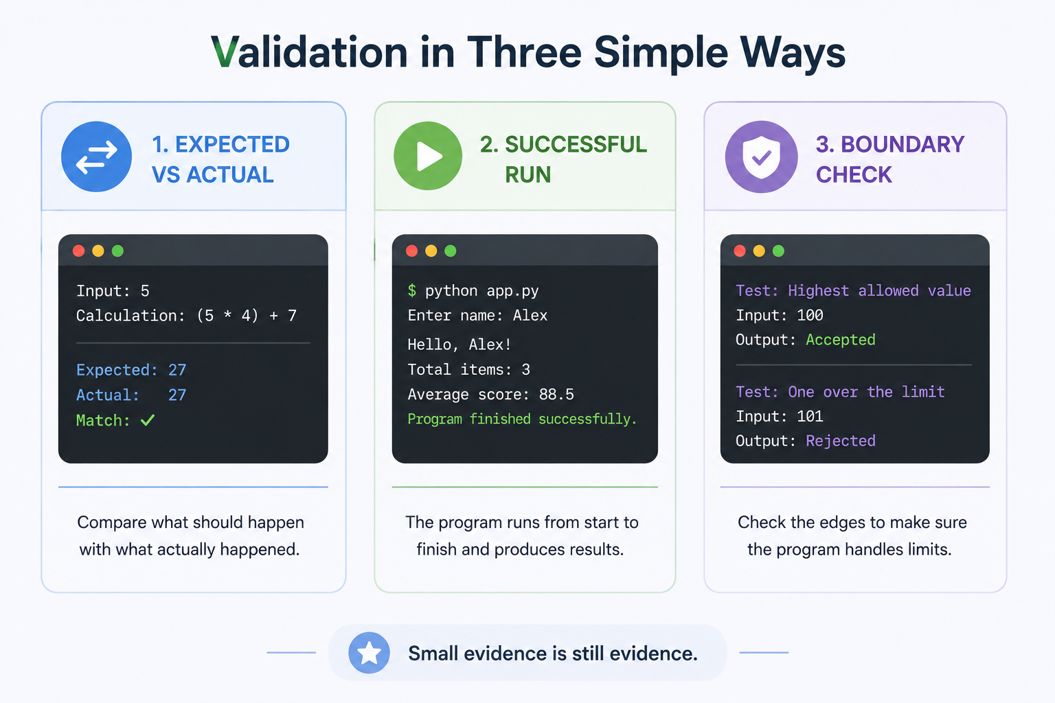
Evidence Can Be Small And Real

Slide 11

Run Instructions Are Part Of The Project
A project should tell someone how to run it.
Good run instructions include the file to run, required data files, setup notes if needed, and the expected result.
Notes:
**Instructor Notes:**
This prepares A16 and helps grading.
**Transition Cue:**
If AI helped during the build, the notes should be collected now while the decisions are still fresh.

Slide 12
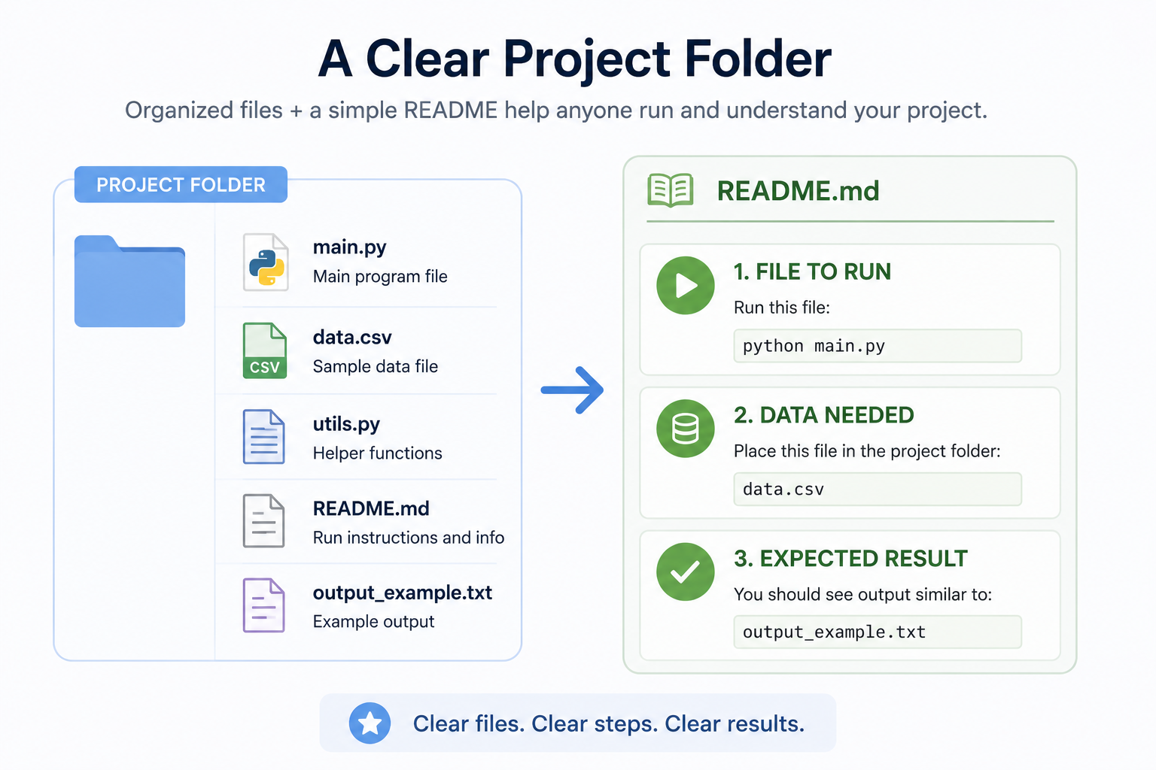
Run Instructions Are Part Of The Project

Slide 13
AI Notes Belong With The Build
If AI helped during the build, record it while the work is fresh.
Useful notes include what AI suggested, what you accepted, what you changed, and how you verified the result.
Notes:
**Instructor Notes:**
This prevents weak after-the-fact AI justification.
**Transition Cue:**
Now model the relationship between behavior and validation evidence.

Slide 14
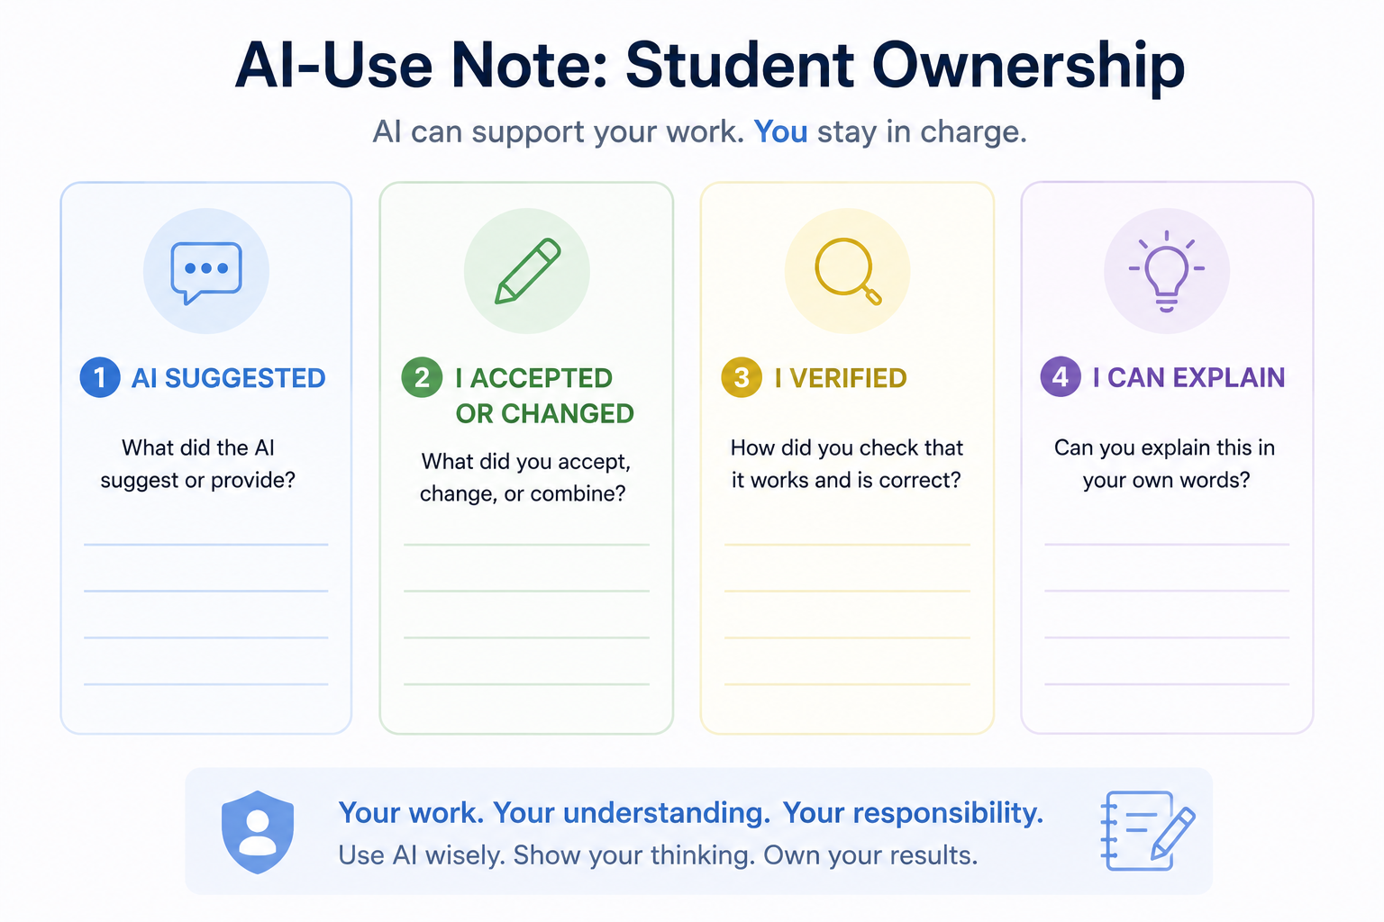
AI Notes Belong With The Build

Slide 15

Demo
“Capstone Validation & Run”

Slide 16

What to Watch For: Validation Evidence
Watch the behavior first.
Then watch the evidence that supports the claim that the behavior works.
Notes:
**Instructor Notes:**
Use with:
`\Demos\Week_08_Capstone_Build_Justification_and_Presentation\01_capstone_validation_example.py`
Then use with (markdown artifact):
`\Demos\Week_08_Capstone_Build_Justification_and_Presentation\02_capstone_validation_notes.md`
Run the validation example and connect it to `02_capstone_validation_notes.md`.
**Demo Connection:**
Primary demo files:
`01_capstone_validation_example.py`,
`02_capstone_validation_notes.md`
**Transition Cue:**
After showing evidence, show the support artifact that helps someone else run the project.

Slide 17
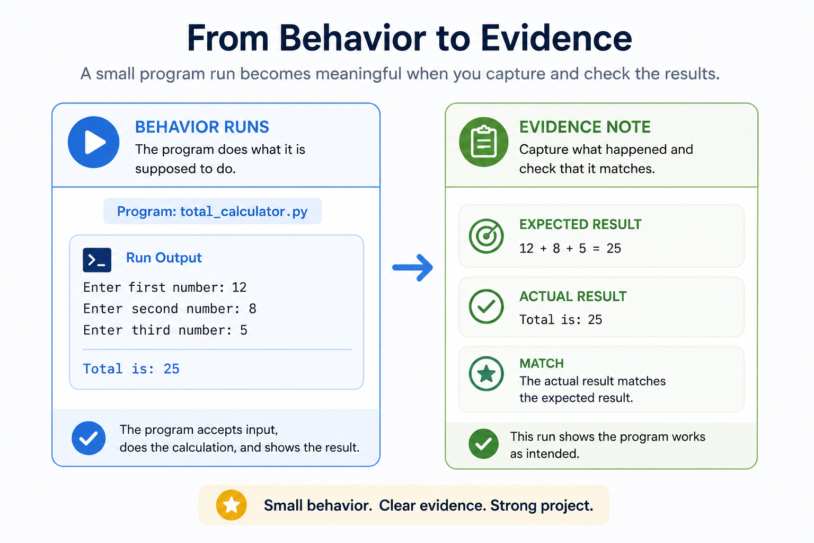
Demo: Validation Evidence

Slide 18

Demo: Run Instructions
Run instructions should reduce confusion.
They should tell someone:
what to open
what to run
what files are needed
what successful output looks like.
Notes:
**Instructor Notes:**
Use with (markdown artifact):
`\Demos\Week_08_Capstone_Build_Justification_and_Presentation\06_run_instructions_example.md`
Show `06_run_instructions_example.md`.
Optional preview if useful (markdown artifact):
`\Demos\Week_08_Capstone_Build_Justification_and_Presentation\03_ai_use_justification_example.md`
**Demo Connection:**
Primary demo artifact: `06_run_instructions_example.md`
**Transition Cue:**
Now convert the examples into the A15 build checklist students should use during work time.

Slide 19
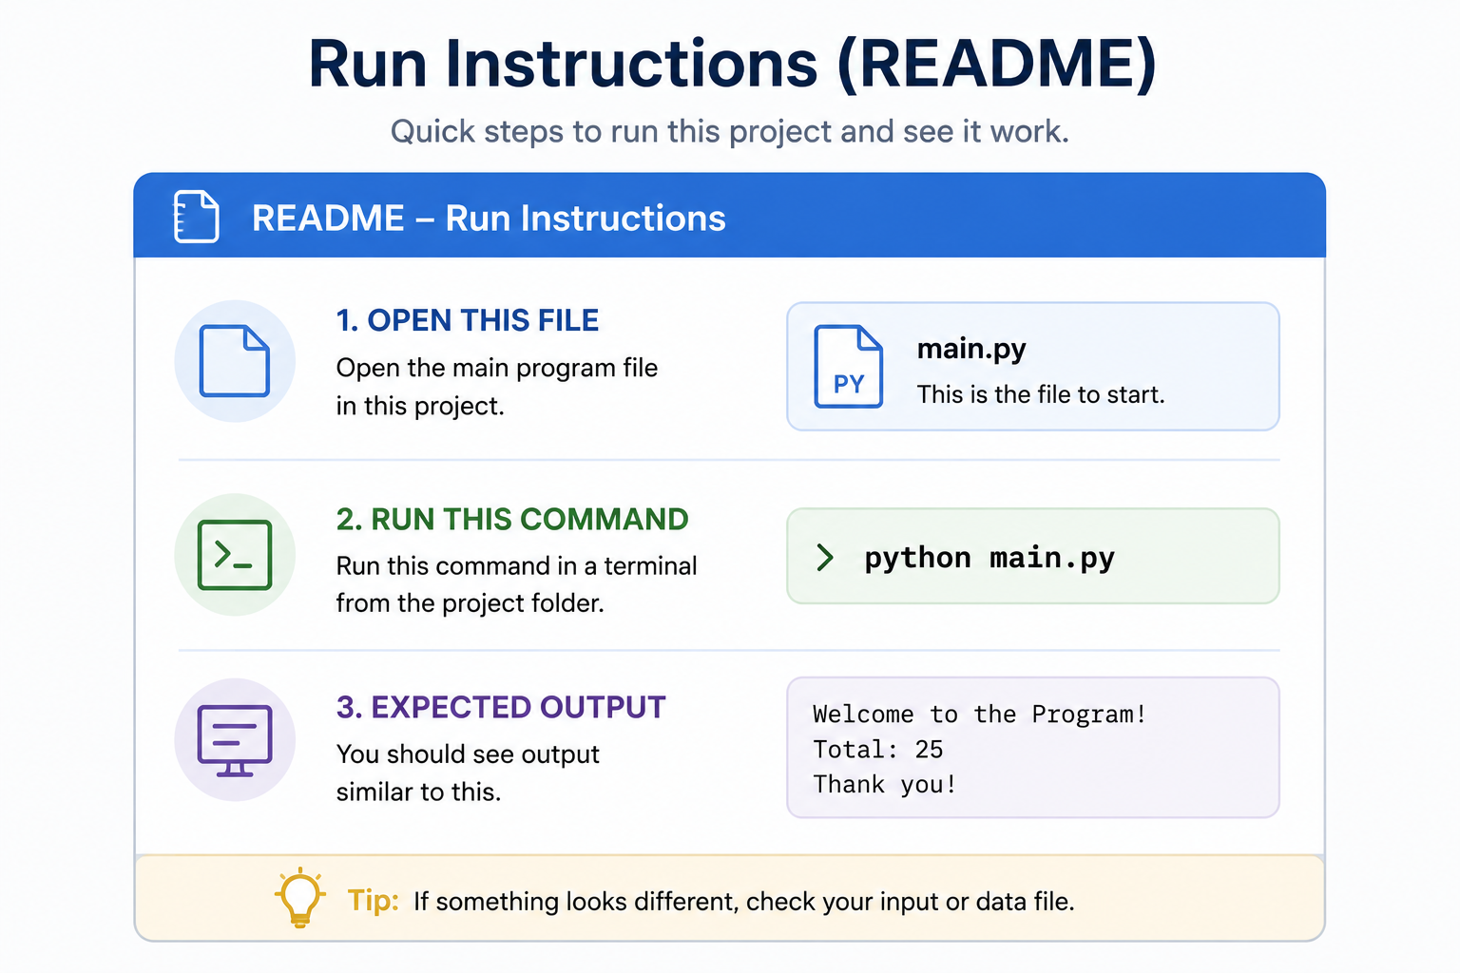
Demo: Run Instructions

Slide 20
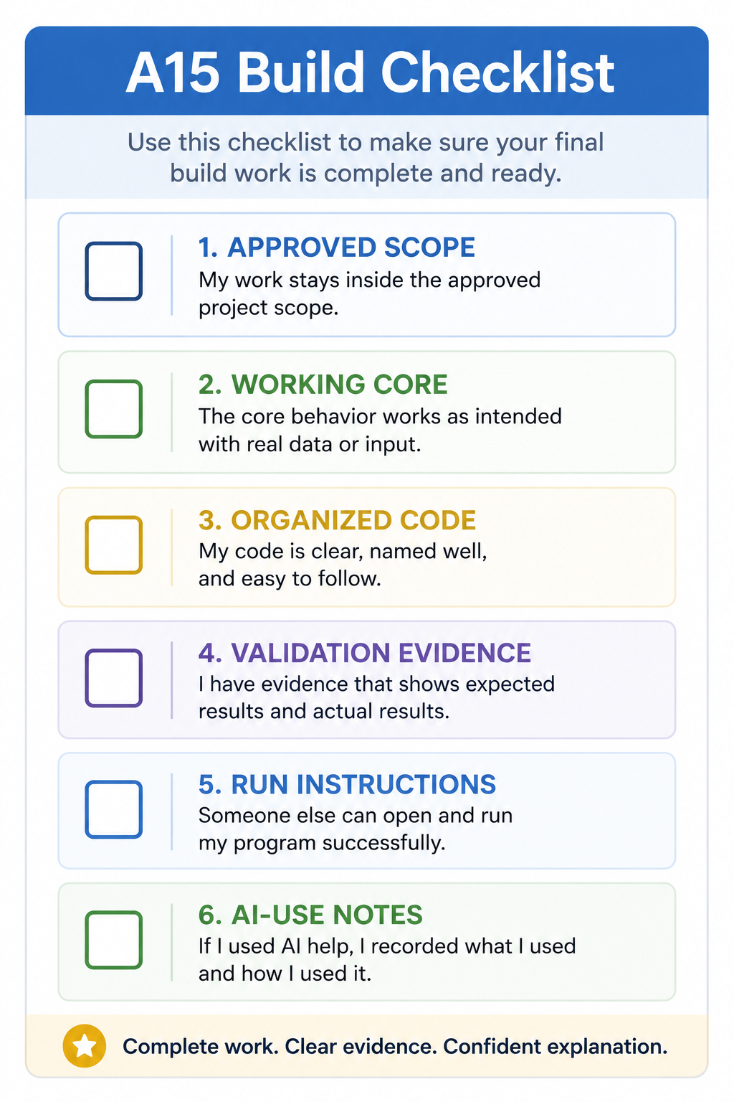
Assignment #15 Build Checklist
approved scope
working core behavior
organized code
data files if needed
validation evidence
run instructions
AI-use notes if used
Notes:
**Instructor Notes:**
This is the transition into work time.
**Transition Cue:**
Make the immediate target small enough that students can act on it before class ends.

Slide 21
Today's Work Target
Before class ends, try to have:
-> One important behavior working or clearly attempted
-> One validation note started
-> README/run instructions started
-> One next-step decision identified
Notes:
**Instructor Notes:**
This gives a realistic day-one finish line.
**Transition Cue:**
Close quickly so students can move into build work with a concrete target.

Slide 22
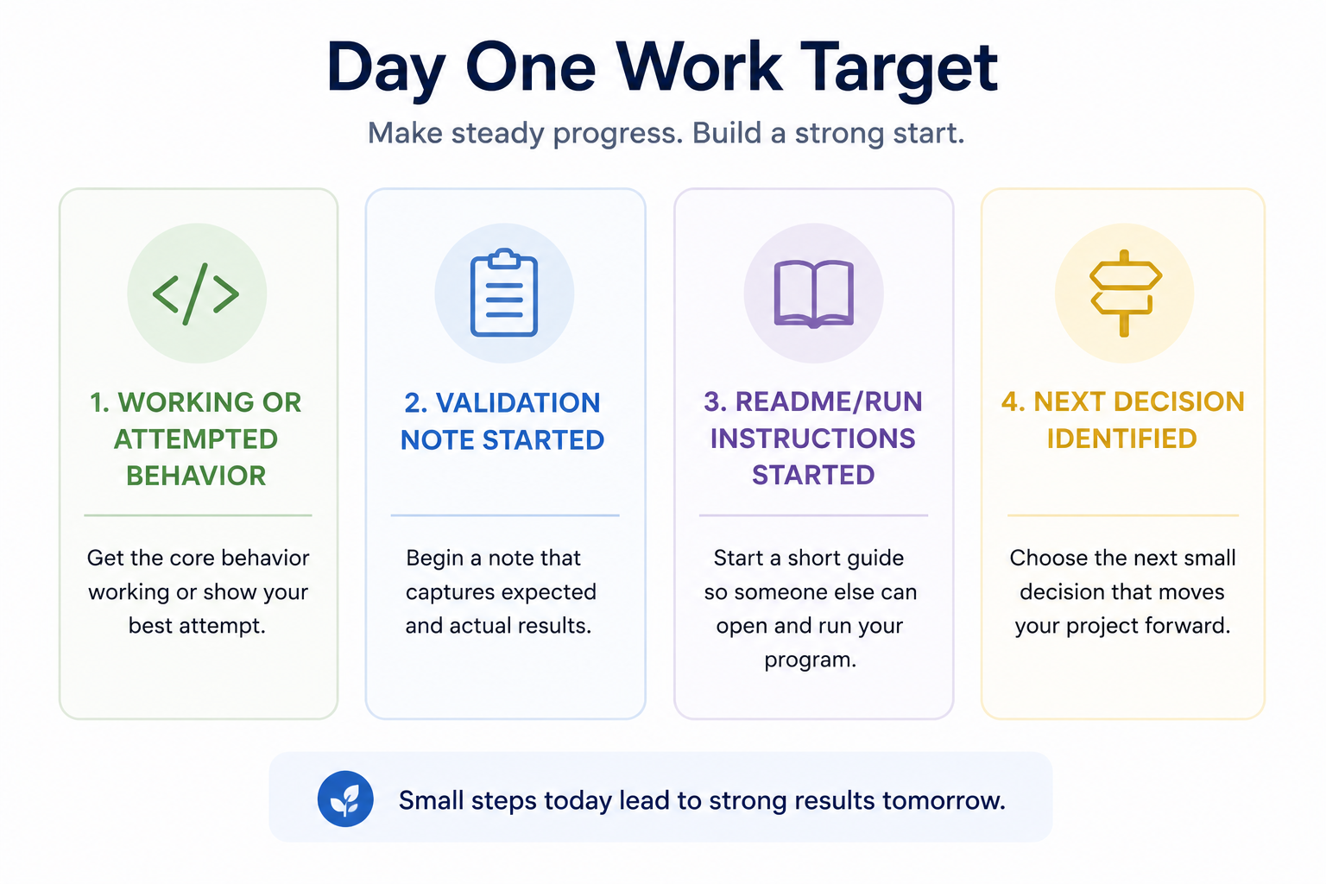
Today's Work Target

Slide 23

Closing Success Check
By the end of today, you should be able to say:
“I know the most important behavior in my project, and I have started proving that it works.”
Notes:
**Instructor Notes:**
Close quickly and move to build support.

Slide 24
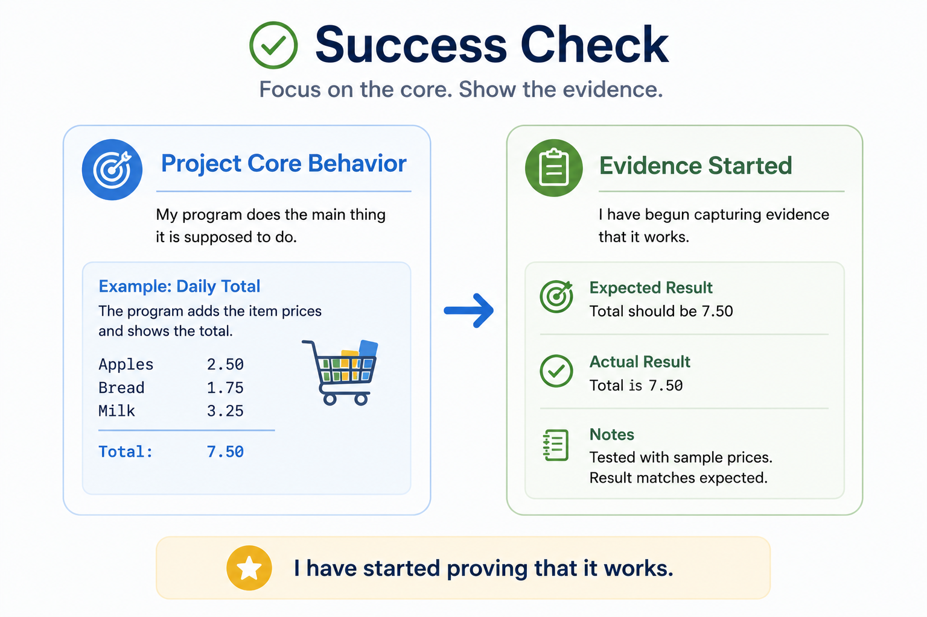
Success Check

Slide 25
Thank you! Have Fun!

