Slide 1
Python Programming Foundations
Week 8 – Capstone Build, Justification, & Presentation
Day 2: “Revision Staging & Presentation Readiness”

Slide 2
Today May Not Need A Lecture
Today is a final-work session.
Depending on class needs, we may use a short reset, begin presentations, or move directly into capstone build and support time.
Notes:
**Instructor Notes:**
This slide names the flexible session design.
**Transition Cue:**
If using this reset, begin by normalizing revision as part of finishing well.

Slide 3
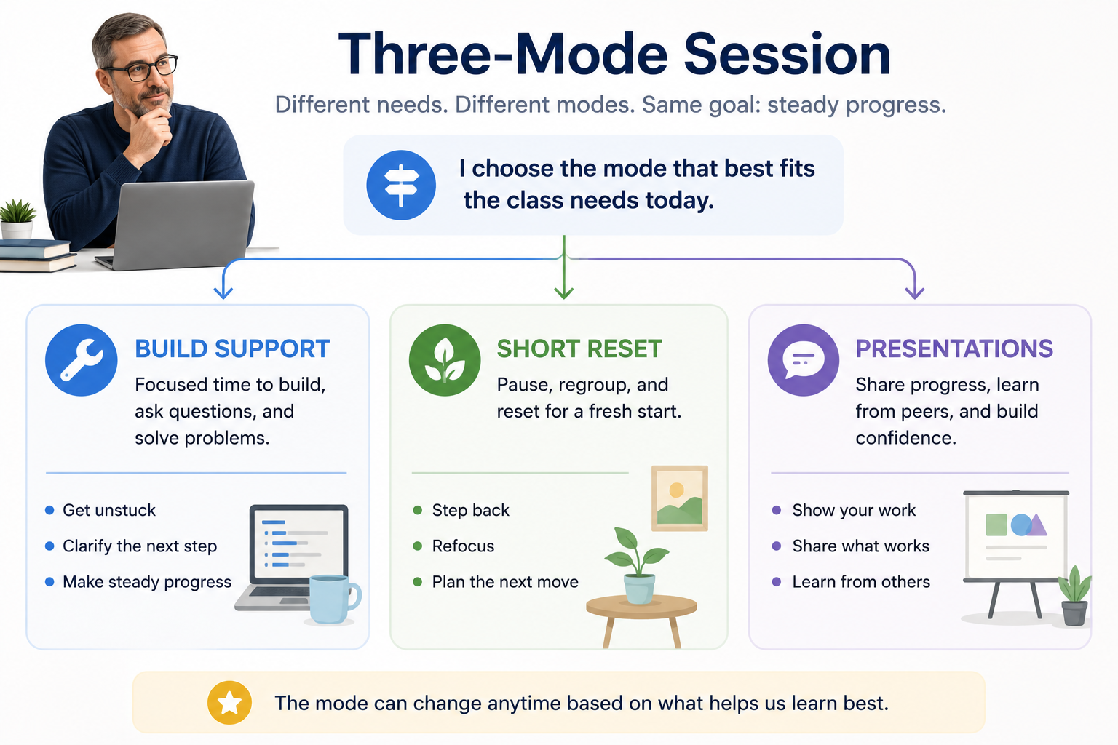
Today May Not Need A Lecture

Slide 4
Revision Is Not Retreat
Revision is not retreat.
When a project touches reality, changing, cutting, or simplifying something can make the final result stronger.
Notes:
**Instructor Notes:**
Use only if students are emotionally resisting simplification.
**Transition Cue:**
If students need the reminder, explain that running the project often reveals the real priorities.

Slide 5
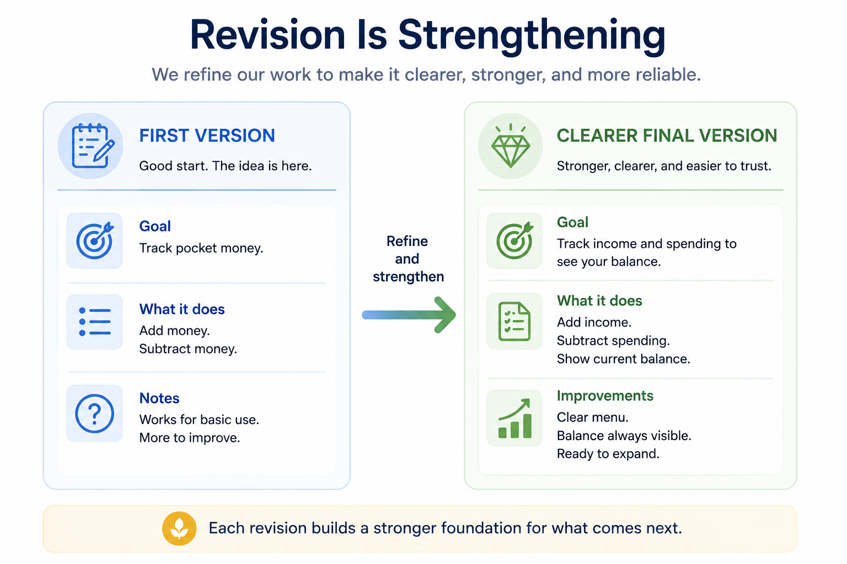
Revision Is Not Retreat

Slide 6
Reality Contact Reveals Priorities
Running the project may reveal:
a feature is too large
a data format is harder than expected
an output needs to be clearer
a smaller core is the better final version
Notes:
**Instructor Notes:**
This is a concise version of the older Day 2 lecture.
**Transition Cue:**
If revision is needed, frame refactoring around coherence rather than cosmetic change.

Slide 7
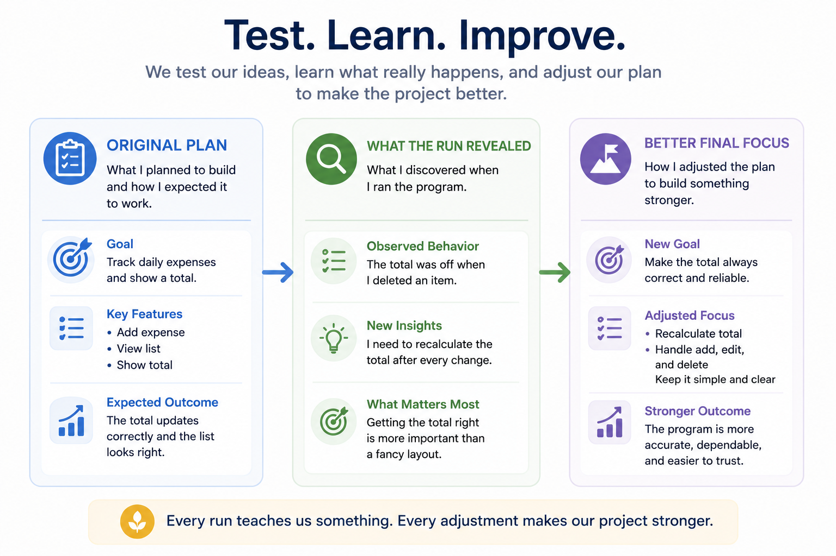
Reality Contact Reveals Priorities

Slide 8
Refactoring Should Improve Coherence
Refactoring should make the project easier to read, run, test, or explain.
Cosmetic changes are fine, but coherence matters more.
Notes:
**Instructor Notes:**
Keep it practical. Do not start a broad refactoring lecture.
**Transition Cue:**
Then ask students to preserve one meaningful revision note for the final explanation.

Slide 9
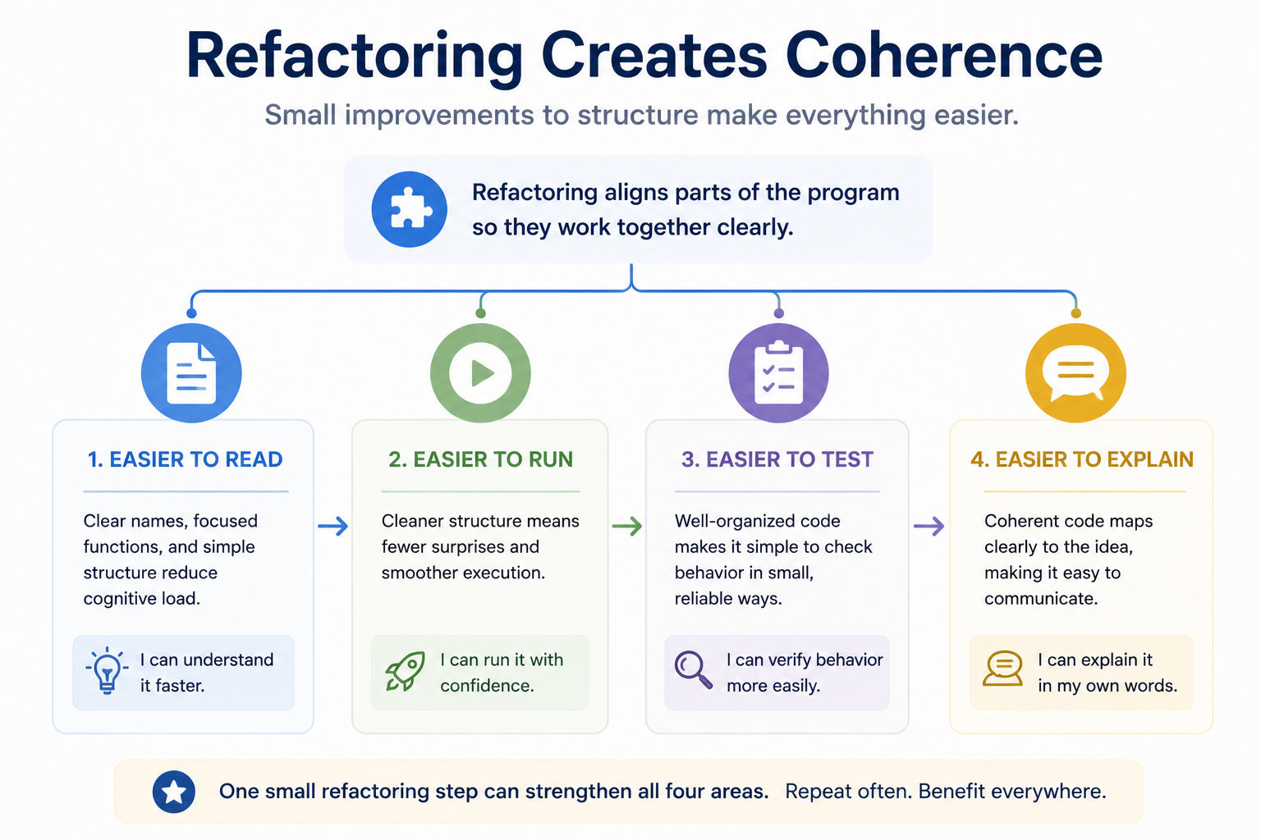
Refactoring Should Improve Coherence

Slide 10
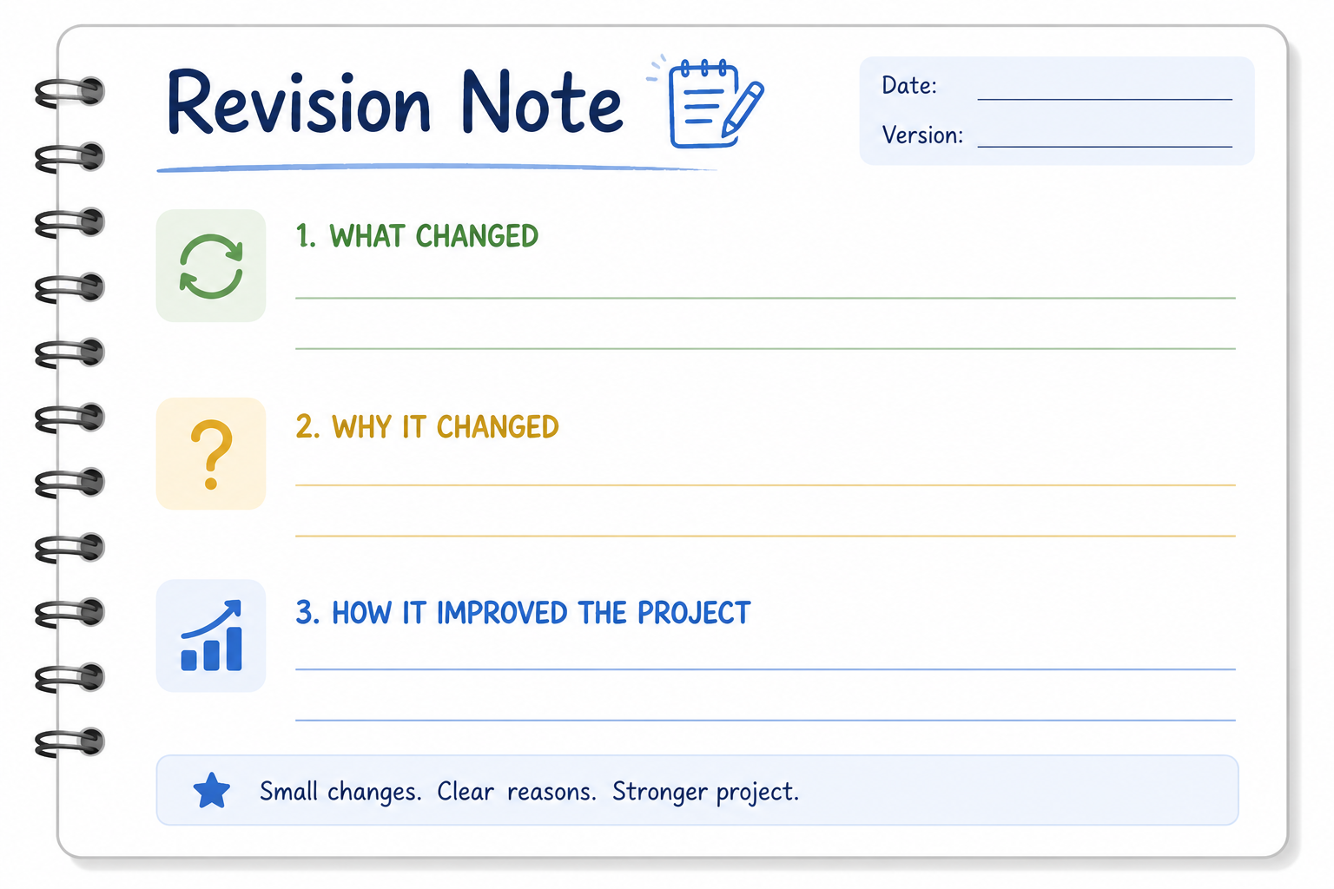
Record One Meaningful Revision
Before final submission, record one meaningful revision:
what changed
why it changed
how the project became stronger or more realistic
Notes:
**Instructor Notes:**
This supports A16 explanation.
Use with, if helpful (markdown artifact):
`\Demos\Week_08_Capstone_Build_Justification_and_Presentation\05_revision_after_reality_contact_example.md`
**Transition Cue:**
If presentations are beginning soon, shift from revision into explanation.

Slide 11

Presentation Is Explanation
Your final presentation should explain:
what you built
what problem or purpose it addresses
how you tested or validated it
what changed during the project
how AI was used, if applicable
how the main logic works (only if asked)
Notes:
**Instructor Notes:**
This can be used as the short pre-presentation reset.
Use with, if helpful (markdown artifact):
`\Demos\Week_08_Capstone_Build_Justification_and_Presentation\04_final_presentation_outline.md`
**Transition Cue:**
Then make AI accountability explicit before students present.

Slide 12
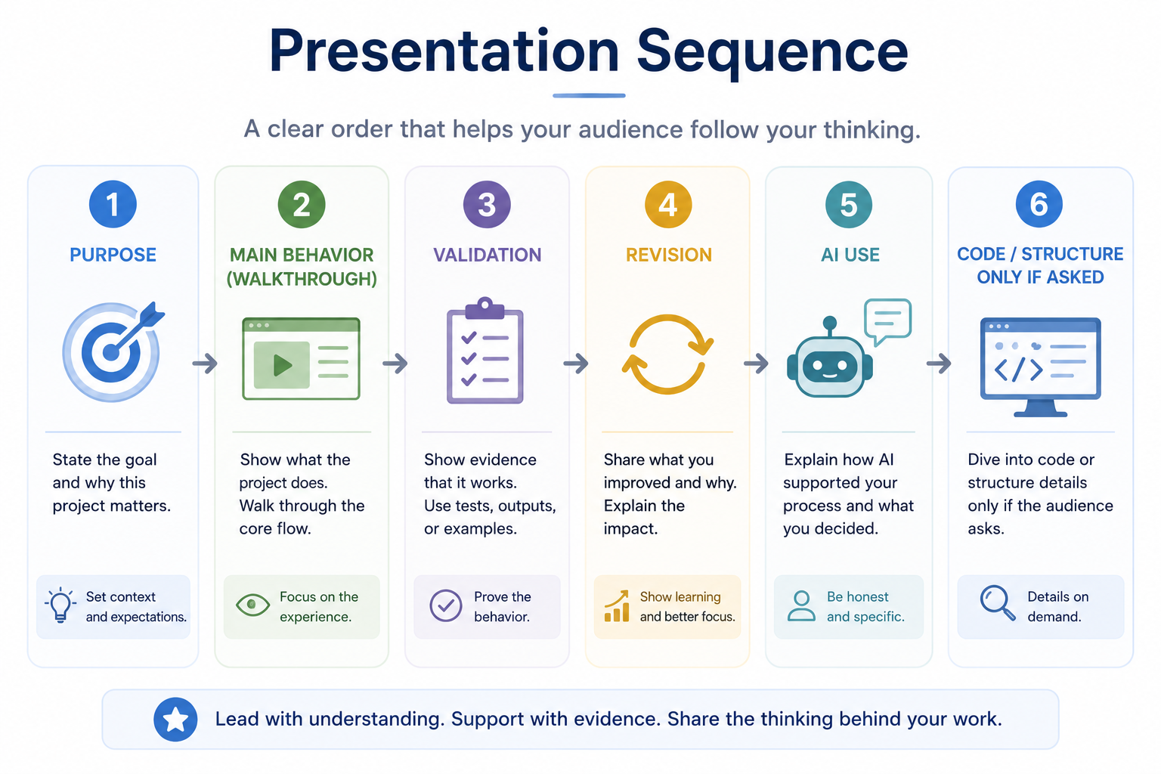
Presentation Is Explanation

Slide 13

AI Use Must Be Accounted For
If AI helped, explain:
what AI contributed
what you accepted
what you changed or rejected
how you verified the result
what decisions remained yours
Notes:
**Instructor Notes:**
Keep it non-accusatory and accountability-focused.
Use with, if helpful (markdown artifact):
`\Demos\Week_08_Capstone_Build_Justification_and_Presentation\03_ai_use_justification_example.md`
**Transition Cue:**
If presentations begin today, convert the explanation checklist into presentation staging.

Slide 14
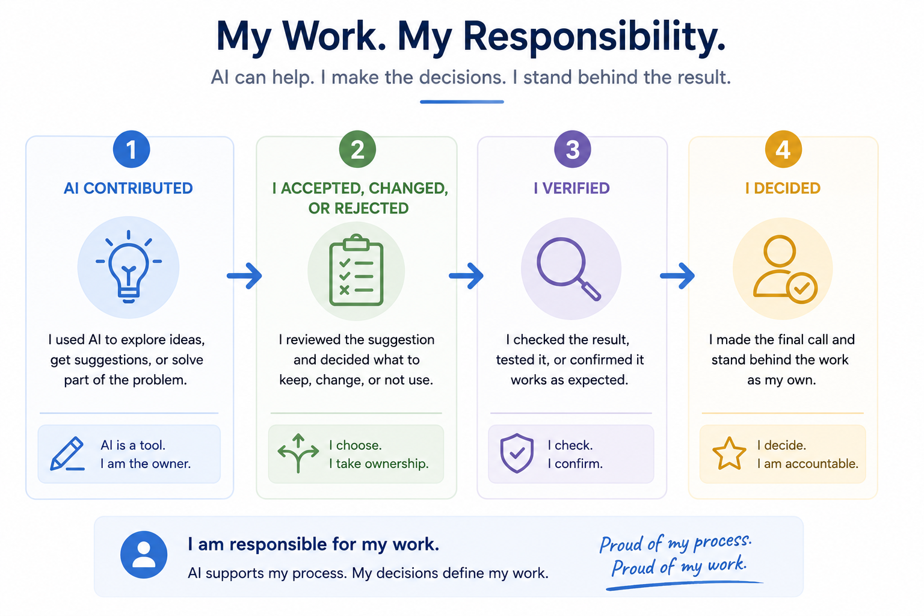
AI Use Must Be Accounted For

Slide 15
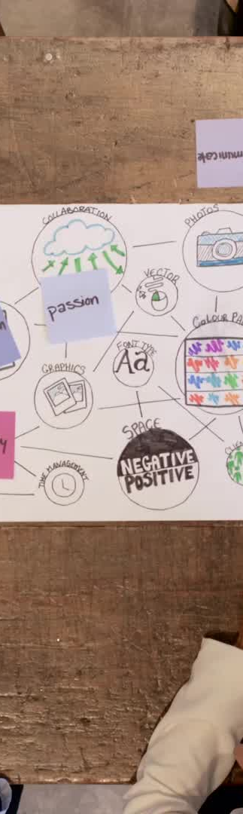
Presentation Staging
Be ready to run the project
Explain the purpose first
Show meaningful behavior
Discuss validation
Answer questions about your choices
Notes:
**Instructor Notes:**
Use if enrollment requires staging presentations across Day 2 and Day 3.
**Transition Cue:**
End the reset immediately and move to the highest-value final work.

Slide 16
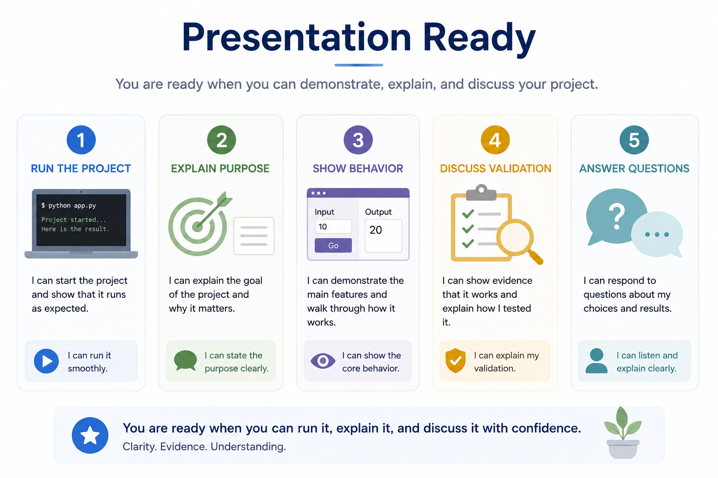
Presentation Staging

Slide 17
Move Into Final Work
Use the remaining time for the highest-value final task:
finish the working core
validate important behavior
complete run instructions
prepare presentation explanation
present if scheduled
Notes:
**Instructor Notes:**
End immediately. Do not extend the lecture unless the class genuinely needs it.

Slide 18
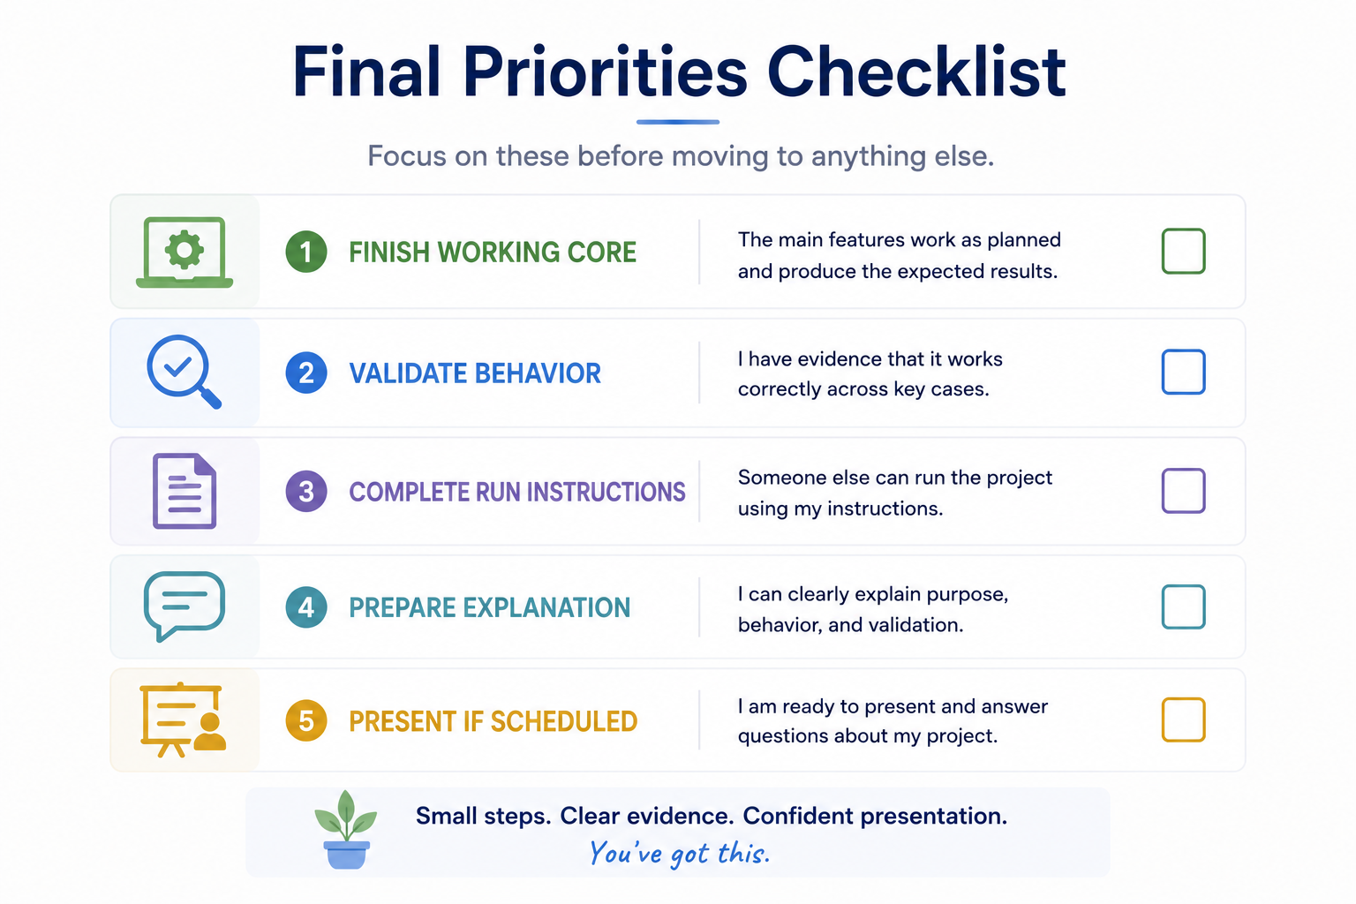
Move Into Final Work

Slide 19
Thank you! Have Fun!

