Slide 1
Python Programming Foundations
Week 8 – Capstone Build, Justification, & Presentation
Day 2/3: “Presentations”

Slide 2
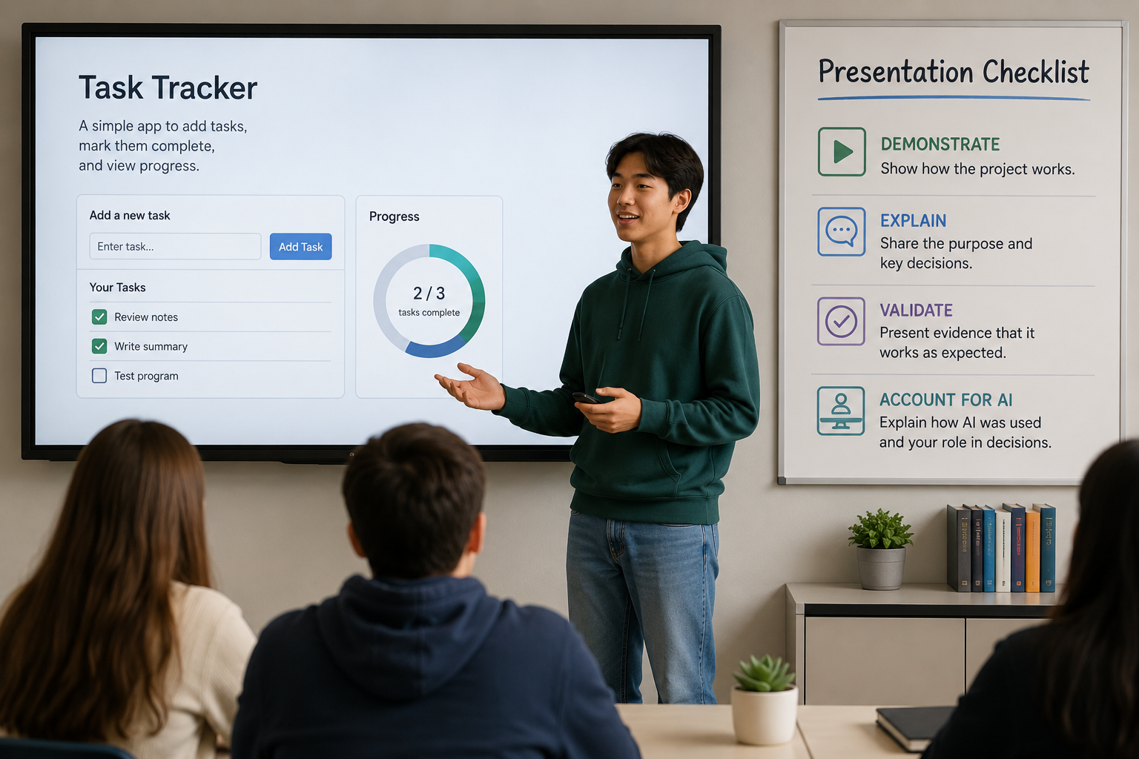
Final Presentation Day
Each presentation should demonstrate the project, explain the main choices, show validation evidence, and account for AI use if applicable.
Notes:
**Instructor Notes:**
Keep opening remarks brief. Move quickly into presentations.
**Transition Cue:**
Move immediately to the visible checklist so students know what each presentation should include.

Slide 3
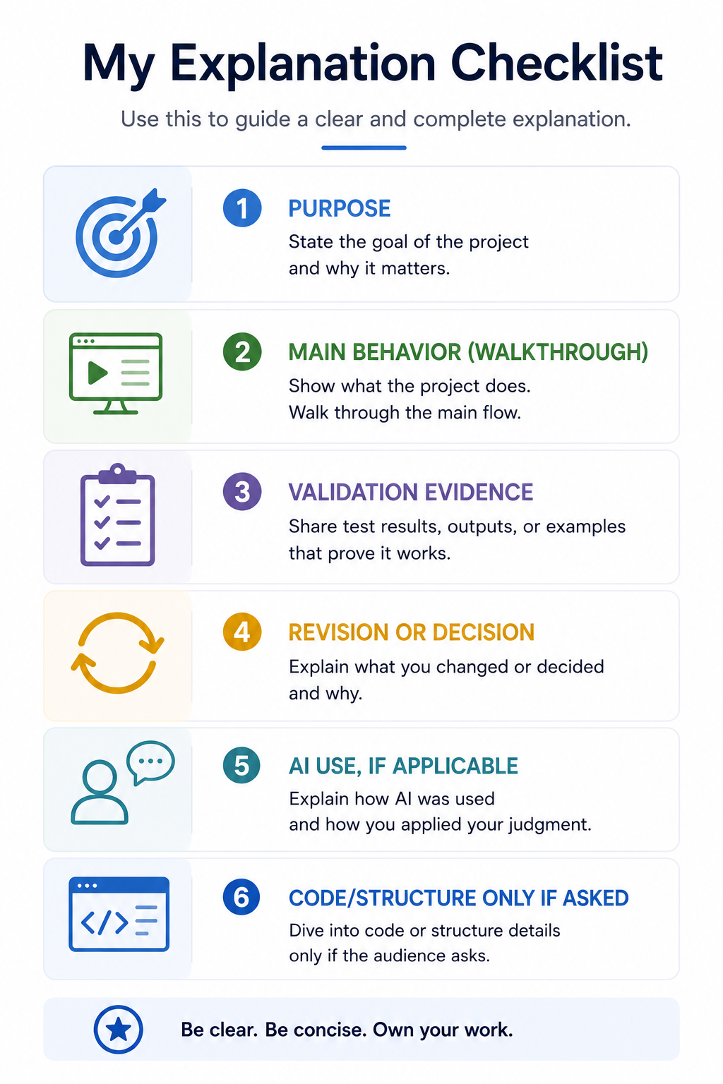
What To Explain
Notes:
**Instructor Notes:**
Use this as a visible checklist while students present.
**Transition Cue:**
Before the first presentation, remind students how to account for AI use if it helped.

Slide 4

AI-Use Accountability
If AI helped, explain:
what it contributed
what you changed or rejected
how you verified the result
what decisions remained yours
This Photo by Unknown Author is licensed under CC BY-NC
Notes:
**Instructor Notes:**
This is a reminder, not a lecture.
**Transition Cue:**
Close the opening reminders by setting the question posture.

Slide 5
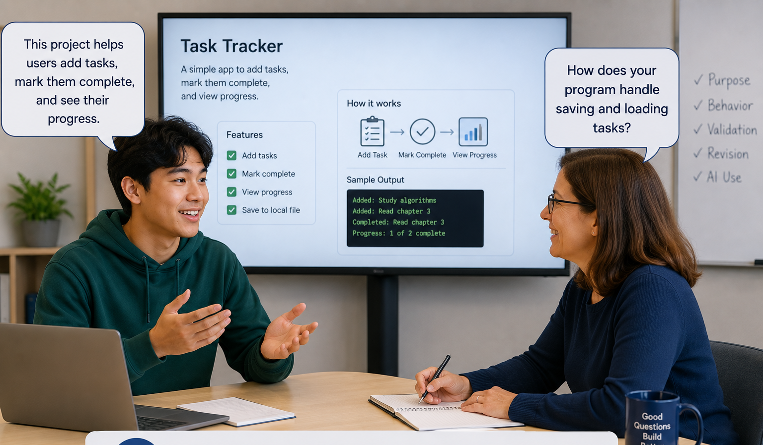
Questions Are Part Of The Assessment
Questions are used to verify understanding.
Be ready to explain what your project does, how it works, how you tested it, and why your choices make sense.
Notes:
**Instructor Notes:**
Set a calm tone. Questions are not "gotchas"; they verify ownership.
**Transition Cue:**
Begin presentations. Do not add additional lecture content.

Slide 6
Thank you! Have Fun!

