Slide 1
Introduction To Algorithms
Week 1 – Algorithms, Precision, and Correctness:
“From Ambiguous Instructions to Testable Algorithms”

Slide 2

Why this is important?
“Because great software starts with great reasoning!”

Slide 3
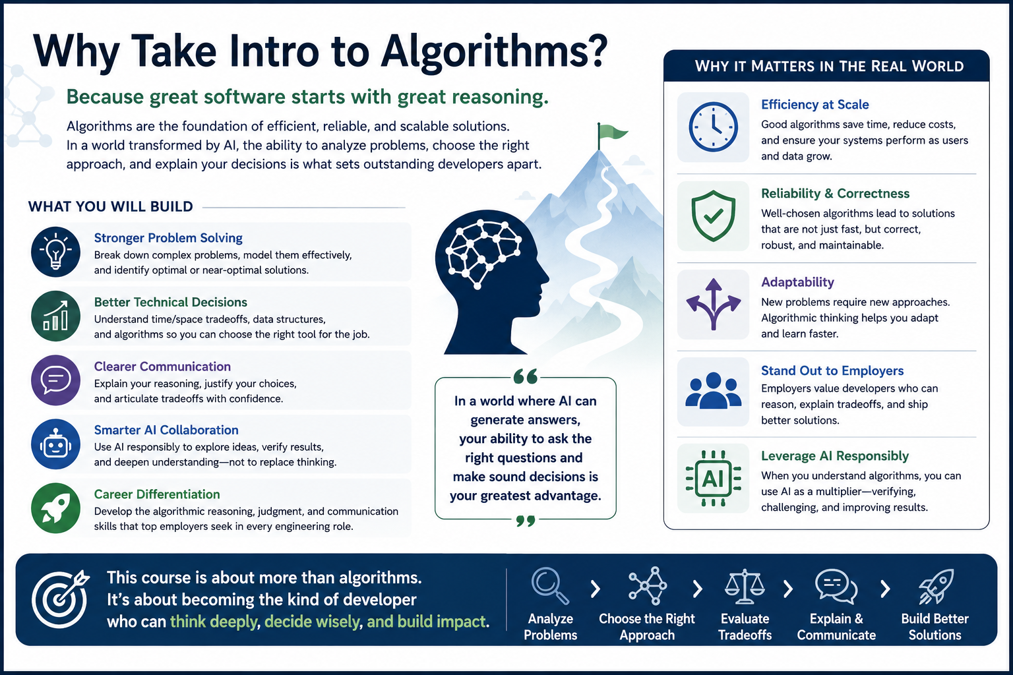

Slide 4
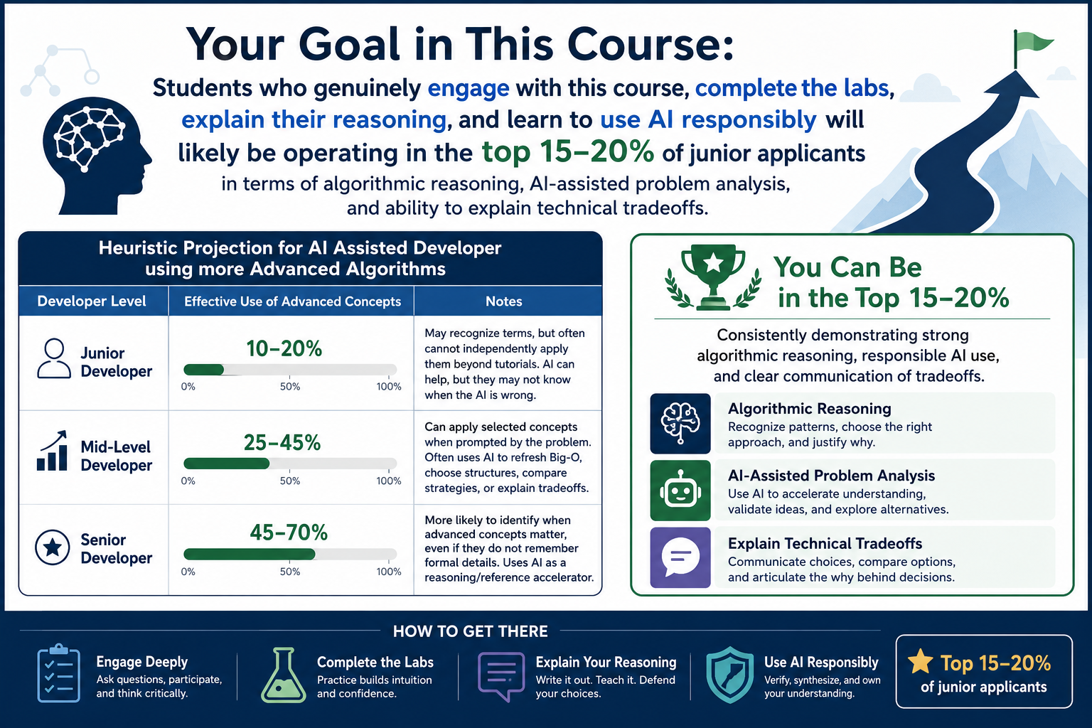
Notes:
Heuristic Projection for AI Assisted Developer using more Advanced Alogorithms"
| Developer Level | Effective Use | Notes |
| Junior Developer | 10-20% | May recognize terms, but often cannot independently apply them beyond tutorials. AI can help, but they may not know when the AI is wrong. |
| Mid-Level Developer | 25-45% | Can apply selected concepts when prompted by the problem. Often uses AI to refresh Big-O, choose structures, compare strategies, or explain tradeoffs. |
| Senior Developer | 45-70% | More likely to identify when advanced concepts matter, even if they do not remember formal details. Uses AI as a reasoning/reference accelerator. |

Slide 5

Why this course matters
Many junior developers can say:
"I made it work."
This course trains you to say:
"Here is the problem I solved. Here are the assumptions I made. Here is the strategy I chose. Here is the evidence that it works. Here is the tradeoff I accepted. Here is how I used AI without surrendering judgment."

Slide 6

What We Will Use Today
definition of algorithm
design before coding
expected result
ambiguity and assumptions
test cases and edge cases
data and compute as early design concerns

Slide 7
Algorithmic Problem Solving
problem -> steps -> evidence -> revision.
- Algorithms are not just code.
- Algorithms are structured ways to solve problems.
- This course focuses on designing, testing, explaining, and improving them.
Notes:
**Instructor Notes:**
Open by positioning the course as a bridge from "I can write Python" to "I can reason about a solution before and after I write Python."
Make clear that this course is not abandoning coding. Instead, it slows down the thinking around the code: why this approach, why this data, why this test, and why this result should be trusted.
**Transition Cue:**
Students may already associate algorithms with code, math, or intimidating formal notation. Start there, then broaden the word so it means a structured problem-solving process that can eventually be implemented and tested.

Slide 8
Terms to Remember
Term | Brief Meaning
Algorithm | A clear, repeatable, testable process for solving a problem
Design Phase | The planning and reasoning work before or alongside coding
Coding Phase | The implementation of the designed procedure
Functional Requirement | What the algorithm must produce or do
Non-functional Requirement | How well the algorithm should behave under constraints
Data-intensive | Work shaped mainly by the amount, speed, or variety of data
Compute-intensive | Work shaped mainly by the amount of processing required
Edge Case | A boundary or unusual input that tests hidden assumptions

Slide 9
How To Use the Textbook
The textbook may look more mathematical than this course feels at first.
For now:
skim for the idea
notice key terms
mark what looks unfamiliar
do not panic over every formula
connect the concept back to Python functions
Notes:
**Instructor Notes:** (Use this slide to lower unnecessary anxiety without lowering expectations.)
Explain that the textbook is intentionally broad and sometimes gives a fuller mathematical treatment than beginning developers need on first contact. That is not a failure by the student. The first goal is to recognize the idea, become familiar with the vocabulary and understand why the concept matters.
Say explicitly: "When you write a Python function that takes input, follows steps, and returns a result, you are already creating an algorithm. This course will help you recognize, test, explain, and improve that process."
Also explain that some textbook topics may appear before students are ready to master them fully. Later topics such as P, NP, NP-Complete, and NP-Hard are important in computer science, but the beginning developer does not need to master them to become competent at introductory algorithmic problem solving.
**Misconception Warning:**
Students may interpret unfamiliar formulas as proof that they are "not math people" or that they cannot learn algorithms. Reframe the formulas as one way experts compress reasoning, not the only way to begin understanding the idea.
**Transition Cue:**
With that textbook posture in mind, today we will start with the developer version of algorithmic thinking: turning a vague instruction into a testable process.

Slide 10
Course Pattern
- Lecture concept
- Instructor demo
- Related but different lab
- Evidence and explanation
- Responsible AI use
Notes:
**Instructor Notes:**
Explain the repeated course rhythm. Emphasize that the demo will be similar to the lab but not the same.
The demo is a teaching example. The lab is a transfer task. Students should look for the pattern from the demo, then apply that pattern to a different scenario instead of copying the demo's exact rules.
**Transition Cue:**
That pattern starts today with a small decision algorithm because decision rules are easy to understand but still reveal ambiguity, assumptions, and edge cases.

Slide 11
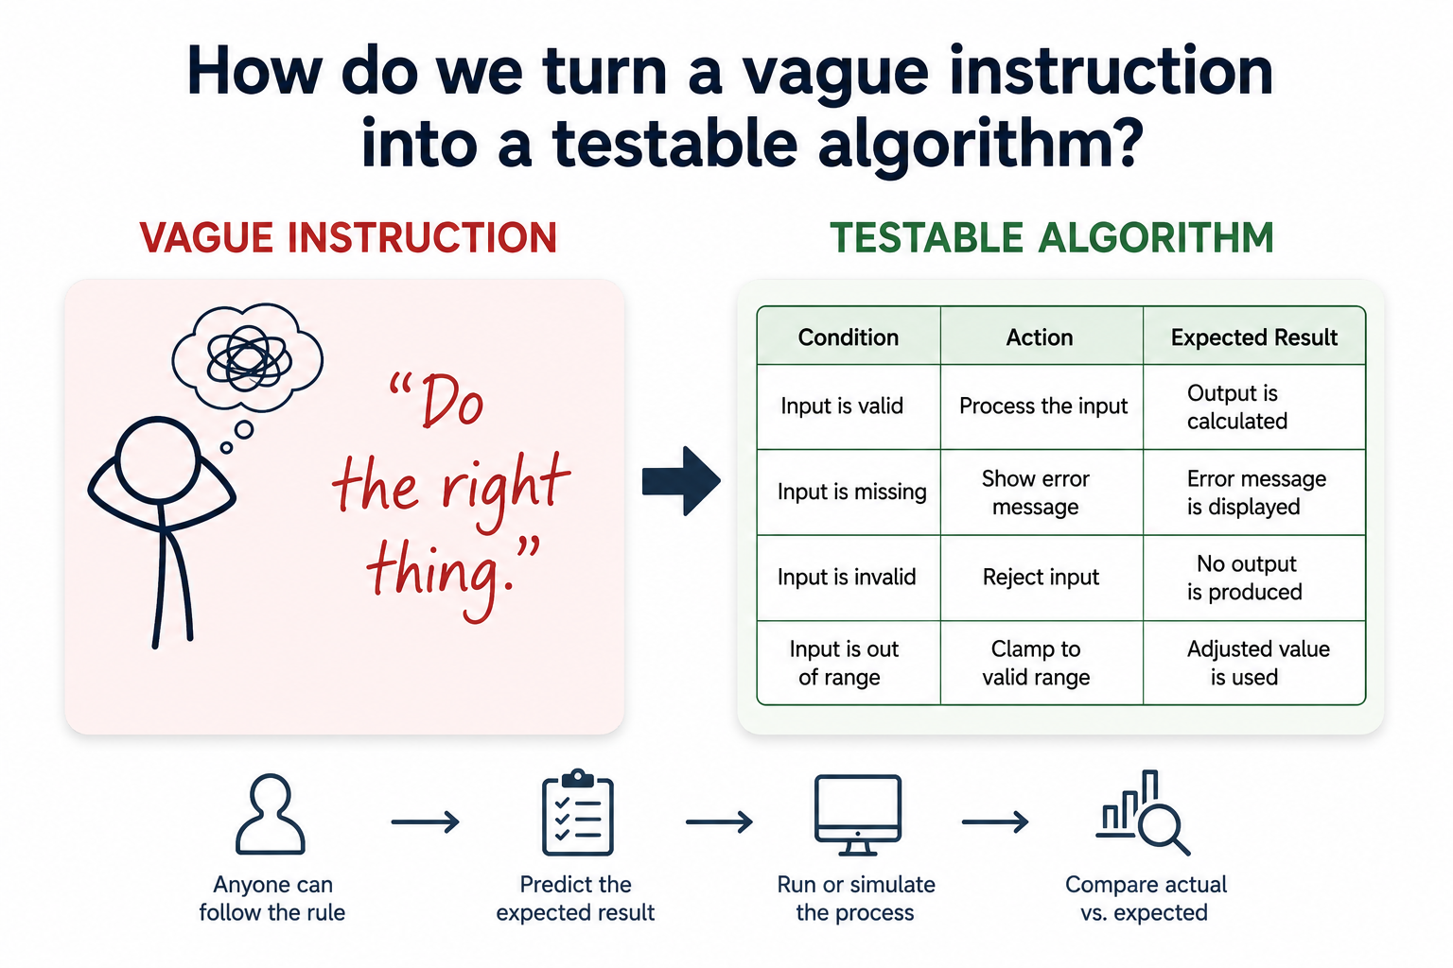
Today’s Question
How do we turn a vague instruction into a testable algorithm?
Notes:
**Instructor Notes:**
This is the anchor question for the entire lesson. Keep returning to it during the demo and lab bridge.
Explain that "testable" means another person can follow the rule, predict an expected result, run or simulate the process, and compare the actual result to the expected one.
**Transition Cue:**
Most everyday instructions feel clear to the person who wrote them. The problem appears when another person or a computer has to follow those instructions without sharing the hidden context.

Slide 12
What Counts As Success Today
name the inputs and outputs
state assumptions
write precise steps
test normal and edge cases
revise when evidence exposes ambiguity
Notes:
**Instructor Notes:**
This slide makes the success target concrete and lowers anxiety. It also sets up the Lab 01 grading emphasis.
Mention that the first week is not about clever code. It is about making a small solution precise enough that it can be reviewed, tested, and improved.
**Transition Cue:** The assigned reading gives vocabulary for this work. The lecture will use those terms, but it will also translate them into small examples students can apply in Lab 01.

Slide 13
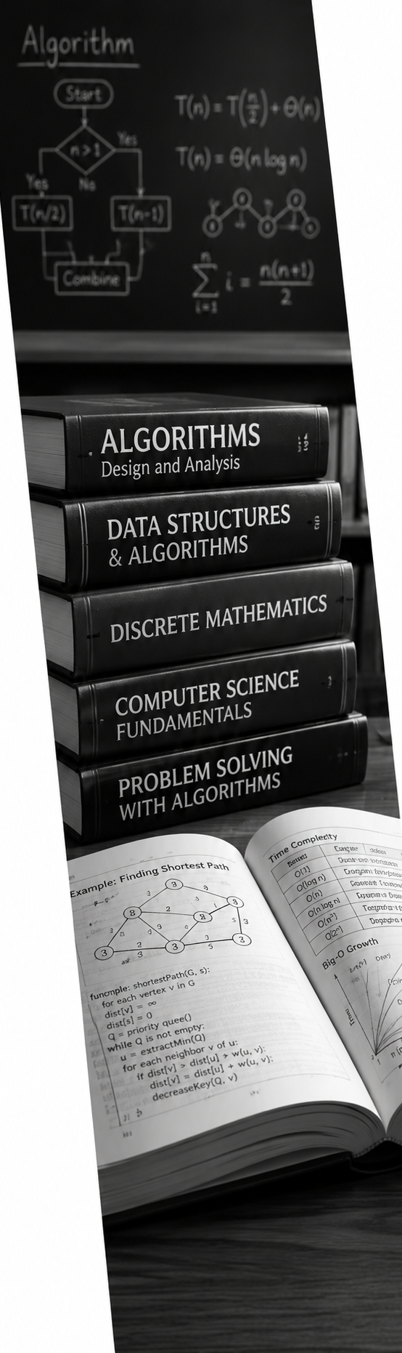
What is an Algorithm?
Textbook Review
An algorithm is a structured process for solving a problem.
It should be:
clear
repeatable
testable
explainable
implementable
Notes:
**Instructor Notes:**
Use the course phrase explicitly: "An algorithm does not have to look mathematical to be real."
Then add the working standard for the course: it must be clear, repeatable, testable, explainable, and implementable. This definition is intentionally practical because students will use it in labs.
**Transition Cue:**
Once students understand what an algorithm is, the next question is how an algorithm is developed. The reading separates that work into design and coding.

Slide 14
Design and Coding
Textbook Review
Algorithm work has two connected phases:
Design: decide the logic
Coding: implement the logic
Good coding cannot fully rescue unclear design.
Notes:
**Instructor Notes:**
(Do not overstate the separation.) In real work, design and coding can loop. The teaching point is that design questions should be visible before students race
into code.
Give a simple example: before writing a function that recommends "bring charger," we should decide what counts as low battery and long time on campus.
**Transition Cue:**
Design is where we decide what the algorithm is supposed to do and how we will know whether it did it correctly.

Slide 15
Requirements
Textbook Review
Functional requirements:
What result should the algorithm produce?
Non-functional requirements:
How well should it perform?
How readable should it be?
How well should it handle growth?
Notes:
**Instructor Notes:**
Keep this introductory. Week 1 does not need full software requirements theory. Students only need the difference between "what it does" and "how well it behaves."
Use a quick example: a functional requirement might be "return approved, denied, or needs review." A non-functional requirement might be "the decision should be easy to explain" or "the approach should still work when there are many records."
**Transition Cue:**
Those requirements lead to three design questions we will keep using in the course: expected result, reasonable approach, and larger-data behavior.

Slide 16
Three Design Questions
Textbook Review
When designing an algorithm, ask:
Does it produce the expected result?
Is this a reasonable way to get the result?
What happens when the data gets larger?
Notes:
**Instructor Notes:**
Use these three as the Week 1 version of correctness, approach fit, and scale.
(Formal Big-O comes later. - Do not introduce formal notation here.) The goal is to plant the questions so Week 2's growth and Big-O discussion has somewhere to attach.
**Transition Cue:**
Now move from: … the reading summary … into the course's working definition of an algorithm: a procedure that starts with information, follows steps, produces a result, and can be checked.

Slide 17

Algorithmic Meaning
“Algorithm" names the reasoning pattern, not only the final code.
Notes:
** Topic Block 1 **
Key Terms
Algorithm - A precise process for solving a problem
Procedure - Ordered steps
Expectd result - What should happen if the algorithm is correct
Testable - Clear enough that we can check the result

Slide 18
An Algorithm is A Procedure
It Answers:
What information do I start with?
What steps do I follow?
What result should I produce?
How will I know it worked?
Notes:
**Instructor Notes:**
Ask students for one everyday process that has steps. If they hesitate, offer examples such as deciding what to wear, calculating a tip, choosing a route, or prioritizing a task
Then ask them to identify the starting information and final decision for that example. The goal is to help them see that algorithmic thinking can begin with ordinary decision processes before it becomes code.
**Transition Cue:**
Once we can describe the process, we can represent that same process in more than one form. The representation changes, but the underlying reasoning should stay the same.

Slide 19
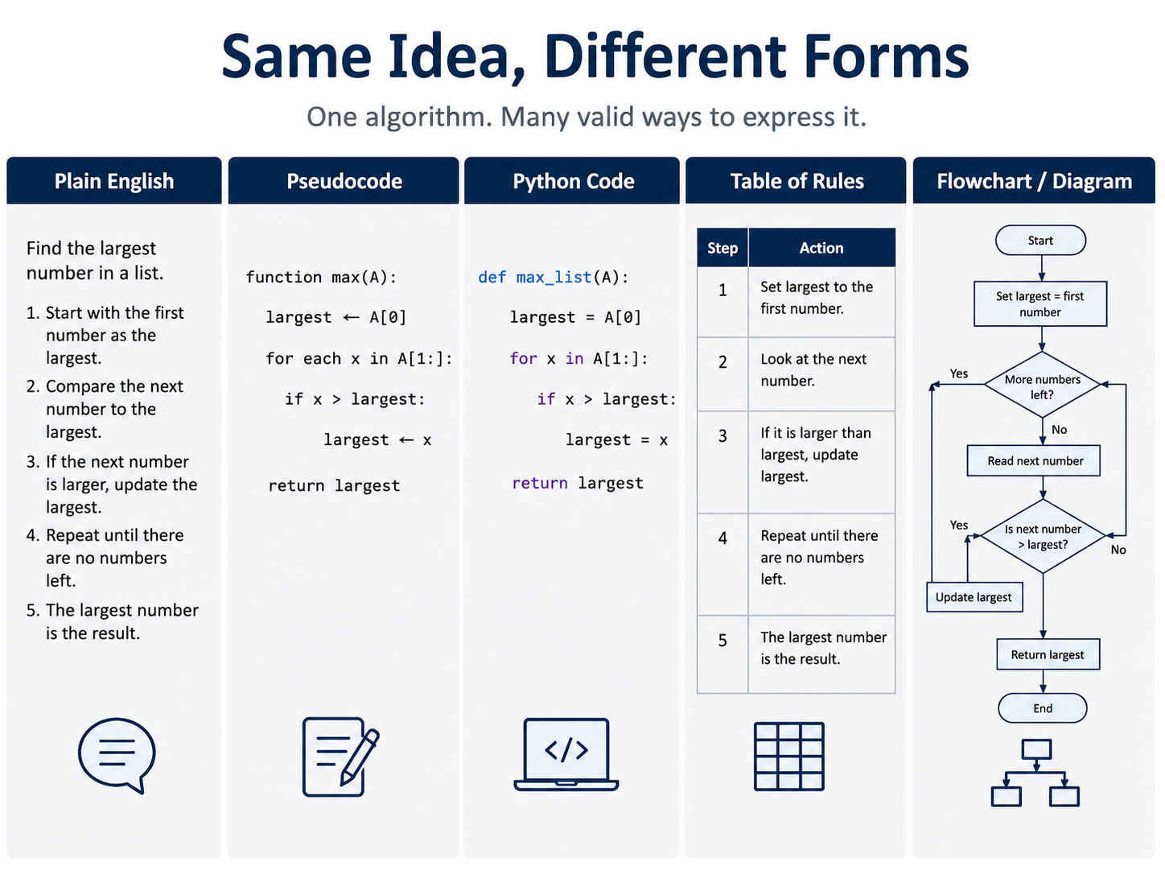
Notes:
**Instructor Notes:**
Use this slide to directly address the misconception that algorithms are only equations or only code.
Say explicitly that plain English can be a valid starting representation when the steps are precise enough to follow and test. Pseudocode and Python are not separate ideas; they are more structured ways to express the same reasoning.
**Transition Cue:**
Next we need to ask what separates a real algorithm from a vague suggestion. The answer is not the format. The answer is whether the process is ordered, precise, repeatable, testable, and connected to a result.

Slide 20
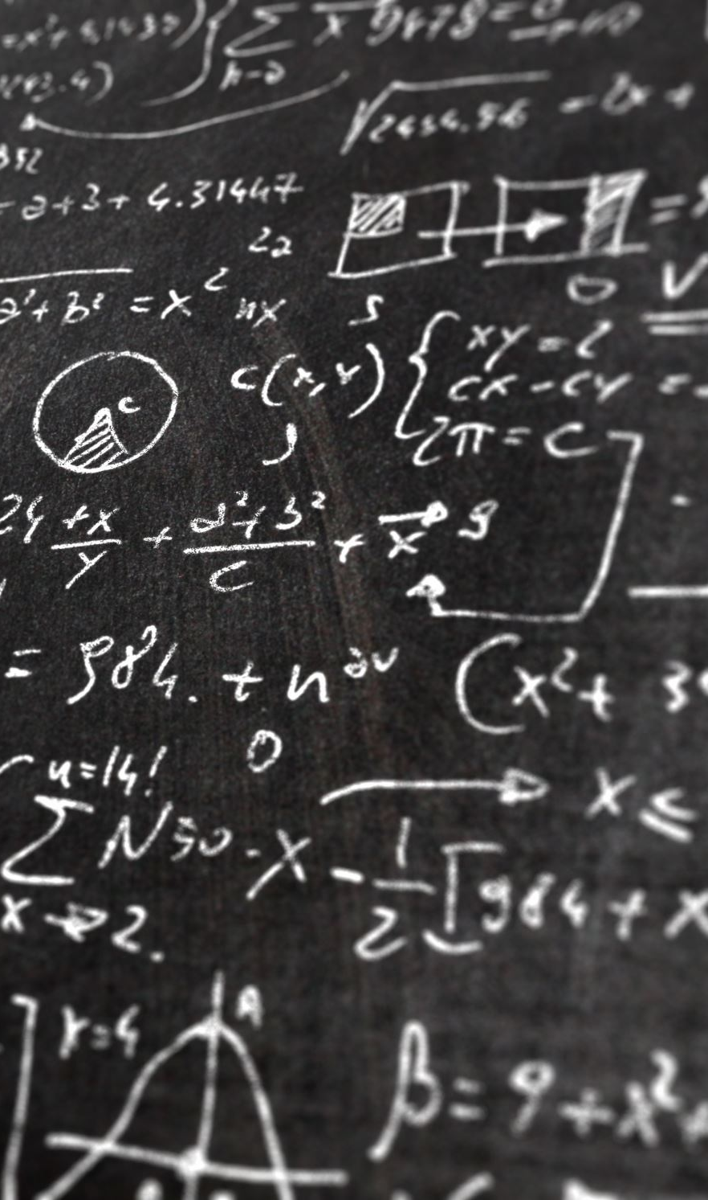
“So, What Makes it Algorithmic?”
The process must be
Ordered
Precise
Repeatable
Testable
Connected to a result
Notes:
**Instructor Notes:**
Use a deliberately weak instruction: "Pick the best option."
Ask students what makes that instruction hard for someone else to follow. The problem is that "best" has not been defined. Best could mean cheapest, fastest, healthiest, easiest, highest quality, or most appropriate for a specific person.
Then connect the weak instruction back to the slide. It is not precise enough, not repeatable across people, and not testable unless "best" is defined with specific rules or scoring criteria.
**Misconception Warning:**
Students may think everyday steps are too simple to be algorithms. That is not true if the steps are precise and testable.
**Transition Cue:**
That is why precision matters. Vague instructions often feel obvious to the person who wrote them because that person is silently filling in hidden decisions. Algorithms require those hidden decisions to be written down.

Slide 21
Vague Instructions Hide Decisions
Vague Words:
Low
Soon
Many
Best
Reasonable
Urgent
Notes:
**Instructor Notes:**
Ask: "What counts as urgent?"
Let students give two or three different answers. One student may define urgent as "due today." Another may define urgent as "affects many people.“ Another may define it as "blocks all work."
Point out that those answers are not just opinions. Each answer implies a different rule. Those hidden rules are part of the algorithm even before code exists.
**Transition Cue:**
The design phase is where we make those hidden rules explicit before we ask Python to execute them.

Slide 22
Design Before Coding
Coding is implementation, not the whole algorithmic
thinking process.
Notes:
** Topic Block 2 **
Key Terms
Design - Deciding how the solution should work
Coding - Turning the design into executable instructions
Assumption - Something treated as true for the solution
Constraint - A limit or rule the solution must respect

Slide 23

Design Phase
Before coding, we define:
Problem
Inputs
Outputs
Assumptions
Constraints
Expected Results
Notes:
**Instructor Notes:**
(Connect each bullet directly to Lab 01)
Students will not only submit code or pseudocode. They will also submit the problem statement, inputs, outputs, assumptions, constraints, and expected results in their README. These design pieces are part of the assessed work because they show whether the student understands the problem before trying to solve it.
**Transition Cue:**
Once the design is clear enough to test, coding becomes the act of making that design executable.

Slide 24
Coding Phase
Coding turns the design into something executable
In this course, Python helps us:
Run the logic
Test cases quickly
Compare results
Revise based on evidence
Notes:
**Instructor Notes:**
Mention that Python is chosen because students have already used it and because it keeps the course focused on algorithmic thinking.
The point is not that Python is the only language for algorithms. The point is that Python gives the class a familiar execution environment where students can run small examples, inspect output, and revise quickly.
**Transition Cue:**
However, getting Python to run is only one part of the job. A running program can still implement the wrong rule or miss an important boundary case.

Slide 25

Running Is Not The Same As Correct
A Program can run and STILL be wrong.
It may:
Use the wrong rule
Miss an edge case
Return the wrong result
Work only for one example
Notes:
**Instructor Notes:**
(This is one of the most important Week 1 points.)
Students often equate "no error message" with correctness. Make the distinction plain: no error message only means Python was able to execute the instructions.
It does not prove that the instructions match the intended rule or produce the right result for important cases.
**Transition Cue:**
That is why we write expected results. The expected result records what we believe should happen before we compare it to what the algorithm actually did.

Slide 26

Expected Results
Expected result:
what we believe should happen
based on the rule we intended
written before or alongside the test
Actual result:
what the algorithm produced
Notes:
**Instructor Notes:**
Explain that expected outputs in tests represent our mental expectation. They are not usually handed to us in real-world data.
In a lab or success example, expected values are included so we can check whether the algorithm behaved the way we intended. In a real-world dataset, the answer usually has to be reasoned out, validated by a subject-matter expert, or confirmed through business rules, tests, or user feedback.
**Transition Cue:**
Now connect expected and actual results to the three design concerns from the reading: Does it produce the expected result, is the approach reasonable, and what happens when the data gets larger?

Slide 27
Algorithm Design Concerns
Need a version of correctness, approach fit, and scale before forma complexity analysis begins
Notes:
** Topic Block 3 **
Key Terms:
Correctness - Whether the algorithm gives expected results for the right reasons
Optimality - Whether the approach is reasonably efficient or suitable
Scale - What happens as the input grows
Evidence - Output, tests, tables, or traces that support a claim

Slide 28
Concern 1: Expected Result
First question:
“Does the algorithm produce the expected result?”
Evidence may include:
test cases
input/output tables
traces
before/after comparisons
Notes:
**Instructor Notes:**
Do not drift into formal proofs.
For Week 1, correctness evidence should be practical and visible. Students should understand that a test table, a trace, or a before/after comparison can support a claim that the algorithm is improving.
**Transition Cue:**
After we have some evidence that the result is correct, we can ask a second question: even if this works, is this a reasonable way to solve the problem?

Slide 29
Concern 2: Reasonable Approach
Second question:
“Is this a reasonable way to get the result?”
Consider:
rule order
readability
unnecessary steps
confusing assumptions
Notes:
**Instructor Notes:**
Use a small decision problem. If a denial rule should stop the process, checking extra rules first may be confusing or wasteful.
For example, if an event registration requires payment and seats are available, the algorithm might check payment first or seat availability first.
Either may work, but the order should be intentional. A reasonable approach is one that a person can read, maintain, and explain.
**Transition Cue:**
The same approach may feel fine when there are only a few examples. Later, when there are hundreds or thousands of inputs, the amount of repeated work starts to matter.

Slide 30
Concern 3: Larger Data
Third question:
“What happens when the input gets larger?”
Ask:
Does the work grow slowly?
Does the work grow quickly?
Does the algorithm repeat work?
Notes:
**Instructor Notes:**
(This is only Big-O intuition. Avoid notation unless students ask. The formal growth vocabulary comes in Week 2.)
For now, the point is only that algorithms do work, and that work may increase as the input grows. Students do not need to calculate complexity yet. They only need to start noticing repeated work and growth behavior.
**Transition Cue:**
Tests and small evidence tables help reveal whether the algorithm behaves as expected. Normal cases and edge cases give us two different kinds of evidence.

Slide 31

Normal Cases And Edge Cases
Normal cases test expected everyday behavior.
Edge cases test boundaries, missing information, or unusual combinations.
Both matter.
Notes:
**Instructor Notes:**
Give the charger example verbally: 25% battery is normal low-battery behavior; exactly 40% is an edge case because it tests the boundary.
Make the distinction clear. A normal case checks an ordinary situation that the algorithm should handle easily.
An edge case checks a boundary, missing value, tie, threshold, or unusual combination that may expose an unclear rule.
**Transition Cue:**
When an edge case fails, it often reveals an assumption that was never written down clearly enough.

Slide 32
Revision Is Part Of The Process
Testing may show:
the rule is unclear
the threshold is wrong
the order matters
the output needs more detail
Revision is not failure. It is evidence-driven improvement.
Notes:
**Instructor Notes:**
This slide sets up the demo failure as a productive moment, not an instructor mistake.
Tell students that revision is part of algorithm design. The first version is often useful because it gives us something concrete to test. The goal is not to pretend the first version is perfect. The goal is to use evidence to improve it.
**Transition Cue:**
Before the demo, connect one more reading idea: algorithms are shaped by both the data they process and the amount of work they ask the computer to do.

Slide 33

Data and Compute Dimensions
Algorithms are affected by the data they process and the work they require from the computer.
Notes:
** Topic Block 4 **
Key Terms
Data-intensive - The challenge is mainly the data
Compute-intensive - The challenge is mainly the processing
Volume - How much data exists
Velocity - How fast data arrives or changes
Variety - How many different forms the data takes

Slide 34

Data-Intensive Algorithms
A data-intensive algorithm is shaped mainly by the data.
Questions:
How much data?
How fast does it arrive?
How many forms does it take?
Notes:
**Instructor Notes:**
Keep this concrete: registration records, support tickets, logs, form submissions, product reviews.
**Transition Cue:**
The reading names this as the data dimension.

Slide 35

The Data Dimension
Data can be described by:
volume: how much
velocity: how fast
variety: how many forms
These affect which algorithmic approach fits.
Notes:
**Instructor Notes:**
Do not make this a big-data lecture.
It is a vocabulary bridge for later data analytics and AI foundations.
**Transition Cue:** Some algorithms are shaped less by data size and more by processing demand.

Slide 36

Compute-Intensive Algorithms
A compute-intensive algorithm is shaped mainly by how much processing it requires.
Examples may include:
simulations
image processing
cryptography
model training
repeated calculations
Notes:
**Instructor Notes:**
The reading references Chapter 16 for deeper compute topics. Treat this as a preview, not a deep dive.
**Transition Cue:**
Some problems are both data-intensive and compute-intensive.

Slide 37

Both Data And Compute
Some algorithms are affected by both:
large data volume
frequent updates
varied data types
heavy processing
Design must consider both dimensions.
Notes:
**Instructor Notes:**
Use an AI example lightly: ranking many support resources by many features can become both a data and compute problem as scale increases.
**Transition Cue:**
For Week 1, the practical takeaway is simple: ask about data and work early.

Slide 38
Week 1: Practical Takeaway
Before coding, ask:
What data do I need?
How much data might there be?
What work must the algorithm do?
How will I test the result?
Notes:
**Instructor Notes:**
This connects the data/compute dimension back to Lab 01 without overwhelming students.
**Transition Cue:**
Now we will apply these ideas to a small decision algorithm.

Slide 39
Demo Scenario
Demo problem:
“Should a student bring a laptop charger to campus?”
Inputs:
battery percent
expected hours on campus
outlet access
Output:
bring charger
charger optional
Notes:
**Instructor Notes:**
Make clear that this is not a lab scenario option. It is the demo scenario.
**Demo File / Artifact:**
`Assignments/Lab_01/demo/demo_code.py`
**Transition Cue:**
(Start with a vague version.)

Slide 40
Vague Rule Version
Initial rule:
If the battery is low, bring the charger.
If campus time is long and outlets are unreliable, bring the charger.
Otherwise, the charger is optional.
Notes:
**Instructor Notes:**
Point out that the revised version still may not be perfect, but it is now testable.
The important improvement is that the rule now names exact boundaries: `40 or below`, `4 or more`, and `outlet access is false`.
These boundaries make it possible to create expected results and compare them to actual results.
**Transition Cue:**
Before running the code, show that this same decision logic can be represented in plain English, pseudocode, Python-style logic, and a test table.

Slide 41
Precise Rule Version
Revised rule:
If battery percent is 40 or below, bring the charger.
Else if expected hours is 4 or more and outlet access is false, bring the charger.
Otherwise, the charger is optional.
Notes:
**Instructor Notes:**
Point out that the revised version still may not be perfect, but it is now testable.
The important improvement is that the rule now names exact boundaries: `40 or below`, `4 or more`, and `outlet access is false`.
These boundaries make it possible to create expected results and compare them to actual results.
**Transition Cue:**
Before running the code, show that this same decision logic can be represented in plain English, pseudocode, Python-style logic, and a test table.

Slide 42
Representation Bridge
Same algorithm, different forms:
precise plain English
pseudocode
Python-style logic
test table
Notes:
**Instructor Notes:**
Use the demo output to show the bridge. Emphasize that the reasoning should stay stable as representation changes.
Say explicitly: if the plain-English rule says `40 or below`, the pseudocode and Python should not quietly change that to `below 40`.
A representation bridge is useful because it helps us detect when the same idea has drifted between formats.
**Observable Output / Evidence:**
The demo prints the revised rules, pseudocode, Python-style logic, and test tables.
S
**Transition Cue:**
Now run the tests and let the evidence show whether the initial rule and revised rule behave the way we expected.

Slide 43
Demo Evidence
Watch for:
expected result
actual result
pass or fail
boundary case
revised rule
Notes:
**Instructor Notes:**
Run the initial rule set first. Ask students to predict the boundary case before revealing the result.
The boundary case is battery exactly `40`, expected campus time `4` hours, and no outlet access.
After the initial rule set fails that case, pause and ask what caused the failure.
The intended answer is that the first version used strict comparisons where the intended rule needed inclusive comparisons.
Then run the revised rule set to show that the corrected threshold passes.
**Observable Output / Evidence:**
Test 4 should expose the exact-threshold issue in the initial version.
**Transition Cue:**
Before moving to the lab, add one small refinement to the demo. The algorithm already works in plain text.
> Now we will add console color as a presentation layer so the evidence is easier for human readers to scan.

Slide 44

Demo Add-On: Console Color
After the plain demo works, add light console color.
The color helps highlight:
section headings
passed tests
failed tests
important boundary cases
Notes:
**Instructor Notes:**
Present this as an add-on step after the plain-text version has already been run and tested.
Say explicitly: "The algorithm is already complete. We are not changing the decision rule. We are improving how the evidence is displayed."
Then add the color support code and rerun the demo. Use the output as the example.
The green and red pass/fail indicators make the failed boundary case easier to notice.
This supports learning because students can see where the evidence points without hunting through plain text.
(Do not over-teach ANSI escape codes in Week 1. )
The main point is readability: console output can be designed for humans, even when the program is still simple.
**Misconception Warning:**
Students may think colorized output is a requirement for Lab 01.
Clarify that it is not required.
The lab requirement is clear evidence.
Color is an optional presentation improvement.
**Transition Cue:**
Because this is only a presentation add-on, the program should still work and remain understandable without color.

Slide 45

Add-On Principle: Presentation Is Separate From Logic
Keep these separate:
algorithm logic: makes the decision
evidence output: shows what happened
presentation layer: makes output easier to scan
Notes:
**Instructor Notes:**
Point out that the final demo includes a `NO_COLOR` fallback. This means the same algorithm and evidence table can still run in plain text if color is disabled or unsupported.
This is a small example of a larger professional habit: do not mix the core logic so tightly with the display layer that the algorithm becomes hard to test, read, or reuse.
For Week 1, students do not need to implement color. They only need to notice the design principle: build the working logic first, verify the evidence, and then optionally improve presentation without changing the algorithm.
**Optional Visual Notes:**
Three-layer diagram: logic -> evidence table -> presentation polish.
**Transition Cue:**
Now the lab asks students to use the same thinking pattern with a different scenario: define the rule, expose hidden assumptions, test the boundary, and revise based on evidence.

Slide 46
From Demo to Lab
In the lab, you will choose a different scenario and create:
problem statement
inputs and outputs
assumptions
pseudocode or Python
normal and edge-case tests
revision note
Notes:
**Instructor Notes:**
Make the transfer explicit: the lab is not about copying the charger demo. It is about applying the same reasoning pattern.
Name the reasoning pattern out loud: choose a small decision problem, identify inputs and outputs, write precise rules, test normal and edge cases, compare expected and actual results, and revise one ambiguity.
**Related Lab Requirements:**
Lab 01 requires at least 5 test cases, including 3 normal cases and 2 edge cases. (Cash - VERIFY THIS STATEMENT)
**Transition Cue:**
Some students may need help seeing how an everyday scenario becomes an algorithm.
The walkthrough artifact is there for that support, but it is not a finished answer to copy.

Slide 47

Walkthrough Support
The walkthrough artifact can help you see the pattern.
If you use it, explain:
what pattern it showed
how you adapted it
what you still decided yourself
Notes:
**Instructor Notes:**
This preserves scaffolding while preventing mindless copying.
If a student uses the walkthrough, the student must explain the general pattern in their own words and identify what they changed for their own scenario.
This turns the walkthrough into a learning support instead of a substitute for thinking.
**Related Artifact:**
`Lab_01_Full_English_Algorithm_Walkthroughs.md`
**Transition Cue:**
The README is where students make the thinking visible. The code or pseudocode shows the algorithm, but the README shows the evidence, assumptions, revision, and explanation.

Slide 48
README Evidence
Your README should show:
inputs and outputs
assumptions
test table
expected vs actual results
before/after revision
AI-use note, if applicable
Notes:
**Instructor Notes:**
This reinforces the GitHub/README submission model and sets expectations early.
Explain that the README is not extra paperwork. It is part of the algorithmic evidence.
When grading, the instructor should be able to open the repository and see the problem, assumptions, tests, expected results, actual results, and revision without hunting through separate documents.
**Transition Cue:**
If students seem ready or if time remains, use the optional examples to deepen the design concerns.
If the class is saturated, skip the optional section and move directly to lab work.

Slide 49

Optional Deepening Section

Slide 50

Example: Expected Result Is Not Always Obvious
Two people may disagree about the expected result when:
the rule is vague
the threshold is missing
priorities conflict
information is incomplete
Notes:
**Instructor Notes:**
Use help desk priority as a quick verbal example without solving the lab scenario.
**When To Use:**
Use if students are struggling to see why expected results matter.

Slide 51

Example: Rule Order Matters
Changing rule order can change the result.
Ask:
Which rule should be checked first?
Which rule wins if two rules conflict?
Should the algorithm stop early?
Notes:
**Instructor Notes:**
This will matter in later search/sort and decision-ladder labs. For Week 1, keep it simple.
**When To Use:**
Use if students ask why the charger rule checks battery before time.

Slide 52

Example: Small Data Can Hide Problems
An approach may seem fine with 5 examples.
It may struggle with:
500 records
5,000 records
repeated updates
mixed data formats
Notes:
**Instructor Notes:**
This foreshadows Week 2 without teaching full complexity yet.
**When To Use:**
Use if time allows or students ask why larger datasets matter in an algorithms course.

Slide 53
Example: Data And Compute Together
Recommendation systems can involve:
many users
many resources
many tags or features
frequent score updates
repeated ranking calculations
Notes:
**Instructor Notes:**
This is a light preview of later AI/data bridge topics. Do not overdevelop it in Week 1.
**Use When:**
Use for advanced learners or if the class asks how this connects to AI.

Slide 54

Wrap up

Slide 55
What To Carry Forward
Algorithms are not just code.
They are:
designed
represented
tested
revised
explained
Notes:
**Instructor Notes:**
This is the core Week 1 takeaway.
**Transition Cue:**
End with the immediate lab action.

Slide 56
Next Step
For Lab 01:
1
choose a scenario
write precise rules
create normal and edge-case tests
compare expected and actual results
revise one ambiguity
Notes:
**Instructor Notes:**
Remind students to start manually. AI critique comes only after their first version and at least three test cases.
**Transition Cue:**
Before students leave, prepare them for the Week 2 reading.

Slide 57
How To Use The Textbook For Next Week's Reading
For next week, read for growth behavior.
Focus on:
what time complexity means
what space complexity means
why input size matters
what O(1), O(n), O(n2), and O(log n) are trying to describe
how best, worst, and average cases differ
Do not panic over formulas. Mark them, skim for meaning, and connect them back to the code examples.
Notes:
**Instructor Notes:**
This slide prepares the Week 2 reading without suggesting that the reading is optional.
Tell students that the textbook may use compact mathematical notation because that is how computer science often communicates growth patterns.
The practical goal for the next reading is recognition and translation:
students should come in ready to talk about how an algorithm's behavior changes when the amount of input grows.

Slide 58
Thank you! Have Fun!

