Slide 1
Introduction To Algorithms
Week 2 – Growth and Big-O Intuition:
“When Working Code Starts to Slow Down”

Slide 2
Terms to Remember
Term | Brief Meaning
Performance analysis | Studying how an algorithm behaves as resources & input size change
Space complexity | How memory use changes as input grows
Time complexity | How the amount of work or time changes as input grows
Input size | The amount of data the algorithm processes
Big-O | A notation for describing growth behavior
Best case | The easiest or fastest likely situation for an algorithm
Worst case | The hardest or slowest likely situation for an algorithm
Average case | Expected behavior across typical inputs
Exact algorithm | Designed to produce an exact correct result
Approximate algorithm | Designed to produce a good-enough result under constraints
Randomized algorithm | Uses randomness as part of its process
Explainability | Ability to describe how or why an algorithm produced a result

Slide 3

What We Will Use Today
correct, understandable, efficient
space and time analysis
input size and growth behavior
Big-O vocabulary
best, worst, and average case
timing evidence and its limits
algorithm selection and explanation

Slide 4
What We Will “Touch On” and Revisit Later
Formal mathematical notation
Recursion-based complexity
Nested recursion
Memory optimization
GPU/CPU details
Rrandomized and approximate algorithms in deeper AI/data contexts

Slide 5
Review Coding Lab
Notes:
** Instructor Notes **
Step through the coding solution(s) for the Lab. Be sure to state that this is only *one* solution of many. NOT the best or only solution.

Slide 6
Review: What Lab 01 Taught Us
Last week, we focused on:
precise rules
expected results
actual results
edge cases
revision based on evidence
Notes:
**Instructor Notes:**
Do not spend long re-teaching Lab but answer questions. The goal is to remind students that evidence helped them decide whether a small algorithm behaved as expected.
Point out that Week 1's evidence mostly answered: "Does this produce the expected result?"
**Transition Cue:**
This week keeps the evidence habit but changes the question from correctness to growth behavior.

Slide 7
Today’s Question
What happens when the amount of data gets larger?
Notes:
**Instructor Notes:**
Make this the anchor question.
Students should leave understanding that an algorithm can work for five items and still become a poor fit for five thousand or five million items.
**Transition Cue:**
That question is the beginning of performance analysis.

Slide 8

From “Works” To “Scales”
Correctness asks:
Does the algorithm produce the expected result?
Growth asks:
How does the work change as input grows?
Notes:
**Instructor Notes:**
Say clearly that correctness still matters. A fast wrong answer is not a good algorithm.
Week 2 adds another lens, not a replacement for Week 1.
**Transition Cue:**
The reading describes algorithm quality using more than one feature.

Slide 9
What Counts as Success Today
compare two approaches
collect timing evidence
describe growth cautiously
use basic Big-O vocabulary
identify a limitation of your evidence
Notes:
**Instructor Notes:**
Emphasize "cautiously." Students should not overclaim from one timing table.
The goal is responsible introductory explanation.
**Transition Cue:**
Start with the reading's view of what makes an algorithm good.

Slide 10
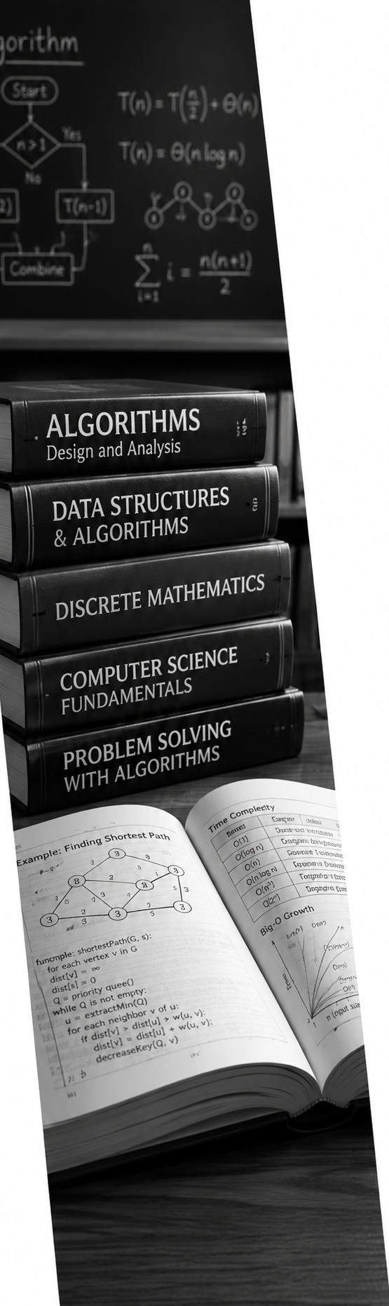
Algorithm Quality
Textbook Review
The reading describes strong algorithms as:
Correct
Understandable
Efficient
Notes:
**Instructor Notes:**
Connect this to student work.
- A solution that works but cannot be explained is hard to trust.
- A solution that is understandable but extremely slow may not fit larger data.
- A solution that is fast but wrong, fails the main purpose.
**Transition Cue:**
Performance analysis helps us reason about the efficiency part without forgetting correctness and understandability.

Slide 11
Performance Analysis
Textbook Review
Performance analysis asks:
How much time might this take?
How much memory might this use?
What happens as input size grows?
Notes:
**Instructor Notes:**
Keep this practical. - Students do not need formal proof yet.
They need to see that algorithms consume resources, and those resources may change when the input changes.
**Transition Cue:**
The reading separates performance analysis into two broad types: space and time.

Slide 12
Space And Time
Textbook Review
Two common analysis types:
Space analysis: memory growth
Time analysis: work or runtime growth
Notes:
**Instructor Notes:**
Use a simple contrast. - A dictionary (a variable, not the book) may use extra memory but reduce repeated lookup work.
- A list may use less structure but require more scanning. This is a tradeoff students will keep seeing.
**Transition Cue:**
Start with space because memory growth is easier to visualize.

Slide 13
Space Complexity
Textbook Review
Space complexity asks how memory use changes.
Patterns can be:
Flat
Converging
Diverging
Notes:
**Instructor Notes:**
Rember: What is “Space” e.g. – how much disk space is used, how much RAM is used, etc.
Use student-friendly language:
- Flat: memory stays about the same.
- Converging: memory growth slows or approaches a limit.
- Diverging: memory keeps increasing as input grows.
Do not spend long on the exact terminology if students are new to it.
The main point is that memory use can have a growth pattern too.
**Transition Cue:**
Time complexity asks a similar growth question, but about work.

Slide 14
Time Complexity
Textbook Review
Time complexity asks:
Can this scale?
What work does the algorithm repeat?
What happens with larger datasets?
What resources are involved?
Notes:
**Instructor Notes:** Mention CPU, GPU, and memory as resource terms from the reading, but do not turn this into a hardware lecture.
For this week, CPU/GPU/memory are reminders that algorithms run on real machines with real limits.
Distinction: Yes, processors use “space” (memory), and the critical point here, is the “speed” by which the operate!
**Transition Cue:**
To reason about time, we need to identify the input size.

Slide 15
Input Size
Textbook Review
Input size is the amount of data the algorithm works on.
Examples:
number of list items
number of records
number of characters
number of graph nodes
Notes:
**Instructor Notes:**
“When we get the demo, we will see how two approaches behave as the input size grows”
(Optional: Use the demo preview - [run the demo to see the results] - in the lookup demo, input size is the number of items in the collection.)
In Lab 02, each student comparison will need to define what input size means for that task.
**Transition Cue:**
Once input size is named, we can ask how the work changes.

Slide 16

Performance Analysis Foundations

Slide 17
Growth Pattern
Growth pattern means:
how work changes
as input size changes
Small inputs can hide the pattern.
Notes:
**Instructor Notes:**
Use a concrete phrase:
"Two approaches can both feel instant with 10 items.
…The difference may become visible with 10,000 items."
**Transition Cue:**
This is why one small example is not enough evidence for performance.

Slide 18
Timing Is Evidence
Timing can show:
what happened in a run
on this machine
with this code
under these conditions
Notes:
**Instructor Notes:**
Make timing useful but limited. Timing is not useless; it is evidence.
But it is evidence from a specific setup, not a universal law.
**Transition Cue:**
Because timing depends on conditions, timing results can be noisy.

Slide 19

Timing Can Be Noisy
Timing can vary because of:
background activity
hardware differences
setup code
number of trials
input construction
Notes:
**Instructor Notes:**
Warn students not to panic if their exact numbers do not match the demo. Focus them on the pattern across increasing input sizes, not one decimal value.
**Transition Cue:**
Big-O gives us language for the pattern behind the timing.

Slide 20

Big-O Is Pattern Language
Big-O describes growth behavior.
It does not mean:
exact seconds
one timing result
every machine behaves identically
Notes:
**Instructor Notes:**
“Big-O is NOT Exact – it describes the general concept!” It is like saying “small”, “average”, “A whole bunch”, etc.
This is the central conceptual safety rail. Students should not confuse measured runtime with Big-O.
Timing can support a growth claim, but Big-O describes how work tends to grow as input size changes.
**Transition Cue:**
Before naming Big-O classes, show what "work" can mean.

Slide 21

What Counts As Work?
Work may include:
comparisons
loop iterations
lookups
calculations
recursive calls
memory writes
Notes:
**Instructor Notes:**
Optional: Use the demo example [run the code to see the output]: - manual list lookup may compare the target to many values.
Set membership avoids walking through the list in the same visible way.
**Transition Cue:**
When work grows with input size, we start naming the growth shape.

Slide 22

Space And Time Tradeoff
Sometimes an approach uses more memory to save time.
Example:
list scanning: less structure, more repeated checking
set lookup: extra structure, faster membership checks
Notes:
**Instructor Notes:**
This is a preview of data structure choice. - Do not fully teach sets yet.
The point is that algorithm selection often involves tradeoffs rather than one perfect answer.
**Transition Cue:**
The reading also asks us to think about computing resources.

Slide 23

CPU, GPU, And Memory
Algorithms use machine resources:
CPU: general processing
GPU: many parallel operations
memory: stored data and working space
Notes:
**Instructor Notes:**
Keep this brief unless students ask.
The purpose is to connect the reading to real computing resources, not to teach computer architecture.
**Transition Cue:**
For Lab 02, we will focus mainly on CPU time and memory intuition.

Slide 24
Week 2 Practical Rule
What is the input size?
What work repeats?
Does memory grow?
Does timing suggest a pattern?
Notes:
**Instructor Notes:**
This slide is the practical bridge into Big-O.
It gives students questions they can use before they fully master notation.
**Transition Cue:**
Now attach names to common growth patterns.

Slide 25

Big-O Vocabulary
Giving a label to growth behavior

Slide 26
Big-O Notation
Big-O gives a label to growth behavior.
Examples:
O(1) “O of one” or “constant time”
O(log n) “O of log n” or “O of logarithmic time”
O(n) “O of n” or “linear time”
O(n2) “O of n squared”
O(n log n) “linearithmic (lin-ear-ith-mic)”
Notes:
**Instructor Notes:**
The textbook may show mathematical notation here.
Acknowledge the notation, but translate immediately: `n` means input size, and the expression describes how work grows as `n` grows.
Use `O(n2)` in slide text for ASCII compatibility, but say "O of n squared“ out loud.
**Transition Cue:**
Start with the simplest growth class: constant time.
“There are quite a few different notations. We will not be needing all of them (See cheat sheet for full list) Let’s look at the most common.”

Slide 27

Constant Time: O(1)
O(1) means the work stays about the same as input grows.
Example idea:
get one known item
check one stored value
return a cached count
Notes:
**Instructor Notes:**
Keep this intuitive - Students do not need logarithm math yet. Use the idea of guessing a number between 1 and 100 by cutting the range in half each time.
**Transition Cue:**
These labels help us compare growth shapes side by side.

Slide 28
Linear Time: O(n)
O(n) means work grows with the input size.
Example idea:
look at each item once
count matching records
find a maximum with one pass
Notes:
**Instructor Notes:**
Keep this intuitive - Students do not need logarithm math yet. Use the idea of guessing a number between 1 and 100 by cutting the range in half each time.
**Transition Cue:**
These labels help us compare growth shapes side by side.

Slide 29
Quadratic Time: O(n2)
O(n2) often appears when work is nested.
Example idea:
compare each item to every other item
check many possible pairs
nested loops over the same input
Notes:
**Instructor Notes:**
Keep this intuitive - Students do not need logarithm math yet. Use the idea of guessing a number between 1 and 100 by cutting the range in half each time.
**Transition Cue:**
These labels help us compare growth shapes side by side.

Slide 30
Logarithmic Time: O(log n)
O(log n) often appears when the search space is repeatedly divided.
Example idea:
binary search
cut the remaining possibilities in half
stop when the target is found
Notes:
**Instructor Notes:**
Keep this intuitive - Students do not need logarithm math yet. Use the idea of guessing a number between 1 and 100 by cutting the range in half each time.
**Transition Cue:**
These labels help us compare growth shapes side by side.

Slide 31
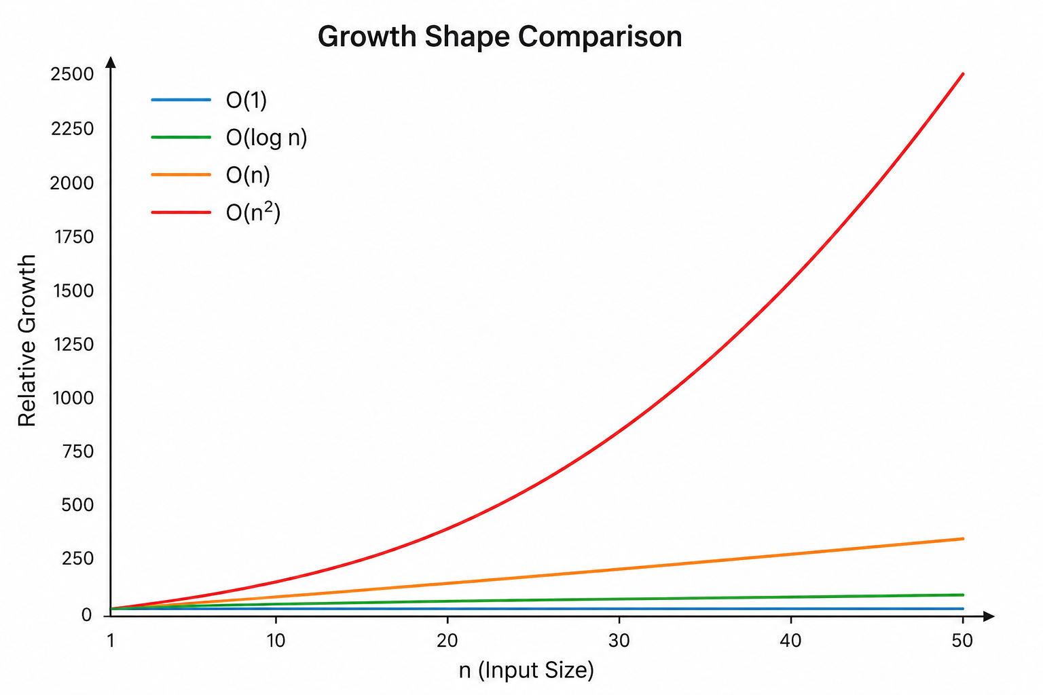
Growth Shape Comparison
Notes:
**Instructor Notes:**
Stress that this is a simplified comparison for this course level.
Real performance also depends on constants, implementation details, and hardware, but growth shape matters as input becomes large.
**Transition Cue:**
The textbook also gives rules for estimating complexity from structure.

Slide 32
Rule 1: Sequential Structure
Sequential steps add together.
If steps happen one after another, estimate the growth of each part and keep the dominant pattern.
Notes:
**Instructor Notes:**
Example: one loop followed by another loop is still usually discussed as linear at this level, not "two separate linear things" as a scary new class.
**Transition Cue:**
Some structures divide the problem rather than scan everything.

Slide 33
Rule 2: Divided Structure
Ignore ½ the remaining possibilities
Repeat
Cut the search space in half
Notes:
**Instructor Notes:**
Connect to logarithmic growth. This is the intuition behind binary search, not a full binary-search lesson.
**Transition Cue:**
Recursive structures need special care because the function calls itself.

Slide 34

Rules 3 & 4: Recursion and Nested Recursion
Recursion:
a function calls itself
Nested recursion:
recursive work happens inside more recursive work
Notes:
**Instructor Notes:**
Keep this intuitive - Students do not need logarithm math yet. Use the idea of guessing a number between 1 and 100 by cutting the range in half each time.
**Transition Cue:**
These labels help us compare growth shapes side by side.

Slide 35

Rule 5: Ignore Constant Multiples
Big-O focuses on growth shape.
For basic analysis, constant multiples are usually ignored.
Example:
3n still grows like n
100n still grows like n
Notes:
**Instructor Notes:**
Students may find this strange because constants matter in real timing. Explain the distinction: constants can matter in practical performance, but Big-O
focuses on how the work scales as input grows very large.
**Transition Cue:**
That distinction is why timing evidence and Big-O reasoning should be used together carefully.

Slide 36
Timing Evidence vs Big-O Reasoning
Timing asks:
What happened in this experiment?
Big-O asks:
What growth pattern should we expect?
Use both carefully.
Notes:
**Instructor Notes:**
This slide prevents overclaiming.
A timing table can suggest a pattern, but it does not prove everything about an algorithm under every condition.
**Transition Cue:**
The reading also explains that performance can be estimated using best, worst, and average cases.

Slide 37

Break
10 Minute “Human” bio-break

Slide 38

Estimating and Selecting

Slide 39
Best, Worst, And Average Case
Best case: easiest input
1
Worst case: hardest input
2
Average case: typical input
3
Notes:
**Instructor Notes:**
Use list lookup.
- Best case: target is first.
- Worst case: target is missing or last.
- Average case: target may appear somewhere in the middle across many inputs.
**Transition Cue:**
That is why one test case does not describe the whole algorithm.

Slide 40

Why Case Matters
The same algorithm may look different depending on:
Where the target appears
Whether the target exists
Whether input is already organized
Whether data has duplicates
Notes:
**Instructor Notes:**
Connect this to Lab 02 timing.
Students should run several input sizes and be careful about what their input data represents.
**Transition Cue:**
After estimating performance, we still have to choose an approach.

Slide 41
Selecting An Algorithm
Correctness
Understandability
Efficiency
Memory use
Data size
Explainability
Notes:
**Instructor Notes:**
Avoid ranking efficiency as the only virtue.
Sometimes the clearer approach is fine for small data.
Sometimes a more complex approach is justified because the data is large or the repeated work is expensive.
Note: THIS is WHY, not using human judgement/oversight in AI-Assisted coding is dangerous. The AI will NOT apply this type of reasoning, as it only “duplicates” previously learned examples of code.
**Transition Cue:**
After selecting an algorithm, we still need to validate it.

Slide 42
Validating Algorithms
Validation depends on the algorithm type:
Exact
Approximate
Randomized
Notes:
**Instructor Notes:**
Define simply:
- Exact: should return the correct result.
- Approximate: should return a useful result within acceptable limits.
- Randomized: may use randomness, so validation may involve repeated runs or
probability-based expectations.
For Week 2, students are mostly working with exact algorithms.
**Transition Cue:**
Even when an algorithm is validated, students must be able to explain it.

Slide 43
What Evidence Does NOT Prove
A timing table does not prove:
Every machine will match
Every input will behave the same
The algorithm is always best
The code has no bugs
Notes:
**Instructor Notes:**
This slide prepares students for the Lab 02 limitation note. Their evidence should be useful and honest, not exaggerated.
**Transition Cue:**
That honesty is part of explainability.

Slide 44
Explainability

Slide 45

Explainability
Explainability means you can describe:
What the algorithm does
Why the approach fits
What evidence supports it
What limits remain
Notes:
**Instructor Notes:**
Tie this to the course's AI-use philosophy. If AI helps explain or improve a solution, the student still has to own the final explanation.
**Transition Cue:**
A good explanation connects the code to evidence.

Slide 46
Good Growth Explanation
A responsible explanation says:
What changed
What evidence showed
What Big-O label likely fits
What the evidence does not prove
Notes:
**Instructor Notes:**
Review the items
**Transition Cue:**
Next show an example (next slide) – Then the demo.

Slide 47
Example
"In my timing table, Approach A increased more as input size grew. This matches the idea of repeated scanning, so linear or worse growth may be involved. However, my timing results are limited by machine noise and only four input sizes."
Notes:
**Instructor Notes:**
This is one example of explainability
"In my timing table, Approach A increased more as input size grew. This matches the idea of repeated scanning, so linear or worse growth may be involved.
However, my timing results are limited by machine noise and only four input sizes."
**Transition Cue:**
Now show those ideas in the instructor demo.

Slide 48
Demo Scenario
Problem:
Compare two ways to check whether values appear in a collection:
Manual list lookup with a loop
Set membership lookup with `in`
The demo uses the same lookup task for both approaches, then repeats the task across larger input sizes.
Evidence:
A timing table across several input sizes.
A formatted comparison summary that interprets the pattern.
Goal
Check whether values appear in a collection
Notes:
**Instructor Notes:**
Make clear that both approaches are correct for the demo task. The comparison is about how the approaches behave as input size grows.
**Demo File / Artifact:**
Lab_02/demo/demo_code.py`
**Transition Cue:**
Before running the demo, predict the repeated work.

Slide 49

Predict The Work
List lookup may:
Check many values
Repeat scanning
Grow with collection size
Set membership may:
Use a structure built for lookup
Avoid visible full scanning
Notes:
**Instructor Notes:**
Do not over-teach hash tables here. Students will learn data structures more directly in Week 3. For now, say that sets are designed for membership checks.
**Transition Cue:**
Now run the timing table and look for the pattern, not one exact number.

Slide 50

Demo Evidence
Watch the table for:
Input size
List lookup time
Set lookup time
Change across rows
Reminder about noisy timing
Notes:
**Instructor Notes:**
Run the demo.
If the numbers vary from a prior run, treat that as a teaching moment. Say: "This is why we do not worship one decimal. We look for a pattern and describe our evidence cautiously."
**Observable Output / Evidence:**
The demo prints a timing table and comparison summary.
**Transition Cue:**
After the evidence appears, translate the table into a growth explanation.

Slide 51

Demo Explanation
Demo explanation pattern:
Both approaches were correct
Timing changed as input grew
List lookup grew more noticeably
Set lookup changed less in this demo
Exact numbers may vary
Notes:
**Instructor Notes:**
Use the printed comparison summary.
Emphasize "in this demo" and "may vary" to model cautious technical language.
**Transition Cue:**
Now model a professional support technique: using AI to review complexity after we have already made our own prediction and collected evidence.

Slide 52

AI-Assisted Complexity Review

Slide 53
AI Can Help Review Complexity
AI can help you:
Analyze likely time complexity
Analyze likely space complexity
Identify repeated work
Explain Big-O in plain language
Suggest alternative approaches
Notes:
**Instructor Notes:**
Frame this as a legitimate professional support technique, not a shortcut.
Many developers do not keep formal Big-O analysis fully memorized.
That does not mean they should ignore growth behavior.
It means they should use tools responsibly to recover, check, and explain the reasoning.
Say explicitly: "AI does not replace your Big-O awareness. AI helps you review and explain it, but you still have to verify the answer against the code and evidence."
**Misconception Warning:**
Students may hear this as permission to ask AI for the answer immediately.
Clarify the order:
manual prediction first,
timing evidence second,
AI-assisted review third,
student-owned explanation last.
**Transition Cue:**
The quality of the AI response depends heavily on the prompt and on whether the student asks for reasoning instead of just an answer.

Slide 54

Useful AI Prompt Pattern
“Analyze this Python function for likely time and space complexity.
Explain the reasoning in beginner-friendly language.
Identify repeated work.
Suggest one alternative if the current approach may not scale.
Do not rewrite the code unless I ask.”
Notes:
**Instructor Notes:**
Use this as a model prompt, not a required script.
The important pieces are:
ask for time complexity,
ask for space complexity,
ask for repeated work,
ask for explanation
and limit unwanted rewriting.
If demonstrating live, use the demo functions `manual_list_lookup` and `batch_set_lookup` because those are already visible and not one of the student lab submission options.
**Transition Cue:**
After AI responds, the student still needs to evaluate the response.

Slide 55

Verify The AI Review
After AI responds, check:
Does it match the code?
Does it identify the repeated work?
Does it match the timing pattern?
Did it overclaim?
Can you restate it yourself?
Notes:
**Instructor Notes:**
This slide is the ownership step. Students should not paste AI's explanation unexamined into their README.
Use the demo example. If AI says list lookup is linear for one lookup, connect that to scanning through the list. If AI discusses repeated batch lookups, connect that to the demo's repeated probes. If AI says set lookup is usually constant-time membership, remind students that this is introductory language and that real implementations still have details and edge cases.
The student-owned explanation should connect three things: the code, the timing evidence, and the Big-O vocabulary.
**Transition Cue:**
The lab now asks students to run a different comparison and write their own evidence-based explanation.
AI may help review that explanation, but it may not replace the student's collected evidence.

Slide 56

Demo Add-On: Console Color
After the plain demo works, add light console color.
The color helps highlight:
section headings
passed tests
failed tests
important boundary cases
Notes:
**Instructor Notes:**
Present this as an add-on step after the plain-text version has already been run and tested.
Say explicitly: "The algorithm is already complete. We are not changing the decision rule. We are improving how the evidence is displayed."
Then add the color support code and rerun the demo. Use the output as the example.
(Do not over-teach ANSI escape codes in Week 2. )
The main point is readability: console output can be designed for humans, even when the program is still simple.
**Misconception Warning:**
Students may think colorized output is a requirement for Lab 02.
Clarify that it is not required.
The lab requirement is clear evidence.
Color is an optional presentation improvement.
**Transition Cue:**
Because this is only a presentation add-on, the program should still work and remain understandable without color.

Slide 57

From Demo to Lab
In Lab 02, you will compare two approaches.
Your work must include:
Two implementations
At least four input sizes
Timing table
Chart or comparison table
Growth explanation
Limitation note
Notes:
**Instructor Notes:**
Make the transfer explicit. Students should not use the demo's list-vs-set lookup scenario as their final comparison. They choose one of the lab options or an instructor-approved alternative.
**Transition Cue:**
The walkthroughs help students see the comparison pattern before coding.

Slide 58

Walkthrough Support
The walkthrough artifact can help you:
Identify both approaches
Predict repeated work
Decide what to time
Explain the difference
If you use it, you must explain the pattern in your own words, what you changes, and your decisions:
Notes:
**Instructor Notes:**
If students use a walkthrough, they must explain the pattern in their own words, how they adapted it, and what they decided themselves.
**Related Artifact:**
`Assignments/Student_Facing/Lab_02_Full_English_Algorithm_Walkthroughs.md`
**Transition Cue:**
The README is where students connect code, timing, and explanation.

Slide 59
README Evidence
Your README should show:
approaches compared
input sizes
timing evidence
chart or comparison table
likely growth pattern
timing limitation
AI-use note, if applicable
Notes:
**Instructor Notes:**
Explain that the “timing limitation” note is not an apology.
It is part of responsible technical communication.
A good limitation note shows that the student understands what the evidence can and cannot claim.
**Transition Cue:**
End by restating the difference between evidence and overclaiming.

Slide 60

Wrap up

Slide 61
What To Carry Forward
Performance analysis asks:
Does it work?
Is it understandable?
How does it grow?
What evidence supports the claim?
Notes:
**Instructor Notes:**
Tie back to the reading's quality features: correct, understandable, efficient. All three matter.
**Transition Cue:**
Students now have the vocabulary needed for Lab 02.

Slide 62

Lab 02 Success Check
Compares two correct approaches
Uses increasing input sizes
Reports measured timing
Explains likely growth
Names a limitation
Notes:
**Instructor Notes:**
Make this slide practical. Students should be able to compare it directly to their README before submitting.
**Transition Cue:**
Finish with the immediate next action.

Slide 63
Next Step
For Lab 02:
1
choose a comparison
implement or attempt both approaches
collect timing evidence
build a table or chart
explain the pattern cautiously
Notes:
**Instructor Notes:**
Remind students to start manually.
AI may help explain a pattern only after they have selected approaches, attempted implementation, and collected at least one timing result.
**Transition Cue:**
Before students leave, prepare them for the Week 3 reading.

Slide 64
How To Use The Textbook For Next Week's Reading
For next week, read for structure choice.
Focus on:
What each structure is for
What operations each structure makes easier
What operations each structure makes harder
How complexity tables can guide decisions
Why tabular, matrix, and abstract structures appear in algorithm work
Do not memorize every operation cost. Use the tables like reference maps.
Notes:
**Instructor Notes:**
This slide prepares the Week 3 reading.
The textbook covers a broad set of structures, including Python built-ins, Series, DataFrames, matrices, vectors, stacks, queues, and trees.
Students do not need to master all of them before class.
The expectation is that students arrive with basic recognition: they should have seen the terms, noticed the operation tables, and be ready to ask which structure fits which problem.

Slide 65
Thank you! Have Fun!

