Slide 1
Introduction To Algorithms
Week 4 – Search and Sort Behavior:
“Preconditions Make Algorithms Honest”

Slide 2
Terms to Remember
Term | Brief Meaning
Sorting algorithm | A procedure that arranges data into a defined order
Searching algorithm | A procedure that tries to locate a target value
Swap | Exchanging the values stored in two variables or positions
Linear search | Search that checks values one at a time
Binary search | Search that repeatedly cuts a sorted search space in half
Interpolation search | Search that estimates likely target position from value distribution
Precondition | Something that must be true before an algorithm is valid
Primary key | A value that uniquely identifies a record
Foreign key | A value that connects one record to another related record
NLP | Natural Language Processing; computing work involving human language

Slide 3

What We Will Use Today
Sorting as preparation for efficient search
Variable swapping
Bubble, selection, insertion, merge, and shell sort recognition
Linear search
Binary search
Sorted-data precondition
Trace tables as evidence
Primary/foreign key lookup as a brief application context

Slide 4
What We Will “Touch On” and Revisit Later
Deeper recursion in merge sort
Ranking and similarity
Hashing and lookup
Database indexing
Graph and tree traversal
Advanced NLP and data-modeling applications

Slide 5
Review Coding Lab
Notes:
** Instructor Notes **
Step through the coding solution(s) for the Lab. Be sure to state that this is only *one* solution of many. NOT the best or only solution.

Slide 6
Review: What Lab 03 Taught Us
Last week, we focused on:
How data was stored
What operation mattered most
Which structure made the operation clearer
Which structure made the operation easier or faster

Slide 7
Today’s Question
When is a faster algorithm not actually better?
Notes:
**Instructor Notes:**
Let students sit with the question briefly. A faster algorithm may be worse if it is wrong, unclear, too expensive to prepare for, or depends on a condition that is not true.
The main example today is binary search. It can be very efficient, but only when the data is sorted.
**Transition Cue:**
This takes us to the idea of preconditions.

Slide 8
What Counts as Success Today
Explain the difference between sorting and searching
Recognize several common sorting algorithms and their basic strategies
Explain why algorithm choice depends on data size, order, and purpose
Trace linear search and binary search at an introductory level
Explain the sorted-data precondition for binary search
Use evidence to show when an algorithm works, fails, or becomes unreliable

Slide 9

Preconditions Make Algorithms Honest
A precondition is something that must be true before the algorithm is valid.
Examples:
binary search requires sorted data
division requires a non-zero divisor
a username lookup requires comparable username values
a date sort requires consistent date representation
Notes:
**Instructor Notes:**
Be explicit that preconditions are not side notes. They are part of the correctness claim.
If students say "the code runs," ask: "What did it assume?"
**Transition Cue:**
Searching and sorting are useful because they make these assumptions visible.

Slide 10
Searching And Sorting Work Together
Sorting asks:
“How should the data be ordered?”
Searching asks:
“How can we find the target?”
The order of the data can change the search strategy.
Notes:
**Instructor Notes:**
Use a physical shelf analogy.
If books are randomly placed, you may have to check one at a time.
If books are alphabetized, you can use the order to make better decisions.
This is the bridge into why sorting appears before searching in many textbook treatments.
**Transition Cue:**
Now we will summarize the reading's big picture.

Slide 11
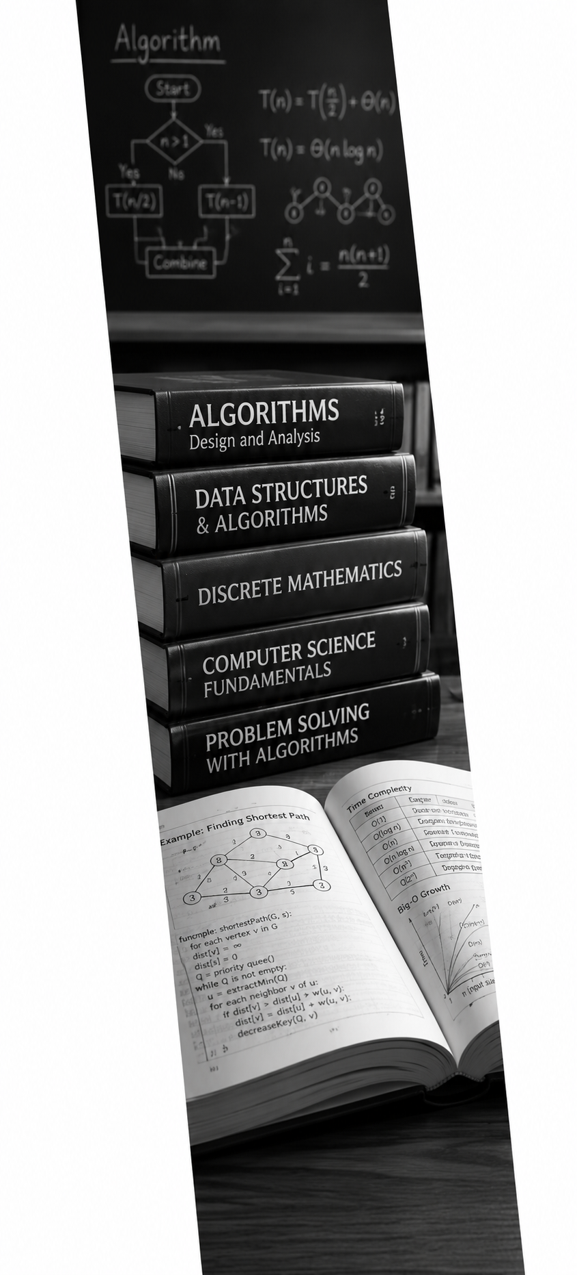
Four Main Areas
Textbook Review
The reading covers:
sorting algorithms
searching algorithms
performance analysis
practical applications
It also briefly defines Natural Language Processing.
Notes:
**Instructor Notes:**
Tell students that not all topics receive equal class time.
Sorting and searching are core.
Performance analysis is threaded through both.
The NLP and historical database examples are context, not new major units.
**Transition Cue:**
Start by separating NLP context from this week's core algorithm work.

Slide 12
NLP Context
Textbook Review
Natural Language Processing is computing work involving human language.
Examples:
search suggestions
document classification
sentiment analysis
text ranking
chatbot response processing
This week is not an NLP lesson.
Notes:
**Instructor Notes:**
This slide prevents confusion if the textbook opens with NLP references.
Explain that NLP systems often need searching, sorting, ranking, indexing, and comparison. That is why the context appears.
Do not turn this into a full NLP lecture. The class will return to AI/data bridges later.
**Transition Cue:**
The core algorithms this week begin with sorting.

Slide 13
Sorting
Textbook Review
Sorting algorithms arrange values into a defined order.
The reading introduces:
bubble sort
selection sort
insertion sort
shell sort
merge sort
Notes:
**Instructor Notes:**
Tell students that they do not need to memorize every line of every sort implementation this week.
They should learn the strategy behind each sort and notice why performance differs.
**Transition Cue:**
Sorting examples also give us another place to practice Big-O reasoning.

Slide 14
Searching
Textbook Review
Searching algorithms try to find a target value.
The reading introduces:
linear search
binary search
interpolation search
Notes:
**Instructor Notes:**
Make clear that Lab 04 emphasizes linear and binary search.
Interpolation search is worth recognizing, but it will not be the main hands-on focus.
**Transition Cue:**
The reading also shows that performance analysis is not a separate chapter box.

Slide 15
Performance Is Interspersed
Textbook Review
The reading discusses performance throughout the chapter.
For each algorithm, ask:
What must be true before it works?
How much work might it do?
How does it behave as data grows?
What tradeoff does it make?
Notes:
**Instructor Notes:**
This slide gives students a stable reading pattern.
Instead of treating every algorithm as a brand-new topic, they can ask the same questions repeatedly.
**Transition Cue:**
Before the sorting algorithms, we need one small mechanical idea: swapping.

Slide 16

Sorting Foundations

Slide 17

Variable Swapping
Many sorting algorithms need to swap two values.
Conceptually:
1. remember one value
2. move the other value
3. put the remembered value into the open spot
Notes:
**Instructor Notes:**
Do not make this too formal.
Show a quick two-card example or two list positions. The purpose is to make later sorting steps less mysterious.
In writing Python, you can mention that Python supports direct tuple-style swapping, but students should still understand the concept.
**Transition Cue:**
The first sorting algorithm is intentionally simple and visible.

Slide 18
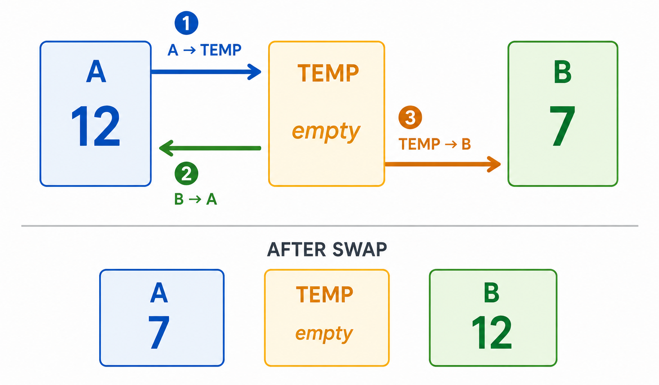
Variable Swapping

Slide 19

Bubble Sort
Bubble sort repeatedly compares neighboring values.
If two neighbors are out of order:
swap them
continue across the list
repeat passes until the list is sorted
Notes:
**Instructor Notes:**
Use a tiny list such as `[5, 2, 4, 1]`. Walk through one pass only unless the group needs more.
The important image is larger values "bubbling" toward the end after repeated neighbor comparisons.
**Transition Cue:**
Bubble sort is easy to understand, but easy does not mean efficient.

Slide 20

Bubble Sort Performance
Bubble sort usually performs poorly on larger lists.
Why?
it makes repeated passes
it compares neighboring values
it may keep checking even after little changes
Common growth label: O(n2)
Notes:
**Instructor Notes:**
Say "n squared" out loud, but keep the explanation concrete:
as the list grows, the repeated passes create a lot of comparisons.
Do not require students to prove the formula.
Connect it to the repeated nested work pattern from Week 2.
**Transition Cue:**
The textbook may mention an optimization for bubble sort. (VERIFY)

Slide 21

Bubble Sort Optimization
Bubble sort can stop early if a full pass makes no swaps.
That means:
the list is already sorted
another pass is unnecessary
the algorithm can avoid wasted work
Notes:
**Instructor Notes:**
This is a good example of refinement. The core idea stays the same, but the algorithm gains a stopping condition.
Connect this to prior labs: evidence can reveal unnecessary work.
**Transition Cue:**
Another simple sorting strategy is selection.

Slide 22

Selection Sort
Selection sort repeatedly selects the next smallest value.
Basic pattern:
find the smallest remaining value
place it in the next sorted position
repeat until finished
Notes:
**Instructor Notes:**
Use cards or a small list.
The key difference from bubble sort is that selection sort looks for the next value to place, instead of repeatedly swapping neighbors.
**Transition Cue:**
Selection sort is organized, but it still scans repeatedly.

Slide 23

Selection Sort Performance
Selection sort repeatedly searches the remaining unsorted values.
Common growth label: O(n2)
It may use fewer swaps than bubble sort, but it still performs many comparisons.
Notes:
**Instructor Notes:**
This is a good place to separate "number of swaps" from "number of comparisons."
Different operations matter in different contexts.
**Transition Cue:**
Insertion sort uses a different mental model.

Slide 24

Insertion Sort
Insertion sort builds a sorted section one value at a time.
Basic pattern:
take the next value
find where it belongs in the sorted section
shift values if needed
insert it
Notes:
**Instructor Notes:**
Use the playing-card analogy if helpful: people often sort a hand of cards by inserting each new card into the correct position.
**Transition Cue:**
Insertion sort can be reasonable when the data is already close to sorted.

Slide 25
Insertion Sort Performance
Insertion sort depends heavily on existing order.
It can be:
efficient for small lists
efficient for nearly sorted data
poor for badly unordered larger lists
Common worst-case growth label: O(n2)
Notes:
**Instructor Notes:**
This slide helps students avoid memorized rankings. Algorithm choice depends on context.
The phrase "worst case" matters here. Nearly sorted data can behave very differently from reversed data.
**Transition Cue:**
Shell sort modifies the insertion idea.

Slide 26

Shell Sort
Shell sort compares values that are farther apart first.
Then it gradually reduces the gap.
Purpose:
move values closer to their final position sooner
finish with smaller local adjustments
Notes:
**Instructor Notes:**
Keep this brief unless the group is ready. Shell sort can be difficult to visualize on a first pass.
The important idea is not implementation mastery. It is recognition that a strategy can be improved by changing how comparisons are organized.
**Transition Cue:**
Merge sort uses a more structured divide-and-combine strategy.

Slide 27
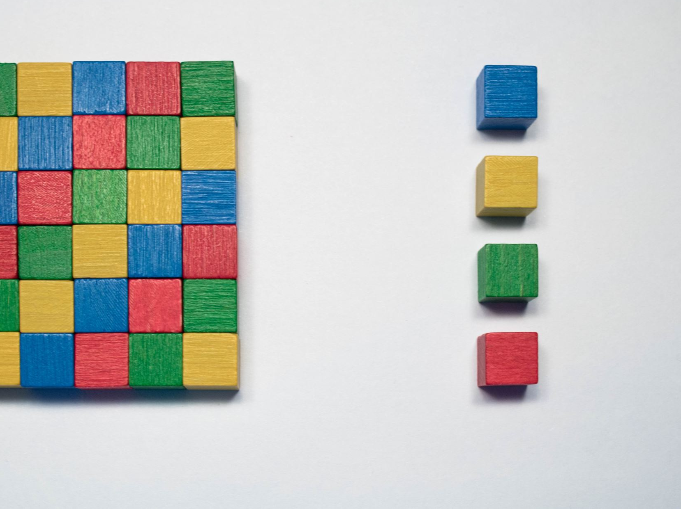
Merge Sort
Merge sort divides, sorts, and combines.
Basic pattern:
split the data
sort smaller pieces
merge sorted pieces back together
Common growth label: O(n log n)
Notes:
**Instructor Notes:**
This is the cleanest bridge to recursion, but do not teach recursion in full yet. Say that the course will return to recursive thinking later.
Use the phrase "divide and combine" as the plain-English anchor.
**Transition Cue:**
Now compare these sorting strategies without turning the lesson into a memory test.

Slide 28
Sorting Strategy Comparison
Algorithm | Strategy | Taken Away
Bubble | compare neighbors | visible but inefficient
Selection | choose next smallest | organized repeated scanning
Insertion | insert into sorted section | useful for small or nearly sorted data
Shell | compare by gaps | refined insertion idea
Merge | divide and combine | stronger growth behavior
Notes:
**Instructor Notes:**
Use this as a strategy table, not a memorization chart. Students should be able to say what the algorithm is trying to do.
**Transition Cue:**
Let’s look at a quick visual to see the differences

Slide 29
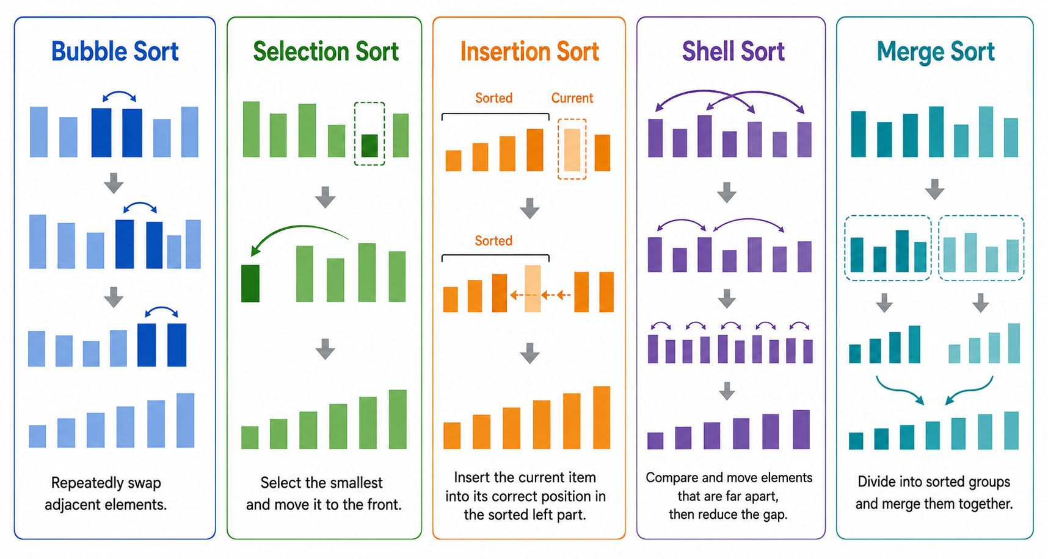
Sorting Comparison
Notes:
**Transition Cue:**
Choosing a sort depends on the context.

Slide 30

Sorting Performance and Choice

Slide 31

Choosing A Sorting Algorithm
Choosing a sort depends on:
data size
current order
memory limits
need for simplicity
need for predictable performance
whether built-in sorting is acceptable
Notes:
**Instructor Notes:**
Mention that professional developers often use built-in library sorting, but understanding sorting algorithms still matters.
It helps developers' reason about performance, assumptions, and data preparation.
**Transition Cue:**
The simplest algorithm is sometimes the right teaching tool, not the right production choice.

Slide 32
Simple Does Not Always Mean Wrong
A simple algorithm can be appropriate when:
the data is small
clarity matters most
the cost is acceptable
the goal is learning or verification
But simple should still be explained honestly.
Notes:
**Instructor Notes:**
This is important for beginner confidence. Do not imply that bubble sort or linear search are "stupid." They are understandable and sometimes sufficient.
The honest answer is context-dependent.
**Transition Cue:**
The danger is claiming performance without evidence or assumptions.

Slide 33
Performance Claims: Needs Conditions
Avoid
Use
"This is faster."
"This is better."
"This always works."
"This is faster when..."
"This is valid if..."
"This performs better for..."
Notes:
**Instructor Notes:**
This slide supports rubric-aligned communication. Students should learn to add conditions to technical claims.
**Transition Cue:**
Sorting matters because it can prepare data for a different search strategy.

Slide 34
Sorting As Preparation
Sorting may be useful before searching when:
many searches will happen
the data will be reused
the search strategy depends on order
the sorting cost is worth the later benefit
Notes:
**Instructor Notes:**
This is a key decision point.
Sorting just to do one search may not be worth it.
Sorting once before many searches may be useful.
This prepares students for binary search without overselling it.
**Transition Cue:**
Now move from arranging data to finding a target.

Slide 35
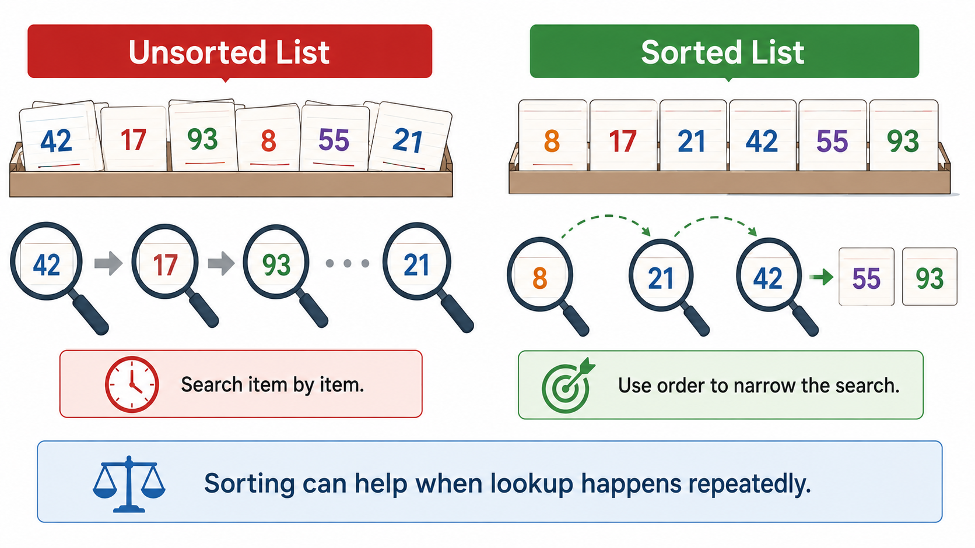
Sorting As Preparation
Notes:
**Transition Cue:**
Now move from arranging data to finding a target.

Slide 36

From Sort To Search
Sorting changes what search can assume.
Unsorted data:
Linear search is safe
Binary search is not trustworthy
Sorted data:
Linear search still works
Binary search can use the order
Notes:
**Instructor Notes:** This slide is the bridge into Lab 04.
Stress that linear search works on sorted data too.
It just may not use the extra information.
**Transition Cue:**
Start with the search that makes the fewest assumptions.

Slide 37

Break
10 Minute “Human” bio-break

Slide 38
Searching Foundations

Slide 39

Linear Search
Linear search checks values one at a time.
It asks:
Is this the target?
If not, check the next value
Stop when found or when the list ends
Notes:
**Instructor Notes:**
Use a small list and target near the end. Students should see that thealgorithm is simple and reliable but may do a lot of work.
**Transition Cue:**
Linear search is reliable because it does not need sorted data.

Slide 40

Linear Search Performance
Linear search:
Best case: target is first
Worst case: target is last or missing
Common growth label: O(n)
It may check every value.
Notes:
**Instructor Notes:**
Tie this back to Week 2. The amount of work can grow with the number of values.
Emphasize that O(n) does not mean bad. It means the work grows roughly with the input size.
**Transition Cue:**
Binary search uses order to reduce the search space.

Slide 41

Binary Search
Binary search repeatedly checks the middle.
If the middle value is:
the target: stop
too low: search the upper half
too high: search the lower half
Notes:
**Instructor Notes:**
Point to low, high, and mid. Students must understand those three variables for the lab trace.
Use a sorted list and ask which half can be ignored after each comparison.
**Transition Cue:**
This only works because the list is sorted.

Slide 42

The Sorted-Data Precondition
Binary search requires sorted data.
If the data is not sorted:
"too low" may not mean the target is above
"too high" may not mean the target is below
the algorithm can discard the wrong half
Notes:
**Instructor Notes:**
This is the central Week 4 slide. Say plainly: binary search on unsorted data is not just less efficient. It is logically unreliable.
**Transition Cue:**
The trace table makes that logic visible.

Slide 43
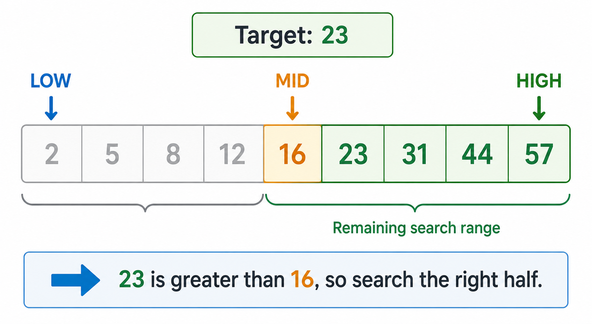
Binary Search

Slide 44
Binary Search Trace (Table)
Step | Low | High | Mid Pos | Value | Decision
1 | 2 | 57 | 5th | 16 | Search greater half
2 | 16 | 57 | 7th (3rd) | 31 | Search lower half
3 | 16 | 31 | 8th (2nd) | 23 | Value found – STOP
Target: 23
Notes:
**Instructor Notes:**
Explain each column. Low and high are the current search boundaries.
Mid is the position being checked. Decision explains which half remains possible.
If students can fill in this table, they are showing more than code execution.
They are showing algorithm understanding.
**Transition Cue:**
The textbook also introduces interpolation search.

Slide 45

Interpolation Search
Interpolation search estimates where the target may be.
It works best when:
data is sorted
values are evenly distributed
the target position can be estimated
Notes:
**Instructor Notes:**
Keep this brief.
Compare it to looking for a word in a dictionary by estimating where it might appear, not always opening exactly in the middle.
Do not make this a lab requirement unless the group is advanced.
**Transition Cue:**
Searching algorithms have different assumptions.

Slide 46
Search Strategy Comparison
Search | Needs Sorted Data? | Basic Idea | Common Growth
Linear | NO | Check one at a time | O(n)
Binary | YES | Cut search space in half | O(log n)
Interpolation | YES, plus distribution assumptions | Estimate likely position | varies
Notes:
**Instructor Notes:**
This table is a good place to reinforce that "best" depends on requirements and assumptions.
**Transition Cue:**
Now connect this back to evidence.

Slide 47
Evidence Before Claims
For search algorithms, evidence can include:
Test cases
Found and Not-found results
Trace tables
Sorted and unsorted comparisons
Explanation of preconditions
Notes:
**Instructor Notes:**
Students may be tempted to submit only working code.
This slide explains why the lab requires trace evidence and precondition explanation.
**Transition Cue:**
AI can help review search code, but it cannot replace the student’s explanation.

Slide 48

Useful AI Prompt Pattern
“Review this linear search and binary search code.
Identify any preconditions.
Check for off-by-one risks.
Explain whether each test case proves the behavior I claim.
Do not rewrite the code unless I ask.”
Notes:
**Instructor Notes:**
This is an AI-assisted review pattern, not a first-step coding prompt. Students should have their own attempt and trace before using it.
Emphasize "Do not rewrite" because the goal is explanation and verification.
**Transition Cue:**
The textbook's application example shows how search ideas appear in real data.

Slide 49

Practical Application Context

Slide 50

Records And Keys
Real systems often search records by keys.
Examples:
product ID
student ID
ticket number
course code
username
Notes:
**Instructor Notes:**
Connect this to the lab suggestions. A key is a value used to identify or find something.
Keep it simple. This is not a database design lecture.
**Transition Cue:**
The textbook uses primary and foreign keys as a brief example.

Slide 51
Primary And Foreign Keys
Primary key:
uniquely identifies one record
Foreign key:
connects a record to another related record
Search and sort help systems find and connect records.
Notes:
**Instructor Notes:**
Use a tiny example:
- `student_id` identifies a student
- `student_id` in an enrollment record connects that enrollment back to the student
Do not overbuild this. The textbook treatment is brief and conceptual.
**Transition Cue:**
The historical database example is about applying search/sort thinking, not writing database code today.

Slide 52
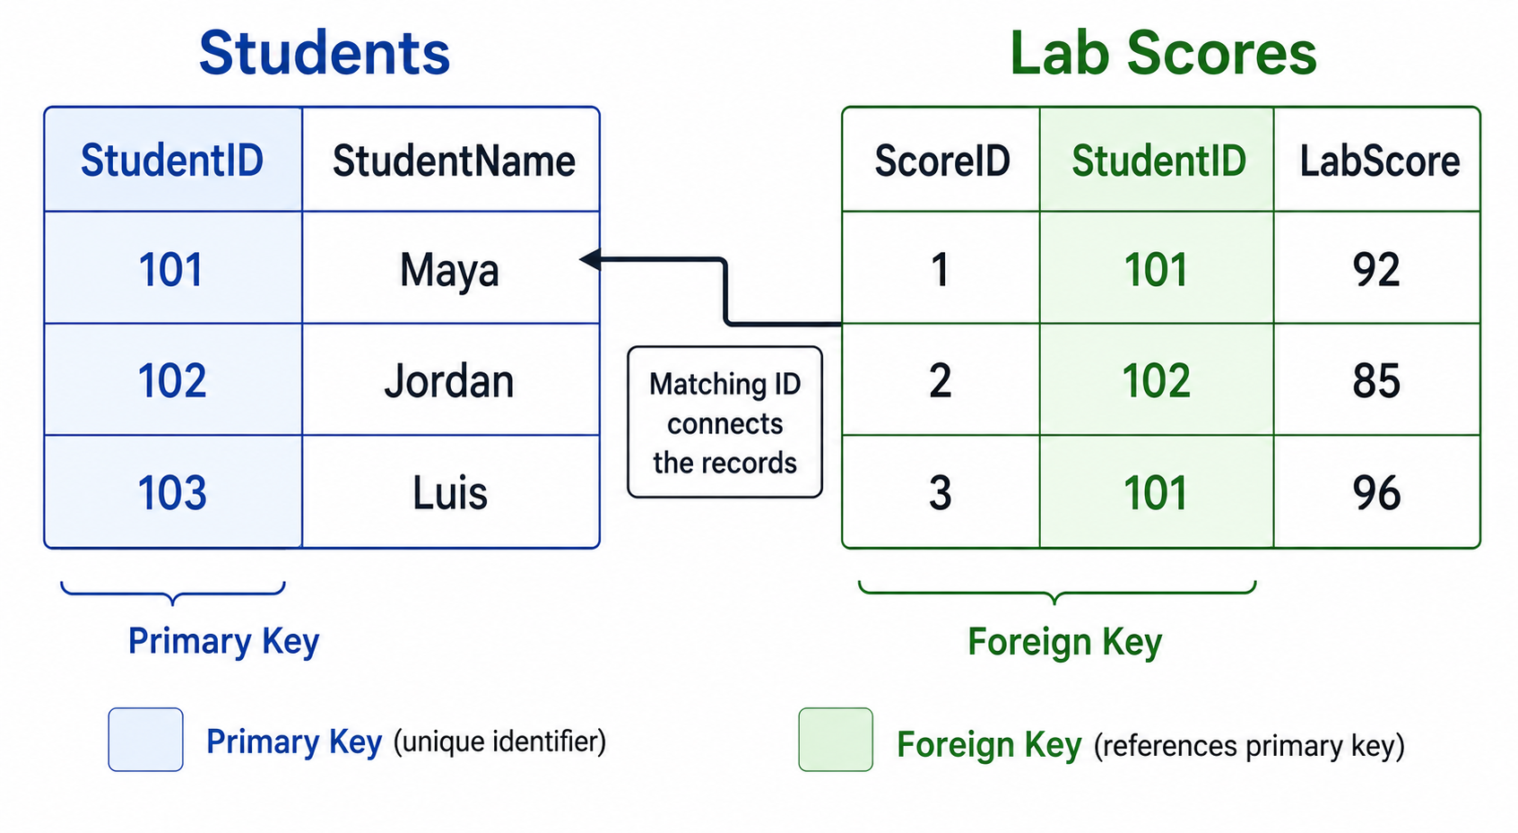
Primary and Foreign Keys

Slide 53

Historical Database Example
The reading's historical database example asks:
What identifies a record?
What connects records?
What should be searched?
What should be sorted?
What lookup pattern matters most?
Notes:
**Instructor Notes:**
This keeps the application grounded without adding a new coding requirement.
If time is short, summarize briefly
**Transition Cue:**
These same ideas appear in language systems too.

Slide 54

NLP Connection, Briefly
NLP (Natural Language Processing) systems may use search and sort ideas to:
find matching terms
rank documents
sort likely responses
retrieve related records
compare text features
This is context, not today's coding target.
Notes:
**Instructor Notes:**
This slide helps future AI/data alignment. Keep it short and practical.
Students should leave seeing why classic algorithms still matter in modern systems.
**Transition Cue:**
Now show search behavior with a small visible demo.

Slide 55

Demo

Slide 56
Demo Scenario
Problem:
Searching book titles on a shelf
Goal
Binary Search results on: Sorted vs Unsorted data

Slide 57
Demo Evidence
The demo produces:
a linear search trace
a binary search trace on sorted data
a binary search trace on unsorted data
a sorted-vs-unsorted summary
Notes:
**Instructor Notes:**
Do not rush the trace.
Ask students what low, high, and mid mean before running the binary search explanation.
The point is not that binary search "fails every time" on unsorted data.
The point is that it is not trustworthy because its reasoning no longer holds.
**Transition Cue:**
Watch the decisions, not just the final result.

Slide 58
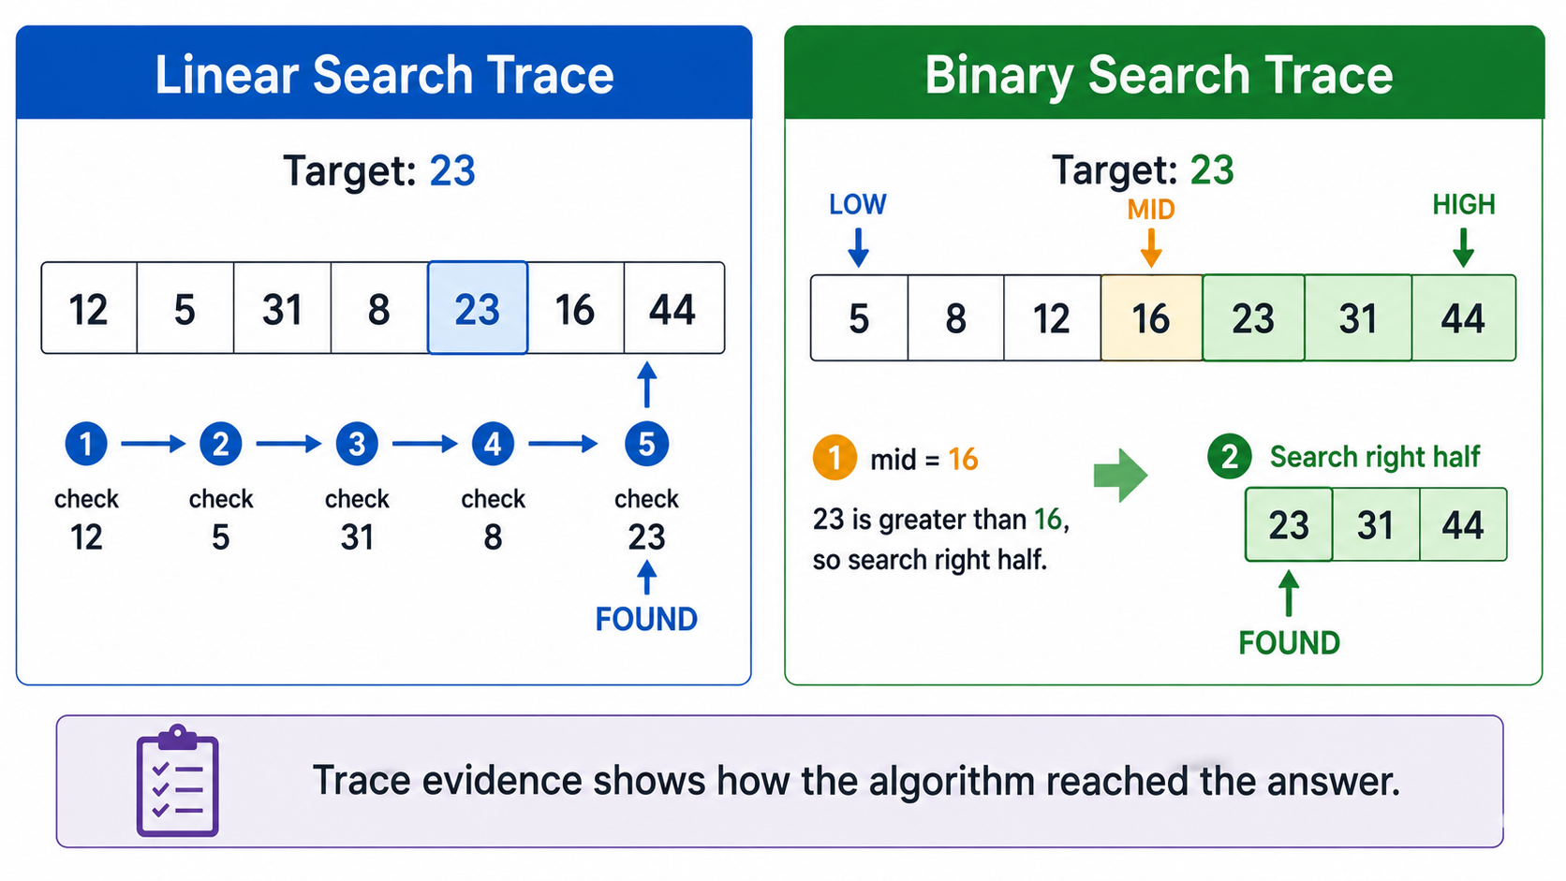
Demo Evidence

Slide 59

Demo Key Question
Ask after each search:
What did the algorithm check?
What did it assume?
What did it ignore?
Was that decision valid?
Notes:
**Instructor Notes:**
This creates the habit students need for the lab. They should explain the algorithm's behavior, not merely report the output.
**Transition Cue:**
The explanation should name the precondition.

Slide 60

Demo Explanation
Example explanation:
“Binary search is valid on the sorted list because each comparison tells us which half can be ignored. On the unsorted list, that decision is unreliable because the values are not arranged in order.”
Notes:
**Instructor Notes:**
This is the sentence pattern students need: algorithm, condition, decision, reason.
Encourage students to use their own words, but the same logical structure.
**Transition Cue:**
Now transfer the demo pattern to Lab 04.

Slide 61

From Demo to Lab
In Lab 04, you will use a different data set.
You must show:
linear search
binary search
found and not-found tests
binary search attempted on unsorted data
trace evidence
precondition explanation
Notes:
**Instructor Notes:**
Name the allowed scenario examples only briefly. The demo used books; the lab should use something else such as product IDs, usernames, ticket numbers, course codes, or attendee names.
**Transition Cue:**
The trace table is part of the submission, not optional decoration.

Slide 62

Walkthrough Support
The walkthrough artifact can help you:
?
If you use it, you must explain the pattern in your own words, what you changes, and your decisions:
Notes:
**Instructor Notes:**
If students use a walkthrough, they must explain the pattern in their own words, how they adapted it, and what they decided themselves.
**Related Artifact:**
`---`
**Transition Cue:**
The README is where students connect code, timing, and explanation.

Slide 63
README Evidence
Your README should show:
test case table
trace table
sorted-data precondition explanation
comparison of linear and binary search
AI-use note, if used note, if applicable
Notes:
**Instructor Notes:**
Remind students that code and explanation belong together in the GitHub submission. The README is where they make the algorithm visible.
**Transition Cue:**
Clarify what AI may and may not do here.

Slide 64

AI Use In Lab 04
Manual first:
Write or trace your own attempt
Create your test cases
Identify the precondition
AI-assisted after:
Review logic
Check edge cases
Explain a confusing trace
Suggest tests
Notes:
**Instructor Notes:**
If AI writes or revises code, students still own the explanation. They must be able to explain low, high, mid, found, not found, and the sorted-data precondition.
**Transition Cue:**
Now define what successful work looks like.

Slide 65

Wrap up

Slide 66

Lab 0n Success Check
Searches correctly
Includes required test cases
Traces at least one search
Explains sorted-data requirements
Avoids claiming binary search is always better
Notes:
**Instructor Notes:**
Make this practical. Students should compare this slide to their README before submitting.
**Transition Cue:**
Wrap the week around the main lesson.

Slide 67
What To Carry Forward
Search and sort algorithms teach a larger lesson:
Algorithms depend on data conditions
Performance depends on context
Correctness includes assumptions
Evidence makes reasoning visible
Notes:
**Instructor Notes:**
This is the conceptual close.
Sorting and searching are specific topics, but preconditions and evidence are transferable.
**Transition Cue:**
Now make the immediate next action concrete.

Slide 68
Next Step
For Lab 04:
1
choose a data set
implement or simulate linear search
implement or simulate binary search
create required tests
build a trace table
explain the sorted-data precondition
Notes:
**Instructor Notes:**
Remind students that binary search on unsorted data is intentionally included to reveal the precondition. It is not a trick.
**Transition Cue:**
Prepare students for the next reading once Week 5 reading details are assigned.

Slide 69
How To Use The Textbook For Next Week's Reading
For next week, read for strategy choice.
Focus on:
Correctness, performance, and scalability
Gunctional and non-functional requirements
Divide and conquer
Dynamic programming
Greedy strategies
PageRank and linear programming as examples
Skim the P, NP-Hard, and NP-Complete section for recognition only.
Notes:
**Instructor Notes:**
This slide prepares the Week 3 reading.
The textbook covers a broad set of structures, including Python built-ins, Series, DataFrames, matrices, vectors, stacks, queues, and trees.
Students do not need to master all of them before class.
The expectation is that students arrive with basic recognition: they should have seen the terms, noticed the operation tables, and be ready to ask which structure fits which problem.

Slide 70
Thank you! Have Fun!

