Slide 1
Introduction To Algorithms
Week 6 – Graph Traversal and Modeling
“Modeling Connected Things”

Slide 2
Terms to Remember
Term | General Meaning | Graph / Network Meaning
Network | Any connected system | A graph model of connected nodes and edges
Node | A point or object | A specific item in the graph
Vertex | A corner or point | Another term for node
Edge | Outside boundary | A relationship or connection between nodes
Link | A connection | Another term for edge
Neighbor | Something nearby | A node directly connected to another node
Path | A route | A sequence of connected nodes
Traversal | Moving through something | Visiting graph nodes using an algorithm
Centrality | Importance | A metric estimating structural importance
Density | How compact something is | How many possible connections actually exist

Slide 3

What We Will Use Today
Graph vocabulary
Directed, Undirected, Simple, and Weighted graph recognition
Adjacency-list representation
Neighborhoods and shortest-path intuition
BFS and DFS traversal
Queue and Stack state as evidence
Model-limit explanation

Slide 4
What We Will “Touch On” and Revisit Later
similarity and recommendation
ranking and centrality ideas
AI/data relationship modeling
explainability and limits of graph-based claims
optional social network analysis context

Slide 5
Review Coding Lab
Notes:
** Instructor Notes **
Step through the coding solution(s) for the Lab. Be sure to state that this is only *one* solution of many. NOT the best or only solution.

Slide 6
Review: What Lab 05 Taught Us
Last week - strategy choice depended on problem shape:
correctness
readability
growth
fit to data
limitations
Notes:
**Instructor Notes:**
Use one student-safe example if available.
The bridge is that strategy depends on representation.
Week 6 begins with a representation choice: model the system as connected parts.
**Transition Cue:**
This week, the shape we care about is connection.

Slide 7
Today’s Question
How can we model connected parts so an algorithm can move through them?
Notes:
**Instructor Notes:**
Let students name connected systems: maps, workflows, course prerequisites, social networks, game rooms, web pages, file dependencies.
The goal is to make "connection" concrete enough to represent and traverse.
**Transition Cue:**
That model is called a graph.

Slide 8

Graphs Model Relationships
A graph is a model of connected things.
It can represent:
places connected by routes
tasks connected by dependencies
people connected by communication
steps connected in a workflow
rooms connected by paths
Notes:
**Instructor Notes:**
Emphasize "model." A graph is not the full real system.
It is a simplified representation that highlights relationships.
This is the primary Week 6 mental model.
**Transition Cue:**
A model helps us see, but it also leaves things out.

Slide 9
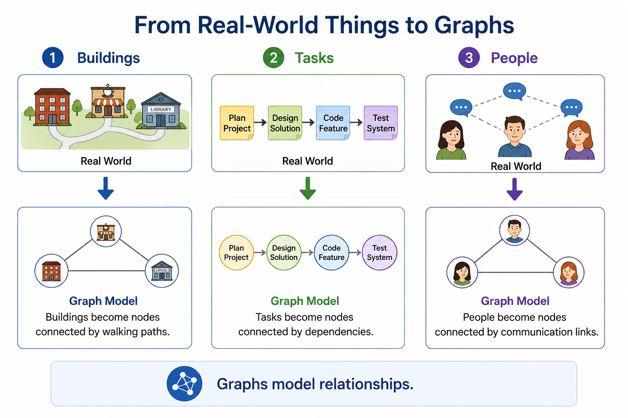
Graph Model

Slide 10
What Counts as Success Today
define nodes and edges
build an adjacency list
trace BFS or DFS
explain traversal evidence
name what the graph le
Notes:
**Instructor Notes:**
This mirrors Lab 06.
Students do not need advanced centrality calculations for success.
They need a clear graph model and visible traversal behavior.
**Transition Cue:**
Now anchor the lesson in the reading.

Slide 11
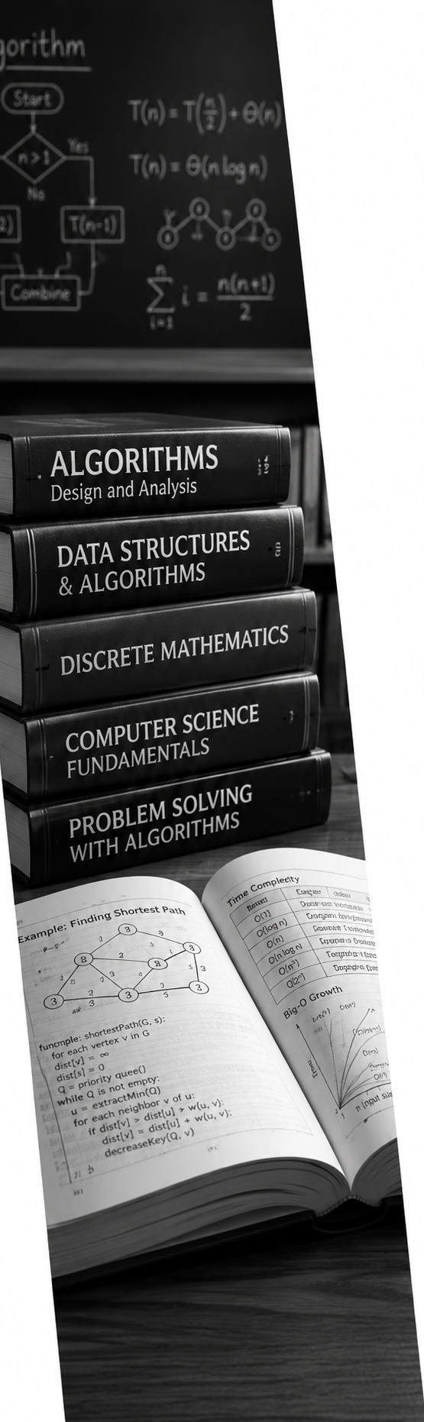
Graph Algorithm Overview
Textbook Review
The reading covers:
graph representation
network theory analysis
graph traversals
case study
neighborhood techniques
Notes:
**Instructor Notes:**
Tell students that not all areas receive equal depth.
Representation and traversal are the core for this course week.
Network metrics are mostly recognition and optional context.
**Transition Cue:**
The first reading challenge is vocabulary.

Slide 12
Terms Become Precise
Textbook Review
Some familiar words become technical:
network
node
edge
neighbor
path
traversal
density
Centrality
Use the graph meaning during this lesson
Notes:
**Instructor Notes:**
This slide responds to the risk that students will use everyday meanings too loosely.
The lesson should repeatedly ask: "What does this term mean in the graph model?"
**Transition Cue:**
The reading also includes formulas.

Slide 13
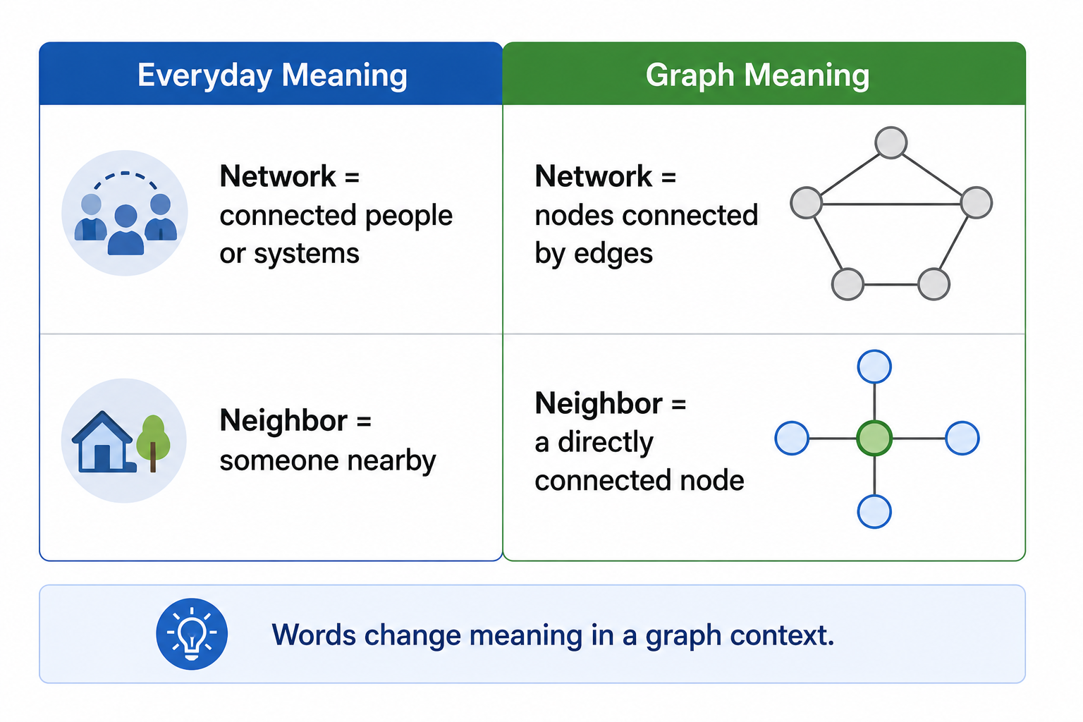
Term Precision

Slide 14
Do Not Panic Over Formulas
Textbook Review
The reading includes advanced graph formulas.
For this week:
notice the term
read for the idea
connect it to a simple graph
do not try to master every formula
Notes:
**Instructor Notes:**
Be explicit: some formulas are complex and advanced.
Students should not treat formula mastery as the Week 6 goal.
The practical goal is graph representation, BFS/DFS traversal, and explanation.
**Transition Cue:**
The required core begins with graph basics.

Slide 15
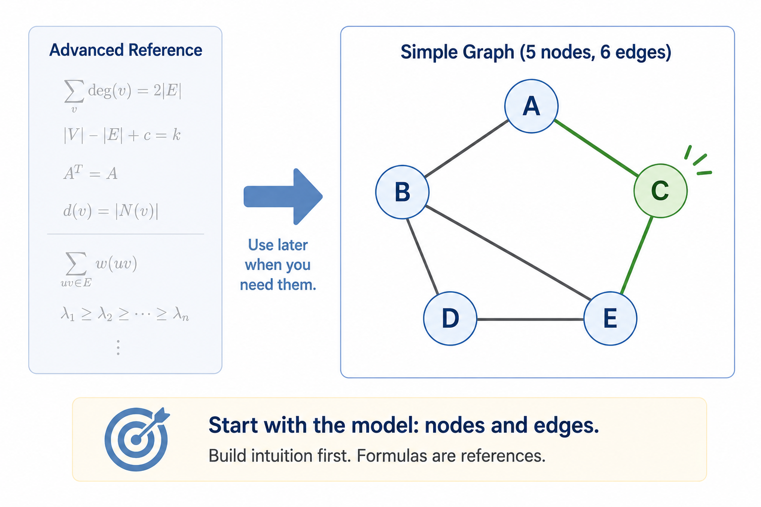
Formula Posture

Slide 16
Graph Basics
Textbook Review
Core graph pieces:
vertices or nodes
edges or links
network structure
simple, directed, undirected, weighted types
Notes:
**Instructor Notes:**
Tie each term to a tiny example.
For a campus map, buildings are nodes and sidewalks are edges.
**Transition Cue:**
The reading also discusses neighborhoods and ego-centered networks.

Slide 17
Neighborhoods
Textbook Review
A neighborhood asks:
What is directly connected?
What is one hop away?
What is two hops away?
What can be reached from here?
Notes:
**Instructor Notes:**
Use "hop" as a friendly bridge.
One-hop neighbors are directly connected.
Two-hop nodes are reachable through one intermediate node.
This prepares BFS.
**Transition Cue:**
The required traversal section is the main lab bridge.

Slide 18
Traversals
Textbook Review
The reading introduces:
breadth-first search (BFS)
depth-first search (DFS)
traversal order
specific searches using traversal
Notes:
**Instructor Notes:**
Frame BFS and DFS as ways to move through the graph.
They are not just code recipes.
They produce visible behavior that can be traced.
**Transition Cue:**
Start with the basic pieces of the model.

Slide 19

Graph Basics and Representation

Slide 20

Node Or Vertex
A node is one thing in the graph.
Examples:
building
person
task
course
web page
game room
Vertex is another term for node.
Notes:
**Instructor Notes:**
Use both words because the textbook may use vertex. For students, "node" will probably be friendlier.
**Transition Cue:**
Nodes matter because edges connect them.

Slide 21

Edge Or Link
An edge is a connection between nodes.
Examples:
sidewalk between buildings
prerequisite relationship
communication link
workflow transition
door between rooms
Notes:
**Instructor Notes:**
Ask students to distinguish the node from the edge in two examples.
This prevents a common confusion where students list things but not relationships.
**Transition Cue:**
Together, nodes and edges form a graph.

Slide 22
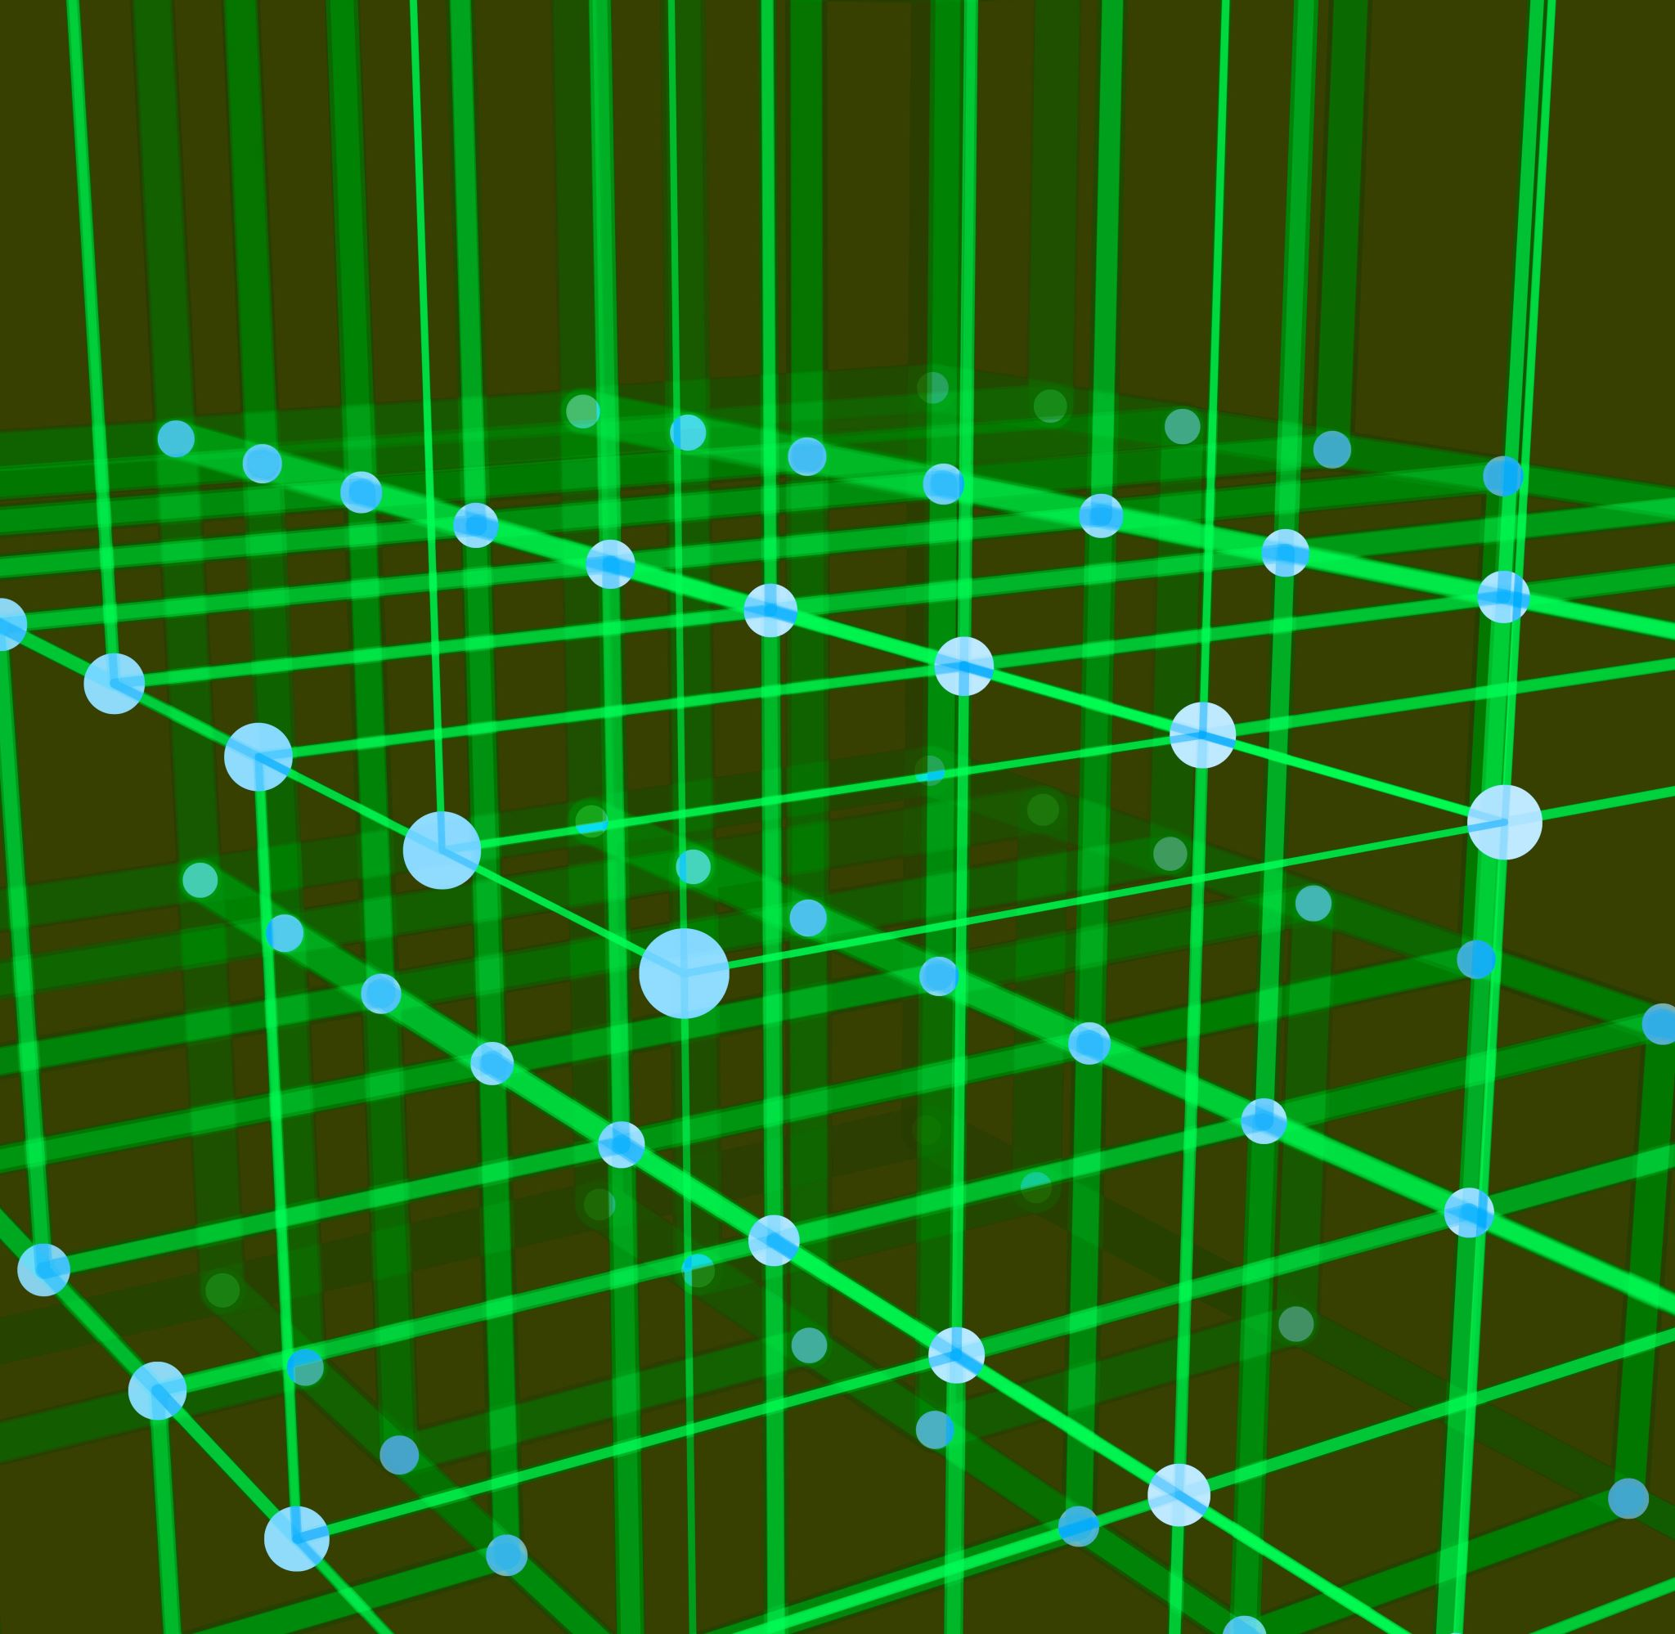
Network
In graph work, a network means:
defined nodes
defined edges
a model of relationships
It does not mean "everything about the real system."
Notes:
**Instructor Notes:**
This is a key term distinction.
A real campus has distances, weather, stairs, doors, crowds, and accessibility.
A graph may choose to model only direct routes.
**Transition Cue:**
Different graph types model different relationship rules.

Slide 23
Simple Graph
A simple graph usually avoids:
duplicate edges
self-loops
extra edge complexity
It is often a good beginner model.
Notes:
**Instructor Notes:**
Keep this practical. A simple graph is enough for most Lab 06 submissions. If students ask about self-loops, explain that a node connecting to itself is possible in graph theory but usually not needed for the lab.
**Transition Cue:**
Some relationships have direction.

Slide 24

Directed Graph
A directed graph has one-way relationships.
Examples:
course prerequisite
workflow step
escalation path
one-way route
Direction changes what can be reached.
Notes:
**Instructor Notes:**
Use a prerequisite example: Course A can lead to Course B, but Course B does not lead backward to Course A.
This prepares the lab option on prerequisites and workflows.
**Transition Cue:**
Other relationships work both ways.

Slide 25

Undirected Graph
An undirected graph has two-way relationships.
Examples:
sidewalk between buildings
hallway between rooms
mutual connection
two-way transit route
Notes:
**Instructor Notes:**
Make clear that undirected edges usually need to appear in both directions if represented as an adjacency list.
This is a major Lab 06 watch-for.
**Transition Cue:**
Some edges also carry a cost or value.

Slide 26

Weighted Graph
A weighted graph adds a value to edges.
Weights may represent:
distance
time
cost
risk
strength of connection
Notes:
**Instructor Notes:**
Keep this recognition-level unless students are ready. Lab 06 does not require weighted path algorithms.
Emphasize that if a model does not include weights, it cannot claim shortest time or lowest cost.
**Transition Cue:**
Now we need a practical way to store graph connections.

Slide 27
Adjacency List
An adjacency list stores each node with its neighbors.
Example:
Parking: Library, Student Center
Library: Parking, Science Hall, Cafeteria
Notes:
**Instructor Notes:**
This is one of the most important implementation slides.
Students should be able to read the adjacency list as "from this node, these neighbors are directly reachable."
**Transition Cue:**
The adjacency list should match the diagram.

Slide 28
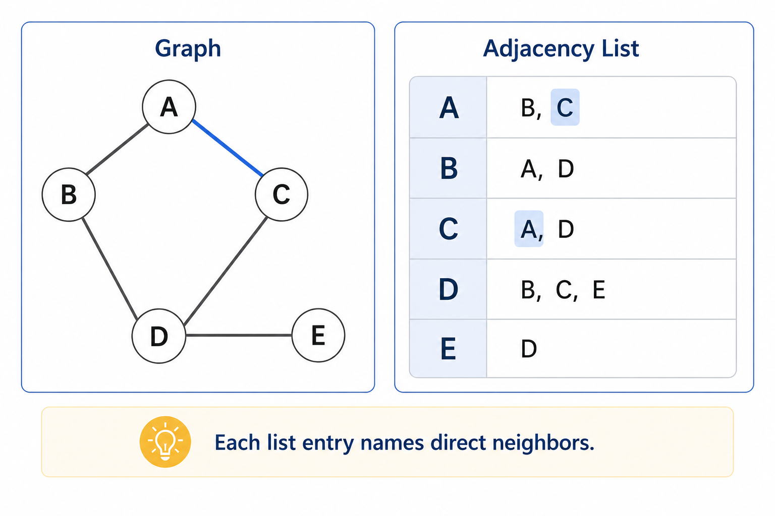
Adjacency List

Slide 29
Diagram And Adjacency List Must Agree
Check the model both ways:
Does every diagram connection appear in the adjacency list?
Does every adjacency-list connection appear in the diagram?
Are directed edges shown clearly?
Are two-way edges listed both ways?
Notes:
**Instructor Notes:**
This is a practical debugging slide.
Students often draw a graph and write an adjacency list that do not match.
This is also a good AI-assisted critique use case after the student drafts the model.
**Transition Cue:**
Before traversing, ask what the model leaves out.

Slide 30

A Graph is a Model
A graph may leave out:
distance
time
priority
capacity
direction
human judgment
real-world messiness
A model is useful, but incomplete.
Notes:
**Instructor Notes:**
This is core to Lab 06. Students must include what their graph leaves out.
Connect this to professional honesty: a model can be useful without being complete.
**Transition Cue:**
Now use graph vocabulary to talk about neighborhoods.

Slide 31
Network Analysis Orientation

Slide 32
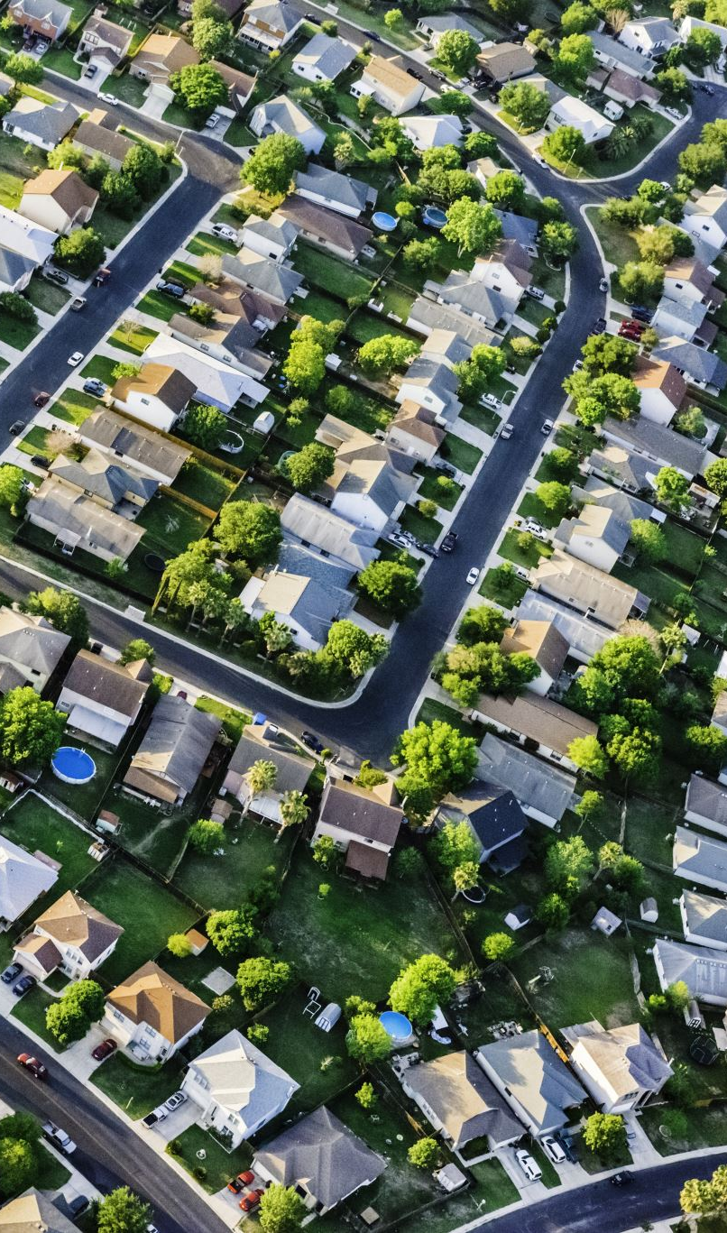
Neighborhood
A neighborhood is what can be reached near a node.
Think:
direct neighbors
one hop away
two hops away
beyond
Notes:
**Instructor Notes:**
Use the campus map idea. From Parking, Library and Student Center may be one
hop away. Cafeteria might be two hops away depending on the edges.
This prepares BFS as outward exploration.
**Transition Cue:**
Ego networks focus on one selected node.

Slide 33
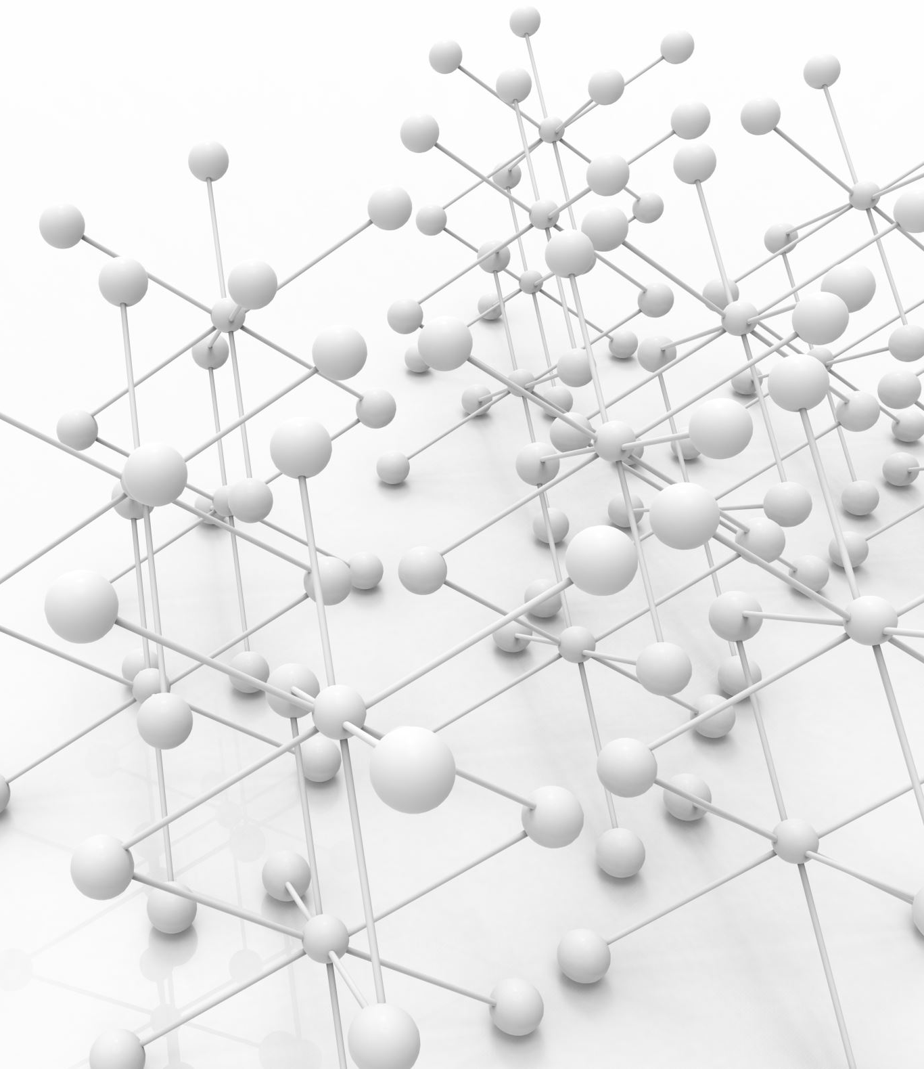
Ego-Centered Network
An ego-centered network starts with one focal node.
It asks:
who or what is directly connected?
what is one hop away?
what is two hops away?
what pattern surrounds this node?
Notes:
**Instructor Notes:**
Use this briefly.
It is useful vocabulary, especially for social networks and communication networks, but it should not consume the lesson.
**Transition Cue:**
One common graph question is the shortest path.

Slide 34

Shortest Path
Shortest path asks:
what route uses the fewest steps?
what route has the lowest cost?
what route reaches the target most directly?
The answer depends on the model.
Notes:
**Instructor Notes:**
Be precise: if the graph is unweighted, shortest may mean fewest edges.
If the graph is weighted, shortest may mean lowest total weight.
Do not teach Dijkstra's algorithm unless as brief reserve language.
**Transition Cue:**
BFS can help explore by layers in unweighted graphs.

Slide 35
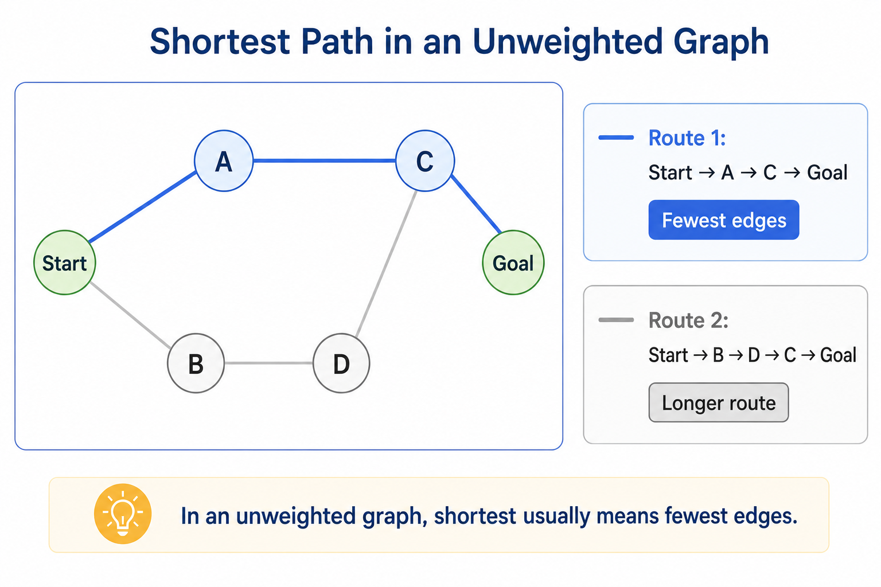
Shortest Path

Slide 36

Creating A Neighborhood
To create a neighborhood:
choose a start node
find direct neighbors
find neighbors of neighbors
decide how far to expand
state what the neighborhood means
Notes:
**Instructor Notes:**
This slide connects textbook neighborhood language to student lab work.
Ask: "If we start at this node, what is one hop away? What is two hops away?"
**Transition Cue:**
The optional reading extends this into network metrics.

Slide 37

Optional Metrics: Recognition Only
The optional reading includes:
triangle
density
degree
betweenness
closeness
eigenvector centrality
For this course: recognize the ideas.
Notes:
**Instructor Notes:**
This is another pressure-release slide.
The formulas may look intimidating.
Students do not need to calculate centrality metrics for Lab 06.
**Transition Cue:**
One metric is simple enough to recognize immediately: degree.

Slide 38

Degree And Density
Degree:
How many edges connect to a node?
Density:
How many possible connections actually exist?
Both describe structure.
Notes:
**Instructor Notes:**
Use only if time allows.
Degree is easy to count visually.
Density is more abstract and should be kept conceptual.
**Transition Cue:**
Other centrality measures describe different kinds of structural importance.

Slide 39

Centrality Is Not Importance By Itself
Centrality measures estimate structural position.
They do not automatically prove:
value
authority
quality
fairness
truth
Metrics need interpretation.
Notes:
**Instructor Notes:**
This is a high-value caution.
Especially in social network analysis, metrics can be misleading if interpreted without context.
Do not turn this into a full ethics lecture but plant the idea.
**Transition Cue:**
Now return to the required traversal algorithms.

Slide 40

Break
10 Minute “Human” bio-break

Slide 41
Graph Traversals

Slide 42
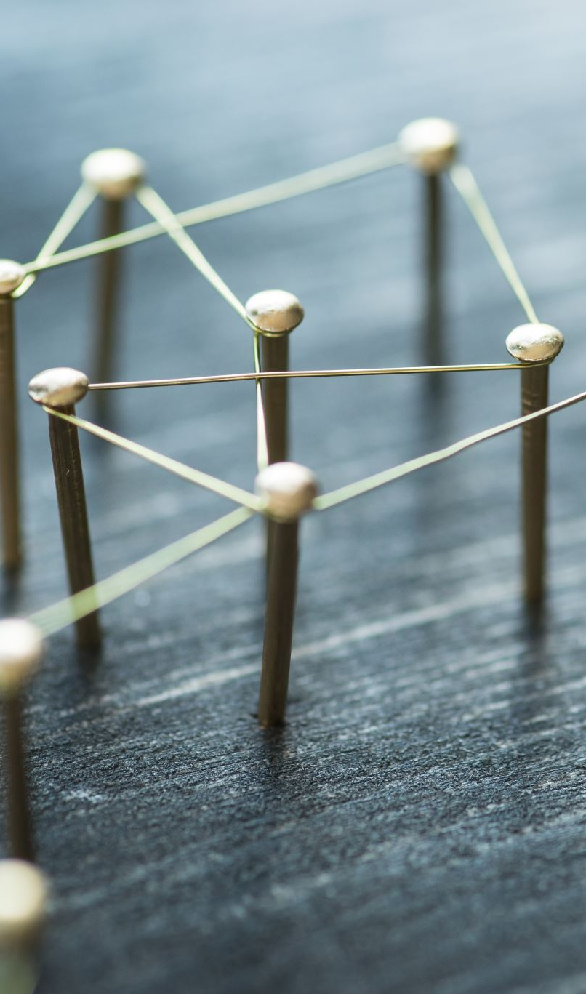
Traversal
Traversal means visiting nodes by following edges.
Traversal depends on:
start node
graph structure
neighbor order
traversal method
Notes:
**Instructor Notes:**
Students may expect traversal to be one fixed answer.
Make clear that traversal order can change when start node, neighbor order, or method changes.
**Transition Cue:**
BFS explores outward by layers.

Slide 43
Breadth-First Search
BFS explores outward by layers.
It tends to visit:
the start node
direct neighbors
neighbors of neighbors
later layers
Notes:
**Instructor Notes:**
Use "ripples in water" or "layers from the start" if helpful.
This is the plain-English anchor.
**Transition Cue:**
BFS usually uses a queue.

Slide 44
BFS Evidence
Step | Current Node | QUEUE State | Visited Nodes
1
2 …
Notes:
**Instructor Notes:**
Explain queue state as the nodes waiting to be visited next.
Students do not need to love the queue mechanics, but they need to see why BFS visits by layers.
**Transition Cue:**
DFS follows one path more deeply.

Slide 45
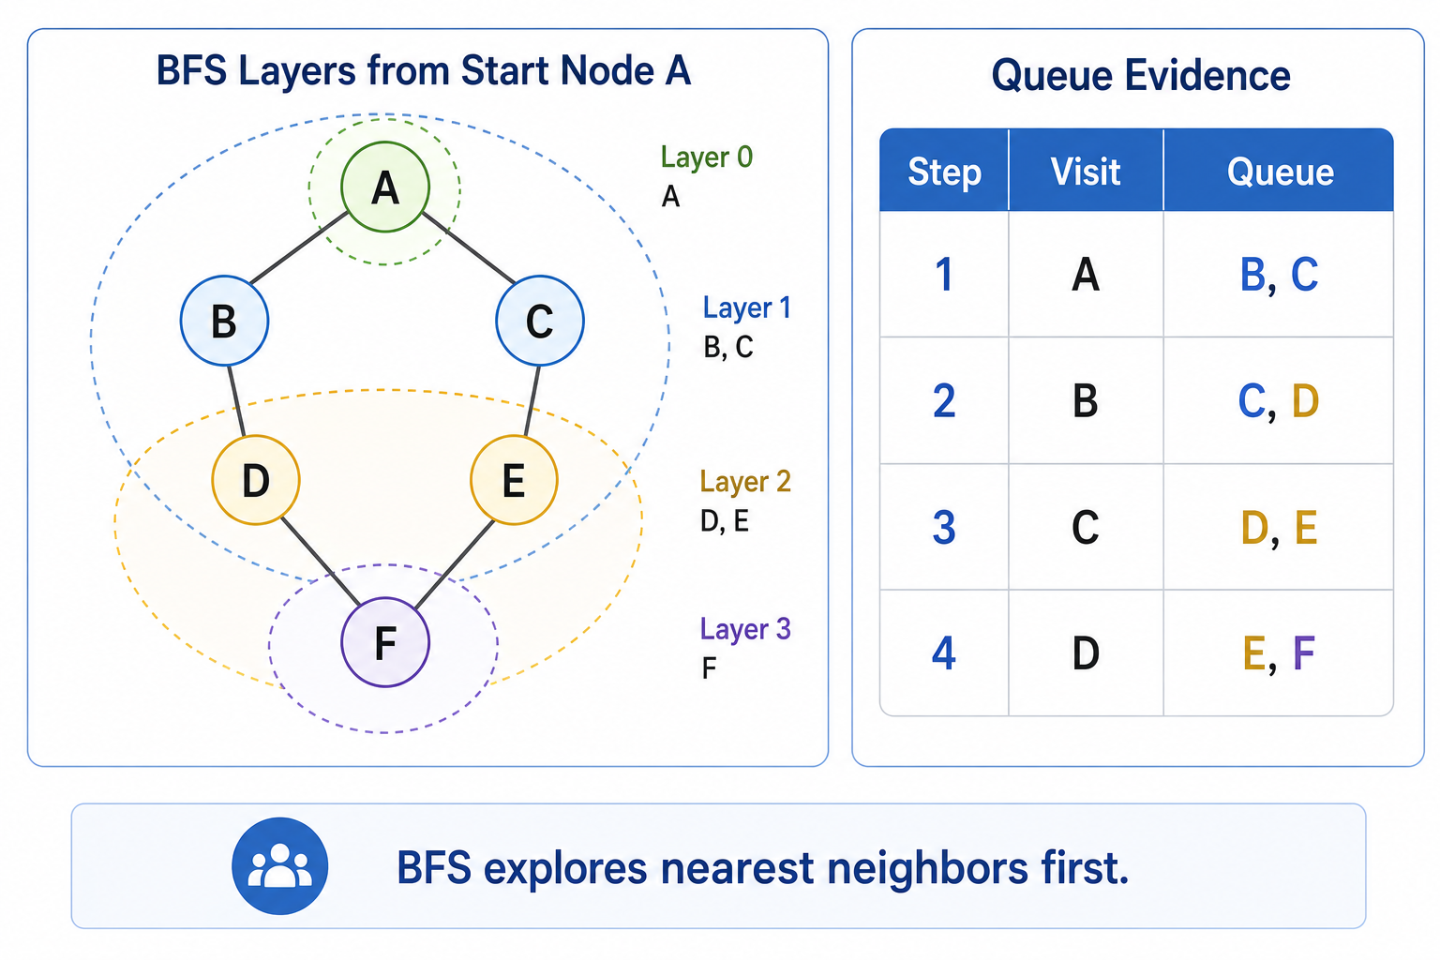
BFS Evidence

Slide 46
Depth-First Search
DFS follows a path deeply before backing up.
It tends to:
choose a neighbor
continue from that neighbor
keep going until it cannot
backtrack and try another path
Notes:
**Instructor Notes:**
Use a hallway or maze analogy if useful. Emphasize that DFS is not "random";
it follows a rule based on neighbor order and stack/call behavior.
**Transition Cue:**
DFS evidence often uses a stack.

Slide 47
DFS Evidence
Step | Current Node | STACK State | Visited Nodes
1
2 …
Notes:
**Instructor Notes:**
Explain stack state as the nodes waiting while the traversal follows a path.
If students compare BFS and DFS tables, they can see the same graph explored in different orders.
**Transition Cue:**
The same graph can produce different traversal orders.

Slide 48
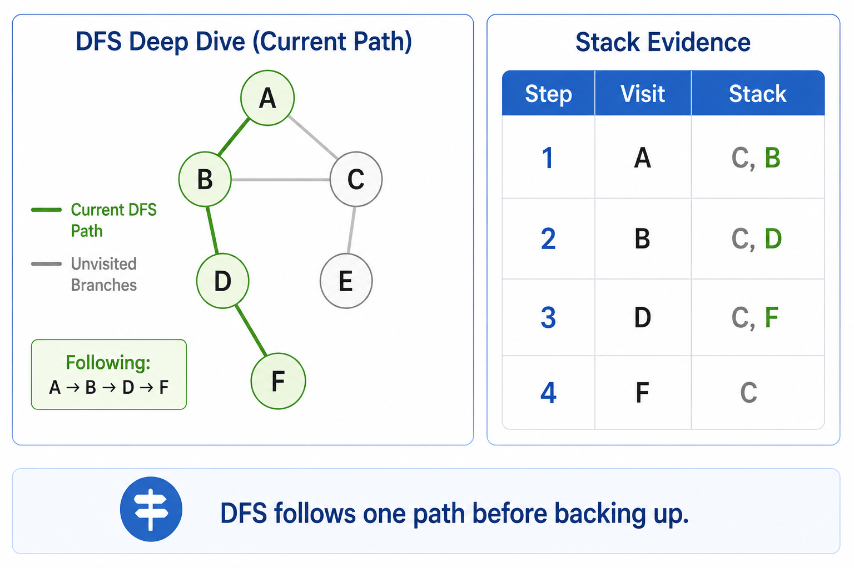
DFS Evidence

Slide 49
BFS vs DFS
Question | BFS | DFS
Explores how? | outward by layers | deeply by path
Common state | queue | stack or call stack
Useful for | near/reachable layers | path exploration
Notes:
**Instructor Notes:**
Do not overstate.
BFS is often associated with shortest paths in unweighted graphs,
but this course should keep the claim careful and beginner-friendly.
**Transition Cue:**
Traversal order depends on neighbor order too.

Slide 50
Neighbor Order Matters
Traversal order can change when:
the start node changes
the neighbor order changes
the graph is directed
the traversal method changes
The evidence should name the conditions.
Notes:
**Instructor Notes:**
This is a common source of confusion.
Two correct BFS implementations may show different orders if neighbors are listed differently.
Connect this directly to Lab 06 explanation requirements.
**Transition Cue:**
The optional material shows how graph ideas scale into network analysis.

Slide 51
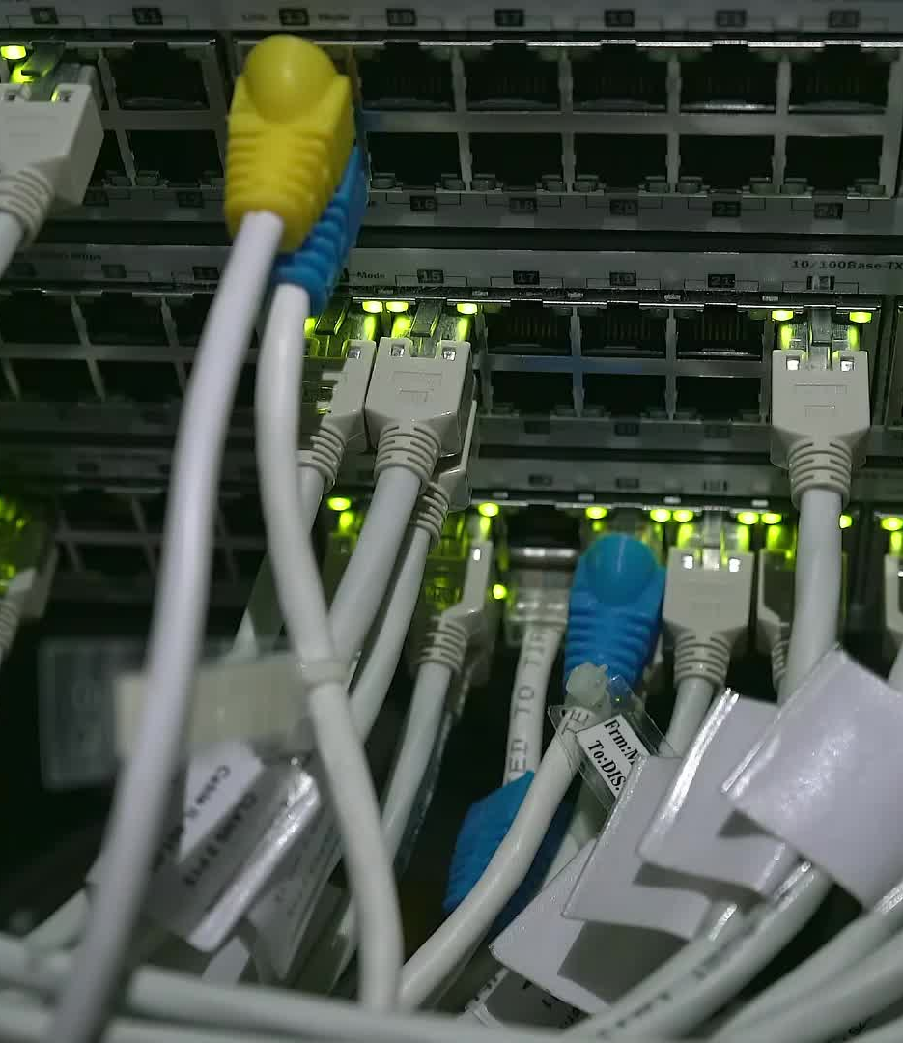
Optional Network Context

Slide 52
Visualizing A Graph
A graph can be shown as:
diagram
adjacency list
traversal table
Python output
library visualization
Each view reveals something different.
Notes:
**Instructor Notes:**
This references the optional Python/visualization reading without requiring students to use graph libraries.
Manual diagrams or Markdown diagrams are acceptable for Lab 06.
**Transition Cue:**
Social network analysis is one applied context.

Slide 53

Social Network Analysis Context
Social network analysis uses graphs to study relationships.
It may ask:
who is connected?
who bridges groups?
where are clusters?
how dense is the network?
Use caution when interpreting results.
Notes:
**Instructor Notes:**
Keep this as context. The fraud detection case study and fraud analytics are skipped for this course week.
Do not encourage students to use sensitive personal data in Lab 06.
**Transition Cue:**
The key caution is that graph metrics do not replace judgment.

Slide 54

Fairness And Closeness
Graph metrics can influence decisions.
Ask:
What data created the graph?
What relationships were included?
What relationships were ignored?
Who could be misrepresented?
Notes:
**Instructor Notes:**
This connects optional closeness/fairness language to responsible reasoning.
The goal is not metric calculation; it is interpretive caution.
**Transition Cue:**
Now return to what students must do in Lab 06.

Slide 55
What To Deeply Learn vs Recognize
Deeply learn now:
nodes and edges
adjacency list
BFS and DFS
traversal evidence
model limits
Recognize for later:
centrality metrics
SNA
graph libraries
Notes:
**Instructor Notes:**
This slide is important for cognitive load. It tells students where to put their effort.
**Transition Cue:**
The demo now shows the required pieces in a small graph.

Slide 56

Demo

Slide 57
Demo Scenario
Problem:
Model a small campus route map with buildings as nodes and sidewalks as edges
Goal
Demonstrate:
a text diagram of the route map
adjacency-list creation
BFS traversal from one start building
DFS traversal from the same start building
Notes:
**Instructor Notes:**
Use the existing Lab 06 demo.
The campus route scenario is intentionally different from the student lab options.
**Transition Cue:**
First, inspect the graph model.

Slide 58

Demo Evidence
text diagram
adjacency list
BFS traversal table
DFS traversal table
traversal summary
Notes:
**Instructor Notes:**
Ask students to compare the text diagram and adjacency list before running the traversals. This reinforces model consistency.
**Transition Cue:**
Watch how queue and stack states change.

Slide 59
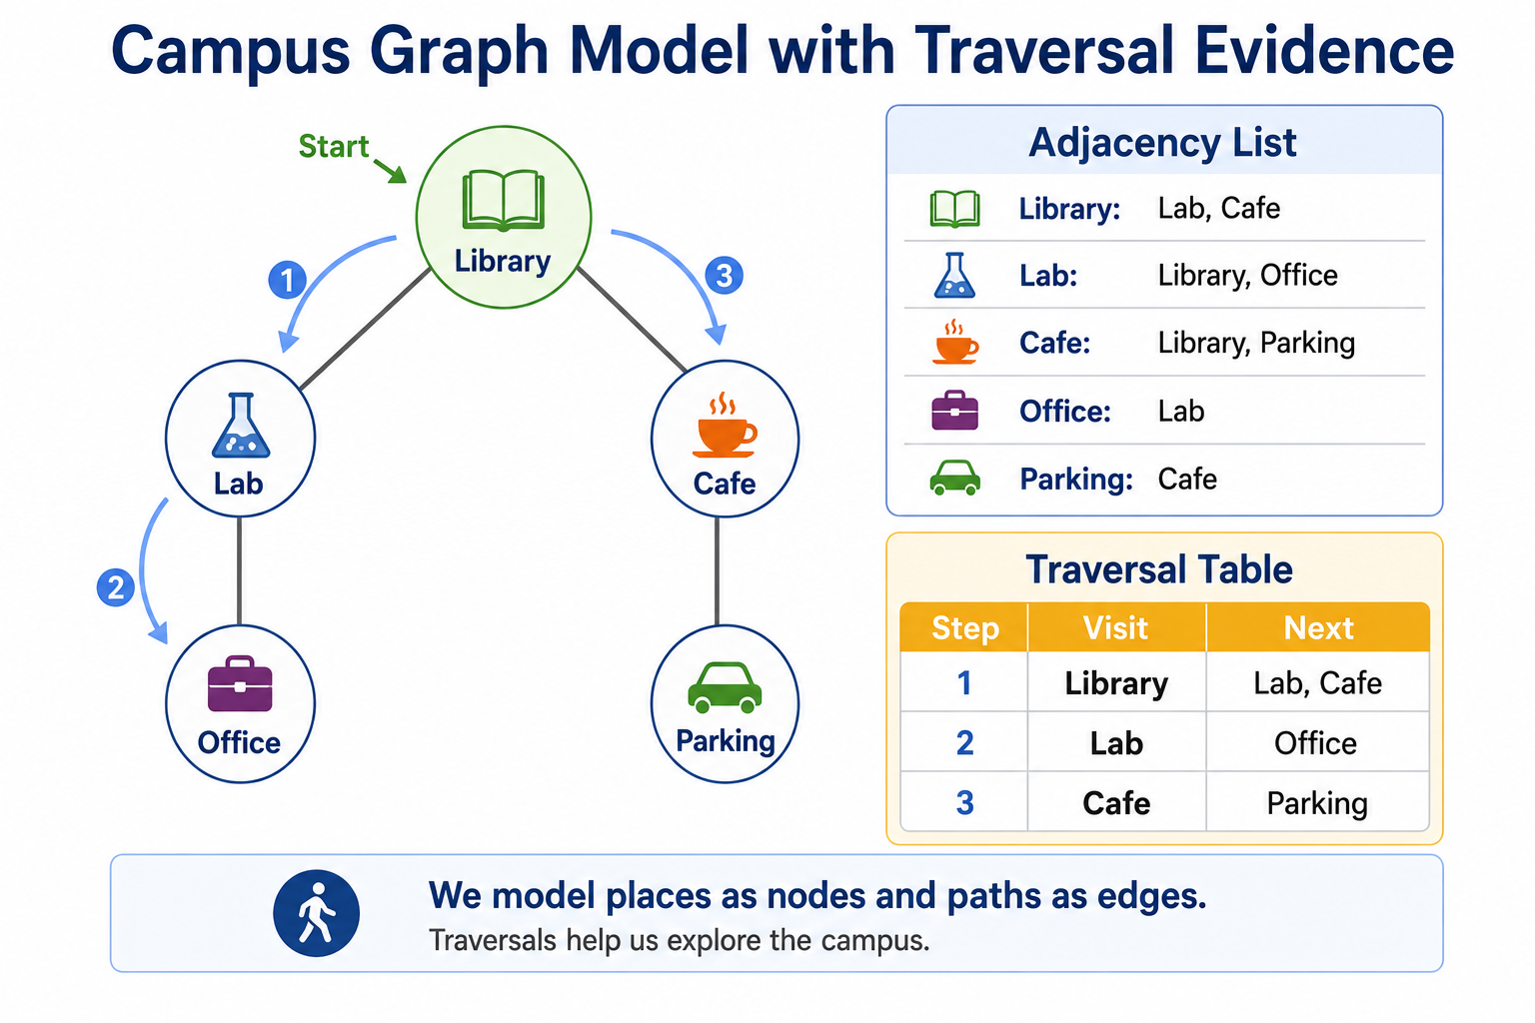
Demo Evidence

Slide 60

Demo Key Questions
What is the current node?
What neighbors are available?
What is waiting in the queue or stack?
What has already been visited?
What does the model leave out?
Notes:
**Instructor Notes:**
These questions prepare students for their own traversal table and explanation.
Do not let the demo become only "run the code and admire the output."
**Transition Cue:**
The explanation should name why BFS and DFS differ.

Slide 61

Demo Explanation
“The graph model stayed the same, but BFS and DFS visited nodes in different orders because BFS explores outward by layers while DFS follows a path more deeply before backing up”
Notes:
**Instructor Notes:**
Encourage students to preserve this logic while using their own words:
same graph,
different method,
different order,
reason.
**Transition Cue:**
Now transfer this to Lab 06.

Slide 62

From Demo to Lab
In Lab 06, you will model a different system.
Options include:
workflow steps
escalation paths
transit stops
game rooms
prerequisites
communication network
grid movement map
Notes:
**Instructor Notes:**
Stress that students should not copy the campus route demo.
They should use the same modeling and traversal pattern with a different system.
**Transition Cue:**
The lab requires both a model and evidence.

Slide 63
Lab 06 Evidence
at least 6 nodes
at least 7 edges
adjacency list
diagram or text representation
BFS or DFS traversal
traversal table
model limitation
Notes:
**Instructor Notes:**
This is the practical submission checklist.
Remind students that a node list without relationships is not enough.
**Transition Cue:**
The README makes the graph reasoning visible.

Slide 64
README Evidence
Your README should show:
What the graph models
What the nodes represent
What the edges represent
What traversal you used
What the traversal shows
What the graph leaves out
AI-use note, if applicable
Notes:
**Instructor Notes:**
Students should understand that the README is not extra paperwork. It is where they explain the model.
**Transition Cue:**
Now clarify the AI-use boundary.

Slide 65

AI Use In Lab 0n
Manual first:
draft your graph
write your adjacency list
choose your start node
attempt traversal evidence
AI-assisted after:
check diagram/list consistency
explain BFS or DFS vocabulary
critique model limits
Notes:
**Instructor Notes:**
Make clear that AI should not replace the student's graph design.
AI can help critique or clarify after the student has a draft.
This matches the student-facing AI-use rule.
**Transition Cue:**
Now close with the main lesson.

Slide 66

Wrap up

Slide 67
What To Carry Forward
Graphs help us reason about connected systems.
Carry forward:
Model the relationships
Make connections explicit
Trace the traversal
Explain what the model shows
State what the model leaves out
Notes:
**Instructor Notes:**
This is the Week 6 takeaway.
Graphs are useful precisely because they force relationships to become visible.
**Transition Cue:**
Now make the immediate next action concrete.

Slide 68

Lab 0n Success Check
Represents relationships clearly
Uses graph vocabulary correctly
Includes adjacency-list evidence
Shows BFS or DFS behavior
Explains model limits
Notes:
**Instructor Notes:**
Students should compare this slide directly to their submission before turning it in.
**Transition Cue:**
Now assign the immediate lab action.

Slide 69
Next Step
For Lab 06:
1
choose a system
identify nodes and edges
build an adjacency list
create a diagram or text representation
run or simulate BFS or DFS
explain what the model leaves out
Notes:
**Instructor Notes:**
Remind students that a simple, well-explained model is better than a fancy model they cannot explain.
**Transition Cue:**
Prepare students for the next reading once Week 7 reading details are assigned.

Slide 70
How To Use The Textbook For Next Week's Reading
Next week connects algorithms to AI, data, recommendations, and security.
As you read:
Focus on representation before advanced methods
Notice how similarity and recommendation depend on chosen features
Skim advanced ML language for recognition
Learn the security vocabulary without trying to master cryptography
Watch for limitations such as cold start, sparse data, and weakest link
Notes:
**Instructor Notes:**
Use this slide to prepare students for the breadth of Week 7.
The next reading touches unsupervised learning, recommendation engines, cryptography basics, and recommended decision-tree material.
Tell students that the Week 7 goal is not to master all of those fields.
The goal is to see how small algorithmic choices appear inside AI/data systems.

Slide 71
Thank you! Have Fun!

