Slide 1
Introduction To Algorithms
Week n – Topic:
“Subtitle”

Slide 2
Terms to Remember
Term | Brief Meaning

Slide 3

What We Will Use Today
a

Slide 4
What We Will “Touch On” and Revisit Later
a

Slide 5
Review Coding Lab
Notes:
** Instructor Notes **
Step through the coding solution(s) for the Lab. Be sure to state that this is only *one* solution of many. NOT the best or only solution.

Slide 6
Review: What Lab 02 Taught Us
Last week, we focused on:
?

Slide 7
Today’s Question
?

Slide 8
What Counts as Success Today
compare two approaches
collect timing evidence
describe growth cautiously
use basic Big-O vocabulary
identify a limitation of your evidence

Slide 9
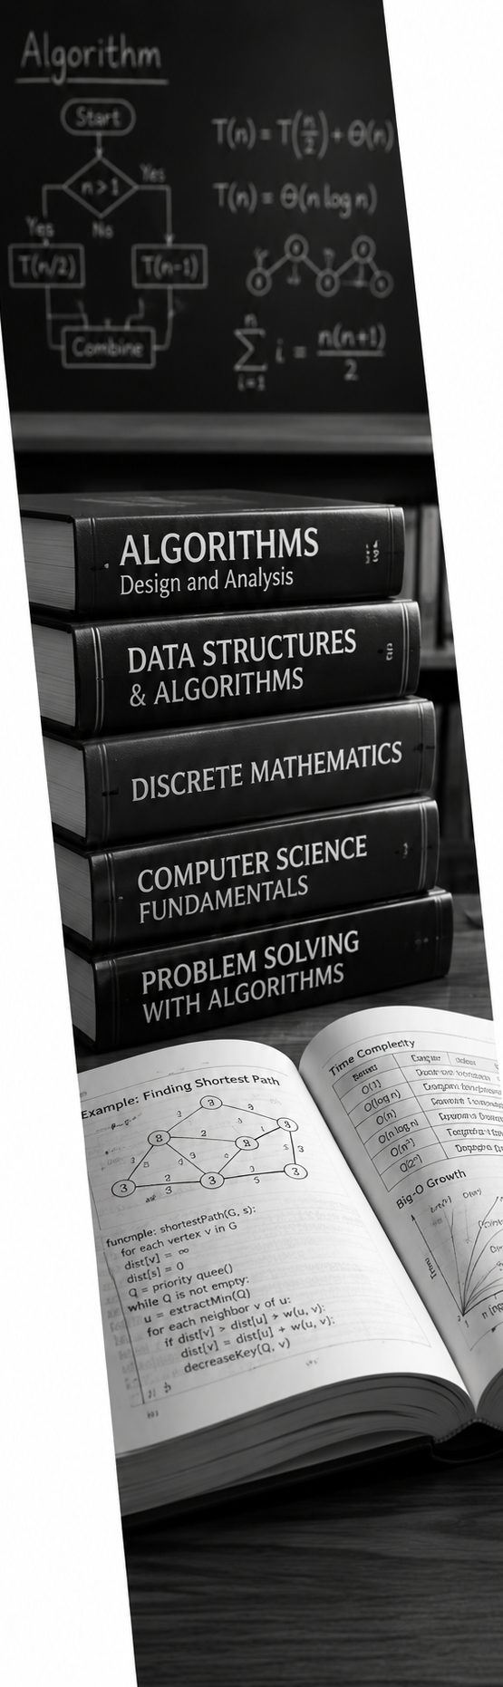
Topic
Textbook Review
?

Slide 10
Secton?

Slide 11
Topic

Slide 12

Break
10 Minute “Human” bio-break

Slide 13

Demo

Slide 14
Demo Scenario
Problem:
Compare two ways to check whether values appear in a collection:
Manual list lookup with a loop
Set membership lookup with `in`
The demo uses the same lookup task for both approaches, then repeats the task across larger input sizes.
Evidence:
A timing table across several input sizes.
A formatted comparison summary that interprets the pattern.
Goal
Check whether values appear in a collection

Slide 16

Demo Evidence
a
Notes:
**Instructor Notes:**
Do not rush the trace.
Ask students what low, high, and mid mean before running the binary search explanation.
The point is not that binary search "fails every time" on unsorted data.
The point is that it is not trustworthy because its reasoning no longer holds.
**Transition Cue:**
Watch the decisions, not just the final result.

Slide 17

Demo Explanation
?

Slide 18

Demo Add-On: Console Color
After the plain demo works, add light console color.
The color helps highlight:
section headings
passed tests
failed tests
important boundary cases
Notes:
**Instructor Notes:**
Present this as an add-on step after the plain-text version has already been run and tested.
Say explicitly: "The algorithm is already complete. We are not changing the decision rule. We are improving how the evidence is displayed."
Then add the color support code and rerun the demo. Use the output as the example.
(Do not over-teach ANSI escape codes. )
The main point is readability: console output can be designed for humans, even when the program is still simple.
**Misconception Warning:**
Students may think colorized output is a requirement for the Lab.
Clarify that it is not required.
The lab requirement is clear evidence.
Color is an optional presentation improvement.
**Transition Cue:**
Because this is only a presentation add-on, the program should still work and remain understandable without color.

Slide 19

From Demo to Lab
In Lab 0n

Slide 20
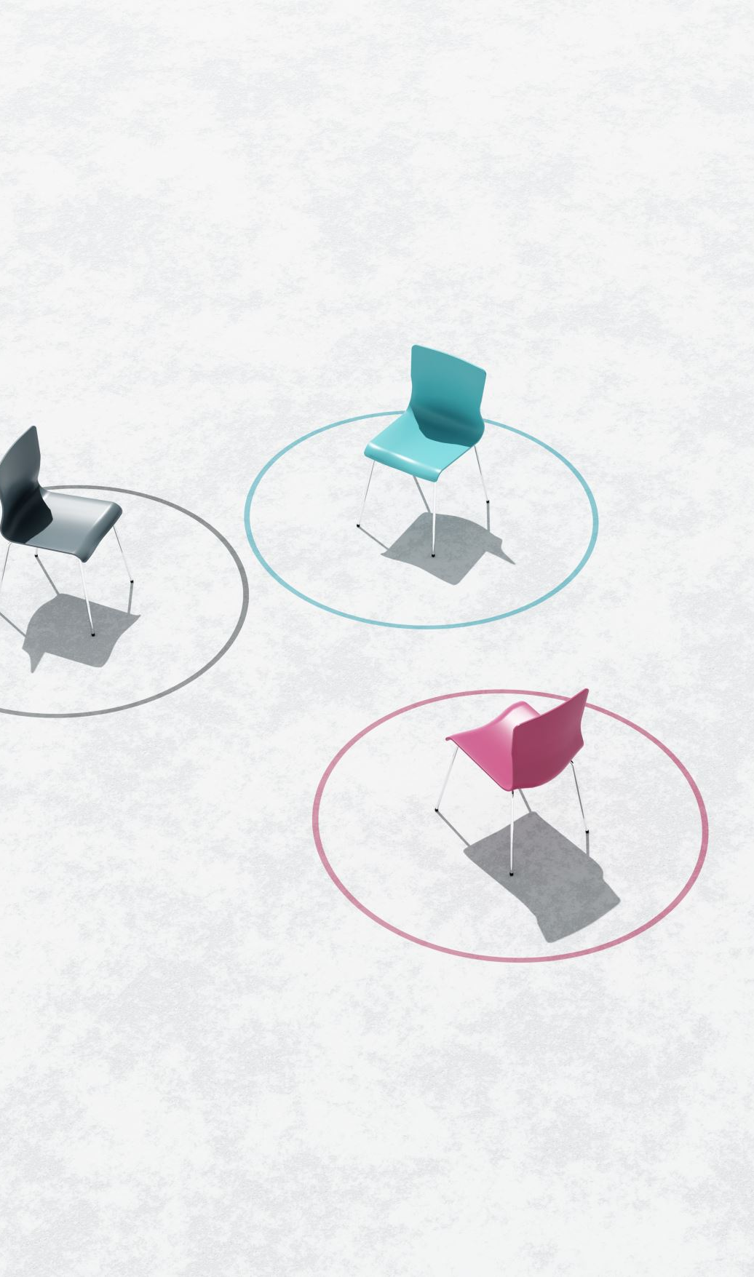
Walkthrough Support
The walkthrough artifact can help you:
?
If you use it, you must explain the pattern in your own words, what you changes, and your decisions:
Notes:
**Instructor Notes:**
If students use a walkthrough, they must explain the pattern in their own words, how they adapted it, and what they decided themselves.
**Related Artifact:**
`---`
**Transition Cue:**
The README is where students connect code, timing, and explanation.

Slide 21
README Evidence
Your README should show:
aaa
AI-use note, if applicable
Notes:
**Instructor Notes:**
Explain that the “timing limitation” note is not an apology.
It is part of responsible technical communication.
A good limitation note shows that the student understands what the evidence can and cannot claim.
**Transition Cue:**
End by restating the difference between evidence and overclaiming.

Slide 22

AI Use In Lab 0n
a

Slide 23

Wrap up

Slide 24
What To Carry Forward
?
Notes:
**Instructor Notes:**
Tie back to the reading's quality features: correct, understandable, efficient. All three matter.
**Transition Cue:**
Students now have the vocabulary needed for Lab 02.

Slide 25

Lab 0n Success Check
a

Slide 26
Next Step
For Lab 0n:
1
?

Slide 27
How To Use The Textbook For Next Week's Reading
?
Notes:
**Instructor Notes:**
This slide prepares the Week 3 reading.
The textbook covers a broad set of structures, including Python built-ins, Series, DataFrames, matrices, vectors, stacks, queues, and trees.
Students do not need to master all of them before class.
The expectation is that students arrive with basic recognition: they should have seen the terms, noticed the operation tables, and be ready to ask which structure fits which problem.

Slide 28
Thank you! Have Fun!

Slide 29
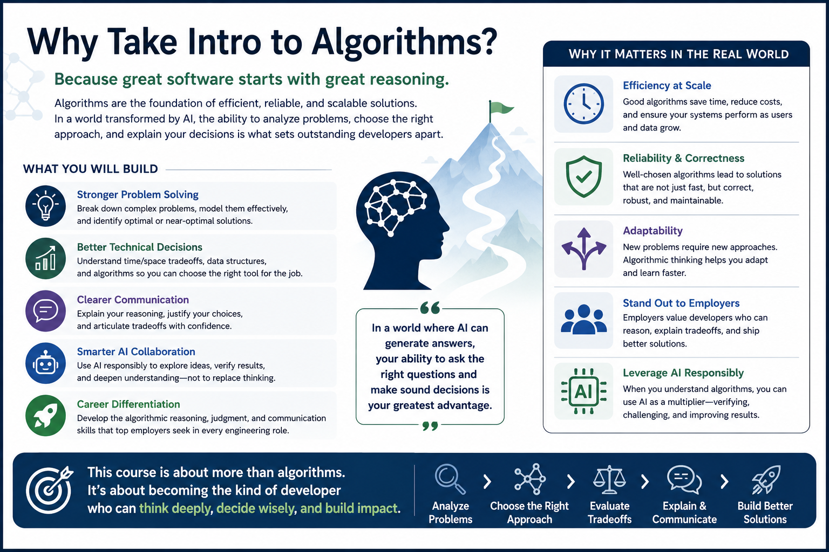

Slide 30

Useful AI Prompt Pattern
“Prompt goes here …”

Slide 31
Image Slide

