Slide 1
Introduction To Algorithms
Week 1 – Algorithms, Precision, and Correctness:
“From Ambiguous Instructions to Testable Algorithms”

Slide 2

Why this is important?
“Because great software starts with great reasoning!”

Slide 3
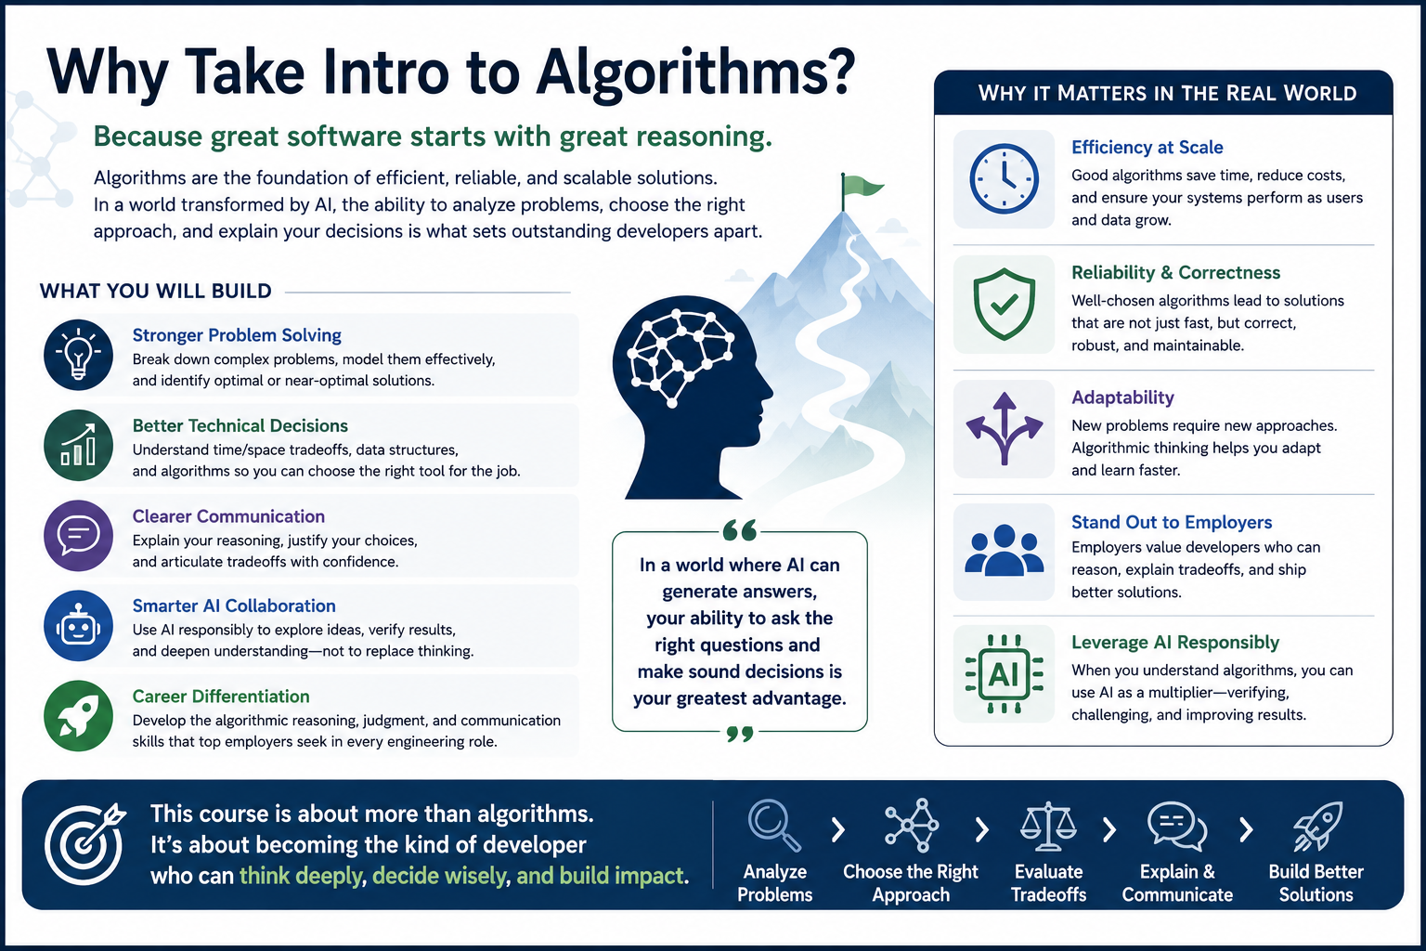
Notes:
Heuristic Projection for AI Assisted Developer using more Advanced Alogorithms"
| Developer Level | Effective Use | Notes |
| Junior Developer | 10-20% | May recognize terms, but often cannot independently apply them beyond tutorials. AI can help, but they may not know when the AI is wrong. |
| Mid-Level Developer | 25-45% | Can apply selected concepts when prompted by the problem. Often uses AI to refresh Big-O, choose structures, compare strategies, or explain tradeoffs. |
| Senior Developer | 45-70% | More likely to identify when advanced concepts matter, even if they do not remember formal details. Uses AI as a reasoning/reference accelerator. |

Slide 4

Why this course matters
Many junior developers can say:
"I made it work."
This course trains you to say:
"Here is the problem I solved. Here are the assumptions I made. Here is the strategy I chose. Here is the evidence that it works. Here is the tradeoff I accepted. Here is how I used AI without surrendering judgment."

Slide 5

What We Will Use Today
definition of algorithm
design before coding
expected result
ambiguity and assumptions
test cases and edge cases
data and compute as early design concerns

Slide 6
Algorithmic Problem Solving
problem -> steps -> evidence -> revision.
- Algorithms are not just code.
- Algorithms are structured ways to solve problems.
- This course focuses on designing, testing, explaining, and improving them.
Notes:
**Instructor Notes:**
Open by positioning the course as a bridge from "I can write Python" to "I can reason about a solution before and after I write Python."
Make clear that this course is not abandoning coding. Instead, it slows down the thinking around the code: why this approach, why this data, why this test, and why this result should be trusted.
**Optional Visual Notes:**
Simple visual path: problem -> steps -> evidence -> revision.
**Transition Cue:**
Students may already associate algorithms with code, math, or intimidating formal notation. Start there, then broaden the word so it means a structured problem-solving process that can eventually be implemented and tested.

Slide 7
Terms to Remember
Term | Brief Meaning
Algorithm | A clear, repeatable, testable process for solving a problem
Design Phase | The planning and reasoning work before or alongside coding
Coding Phase | The implementation of the designed procedure
Functional Requirement | What the algorithm must produce or do
Non-functional Requirement | How well the algorithm should behave under constraints
Data-intensive | Work shaped mainly by the amount, speed, or variety of data
Compute-intensive | Work shaped mainly by the amount of processing required
Edge Case | A boundary or unusual input that tests hidden assumptions

Slide 8
How To Use the Textbook
The textbook may look more mathematical than this course feels at first.
For now:
skim for the idea
notice key terms
mark what looks unfamiliar
do not panic over every formula
connect the concept back to Python functions
Notes:
**Instructor Notes:** (Use this slide to lower unnecessary anxiety without lowering expectations.)
Explain that the textbook is intentionally broad and sometimes gives a fuller mathematical treatment than beginning developers need on first contact. That is not a failure by the student. The first goal is to recognize the idea, become familiar with the vocabulary and understand why the concept matters.
Say explicitly: "When you write a Python function that takes input, follows steps, and returns a result, you are already creating an algorithm. This course will help you recognize, test, explain, and improve that process."
Also explain that some textbook topics may appear before students are ready to master them fully. Later topics such as P, NP, NP-Complete, and NP-Hard are important in computer science, but the beginning developer does not need to master them to become competent at introductory algorithmic problem solving.
**Misconception Warning:**
Students may interpret unfamiliar formulas as proof that they are "not math people" or that they cannot learn algorithms. Reframe the formulas as one way experts compress reasoning, not the only way to begin understanding the idea.
**Transition Cue:**
With that textbook posture in mind, today we will start with the developer version of algorithmic thinking: turning a vague instruction into a testable process.

Slide 9
Course Pattern
- Lecture concept
- Instructor demo
- Related but different lab
- Evidence and explanation
- Responsible AI use
Notes:
**Instructor Notes:**
Explain the repeated course rhythm. Emphasize that the demo will be similar to the lab but not the same.
The demo is a teaching example. The lab is a transfer task. Students should look for the pattern from the demo, then apply that pattern to a different scenario instead of copying the demo's exact rules.
**Transition Cue:**
That pattern starts today with a small decision algorithm because decision rules are easy to understand but still reveal ambiguity, assumptions, and edge cases.

Slide 10
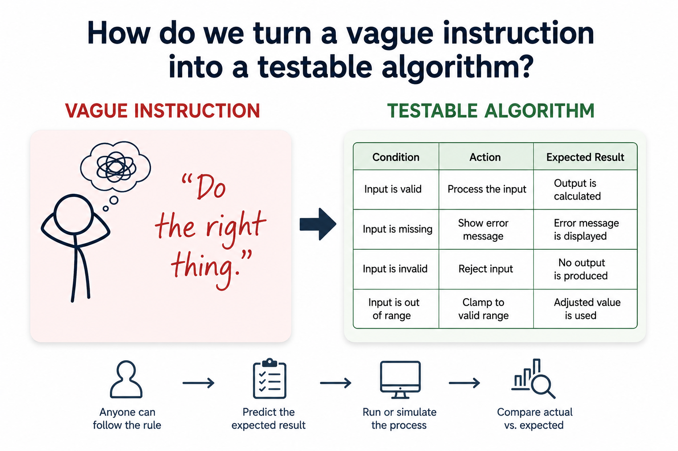
Today’s Question
How do we turn a vague instruction into a testable algorithm?
Notes:
**Instructor Notes:**
This is the anchor question for the entire lesson. Keep returning to it during the demo and lab bridge.
Explain that "testable" means another person can follow the rule, predict an expected result, run or simulate the process, and compare the actual result to the expected one.
**Transition Cue:**
Most everyday instructions feel clear to the person who wrote them. The problem appears when another person or a computer has to follow those instructions without sharing the hidden context.

Slide 11
What Counts As Success Today
name the inputs and outputs
state assumptions
write precise steps
test normal and edge cases
revise when evidence exposes ambiguity
Notes:
**Instructor Notes:**
This slide makes the success target concrete and lowers anxiety. It also sets up the Lab 01 grading emphasis.
Mention that the first week is not about clever code. It is about making a small solution precise enough that it can be reviewed, tested, and improved.
**Transition Cue:** The assigned reading gives vocabulary for this work. The lecture will use those terms, but it will also translate them into small examples students can apply in Lab 01.

Slide 12
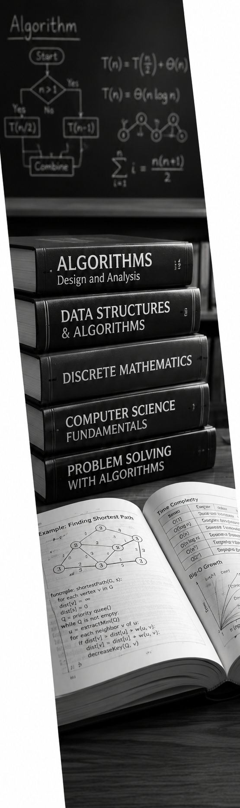
What is an Algorithm?
Textbook Review
An algorithm is a structured process for solving a problem.
It should be:
clear
repeatable
testable
explainable
implementable
Notes:
**Instructor Notes:**
Use the course phrase explicitly: "An algorithm does not have to look mathematical to be real."
Then add the working standard for the course: it must be clear, repeatable, testable, explainable, and implementable. This definition is intentionally practical because students will use it in labs.
**Transition Cue:**
Once students understand what an algorithm is, the next question is how an algorithm is developed. The reading separates that work into design and coding.

Slide 13
Design and Coding
Textbook Review
Algorithm work has two connected phases:
Design: decide the logic
Coding: implement the logic
Good coding cannot fully rescue unclear design.
Notes:
**Instructor Notes:**
(Do not overstate the separation.) In real work, design and coding can loop. The teaching point is that design questions should be visible before students race
into code.
Give a simple example: before writing a function that recommends "bring charger," we should decide what counts as low battery and long time on campus.
**Transition Cue:**
Design is where we decide what the algorithm is supposed to do and how we will know whether it did it correctly.

Slide 14
Requirements
Textbook Review
Functional requirements:
What result should the algorithm produce?
Non-functional requirements:
How well should it perform?
How readable should it be?
How well should it handle growth?
Notes:
**Instructor Notes:**
Keep this introductory. Week 1 does not need full software requirements theory. Students only need the difference between "what it does" and "how well it behaves."
Use a quick example: a functional requirement might be "return approved, denied, or needs review." A non-functional requirement might be "the decision should be easy to explain" or "the approach should still work when there are many records."
**Transition Cue:**
Those requirements lead to three design questions we will keep using in the course: expected result, reasonable approach, and larger-data behavior.

Slide 15
Three Design Questions
Textbook Review
When designing an algorithm, ask:
Does it produce the expected result?
Is this a reasonable way to get the result?
What happens when the data gets larger?
Notes:
**Instructor Notes:**
Use these three as the Week 1 version of correctness, approach fit, and scale.
(Formal Big-O comes later. - Do not introduce formal notation here.) The goal is to plant the questions so Week 2's growth and Big-O discussion has somewhere to attach.
**Transition Cue:**
Now move from: … the reading summary … into the course's working definition of an algorithm: a procedure that starts with information, follows steps, produces a result, and can be checked.

Slide 16
An Algorithm is A Procedure
It Answers:
What information do I start with?
What steps do I follow?
What result should I produce?
How will I know it worked?
Notes:
**Instructor Notes:**
Ask students for one everyday process that has steps. If they hesitate, offer examples such as deciding what to wear, calculating a tip, choosing a route, or prioritizing a task
Then ask them to identify the starting information and final decision for that example. The goal is to help them see that algorithmic thinking can begin with ordinary decision processes before it becomes code.
**Transition Cue:**
Once we can describe the process, we can represent that same process in more than one form. The representation changes, but the underlying reasoning should stay the same.

