Slide 1
Python Programming Foundations
Week n – Topic
Day n: “Subtitle”

Slide 3

Quick Review
Monday made output visible.
Tuesday made numeric value flow visible.
Notes:
**Instructor Notes:**
Ask students to recall one idea from each day:
- Monday: What does `print()` do?
- Tuesday: What does an expression create?
Keep this short. The point is to bridge into integration.
**Transition Cue:**
Now we focus on completing small programs, not collecting more topics.

Slide 4

What We Will Use Today
a

Slide 5
What We Will “Skip” For Now
a

Slide 6
Review Coding Lab
Notes:
** Instructor Notes **
Step through the coding solution(s) for the Lab. Be sure to state that this is only *one* solution of many. NOT the best or only solution.

Slide 7
What Counts as Success Today
Working baseline -> compare structure -> revise one meaningful thing -> explain the improvement.
A useful revision should make the program:
clearer
easier to test
easier to change
easier to explain
Notes:
**Instructor Notes:**
This protects against both overbuilding and aimless polishing.
One meaningful improvement is enough.
**Transition Cue:**
Let's name what we will use today.

Slide 8
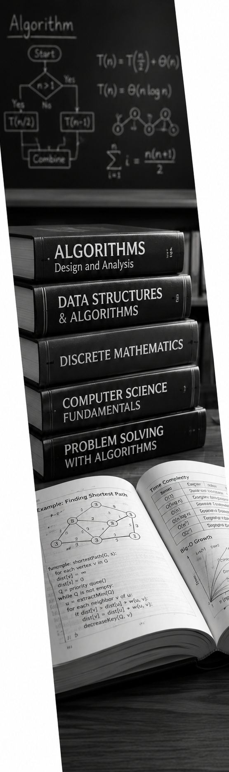
Topic
Textbook Review
?

Slide 9
Secton?

Slide 10
Topic

Slide 11

Demo #1
“Basic Type Awareness”

Slide 12

What to Watch For
a
Notes:
**Instructor Notes:**
Do not rush the trace.
Ask students what low, high, and mid mean before running the binary search explanation.
The point is not that binary search "fails every time" on unsorted data.
The point is that it is not trustworthy because its reasoning no longer holds.
**Transition Cue:**
Watch the decisions, not just the final result.

Slide 14

Demo Explanation
?

Slide 15

From Demo to Lab
In Lab 0n

Slide 16
README Evidence
Your README should show:
aaa
AI-use note, if applicable
Notes:
**Instructor Notes:**
Explain that the “timing limitation” note is not an apology.
It is part of responsible technical communication.
A good limitation note shows that the student understands what the evidence can and cannot claim.
**Transition Cue:**
End by restating the difference between evidence and overclaiming.

Slide 17

AI Use In Lab 0n
a

Slide 18

Closing Success Check
a

Slide 19
Thank you! Have Fun!

Slide 20

Useful AI Prompt Pattern
“Prompt goes here …”

Slide 21
Image Slide

