Slide 1
HTML: “Something Exists”
Week 1 - Lecture 1
Notes:
Good morning.
For the next ten minutes, we’re going to talk about variable types — not just what they are in Python, but why they exist at all.
I’ll assume a mixed background in the room, so we’ll build this from the ground up and connect it to - how programming works across many languages.
(Pause — make eye contact)
“If you understand the idea of variable types, learning new languages becomes much easier.”

Slide 2
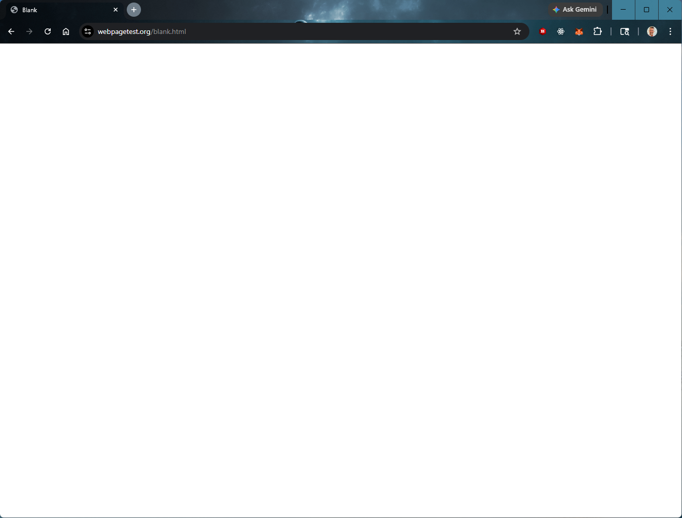
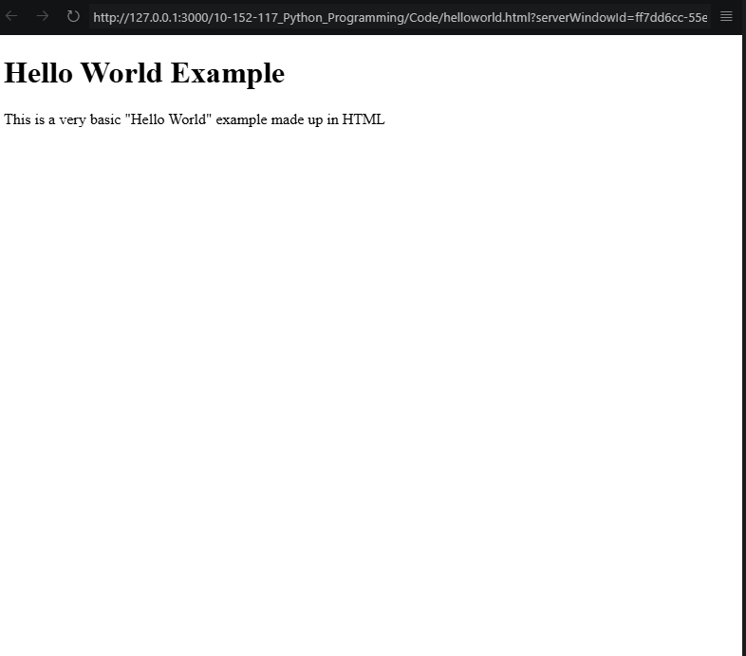
Build Something That Exists (Not something impressive)
Blank Browser
Simple HTML Page

Slide 3

We Build In Layers
CSS: Appearance
JS: Behavior
HTML: Structure

Slide 4
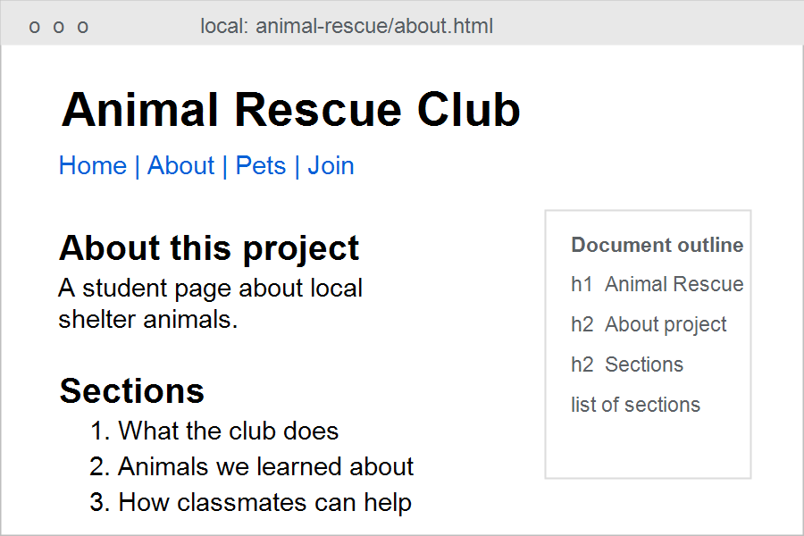
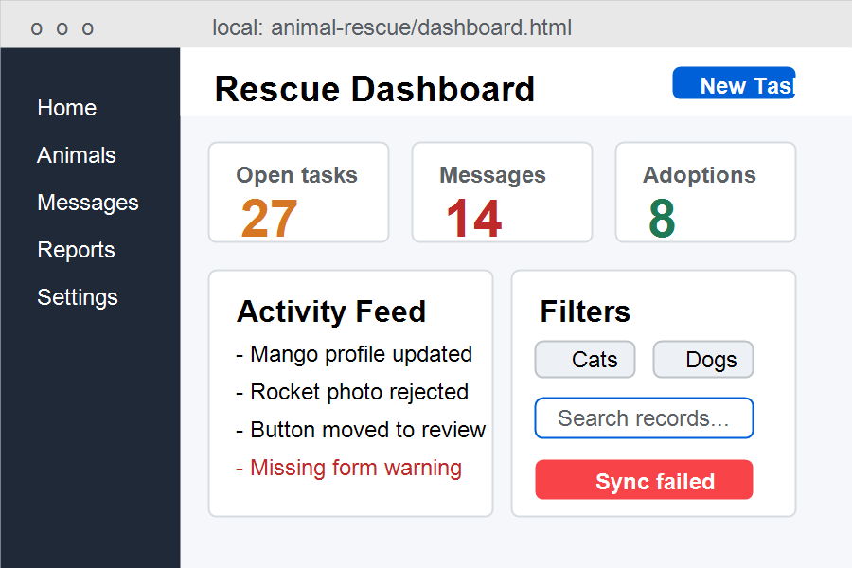
Web Page - Core Concept
Note: a web page can become part of an app, but it doesn’t start that way!
Document
Complex App UI
Notes:
test

Slide 5
HTML defines meaning Not appearance!
Semantic HTML
Styled View
<!DOCTYPE html>
<head>
<title>HTML "Hello World"</title>
</head>
<body>
<h1>Hello World Example</h1>
<p>This is a very basic "Hello World" example made up in HTML</p>
</body>
</html>

Slide 6
System Thinking
Pages are connected. (“Connection” and “flow” are systems thinking)
Not Isolated.
System
Home Page
About Page
Topic Page

Slide 7
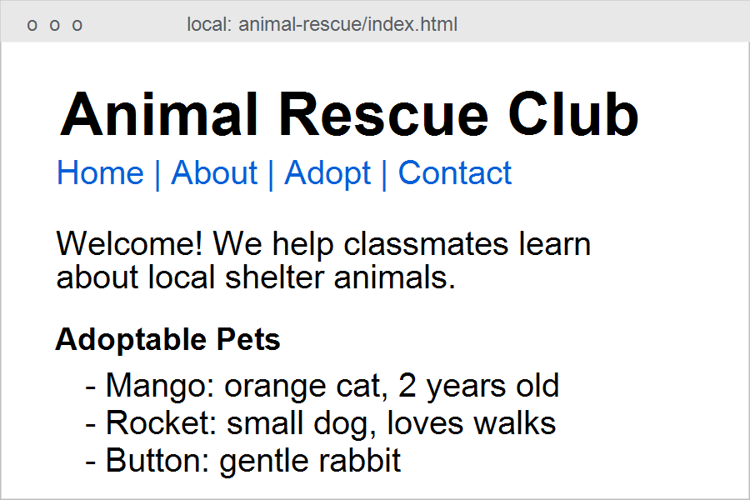
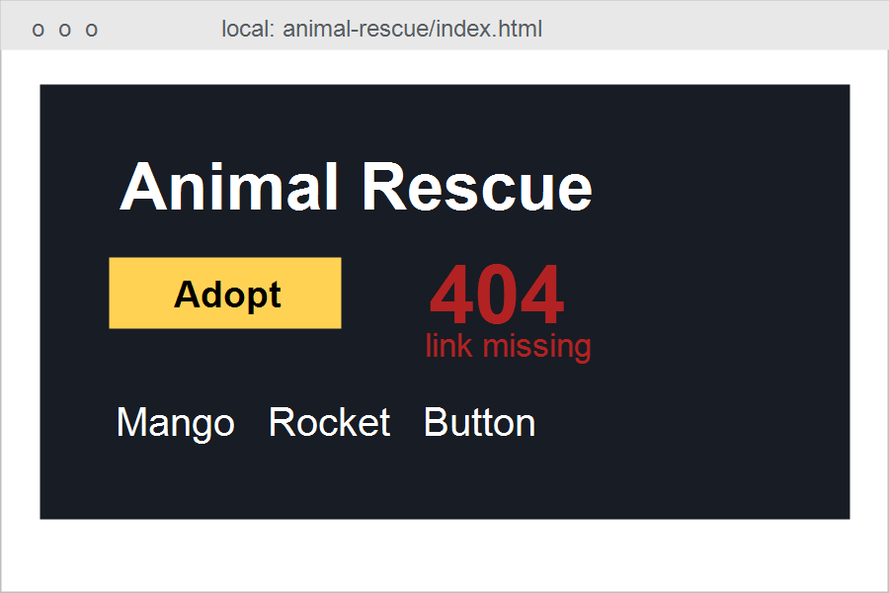
Contrast
“Same project. Opposite priorities.”
Ugly but working
Styled but broken

Slide 8
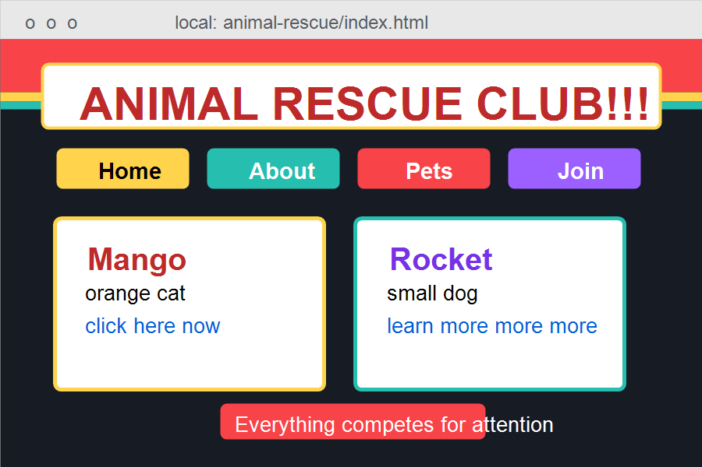
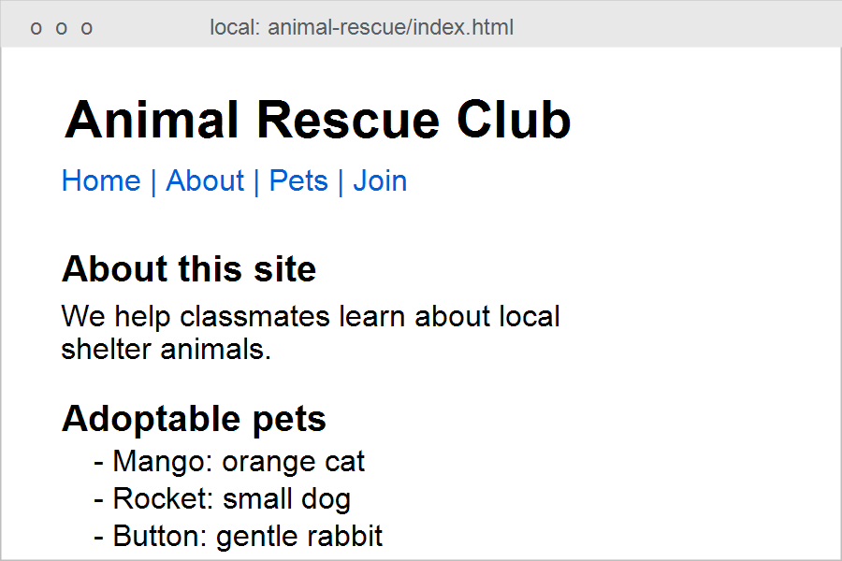
Common Failure
“Trying to make it look good too early.”
Competing Styled Elements & Visual noise
Plain, readable structure
Notes:
Common Mistakes / Watch-Fors
* Trying to make it look good (premature CSS thinking)
* Putting everything in one page
* Broken links (file names don’t match)
* Ignoring structure (just dumping content)

Slide 9
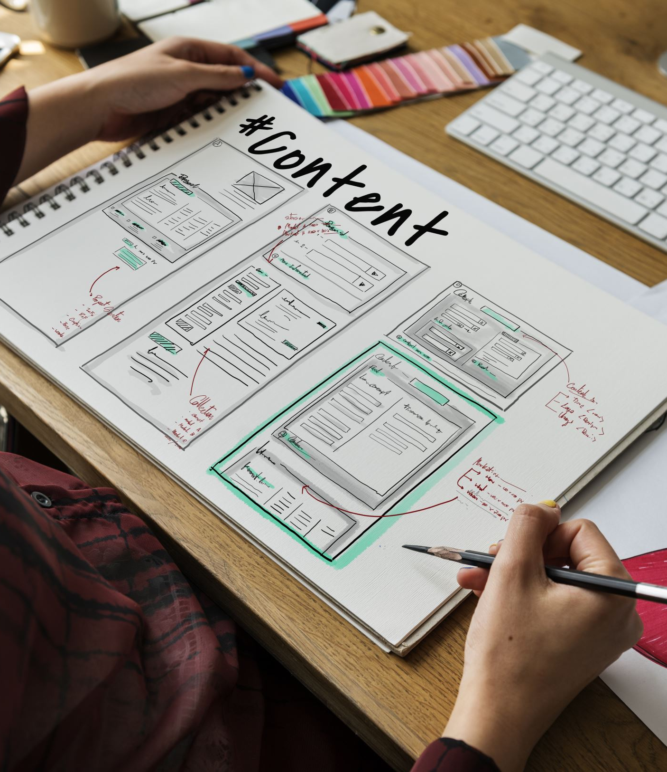
Structure
Assignment
System Layout
Index
About
Topic
links between them
Notes:
(We will start using “duplicated” information [Nav bar] on each page)
> “In lab, your goal is not design.
> Your goal is to create a working multi-page structure.”
Focus on:
* pages exist
* navigation works
* content is organized

Slide 10
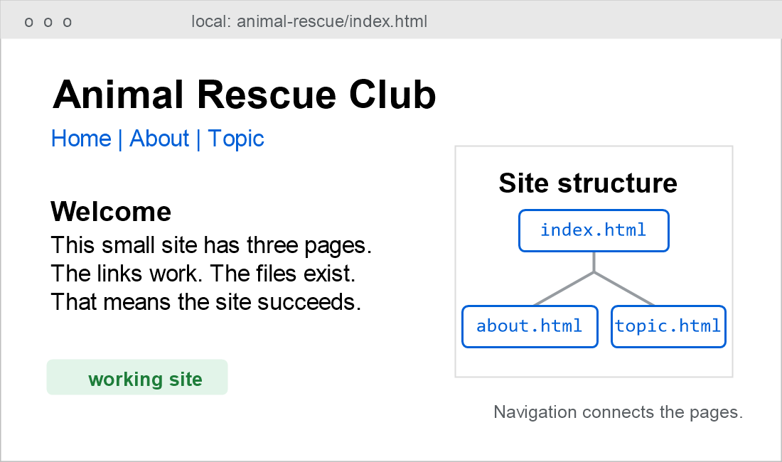
Working = Success
If it works, you succeeded

Slide 11
Thank you!

