Slide 1
Web Development Foundations
Week 1 – HTML: Something Exists
Day 1: “HTML Foundations Live”

Slide 2
Beginnings
Build something that exists.
A web page starts as a file.
The browser reads that file.
If the page opens, the first goal is met.
Visual polish comes later.
Notes:
**Instructor notes:**
- Start with pressure reduction.
- Say that professional-looking pages come later.
- Today's success condition is visible existence in a browser.
**Transition cue:**
"Before we make it pretty or interactive, the browser needs something real to read."

Slide 3
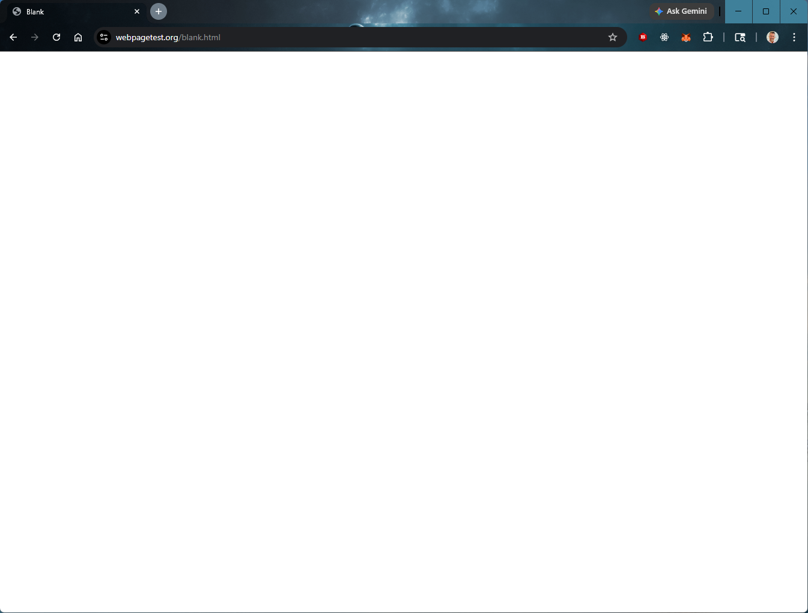
A “blank” page

Slide 4
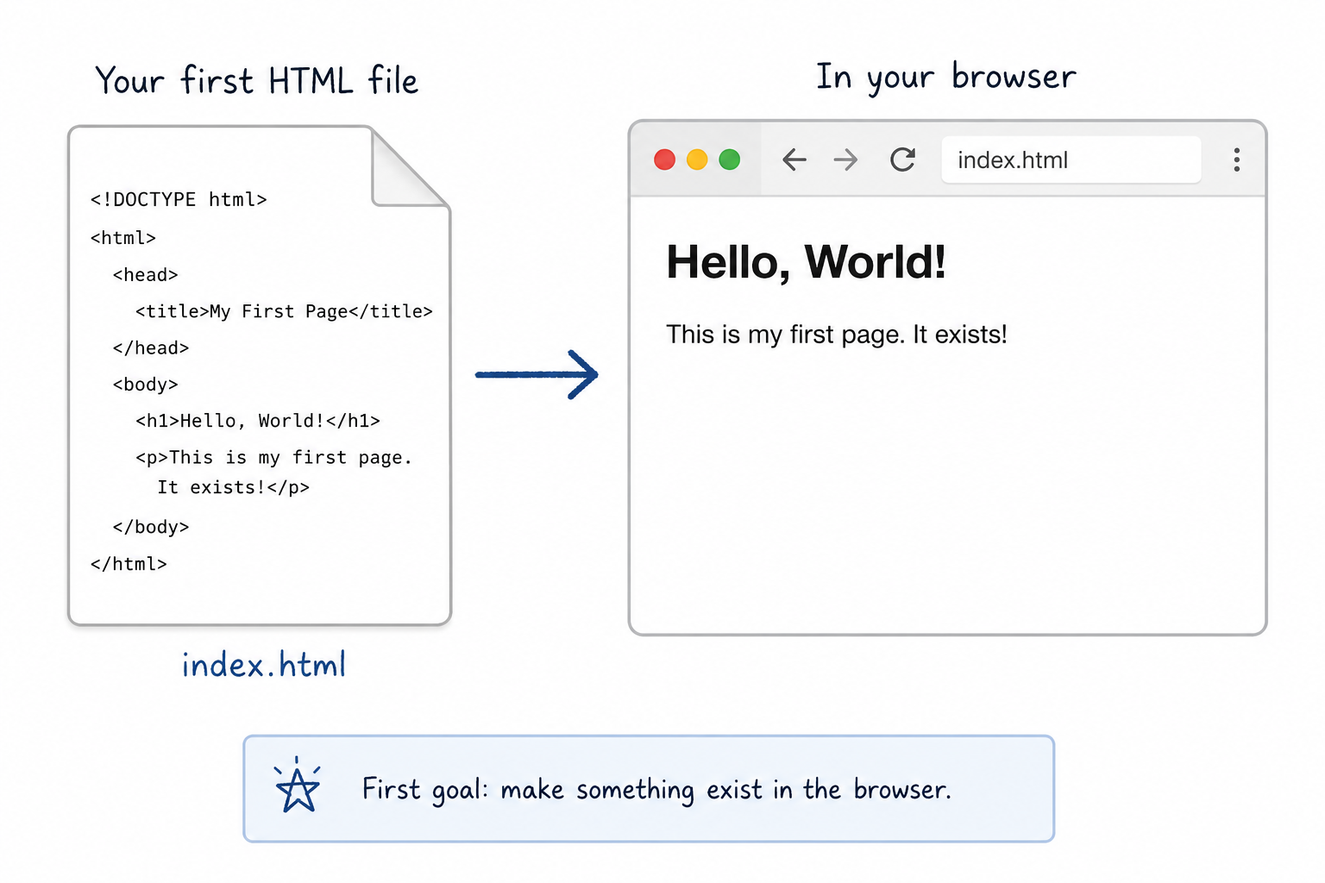
Something Exists

Slide 5

Course Layer Map
Web pages have layers:
HTML gives content structure.
CSS controls appearance.
JavaScript adds behavior.
Today: HTML only.
Notes:
**Instructor notes:**
- Establish the course's separation of concerns.
- HTML comes first because CSS and JavaScript need something to attach to.
- Avoid going into CSS/JS details.
**Transition cue:**
"Today we only work in the first layer."

Slide 6
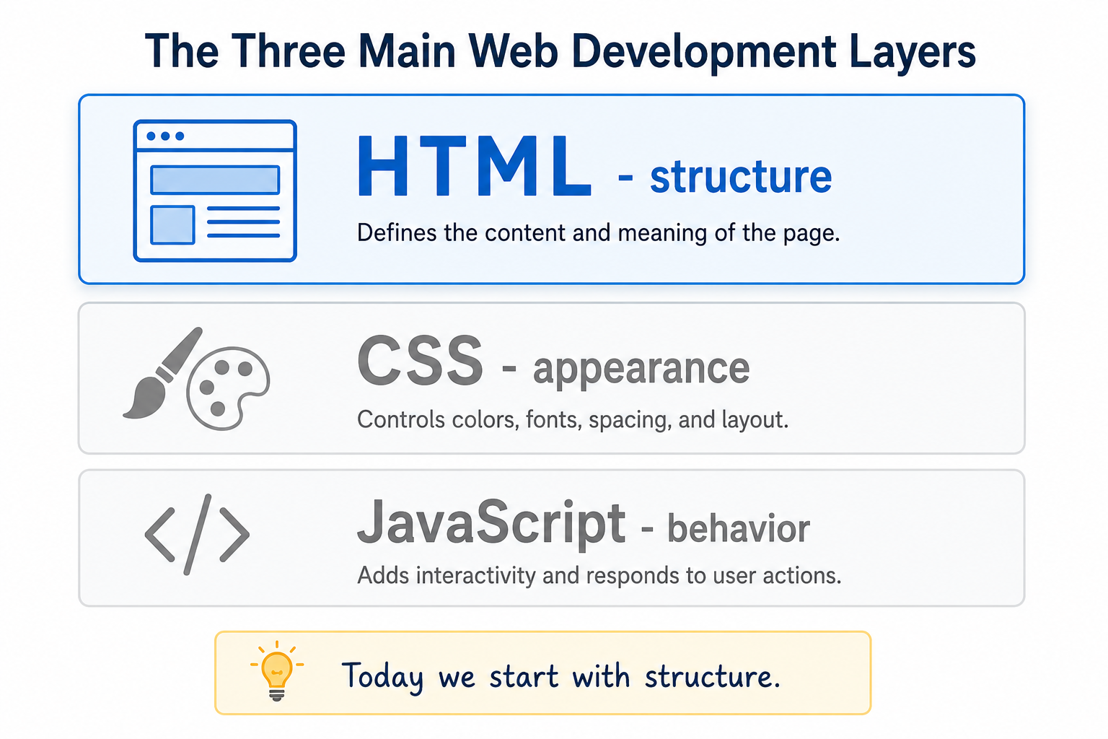
Web Page Layers

Slide 7
Core Idea
HTML gives content meaning.
A heading means "this is a heading."
A paragraph means "this is body text."
A link means "go somewhere."
Notes:
**Instructor notes:**
Explain heading, paragraph, and link as meaning.
Appearance will feel unfinished because CSS has not arrived yet.
**Transition cue:**
"So what does a meaningful page look like as a file?"

Slide 8
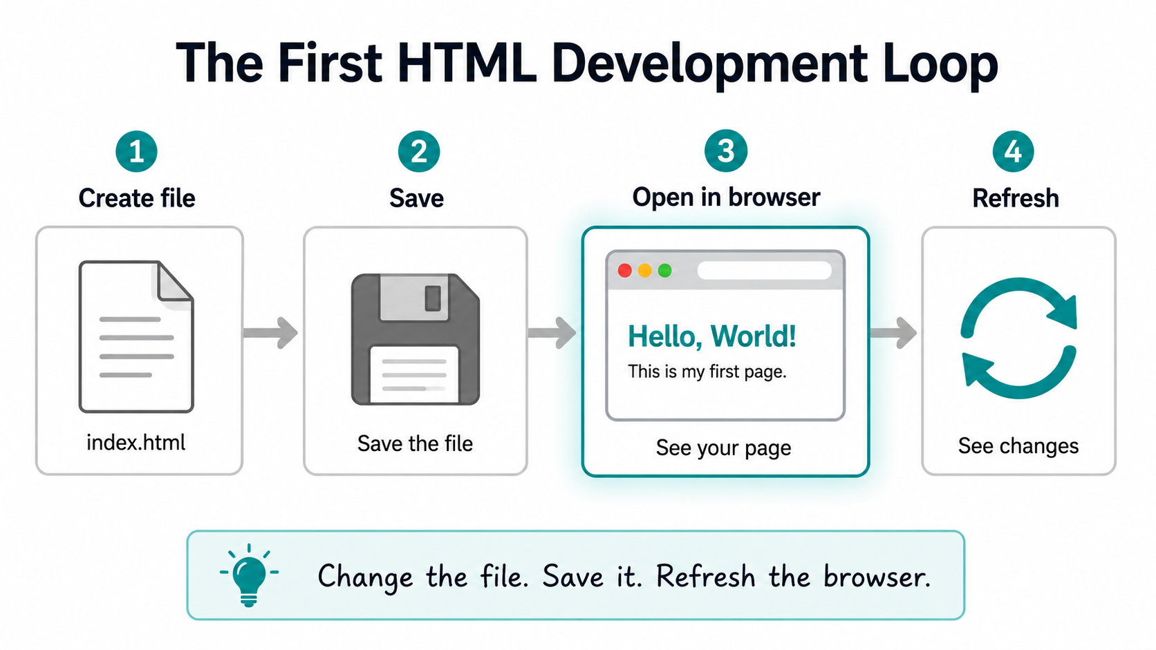
HTML Dev Loop

Slide 9

File To Browser
File -> Save -> Browser -> Refresh
The file stores the structure.
Save writes your changes.
The browser reads the saved file.
Refresh shows the latest saved version.
Notes:
**Instructor notes:**
This is the first development loop.
Students need to see that the browser does not magically know unsaved changes.
**Transition cue:**
"Let's look at the minimum file the browser can understand."

Slide 10

What We Will Use Today
`index.html`
`<!doctype html>`
`html`, `head`, `title`, `body`
`h1` and `p`
save and refresh
Notes:
**Instructor notes:**
Use this as the scope boundary before the first code demo.
Keep the visible focus on active tools only.
Keep the tone calm and practical.
**Transition cue:**
"That also means a few tempting tools are intentionally not in our hands yet."

Slide 11
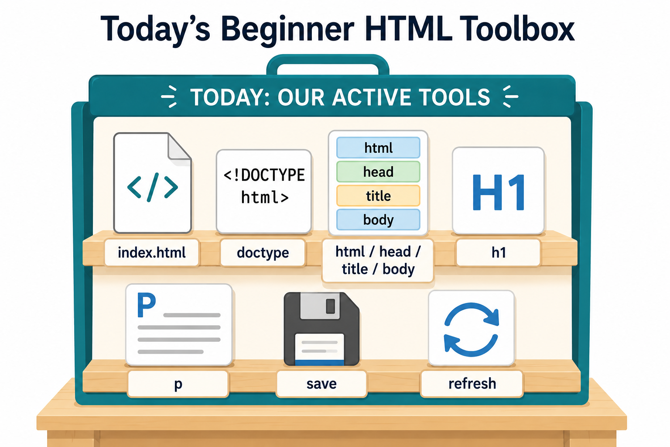
Toolbox

Slide 12
What We Will “Skip” For Now
CSS will handle appearance.
JavaScript will handle behavior.
Layout tools will help arrange pages.
Frameworks and publishing come much later.
Today, the win is HTML structure that opens.
Notes:
**Instructor notes:**
Explain that parked topics are not forbidden or scary; they are simply not today's job.
Use this to reduce the common beginner urge to style before the structure works.
Name this as separation of concerns by example: active tools and deferred tools stay separate.
**Transition cue:**
"Now let's see the shape today's tools create."

Slide 13
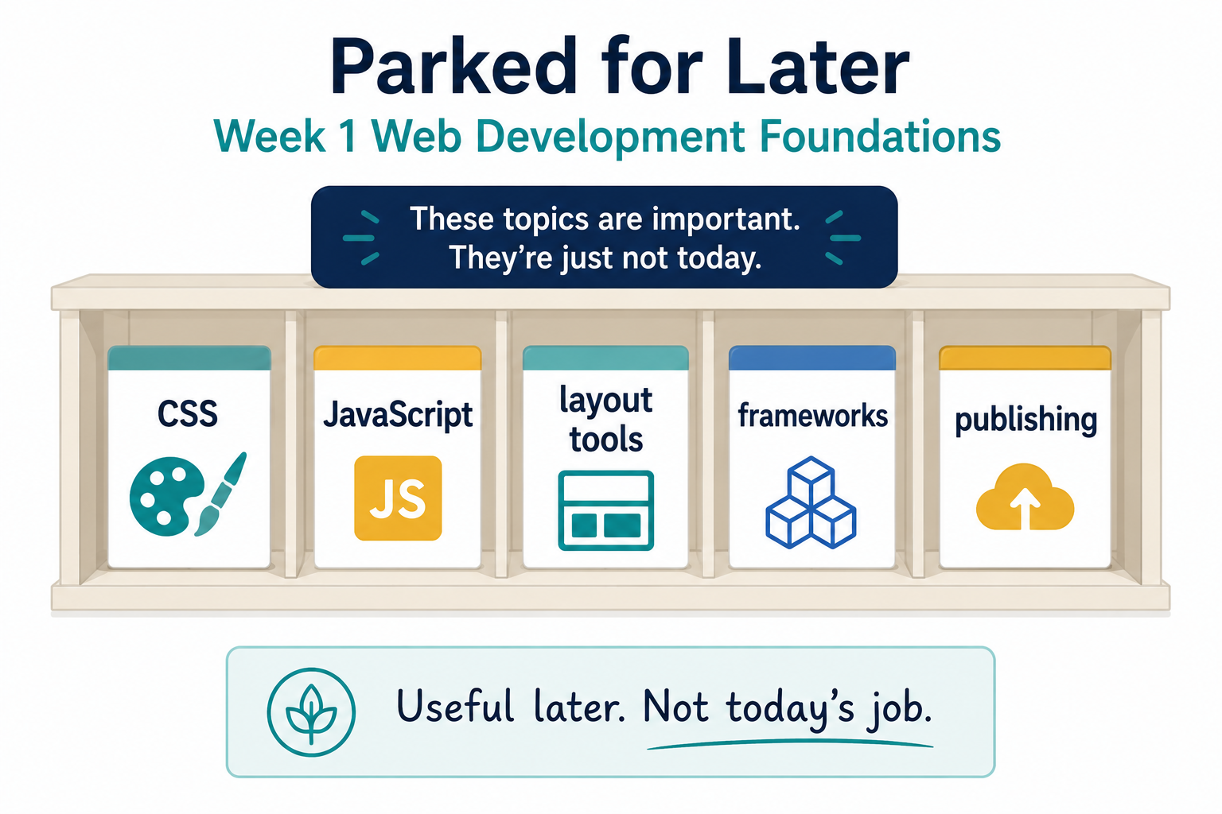
Parked For Later

Slide 14
The Smallest Useful Page
Every first page needs a shape.
`<!doctype html>` tells the browser what kind of document this is.
`head` stores page information.
`body` stores visible content.
The browser uses the shape to understand the page.
Notes:
**Instructor notes:**
Keep this conceptual.
The exact typing happens in the demo.
**Transition cue:**
"Now we will build that shape from nothing."

Slide 15
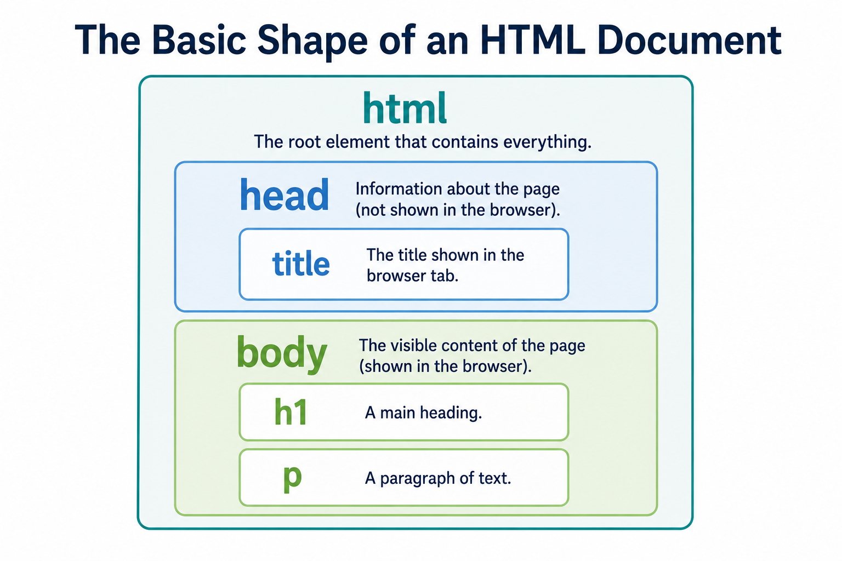
HTML Document Shape

Slide 16

Demo #1
“First Page”

Slide 17

What to Watch For
file name: `index.html`
save before refresh
browser tab title
visible page heading
Goal: one page that opens in the browser.
Notes:
**Instructor notes:**
Create a new folder and file.
Narrate file naming: `index.html` is the common home page name.
Do not mention hosting/deployment.
**Transition cue:**
"I am going to type this slowly enough that the shape is visible.“
Demo connection:
- `01_monday_hello_world/index.html`

Slide 18
Demo: First Page
Type. Save. Refresh. Observe.
- Type the structure.
- Save the file.
- Open or refresh the browser.
- Change one line and confirm the browser updates.
Notes:
**Instructor notes:**
- Type:
- `<!doctype html>`
- `<html lang="en">`
- `<head>`
- `<meta charset="utf-8">`
- `<title>Hello World</title>`
- `<body>`
- `<h1>Hello World</h1>`
- `<p>This is my first web page.</p>`
- Save and open in browser.
- Change one line and refresh.
**Transition cue:**
"Now that it exists, what exactly did the browser use?"

Slide 19

What The Browser Did
The browser did not guess.
`<title>` became the browser tab label.
`<h1>` became the visible page heading.
`<p>` became visible paragraph text.
The result came from the saved HTML structure.
Notes:
**Instructor notes:**
Reinforce that HTML is interpreted by the browser.
Avoid making this mystical.
**Transition cue:**
"One early confusion is the difference between two different 'titles.'"

Slide 20
Title Versus Heading
`<title>` names the browser tab.
`<h1>` names the page content.
Common confusion:
The title may not appear inside the page.
The heading may not appear in the browser tab.
Both are useful, but they do different jobs.
Notes:
**Instructor notes:**
Show both in the demo.
This small distinction prevents lots of beginner confusion.
**Transition cue:**
"This page is not impressive. That is fine."

Slide 21
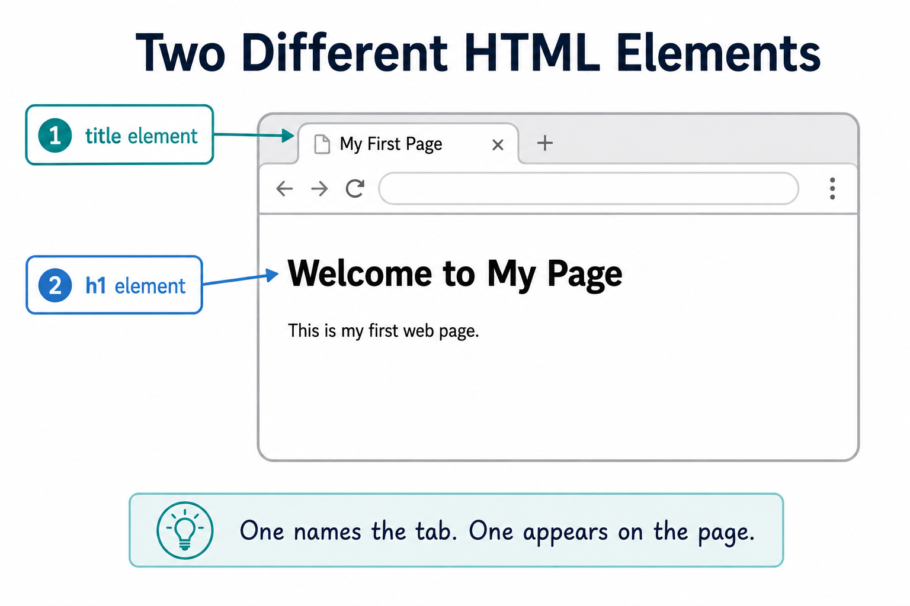
Title vs. Headings

Slide 22
Contrast
Working beats pretty.
This week, every time.
Prioritize:
the file opens
the content is structured
the links work
the page can be changed and refreshed
Notes:
**Instructor notes:**
Explicitly tell students not to chase styling.
A plain working page is a success.
**Transition cue:**
"Here is what usually goes wrong in Week 1."

Slide 23
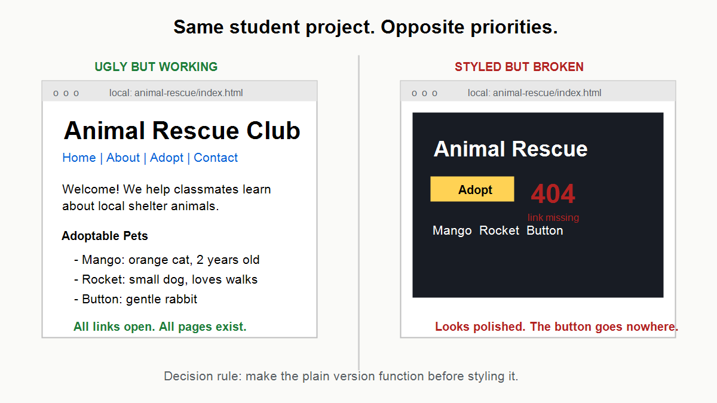
Working First!

Slide 24
Common Mistakes
Unsaved file
Wrong file name
Broken tag pair
Expecting CSS
“Fix one small thing, then refresh and check again.”
Notes:
**Instructor notes:**
Explain each briefly.
Keep the tone normal: mistakes are part of the loop.
**Transition cue:**
"The lab takes this from one page to a small connected site."

Slide 25
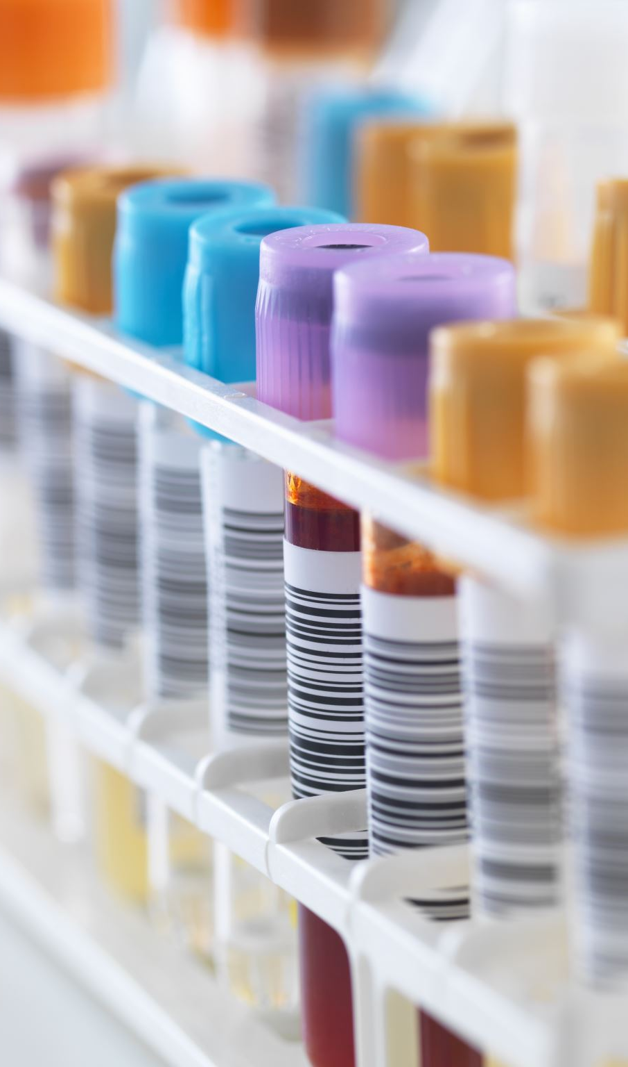
Lab
Start the first page.
create the project folder
create `index.html`
add a heading and paragraph
save, open, refresh, and revise
Do not worry about the full site yet.
Notes:
**Instructor notes:**
Emphasize that Tuesday is the first build loop, not the full endpoint.
Students need one working page before the multi-page assignment makes sense.
Preview only lightly that Wednesday will show how one page grows into a site.
**Transition cue:**
"What evidence should you preserve as you work?“
Lab connection:
- `Assignments/1_HTML_Multi-Page_Site.md`

Slide 26
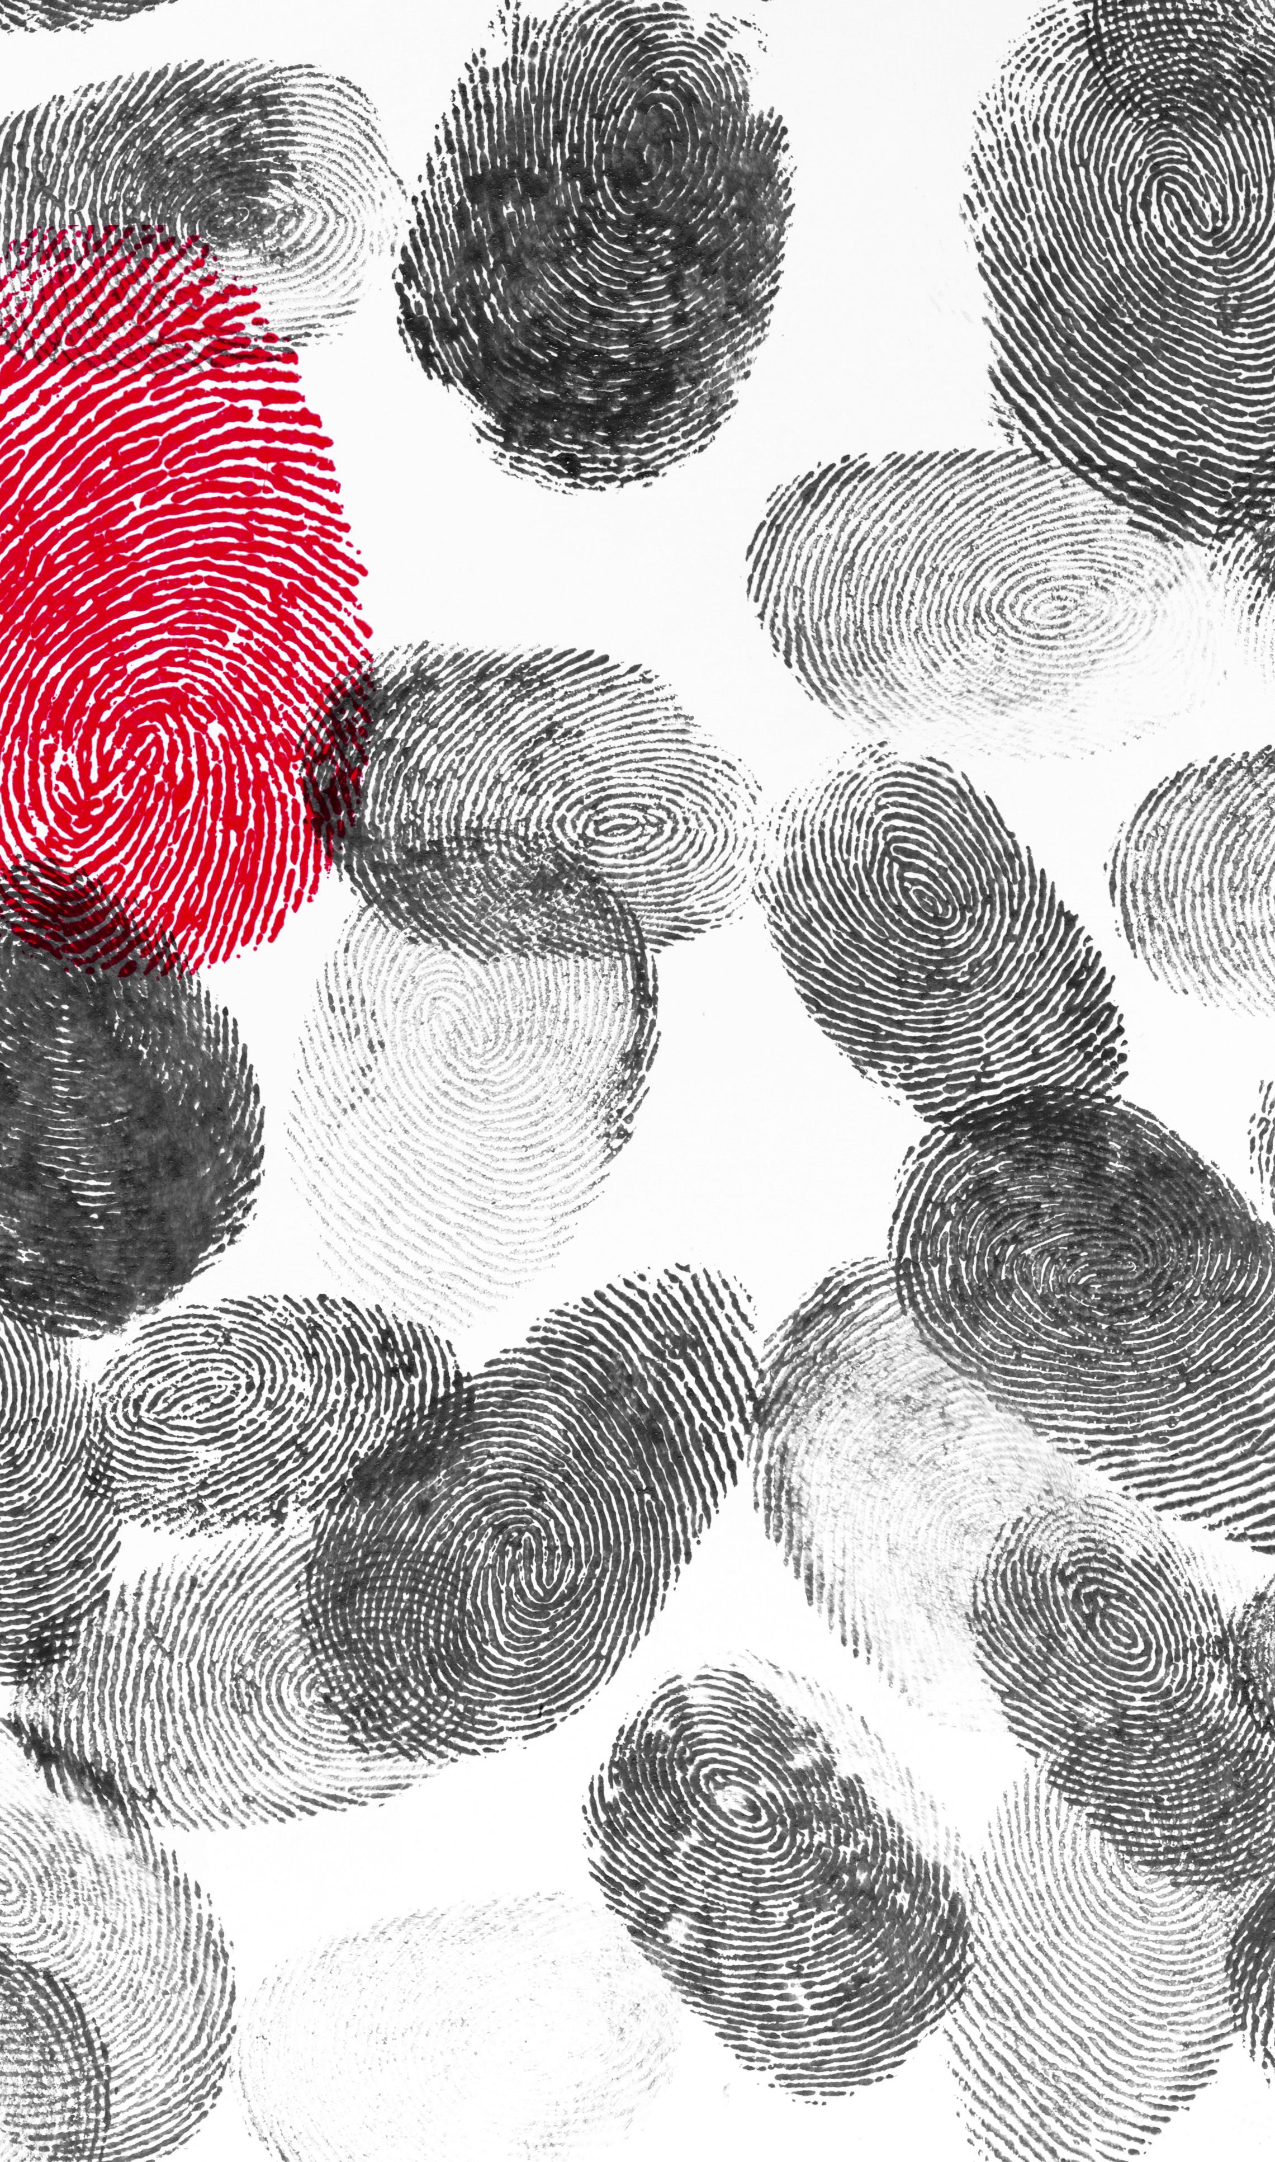
Evidence
Your initial output should include:
your project folder
your `index.html` file
a page that opens in the browser
notes about what changed
The full reflection comes after the site has been refined.
Notes:
**Instructor notes:**
Keep evidence expectations limited to the first lab moment.
Do not ask students to prove navigation before Wednesday introduces it.
Mention that later evidence will include multiple pages and the final reflection.
**Transition cue:**
"Wednesday continues this same site by improving structure and navigation."

Slide 27

Closing Success Check
If your page opens, and the structure makes sense, you are on track.
Week 1 success is:
visible page
clear structure
saved files
working links beginning to form
Notes:
**Instructor notes:**
Close with confidence.
Re-state: ugly is not failure in Week 1.
Mention that Wednesday will continue the same site by adding structure and navigation.
**Transition cue:**
End.

Slide 28
Thank you! Have Fun!

