Slide 1
Web Development Foundations
Week 2 – “I Can Control Appearance”
Day 1: “CSS Foundations”

Slide 2

From Structure To Appearance
Last week:
HTML made the site exist.
Structure gave content meaning.
This week:
CSS changes how that structure appears.
We add a new layer.
Notes:
**Instructor notes:**
Frame Week 2 as continuation, not restart.
Use the phrase "add a layer" early.
Avoid making CSS sound like decoration only; it affects readability and usability.
**Transition cue:**
- "Before we add the new layer, let's look at one successful HTML-only path."

Slide 3
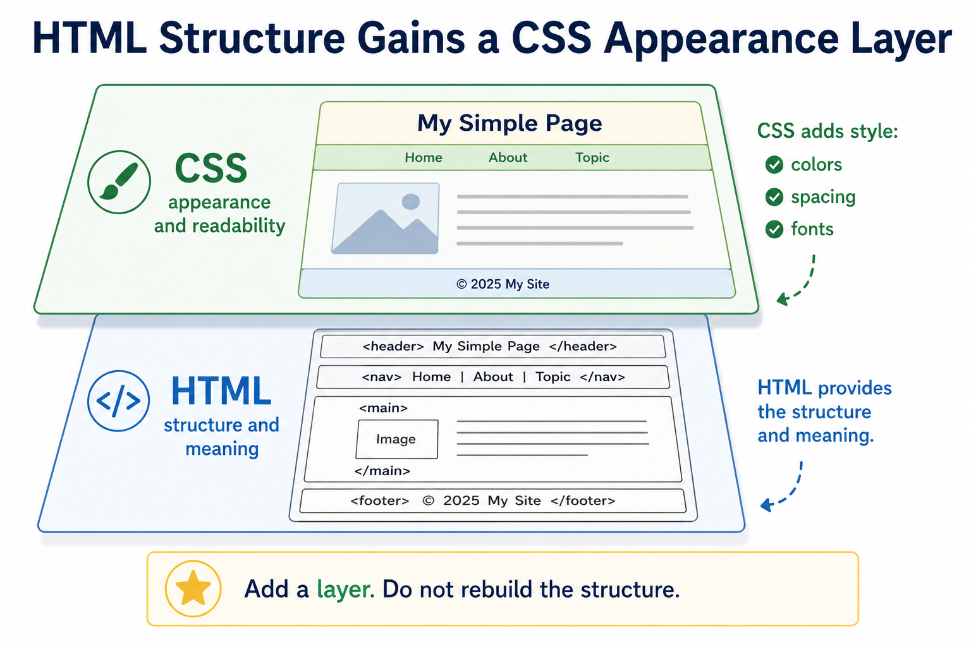
Structure To Appearance

Slide 4

Lab Review: One Successful HTML Path
One successful Week 1 path:
at least three pages
clear headings and paragraphs
lists where useful
navigation between pages
semantic regions
What we will see is one acceptable path, not the only answer.
This Photo by Unknown Author is licensed under CC BY-SA
Notes:
**Instructor notes:**
Open `Assignments/Success_Solutions/Week_01_HTML_Multi_Page_Site/success_solution/index.html`.
Click through `tips.html` and `schedule.html`.
Keep the review concise; the purpose is to bridge, not reteach Week 1.
Normalize revision and recovery.
**Transition cue:**
"This structure works. Now we can ask how the experience should feel."

Slide 5
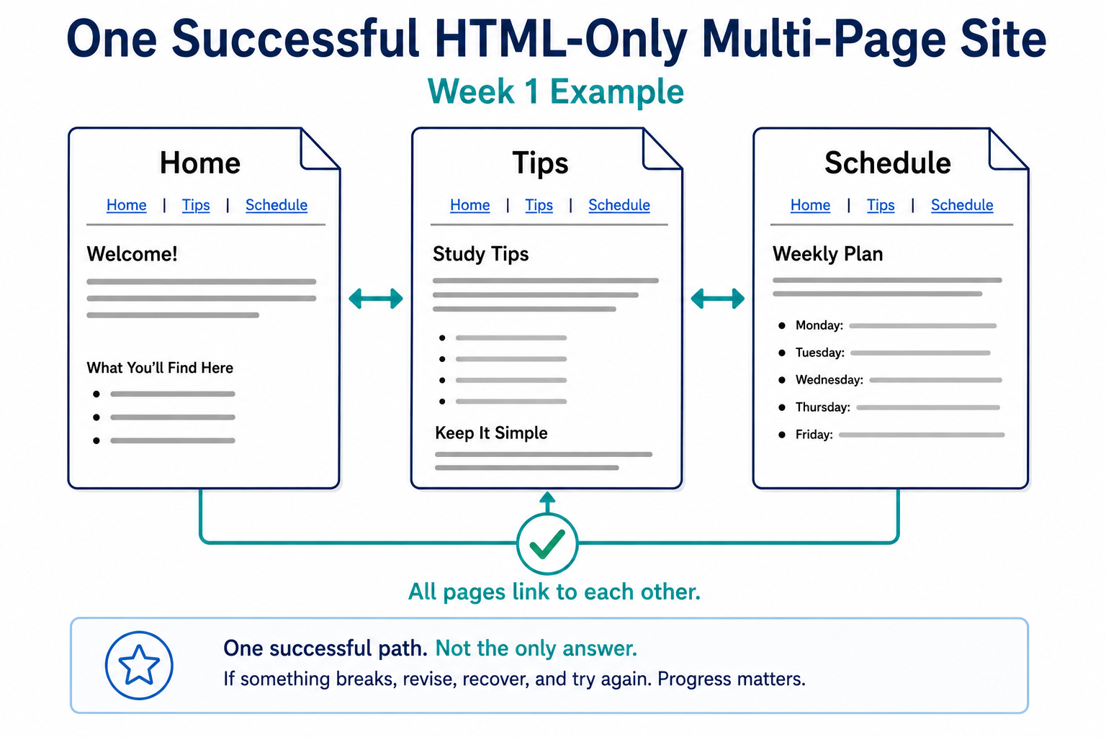
Successful HTML Path

Slide 6

Review Coding Lab
Notes:
** Instructor Notes **
Step through the coding solution(s) for the Lab. Be sure to state that this is only *one* solution of many. NOT the best or only solution.

Slide 7
What Week 1 Proved
the browser can read your files
pages can link to each other
headings and sections create meaning
plain can still be correct
Going forward: “CSS should improve the experience without replacing the structure.”
Notes:
**Instructor notes:**
Emphasize that Week 2 builds on the same site.
Students should not delete working HTML to "start over."
This slide protects continuity.
**Transition cue:**
"That gives us the boundary: HTML keeps meaning; CSS changes presentation."

Slide 8
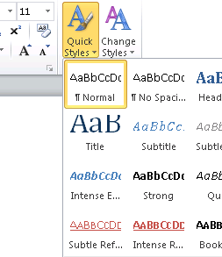
CSS Is A Separate Layer
CSS controls appearance.
color
font
spacing
readable line length
visual consistency
HTML still controls structure and meaning.
This Photo by Unknown Author is licensed under CC BY-SA
Notes:
**Instructor notes:**
Tie directly to reading: CSS styles HTML; it does not replace HTML.
Say "separate layer" more than once.
Avoid going into the cascade deeply today.
**Transition cue:**
"So, what counts as success for our first day with CSS?"

Slide 9
What Counts as Success Today
one stylesheet is connected
one rule visibly changes the page
you can name the selector
you can name one property and value
the page remains readable
Notes:
**Instructor notes:**
Keep this intentionally smaller than the full Assignment 2 endpoint.
Reinforce that attractive design comes after the connection works.
Make "visible change" the first confidence target.
**Transition cue:**
"Here are the tools we need for that first visible change."

Slide 10
What We Will Use Today
`styles.css`
stylesheet link
selector
property
value
save and refresh
Notes:
**Instructor notes:**
This is the active set for Monday.
Students may have read about many more properties; keep the working set narrow.
Avoid class/id depth here; introduce recognition later.
**Transition cue:**
"A few useful tools are parked because they solve problems we are not working on yet."

Slide 11
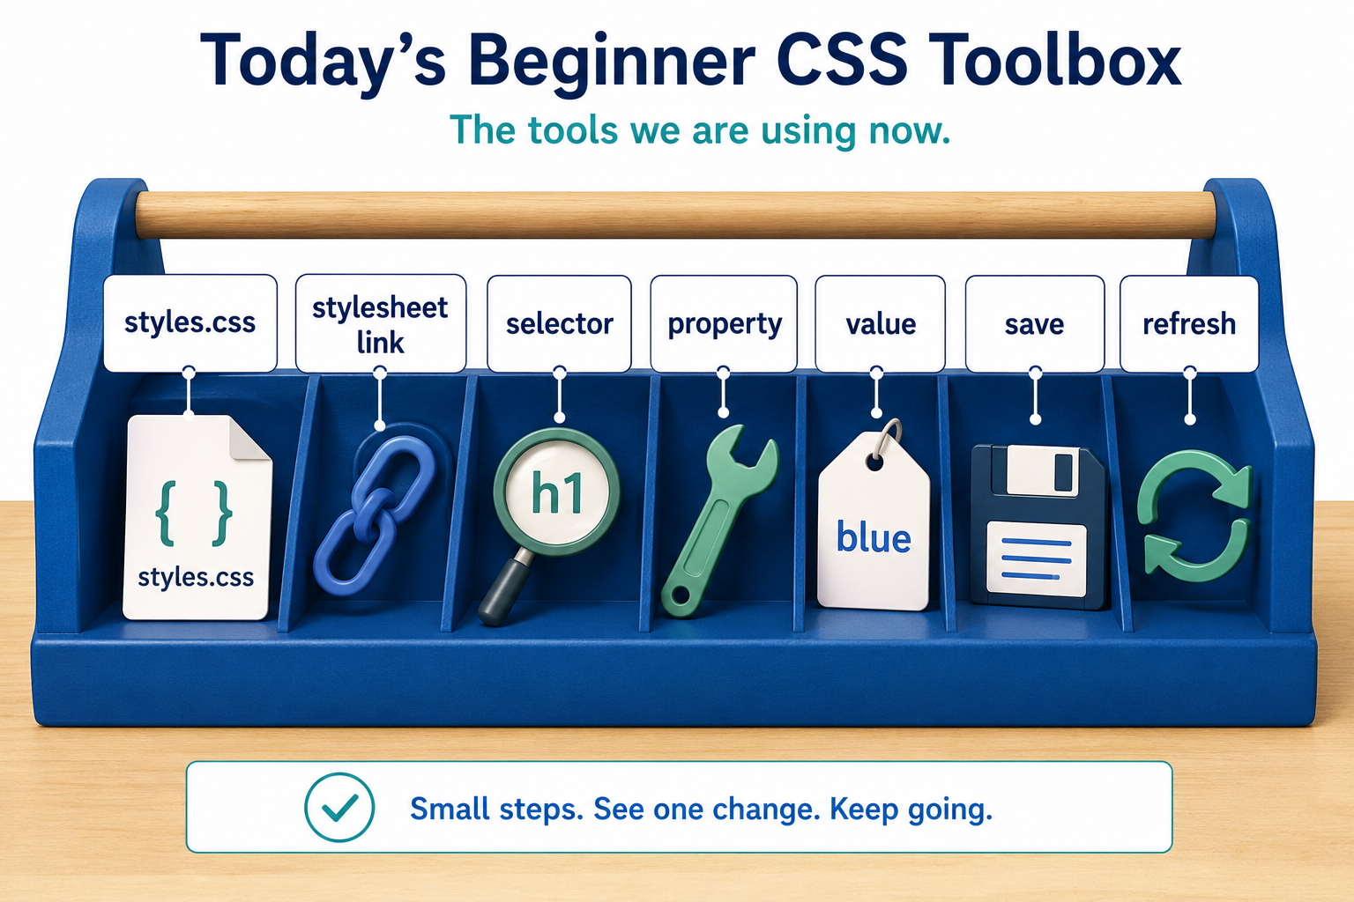
Toolbox

Slide 12
What We Will “Skip” For Now
full layout systems
Flexbox
media queries
animation
JavaScript behavior
Today: connect CSS and make readable changes.
Notes:
**Instructor notes:**
Use this to reduce overload from the textbook and the web.
Clarify that Flexbox and responsive design are coming soon, but not today.
If time is tight, this can be compressed verbally.
**Transition cue:**
"Now we can look at the smallest useful CSS unit: a rule."

Slide 13
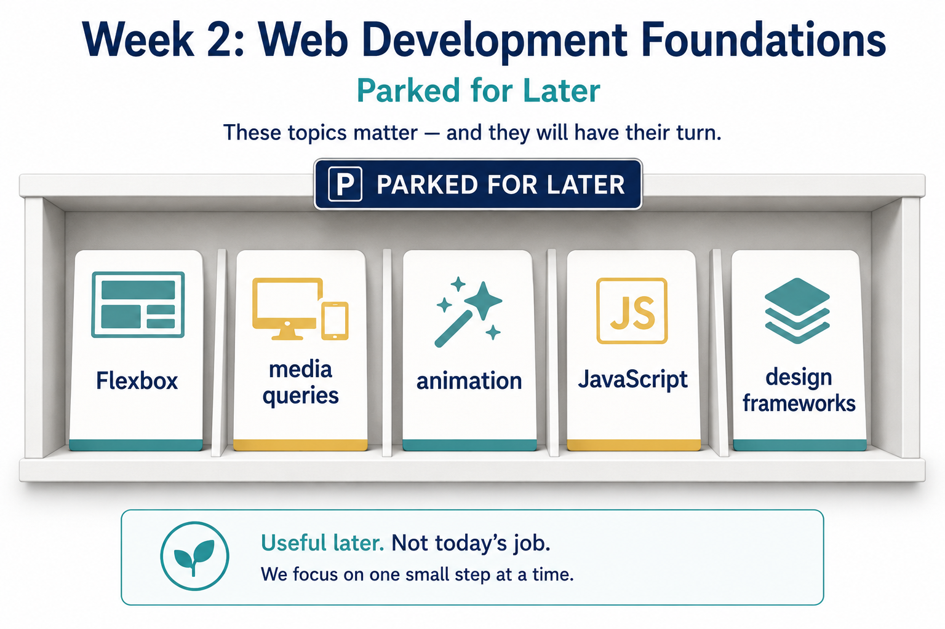
Parked For Later

Slide 14
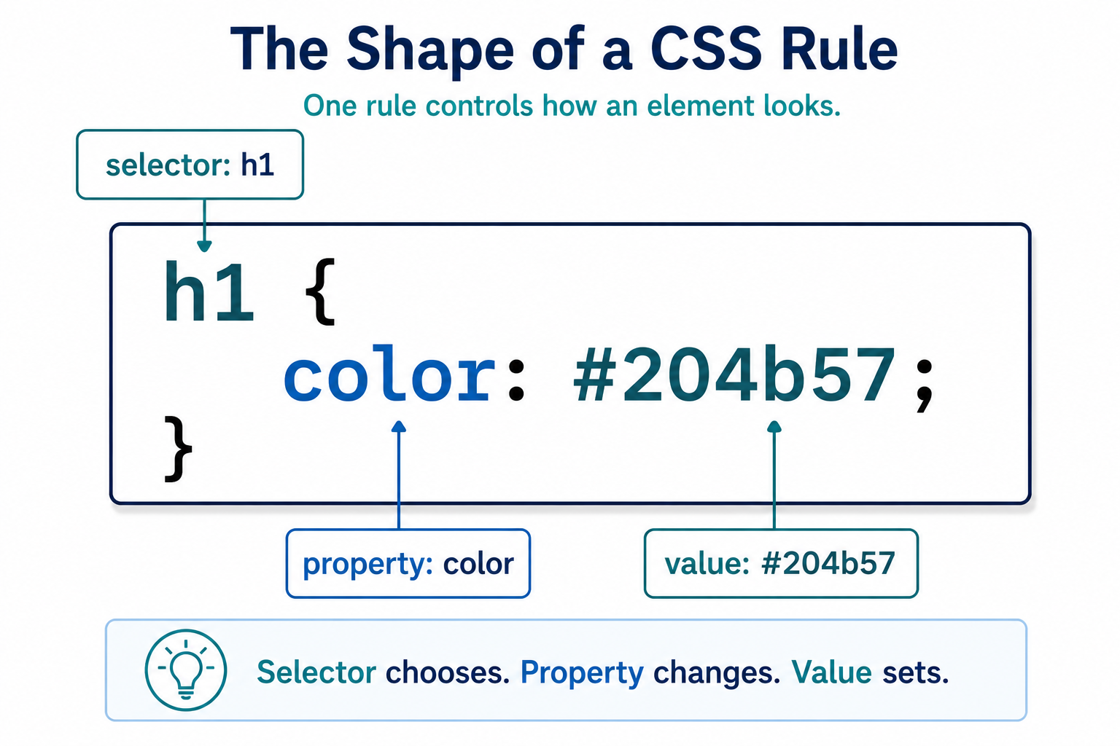
A CSS Rule Has Parts
Notes:
**Instructor notes:**
Explain selector as "what to style."
Explain property as "what part of appearance changes."
Explain value as "the chosen setting."
Do not teach every selector type today.
**Transition cue:**
"The rule can only work if the HTML page knows where the stylesheet is."

Slide 15
External Stylesheet Connection
The HTML page must link to the CSS file.
In `head`:
<link rel="stylesheet" href="styles.css">
If the link is wrong, the CSS rules are ignored.
Notes:
**Instructor notes:**
Show that the link belongs in `head`, not `body`.
Connect to Week 1 exact-file-name habit.
Mention that `href` must match the CSS file name.
**Transition cue:**
- "Let's build the first stylesheet and prove the connection."

Slide 16
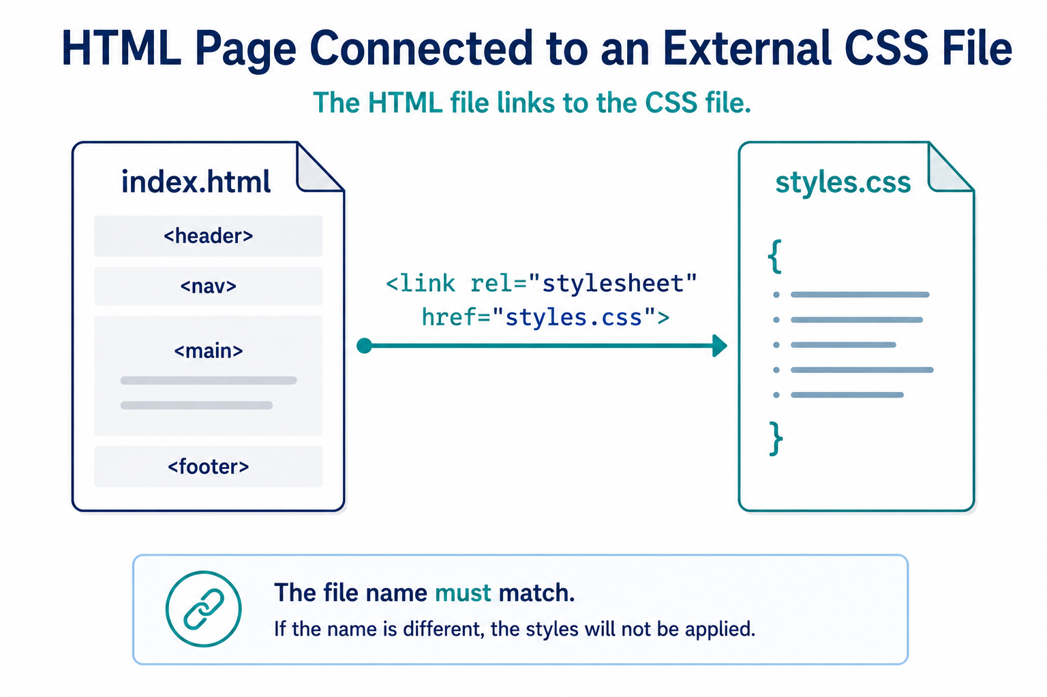
External Stylesheet Connection

Slide 17

Demo
“First Styles”

Slide 18

What to Watch For
stylesheet link
first visible change
one selector at a time
save and refresh
HTML content staying the same
Notes:
**Instructor notes:**
Use `Demos/Week_02_CSS_Appearance/01_monday_first_styles/`.
Type the `link rel="stylesheet"` line if showing from scratch.
Type `body`, `h1`, `p`, and `a` rules in small steps.
Refresh after each meaningful change.
If useful, temporarily break the `href` file name to show no styles apply.
**Transition cue:**
"Now that the page looks different, let's name what actually changed.“
Demo connection:
- `Demos/Week_02_CSS_Appearance/01_monday_first_styles/index.html`
- `Demos/Week_02_CSS_Appearance/01_monday_first_styles/styles.css`

Slide 19
What Changed And What Did Not
CSS changed:
CSS did not change:
text color
background color
font
line length
line spacing
headings as headings
paragraphs as paragraphs
links as links
page meaning
Notes:
**Instructor notes:**
Reinforce separation of concerns.
Connect "appearance changed" to "meaning stayed stable."
This is the key conceptual payoff of the demo.
**Transition cue:**
"When CSS does not work, the problem is usually small and checkable."

Slide 20
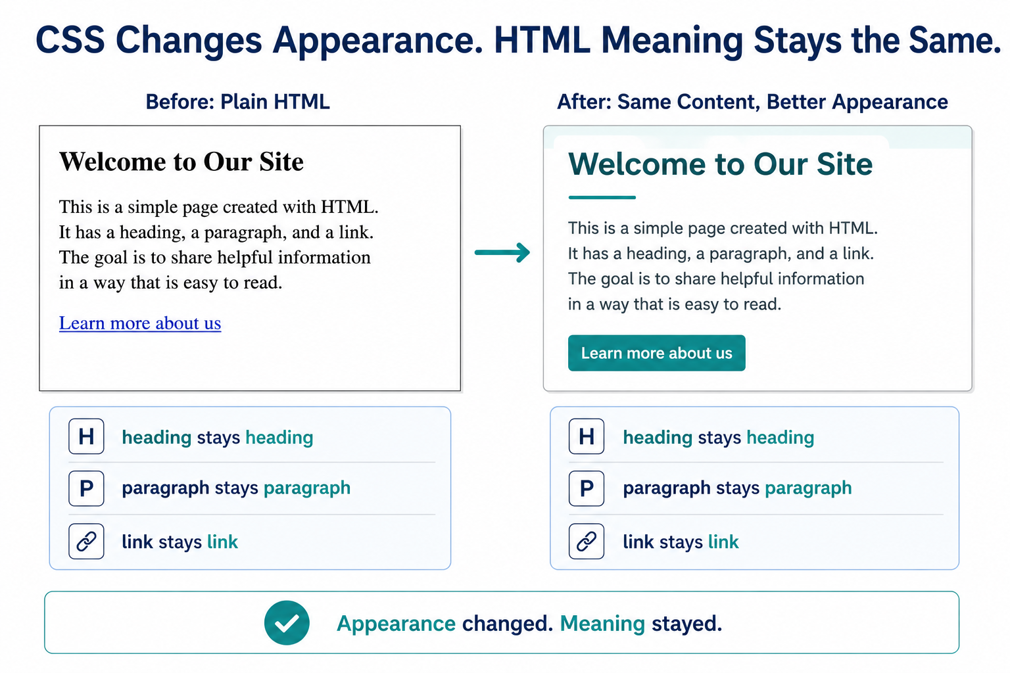
What Changed And What Did Not

Slide 21
Common Mistakes
stylesheet not linked
wrong file name
missing `{ }`
missing `:`
missing `;`
expecting unsaved changes to appear
➡️ “Check Connection First”
Notes:
**Instructor notes:**
Keep the tone normal and repair-oriented.
Tie file-name mismatch back to Week 1 link problems.
Do not turn this into a full debugging lecture; Week 6 handles deeper debugging.
**Transition cue:**
"Tuesday lab starts with this same first styling layer."

Slide 22
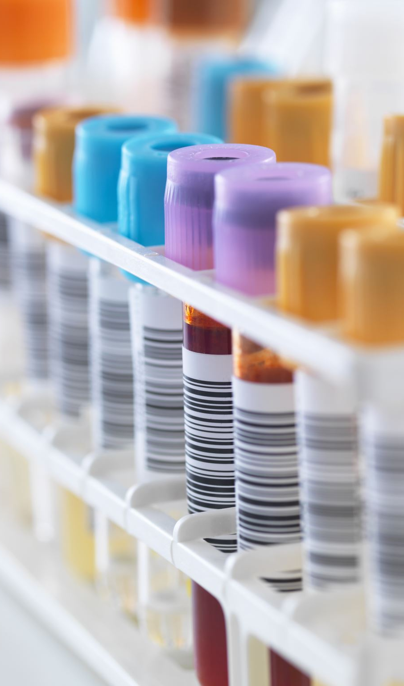
Lab
Add the first CSS layer.
create `styles.css`
link it to your site
style text, color, and spacing
keep the site readable
do not rebuild the HTML
Notes:
**Instructor notes:**
This is Assignment 2 Iteration 1.
Keep the endpoint scoped to first styling, not full visual consistency.
Students may style one page first, then continue linking across pages as lab time allows.
**Transition cue:**
"As you work, preserve evidence that the new layer is connected."

Slide 23
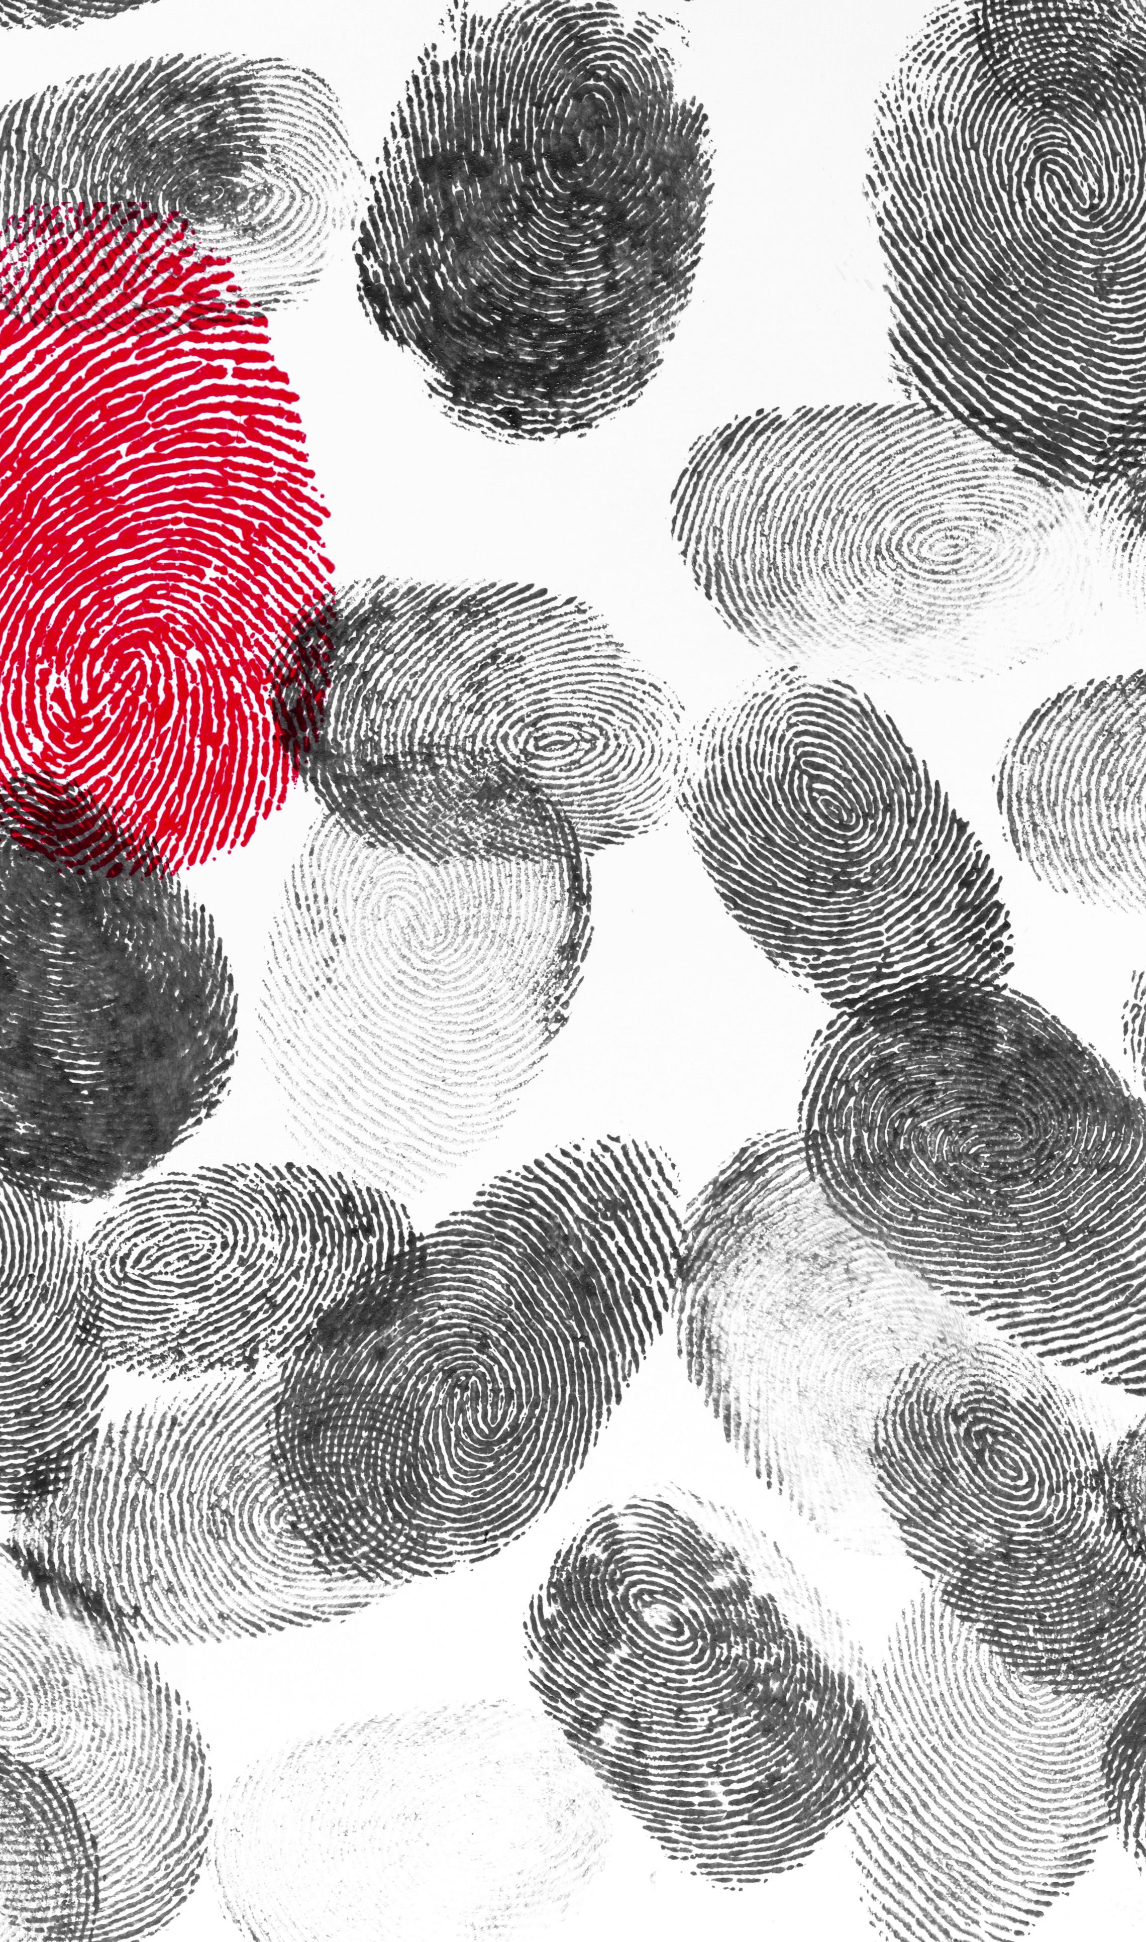
Evidence
Evidence for the Lab:
HTML files still open
`styles.css` exists
at least one page links to it
visible style changes appear
readability improves or stays clear
Notes:
**Instructor notes:**
Evidence is about connection and first visible changes.
Thursday/Wednesday will reinforce full consistency across pages.
Encourage students to notice what changed and why.
**Transition cue:**
"Today, a simple connected stylesheet is enough."

Slide 24

Closing Success Check
If CSS is linked, one rule visibly works, and the page is still readable, you are on track.
Style is a layer.
Structure stays underneath.

Slide 25
Thank you! Have Fun!

