Slide 1
AI Classification
“A Practical Use”

Slide 2

AI Interaction
Three General Classifications

Slide 3
Three “Main” Classifications of AI Use
A useful shorthand is:
AI Assistance — AI supports your thinking.
AI Enabled / Collaboration — AI works with you.
AI Embedded — Three Classifications of AI Use

Slide 4
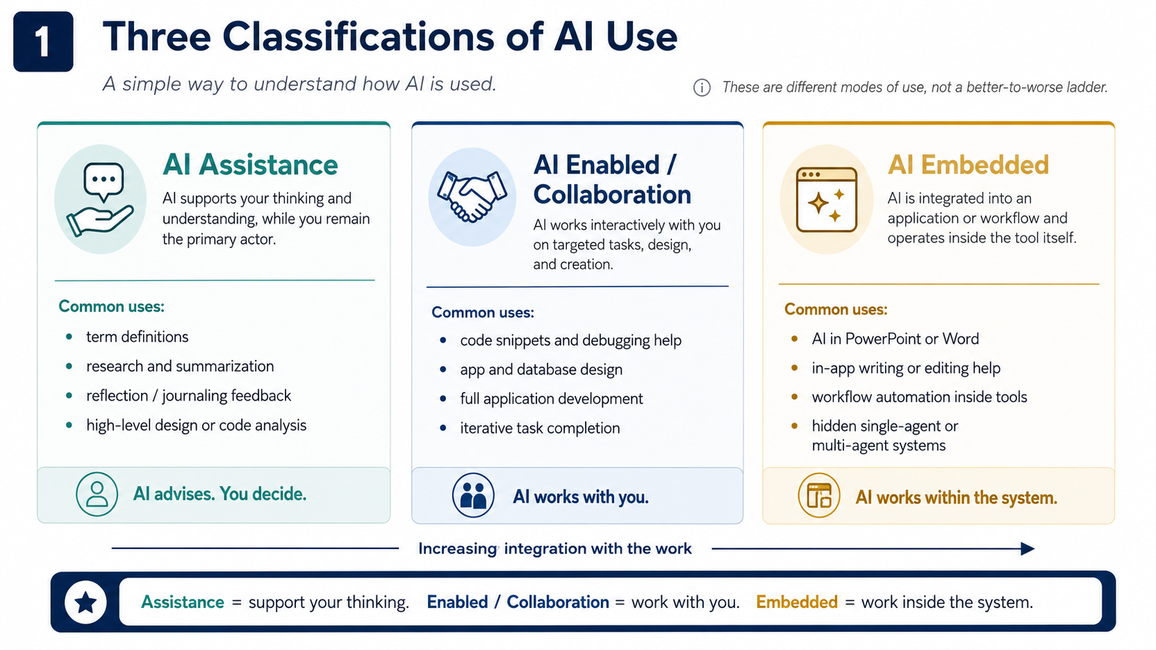

Slide 5
In Practice, the Boundaries Overlap
The three classifications are useful because they simplify Human–AI interaction into recognizable modes.
Reality is less tidy.
A single interaction or project may move between all three.

Slide 6
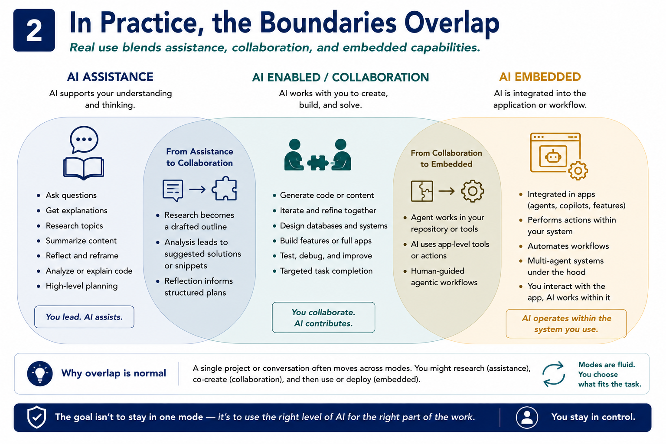
Really, They Overlap!

Slide 7
A “Fourth” Classification!
AI Creation/Development
Creating LLM’s (Large Language Models)
Creating CAG’s & RAG’s and Other types
This requires more in depth knowledge of:
Algorithmic processing
Neural Networks
Types of AI models:
Descriptive/Analytical
Predictive
Generative
Model Training and extensive Testing methodologies
Data Analytics/Science

Slide 8

AI Interaction
A Different Lens

Slide 9
Agency & Interaction
The overlap becomes easier to understand when the three classifications are examined using two independent dimensions.
The first is AI Agency / Operational Autonomy
The second is Application Integration.
These dimensions explain why two AI systems can belong to the same broad classification while behaving very differently.
The two dimensions create four useful regions…

Slide 10
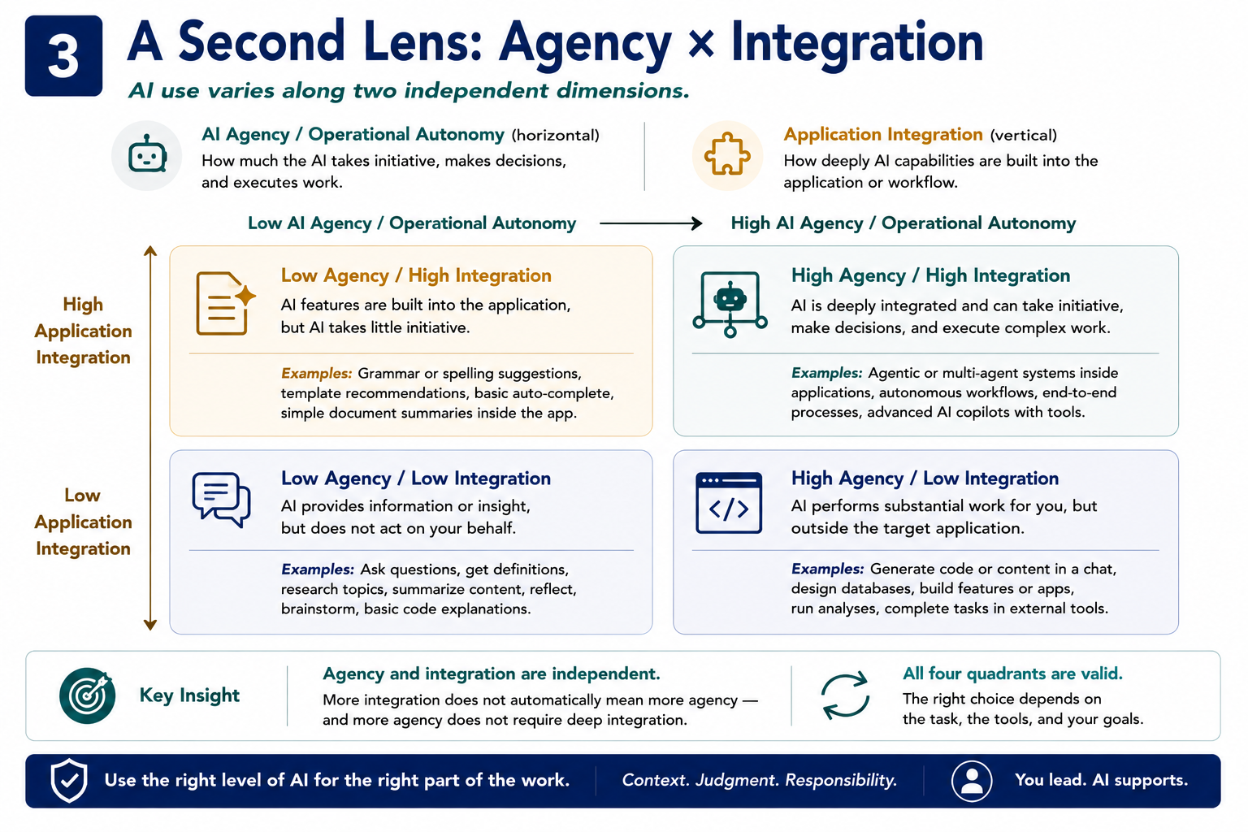
A&I Relationship

Slide 11

AI Interaction
Classification “combined with” Agency & Interaction

Slide 12

Where the Three Classifications Fit
The three classifications are therefore not isolated boxes.
They occupy recognizable but overlapping regions across the Agency × Integration dimensions.

Slide 13
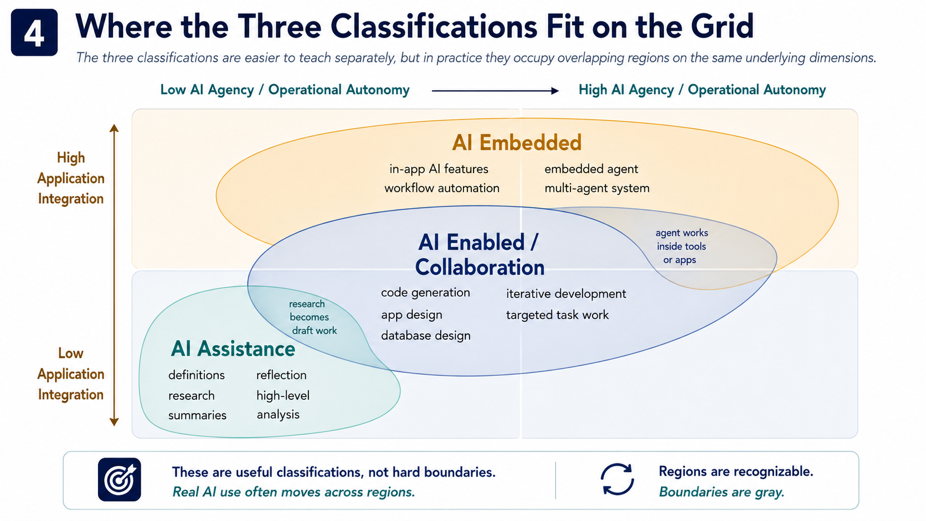

Slide 14

Conclusion
Artificial intelligence is not used in only one way.
Sometimes AI explains.
Sometimes it collaborates.
Sometimes it operates within the systems people use.
And increasingly, a single workflow may move among all three.
The three classifications provide an accessible starting point:
Assistance → Collaboration → Embedded
The Agency × Integration model reveals the deeper structure beneath them.
The important lesson is not to force every AI use case into one perfectly defined box.

Slide 15
Thank you!
Have Fun!

