Slide 1
While You’re Waiting…
Consider the following questions.
Why do some students lack the social skills needed to interact appropriately with others in the school setting?
Why do some kids, even after social skills instruction, fail to display desired behaviors?
When you think of a student in your class who lacks appropriate interaction behaviors, what skills in particular would you like to see him/her display?

Slide 2
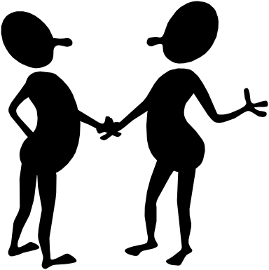
“Socially Skilled”: The ability to respond to social activities or environments in a manner that produces, maintains, & enhances positive interpersonal effects.
“Social Competence” OR “Social-Emotional Health” One’s overall social capability… the composite or multitude of desires & abilities that result in being “socially skilled”.
So… what makes you so socially able?
-Motivated to learn appropriate actions
-Perceive social situations accurately
-Able to identify the skills to use
-Able to adequately perform the necessary skills
-Sensitive to social feedback
-Can tweak behaviors to fit situational requirements
-Willing & able to emulate behaviors of others
-Able to generalize to appropriate situations .

Slide 3

“Social Skills Training”: The teaching of appropriate interaction skills.
  Direct instruction via planned lessons & spontaneous training in a “teachable moment”.
  Indirect via prompting, modeling, “descriptive praise”, & “ripple effect”.
Objective of SST: To help students develop the ability to relate well to others who share an activity and/or setting.

Slide 4

Fitting In
How comfortable would you feel at:
  Streetcorner gathering
  Black barbershop
  Traditional large-family Chinese New Year meal
  Knighthood induction ceremony
Cultural informants: What is needed for success in each of the above settings/events?
Might some of us become more socially skilled than others in the above situations. Why?
Might some of your students lack social skills for the school setting?
  Why? .
Notes:
My story of not fitting in at Knights of Malta induction ceremony (20 generations of welfare)
Cross arms activity.
Now imagine what we are asking our socially unskilled kids to do: We're expecting them to immediately change a behavior that is:
-indelibly etched into their brains
-feels "comfortable“
& has been "assigned" to them by others labeling them as type of person who "does that thing".
Kids who display “wrong” behaviors as interact with others will have long & arduous path to travel as work to change to "a better way".
Thank goodness they have a patient & supportive teacher like you. You'll focus on progress rather than perfection, seeing evidence of the new rather than vestiges of the old.

Slide 5
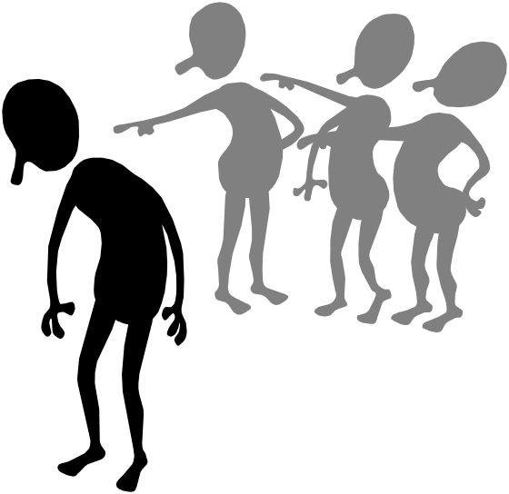
So… which groups of kids struggle the most with social challenges?
PDD: Aspergers & Autism
Mentally Retarded
BD
A major diagnostic criteria for these disabilities
The defining characteristic of BD
  3X more likely to be socially rejected than gen. ed. kids
  2X “ “ “ “ “ “ “ LD & MR kids
Low income (“disorganized” segment… labeled or not)
One’s social competence affects later life:
  Job security
  Love & social relationships
  Interactions with legal authorities.
Notes:
Won’t “grow out of it”. We need to intervene. Expand the definition of a school’s role.

Slide 6


The Usual Please
Anyone here teach social skills?
If so:
  How so?
  Which curriculum?
  With whom?
  How often?
If not: Why not?
Notes:
Oddly, and sadly most BD kids not taught social skills.
IEP mentions behavior goals, but try to meet by behavior mod and curriculum of control (points & penalties)

Slide 7

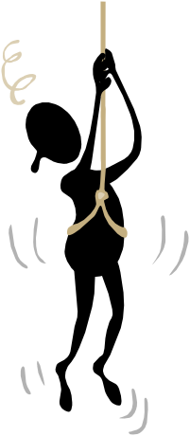
SESSION AGENDA
Overview
Different types of social skills
Why don’t our kids have them?
Why don’t kids show them after they’ve been taught?
Procedures for teaching S.S. to large & small groups
Cultural issues
Without a net: Teaching S.S. without $1000 curricula

Slide 8

Social Skills Training ^
Different Realms
  Survival: Form the basic foundation for acquisition of more advanced skills & those in other realms such as:
    Social interaction
    Appropriate classroom behavior, work habits, & academic survival skills. (see below)
  Interpersonal: Enhance chances of successful social interaction with persons of all ages & relationships.
  Problem solving: Thinking strategies to prevent social problems or escape social discomfort.
  Conflict resolution: Dealing with highly emotional situations, & resolving existing intrapersonal & interpersonal conflicts.
  Others are often listed, like “Interpersonal perspective taking”, “Feelings identification”, “Communication skills”, etc. However, we’ll address the first four.

Slide 9

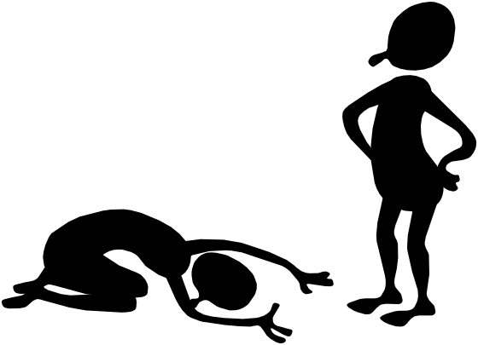
1. Survival Skills ^
What are the basic social skills? When in someone’s presence, …
  Acknowledge the other person
  Listen attentively & respond appropriately
  Conduct an accurate on-going self-evaluation of behavior
  Self reinforce for success
What are the basic appropriate classroom behavior, work habits, & academic survival skills? Able & willing to…
  Comply with directions
  Maintain attention to task
  Seek assistance, attention & answers appropriately
  Accept & learn from consequences related to actions.

Slide 10
Which skills would you work on developing in Gayle?
Video: The Friday spelling test.

Slide 11

2. Interpersonal Skills ^
To enhance the chances of social success & building of friendships, one must know how to…?
Share
Ask for permission
Join an activity
Contribute to discussions
Answer questions
Interrupt a busy person or conversation
Wait for one’s turn or authority figure’s attention
Begin/End a conversation
Give/Accept compliments.
Notes:
What did you teach your own toddlers, and other people’s kindergartners?

Slide 12
Which skills would you work on?
(and with whom?)
Video: Shelly & lunchtime in the classroom.

Slide 13
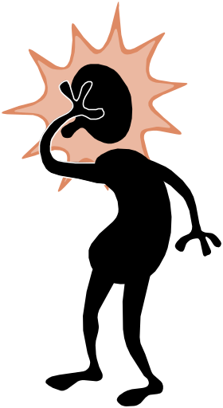

3. Conflict resolution (intra & interpersonal) ^
Includes social skills for dealing with life’s frustrations & threats. They include being able to deal with…
Being left out
Negative peer pressure. Others?
Teasing & taunting
Accusations
Anger directed at you by others
The urge or pressure to fight
Losing
Making mistakes (publicly & privately)
Fear
Anger .
Notes:
Think of the major concerns, fears, & pressures at different times of your childhood & youth.

Slide 14
Which skills would you work on?
(and with whom?)
Video: Craig during “down time” while waiting to be called to the assembly.

Slide 15
Problem Solving & Conflict Resolution ^
When one is involved in or facing a “problematic situation”, one needs to be able to…?
Ask for help
Apologize
Negotiate.
Understand & consider the feelings of others
Understand & manage one’s own feelings
Decide what to do & Make good choices
Go with “Plan B”
Respond to failure appropriately (accept it & learn from the experience)
Accept consequences (and learn from the experience)
Act assertively (not passive or aggressive)
Use “I (us & we) messages”. Click for 3 parts of I message

Slide 16

CLICKERS:
Which is the properly phrased “I message”?
(Eye brows through my lesson plan before each class)
“I get upset when you treat others badly.”
“I need for all of my students to be sitting criss-cross applesauce.”
“I’m unable to teach when you’re so noisy.”
“I’m disappointed to see that you’re out of your seat again.”
All of the above (numbered) statements are properly phrased “I messages”.

Slide 17
Select a negative “YOU Statement”. Imagine the situation in which it was said. Rephrase it. (Self or partners)
“Use your garbage mouth again & you’re headed to the office.”
“With your attitude, you’re gonna end up dead or on welfare.”
“You’ve got more excuses than any 12 people I know. You know, it’s not that you’re stupid. You’re just lazy.”
“You’re more trouble than you’re worth.”
“Why do you always yell out answers?
Can’t you raise your hand?”
“Why are you out of your seat again?
Are you hyperactive or rude?”
“If you’re not writing, you’re not earning points & can’t go.”
“Be careful Atlas! You’re going to drop it.”
BETTER YET: Recollect a “negative you message” heard (or said) recently. Rephrase it.
* Feel free to disapprove of the BEHAVIOR, but NOT the student’s CHARACTER. (“Symptom Estrangement” or “Descriptive Criticism”).

Slide 18

Why Don’t Kids Have Social Skills? (before instruction)
Never learned “appropriate behavior”
  Misread social cues given off by others (Neurological?)
    Don’t notice boredom or rejection by others
    View social forays of others as being threatening
  Lack of supervision & training by elders
  An alternative value & response system was taught
Know (cognitively) what they should do, but don’t have:
  Practice
  Self-management due to:
    Being overwhelmed by emotions
    Misinterpretation of situational cues.

Slide 19


Manners & Boundaries:
Civility, “Appropriate Behavior” &
Re-channeling of Negative Energies
Includes:
  Knowing oneself & one’s emotions
  Sizing up a situation quickly & responding within an acceptable conversational or interactional time frame
  Proficient reading of the signals of others
    facial expressions & body language
    voice (volume, intonation)
    contextual cues
  Having a practiced, easily accessed set of
    verbal skills (vocabulary, intonation)
    physical actions (hand extension, eye contact, smile).

Slide 20
Why Don’t Kids Have Social Skills? (after instruction)
Don’t view skills as being useful in their lives.
New actions don’t bring equal or better benefits.
Display of new behavior is awkwardly performed. Student is unsuccessful. Views initial failure of new strategies as harbinger of future failure.
Know what to do, but past interactions finds them objectionable to others. Due to the interpersonal history, they are quickly rejected or rarely given the chance to display their new skills.
Under stress, resorts to old patterns of reaction.
Notes:
(me H20 hole & “compliment & be self”)
(Screw you kid)

Slide 21
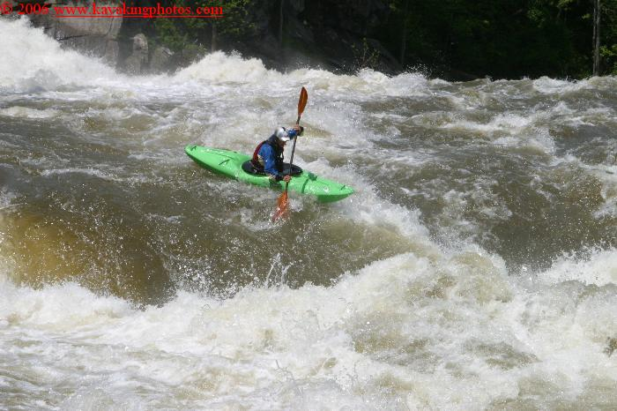
The Flume: Class IV section
(Bulls Bridge, Housatonic River, CT)

Slide 22

Types of Interpersonal Deficiencies ^
Skill deficit: Student cannot I.D. correct response for a social situation; actions are not in the student's behavior repertoire.
Performance deficit: Correct social response can be identified by the student when questioned, but is displayed only during the role play situations.
How do we respond to each?
Skill deficits usually respond to direct instruction.
Performance deficits usually require a guarantee that the new behavior will capture at least the same amount of benefits as the current behavioral response (& practice, practice, practice to make it default choice).

Slide 23
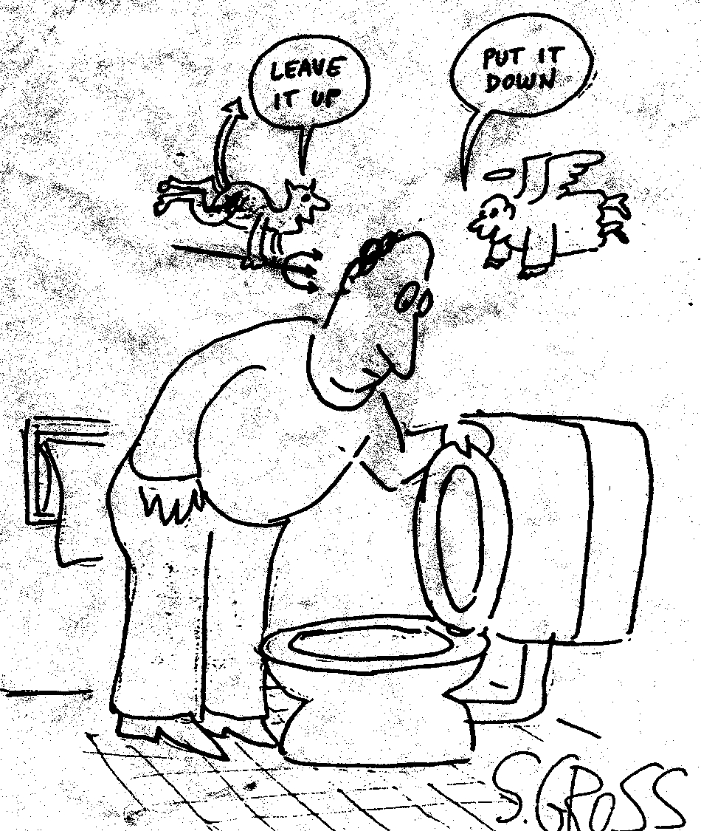
Skill Deficit or Performance Deficit?
Notes:
Performance deficit, but what factors are being considered?
Fairness: “I have to decide each time if the seat is in the correct position for what I plan to do. Why not her?”
Penalties: “I’m gonna hear it from her.”
Benefits: “Sweet revenge & funny when I hear a splash in the middle of the night and pretend I’m still asleep.”

Slide 24
Teaching as it was… & should be
Same ol’, Same ol’…
As with the teaching of academics, begin with the prerequisite skills & then move on to the more advanced ones.
Old School (Pre-NCLB & High stakes testing)
Your social skills curriculum will be comprised of realistic, meaningful lessons that teach what is next in line for students to learn (with regard to classroom decorum & social needs).
Notes:
(shaky voice) Yeah, sonny… I remember when…

Slide 25
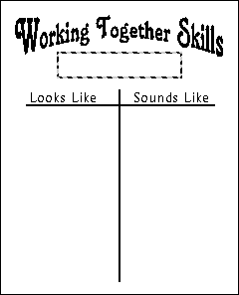

Teaching Social Skills: Whole Class ^
Hold a class-wide discussion on the need for “people skills”. Have students contribute which skills create a more productive & pleasant learning environment.
Select one social skill for the week.
With kids, operationalize the behaviors via a “T-chart”
        Click to enlarge
        Click for example (attentive listening)
Motivate as usual
  (posters, charts, point sheets, descriptive praise, etc.)
Ingrain the skill
  Practice immediately (e.g., Active listening & recognition of others practiced via round robin questioning session)
  Give a daily mini-lesson everyday (or review periodically during left-over instructional time
  Recognize youngsters for displays & approximations
http://home.att.net/~clnetwork/socialsk.htm for more detail on teaching the whole class

Slide 26
Teaching to Small Groups ^
SELECT target students via assessment (Teach all the kids in a self-contained BD class).
Identify reinforcers that MOTIVATE.
Identify & define the TARGET behaviors.
TASK ANALYZE the target behavior. (if not already done by a packaged program)
TEACH.
**We’ll do it all during a later activity**

Slide 27
Teaching social skills
Video: Teaching social skills to a small group.
NEA video of man with BD kids (3rd or 4th sequence)
Notes:
NEA video of man with BD kids (3rd or 4th sequence)

Slide 28

Jerry-Riggs & MacGyvers ^
Follow the suggested guidelines as best you can, modifying and improvising as necessary.
Create groups of 1-5 students with similar skill needs
Choose easy-to-master skills 1st
Set up rules & procedures
Collect data
Teach to high-status kids 1st
Conduct sessions early in the morning
Make the lessons fun
Make lessons pertinent to their lives
  How would you modify any of the following recommended skills to be more applicable to the lives of certain youngsters? (Next slide)
Notes:
Why 1-5? All get a chance to observe others & all get a chance to model and practice skills.
Why E-Z ones first? For kid’s reinforcement/motivation (and yours).
What rules/procedures will you reinforce? One person speaks at a time, attention to others, being respectful & supportive (all of which might have to be taught in preparation).
Which rules & procedures?
Why & how teach to high-status kids 1st? Leaders will be followed. Have them explain benefits of behavior, when use it, & demo the behavior 1st (and receive reinforcement).
Why conduct sessions early in the morning? Kids are alert & have all day to practice the skill.
How make lessons fun? Following directions taught via candy making, magic tricks, & assembly of interesting items. Race: 14 steps on board…1st says read all directions before starting. Last says do only step 6 & 7 (write name on paper & raise hand to show when done). Others say stand up next to desk, flap wings and honk like goose. Write “I need to follow directions.” on the board.
What modification would you make for age, culture, & other aspects of life?
Why collect data? For IEP criteria, to motivate youngster to set higher goals, to promote inner control over the new behavior (via self-monitoring).

Slide 29
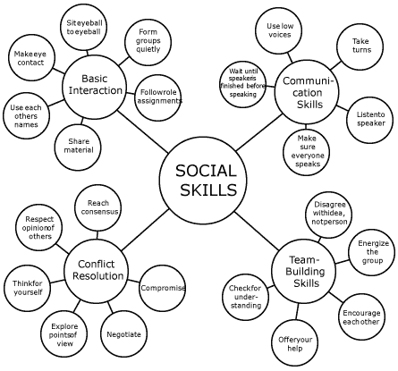
Take a minute to review these behaviors. Might some of the preferred actions ever be contra-indicated with certain kids?
From Kay Burke http://www.phschool.com/eteach/professional_development/teaching_the_social_skills/essay.html
Notes:
Sit Eyeball 2 eyeball – males look at common object
Wait till speaker finished – Hawaiian versus 1st peoples
Take turns – authority always get turn when speaks (even if other kid in authority)
Low Voices – AA show belief with emotion

Slide 30
The American Way?
If a student displays actions appropriate in his/her cultural group, but “incorrect” in mainstream North American culture (e.g., lowering one's eyes when spoken to by an adult, physically fighting when mother's honor is insulted by another), is it appropriate to teach the "right ways" preferred in the schools (and found in social skills kits)?
When, how & why would you do so?
Notes:
Teach better ways to handle “Ya mama.”?

Slide 31
When does differentiation of behaviors for different situations & settings trump “generalization” to other settings?
“Streetcorner kids”. Why?
Traditional cultural differences are present in the home... Differences in “correct behavior” such as?
  Eye contact
  Body spacing & touch conformities
  Gender constrictions on body spacing & touch
  Conversational pauses
  How one responds to directions one does not wish to follow.
Notes:
Orthodox Jew & Moslem women & handshakes
Hawaiian versus 1st people’s pauses.

Slide 32
Be Like Me
Often, packaged social skills programs promote social actions that, while esteemed by adults, would never be shown by any socially accepted kids in the mainstream (or student’s social group).
In that case, becoming skilled in the new behavior does little to promote acceptance & positive interactions in most of the youngster’s lifespace.

Slide 33
The Typical Social Skills Lesson (desired outcome)
Situation: Victor shows his yellow lunch card to the cashier. Joe, standing behind him with two other kids (from higher economic standing) taunts Victor saying “Hey Po’ Boy…Eating on my parents’ taxes again? How do you like the food I’m buying for you?” Joe’s friends chuckle.
Victor: “Please mind your own business.”
Joe: “Yeah, sure dirtball. You just go on over to your friends at the trailer trash table.”
Victor: “Joe, I don't appreciate the way you talk about me and my family.” (Victor walks away.)
Notes:
Essentially, put your tail between your legs and run away.
Teach “ready retorts” for recurrent theme insults & taunts.

Slide 34
Role Play #1
(to be followed by discussion).
Situation: Two teams are playing basketball. Time is running out & the score is close when Kip & Casey have a 2-on-1 fast break.
The sole defender goes out to guard Kip who pulls up to miss a long-distance jump shot from beyond the 3-point circle. Casey is furious because he was wide open under the basket hoping for the ball.
Casey: Yo' Punk! W’sup with not passing the ball to me under the net? Open yo’ eyes, sleepy.”
Kip: Man, my blindfolded hook beats yo’ best lay up.
Casey: I ain’t seein’ all dat today. Yo’ “J” is broke.
Kip: Man, you be gettin’ used like soap by yo’ man the whole game. Don’t be talking no trash to me ‘til you get yo’ game on, Bubbles.
Casey: Your mama throws better when she’s workin’ the pole, J man.
Kip: Oh…playin’ house, huh? N----er, yo’ mama score more times today than you. She better at lay downs than yo’ lay ups. (Casey moves aggressively toward Kip who says “Bring it on soapy.”).
Notes:
Voice over

Slide 35
Role Play #2 (to be followed by discussion)
Casey: Hey, Kip. I was open under the hoop. Pass the ball, man. (Respectful with suggestion. Disagreement is with the problem, not the person.)
Kip: Alright, man. I'll get you next time. I thought I could hit it or you’d get the rebound. (Has opportunity to respond with reason)
Casey: Let's just get the ball back, Bro. (Focus on solution & keeping the bond)
Outcome: They play hard. Kip gets a rebound and passes “the rock” down-court to Casey who scores on a break-away lay-up.
Notes:
Gives an acceptable alternative to a common response pattern.

Slide 36
Micro-Cultures: Teaching “Tough” Kids^
Joke & laugh about the new behaviors in order to…?
  Address & defuse the issues up front (& again later)
Switch to serious tone to talk about their importance.
  Why would “resistant” kids want to use the new actions if they’re contra-indicated in their milieu?
  What are the benefits outside of their present life- space?
  Job interviews, disciplinary meetings, police stops, meeting new people outside of group, etc.
We must also engage in “character education” in order to avoid…?
creating better manipulators.

Slide 37
From Talk to Action…
During the rest of today’s session, we’ll be putting this information into practice… Remembering that each lesson or experience should be processed & evaluated in 2 ways:
  How well was the behavior displayed? (Social skills)
  What has been learned from the experiences? (Cognitive skills)
In other words…Students report on what they have learned from a role play or real-life attempt as well as their progress in displaying appropriate social skills via the 5 W & HA! example (click here).

Slide 38
Select Target Students ^
Student’s Self Assessment
  1st step - Students complete (by self or in conference)
  “Teaching Social Skills: Student Self-Report Form” (elem.)
  OR “How Are My Social Skills Checklist” (adolescent)
  (Pages 1 - 4 in your packet)
  2nd step – Use the information for…?
  - understanding of the student
  - determining accuracy of self perceptions
  - conversation starters to attempt to motivate active participation from the student.
  ?Any thoughts on the questions asked of the students?
  If you’re enrolled in an online staff development course, you can find a checklist at: http://www.4-h.uiuc.edu/opps/pyd_club/lp_careadult_socialskills.pdf

Slide 39
Teacher’s Assessment ^
  1st step – Complete the “Social Competence Screening Form” (SCSF) (To identify students in most need) (Page 5 in packet)
  2nd step – Complete the “Social Skills Matching Form”, circling the numbers of the students (from the SCSF) who need instruction in each of the 23 skills listed (or others you identify). (Pages 6-7 in packet)
  3rd step - Use info from the SSMF to form groups for each social skill unit.
Your Task: Complete the teacher forms.
  Take 10 minutes to do so.
  Tom is available to explain & assist.
If you’re enrolled in an online staff development course, you can find a checklist at: http://www.centraliowachildcare.org/healthconsulting/schoolagescreentoolkg.pdf

Slide 40

2. Identify reinforcers that will motivate participation. ^
Move Clifford along the wall toward Emily
Raffle tix
Group or individual points toward event or privilege (1-3 points for each 5 min. review of attention/participation)
Progressively open or close window blinds
Others that might work for your students?

Slide 41
3. Identify & define target behaviors. ^
Decide upon the most needed social behavior.
Define the behavior so precisely that everyone agrees as to which actions are to be demonstrated. Instead of “Student will be polite.”, identify the actions:
  Students will say “Thank you.” when someone does something nice for them or gives them something.
  Students will say “Excuse me.” when needing to interrupt conversations or concentration of others.
  Rather than uttering a directive when seeking assistance, students will make a request that includes the word “Please”.
Notes:
Ask them to define “standing” as prep for exercise.

Slide 42

Precision Definitions: Brainstorm with me
Asking permission:
“Student verbally requests the privilege of engaging in an action.”
Staying out of fights:
“Student walks away from verbal or physical aggression aimed at him/her.”
Showing Sports(wo)manship:
“Student…
  accepts referee’s call without comment.”
  abides by the rules & their intent.”
  congratulates an opponent at end of a contest.”

Slide 43
Your task: (5 minutes) ^
Go to your completed “Social Skills Matching Form”
By yourself or with your colleague(s)
  Decide which social skill is most important to teach
  Precisely define the behavior so that it is:
    specific to the setting and students of concern
    able to be identified as “displayed” or “not displayed” by anyone observing the youngster(s).
Be ready to offer your definition to our group (if selected randomly by Dr. Mac from the roster).

Slide 44

4. Task analyze the target behavior ^
Delineate the simple behaviors that comprise the complex “behaviorally defined” action. They might be displayed either:
  in sequential order
  at the same time as other sub-behaviors
Same time: “Listening”
  Face up with eyes on speaker
  Nose pointed toward speaker
  Lips closed except for ‘positive sounds (explained)
  Be able to paraphrase message & comment respectfully.
Notes:
Humorous story: Teacher reviewing “listening” sub-behaviors with small group. Showed picture of eyes and selected youth said “on speaker”. Then she showed side of head and chosen student said “head up”. Showed picture of nose and selected youngsters thought long and hard before saying “breathe softly”.

Slide 45
Sub-skills in Sequential Order:
“Respecting the Opinion of Others” ^
Offer an empathy statement:
  “I know that you feel that way, but…”
  “I can see how you might think that way, however…”
Give an assertive (not hostile) statement of feelings: (If applicable)
  “this really gets my goat.”
  “it’s frustration to have my views distorted.”
Disagree on subject without attacking speaker:
  “I view it differently, because…”
  “The way I see it, the truth is that…” .

Slide 46
Another One in Sequential Order
“Following directions”
  Listen carefully to the direction
  Restate the direction (out loud or to self)
  If confused, ask for clarification
  Attempt to accomplish the task
  Ask for assistance if needed.

Slide 47
Your Task (5 minutes): Use T.A. to “Break Down” the complex, multi-step behavior ^
Task analyze the behavior that you selected as being the most needed.
OR Select “Greeting others”
  Familiar (family & friends)
  Unfamiliar
    Adult
    Peer
      Same gender
      Other gender
      Younger
      Older
OR Select a behavior from the “Social Skills Matching Form”.

Slide 48
5. TEACH ^
Plan out a unit for the teaching of the behavior. Do so as you would for a unit on academic material.
Would anyone like to share a couple of ideas of some parts of lessons that would be in their unit?
Examples of social skills units planned using today’s process can be found at: www.behavioradvisor.com/SocialSkills.html
Essentially, the steps to follow when teaching social skills are…

Slide 49
Tell ‘em: Introduce & discuss What’s in your intro? ^
  Observations on class behavior toward others
  Belief in ability to do better
  Overview of program
  Why & how program will benefit them. How will it benefit them? ?
Show ‘em: Model the new behavior (perhaps with co-teacher) (YouTube “social skills training”).
Watch ‘em: Role play
Share with ‘em: Feedback
Send ‘em forth: (perhaps placed in situations where can use skill)
  Positive recognition for use (perhaps prompted at 1st)
  Homework assignments (5W & HA sheets)
  Surprise tests.
Bring ‘em back:
  Periodic review sessions
  Role play troublesome situations
  Set new goals .
Sequence #4 of NEA video (“connecting”) here. Male T with BD students.?
Notes:
What’s included in the introduction? Observations on class behavior, belief in ability to do better, overview of program, why & how benefit them.
Why & How will it benefit them? Return to general education, less disciplinary action, higher grades, preparation for future job, skill needed next year that they can master now, will help them when meet parents of someone they are dating, etc.
Positive recognition (Prompted): Pedro is going to be congratulated by the principal for being "Most improved student" with regard to behavior. As the principal approaches, the teacher whispers into Pedro's ear "Remember to wipe the booger off your finger before shaking hands with Mr. Yoon."
Wording for more socially advanced student: "What do we do with boogers before we shake hands?"
(The student must decide on correct course of action)

Slide 50
6. Follow-up ^
Monitor performance. Collect data for evaluation & decision- making purposes (Pages 12 -13 in your packet)
Teach new social skills while periodically revisiting old ones.
Work on “generalization”
(while observing the cautions we mentioned)...

Slide 51
Poof! ^
Biggest problem in social skills training is getting behaviors to:
  endure longer than end of the training session, &
  transfer to other settings.
What factors would hinder generalization?
  Lack of cues & prompts in new setting
  Different cues being present (not practiced before)
  Skills we taught are not promoted in new setting
  Lack of opportunity to display the new behavior
  Lack of reinforcement for display in new setting.

Slide 52

Transfer Training: How do we promote Generalization? ^
Practice throughout the day
    different settings
    under varied conditions
Prompt & coach in naturally occurring situations
Unannounced tests involving other staff & students
Self-report forms (click) after each event, period, or day.
Periodic meetings to access progress & success.

Slide 53
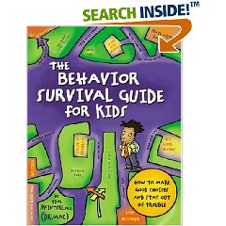
Published Curricula & More ^
(Goldstein & McGinnis) The Prepare Curriculum & Skillstreaming
    in early childhood
    the elementary school child
    the adolescent
(Boys Town Press) Basic social skills for youth
(Hill Walker) Walker Social Skills Curriculum – “Accepts”
“Model Me Kids” Video Training Series (click to go to sample)
Self-help books from:
  MaginationPress.com
  FreeSpirit.com (search for “social skills”)
    (McIntyre) The Behavior Survival Guide for Kids
    (+ lesson plans)

Slide 54
Complete the T-Chart for “Positively Recognizing The Attempts of Others” ^
Back to Steps slide By Laura Candler at http://home.att.net/~clnetwork/socialsk.htm

Slide 55
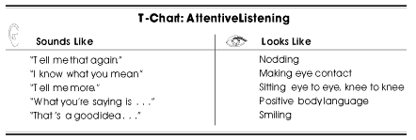
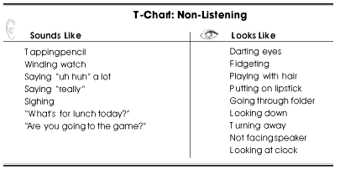
Operationalize the Behavior.
Make it “observable & measurable” ^
Brainstormed with kids.
Go to Blank
From Kay Burke http://www.phschool.com/eteach/professional_development/teaching_the_social_skills/essay.html

Slide 56
Return to the previous point
Name: Pablo Date: February 24, 20 - - ^
Skill: (Home work) Greeting adults & kids you don’t know
Steps to follow:
1. Look at the person’s eyes
2. Smile
3. Using a “happy to see you” voice, say “Hello.” or “Good morning.”
5. Extra: Compliment, Talk about weather, or Ask a question.
Goal: Each time that I make a polite greeting, I will record the “5Ws & HA!”
Who did I say it to?
What did I say?
When & Where did I say it?
Why did I greet them?
How did they respond?
Analysis? (How well did I perform the behavior? Does anything need changing? What did I learn? )

Slide 57
3 Parts of an “I message”
When (describe what happened without using “you”)
I feel (identify feelings)
I would like (make a request)
Show Intervention Central Video
Return to the rest of slide show

Slide 58
Extra Time
Criticizing a student’s performance…

Slide 59
C - Sandwiches: Emotional Health Food ^
“Eddie, you did a great job of remembering to put your backpack on your closet hook. Now your jacket has to be put away too. (Student says “Oh!”…and goes to the closet) I know we’re going to see your items on the hook from now on.”
Luis, I appreciate your help in keeping Rodney on task. However, prodding someone to finish so that you can copy his answers deprives you of true learning. From now on, I look forward to seeing you working hard on your own assignment in-between the reminders to Rod.
Pon
Notes:
We can better assure that our suggestions for improvement are heard if we place them between two statements that focus on progress or what was done correctly. Here are some examples.

Slide 60

Finding the Pony in the Pile of Manure~
“Jackson, I admire your generosity to friends. It’s a positive personal trait to want to provide them with the lunch that they forgot to bring.
That said, extorting money from others on their behalf detracts from that act of friendship. It can bring you trouble and keep others from seeing your friendship efforts positively.
However, let me reiterate: Your attempts to please friends is an admirable characteristic. So let’s discuss how to be both friendly and law-abiding.”
(Engage in Problem Solving) click

Slide 61
Clickers:
Which one is the properly phrased
“Criticism Sandwich”?
1. “You can be proud of remembering to capitalize the first word of each sentence, even if you forgot to use any punctuation. So what do we need to remember? Right. Don’t leave out those commas, periods, and question marks in the next draft.”
2. “You’ve added many more adjectives, creating a more interesting piece. Now let’s focus on adding more adverbs in the last rewrite. You’re getting the hang of adding details, and I’m anxious to read a final draft with even more detail.”
3. Both of the above items are examples of well-worded “criticism sandwiches”. Activ

Slide 62
This slide show was developed by:
Tom McIntyre
Coordinator of the graduate program in behavior disorders
Department of Special Education
Hunter College
New York, NY 1021
Thomas.mcintyre@hunter.cuny.edu
www.BehaviorAdvisor.com

Slide 63
To Do 4 Online
Reproduce the participant packet (PDF form?) for downloading with this Powerpoint show.

Slide 64


Click for flashdrive avi

