Slide 1


Slide 2




What is Svelte?
Svelte is a lightweight component-based
web framework developed by Rich Harris
in 2016.
Former front end developer creating interactive articles with The Guardian and the New York Times graphics team. He now works at Vercel as of 2021.

Slide 3
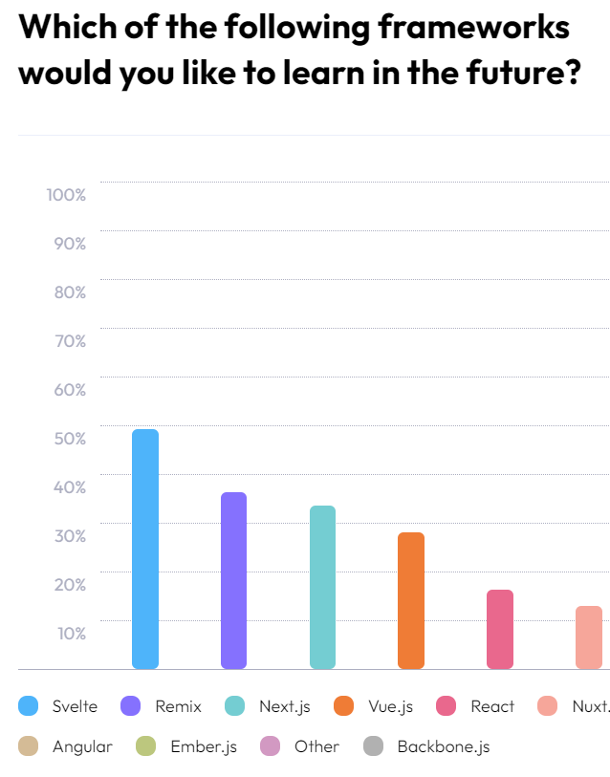
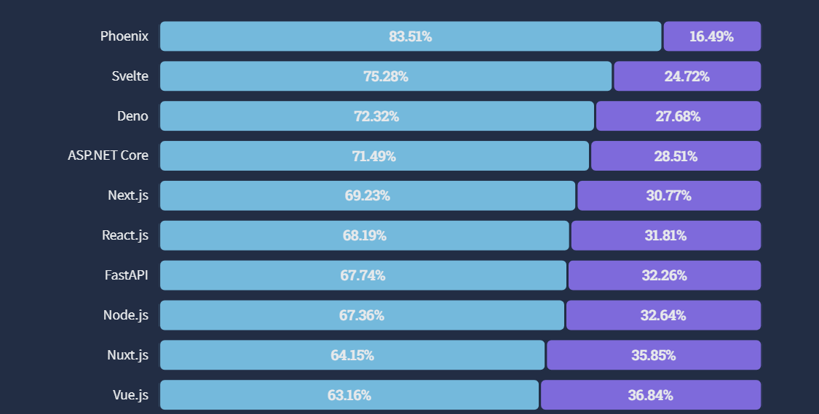
Why do people like it? (Svelte vs. React)
2nd Most Loved Web Framework in 2022 (StackOverflow)
State of Frontend Survey, 2022

Slide 4
Why do people like it? (Svelte vs. React)
Compiled framework
Small bundle size, optimized to be lightweight and fast (great for mobile)
Very easy to learn and get started
High popularity, growing community and support
Maintained by core developers and the community
Virtual DOM
Large bundle size, but intended to provide lots of features and capabilities
Somewhat easy to learn (hooks are weird)
Extremely popular, huge community and support
Maintained by Meta

Slide 5
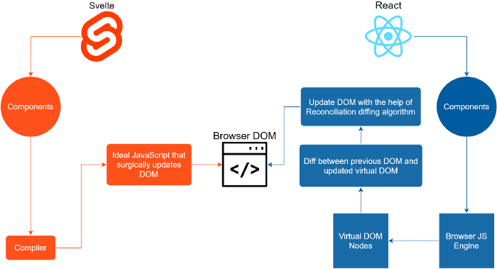
More Comparisons – Virtual vs. Real DOM

Slide 6

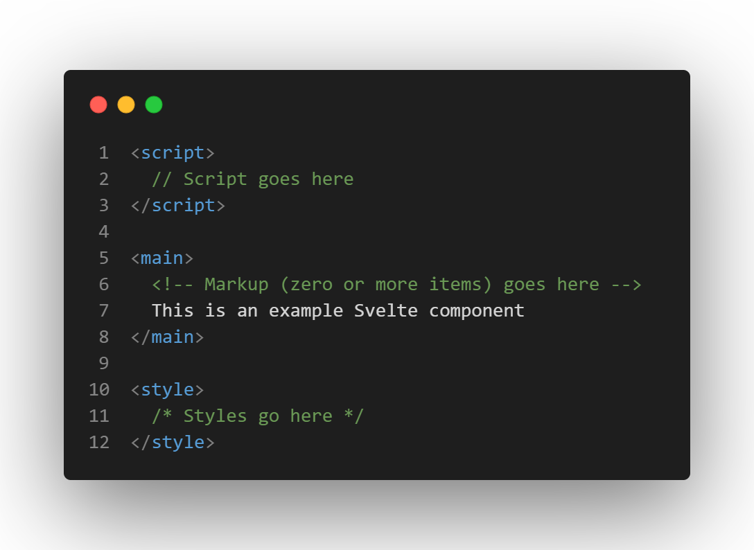
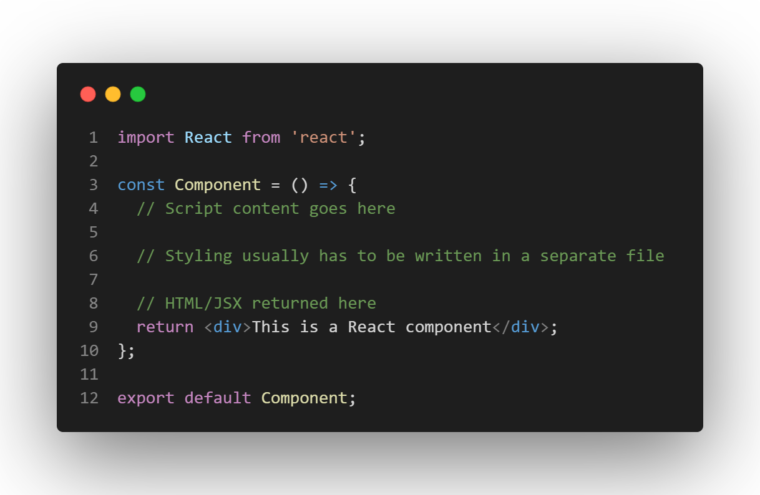
More Comparisons – Components
Looks more familiar, like a regular HTML file
.svelte
.js/ts/jsx/tsx

Slide 7

SvelteKit
Adds many features required in a modern web application:
Routing
Error handling
Data fetching
Production build optimization
Server-side rendering
Environment variables
SvelteKit is a “metaframework” built for Svelte, allowing you to create full-stack projects easily
(Similar to Next.js for React)
( SvelteKit v1.0 was released on December 14, 2022 )

Slide 8
SVELTE(KIT)
WALKTHROUGH
git clone <workshop-uri>
cd svelte-workshop

Slide 10

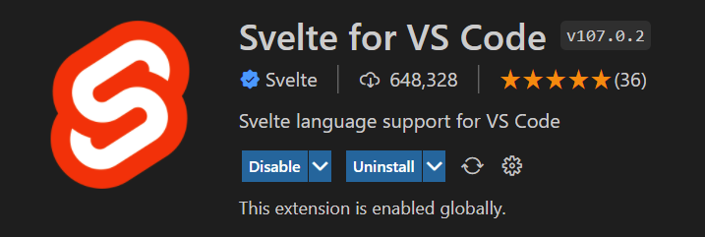
git checkout start
SvelteKit Project Creation
SvelteKit provides a creation tool through npm/pnpm
npm create svelte@latest <directory>
Install dependencies using
npm install
Start the “website” using
npm run dev
Official recommended editing environment
+

Slide 11
git reset --hard
git checkout step0 --force
The Basics
Svelte components consist of 3 sections: scripts, markup, and styles
Logic (JS) goes in the <script> tag
Use the let keyword to automatically create state
Styles (CSS) go in the <style> tag
Styles are scoped to the work only in the component
Markup (HTML) goes anywhere outside of these tags
Use brackets {} to include non-HTML

Slide 12
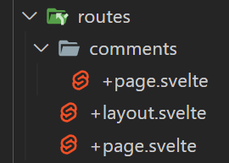


git reset --hard
git checkout step1
File Based Routing - Pages
example.com/comments
Tip: Global CSS can be imported in a +layout.svelte file (layouts explained in next step)
example.com/
+page.svelte

Slide 13
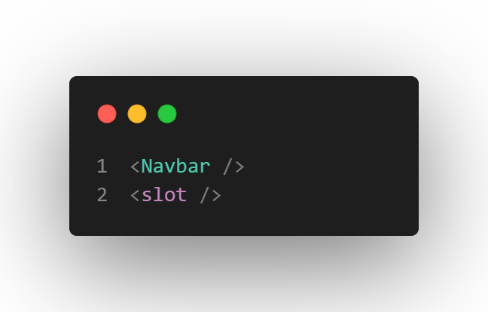
git reset --hard
git checkout step2
File Based Routing - Layouts
Any content you want to keep across different sub-routes
+layout.svelte
<Navbar> component will be shown on both / and /comments
Special <slot> tag, which displays the content of the other routes

Slide 14
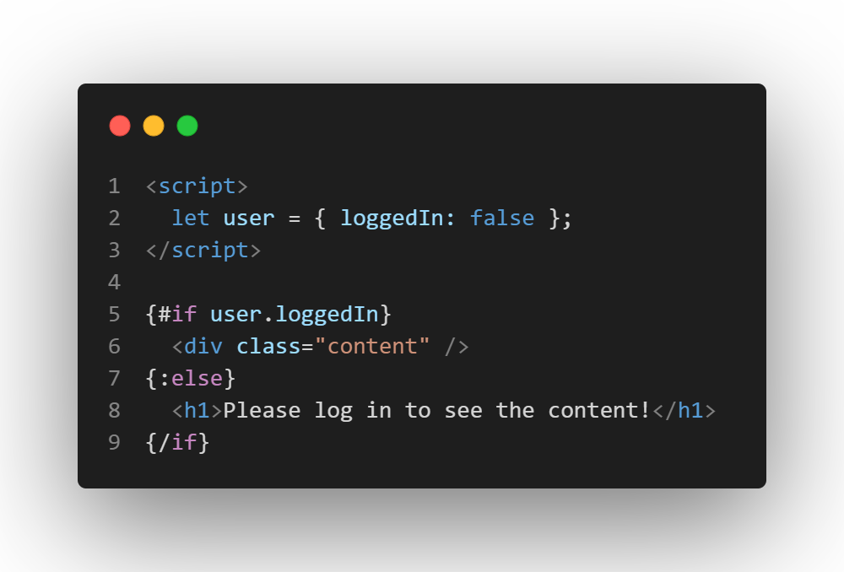
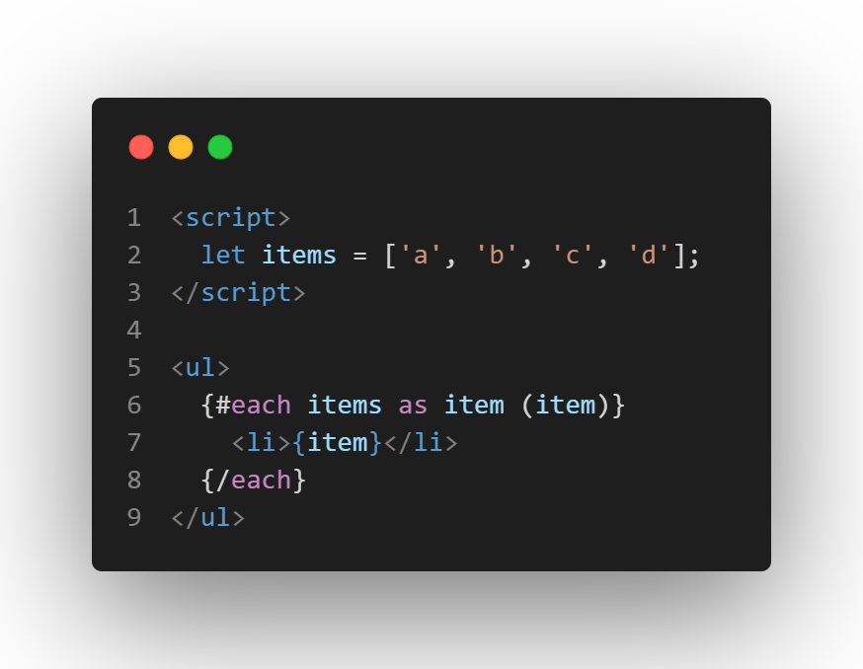
git reset --hard
git checkout step3
Loops and Conditional Rendering
If you want to show only some content depending on a condition, use an #if or (#if :else) block
If you have an array of items you want to display, use an #each block
Make sure to include a key

Slide 15
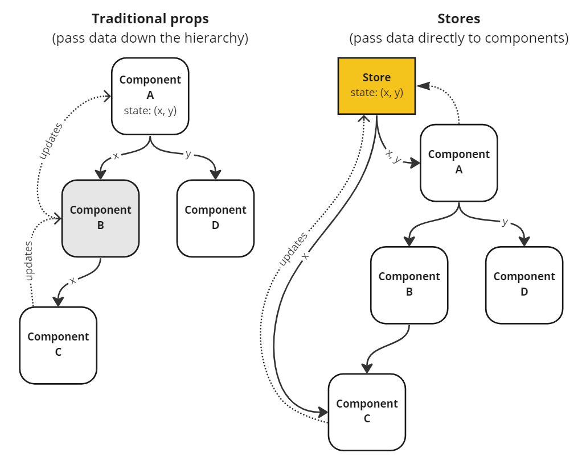
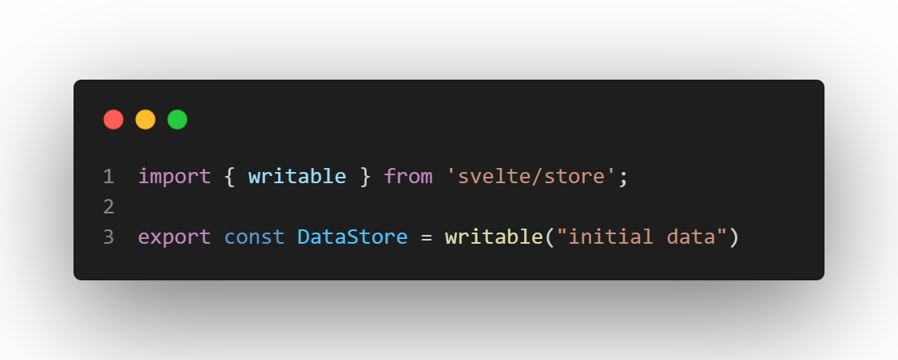
git reset --hard
git checkout step4
Import the store into your component and access it’s value with $StoreName
Writable Stores

Slide 16
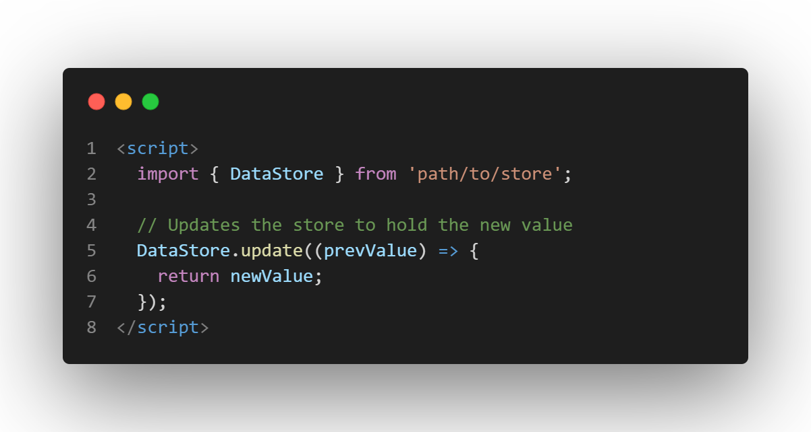
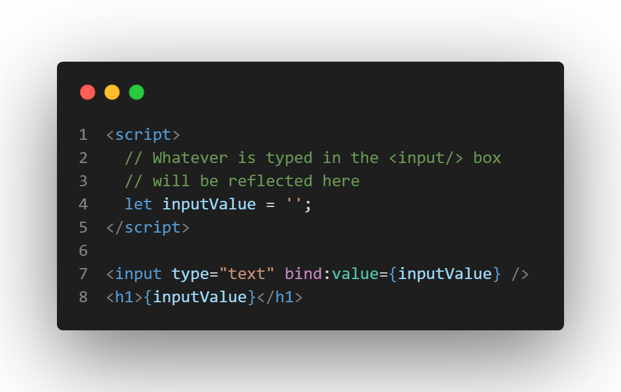
git reset --hard
git checkout step5
Updating Stores and Binding
To keep track of user input, use bind:value={someState}. The value will then be saved to your component’s state
To update a store’s value, simply import the store and call its update function!

Slide 17
git reset --hard
git checkout step6
Task
Add a “delete” button on each comment. When the button is clicked, remove that comment from the array of comments (comment should disappear).
Hint 1: You only need to modify Comment.svelte
Hint 2: Use the filter function on the comments array
To see solution:
git checkout step7

Slide 18
QUESTIONS?
git reset --hard
git checkout complete

