Slide 1
檔案處理及 SQLite 資料庫
簡報者

Slide 2
存取檔案
SQLite

Slide 3


App 可以存取的檔案來源
Cloud
Credential Locker
App
App
File Open/Save Picker APIs
Picker Provider apps
Publishers Shared Folder
檔案系統
背景傳輸
r/w
r/w
r/w
r/w
Temp
圖片 (Pictures) 影片 (Videos) 音樂 (Music)
- 需要在專案設定檔中指定存取權限
App data Folders
Roaming
App data Folders
App
常用目錄
Local
r/w
AppData 目錄
r/w
App 套件
r/w
可移除裝置 (SD Card)
r/o

Slide 4





App 套件目錄及 AppData 目錄
套件管理員會在安裝 app 時把 app 的內容放在 App 套件目錄裡
這個目錄下的內容是唯讀的
App 可以將資料儲存在 AppData 目錄
設定及屬性值會儲存在 app settings dictionary 中
資料以檔案的形式儲存
結構化資料使用資料庫儲存
App Package Folder
Package Manager
Creates root folder
sandboxed to App
Install
DB
Files (r/o)
App Data Folder
App
Creates/Manages
files and settings
WinRT Storage APIs
Local or Roaming
Settings File
DB
Application
Files
Database file

Slide 5
存取資料的方式
File Type/ API | 安裝目錄 | App data 目錄 | 範例
透過 URIs 使用 Windows.Storage API 存取檔案 | ms-appx:/// | ms-appdata:///local/ ms-appdata:///roaming/ ms-appdata:///temp/ | var file = await Windows.StorageFile.GetFileFromApplicationUriAsync( new Uri("ms-appdata:///local/AppConfig.xml"));
透過 StorageFolder 參考呼叫 Windows.Storage API | Windows. ApplicationModel.Package.Current. InstalledLocation | Windows.Storage. ApplicationData. Current .LocalFolder / .RoamingFolder / .TempFolder | var localFolder = Windows.Storage.ApplicationData.Current.LocalFolder; Windows.Storage.StorageFile storageFile = await localFolder.GetFileAsync("CaptainsLog.store");

Slide 6
資料儲存基本觀念

Slide 7
檔案寫入
This method will write text to a file
private async void writeTextToLocalStorageFile(string filename, string text) { StorageFolder fold = Windows.Storage.ApplicationData.Current.LocalFolder; StorageFile file = await fold.CreateFileAsync(filename, CreationCollisionOption.ReplaceExisting); await FileIO.WriteTextAsync(file, text); }
Sets the target folder
Sets action if file already exists

Slide 8
讀取檔案內容
This method will read contents of a file into a string
private async Task<string> readTextFromLocalStorage(string filename) { var fold = Windows.Storage.ApplicationData.Current.LocalFolder; StorageFile file = await fold.GetFileAsync(filename); string result = await FileIO.ReadTextAsync(file); return result; }

Slide 9
本地設定值
Windows.Storage.ApplicationDataContainer localSettings = Windows.Storage.ApplicationData.Current.LocalSettings;
// Create a simple setting localSettings.Values["exampleSetting"] = "Hello Windows"; // Read data from a simple setting if (localSettings.ContainsKey("exampleSetting")) { // Access data in value string data = localSettings.Values[ "exampleSetting" ].ToString(); } // Delete a simple setting localSettings.Values.Remove("exampleSetting"); // Composite setting Windows.Storage.ApplicationDataCompositeValue composite = new Windows.Storage.ApplicationDataCompositeValue(); composite["intVal"] = 1; composite["strVal"] = "string"; localSettings.Values["exampleCompositeSetting"] = composite;

Slide 10
漫遊設定及漫遊目錄
Roaming data enables an application to synchronise data and/or settings across different devices
Synced across all the users’ devices where the same app is installed
RoamingFolder and RoamingSettings are synced through the cloud
Limited to max 100KB for apps acquired from the consumer store

Slide 11
File Handling

Slide 12
同樣發佈者的 Apps 可以共享檔案內容及設定值

Slide 13
發行者的共享目錄
必須要有子目錄. 在 app manifest 中設定加入. 安裝 app 時會自動產生目錄.
<Package> <Extensions>
<Extension Category="windows.publisherCacheFolder"> <PublisherCacheFolder> <Folder Name="Folder1"> </PublisherCacheFolder> </Extension>
</Extensions> </Package>

Slide 14
存取發行者的共享目錄
存取 “fonts” 目錄
Windows.Storage.ApplicationData.Current .GetPublisherCacheFolder("fonts");
清除目錄資料
Windows.Storage.ApplicationData.Current .ClearPublisherCacheFolderAsync();

Slide 15
常用目錄

Slide 16
常用目錄
KnownFolders 是一組簡化開發人員在手機上存取用戶資料的 API
Rather than searching through all the possible different locations on the device for a particular type of file a program can request a single list of all the files
This includes files on the SD card (if inserted) along with files held on the device
有註冊存取權限的 app 都可以存取在 KnownFolders 以下的內容
或是使用 FileOpenPicker API 來讓使用者自行挑選這些目錄下的檔案來進行操作
No capabilities required as consent is implied

Slide 17
常用目錄
實體路徑
使用 KnowFolders API
Internal storage
KnownFolders.PicturesLibrary. GetFilesAsync()
C:\Users\Public\Pictures\Seattle\
C:\Users\Public\Pictures\Birthday\
StorageFile: Pic01.jpg
C:\Users\Public\Pictures\Pic01.jpg
StorageFile: Pic01.jpg
StorageFile: Pic02.jpg
SD Card (if present)
D:\Pictures\Portland\
D:\Pictures\Birthday\
D:\Pictures\Pic01.jpg
D:\Pictures\Pic02.jpg
D:\Pictures\Hawaii\Pic02.jpg

Slide 18
存取用戶資料
var pictures = await Windows.Storage.KnownFolders.PicturesLibrary.GetFilesAsync();
KnownFolders provides access to:
Pictures
Videos
Music

Slide 19
透過 KnownFolders 可以直接存取用戶資料 (不過要先在 app manifest 中宣告)

Slide 20
File Open/Save Pickers

Slide 21
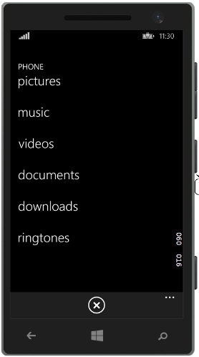
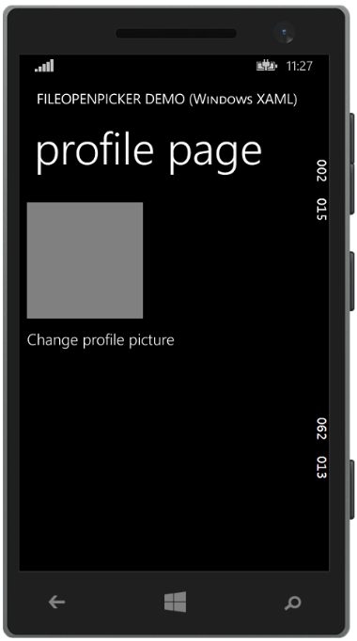
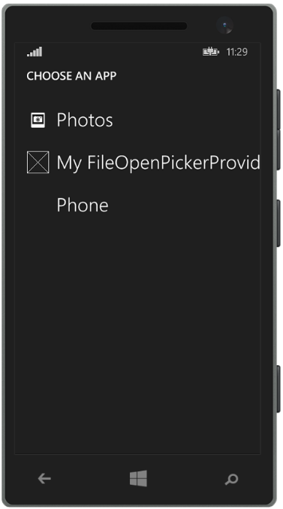
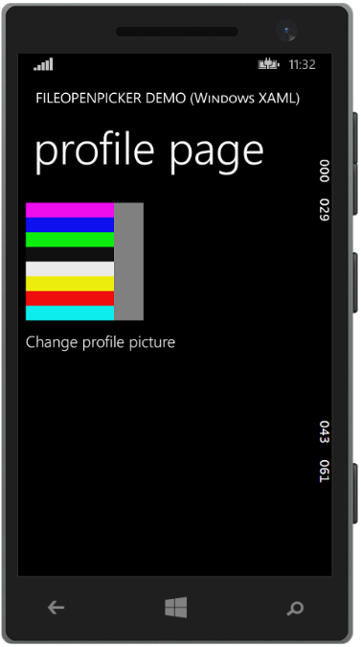
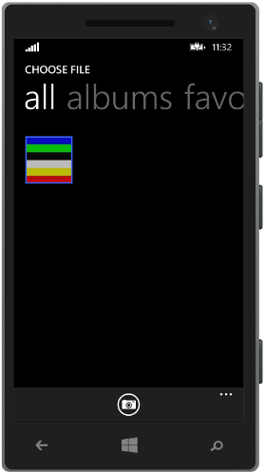

FileOpenPicker/FileSavePicker 操作畫面
Other apps…
您的 app
系統選擇 app 來處理檔案
Provider UI
Your app

Slide 22
使用 Picker
App 應該不必在乎處理的檔案儲存在什麼位置
Apps 可以存取各種類型的檔案
允許 app 存取不在 app data 目錄中的檔案
在不需要特別宣告的情況下，不透過 KnownFolders API 存取 Pictures Library, Videos Library，使用者在挑選檔案時就表示同意授權
存取的檔案可以在雲端或是在裝置上
同時支援讀取及寫入
不論檔案在雲端或裝置上都可以寫入
Update latest changes as required (handled by the provider)

Slide 23
讀取檔案
//Create the picker object FileOpenPicker openPicker = new FileOpenPicker(); openPicker.ViewMode = PickerViewMode.Thumbnail; openPicker.SuggestedStartLocation = PickerLocationId.PicturesLibrary; // Users expect to have a filtered view of their folders openPicker.FileTypeFilter.Add(".jpg"); openPicker.FileTypeFilter.Add(".png"); // Open the picker for the user to pick a file StorageFile file = await openPicker.PickSingleFileAsync(); if (file != null) { // Do something with the file... }
Note: The Windows Phone 8.1 PickSingleFileAndContinue() API has been deprecated (Yay!)

Slide 24
儲存檔案
//Create the picker object FileSavePicker savePicker = new FileSavePicker(); savePicker.SuggestedStartLocation = PickerLocationId.DocumentsLibrary; // Dropdown of file types the user can save the file as savePicker.FileTypeChoices.Add("Plain Text", new List<string>() { ".txt" }); // Default file name if the user does not type one in or select a file to replace savePicker.SuggestedFileName = "New Document"; // Open the picker for the user to select the target file StorageFile file = await openPicker.PickSaveFileAsync(); // Save the content to the file ...

Slide 25
使用 File Open/Save pickers
demo

Slide 26
File Picker Provider apps
您可以建立支援 Picker Provider apps
當使用者在 Picker UI 畫面時，除了檔案目錄之外可以選擇這類型 app
讓使用者可以透過不同的方式讀取或儲存檔案
範例: OneDrive app 就是一個 picker provider，它讓使者可以選擇讀取或儲存在 OneDrive 上的檔案
參考 MSDN 上的文件取得更多的訊息

Slide 27
File Pickers 讓使用者可以選擇存取檔案系統或是 File Picker Provider 上的檔案

Slide 28
AccessCache

Slide 29
什麼是 AccessCache?
假設一個 app 使用 File pickers 讀取或儲存了一個檔案…
如果用戶想要重新開啟上週編輯過的文件要怎麼做?
如果要再次打開相同的檔案，需要用戶透過 picker 選擇嗎?
我們需要一個新的方式來記錄用戶曾經處理過的檔案、目錄以及權限等資訊
這個需求可以透過 Windows.Storage.AccessCache.StorageApplicationPermissions 來完成

Slide 30
FutureAccessList 以及 MostRecentlyUsedList
所有 app 都會有 FutureAccessList 以及 MostRecentlyUsedList (MRU)
MRU 列表用來追蹤使用者經常開啟的檔案及目錄
上限 25 個項目，系統會自動管理，所以最舊的項目就會被移掉
FutureAccessList 列表用來追蹤可以儲存的目錄
上限 1000 個項目，但是並不是系統自動管理的，所以必須手動清除內容
如果檔案或目錄位置改變成了，FutureAccessList 會自動更新
當用戶開啟一個檔案，您應該把該檔案或目錄加入 MRU 以及 FutureAccessList

Slide 31
使用範例 – Saving in the AccessCache
// Open the picker for the user to pick a file StorageFile file = await openPicker.PickSingleFileAsync(); if (file != null) { // Save the picked file in the AccessCache // Add to MRU with metadata (For example, a string that represents the date) string mruToken = StorageApplicationPermissions.MostRecentlyUsedList.Add(file, "20120716"); // Add to FA without metadata string faToken = StorageApplicationPermissions.FutureAccessList.Add(file); } else { // The file picker was dismissed with no file selected to save }

Slide 32
從 Access Cache 中讀取
// get the token for the first item in our MRU // use it to retrieve a StorageFile for that file String mruFirstToken = StorageApplicationPermissions.MostRecentlyUsedList.Entries.First().Token; StorageFile retrievedFile = await StorageApplicationPermissions.MostRecentlyUsedList.GetFileAsync(mruFirstToken); ... // Retrieve tokens for all items in the MRU AccessListEntryView mruEntries = StorageApplicationPermissions.MostRecentlyUsedList.Entries; if (mruEntries.Count > 0) { foreach (AccessListEntry entry in mruEntries) { String mruToken = entry.Token; // Continue processing the MRU entry ... } }

Slide 33
SQLite

Slide 34
Why SQLite?
Worlds’ most popular database
Widely used on iOS, Android, Python, Mono etc…
Public Domain
Small, Fast, Reliable
Rich Features
Embedded SQL in-process database engine
Read/writes to ordinary disk files
Supports multiple tables, indices, triggers and views
Cross-platform – freely copy database files between 32-bit and 64-bit, or little endian and big endian
Reliable
Reputation for being very reliable
Large automated test suite
All transactions are ACID even if interrupted by system crashes or power failures

Slide 35
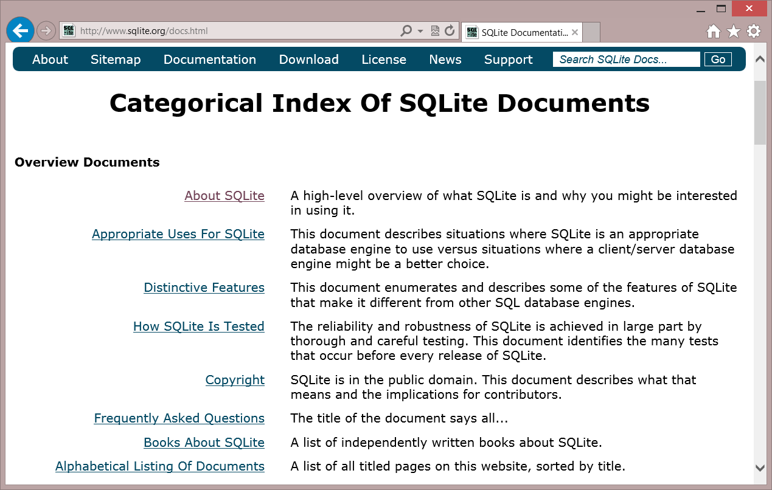
SQLite.org
Documentation
SQL Syntax
C/C++ API Reference
Source and tools download

Slide 36
Choice of .NET APIs
SQLitePCL SQL statements Thin wrapper around the SQLite C API
SQLite-NET
LINQ syntax Lightweight ORM
var db = new SQLite.SQLiteAsyncConnection(App.DBPath);
var _customer = await (from c in db.Table<Customer>() where c.Id == customerId select c).FirstOrDefaultAsync(); if (customer != null) { var Id = _customer.Id; var Name = _customer.Name; }
using (var conn = new SQLiteConnection("demo.db")) { Customer customer = null;
using (var statement = conn.Prepare( "SELECT Id, Name FROM Customer WHERE Id = ?"))
{
statement.Bind(1, customerId);
if (SQLiteResult.DONE == statement.Step()) {
customer = new Customer() {
Id = (long)statement[0],
Name = (string)statement[1] };
}
}
}
…and others!

Slide 37
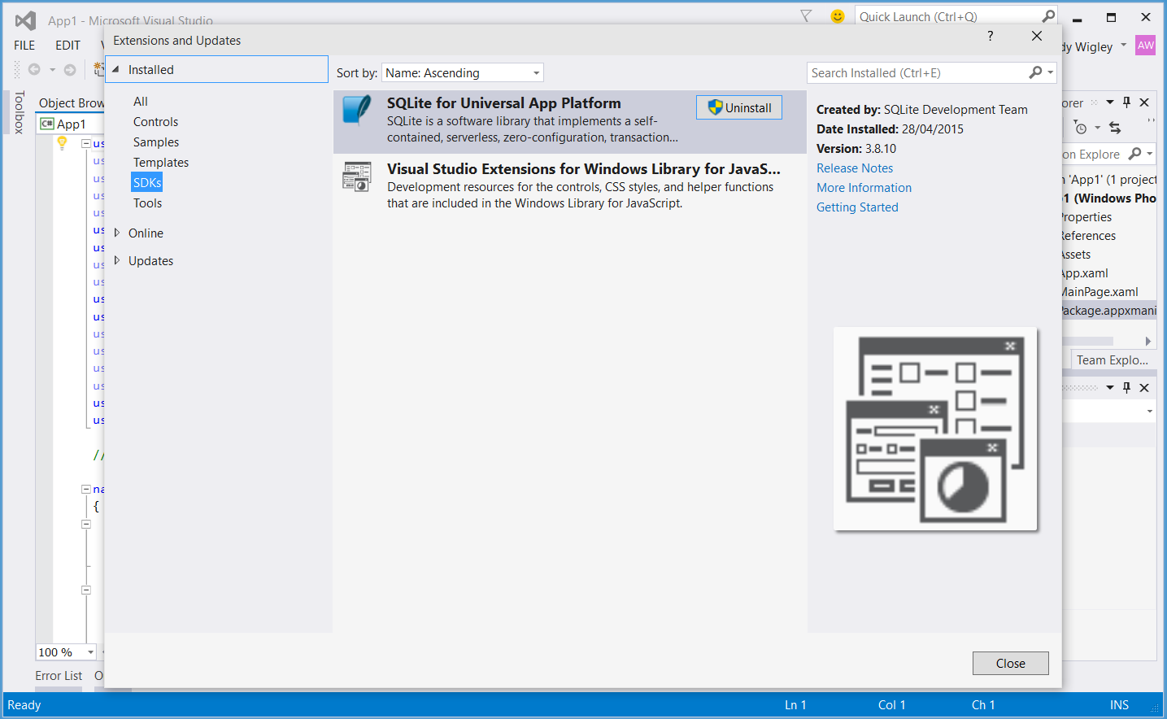
Installing the SQLite Library
Visual Studio Extension (.vsix)
Install from Visual Studio
Tools – Extensions and Updates…
Or download from SQLite.org

Slide 38
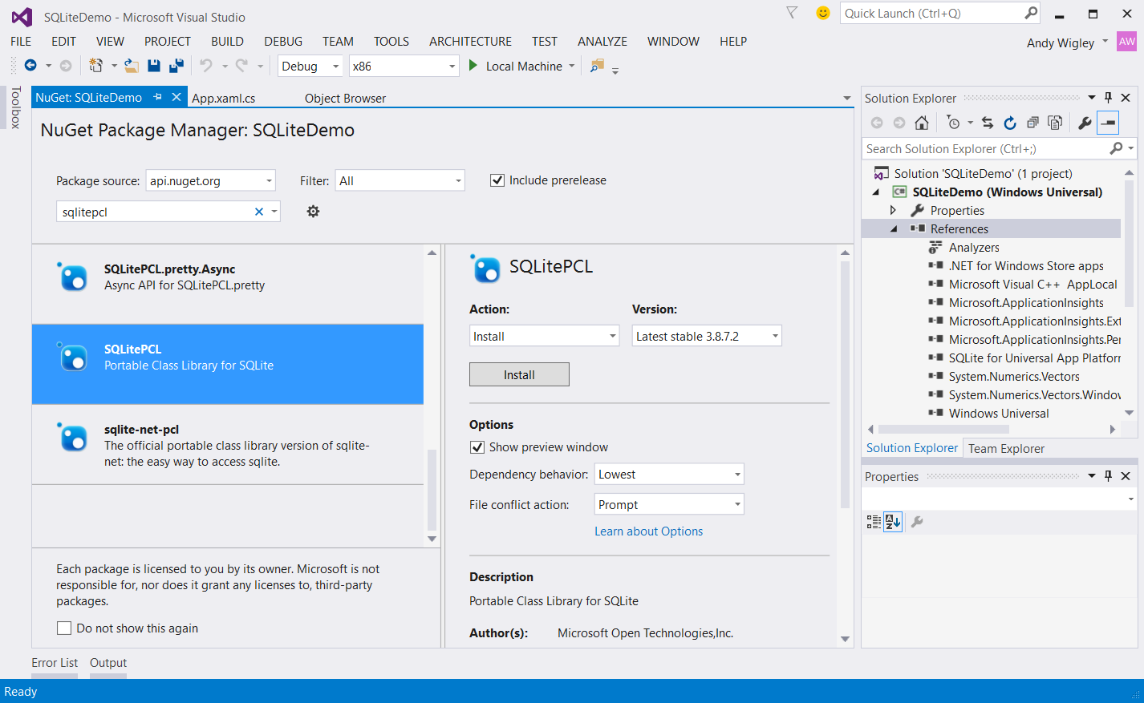
Installing SQLitePCL to your Solution

Slide 39
SQLitePCL The basics

Slide 40
Defining tables
SQLitePCL is really a thin wrapper around the SQLite ‘C’ API
Interact with the database using
SQL statements
Parameterized queries and statements

Slide 41
Create database and tables
private void LoadDatabase() { // Get a reference to the SQLite database conn = new SQLiteConnection("sqlitepcldemo.db"); string sql = @"CREATE TABLE IF NOT EXISTS Customer (Id INTEGER PRIMARY KEY AUTOINCREMENT NOT NULL, Name VARCHAR( 140 ), City VARCHAR( 140 ), Contact VARCHAR( 140 ) );"; using (var statement = conn.Prepare(sql)) { statement.Step(); } }

Slide 42
Insert
// SqlConnection was opened in App.xaml.cs and exposed through property conn var db = App.conn; try { using (var custstmt = db.Prepare("INSERT INTO Customer (Name, City, Contact) VALUES (?, ?, ?)")) { custstmt.Bind(1, customerName); custstmt.Bind(2, customerCity); custstmt.Bind(3, customerContact); custstmt.Step(); } } catch (Exception ex) { // TODO: Handle error }

Slide 43
Select
public Customer GetCustomer(int customerId) { Customer customer = null; using (var statement = dbconn.Prepare("SELECT Id, Name, City, Contact FROM Customer WHERE Id = ?")) { statement.Bind(1, customerId); if (SQLiteResult.DONE == statement.Step()) { customer = new Customer() { Id = (long)statement[0], Name = (string)statement[1], City = (string)statement[2], Contact = (string)statement[3] }; } } return customer; }

Slide 44
Update
// See if the customer already exists var existingCustomer = GetCustomer(customer.Id); if (existingCustomer != null) { using (var custstmt = dbconn.Prepare("UPDATE Customer SET Name = ?, City = ?, Contact = ? WHERE Id=?")) { // NOTE when using anonymous parameters the first has an index of 1, not 0. custstmt.Bind(1, customer.Name); custstmt.Bind(2, customer.City); custstmt.Bind(3, customer.Contact); custstmt.Bind(4, customer.Id); custstmt.Step(); } }

Slide 45
Delete
public void DeleteCustomer(int customerId) { using (var statement = dbconn.Prepare("DELETE FROM Customer WHERE Id = ?")) { statement.Bind(1, customerId); statement.Step(); } }

Slide 46
SQLite using SQLitePCL

Slide 47
Transactions, relations and other constraints

Slide 48
Transactions
No changes can be made to the database except within a transaction
Any command that changes the database will automatically execute within a transaction if one is not already in effect
Transactions can be started manually using the BEGIN TRANSACTION statement
Such transactions persist until the next COMMIT TRANSACTION or ROLLBACK TRANSACTION
Transaction will also rollback if the database is closed

Slide 49
Manual transaction – SQLitePCL
SQLite-NET
using (var statement = dbconn.Prepare("BEGIN TRANSACTION")) { statement.Step(); } // Execute one or more statements… using (var custstmt = dbconn.Prepare( "INSERT INTO Customer (Name, City, Contact) VALUES (?, ?, ?)")) { ... } using (var projstmt = dbconn.Prepare( "INSERT INTO Project (Name, Title, DueDate, CustomerId) VALUES (?, ?, ?, ?)")) { ... } // COMMIT to accept all changes or ROLLBACK TRANSACTION to discard pending changes using (var statement = dbconn.Prepare(“COMMIT TRANSACTION")) { statement.Step(); }

Slide 50
Relations
Parent – Child relationship between records in one table and those in another
Example:
Each Customer has a collection of one or more Projects
Relationship represented in the database by a column in the child object which stores the ID of the parent
Foreign key constraints enforce the relationship and maintain db integrity

Slide 51
Creating foreign key constraints
With SQLiteWinRT, FK constraint is defined in the CREATE TABLE statement
CREATE TABLE IF NOT EXISTS Project
(Id INTEGER PRIMARY KEY AUTOINCREMENT NOT NULL,
CustomerId INTEGER,
Name VARCHAR( 140 ),
Description VARCHAR( 140 ),
DueDate DATETIME,
FOREIGN KEY(CustomerId) REFERENCES Customer(Id)
);

Slide 52
Enforcing foreign key constraints
Defining a foreign key constraint on the table is not enough!
Foreign key constraints are disabled by default (for backwards compatibility)
Must be enabled at runtime using a PRAGMA
// Turn on Foreign Key constraints
sql = @"PRAGMA foreign_keys = ON";
using (var statement = dbconn.Prepare(sql))
{
statement.Step();
}

Slide 53
Other constraints
Type | Description | SQLite-NET
PRIMARY KEY | Defines the column(s) of the primary key - 1 per table max | Declare by using [PrimaryKey] attribute
UNIQUE | Column constraint enforces unique values in that column | Declare by using [Unique] attribute
NOT NULL | Column constraint prevents null values | No way of declaring with SQLite.NET
CHECK | Column or Table constraint: constraint expression is evaluated on every insert or update, and if ‘0’ returned, constraint fails | No way of declaring with SQLite.NET
See http://sqlite.org/lang_createtable.html for more information

Slide 54
Indexes
Index is created automatically for PRIMARY KEY columns
Important to create indices on foreign key columns or columns used to select records from large tables
// Create index on Foreign Key column
sql = @"CREATE INDEX IF NOT EXISTS fk_customer_project_idx
ON project (customerId) ASC";
using (var statement = dbconn.Prepare(sql))
{
statement.Step();
}

Slide 55
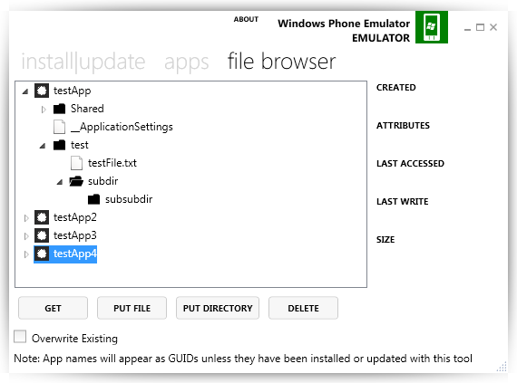
Transferring databases to desktop
For Desktop: go to %USERPROFILE%\AppData\Local\Packages\{PackageId}
For Mobile: Windows Phone Power Tools for WP8.1 – https://wptools.codeplex.com Still works with Windows 10 devices Although you must install the VS2013 – Windows Phone 8.0 SDK to install a device connectivity DLL dependency.

Slide 56
File
SQLite

