Slide 1

Covert Channels Through Branch Predictors: a Feasibility Study
Dmitry Evtyushkin¹
Dmitry Ponomarev¹ Nael Abu-Ghazaleh²
¹State University of New York at Binghamton
Department of Computer Science
²University of California at Riverside
Department of Computer Science & Engineering
Hardware and Architectural Support for Security and Privacy (HASP)
June 14, 2015
Portland, OR, USA
in conjunction with ISCA 2015

Slide 2
Presentation Outline
What is covert channel? How can it be used?
Architectural covert channels
Branch Predictor in CPU
Constructing covert channel through Branch Predictor
Results
Optimizations
Conclusion

Slide 3

Covert Channels
Data Sharing Mechanisms:
Shared Memory
Networking
File system
IPC
etc...

Slide 4
Covert Channels
Sharing is not desirable:
Violates security policy
  Information Flow Control (IFC) schemes
    TaintDroid (OSDI '10)
  Applications in different Security Domains
Covert Channels:
Transfer information through channels not intended for information transfer

Slide 5





Covert Channel Usage Example
Application is isolated
or password data is tainted
Are passwords secure?
No IPC
$*$&%*&$(*&&@(#&
No File System Access
Password Manager
No Network Access
(Malicious)
Passwords are secure as long as OS enforces security policies
$*$&%*&$(*&&@(#&
Weather Widget
Network Access
(Malicious)

Slide 6
Covert Channel Usage Example
Shared resources can be used to construct covert channels:
OS resources
  File descriptors, free space, etc.
Network latencies
Power and Thermal effects
Architectural resources
  Caches
  Functional units
  Branch predictor
  Other resources
Others

Slide 7




Contention-based Architectural Covert Channels
mul %r1,%r1
mul %r1,%r1
mul %r1,%r1
mul %r1,%r1
mul %r1,%r1
mul %r1,%r1
mul %r1,%r1
mul %r1,%r1
0
1
Trojan
Spy
0
1
Multiplication Units
CPU

Slide 8
Branch Prediction Unit
Properties that make covert channel possible:
During execution branch predictor accumulates state
BP is shared among all processes on core
BP is not flushed on context switches
Parallel threads in SMT share same BP
Branch mispredictions have high cost

Slide 9

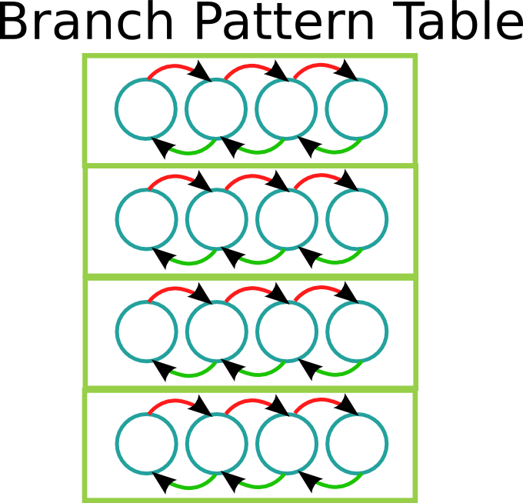


Branch Predictor Operation

Slide 10
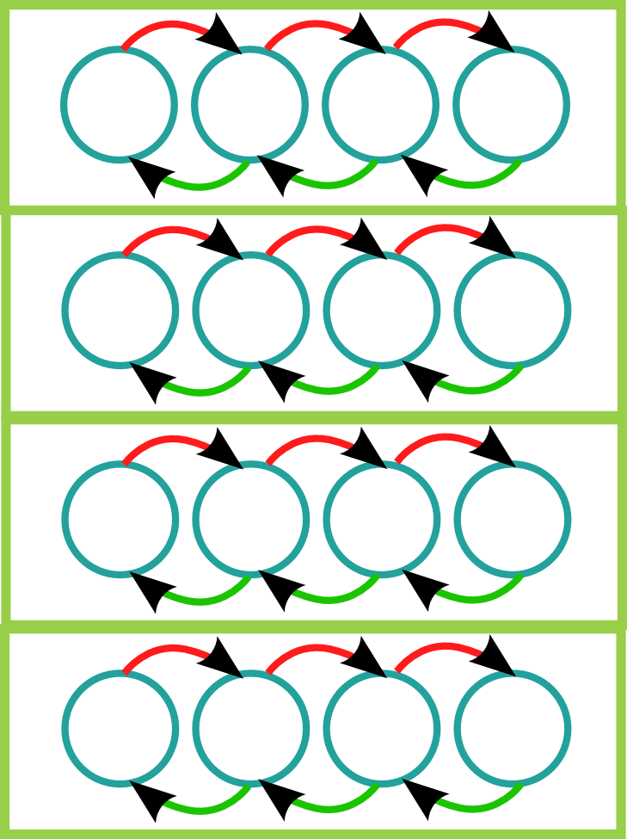
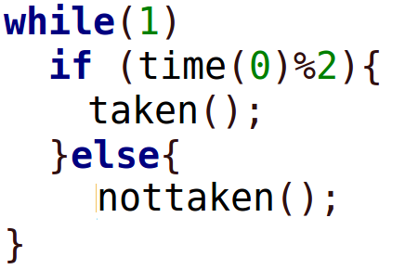
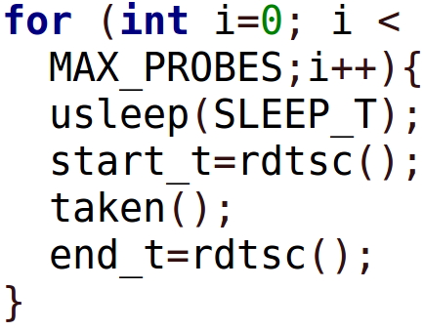
Constructing Covert Channel
Not-taken
Taken
1

Slide 11
Scheduling Trojan and Spy
Single Threaded Scenario:
Quanta
Setting affinity mask to run Trojan and Spy on the same core
Q1 | Q2 | Q3 | Q4 | Q5
Thread 0
Multi Threaded Scenario (SMT):
Quanta
Setting affinity mask to run Trojan and Spy on parallel virtual cores
Q1 | Q2 | Q3 | Q4 | Q5
Thread 0
Thread 1

Slide 12
Branch Code
br_taken:
push %rbp
movl $0x1,-0x8(%rbp)
cmpl $0x0,-0x8(%rbp)
jne .L2
nop
nop
.L2:
cmpl $0x0,-0x8(%rbp)
jne .L3
nop
nop
nop
.L3:
......................
Notes:
Trojan and Spy execute large number of branch instructions
  500K for Trojan
  30K for Spy
Trojan and Spy execute the similar code
Nop instructions to randomize layout

Slide 13
Evaluation Platform
Real hardware
Intel Core i7-4800MQ CPU (Haswell)
Ubuntu 14.04.2 generic Linux kernel version 3.16.0-31

Slide 14
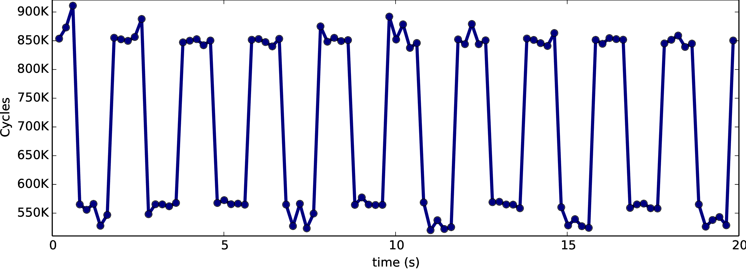
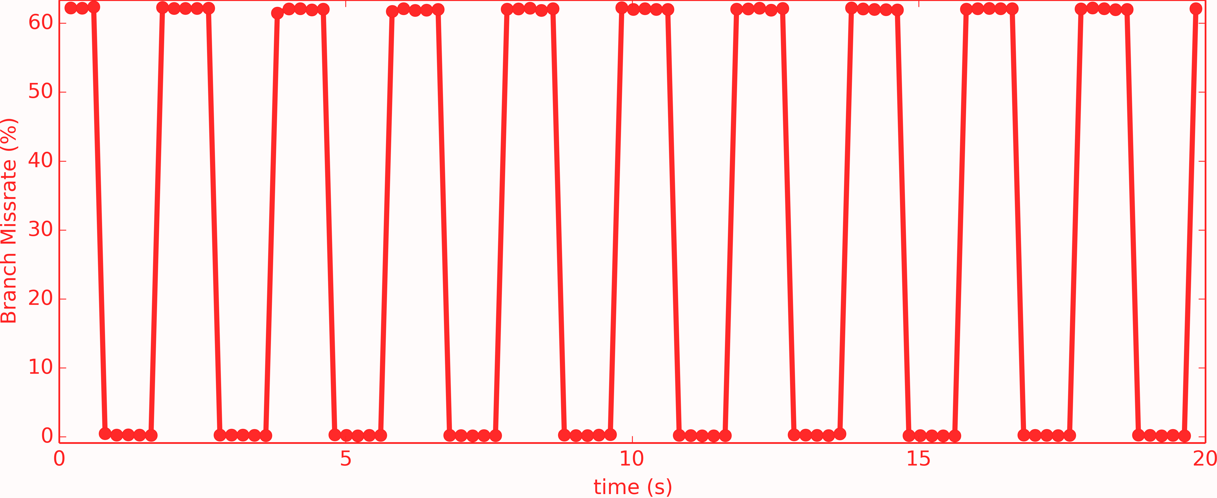
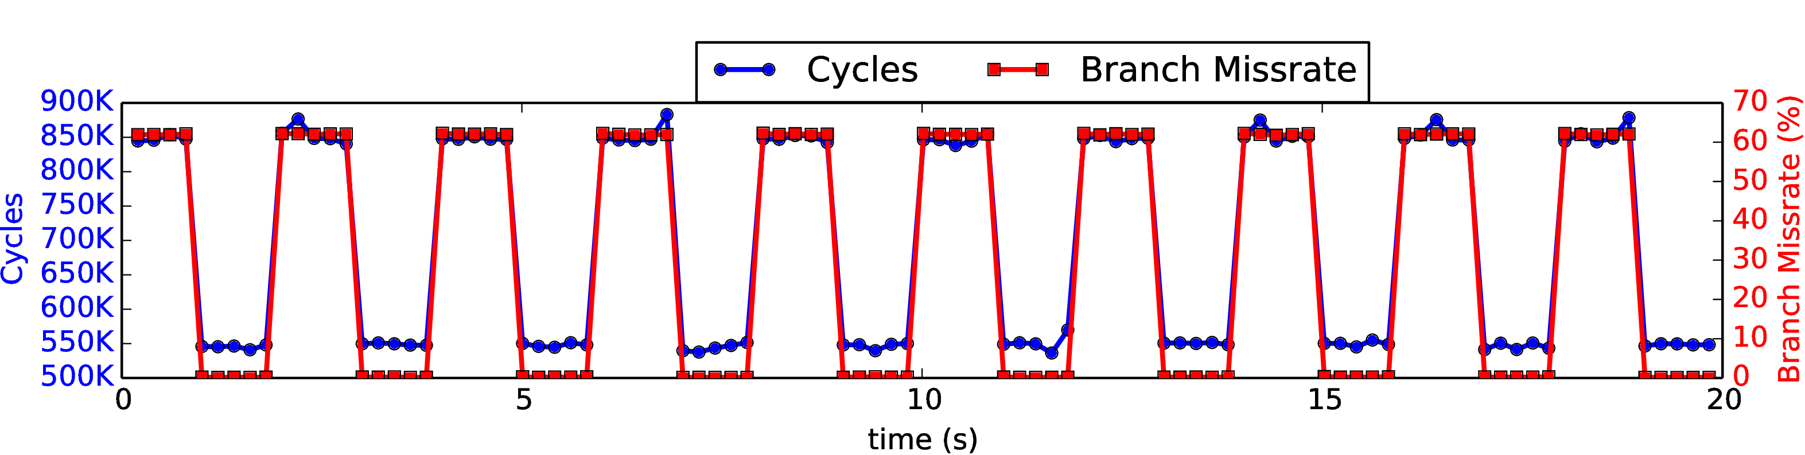
Results: Single Thread
Single Thread, no interference:

Slide 15
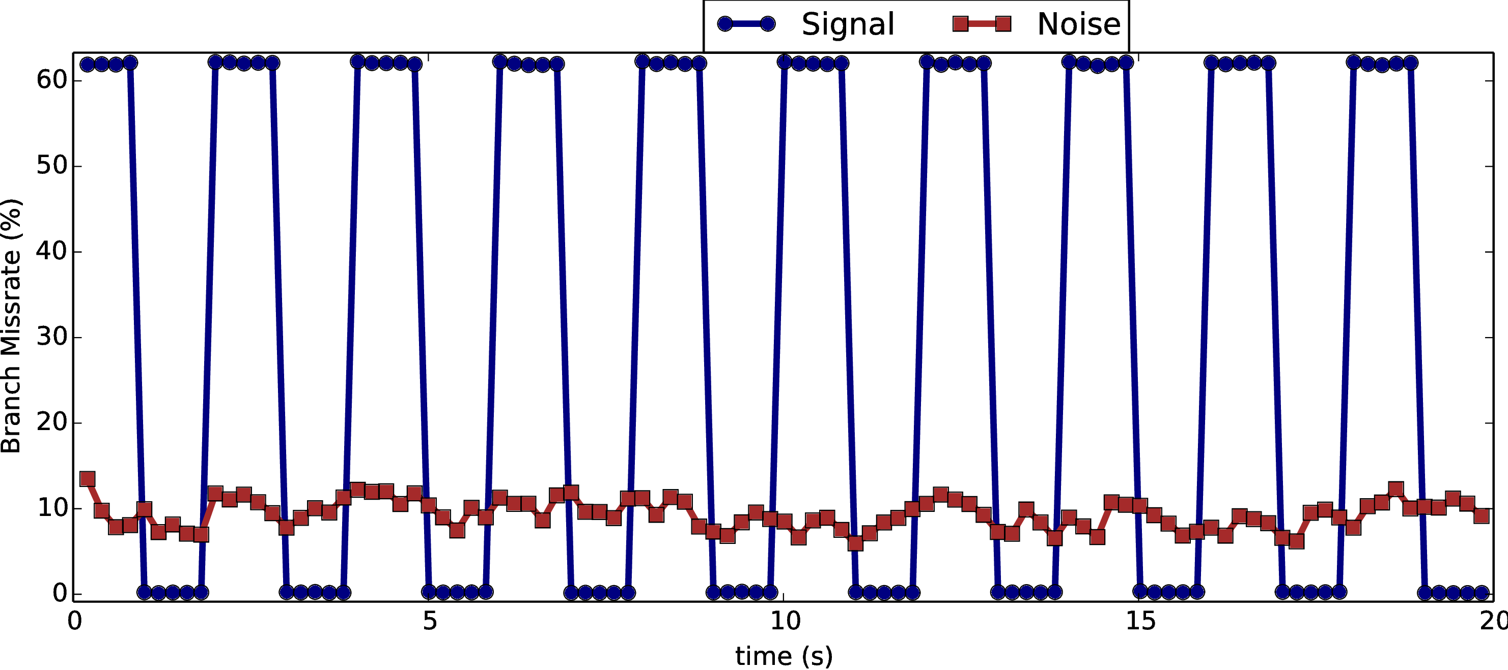
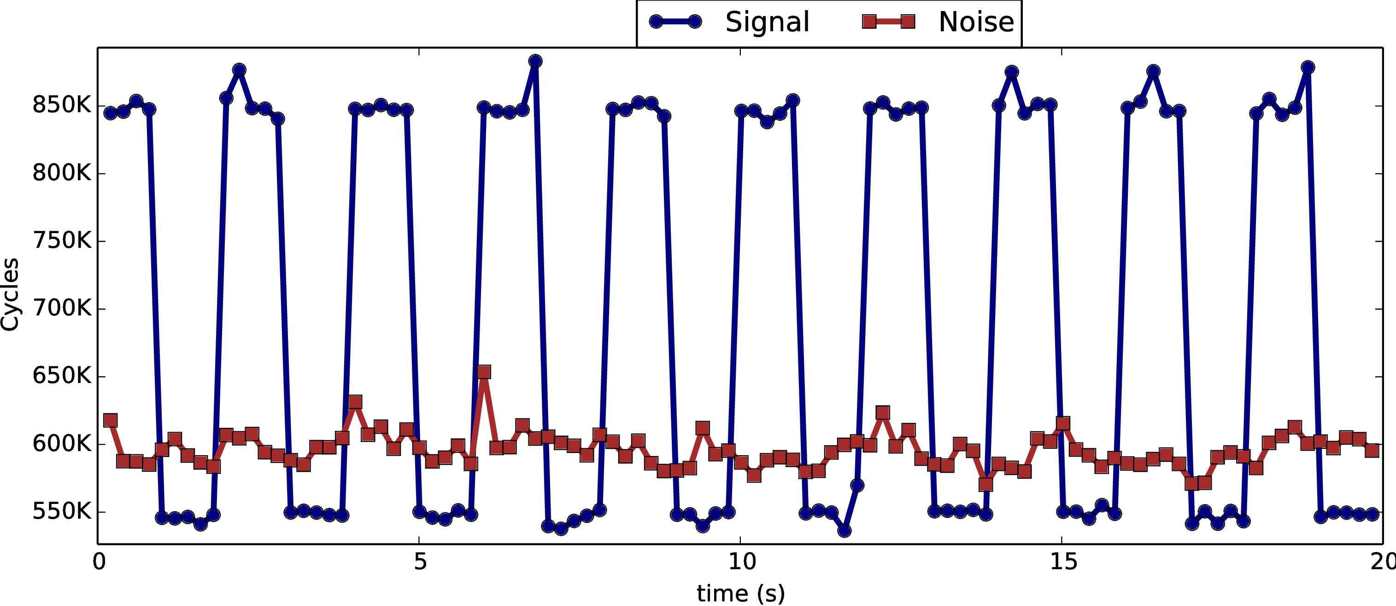
Signal vs Noise
Single Thread, no interference, cpuburn as noise:
High SNR
Stable signal
Possibly high capacity
Asynchronous signal

Slide 16
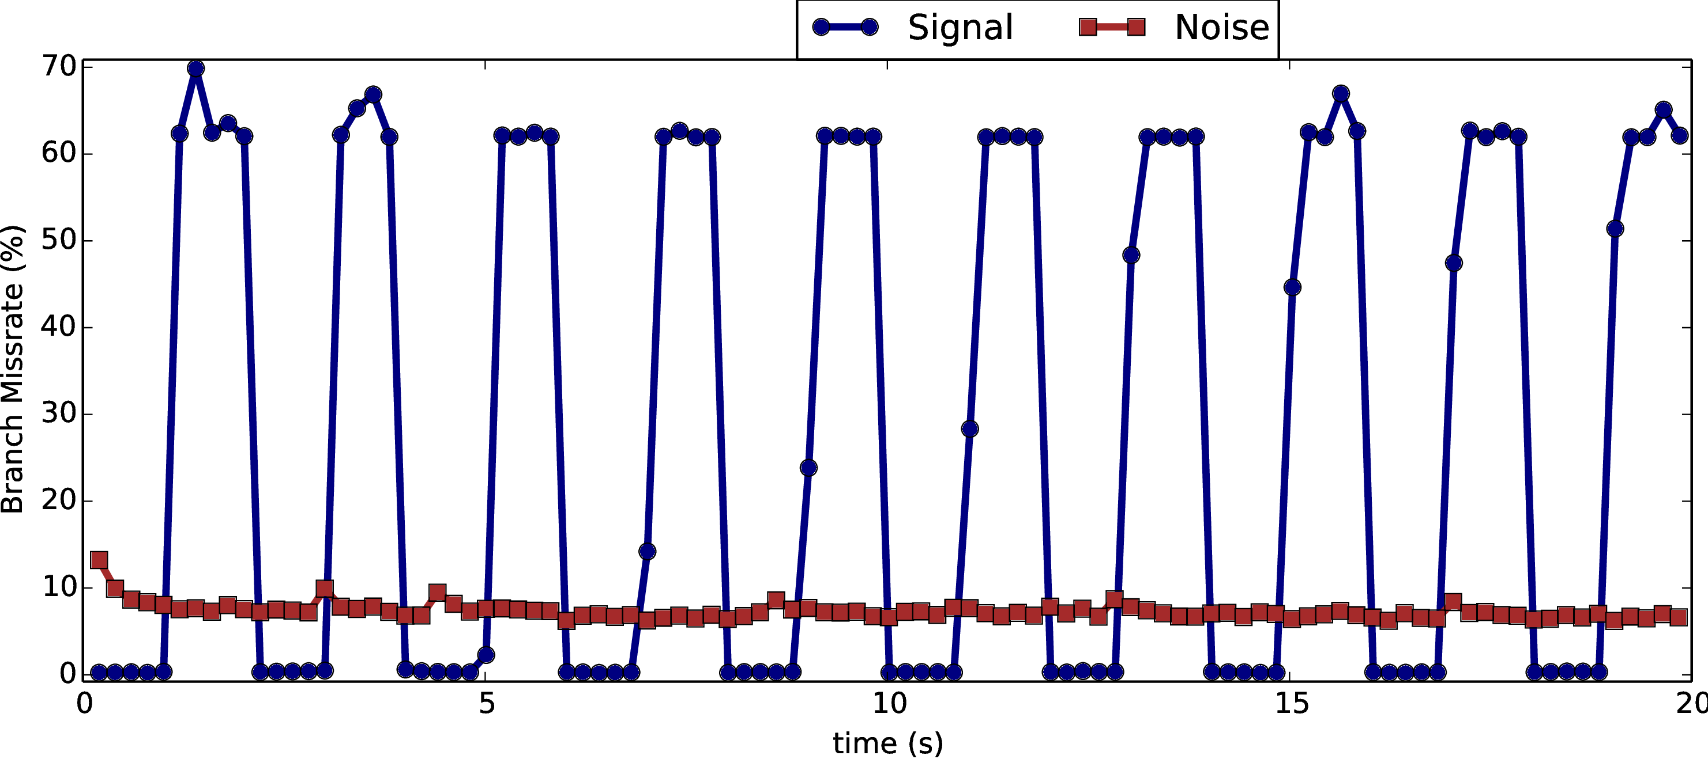
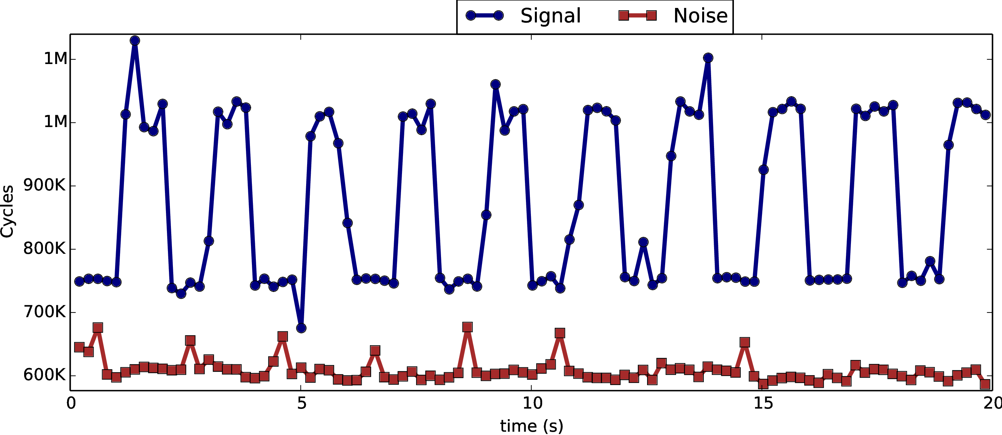
SMT Results
Multi Thread, no interference, cpuburn as noise:

Slide 17
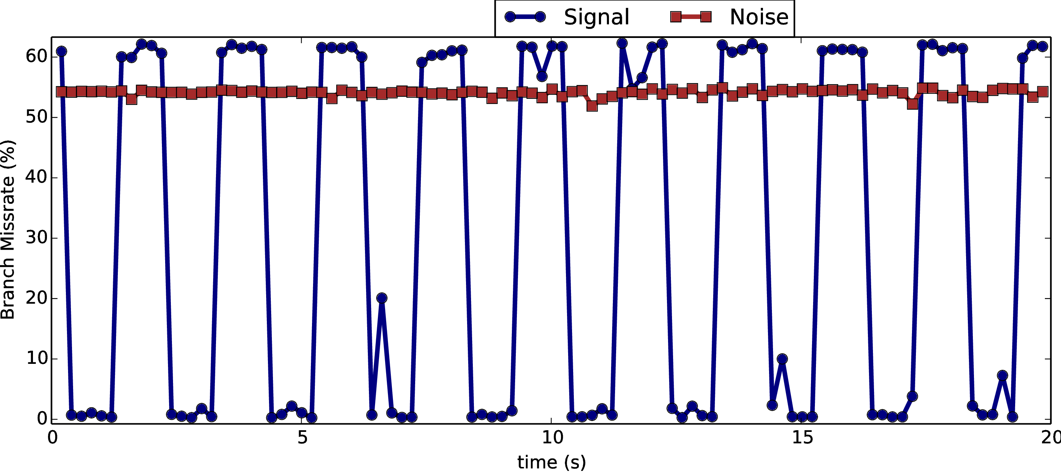
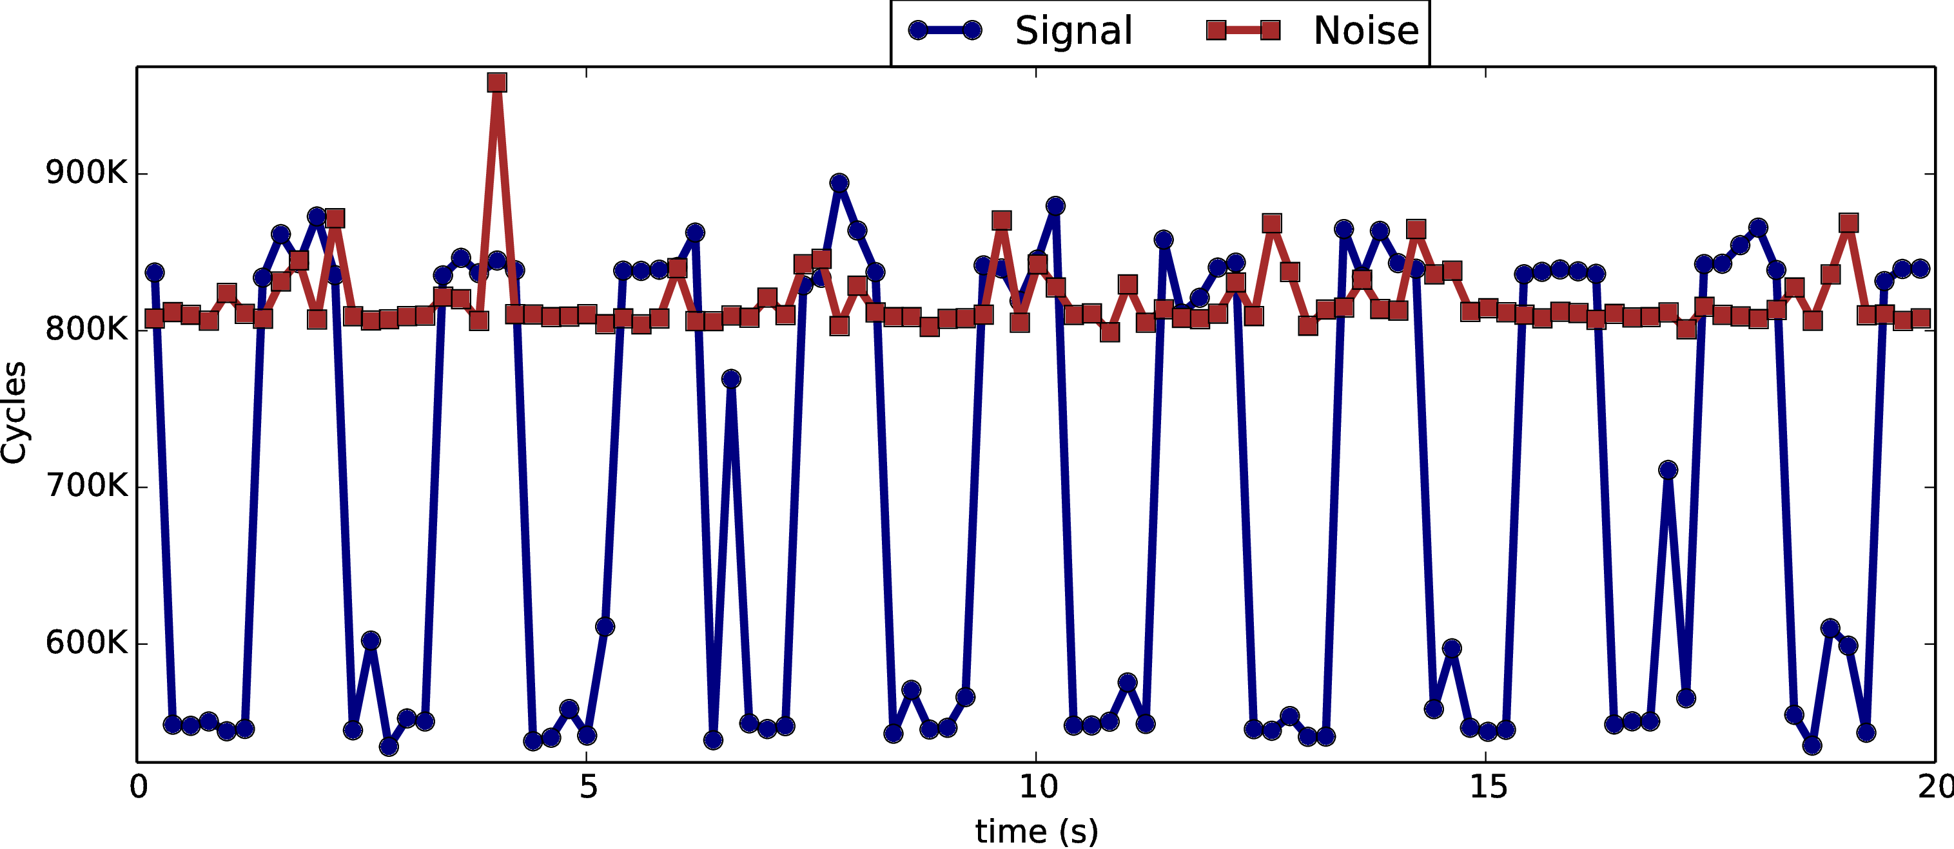
Realistic example
Single Thread, Browser with YouTube as noise/interference

Slide 18
Possible optimizations
What we present is only a prototype
Can transmit multiple bits at once
Can make scheduling faster
For more accuracy, can reverse-engineer BP to find optimal number of branch instructions/nops

Slide 19
Conclusions
Branch predictor can be used as an effective covert channel media
Covert channel through BP has desirable properties
It should be considered when implementing secure systems free of covert and side channels

Slide 20
Thank you!

