Slide 1
QC Antivirus Project Updates
01/20/2022

Slide 2
ibmq_lima
ibmq_bogota
ibmq_casablanca
ibmq_perth
ibmq_quito
ibmq_santiago
ibmq_jakarta
ibmq_belem
ibmq_manila
ibmq_lagos

Slide 3
ibmq_lima
ibmq_bogota
ibmq_casablanca
ibmq_perth
ibmq_quito
ibmq_santiago
ibmq_jakarta
ibmq_belem
ibmq_manila
ibmq_lagos

Slide 4
Victim Circuit
Malicious Circuit
ibmq_lima

Slide 5
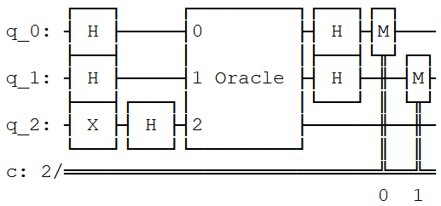
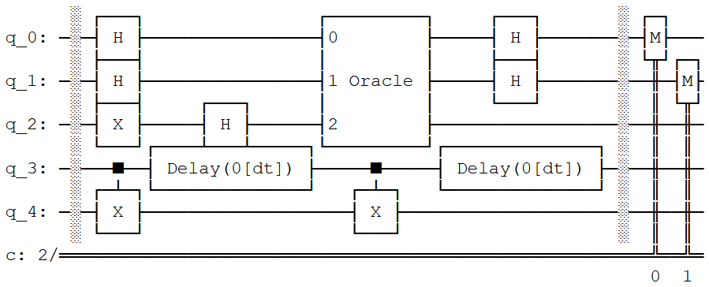
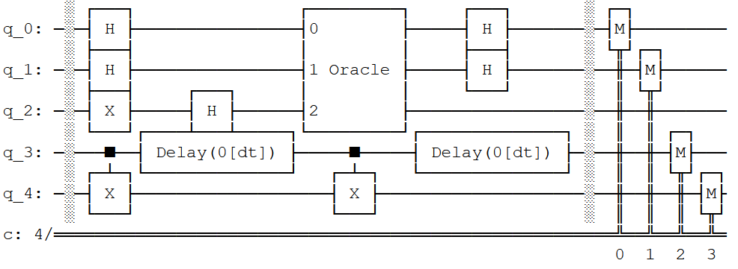
Original Design
Design D1
Design D2

Slide 6
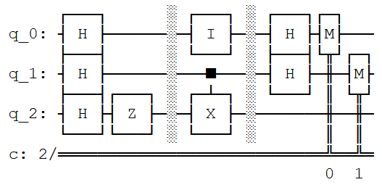
Problem with the Barriers in between
dt1
dt2
dt3

