Slide 1
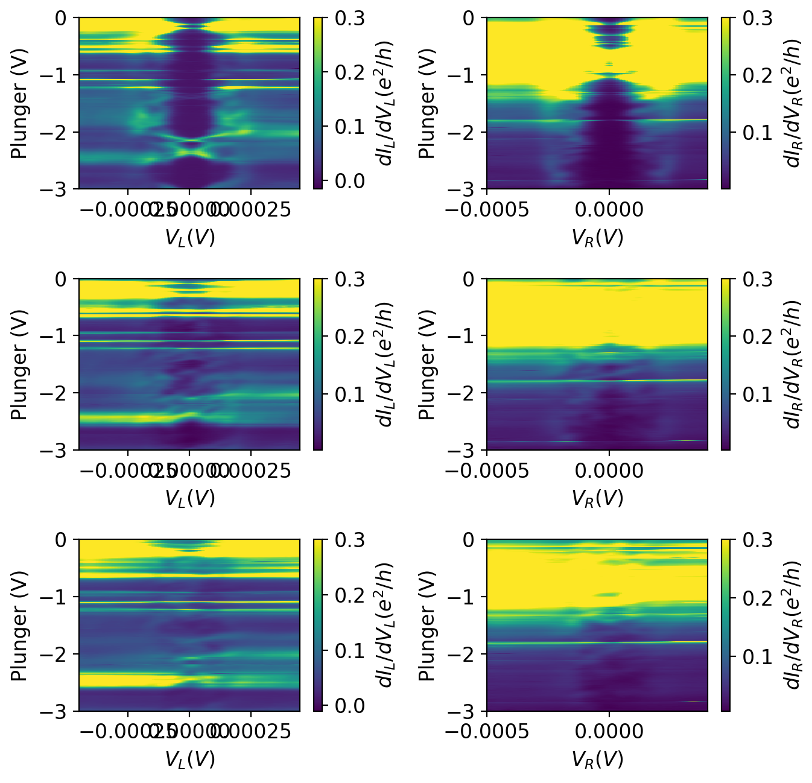
Fig 5 full ranges

Slide 2
Fig 5 full ranges
High-conductance regions cause voltage-divider effects.
We opted to simply present raw data, but only deep in the tunneling regime where divider effects are small.
Corrections can also be made in post-processing, but we chose not to do this for simplicity, and to avoid any concerns about not showing “raw” data.

Slide 3
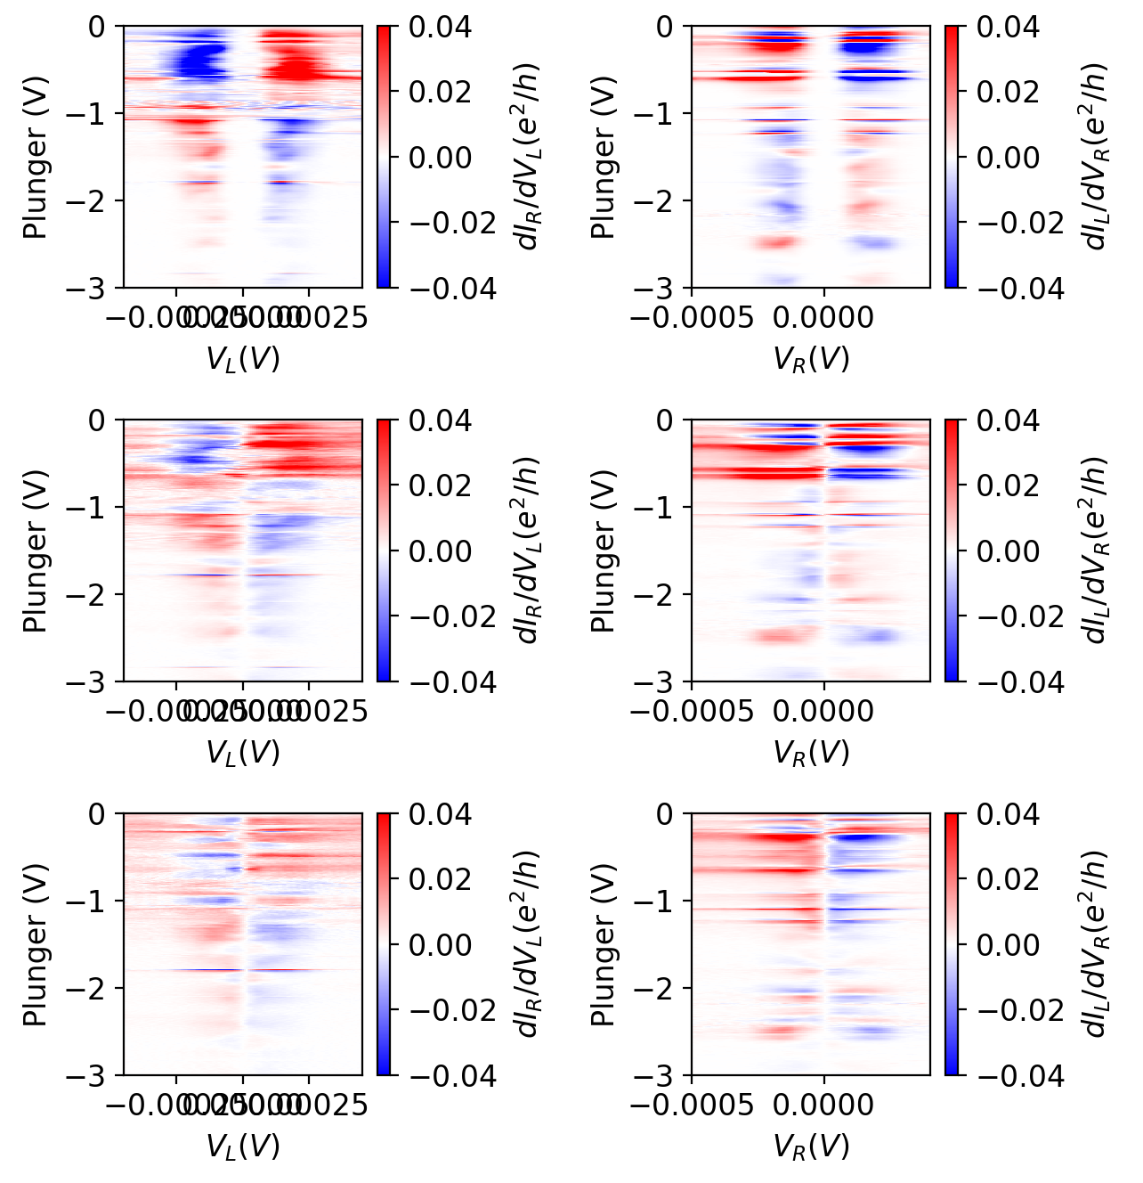
Fig 5/6 full ranges

