Slide 1







IBM Data Analytics Capstone Project
Carrissa Smith
October 14, 2024

Slide 2



OUTLINE
Executive Summary
Introduction
Methodology
Results
Visualization – Charts
Dashboard
Discussion
Findings & Implications
Conclusion
Appendix

Slide 3

EXECUTIVE SUMMARY
Project Scenario: I have recently been hired as a Data Analyst by a global IT and business consulting services firm that is known for their expertise in IT solutions and their team of highly experienced IT consultants. In order to keep pace with changing technologies and remain competitive, my organization regularly analyzes data to help identify future skill requirements.

Slide 4
EXECUTIVE SUMMARY
Data Collection was done to gather the top programming skills that are most in demand from:
Job postings
Training portals
Surveys
Data Wrangling was done by cleaning up the data set and ensuring it is ready for data analysis.
Exploratory Data Analysis was done to understand the dataset.
Visualizations using Python to highlight the distribution of data, relationships between data, the composition of data, and comparison of data
Dashboards using Google Looker Studios was done to showcase current technology usage, future technology trends and demographics.

Slide 5

INTRODUCTION
Problem Statement: To collect data from various sources and identify trends for this year's report on emerging skills.
The nature of the analysis is primarily data-driven, consisting of data collection, wrangling, exploratory data analysis, visualization and dashboarding.
Questions for analysis:
What are the top programming languages in demand?
What are the top database skills in demand?
What are the popular IDEs?

Slide 6

METHODOLOGY
Data sources: Website and Github API
Method 1: Some data was collected using Github Jobs API in Python and stored in an excel spreadsheet.
Method 2: Some data was web scraped from a given website using Beautiful Soup in Python and stored in a csv file.
Plan: Collected data used to gather insights on top programming languages and databases through the processes of:
Cleaning
Analyzing
Visualizing

Slide 7
RESULTS

Slide 8
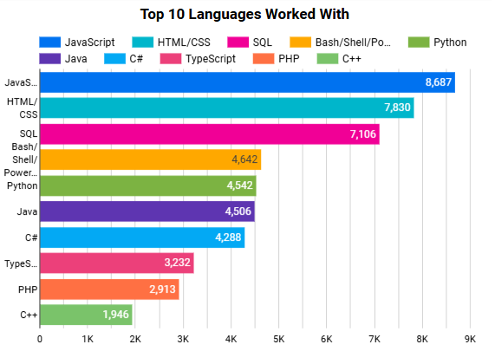
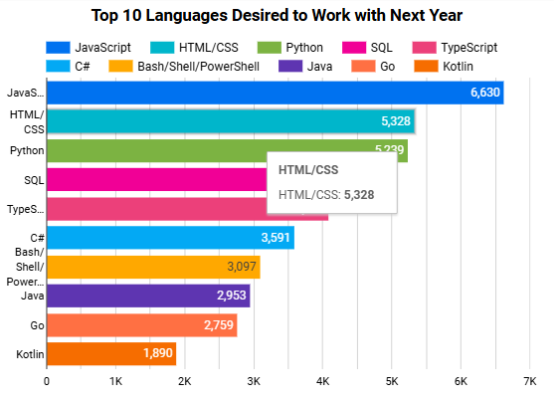
PROGRAMMING LANGUAGE TRENDS
Current Year
Next Year
<Bar chart of top 10 programming languages for the current year goes here.>
< Bar chart of top 10 programming languages for the next year goes here.>

Slide 9
PROGRAMMING LANGUAGE TRENDS - FINDINGS & IMPLICATIONS
Findings
JavaScript and HTML/CSS are the languages currently used the most and desired the most to be worked with in the coming year.
The Python Language is currently the 5th most used language but 3rd most desired language to work with next year.
PHP and C++ are in the top 10 currently used programming languages but are not in the top 10 languages desired to work with next year.
Implications
JavaScript and HTML/CSS will remain top and relevant programming languages in the incoming year.
Python is likely to be in the top 3 programming languages for the incoming year.
Kotlin and Go will potentially replace PHP and C++ in top 10 programming languages used in the incoming year.

Slide 10
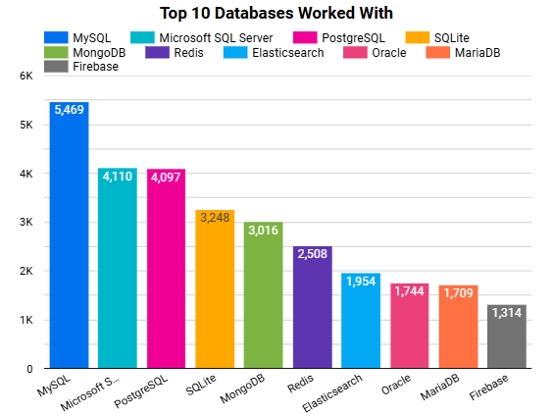
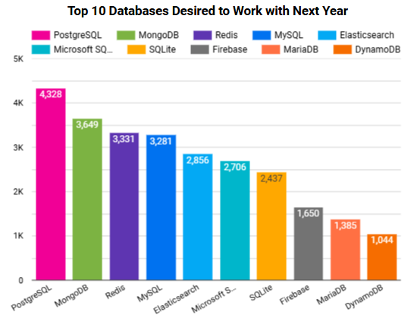
DATABASE TRENDS
Current Year
Next Year
< Bar chart of top 10 databases for the current year goes here >
< Bar chart of top 10 databases for the next year goes here.>

Slide 11
DATABASE TRENDS - FINDINGS & IMPLICATIONS
Findings
MySQL is the database currently used the most but is the 4th most desired database to work with next year.
PostgreSQL is currently the 3rd most used database and the most desired database to work with next year.
Microsoft SQL Server is currently the 2nd most used database but is the 6th most desired database to work with next year.
Implications
MySQL may not be the top database most used in the incoming year.
PostgreSQL will have a significant growth in users in the incoming year.
Microsoft SQL Server may not be in the top 3 databases most used in the incoming year.

Slide 12

DASHBOARD
Capstone/Dashboard.pdf at main · casmith101/Capstone (github.com)

Slide 13
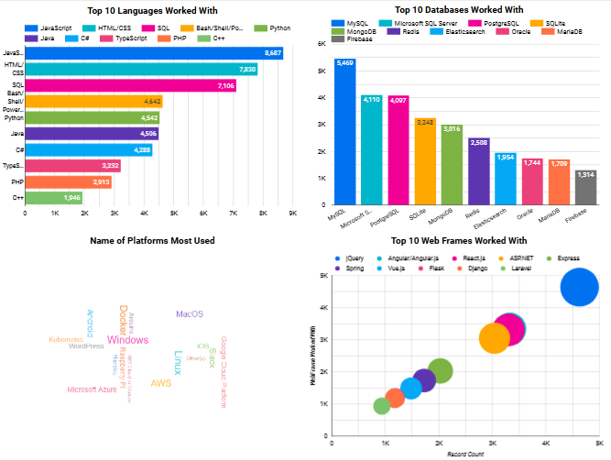
DASHBOARD TAB 1
Screenshot of dashboard tab 1 goes here

Slide 14
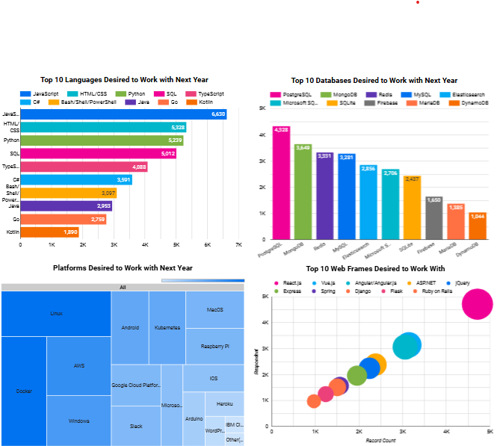
DASHBOARD TAB 2
Screenshot of dashboard tab 2 goes here

Slide 15
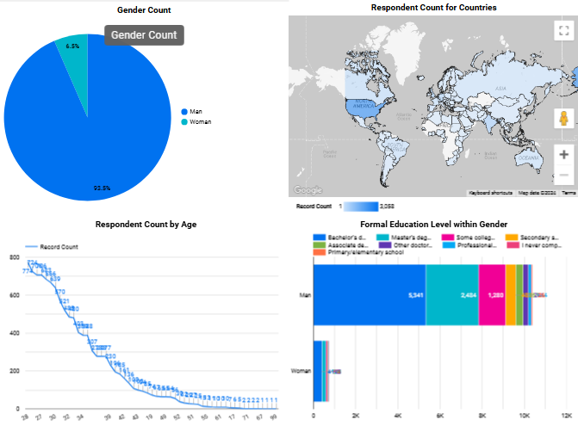
DASHBOARD TAB 3
Screenshot of dashboard tab 3 goes here

Slide 16
DISCUSSION
The company would need to ensure that JavaScript and HTML/CSS skill requirements are emphasized for the upcoming year as these languages will remain top languages in the field. Python is a growing language and so the company would need to ensure that persons learn Python. As it relates to the usage of databases, PostgreSQl is likely to be the top database in the coming year.

Slide 17
OVERALL FINDINGS & IMPLICATIONS
Findings
JavaScript and HTML/CSS are the languages currently used the most and desired the most to be worked with in the coming year. The Python Language is currently the 5th most used language but 3rd most desired language to work with next year.
PostgreSQL is currently the 3rd most used database and the most desired database to work with next year.
Microsoft SQL Server is currently the 2nd most used database but is the 6th most desired database to work with next year.
Implications
JavaScript and HTML/CSS will continue to be top languages possibly because of many job listings for JavaScript as shown in the Job Postings bar chart in the appendix. Python is also a growing language.
PostgreSQL will have a significant growth in users in the incoming year.
Microsoft SQL Server is not as popular and will more than likely not be in the top 5 databases most used for the incoming year.

Slide 18

CONCLUSION
JavaScript and HTML/CSS should be considered if they are not already in use as they will remain top languages.
Python programming language usage is growing.
PostgreSQL database usage is growing.

Slide 19

APPENDIX
Include any relevant additional charts, or tables that you may have created during the analysis phase.

Slide 20
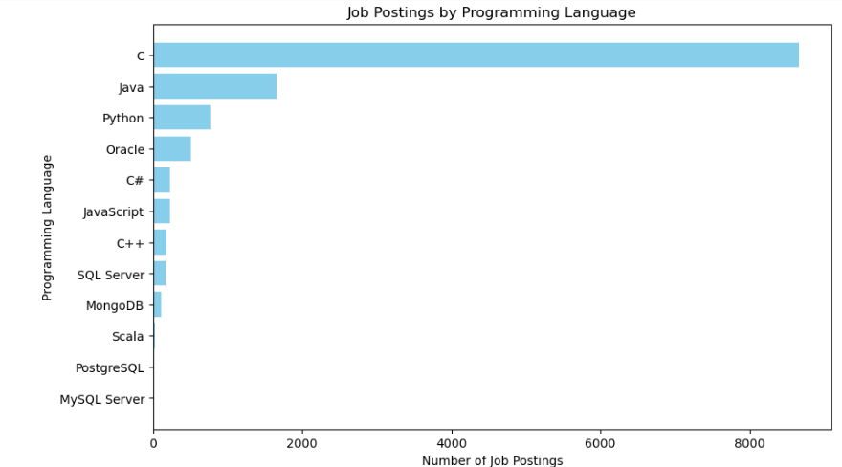
JOB POSTINGS

Slide 21
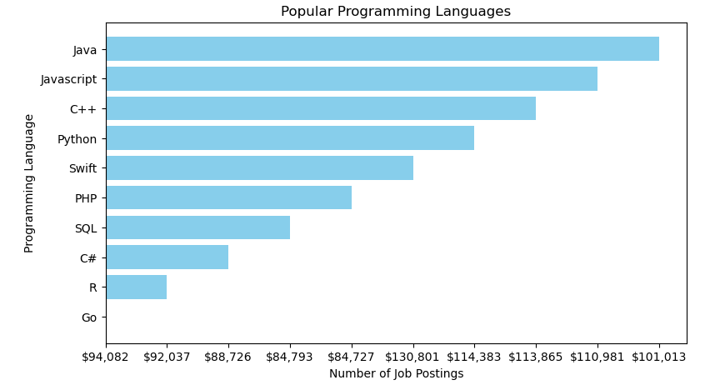
POPULAR LANGUAGES

