Slide 1
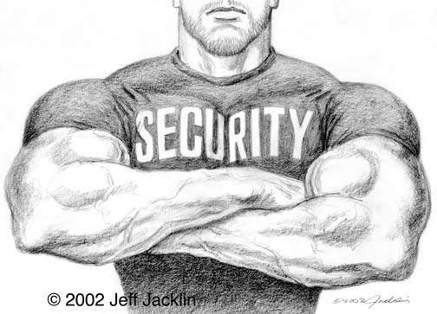
Security
Security The Internet and you.

Slide 2
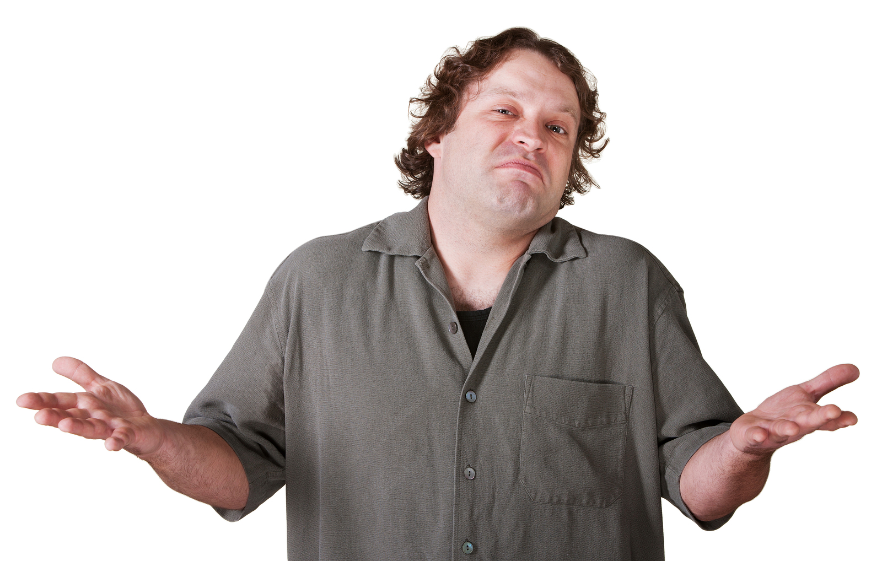
Why should I care?

Slide 3
2015 Cyberattacks
Primera Blue Cross – 11 million customers
Anthem - tens of millions customers
Staples – 1.6 million credit cards
Home Depot – 56 million credit cards
JPMorgan chase – 83 million households
Federal Government – 4 million employees
Utah – 280,000 SSNs

Slide 4
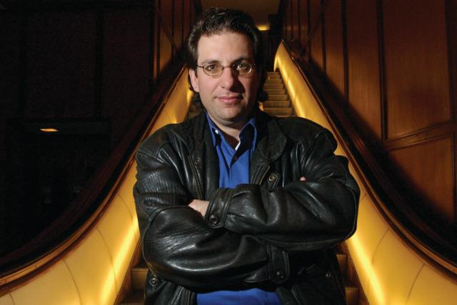
Why do hackers hack?
PII - Personally Identifiable Information
PHI - Protected Health Information
Cause disruptions to the business
Kevin Mitnick “for the pursuit of knowledge and adventure”

Slide 5
What is PII?
PII - Information that can be used on its own or with other information to identify, contact, or locate a single person, or to identify an individual in context.
Examples: Full name, Home address, Email address, National identification number, Passport number, Credit card numbers, Date of birth, Login name
Black market credit card value: $0.50 - $1.00 each.

Slide 6
What is PHI?
PHI - Any information about health status, provision of health care, or payment for health care that can be linked to a specific individual
Physical or mental health or condition
The provision of health care
Payment information for health care
PII that can link to above information
Black Market Value $10.00: 10-20 times that of PII.
Why? Drugs, Less secure, easier to obtain.

Slide 7
Common attacks
SQL Injection
Cross Site Scripting
Cross Site Request Forgery
Clickjacking
Social Engineering

Slide 8
Cross Site Scripting (XSS)
XSS – Injecting client-side script into a site.
Why is it dangerous? [Demo]
How can I prevent it? [Code Review]

Slide 9
SQL Injection
Inject SQL into a vulnerable site.
Let’s hack something… [Demo]
How do I defend against it? [Code Review]

Slide 10
Cross Site Request Forgery
When a program causes a user's Web browser to perform an unwanted action on a trusted site for which the user is currently authenticated
HTTP referer
CAPTCHA
Re-Authentication (Like amazon.com)

Slide 11
Clickjacking
the malicious practice of manipulating a website user's activity by concealing hyperlinks beneath legitimate clickable content, thereby causing the user to perform actions of which they are unaware.
Lets see it!
Lets prevent it!

Slide 12
General Best Practices
Don’t give away information - “Your password is invalid” or “username not found”
Don’t be predictable - admin/admin
Always change default creds – sa/””

Slide 13
OWASP
The Open Web Application Security Project
https://www.owasp.org
Core Purpose - Be the thriving global community that drives visibility and evolution in the safety and security of the world’s software.

Slide 14
Authentication

