Slide 1
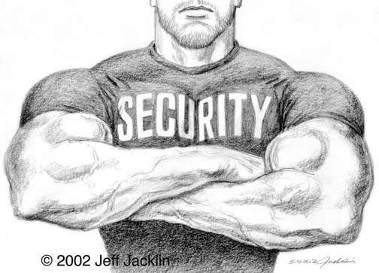
Security
Security The Internet and you.

Slide 2
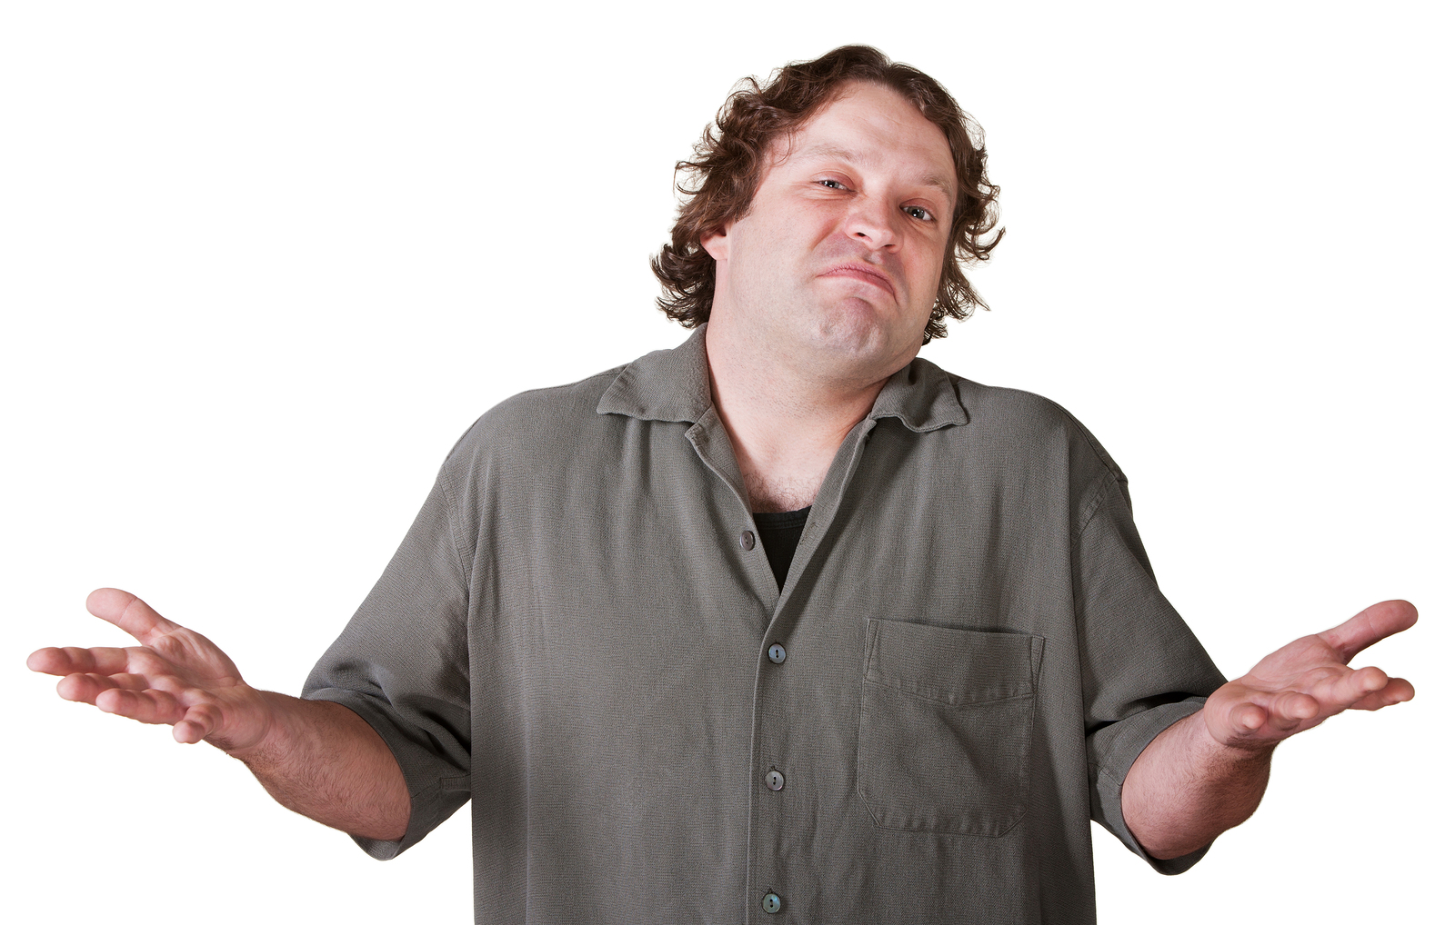
Why should I care?

Slide 3
2015 Cyberattacks
Primera Blue Cross – 11 million customers
Anthem - tens of millions customers
Staples – 1.6 million credit cards
Home Depot – 56 million credit cards
JPMorgan chase – 83 million households
Federal Government – 4 million employees

Slide 4
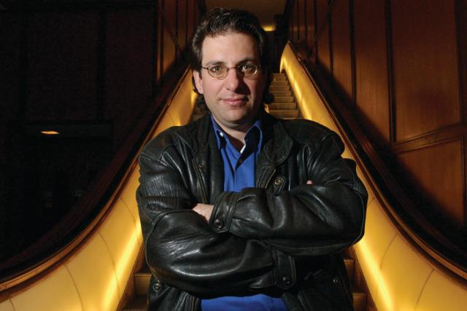
Why do hackers hack?
PII - Personally Identifiable Information
PHI - Protected Health Information
Cause disruptions to the business
Kevin Mitnick “for the pursuit of knowledge and adventure”

Slide 5
What is PII?
PII - Information that can be used on its own or with other information to identify, contact, or locate a single person, or to identify an individual in context.
Examples: Full name, Home address, Email address, National identification number, Passport number, Credit card numbers, Date of birth, Login name
Black market credit card value: $0.50 - $1.00 each.

Slide 6
What is PHI?
PHI - Any information about health status, provision of health care, or payment for health care that can be linked to a specific individual
Physical or mental health or condition
The provision of health care
Payment information for health care
PII that can link to above information
Black Market Value $10.00: 10-20 times that of PII.
Why? Drugs, Less secure, easier to obtain.

Slide 7
Common attacks
SQL Injection
Cross Site Scripting
Cross Site Request Forgery
Clickjacking
Social Engineering

Slide 8
Cross Site Scripting (XSS)
XSS – Injecting client-side script into a site.
Why is it dangerous? [Demo]
How can I prevent it? [Code Review]

Slide 9
SQL Injection
Inject SQL into a vulnerable site.
Let’s hack something… [Demo]
How do I defend against it? [Code Review]

Slide 10
General Best Practices
Don’t give away information - “Your password is invalid” or “username not found”
Don’t be predictable - admin/admin
Always change default creds – sa/””

Slide 11
Cross Site Request Forgery
HTTP referer
CAPTCHA
Re-Authentication
Synchronizer Token Pattern

