Slide 1

Security
Security The Internet and you.

Slide 2

Why should I care?

Slide 3
Cyberattacks
$6 Billion Annual cost in healthcare alone
Attacks against healthcare doubled in 5 years
Nearly 90% of heath-care providers hit with data breaches in past 2 years (source: bloomberg)
2014 – FBI Warns healthcare is “lax” compared to other sectors

Slide 4
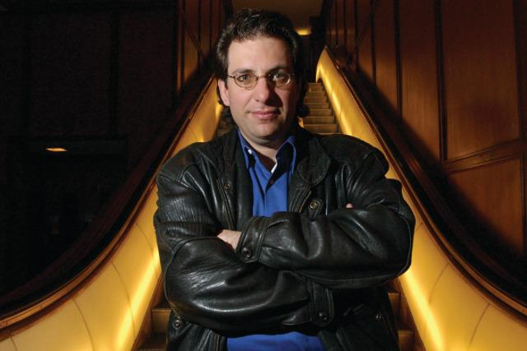
Why do hackers hack?
PII - Personally Identifiable Information
PHI - Protected Health Information
Cause disruptions to the business
Kevin Mitnick “for the pursuit of knowledge and adventure”

Slide 5
What is PII?
PII - Information that can be used on its own or with other information to identify, contact, or locate a single person, or to identify an individual in context.
Examples: Full name, Home address, Email address, National identification number, Passport number, Credit card numbers, Date of birth, Login name
Black market credit card value: $0.50 - $1.00 each.

Slide 6
What is PHI?
PHI - Any information about health status, provision of health care, or payment for health care that can be linked to a specific individual
Physical or mental health or condition
The provision of health care
Payment information for health care
PII that can link to above information
Black Market Value $10.00 - $20.00: 20-40 times that of PII.
Fullz or Kitz PHI with fake documents $1,000+
Why?

Slide 7

OWASP
The Open Web Application Security Project
https://www.owasp.org
Core Purpose - Be the thriving global community that drives visibility and evolution in the safety and security of the world’s software.

Slide 8
Common attacks
Social Engineering
SQL Injection 1*
Cross Site Scripting 3*
Cross Site Request Forgery 8*
Clickjacking
https://www.owasp.org/index.php/Top_10_2013-Top_10
*OWASP ranking 2013

Slide 9
Social Engineering
The weakest link in the Information Security Chain.
Never give out confidential information.
Safeguard even inconsequential information about yourself.
Lie to security questions, and remember your lies.

Slide 10
SQL Injection
Inject SQL into a vulnerable site.
Let’s hack something… [Demo]
http://testfire.net/
'AND 1=(SELECT COUNT(*) FROM probe);--
' OR 1=1;--
'; DROP TABLE probeResult;--

Slide 11
Cross Site Scripting (XSS)
XSS – Injecting client-side script into a site.
Reflected [Demo]
Persisted
Why is it dangerous?
http://testfire.net/
(see XSS/Attacks.txt)

Slide 12
Defense!
How can I defend against Injection?

Slide 13
Cross Site Request Forgery
When a program causes a user's Web browser to perform an unwanted action on a trusted site for which the user is currently authenticated
HTTP referer
CAPTCHA - Anti-Pattern, bad for disabled users
Re-Authentication (Like amazon.com)
Anti-Xsrf Token (site.master.cs) (See-Surf)

Slide 14
Clickjacking
the malicious practice of manipulating a website user's activity by concealing hyperlinks beneath legitimate clickable content, thereby causing the user to perform actions of which they are unaware.
Lets see it!
Lets prevent it!

Slide 15
Authentication
account lockout, password history/expiration, etc.
Multi-factor authentication(bio, phone, flash drive)
Storing passwords
Password Salt… Yum!
What makes a good password and why do I need one
What is a rainbow table

Slide 16
General Best Practices
Don’t give away information - “Your password is invalid” or “username not found”
Don’t be predictable - admin/admin
Always change default creds – sa/””
<deployment retail="true“ />
Turn off tracing/use custom errors
Force SSL
Encrypt web.config
C:\Windows\Microsoft.NET\Framework\v4.0.30319>aspnet_regiis -pef "connectionStrings" "C:\Users\mabank\Home\Sandbox\Learning\Security"

Slide 17
Extra Credit - Was my site secure?
What were some vulnerabilities you saw in my site during the demo?
Are OUR sites secure? Look for vulnerabilities where it matters.

Slide 18
Presentation Guideline
How to mitigate against:
SQL Injection
Cross Site Request Forgery
Cross Site Scripting
Clickjacking
Authentication
account lockout, password history/expiration, etc.
Multi-factor authentication
What is the correct way of storing passwords?
Why should passwords be salted?
Input validation
PII/PHI (e.g. masking certain data in the UI)
What is OWASP?
How it relates to Javascript/.NET

