Slide 1
Predicting Obesity Through Physical Activity UCI Obesity Dataset
By: Cason Henderson

Slide 2
Introduction
2111 rows and 17 columns
Purpose: Predict obesity using physical activity data.
Machine Learning Methods
Significance: Potential for predictive health technology.
Classification Question: Can we classify individuals as obese based on physical activity?

Slide 3

Background
Data collected: Mexico, Peru, and Colombia.
Focused on eating habits and physical activity
Mix of real-world and user-input data (23% and 77%)
Scale:
Insufficient Weight: 0
Normal Weight: 1
Overweight Level I: 2
Overweight Level II: 3
Obesity Type I: 4
Obesity Type II: 5
Obesity Type III: 6

Slide 4
Exploratory Analysis
Key Variables: Physical Activity Frequency, Weight, and Obesity Level
No missing values in most columns.
Skewed distributions in weight and height.

Slide 5
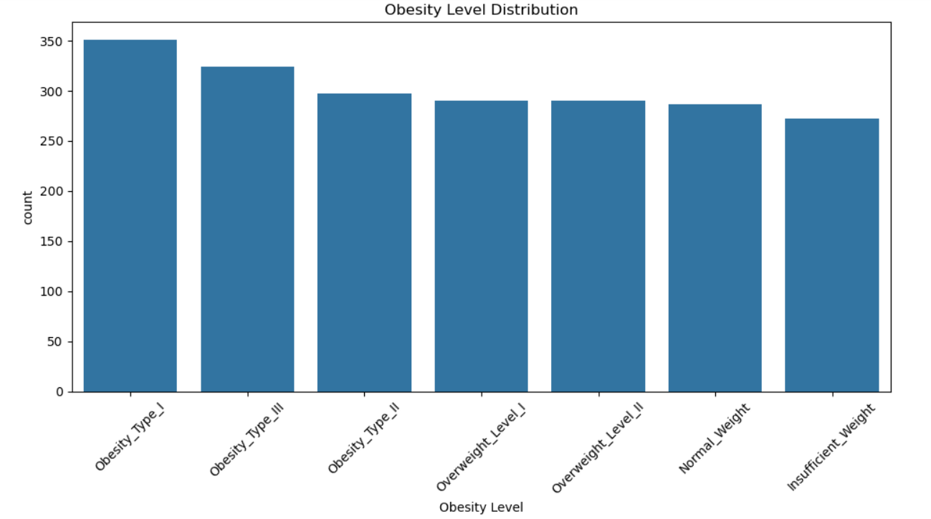
Bar plot

Slide 6
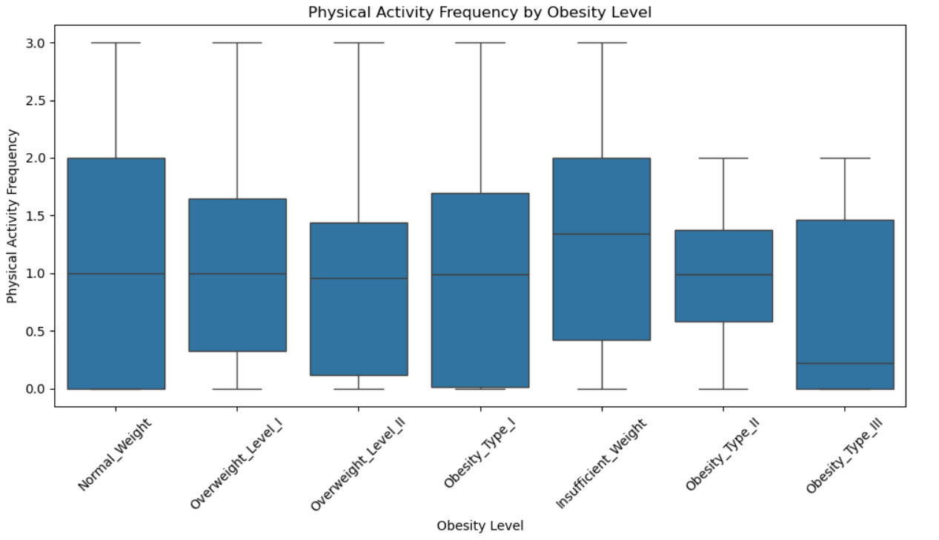
Box and Whisker Plot

Slide 7
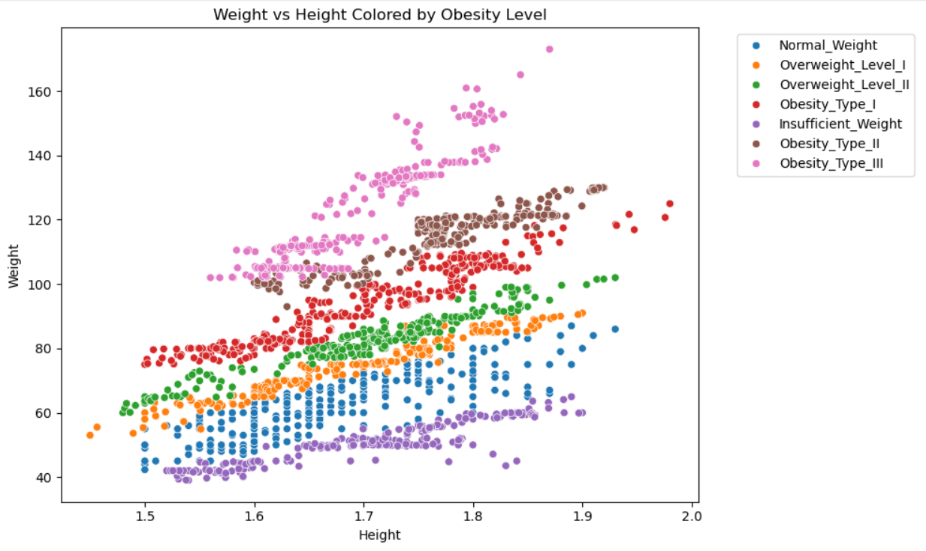
Scatter Plot

Slide 8
Methods for Linear and Logistic Regression
Data Prep: Imputation, normalization, variable renaming.
Models used: Random Forest, Support Vector Machine, Logistic Regression, Gradient, Linear Regression
Train/Test Splits: 70/30 and 80/20 splits across models.

Slide 9
Experimental Design and Results
Logistic: Best Classification: Random Forest Classification
- Precision, Recall, and F1 score
Worst Classification: Logistic Regression
Stable support
Linear: BMI Residual Prediction
- Highest R^2 value and lower RMSE

Slide 10
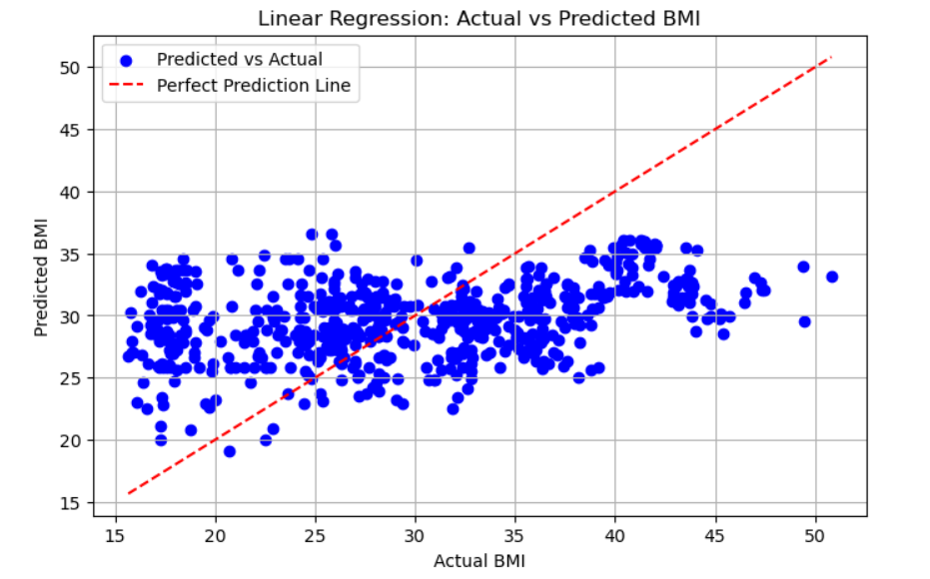
Linear Regression

Slide 11
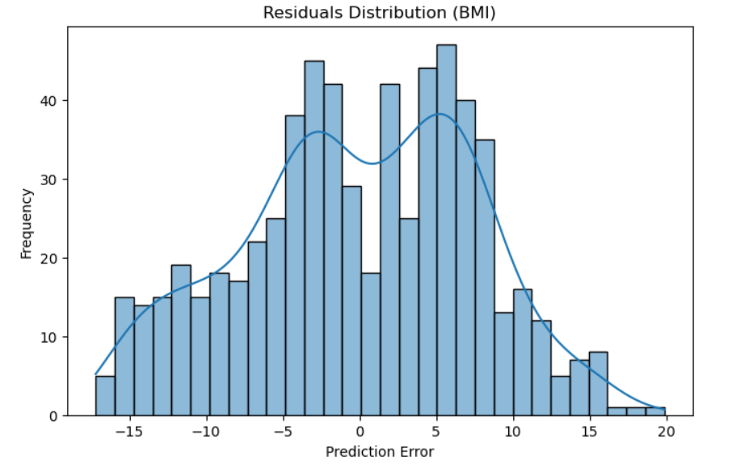
Residual Plot

Slide 12
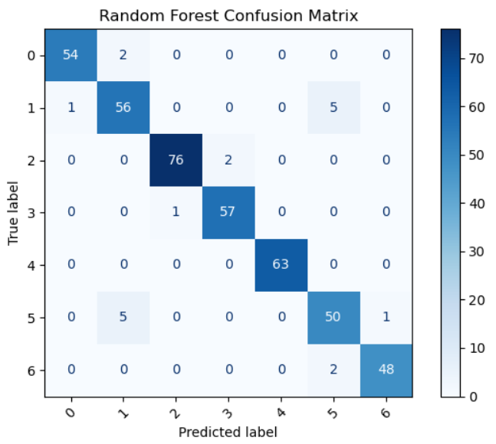
Confusion Matrix

Slide 13
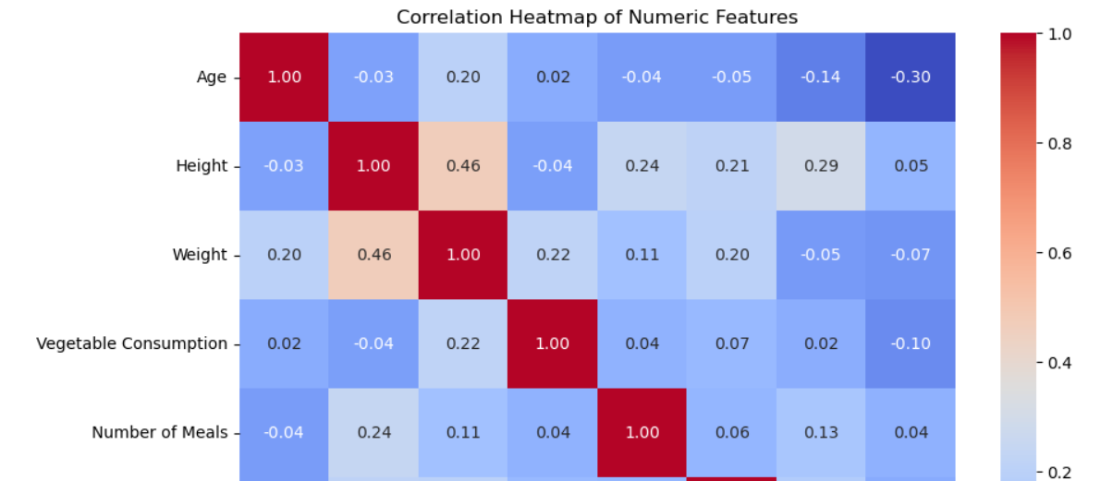
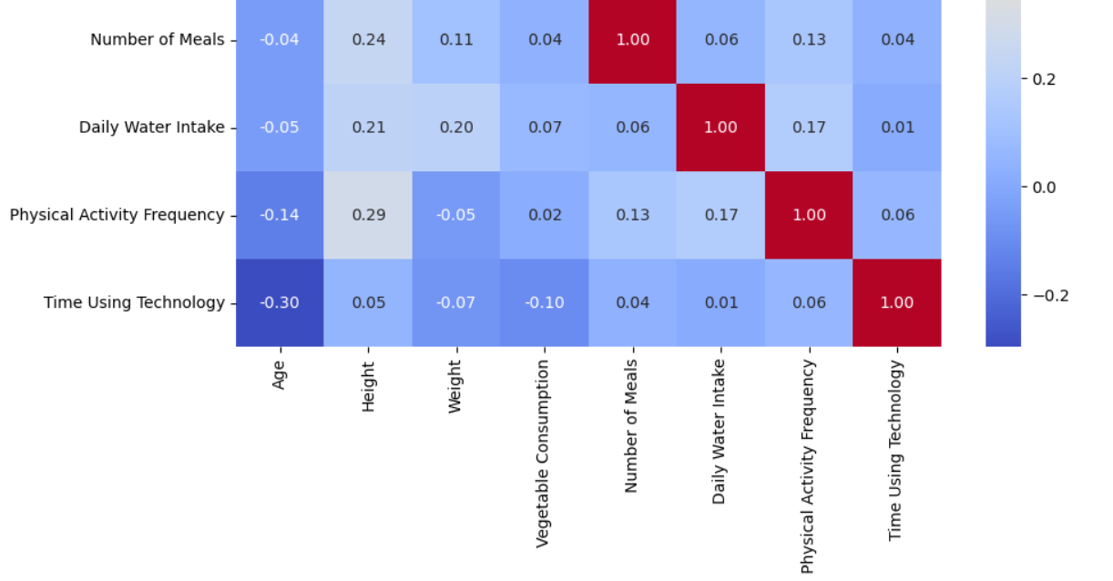
Correlation Heatmap

Slide 14
Limitations and Future Work
Dataset is cross-sectional → no causality
Missing socioeconomic/dietary data
Some variables (e.g., smoking, alcohol) not strongly predictive
Test deep learning models
Use longitudinal or more diverse data
Incorporate additional health indicators (diet, income, medical history)

Slide 15
Conclusion
- Physical activity is a strong indicator of obesity classification
- Random Forest performed best among models tested
- Machine Learning can support early health risk prediction.
Answer: While Physical Activity plays a vital role – Diet is just as important in determining obesity

Slide 16
Sources
https://archive.ics.uci.edu/dataset/544/estimation+of+obesity+levels+based+on+eating+habits+and+physical+condition
Python libraries: Pandas, Scikit-learn, Seaborn, Matplotlib

