Slide 1

TOR: The Onion Router
Nicholas Taubert, CSC335

Slide 2
Overview
What is TOR?
How does TOR work?
Why use TOR?
What are the downsides of TOR?

Slide 3
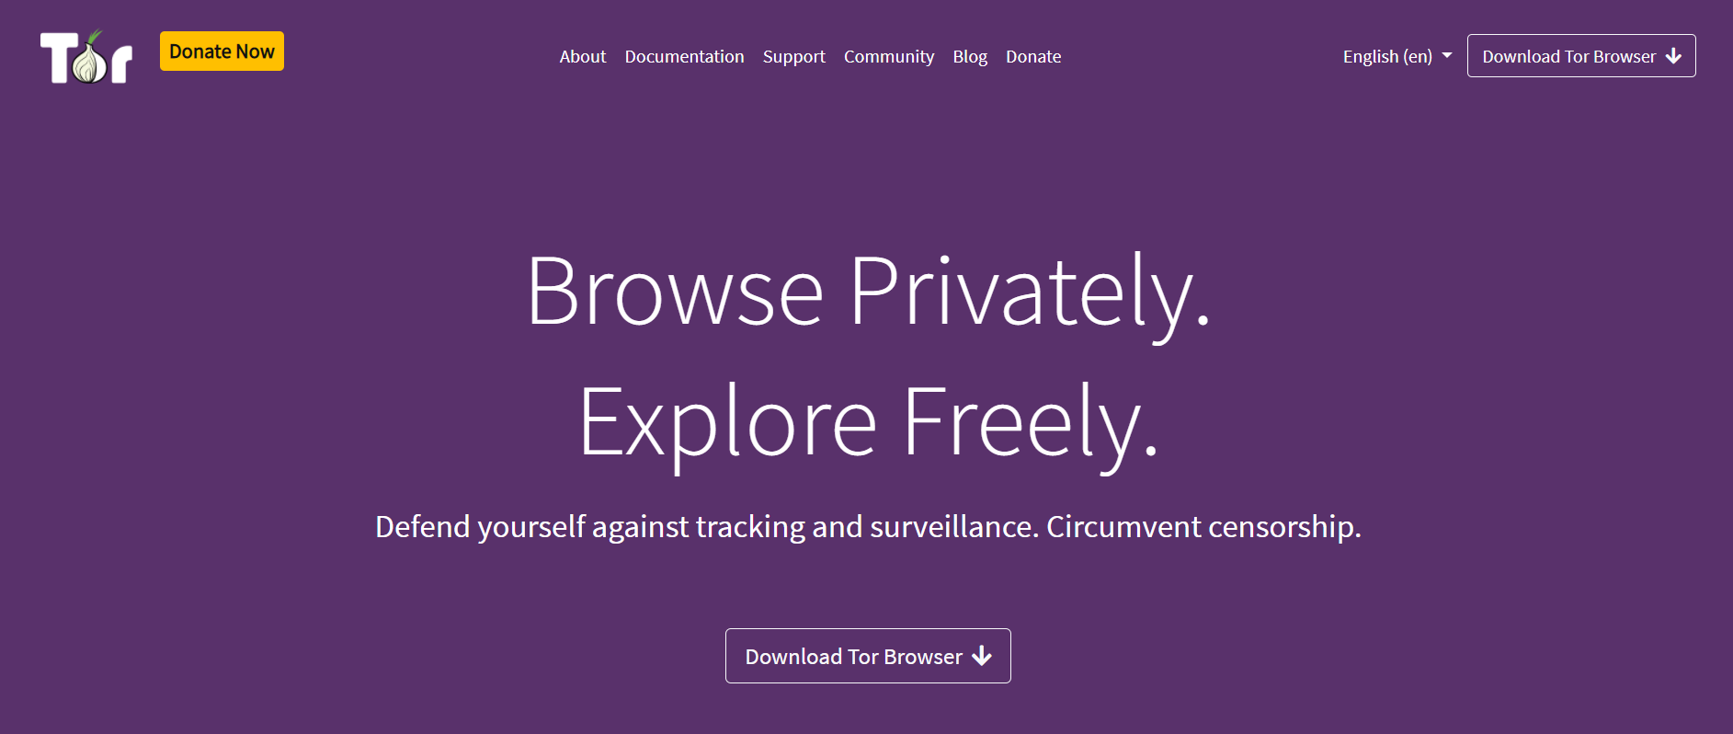
What is TOR?
A screenshot of torproject.org’s landing page, where users can download the TOR browser

Slide 4
Overview
What is TOR?
How does TOR work?
Why use TOR?
What are the downsides of TOR?

Slide 5
How does TOR work?
User Computer
Relay Node 1
Relay Node 4
Usually uses TLS port 443 and 80, though could also use 9001 and 9030.
Relay Node 2
Relay Node 5
Relay Node 3
Relay Node 6
Destination

Slide 6
How does TOR work?
User Computer
Relay Node 1
Relay Node 4
Usually uses TLS port 443 and 80, though could also use 9001 and 9030.
Relay Node 2
Relay Node 5
Relay Node 3
Relay Node 6
Destination

Slide 7
How does TOR work?
User Computer
Relay Node 1
Relay Node 4
Usually uses TLS port 443 and 80, though could also use 9001 and 9030.
Relay Node 2
Relay Node 5
Relay Node 3
Relay Node 6
Destination

Slide 8
How does TOR work?
User Computer
⚿⚿⚿⚿
Relay Node 1⚿
Relay Node 4
Relay Node 2⚿
Relay Node 5⚿
Using the Diffie-Hellman method, an AES key is generated between the user and each relay node involved in the circuit.
Relay Node 3
Relay Node 6⚿
Destination

Slide 9
How does TOR work?
User Computer
⚿⚿⚿⚿
Relay Node 1⚿
Relay Node 4
Relay Node 2⚿
Relay Node 5⚿
Using the Diffie-Hellman method, an AES key is generated between the user and each relay node involved in the circuit.
Relay Node 3
Relay Node 6⚿
Destination

Slide 10
How does TOR work?
User Computer
⚿⚿⚿⚿
Relay Node 1⚿
Relay Node 4
Relay Node 2⚿
Relay Node 5⚿
Using the Diffie-Hellman method, an AES key is generated between the user and each relay node involved in the circuit.
Relay Node 3
Relay Node 6⚿
Destination

Slide 11
How does TOR work?
User Computer
⚿⚿⚿⚿
Relay Node 1⚿
Relay Node 4
Relay Node 2⚿
Relay Node 5⚿
Using the Diffie-Hellman method, an AES key is generated between the user and each relay node involved in the circuit.
Relay Node 3
Relay Node 6⚿
Destination

Slide 12
Overview
What is TOR?
How does TOR work?
Why use TOR?
What are the downsides of TOR?

Slide 13
Why use TOR?
User Computer
Destination
Government
Many governments, businesses, and other organizations block access to particular websites.

Slide 14
Why use TOR?
User Computer
Destination
Government
Relay Node 1
Relay Node 2
Relay Node 3
Relay Node 4
TOR can circumvent this by accessing the destination with nodes outside the organization.

Slide 15
Why use TOR?
👓
User Computer
Destination
Relay Node 1
Relay Node 2
Relay Node 3
Relay Node 4
Some users can access sites directly, but choose not to for privacy reasons.

Slide 16
Why use TOR?
User Computer
Destination.onion
Relay Node 1
Relay Node 2
Relay Node 3
Relay Node 4
.onion sites cannot be accessed like traditional sites; only through certain nodes in the onion router.

Slide 17
Overview
What is TOR?
How does TOR work?
Why use TOR?
What are the downsides of TOR?

Slide 18
What are the downsides of TOR?
User Computer
⏰
Relay Node 1
⏰
Relay Node 2
⏰
Relay Node 3
⏰
Destination
VS
User Computer
⏰
Destination

Slide 19
What are the downsides of TOR?
Relay Node 1
Relay Node 2
Relay Node 3
User Computer
Relay Node 4
Relay Node 5
Relay Node 6
Destination
👓
👓
Relay Node 7
Relay Node 8
Relay Node 9
If one organization owns enough nodes, they can track traffic.

Slide 20
What are the downsides of TOR?
User Computer
Entry Node
Exit
Node
Destination
👓
👓
If one organization owns enough nodes, they can track traffic.

Slide 21
What are the downsides of TOR?
A company owning 4/9 nodes is much more likely to own the entry and exit nodes of a circuit than a company with 4/36 nodes.

Slide 22
What are the downsides of TOR?
User Computer
Relay Node 1
Government
Many organizations simply block access to known TOR relay nodes.

Slide 23
Overview
What is TOR?
How does TOR work?
Why use TOR?
What are the downsides of TOR?

Slide 24
Works Cited
Bee. “How Does Tor Really Work? The Definitive Visual Guide (2020).” Skerritt.blog, 24 Dec. 2020, https://skerritt.blog/how-does-tor-really-work/.
Dingledine, Roger, et al. “Tor: The Second-Generation Onion Router.” Defense Technical Information Center, 2004, https://doi.org/10.21236/ada465464. Accessed 24 Sept. 2021. can also be found on https://citeseerx.ist.psu.edu/viewdoc/summary?doi=10.1.1.1077.4018
H. K. Wardana, L. F. Handianto and B. W. Yohanes, "The onion routing performance using shadow-plugin-TOR," 2017 4th International Conference on Electrical Engineering, Computer Science and Informatics (EECSI), 2017, pp. 1-5, doi: 10.1109/EECSI.2017.8239183.
M. G. Reed, P. F. Syverson and D. M. Goldschlag, "Anonymous connections and onion routing," in IEEE Journal on Selected Areas in Communications, vol. 16, no. 4, pp. 482-494, May 1998, doi: 10.1109/49.668972.
Porup, J.M. “What Is the Tor Browser? And How It Can Help Protect Your Identity.” CSO Online, CSO, 15 Oct. 2019, https://www.csoonline.com/article/3287653/what-is-the-tor-browser-how-it-works-and-how-it-can-help-you-protect-your-identity-online.html.
Rob Jansen and Aaron Johnson. 2016. Safely Measuring Tor. In Proceedings of the 2016 ACM SIGSAC Conference on Computer and Communications Security (CCS '16). Association for Computing Machinery, New York, NY, USA, 1553–1567. DOI:https://doi.org/10.1145/2976749.2978310
The Tor Project, Inc. “Tor Project FAQ.” Tor Project: FAQ, 2019, https://2019.www.torproject.org/docs/faq.html.en
“The Tor Project: Privacy &amp; Freedom Online.” Tor Project | Anonymity Online, https://www.torproject.org/.

