Slide 1
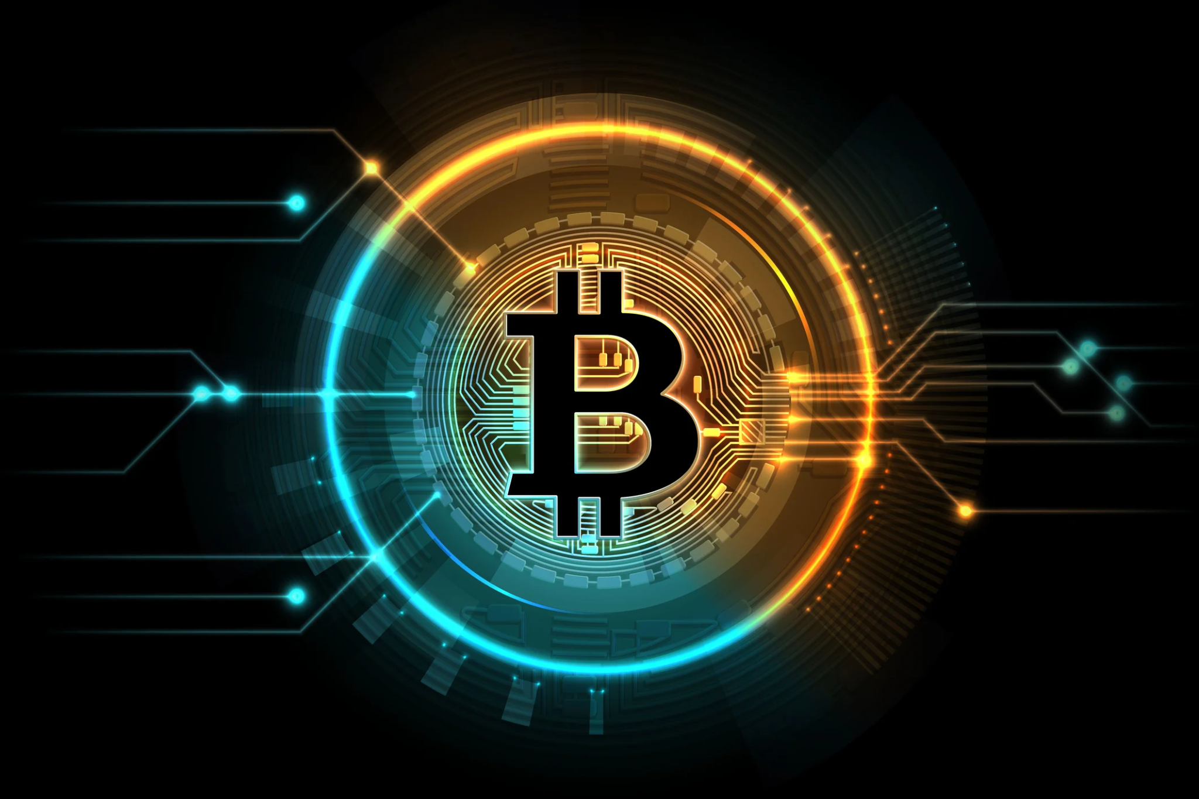
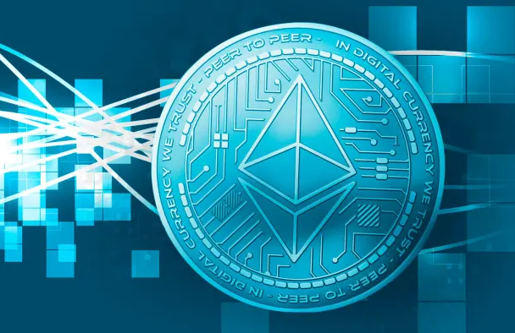
Cryptocurrency
Mistrust

Slide 2
Topics That Will Be Covered
Brief introduction on what cryptocurrencies are
Explain some of the wallet storage systems security and flaws
Delve into market volatility and insider trading
Discuss ISO and pump and dump scams
Discuss the lack of government regulation

Slide 3
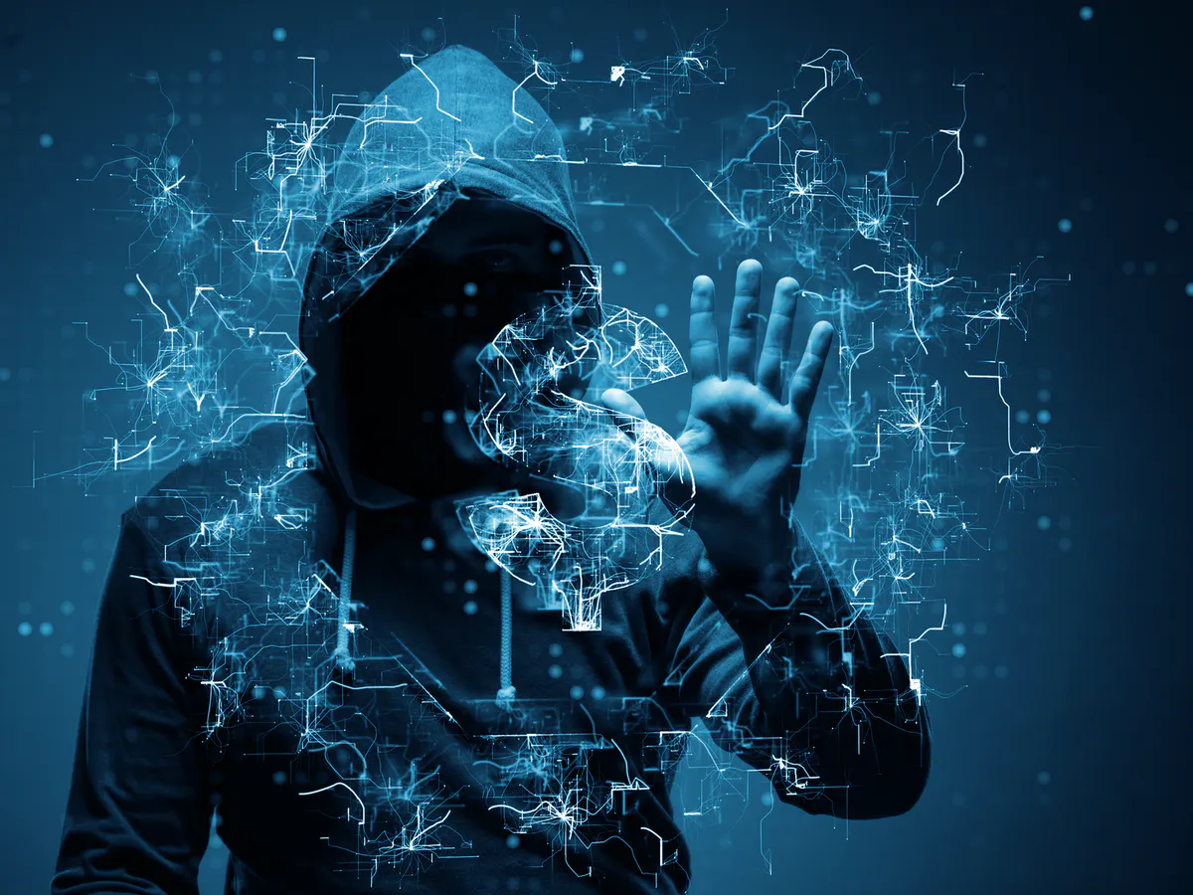
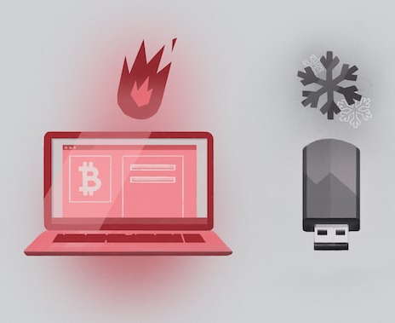
Crypto 101
All money must be exchangeable, measurable, and valuable
Crypto is stored in 2 general categories of wallets: hot and cold
There are over 2000 different crypto currencies in the world
Crypto makes anonymous purchases easy

Slide 4
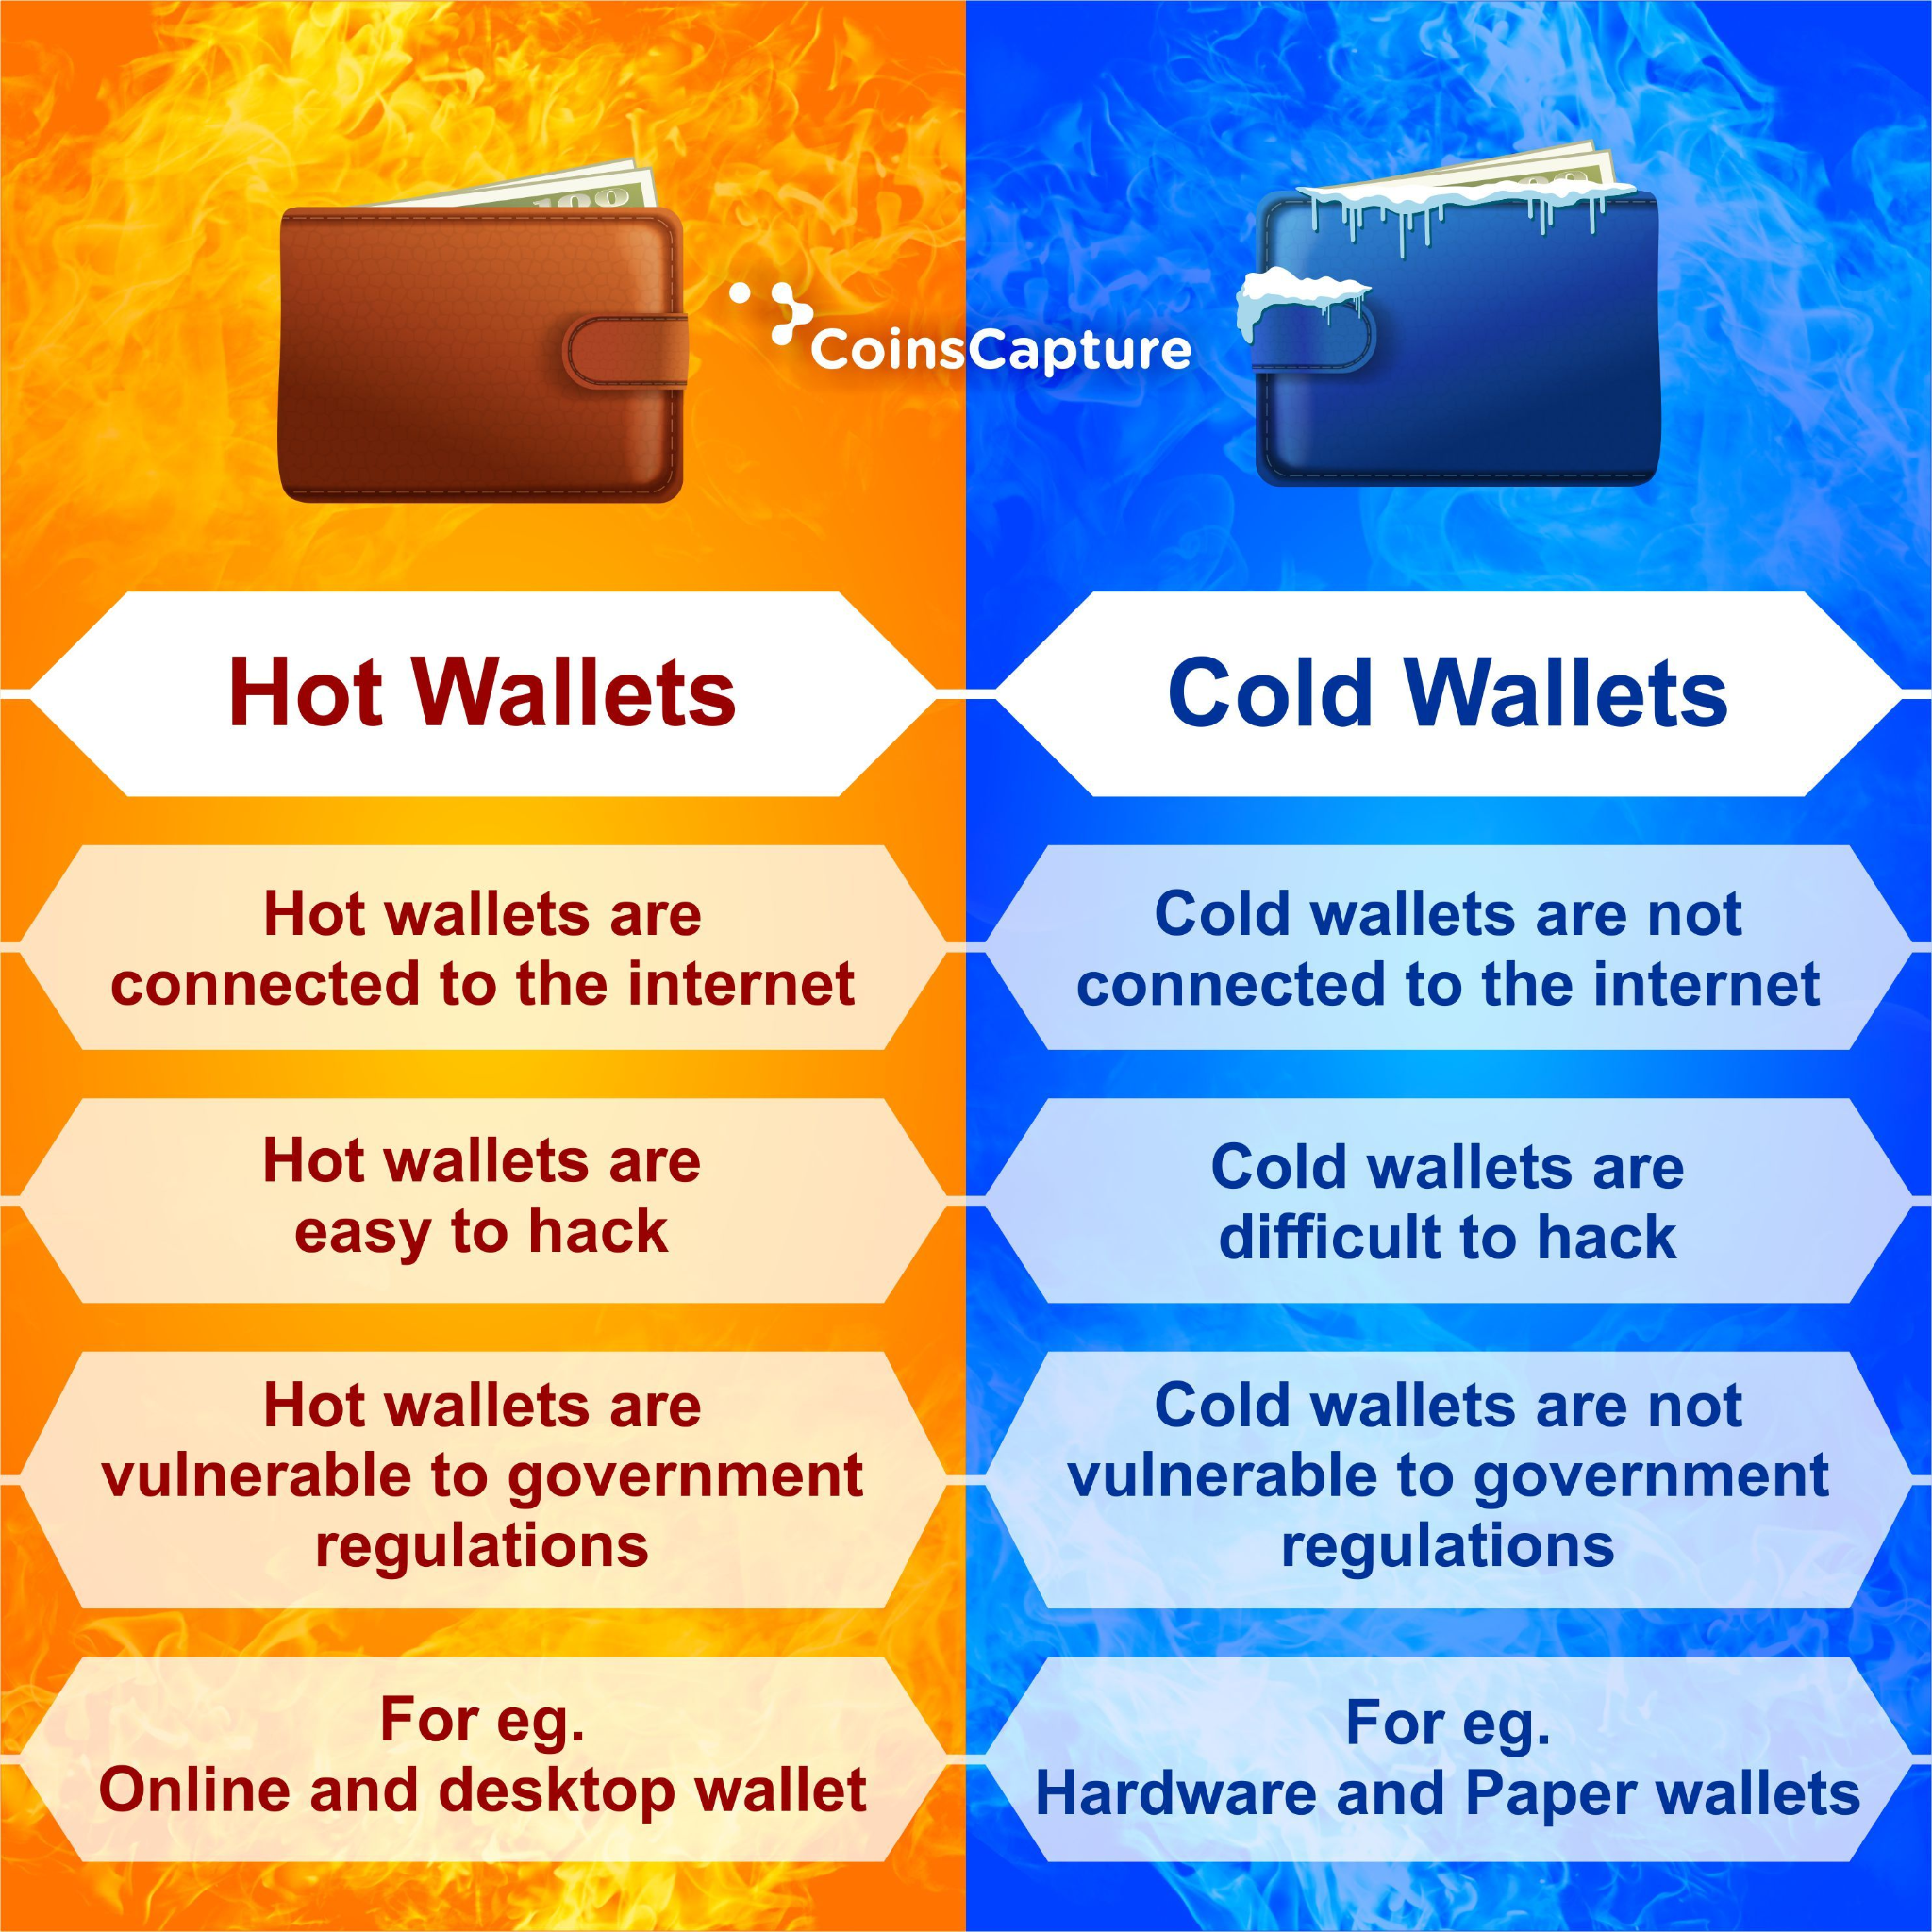

Slide 5
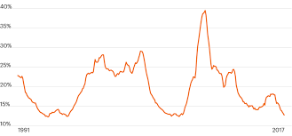

Market Volatility & Insider Trading

Slide 6
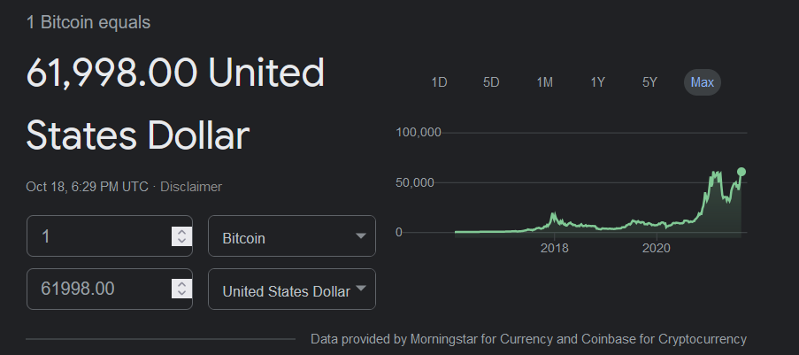

Slide 7
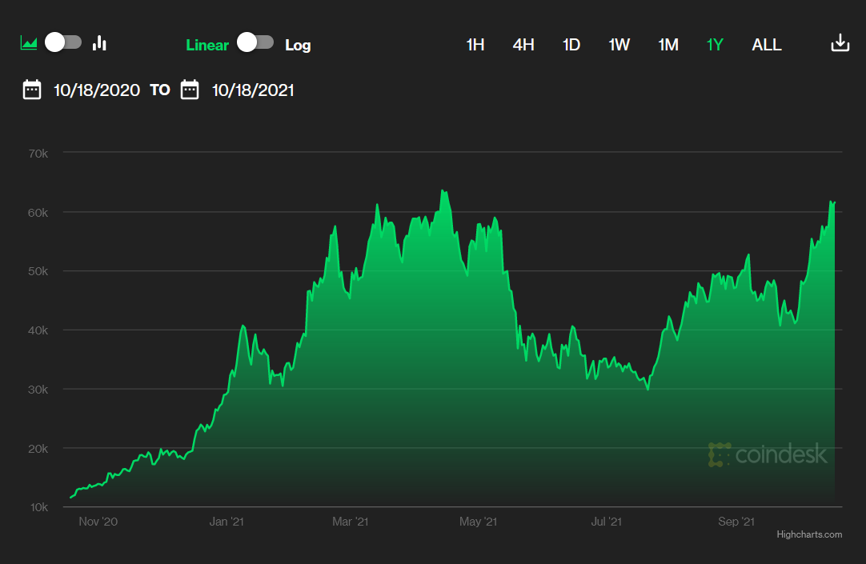

Slide 8
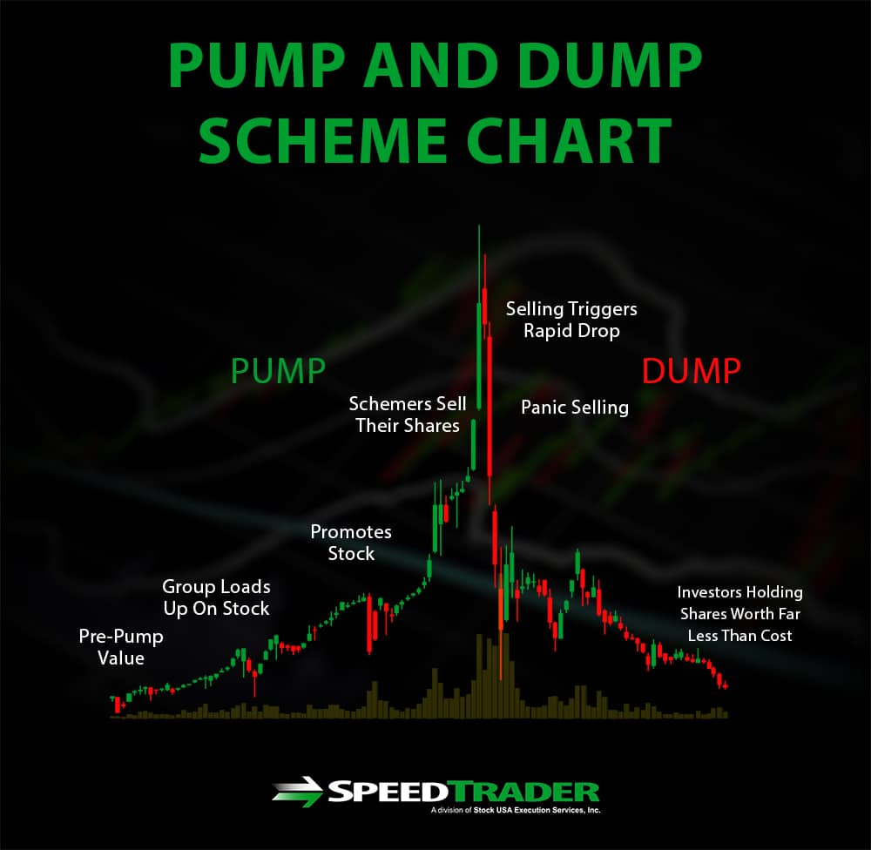

Slide 9
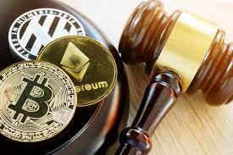
Government Regulation

Slide 10
Sources
Google Images, Google, http://www.google.com/images.
M. H. u. Rehman, K. Salah, E. Damiani and D. Svetinovic, "Trust in Blockchain Cryptocurrency Ecosystem," in IEEE Transactions on
Engineering Management, vol. 67, no. 4, pp. 1196-1212, Nov. 2020, doi: 10.1109/TEM.2019.2948861.
Royal, James, and Kevin Voigt. “What Is Cryptocurrency? Beginners Guide to Digital Cash.” NerdWallet, 15 Oct. 2021,
https://www.nerdwallet.com/article/investing/cryptocurrency-7-things-to-know.
Voigt, Kevin. “What Is Blockchain and How Does It Work?” NerdWallet, 24 June 2021,
https://www.nerdwallet.com/article/investing/blockchain.

