Slide 1

Altova®
Product Line Overview

Slide 2

XMLSpy Overview
Facilitates design, editing and debugging of all XML-related technologies
XML, DTD, XML Schema, XSLT 1.0/2.0, XPath 1.0/2.0, Web services, WSDL, SOAP, XQuery, etc.
Auto-generates class files from XML Schemas
Java, C++, C#
Comprehensive database support
Access®, SQL Server, MySQL®, Oracle®, DB2®, Sybase®, or any ADO/ODBC database
Optional Visual Studio® .NET and Eclipse integration

Slide 3
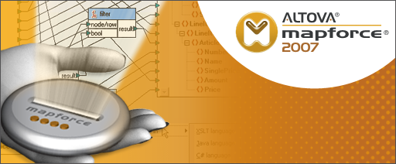
MapForce Overview
Integrates XML, databases, flat files, EDI, and now Web services
Graphical, drag-and-drop data-mapping design
Converts data instantly
Auto-generates royalty-free source code
XSLT 1.0/2.0, XQuery, C++, C#, Java
Builds Web services graphically
Maps data sources to Web services operations
Generates code to implement Web services on Web servers
Standard and user defined data processing functions
Multi-stage mappings from multiple sources to multiple targets
Optional Visual Studio® .NET and Eclipse integration

Slide 4

StyleVision Overview
Transforms XML and database content into HTML, PDF, and Word/RTF
XSLT 1.0/2.0 and XSL:FO stylesheet design
Builds XML and database enabled Authentic® electronic forms
Single-source/multi-channel publishing
HTML, PDF, e-forms and Word/RTF output all from the same stylesheet
Single-step database reporting
HTML to XML conversion

Slide 5

SemanticWorks Overview
Visual creation and editing of RDF, RDF Schema (RDFS), OWL Lite, OWL DL, and OWL Full documents
Intelligent entry helpers offer context-sensitive editing choices
Syntax and semantics checking according to selected language (i.e., RDF, OWL Full, etc.)
Auto-generation and editing of RDF/XML or N-triples formats based on visual RDF/OWL design
Notes:
Background slide has typo – use new one

Slide 6
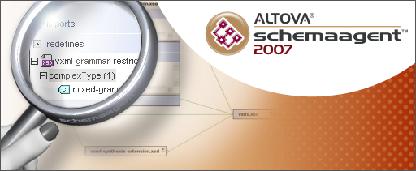
SchemaAgent Overview
A new way to model and manage XML schemas
Helps coordinate XML Schema development by:
Cataloging existing schemas and their components
Visually representing relationships between schemas
Combining various schema components into new schemas
Configurable for networked or local use
Supports any standard schema repository
Displays schemas used in MapForce data mappings

Slide 7

UModel Overview
Makes UML easy and affordable
Provides versatile software modeling capabilities
Generates Java and C# code from UML models
Reverse engineers existing Java and C# applications
Includes round-trip engineering functionality
Supports UML 2.1 standard
Interoperates with other UML tools via XMI 2.1 specification

Slide 8

DatabaseSpy Overview
Connects to all major relational databases
Oracle, Microsoft SQL Server, IBM DB2, Sybase, MySQL, Access
Connection wizard
Exposes database content and structure via the Database Browser
Simplifies query writing and editing with the SQL Editor
Graphical database design and development with the Database Design Editor
Organizes connections and views into project files
Exports and imports data in a variety of formats
XML, XML Structure, HTML, CSV, Excel

Slide 9

DiffDog Overview
File differencing and merging
Support for comparing any text-based files
Direct editing of compared files
Directory differencing and merging
XML-aware differencing capabilities

Slide 10
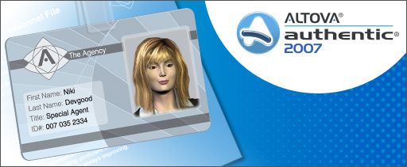
Authentic Overview
Electronic forms based data entry for XML documents and relational databases
Non-technical word processor style WYSIWYG interface
Behind the scenes XML and database formatting
Browser and desktop editions
Offered under a FREE software license

