Slide 1
接口性能趋势分析报告
生成时间: 2025-09-09 17:39:42

Slide 2
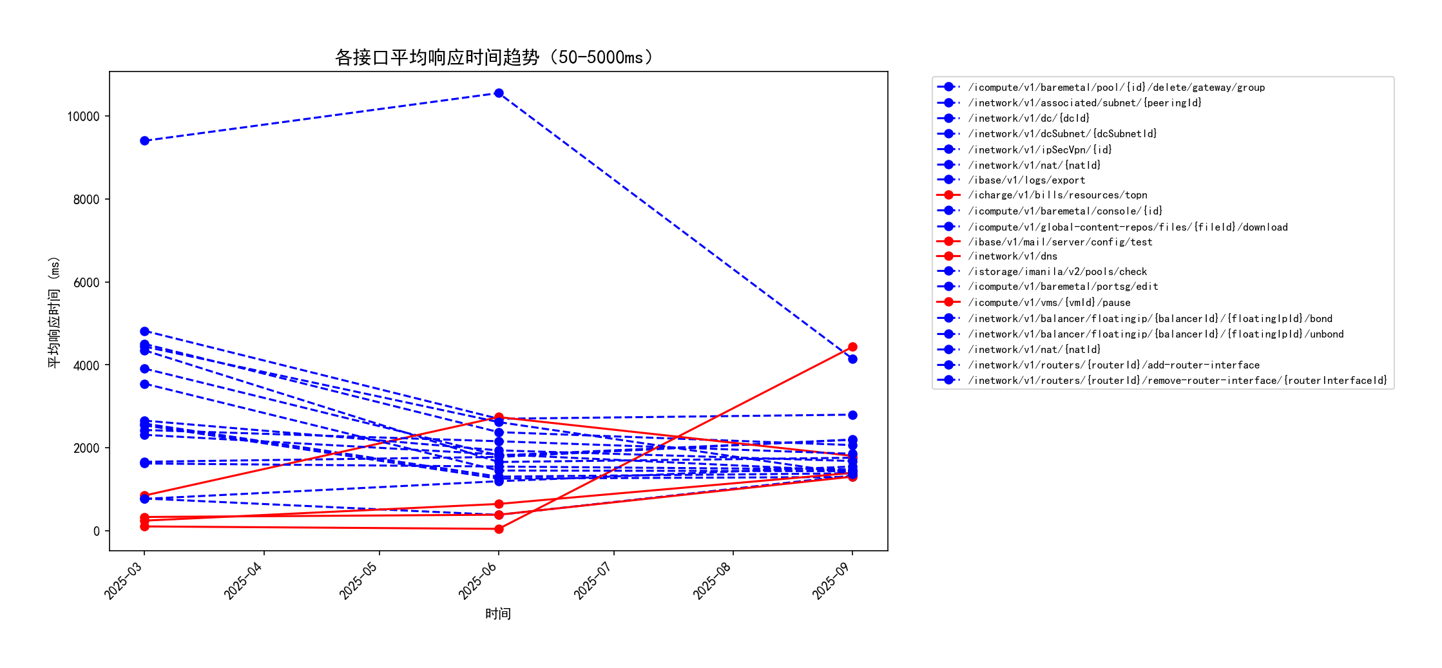
各接口平均响应时间趋势（50-5000ms）

Slide 3
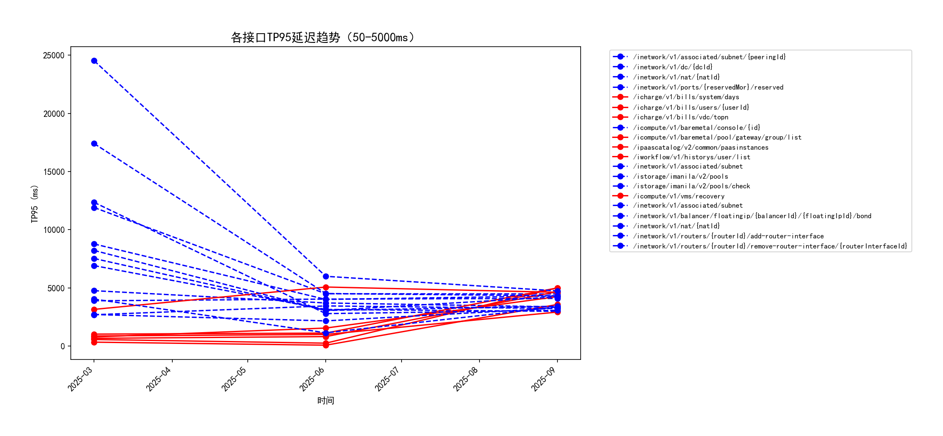
各接口TP95延迟趋势（50-5000ms）

Slide 4
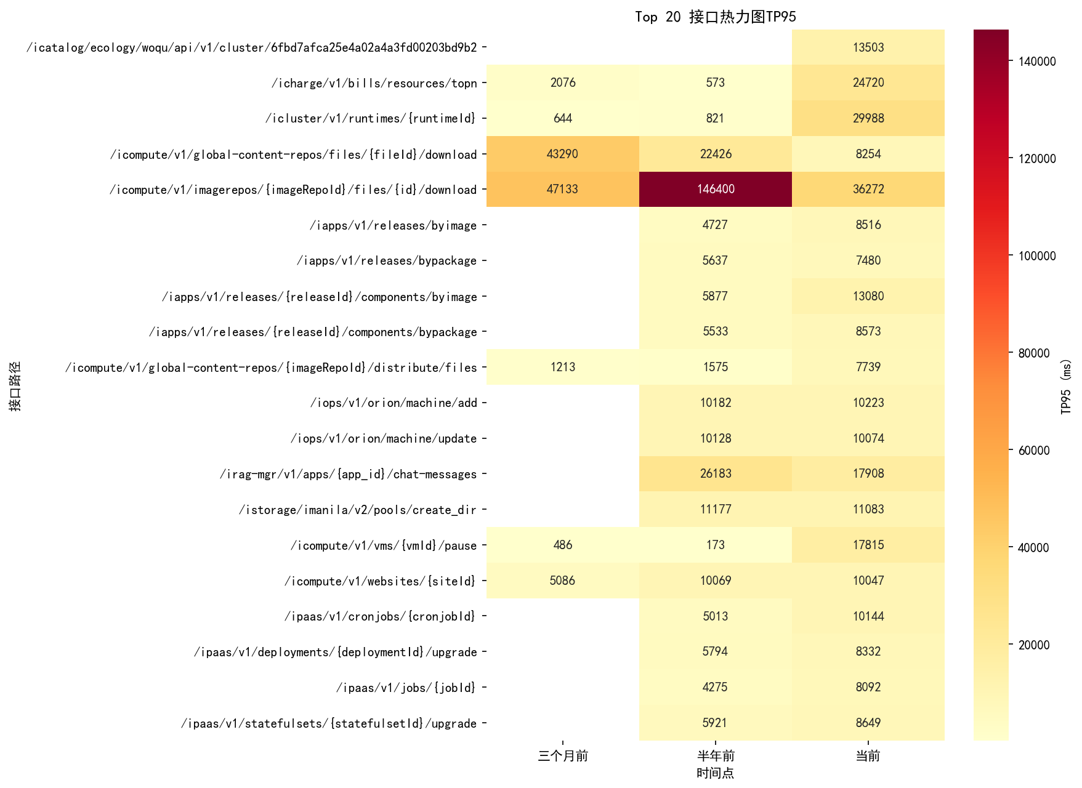
接口TP95热力图

Slide 5
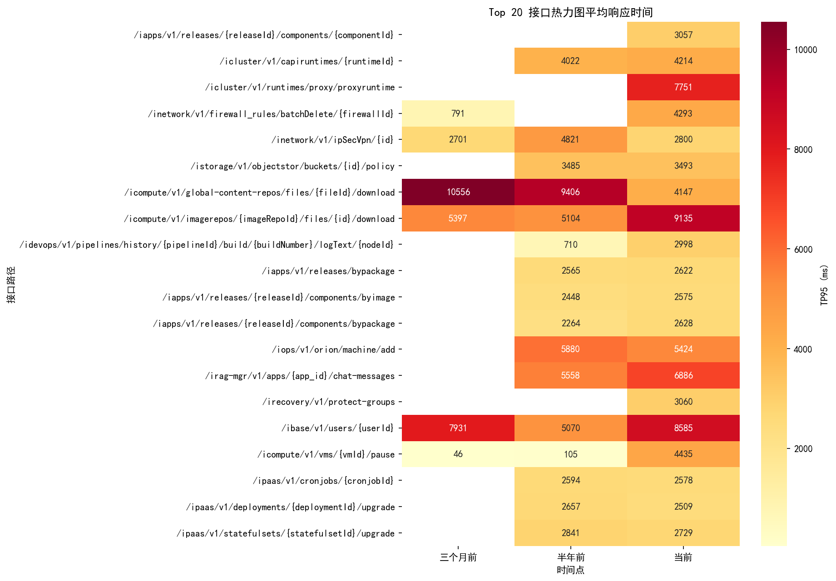
接口AVG热力图

Slide 6
Top 10 TP95性能退步接口
接口标识 | TP95_半年前 | TP95_当前 | TP95_变化 | TP95_变化率
GET /icluster/v1/runtimes/{runtimeId} | 821 | 29988 | 29167 | 3552.62
GET /icharge/v1/bills/resources/topn | 573 | 24720 | 24147 | 4214.14
PUT /icompute/v1/vms/{vmId}/pause | 173 | 17815 | 17642 | 10197.69
POST /iapps/v1/releases/{releaseId}/components/byimage | 5877 | 13080 | 7203 | 122.56
POST /icompute/v1/global-content-repos/{imageRepoId}/distribute/files | 1575 | 7739 | 6164 | 391.37
PUT /ipaas/v1/cronjobs/{cronjobId} | 5013 | 10144 | 5131 | 102.35
POST /ipluto/v1/pim/update | 299 | 5073 | 4774 | 1596.66
PUT /icompute/v1/multicloud/vms/import | 967 | 5607 | 4640 | 479.83
GET /icharge/v1/bills/users/{userId} | 560 | 5000 | 4440 | 792.86
GET /icharge/v1/bills/system/days | 659 | 4678 | 4019 | 609.86

Slide 7
Top 10 TP95性能优化接口
接口标识 | TP95_半年前 | TP95_当前 | TP95_变化 | TP95_变化率
GET /icompute/v1/imagerepos/{imageRepoId}/files/{id}/download | 146400 | 36272 | -110128 | -75.22
GET /ipaas/v1/configmaps | 22085 | 159 | -21926 | -99.28
PUT /inetwork/v1/nat/{natId} | 24525 | 4738 | -19787 | -80.68
GET /icompute/v1/global-content-repos/files/{fileId}/download | 22426 | 8254 | -14172 | -63.19
PUT /inetwork/v1/routers/{routerId}/add-router-interface | 17404 | 4317 | -13087 | -75.2
PUT /icompute/v1/vms/{vmId}/poweroff | 15265 | 2854 | -12411 | -81.3
POST /inetwork/v1/routers/port/qos/unbind | 13348 | 2413 | -10935 | -81.92
POST /inetwork/v1/routers/port/qos/bind | 13250 | 2627 | -10623 | -80.17
GET /ipaas/v1/pods/namespaces/{namespace}/{podName}/configs | 10746 | 507 | -10239 | -95.28
PUT /inetwork/v1/routers/{routerId}/remove-router-interface/{routerInterfaceId} | 12346 | 3069 | -9277 | -75.14

Slide 8
Top 10 AVG性能退步接口
接口标识 | 平均响应时间_半年前 | 平均响应时间_当前 | 平均响应时间_变化 | 平均响应时间_变化率
PUT /icompute/v1/vms/{vmId}/pause | 105 | 4435 | 4330 | 4123.81
GET /icompute/v1/imagerepos/{imageRepoId}/files/{id}/download | 5104 | 9135 | 4031 | 78.98
PUT /ibase/v1/users/{userId} | 5070 | 8585 | 3515 | 69.33
GET /idevops/v1/pipelines/history/{pipelineId}/build/{buildNumber}/logText/{nodeId} | 710 | 2998 | 2288 | 322.25
POST /irag-mgr/v1/apps/{app_id}/chat-messages | 5558 | 6886 | 1328 | 23.89
GET /ipluto/v1/platform/{namespace}/listService | 314 | 1571 | 1257 | 400.32
GET /icharge/v1/bills/resources/topn | 245 | 1397 | 1152 | 470.2
PUT /icompute/v1/vms/{vmId}/reset | 166 | 1253 | 1087 | 654.82
POST /inetwork/v1/dns | 333 | 1306 | 973 | 292.19
DELETE /icompute/v1/global-content-repos/files/{fileId} | 161 | 1132 | 971 | 603.11

Slide 9
Top 10 AVG性能优化接口
接口标识 | 平均响应时间_半年前 | 平均响应时间_当前 | 平均响应时间_变化 | 平均响应时间_变化率
GET /icompute/v1/global-content-repos/files/{fileId}/download | 9406 | 4147 | -5259 | -55.91
PUT /inetwork/v1/nat/{natId} | 4442 | 1373 | -3069 | -69.09
DELETE /inetwork/v1/dcSubnet/{dcSubnetId} | 4351 | 1761 | -2590 | -59.53
DELETE /inetwork/v1/nat/{natId} | 4505 | 2066 | -2439 | -54.14
PUT /inetwork/v1/routers/{routerId}/remove-router-interface/{routerInterfaceId} | 3547 | 1437 | -2110 | -59.49
POST /inetwork/v1/routers/{routerId}/add-host-route | 2974 | 878 | -2096 | -70.48
DELETE /inetwork/v1/ipSecVpn/{id} | 4821 | 2800 | -2021 | -41.92
PUT /inetwork/v1/balancers/{balancerId} | 2473 | 556 | -1917 | -77.52
POST /istorage/imanila/v2/pools/create_dir | 2927 | 1031 | -1896 | -64.78
POST /istorage/v1/objstorObj/policy | 2951 | 1116 | -1835 | -62.18

