Slide 1
接口性能趋势分析报告
生成时间: 2025-09-09 15:27:43

Slide 2
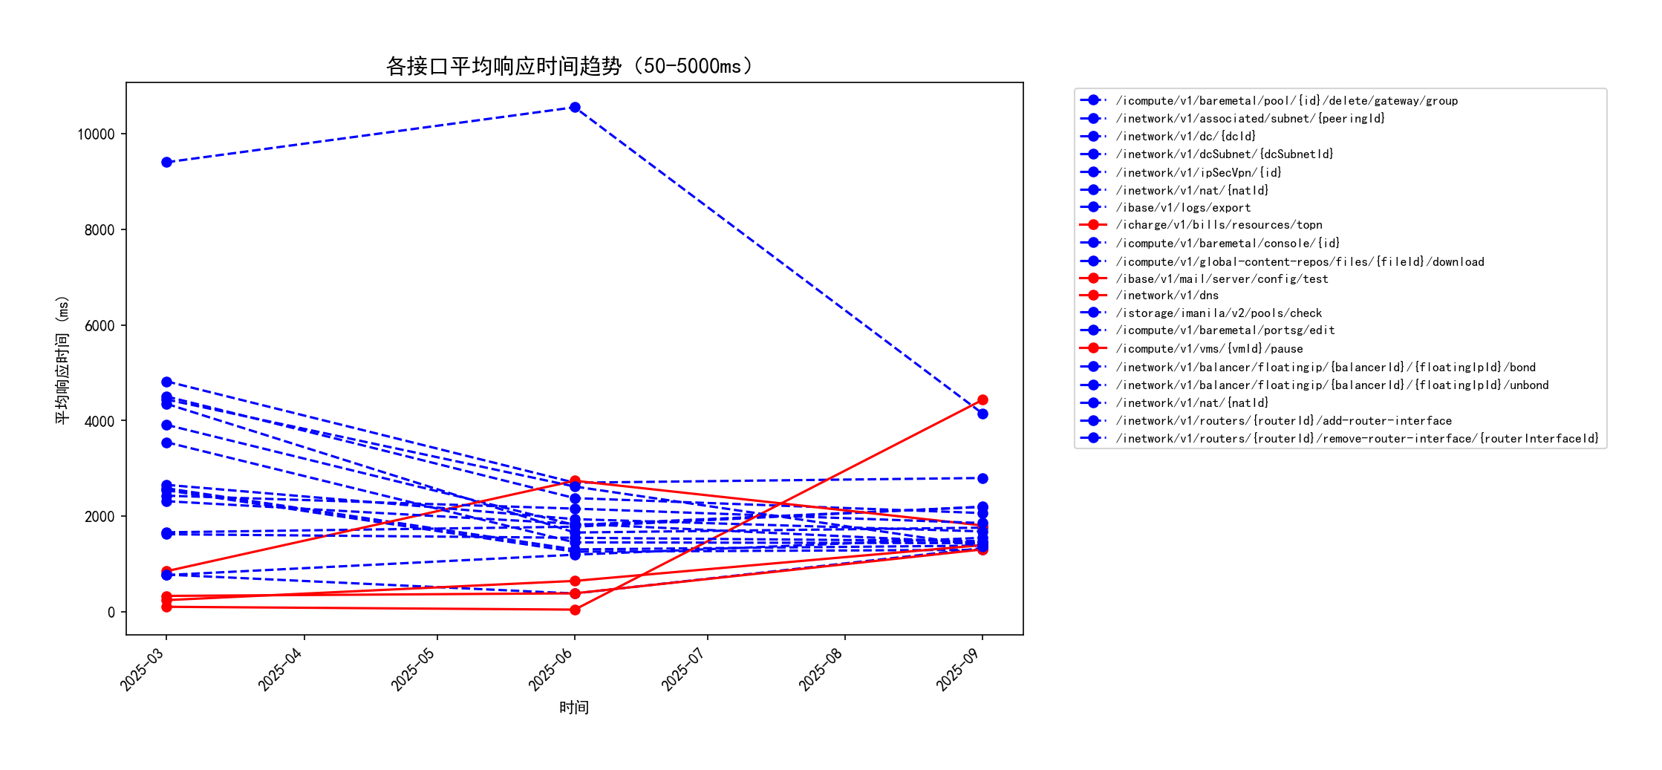
各接口平均响应时间趋势（50-5000ms）

Slide 3
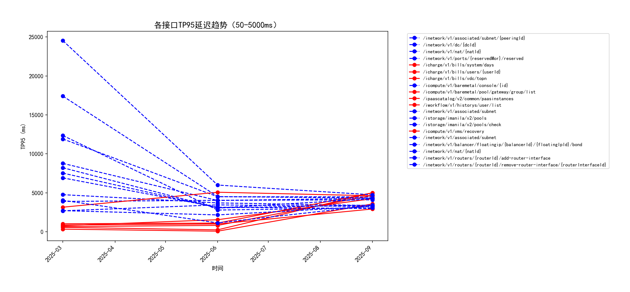
各接口TP95延迟趋势（50-5000ms）

Slide 4
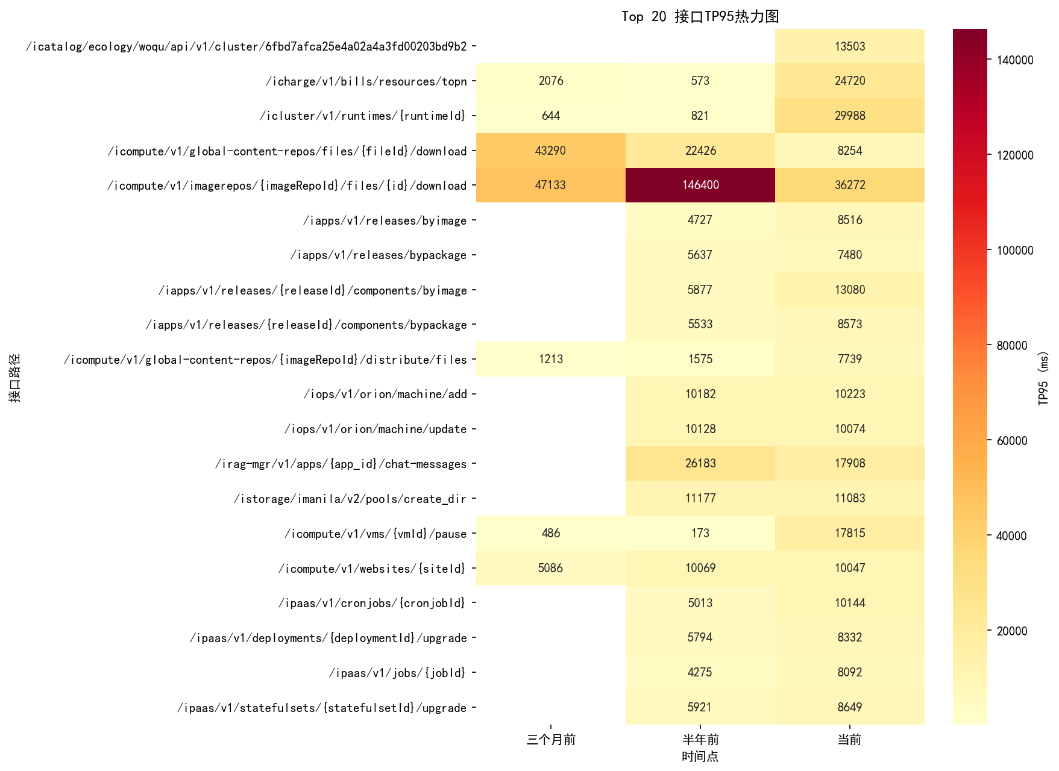
接口TP95热力图

Slide 5
Top 10 性能退步接口
接口标识 | TP95_半年前 | TP95_当前 | TP95_变化 | TP95_变化率
GET /icluster/v1/runtimes/{runtimeId} | 821 | 29988 | 29167 | 3552.62
GET /icharge/v1/bills/resources/topn | 573 | 24720 | 24147 | 4214.14
PUT /icompute/v1/vms/{vmId}/pause | 173 | 17815 | 17642 | 10197.69
POST /iapps/v1/releases/{releaseId}/components/byimage | 5877 | 13080 | 7203 | 122.56
POST /icompute/v1/global-content-repos/{imageRepoId}/distribute/files | 1575 | 7739 | 6164 | 391.37
PUT /ipaas/v1/cronjobs/{cronjobId} | 5013 | 10144 | 5131 | 102.35
POST /ipluto/v1/pim/update | 299 | 5073 | 4774 | 1596.66
PUT /icompute/v1/multicloud/vms/import | 967 | 5607 | 4640 | 479.83
GET /icharge/v1/bills/users/{userId} | 560 | 5000 | 4440 | 792.86
GET /icharge/v1/bills/system/days | 659 | 4678 | 4019 | 609.86

Slide 6
Top 10 性能优化接口
接口标识 | TP95_半年前 | TP95_当前 | TP95_变化 | TP95_变化率
GET /icompute/v1/imagerepos/{imageRepoId}/files/{id}/download | 146400 | 36272 | -110128 | -75.22
GET /ipaas/v1/configmaps | 22085 | 159 | -21926 | -99.28
PUT /inetwork/v1/nat/{natId} | 24525 | 4738 | -19787 | -80.68
GET /icompute/v1/global-content-repos/files/{fileId}/download | 22426 | 8254 | -14172 | -63.19
PUT /inetwork/v1/routers/{routerId}/add-router-interface | 17404 | 4317 | -13087 | -75.2
PUT /icompute/v1/vms/{vmId}/poweroff | 15265 | 2854 | -12411 | -81.3
POST /inetwork/v1/routers/port/qos/unbind | 13348 | 2413 | -10935 | -81.92
POST /inetwork/v1/routers/port/qos/bind | 13250 | 2627 | -10623 | -80.17
GET /ipaas/v1/pods/namespaces/{namespace}/{podName}/configs | 10746 | 507 | -10239 | -95.28
PUT /inetwork/v1/routers/{routerId}/remove-router-interface/{routerInterfaceId} | 12346 | 3069 | -9277 | -75.14

